Slide 1
Train from scratch
Zhu Rui
2020/03/20
Notes:
1.根据数据特点分析清楚问题，任务侧重关注遮挡。
2.分析结果的badcase
3. 尝试不同模块、组合多个模块

Slide 2
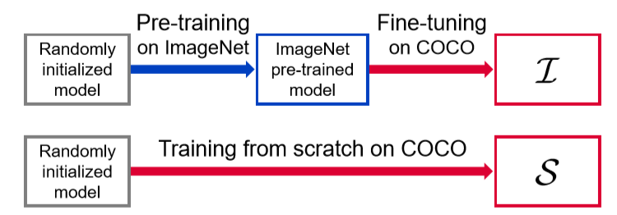
Background
Pre-train models:
Backbone networks (e.g., VGGNet, ResNet) pre-trained on large-scale classification dataset
(e.g., ImageNet, OpenImages with millions of images and accurate annotations).
Widely applied on various CV tasks (e.g., detection, segmentation ), named Fine-tuning.
Fine-tuning usually can boost the performance compared with training from scratch.
But the effect of pre-train model is still unknown, and people attribute it to transfer learning.
Notes:
1.根据数据特点分析清楚问题，任务侧重关注遮挡。
2.分析结果的badcase
3. 尝试不同模块、组合多个模块

Slide 3
Background
DSOD[1]:
The first paper to suggest training detectors from scratch without pre-training models.
Get the similar accuracy between the two models (from scratch V.S. fine-tuning).
Attribute to the superiority of the backbone network structure (i.e., DenseNet).
I think the conclusion from DSOD is just empirical and not convincing, and DSOD has not
make it clear. Besides, I think Batch Normalization may help train from scratch because
I have performed two small experiments to validate.
The effect of pre-train is still unknown.
[1] Shen, Zhiqiang, et al. "Dsod: Learning deeply supervised object detectors from scratch.“ ICCV 2017.
Notes:
1.根据数据特点分析清楚问题，任务侧重关注遮挡。
2.分析结果的badcase
3. 尝试不同模块、组合多个模块

Slide 4
Background
DSOD empirically concludes two principles for successfully training from scratch:
Choose one-stage detector, not two-stage:
RoI-pooling hinders the gradients being smoothly back-propagated.
Pre-train helps the parameter initialization of those layers before RoI-pooling.
input
image
CNN
features
Final
Cls & Reg
Detector | Performance
two-stage | Fail to convergence
one-stage | success
one-stage:
input
image
CNN
features
RPN
Cls & Reg
two-stage:
RoI pooling
features
FC
features
Final
Cls & Reg
Notes:
1.根据数据特点分析清楚问题，任务侧重关注遮挡。
2.分析结果的badcase
3. 尝试不同模块、组合多个模块

Slide 5
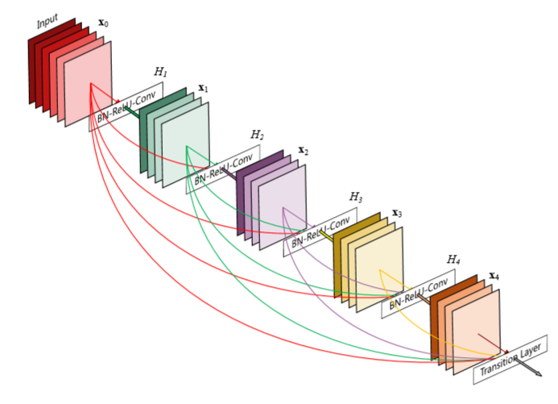
Background
DSOD empirically concludes two principles for successfully training from scratch:
The structure of DenseNet provides deep supervision to help convergence:
Network | Performance
ResNet | 63.8%
VGGNet | 69.6%
DenseNet | 77.3%
Notes:
1.根据数据特点分析清楚问题，任务侧重关注遮挡。
2.分析结果的badcase
3. 尝试不同模块、组合多个模块

Slide 6
Background
How Does Batch Normalization Help Optimization? [1]:
The original BatchNorm paper explains the effect via Internal Covariate Shift,
which is not convincing.
This paper uses experiments and plots ICS, concluding that there are no relationship
between ICS and the performance of BatchNorm.
Figure out the effect of BN by gradient analysis, strict proof, and sufficient figures.
Reliable and stable gradients -> allow larger learning step -> avoid gradient explosion and
local minimum
Apply gradient analysis on DSOD and explore what really help the performance of
training from scratch.
[1] Santurkar, Shibani, et al. "How does batch normalization help optimization?." NIPS 2018.
Notes:
1.根据数据特点分析清楚问题，任务侧重关注遮挡。
2.分析结果的badcase
3. 尝试不同模块、组合多个模块

Slide 7
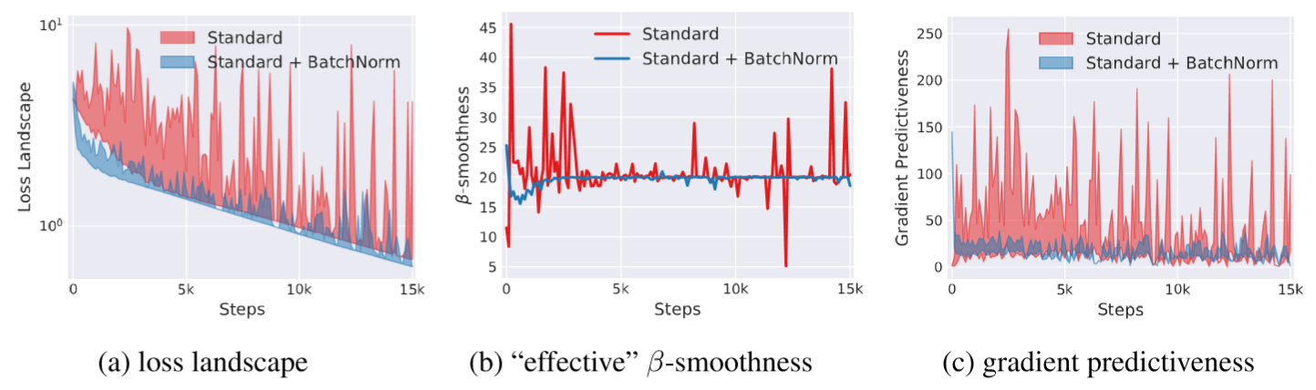
Background
How Does Batch Normalization Help Optimization? :
Lipschitz continuity:
Notes:
1.根据数据特点分析清楚问题，任务侧重关注遮挡。
2.分析结果的badcase
3. 尝试不同模块、组合多个模块

Slide 8
Background
ScratchDet[1]:
By gradient analysis and extensive experiments, we conclude that the key factor for
training from scratch is BatchNorm, not the structure of DenseNet. Because BN helps
make gradient stable and optimization landscape smoother.
Drawbacks: I just analyze the model from scratch and ignore the pre-trained one.
The gradient analysis is not enough and I believe there are lots of methods
and different perspectives to demonstrate.
So future job I will focus on the effect of pre-train, and use various kinds of tools
(e.g., gradient, eigenvalue, statistics, optimization and so on) to figure out this problem.
[1] Zhu, Rui, et al. "ScratchDet: Training Single-Shot Object Detectors from Scratch." CVPR 2019.
Notes:
1.根据数据特点分析清楚问题，任务侧重关注遮挡。
2.分析结果的badcase
3. 尝试不同模块、组合多个模块

Slide 9
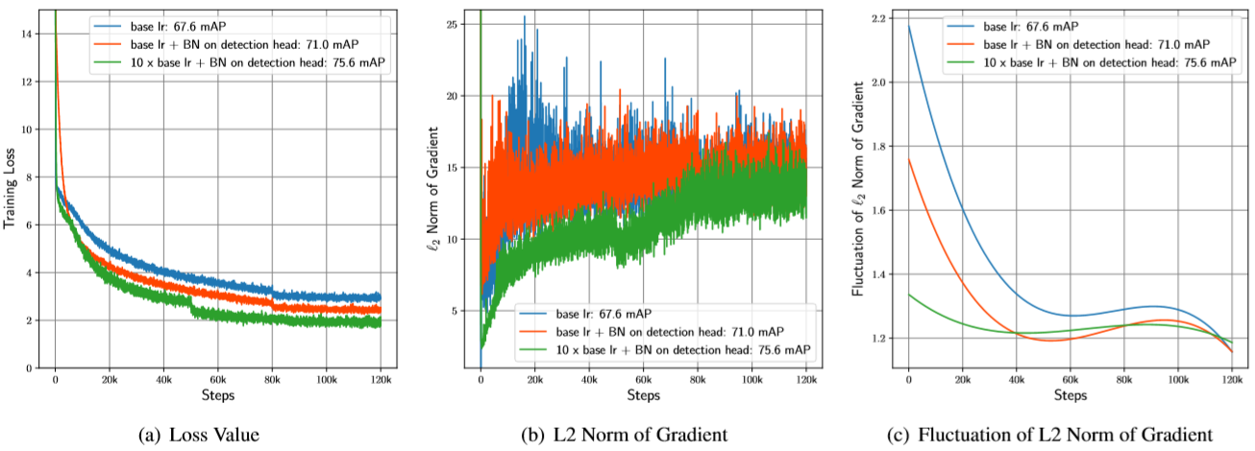
Background
ScratchDet:
Gradient analysis:
Notes:
1.根据数据特点分析清楚问题，任务侧重关注遮挡。
2.分析结果的badcase
3. 尝试不同模块、组合多个模块

Slide 10
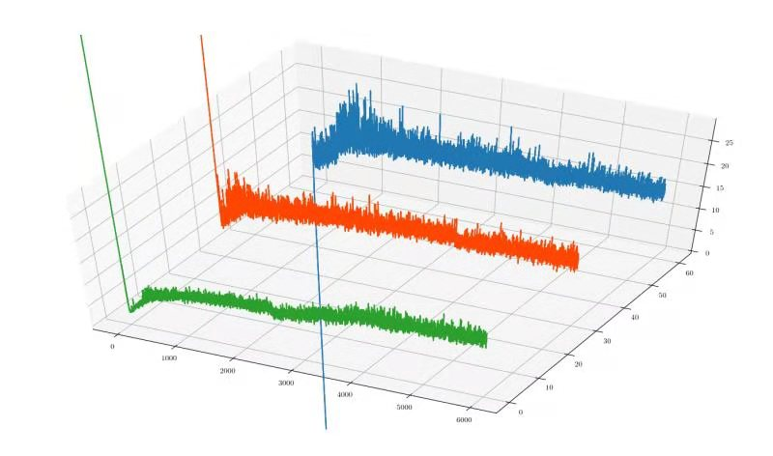
Background
ScratchDet:
Gradient analysis:
Notes:
1.根据数据特点分析清楚问题，任务侧重关注遮挡。
2.分析结果的badcase
3. 尝试不同模块、组合多个模块

Slide 11
Background
Rethinking ImageNet pre-training [1]:
This paper presents extensive experiments with huge computation and time consuming,
observing that successful training from scratch need two conditions:
3~5 times training time and large scale target dataset.
(cannot get good performance on small dataset when training from scratch)
Acknowledge the importance of Normalization in training from scratch.
Two-stage detectors also can train from scratch.
This paper gives enough experiments parameter setting and share some experience,
but the radical reason of pre-training is still unsolved.
[1] He, Kaiming, Ross Girshick, and Piotr Dollár. "Rethinking imagenet pre-training." ICCV, 2019.
Notes:
1.根据数据特点分析清楚问题，任务侧重关注遮挡。
2.分析结果的badcase
3. 尝试不同模块、组合多个模块

Slide 12
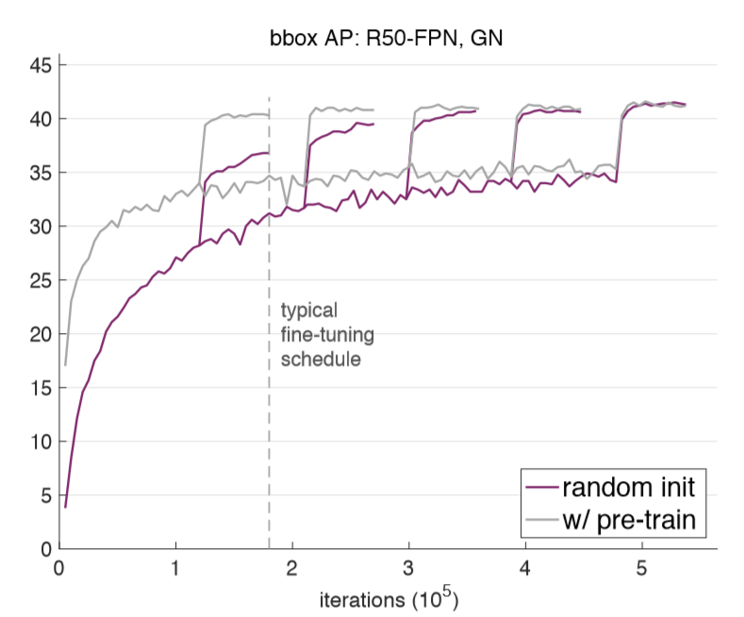
Background
Rethinking ImageNet pre-training [1]:
Training progress:
Notes:
1.根据数据特点分析清楚问题，任务侧重关注遮挡。
2.分析结果的badcase
3. 尝试不同模块、组合多个模块

Slide 13
Thank You ！

