Slide 1

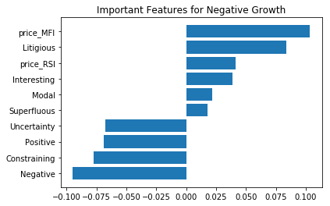
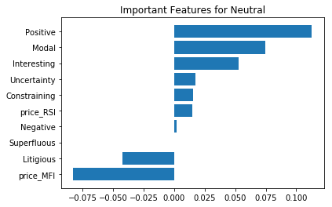
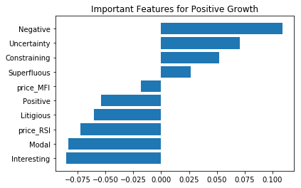
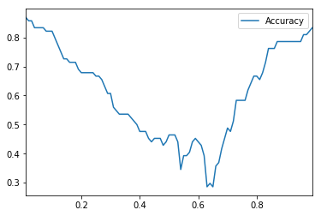
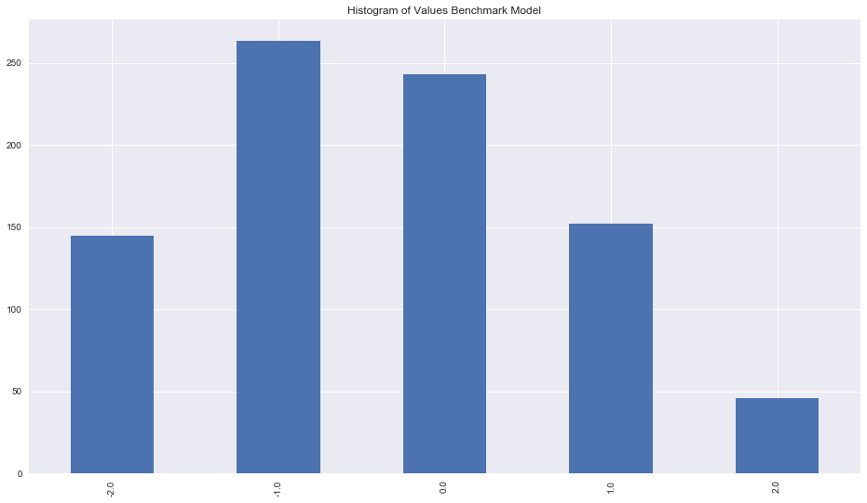
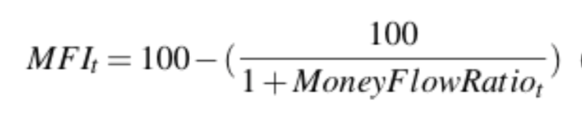
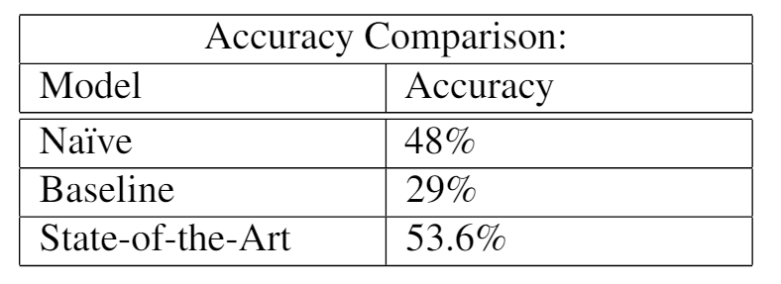
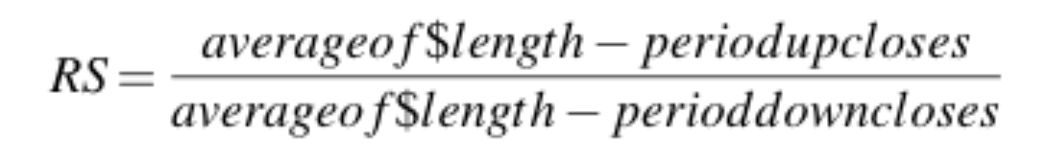
OPTIONAL LOGO HERE
Sentiment Analysis with News Headlines
Xinhui Gu, Tony Peng, Patrick Sun, Lue Xiong UC Berkeley, Haas School of Business
Introduction
Labeling Setup
State-of-the-art Model
Feature Importance
we aim to demonstrate the predictability of future stock movements using sentiment analysis, which specifically takes the form of news headlines. The way in which we will achieve this is through the employment of various machine learning techniques: starting from data collection, data cleaning, then using the data to generate various features that capture the signals in the market, and finally deploy our machine learning model using this carefully tuned dataset.
Using daily return data from 3/27/2014 to 9/12/2017 and a training set, validation and test set split of 70%, 20% and 10%, we compare the performance of 3 models. We aim to predict 10 days return, due to the fact that on a daily basis, return is negligible. We assume a mean of 0 and have a band around the mean to make sure that the positive and negative labels are significant enough. With this band, we created three labels as follows:
If the return on a particular 10-day period is greater than 0.3 times the standard deviation of all 10 day returns, which is 1.3% we label that day as positive.
If the return on a particular 10-day period is smaller than 0.3 times the standard deviation of all 10 day returns, we label that day as negative.
else, we label that day as neutral.
Here we used a multi-class support vector machine method to classify the returns as three types: positive, neutral and negative as labeled before, which is our y variable. We cross validated the regularization parameter, which had an optimal value around 1. We will use this value in all our following experiments:
With the same band we used in the Naïve and Baseline model, the result on the test set has an accuracy of 60.7%. However all predictions are 1s
After increasing the band around neutral returns to 1.15 standard deviation around 0, which is a 5% return as a threshold, we achieved a test set accuracy of 84.5%. However all prediction are 0s.
The problem is, the larger the threshold, more labels are 0s. On the other hand, the smaller the threshold, more labels are 1s. Therefore we always end up with extreme unbalanced data in our prediction and test set labels. Ideally we hope there is a local peak in the middle of somewhere even though its accuracy is not as high as accuracy at either end. Hence we ran a simulation where we treat the band threshold as a hyper-parameter. Below is a plot of the accuracy against the number of standard deviations we use as a threshold
Data Collection, Cleaning and Feature Engineering
Collection:
We use the GlobalNews API service from Xignite, a market data provider for data collection. Even though its service only provides news headlines up to 2014-3-27, their data are highly organized by date and we obtained a total of 33,808 news spanning over 1265 days.
Cleaning:
Delete all the text data in the weekend in order to match news sentiment to trading days.
Separate headlines into words for each day .
Use the 2014 Master Dictionary from Prof.Bill McDonald's web page. The dictionary is an extension of the 12dicts word list, which are widely used for textual analysis in financial applications. The dictionary contains seven sentiment category identifiers that we are going to use in our model building.
Feature Engineering:
Naïve Model
We calculated the percentage of positive labels to be 68%, negative labels to be 29% and the rest being neutral. Therefore, our naive model is that we would randomly predict an up move on each day with probability 68% and 29% for a down move on our test set. Then we would compare our prediction with the actual positive or negative returns on that day according to the label rule described before. The result is that our naive model had a prediction accuracy of 48% in the test set.
Baseline Model
For the baseline model, we used a slightly more sophisticated approach than just a Trinomial distribution. Every day we count the number of positive words and negative words in all the relevant headlines and subtract them. Since on average there should be equal number of positive and negative words for the company on a day, we can again assume this difference to have a mean of 0, then out baseline model's prediction rule is as follows:
If the difference on a day is greater than 0.3 standard deviation above 0, we label that day as positive
If the difference on a day is smaller than 0.3 standard deviation below 0, we label that day as negative
If the difference on a particular day is between 0.3 and -0.3 times the standard deviation around 0, we label that day as neutral.
Negative
Positive
Modal
Interesting
Litigious
Constraining
Superfluous
Uncertainty
Price Money Flow Index
Price Relative Strength Index
Application & Limitation
Since we can predict the movement of one stock, this can be generalized to a portfolio of stocks. We long the ones that we predicted to be positive over the next period and short the ones with negative prediction. However this does not tell us how much we should long or short each one, a modification that can fix this problem is to use a ML algorithm to output an ordinal number instead of a categorical number. Then we can determine the amount of short and long proportional to the size of the outcome.
From this graph, we see a peak of accuracy at around 0.5 times the standard deviation and a accuracy of around 53.6%. The key of the problem is to find a optimal parameter value that gives a fairly balanced dataset. The results of all three models are summarized below:
Conclusion
One of the very interesting phenomenon that we discovered during the project is the convexity of the accuracy function. This problem makes it difficult for us to tune the hyper-parameters even if there exists a optimal hyper-parameters set. Also the models predictive power are greatly dependent on the selection of the metric.
Notes:
1

