Slide 1

Adapting DeepDPM for a streaming data
DeepDPM - Deep Clustering With an Unknown Number of Clusters
by Meitar Ronen Shahaf E. Finder Oren Freifeld
Tomer Habusha tomerhabusha@gmail.com
Guy Davidi guydavidix@gmail.com
School of Electrical Engineering, Tel Aviv University, Oct 2022

Slide 2
Topics
Introduction:
The problem
DeepDpm
Research Directions and Methods:
Improving Network Architecture
Adapting to Streaming Data
Experiments and Results

Slide 3
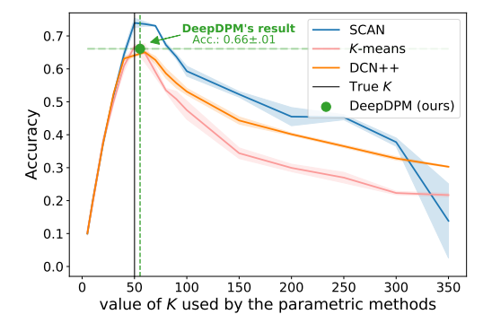
The Problem - General
Most deep-clustering methods are parametric and require a predefined and fixed number of clusters, denoted by K.
Using the wrong K can have a significant negative effect on parametric methods.
Using model-selection criteria to choose k’s optimal value might become computationally expensive , especially in DL.

Slide 4
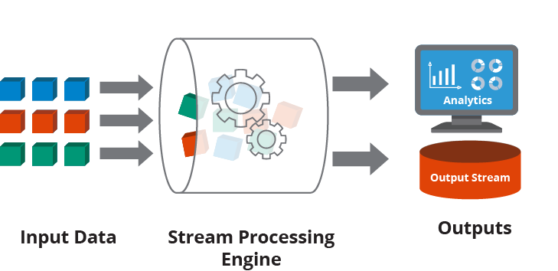
The Problem - Streaming Data
Infinite data stream arriving rapidly.
Clusters statistics can change with time (e.g: number, centers and weights).
Real-time requirements.

Slide 5
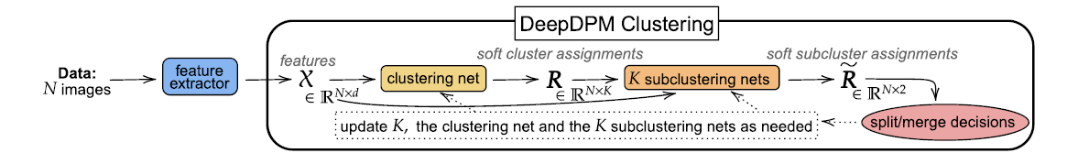
DeepDPM -General
Non Parametric method for deep clustering that does not require K in advance as it infers it during the learning.
Combines DPM (Dirichlet Process Mixture) and DL (Deep Learning).
The main advantage of the system is its adaptivity, flexibility and robusting to initial K.
Adaptive algorithm with five major steps

Slide 6
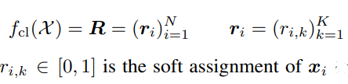
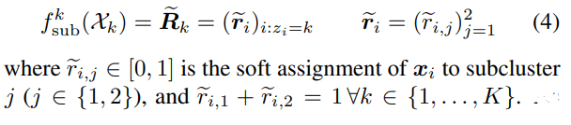
DeepDPM - Steps (1)
Feature extractor:
Paradigm 1: a two-step approach in which features are learned once (using Scan / Moco).
Paradigm 2: an end to-end approach, where features and clustering are learned jointly.
Clustering net:
Maximum a posteriori estimation (MAP) classifier.
Architecture: input layer, a single hidden layer (50 neurons) and an output layer (k neurons).
K sub clustering net :
Architecture: input layer (k neurons), hidden layer (Hidden_dim*k neurons, detaching different sub-clustering nets ), output layer (2*k neurons) , 2 FC layers

Slide 7
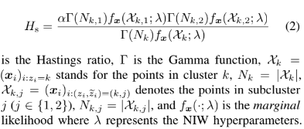
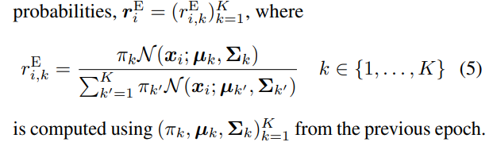
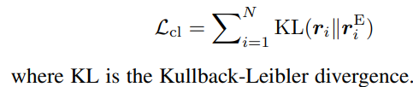
DeepDPM - Steps (2)
Split or merge decisions
Only by factor 2
A split proposal is accepted with probabilty min (1, Hs)
A merge proposal is accepted with probabilty min (1, 1/Hs)
Updating net:
add\remove neurons\weights\parameters
E-step of the EM-GMM algorithm: Loss function:

Slide 8
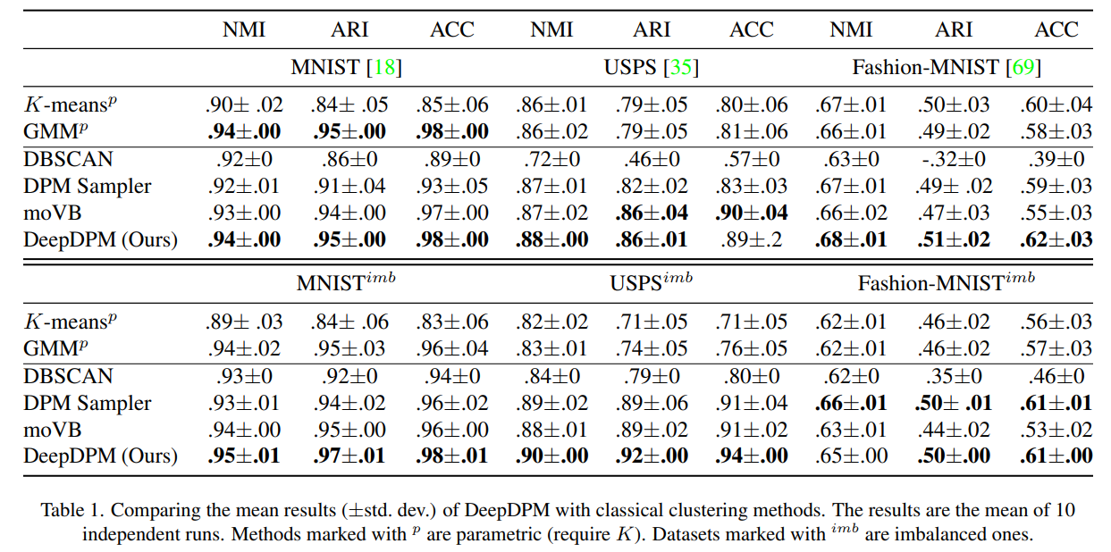
DeepDPM - results
Main Datasets (balanced and imbalanced) :
MNIST
USPS
Fashion-MNIST
ImageNet
Evaluating Results Parameters:
ACC - clustering accuracy
NMI - normalized mutual information
ARI - adjust rand index

Slide 9
Research directions and Methods
Improving Network Architecture - especially Sub-clustering network
Adapting to Streaming Data
Adapting to segmentation problem
Improving feature extractor method
Changing split/merge algorithm

Slide 10
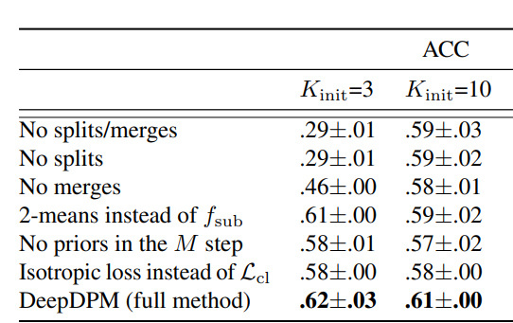
Improving Network architecture by changing sub-clustering network (1)
Paper’s code implementation for sub-clustering net:
Hard coded number of hidden-Layers = 1 and number of neurons = 50
2-means is the only different ablation
Method:
Changing code implementation for supporting more than 1 hidden layer:
updating sub-clustering class
updating merge\split and updating net functions
code configurable
Experiments:
changing number of neurons
changing number of hidden layers
changing activation function from relu to tanh
combination
Results:
Without significant change in results compared to the paper’s results

Slide 11
Improving Network architecture by changing sub-clustering network (2)
Dataset | Dropout | Number of hidden Layers | Number of neurons | Activation function | Acc | Final K
MNIST | 0 | 1 | 50 | relu | 0.98+0.00 (paper) | 10
MNIST | 0.5 | 1 | 50 | relu | 0.9787 | 10
MNIST | 0.5 | 1 | 75 | relu | 0.97873 | 10
MNIST | 0 | 2 | 50 | relu | 0.78364 | 8
MNIST | 0 | 2 | 25 | relu | 0.97871 | 10
MNIST | 0.3 | 2 | 25 | relu | 0.9787 | 10
MNIST | 0 | 2 | 15 | relu | 0.9787 | 10
MNIST | 0 | 2 | 50 | tanh | 0.9787 | 10

Slide 12
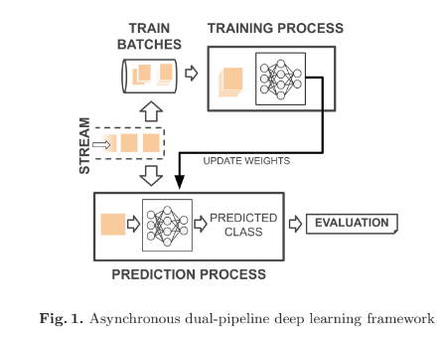
Adapting DeepDPM to streaming data - Method (1)
Learning about Deep Learning Classification Models for streaming data pipelines :
Paper : “On the Performance of Deep Learning Models for Time Series Classification in Streaming”, Jan 2021
Evaluate models such as MLP, CNN, LSTM and Temporal Convolutional Network (TCN) over several time-series datasets that are simulated as streams.
ADLStream Framework.
Paper: “Deep learning for time series classification: a review"
Using UCRAArchive_2018.
Using paper implantation.

Slide 13
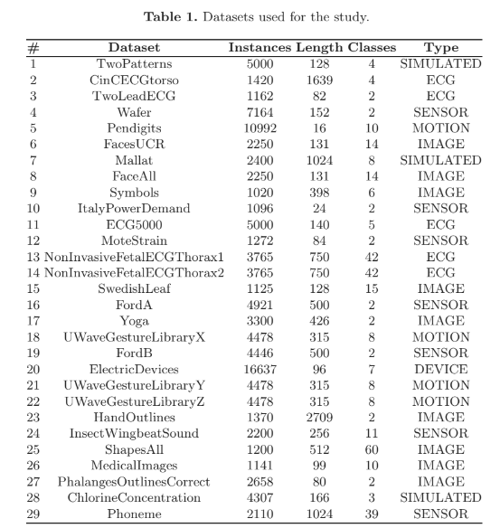
Adapting DeepDPM to streaming data - Method (2)
Datests: Using UCRAArchive_2018
one-dimensional time series datasets
Different characteristics and different domains.
Data format:
TSV files
One time series exemplar per row.
First value in the row is the class label
In our work we focused on two datasets:
Medical_Images
Train - 381, Test - 760, Classes - 10
MelbournePedestrian
Train - 1194, Test - 2439, Classes - 10
Notes:
MedicalImages: Histograms of pixel intensity of medical images. The classes are different human body regions.
PedestrianCountingSystem: The City of Melbourne, Australia has developed an automated pedestrian counting system to better understand pedestrian activity within the municipality, such as how people use different city locations at different time of the day. The data analysis can facility decision making and urban planning for the future. MelbournePedestrian Data are pedestrian count for 12 months of the year 2017

Slide 14
Adapting DeepDPM to streaming data - Method (3)
Pre-processing data :
Converting Datasets format to .pt format
Deal with “empty values”
Normalizing data
Using some of the built-in functionality for custom data
Changing DeepDPM to deal with time series files
Changing functions get_train_data and get_test_data
Paradigm Replacing:
Time dimensional -> Feature dimensional
Move from Paradigm 1 (a two-step approach →DeepDPM.py) to Paradigm 2 (an end to-end approach→DeepDPM_alternations.py)
Add AE alternations for feature extraction (size: latent_dim)
Changing DeepDPM_alternations to deal with time series files

Slide 15
Adapting DeepDPM to streaming data - Method (4)
Main Hyperparameters:
init_k: the initial guess for K
beta: coefficient of the regularization term on "clustering"
lr: learning rate
train_cluster_net: Number of epochs to pretrain the cluster net
lambda: coefficient of the reconstruction loss
number_of_ae_alternations:
When performing feature learning and clustering in alternation, we need to choose the number of times we perform the alternations.
one alternation includes training the AE followed by the DeepDPM training.
latent_dim: the AE's learned embeddings dimension.
Other parameters set to default values

Slide 16
Experiments and Results (1)
Medical_Images
Best Results:
Conclusions:
Calibrating Hyperparameters magnitude.
Dataset with more samples is needed.
Dataset | init_k | beta | lr | train_cluster_net | lambda | number_of_ae_alternation | latent_dim | accuracy | Final K
Medical Images | 1 | 0.001 | 0.01 | 350 | 0.5 | 2 | 5 | 0.26842 | 7
Medical Images | 1 | 0.005 | 0.01 | 300 | 0.5 | 2 | 5 | 0.26316 | 7
Medical Images | 1 | 0.005 | 0.01 | 300 | 0.5 | 2 | 5 | 0.31184 | 6
Medical Images | 1 | 0.001 | 0.01 | 320 | 0.5 | 2 | 5 | 0.38158 | 5
Medical Images | 1 | 0.005 | 0.01 | 330 | 0.5 | 2 | 5 | 0.29868 | 5
Medical Images | Paper’s result for MLP classifier (k is known) |  |  |  |  |  |  | 0.722 | 10

Slide 17
Experiments and Results (2)
MelbournePedestrian
Results with K=9, 10:
Dataset | init_k | beta | lr | train_cluster_net | lambda | number_of_ae_alternation | latent_dim | accuracy | Final K
MelbournePedestrian | 1 | 0.0008 | 0.008 | 250 | 0.5 | 3 | 12 | 0.42025 | 10
MelbournePedestrian | 1 | 0.0008 | 0.008 | 250 | 0.5 | 3 | 24 | 0.41451 | 10
MelbournePedestrian | 1 | 0.001 | 0.01 | 250 | 0.5 | 3 | 12 | 0.51907 | 9
MelbournePedestrian | 1 | 0.002 | 0.02 | 250 | 0.5 | 3 | 12 | 0.50841 | 9
MelbournePedestrian | 1 | 0.001 | 0.01 | 250 | 0.5 | 3 | 12 | 0.4551 | 9
MelbournePedestrian | Paper’s result for MLP classifier (k is known) |  |  |  |  |  |  | 0.8708 | 10

Slide 18
Experiments and Results (3)
Average Results:
Dataset | init_k | beta | lr | train_cluster_net | lambda | number_of_ae_alternation | latent_dim | avg acc (over ~6 runnings) | avg K (over ~6 runnings)
MelbournePedestrian | 1 | 0.0008 | 0.008 | 250 | 0.5 | 3 | 24 | 0.455 | 8
MelbournePedestrian | 1 | 0.001 | 0.01 | 250 | 0.5 | 3 | 12 | 0.456 | 7.83
MelbournePedestrian | 1 | 0.0008 | 0.008 | 250 | 0.5 | 3 | 12 | 0.455 | 7.71
MelbournePedestrian | Paper’s result for MLP classifier (k is known) |  |  |  |  |  |  | 0.8708 | 10

Slide 19
Conclusions
Adapting 1 - dimensional Time series datasets to DeepDPM - Success.
Getting correct number of classes - Success.
Getting high accuracy - far from paper’s results.
High dependency on the dataset size.
Instability in the convergence of the results.
Future work:
Mathematical changes on DeepDPM algorithm for time series datasets.
Work with multi dimensional time series datasets.

