Slide 1
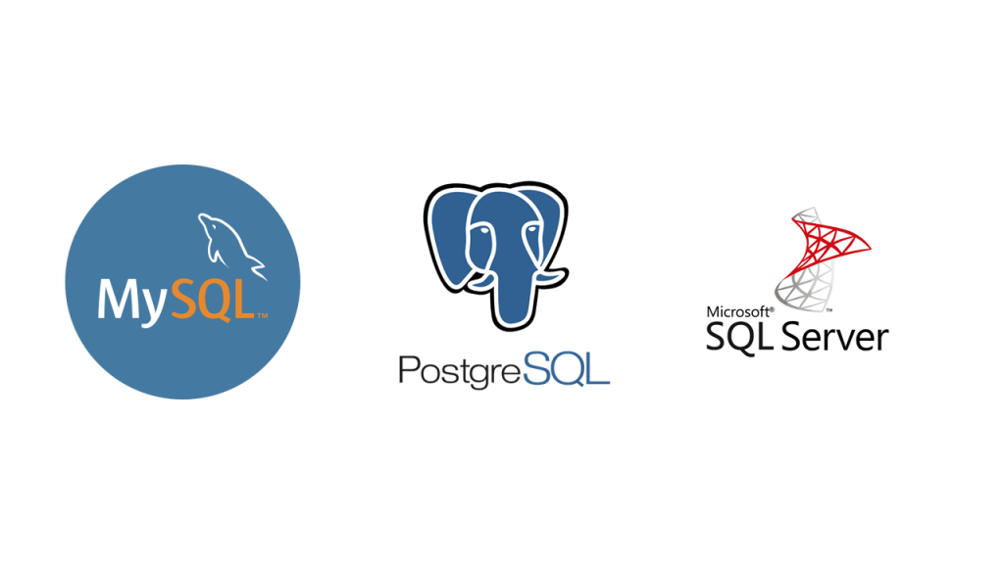
The big three RDMBS

Slide 2
• Introduction:
PostgreSQL is an advanced object-relational database management system that uses Structured Query Language (SQL) in addition to its own procedural language, PL/pgSQL. ... SQL Server is a Relational Database Management System (RDBM) developed and operated by Microsoft. PostgreSQL has a lot of capability. Built using an object-relational model, it supports complex structures and a breadth of built-in and user-defined data types. It provides extensive data capacity and is trusted for its data integrity
Microsoft SQL Server is a relational database management system developed by Microsoft. As a database server, it is a software product with the primary function of storing and retrieving data as requested by other software applications, which may run either on the same computer or on another computer across a network.
MySQL is a relational database management system based on SQL – Structured Query Language. The application is used for a wide range of purposes, including data warehousing, e-commerce, and logging applications. The most common use for mySQL however, is for the purpose of a web database.
Both PostgreSQL and MySQL are time-proven solutions that can compete with enterprise solutions such as Oracle and SQL Server. MySQL has been famous for its ease of use and speed, while PostgreSQL has many more advanced features, which is the reason that PostgreSQL is often described as an open-source version of Oracle.

Slide 3
MySQL
• Key features:
- Relational Database Management System (RDBMS) MySQL is a relational database management system.
- Easy to use. MySQL is easy to use.
- It is secure.
- Client/ Server Architecture.
- Free to download.
- It is scalable.
- Speed.
- High Flexibility.

Slide 4
PostgreSQL
• Key features:
- Sophisticated locking.
- View.
- Foreign key referential integrity.
- Rules.
- Inheritance.
- MVCC (Multiple version concurrency control).
- Subselects.
- Transactions.

Slide 5
Microsoft SQL server
• Key features:
- Intelligence across all your data with Big Data Clusters. Break down data silos.
- Choice of language and platform. Run SQL Server anywhere.
- Industry-leading performance. #1 in performance.
- Most secured data platform.
- Unparalleled high availability.
- End-to-end mobile BI.
- SQL Server on Azure.

Slide 6
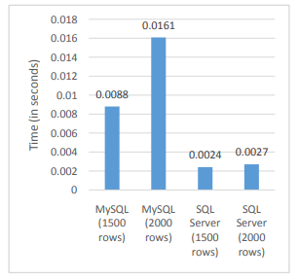
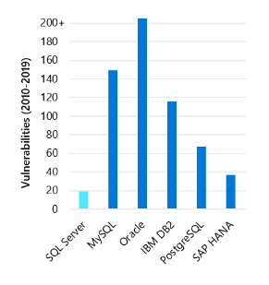
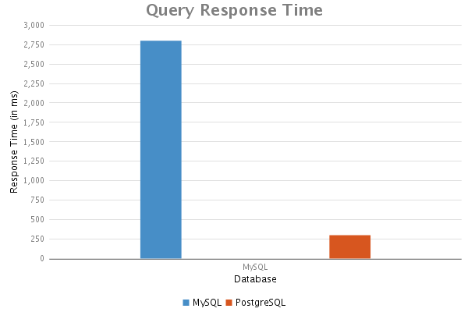
Comparing "the big three"

Slide 7
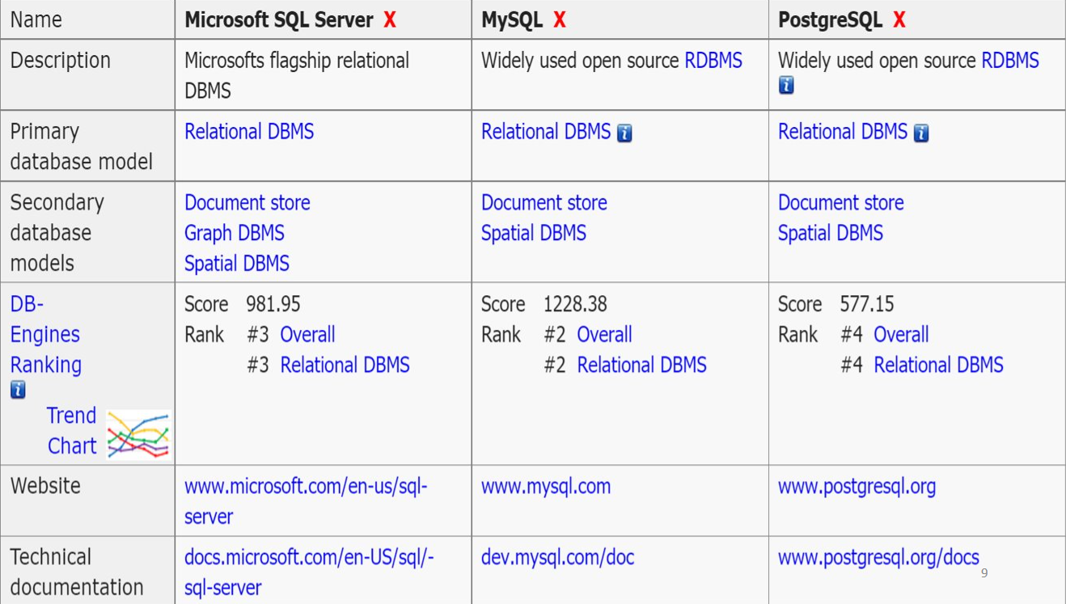

Slide 8
Thank you
for your attention
Made by Mahdi Krimi

