Slide 1

Data Science Workshop: Crypto anomalies
Proof of Concept
Oz Cabiri
Guy Harem

Slide 2
Topic 1: crypto arbitrage
Problem: Cryptocurrency prices can vary across exchanges, creating opportunities for arbitrage, where traders exploit price differences to make a profit
Motivation: Exploiting arbitrage opportunities can maximize profits across different exchanges
Question: Can machine learning algorithms accurately identify arbitrage opportunities between multiple cryptocurrency exchanges using real-time price and volume data?
Goal: Develop a ML model to identify arbitrage opportunities in real-time between cryptocurrency exchanges

Slide 3
FEASIBILTY ANALYSIS
Main Dataset: Binance and Coinbase Historical Market Data
Supporting Dataset: Kraken, Bitfinex, etc.
Dataset Features:
Available data: Open/Close Time, Open/High/Low/Close Price, Volume, Quote asset Volume, Number of Trades, Taker Buy Base/Quote Asset Volume, Ignore
All databases contain main features we need for the analysis
Datasets might not correlate exactly by timestamp, order and units

Slide 4
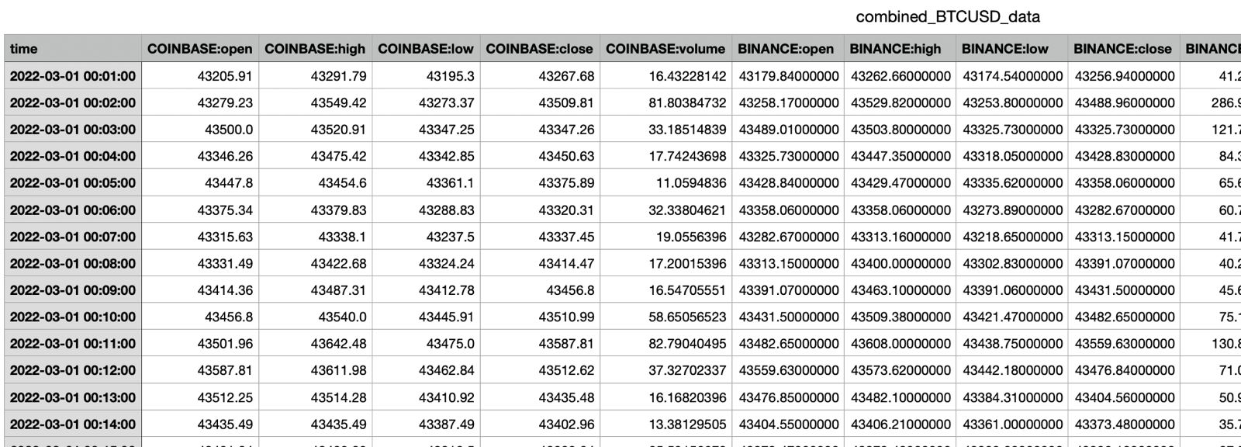
Proof of concept
Using ML we can believe we can identify these discrepancies and derive a model that will recognize them in real-time
Feature engineering: moving average, spread difference, high/low

Slide 5
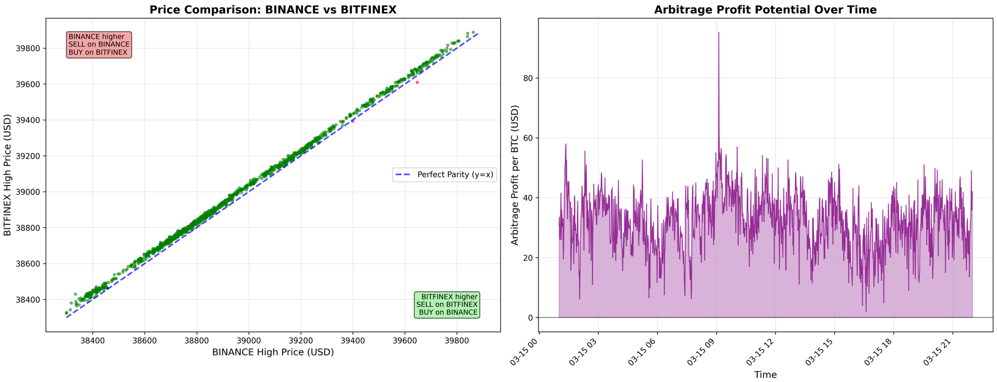

Slide 6
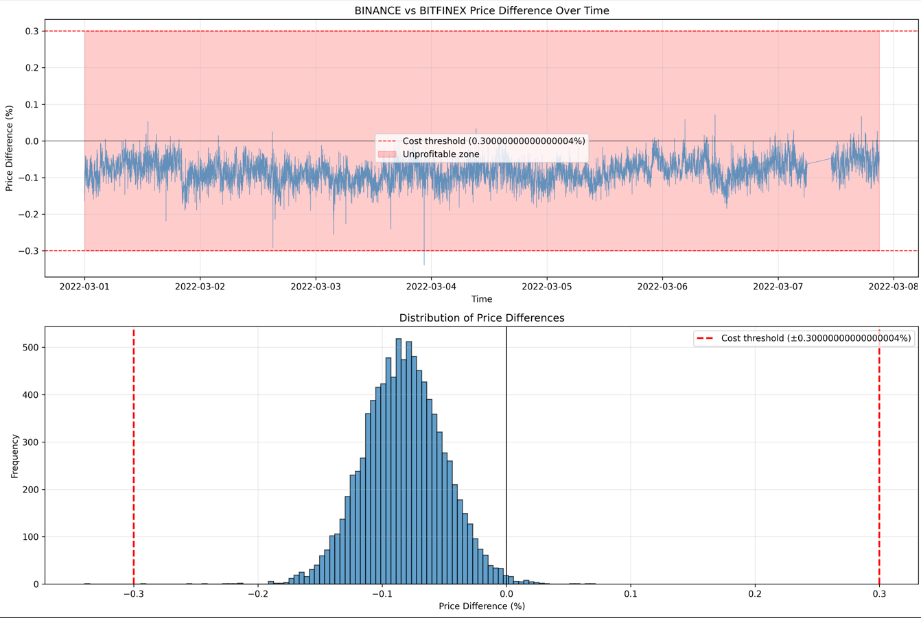

Slide 7
Initial approach + workplan
Get datasets with API✅
Adjust database structure and units to be uniform✅
Combine datasets✅
Clean outliers, irrelevant data and problematic entries
Data engineering: identify feature importance
Fine-tune ML algorithms to detect arbitrage opportunities
Apply model on real-time data

Slide 8
Milestones
Retrieve relevant datasets using APIs + merge datasets (P1)
Data engineering: decide on features, identify setbacks and consider possible solutions (P2)
Workable model on existing data (P3)
Deploy model on real-time data + derive conclusions on model’s accuracy and viability (final)

Slide 9
What does success look like?
Consistently find arbitrage on historical data
Usable model to apply on real-time data
OR
Understand if arbitrage opportunities still exist in today’s market

Slide 10
Topic 2: Pump n’ Dump
Problem: Pump n’ Dumps are where prices are artificially inflated before being rapidly sold off, misleading traders
Motivation: Identifying these patterns can help prevent market manipulation, improve trading strategies, and protect investors
Question: Can machine learning algorithms effectively detect pump-and-dump schemes in cryptocurrency markets across multiple exchanges using historical price and volume data?
Goal: Develop a machine learning model to detect pump-and-dump activities

Slide 11
FEASIBILTY ANALYSIS
Main Dataset: Binance Historical Market Data
Supporting Dataset: Coinbase, Kraken, Bitfinex, etc.
Dataset Features:
Available data: Open/Close Time, Open/High/Low/Close Price, Volume, Quote asset Volume, Number of Trades, Taker Buy Base/Quote Asset Volume, Ignore
All databases contain main features we need for the analysis
Datasets might not correlate exactly by timestamp, order and units

Slide 12
Proof of concept
We will try to train a ML model to identify patterns of known Pump n’ Dumps and derive a model that identifies those schemes
Possible identifiers: sudden spike in volume/price, fast reversal, abnormal candle stick patterns

Slide 13
Initial approach + workplan
Get datasets with API✅
Adjust database structure and units to be uniform✅
Combine datasets✅
Clean outliers, irrelevant data and problematic entries
Data engineering: identify feature importance
Fine-tune ML algorithms to detect arbitrage opportunities
Apply model on real-time data

Slide 14
Milestones
Retrieve relevant datasets using APIs + merge datasets (P1)
Data engineering: decide on features, identify setbacks and consider possible solutions (P2)
Workable model on existing data (P3)
Deploy model on real-time data + derive conclusions on model’s accuracy and viability (final)

Slide 15
What does success look like?
Consistently detect Pump n’ Dumps on historical data
Usable model to apply on real-time data

Slide 16
Arbitrage: Pros and Cons
Pros:
Real-Time Profit Opportunities
Market Efficiency: Promotes efficient price discovery by reducing price differences between exchanges
Practical Application: Useful for algorithmic trading, providing real-world financial applications and insights into market dynamics

Slide 17
Arbitrage: Pros and Cons
Cons:
Market Conditions: Arbitrage opportunities often exist only for very short periods
Transaction Costs: Profits from arbitrage can be eaten up by transaction fees
Requires Real-Time Data: Successful arbitrage detection demands access to live data feeds and low-latency algorithms, which may increase technical complexity

Slide 18
Pump n’ Dump: Pros and Cons
Pros:
Market Integrity and Risk Mitigation: Helps identify manipulative activities, protects investors from sudden possible significant losses
Wide Applicability: Relevant across all exchanges and assets, helping improve market oversight and trading strategies
High profile Pump n’ Dumps data exist and easy to find

Slide 19
Pump n’ Dump: Pros and Cons
Cons:
Data Complexity: Identifying pump-and-dump schemes requires detailed, high-frequency data and complex pattern recognition, which can be difficult to model accurately
False Positives: Genuine market fluctuations or news-driven events might be mistakenly classified as pump-and-dump action

Slide 20
Questions?

