Slide 1
Predicting the Workforce
MaxFlow Analytics
(Company 5, CASA International)
Project: Data Science
Master of Statistics and Data Science
15 December 2023
H. Görkem Uyanık

Slide 2
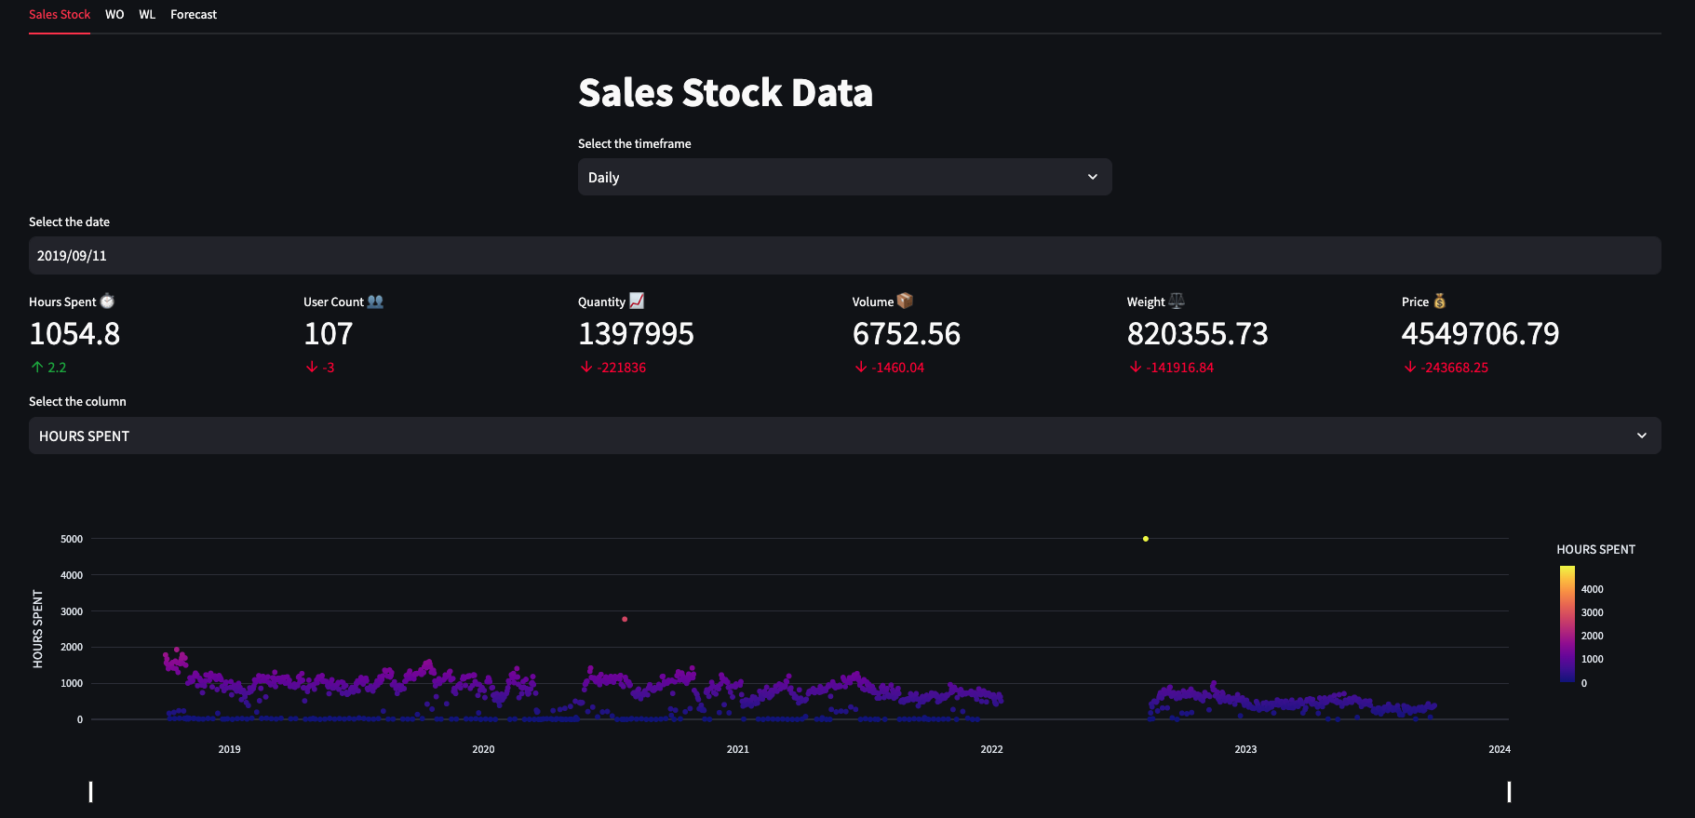
Links
https://github.com/guyanik/pds
https://maxflow.streamlit.app/

Slide 3

Introduction
International chain of contemporary interior decoration shops, with a total of more than 500 stores, subsidiaries and franchisees
Objects for interior decoration, giftware, household and bath products, textiles and small items of furniture

Slide 4
Introduction
Research Question: What is the required daily workforce according to the workload in the warehouse?
Data:
Sales Stock
Sales Order (WO)
Sales Order (WL)
Data pipeline
Detecting files without timestamps and completing them
Daily aggregation by date and teams (locus)
Filling missing dates with 0 values

Slide 5
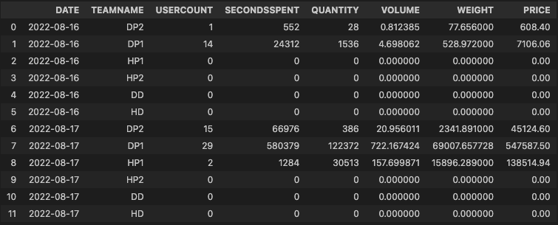
Introduction
Sales Stock Data

Slide 6
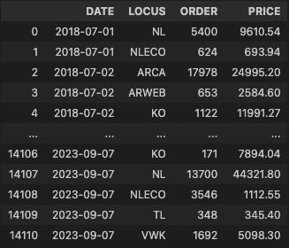
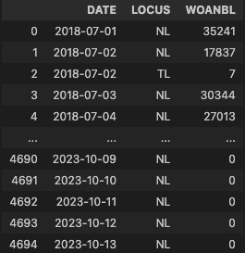
Introduction
Sales Order

Slide 7
Demonstration

Slide 8
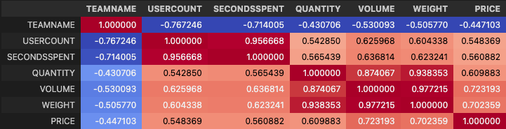
Results & Insights
Correlation between sales orders and sales stock quantity: 82%

Slide 9
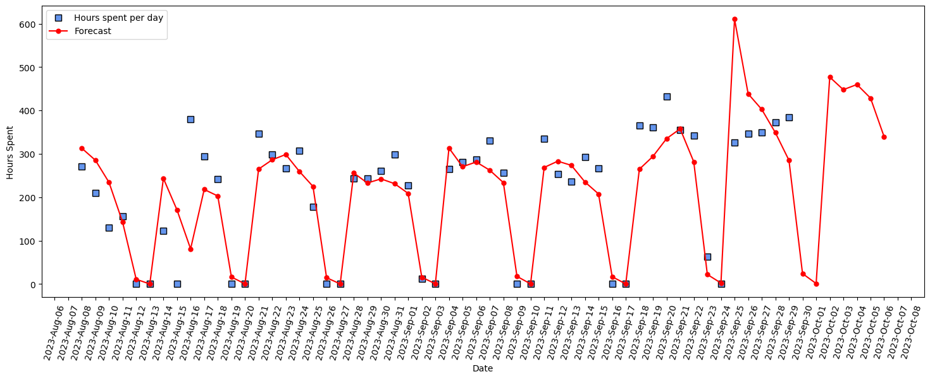
Results: Holt-Winters Method
Seasonality: 7 days (correlation: 80%)
MAE: 51 hours (last 60 days)
MAE: 110 hours (last 5 days)

Slide 10
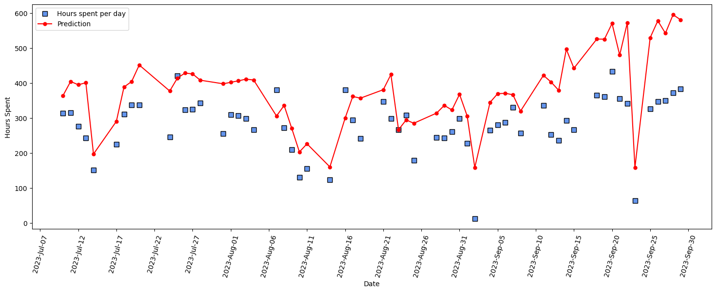
Results: Random Forest
MAE: 105 hours

Slide 11
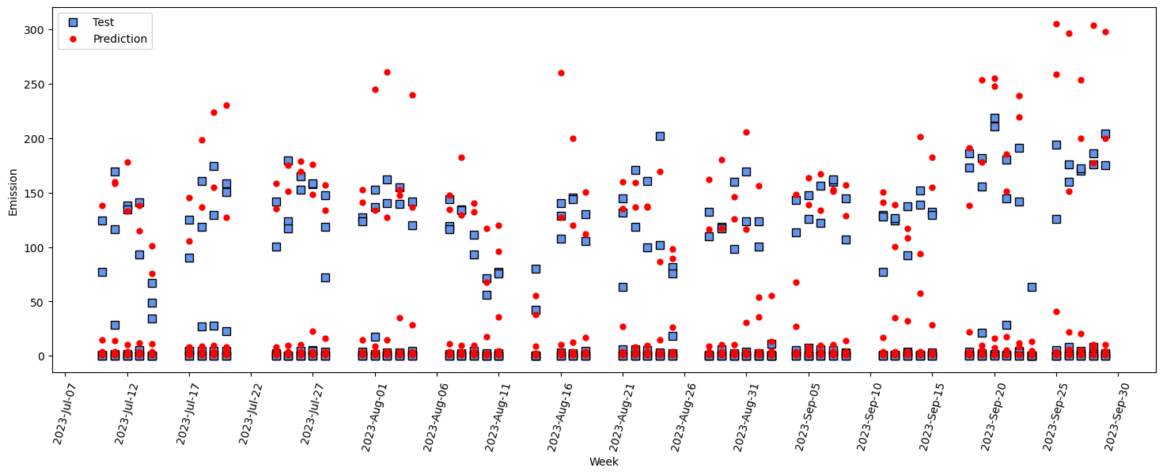
Results: XGBoost (teams)
MAE: 16 hours

Slide 12
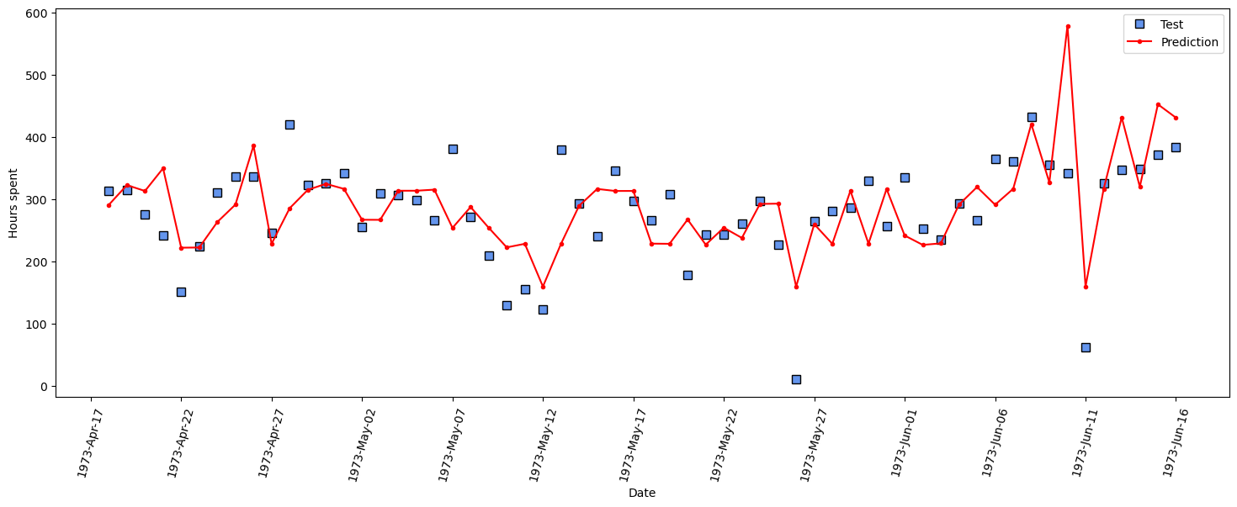
Results: XGBoost
MAE: 50 hours

Slide 13
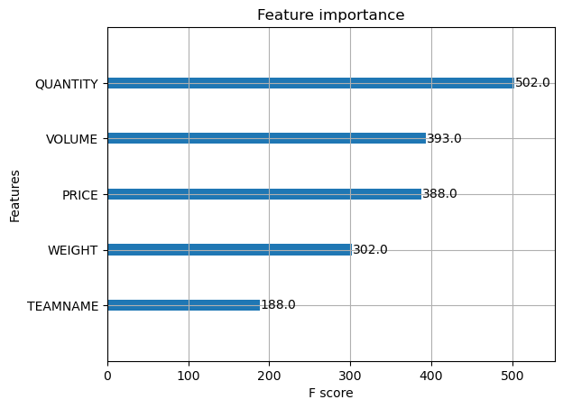
Results: XGBoost

Slide 14
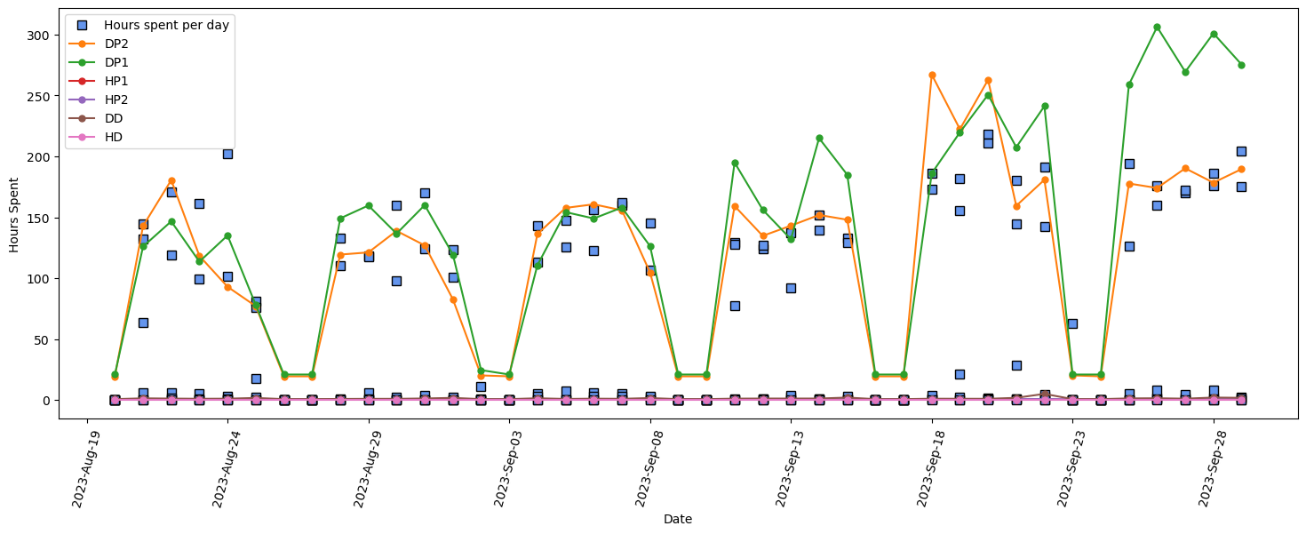
Results: LSTM (teams)
MAE: 11 hours

Slide 15
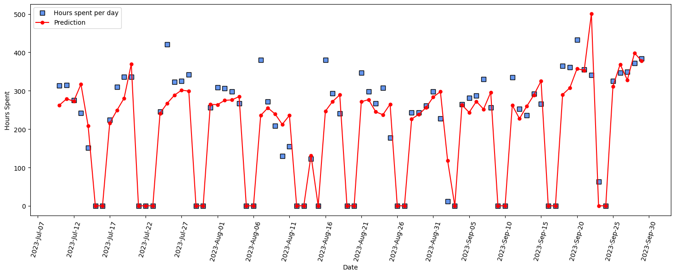
Results: LSTM
MAE: 33 hours
Building a forecasting model for future values: unachievable

Slide 16
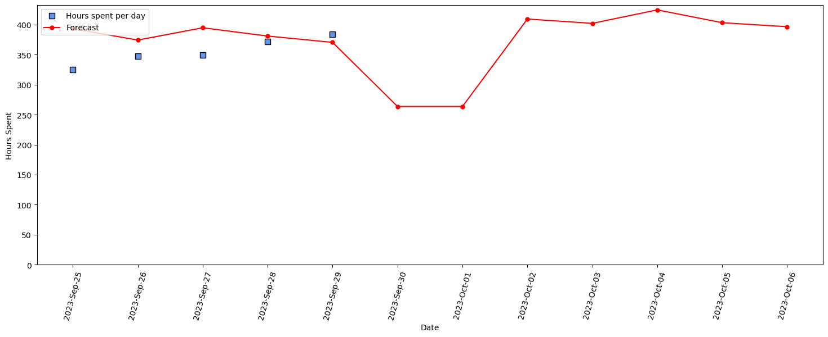
Results: ARIMA
MAE: 33 hours (last 5 days)
Not good at predicting weekends

Slide 17
Key Lessons Learned
Data pipeline and data cleaning (aggregation, feature selection)
Understanding and analysing the data according to main objective
Communication

Slide 18
Main Challenges
Number of files and size of data (~80 GB for sales stock data)
Model selection
Communication

Slide 19
Conclusion
LSTM: best for prediction
ARIMA: best for getting future values

Slide 20
Thank you
Links:
https://github.com/guyanik/pds
https://maxflow.streamlit.app/

