Slide 1
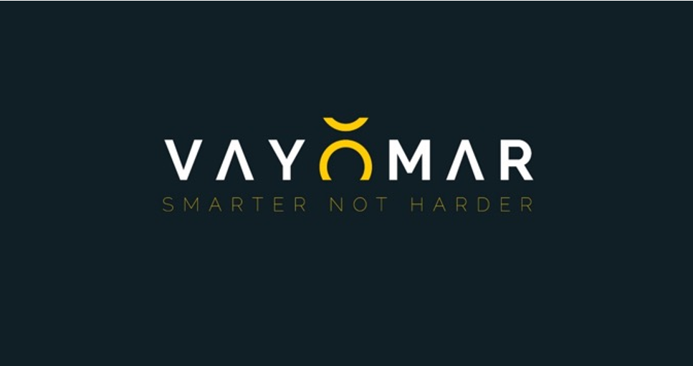
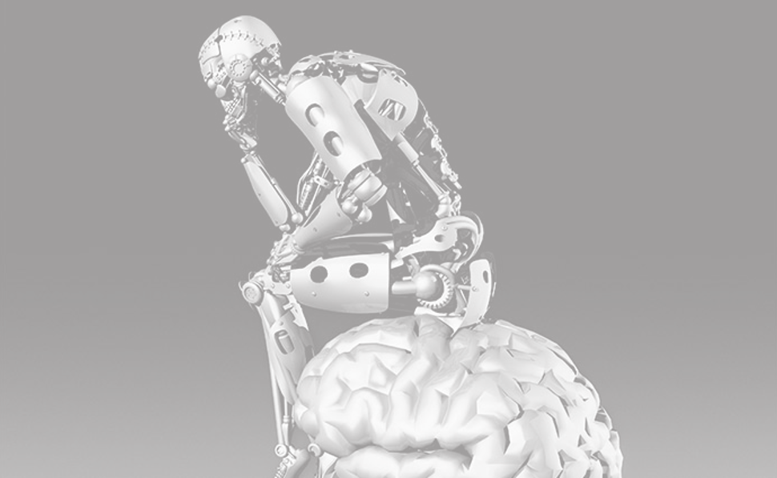
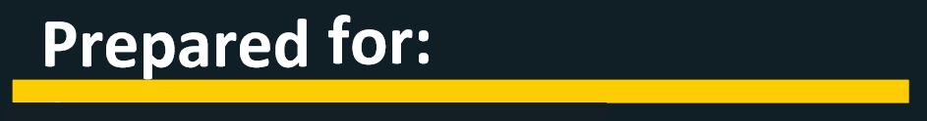
<TITLE>
<CUSTOMER_LINE_1>
<CUSTOMER_LINE_2>
<CUSTOMER_LINE_3>
<CUSTOMER_LINE_4>
<CUSTOMER_EMAIL_1>
<CUSTOMER_EMAIL_2>
<CUSTOMER_EMAIL_3>

Slide 2


<INTRO>
BACKGROUND
<BACKGROUND>
VAYOMAR GLOBAL1

Slide 3

DESIRED OUTCOMES
<DESIRED_OUTCOMES>
VAYOMAR GLOBAL

Slide 4


PROGRAM SESSION STRUCTURE
<PROGRAM_STRUCTURE>
DESIRED OUTCOMES
VAYOMAR GLOBAL

Slide 5
PROGRAM SESSION STRUCTURE
Academy (MBA style learning):
The Academy component serves as the foundational stage for equipping participants with the essential mindset, theoretical tools, methodological best practices and knowledge, necessary for their respective roles. The Academy can be taken as a stand alone component of the program with the other components added in a later time should the company wish to embrace this program in a multiphase approach.
As part of the Academy, participants will engage in a dynamic learning format that combines interactive lectures, case studies, breakout sessions and group discussions. We will guide participants through a range of relevant topics which will be curated in the first phase of this engagement.
To enhance the learning experience and promote practical application, we will incorporate specific use-cases and scenarios into the program. These real-life examples will be carefully selected and developed in collaboration with your team and select stakeholders of your choice, to ensure their relevance and alignment with the participants' roles and challenges. Overall, the Academy component offers a robust foundation for participants to build upon throughout their careers.
We provide an immersive and transformative learning experience that equips mid-level managers with the necessary skills and knowledge to excel in their roles and contribute to the overall success of their organizations.
DESIRED OUTCOMES
VAYOMAR GLOBAL

Slide 6
PROGRAM SESSION STRUCTURE
Individual Development Plan (IDP):
Designed to help individuals identify their development needs and career objectives an IDP typically include:
Career objectives: The individual identifies their long-term career goals. These could be things like becoming a manager, mastering a specific skill, transitioning to a different role or industry, or achieving a particular certification or qualification.
Skills assessment: The individual, often in consultation with their manager, identifies their current skills and knowledge, and how these align with their career objectives. This can involve identifying both strengths and areas for improvement.
Development activities: Based on the career objectives and skills assessment, the individual identifies specific activities to undertake to achieve their goals. This could involve things like training courses, reading books, on-the-job learning, mentoring, or attending conferences.
Timeline: The individual establishes a timeline for completing their development activities. This helps to provide structure and motivation.
Review and update: The IDP is not a static document. It should be reviewed and updated regularly (typically annually, but this can vary depending on the individual and the company) to ensure it remains relevant as the individual's skills, knowledge, and career objectives evolve. The benefits of an IDP for the individual include increased self-awareness, motivation, and career satisfaction. For the company, benefits can include increased employee engagement and retention, as well as improved performance and productivity.
DESIRED OUTCOMES
VAYOMAR GLOBAL

Slide 7
PROGRAM SESSION STRUCTURE
PODS:
he main objective of the PODs (is to provide participants with real-world learning experiences that allow them to implement theoretical tools and best practices from the sessions.
Participants will be divided into smaller PODs, each focusing on a specific stakeholder or business unit they work with and a current use case. These PODs will meet between sessions to collaborate, think critically, and apply the tools and methodologies to their unique case scenarios.
To ensure effective incorporation of the methodologies, each POD will receive a coaching session from Vayomar. This will help guide their application of the concepts and ensure they are effectively integrated into their daily practices. Additionally, every session will include time for PODs to present their work and progress. This approach not only reinforces learning and foster accountability but also creates actual usable work product .
DESIRED OUTCOMES
VAYOMAR GLOBAL

Slide 8
PROGRAM SESSION STRUCTURE
Project Based Learning (Practicum):
The main objective of the Practicum is to provide participants with a real-world learning experience that allows them to implement the theoretical tools and best practices learned in the Academy.
By engaging in project-based learning, participants will have the chance to apply their knowledge to practical situations that will be curated around current needs and challenges most relevant to the company’s current road map, thus fostering a deeper understanding of the concepts and enhancing their problem-solving and decision-making skills. These activities will be facilitated in a way that is closely linked to your company’s cultural and operational realty.
The projects undertaken during the Practicum will focus on cross-organizational focus areas that do not have a specific owner within the company. This approach encourages collaboration and interdepartmental cooperation, allowing participants to gain insights into different aspects of the organization and develop a broader perspective. We advise that each project be assigned an executive sponsor from within the company. These sponsors will provide guidance, resources and will help the work-groups navigate potential challenges and ensure the successful execution of their projects. Importantly, the projects developed during the Practicum will adhere to a “return on investment (ROI) within the first year” guideline.
This focus on tangible outcomes ensures that the projects are not only valuable learning experiences but also contribute to the organization's overall success in a way that justifies the significant investment in this program.
DESIRED OUTCOMES
VAYOMAR GLOBAL

Slide 9
PROGRAM SESSION STRUCTURE
Scenario Harvesting
At Vayomar, we have learned that “One Size” does not fit all. In spite of the vast and comprehensive list of insights that we have gathered in over two decades of our work with countless organizations across the globe, and which do have a universal truth at their base, we have learned that in order for our programs to be well-received and our methodologies truly internalized by the people we train/consult, they must be anchored in examples and delivered using language and terminology that is “native” to them.
Therefore, during this phase of the engagement we work with you (and specific individuals of your choice from within the company) to collect real-life examples of daily situations that the program’s participants encounter and find challenging. We then incorporate these examples into our workshops and into the examples we provide on how to most practically use the tools and methodologies we are sharing with the program participants. By using “their world” scenarios, we avoid coming across as “ivory tower” or “generically” academics and are perceived as “one of them” in terms of our real understanding of their difficulties and needs.
DESIRED OUTCOMES
VAYOMAR GLOBAL

Slide 10
PROGRAM SESSION STRUCTURE
Scoping and design:
A series of meetings with your team and key stakeholders, during which specific desired outcomes for the program will be determined, as well as define the specific content that will be introduced in the program. During this phase we will harvest relevant use cases and scenarios that will be introduced in the program’s Academy component as “your world” examples to apply to the theoretical tools. In case you elect to include the practicum element of the program we will also define with you the practicum’s projects constraints (program’s intensity, executive sponsorship involvement etc.).
DESIRED OUTCOMES
VAYOMAR GLOBAL

Slide 11
PROGRAM SESSION STRUCTURE
Scoping and design:
A series of meetings with your team and key stakeholders, during which specific desired outcomes for the program will be determined, as well as define the specific content that will be introduced in the program. During this phase we will harvest relevant use cases and scenarios that will be introduced in the program as “your world” examples to apply to the theoretical tools.
DESIRED OUTCOMES
VAYOMAR GLOBAL

Slide 12
PROGRAM SESSION STRUCTURE
Steering Committee:
To ensure the program achieves its intended outcomes, the committee will oversee continuous monitoring of the program's progress throughout its duration. The committee will be able to suggest real-time adjustments when necessary, guided by insights gained from sessions and feedback provided by participants and Vayomar’s trainers. Committee members, selected by you, may include members of your team, representatives from the participant pool, or their respective managers.
DESIRED OUTCOMES
VAYOMAR GLOBAL

Slide 13
PROGRAM SESSION STRUCTURE
Scoping & Design Sessions
During these series of calls/meetings, we will work with you to define clear and measurable desired outcomes that this engagement is intended to service. Some of these outcomes may be strategic in nature, looking at the broader business and operational objectives currently driving the company and others will relate more tactically to the project’s short terms KPIs. We will further work with you to explore possible or expected obstacles that we will need to wisely mitigate in order to ensure that the above-mentioned desired outcomes and KPIs are successfully driven by this engagement.
In addition, we will work with you to gain knowledge about this program’s participants as well as their current mental and emotional states of mind alongside the more objective circumstances of their operational environments. This is meant to help us use language and examples in our sessions with them, that are less generic and more relatable to them.
DESIRED OUTCOMES
VAYOMAR GLOBAL

Slide 14
PROGRAM SESSION STRUCTURE
1-on-1 Interviews
These interviews can be an extension to the Scoping & Design process and are often used in preparation for executive level offsites or more lengthy training programs. In such cases, we like to meet with several individuals that are expected to be participants in our program and ask them the following questions:
What would you consider to be a successful outcome from this program?
What are some potential forces that may work against our ability to secure this successful outcome?
What “theme” would you select for this program, that you feel best encapsulates its essence?
What advice do you have for “me” (“me” = Vayomar Trainer/Facilitator)?
DESIRED OUTCOMES
VAYOMAR GLOBAL

Slide 15
PROGRAM SESSION STRUCTURE
1-on-1 Coaching Sessions
During these sessions, we place a high focus on personalization to the individual we are coaching. Based on the initial Scoping & Design of this engagement, we begin by aligning expectations with the coachee around the process and methodological components that we will be bringing into the coaching process. Sometimes, these components will have been defined ahead of time (during the Scoping & Design phase) and in other times, they are decided upon with the coachee.
DESIRED OUTCOMES
VAYOMAR GLOBAL

Slide 16
PROGRAM SESSION STRUCTURE
Role-playing Kits
True upskilling often required practice. That’s why, in addition to our highly interactive workshops and training sessions (which often include break-out sessions in which participants can grapple with practical exercises), we offer a more robust role-playing component that is based on more advanced case-studies that are created ahead of the workshops.
Working with selected individuals of your choice, we collect information about key stakeholders (internal and/or external) which whom the program participants must learn to interact more effectively with. We also collect information about the internal processes within which these interactions take place (i.e. – customer facing sale cycles, internal project life-cycles, ect). When we are done creating these kits, they are shared with the program participants and they are expected to have read through them thoroughly ahead of their next role-playing session with us.
During the role-playing sessions, participants can either participate in the role-playing as themselves or as the persona around which a specific kit was built around. As they roleplay, other participants are asked to apply “active listening” by answering specific questions in a form that is given to them. When the role-playing part is complete (15-30 minutes on average), a discussion is conducted, in which the role play is reflected upon and feedback is given to the individuals who were in it. This feedback is given by the fellow participants as well as by our trainer/facilitator.
DESIRED OUTCOMES
VAYOMAR GLOBAL

Slide 17
PROGRAM SESSION STRUCTURE
At the end of each feedback round, the person playing themselves in the role-play received a scorecard which contains the feedback from their fellow participants as well as from our trainer/facilitator. In cases where programs are long enough to allow a single participant to participate in several role-playing rounds, meaningful insights can be derived from their accumulated feedback forms.
These insights pertain to their learning graph, strengths and ongoing weaknesses and can prove valuable to their ongoing individual development plan (IDP).
[We will need a couple of images/visuals that show parts of the simulation kit]
DESIRED OUTCOMES
VAYOMAR GLOBAL

Slide 18
PROGRAM SESSION STRUCTURE
Kickoff Sessions
In this session, participants will be introduced to the context of the program as well as its intended desired outcomes and the program sponsor’s overall expectations of them. This session may also include:
Logistical information about the program’s length, schedule and contents
The estimated overall time and effort that each participant will be required to put in
Q&A
Inspirational content from Vayomar
.
DESIRED OUTCOMES
VAYOMAR GLOBAL

Slide 19
PROGRAM SESSION STRUCTURE
Steering Committee Calls
To ensure the program achieves its intended outcomes, the committee will oversee continuous monitoring of the program's progress throughout its duration. The committee will be able to suggest real-time adjustments, when necessary, guided by insights gained from sessions and feedback provided by participants and Vayomar’s trainers. Committee members, selected by you, may include members of your team, representatives from the participant pool, or their respective managers.
DESIRED OUTCOMES
VAYOMAR GLOBAL

Slide 20
PROGRAM SESSION STRUCTURE
Pod Coaching Sessions
To ensure the program achieves its intended outcomes, and that its participants are able to practically apply the tools and methodologies taught to them in their daily routines, this MBA-like program component will require them to work in smaller groups on a selected case study (longer programs may include multiple case studies). The types of case studies from which each Pod will be able to select can be determined in advance, during the Scoping & Design phase of this engagement.
Each Pod will be expected to convene several times between their training sessions with Vayomar, in order to develop their selected case study and be ready to share their progress in the next group session with Vayomar. To assist them, each Pod will receive a 30-minute virtual coaching session with a Vayomar trainer.
DESIRED OUTCOMES
VAYOMAR GLOBAL

Slide 21
PROGRAM SESSION STRUCTURE
Program Debrief Sessions
Following the completion of this engagement, we will conduct several virtual calls with you, during which we will conduct a structured debriefing process about every phase of this program. The goal of this phase is to harvest meaningful learning and actionable insights that may inform the design of potential extensions of this program or pre-defined next phases as well as potential future programs of a similar nature.
DESIRED OUTCOMES
VAYOMAR GLOBAL

Slide 22
PROGRAM SESSION STRUCTURE
Teaser Campaign
Given the limited amount of time we will have with the participants of this program, we’d like to ensure that no time is waisted in the earlier parts, but helping the participants “hit the ground running”. This can be done by building up their curiosity and excitement about their upcoming sessions with us, using short and catchy teasers that are designed in context of the program’s desired outcomes, structure and selected content. These teasers are normally shared in the weeks leading up to the program, often on a cadence of once or twice a week. They often include a very short (and intriguing) texts, alongside a stimulation and curious visual.
[We will need a couple of images/visuals that show parts of the simulation kit]
DESIRED OUTCOMES
VAYOMAR GLOBAL

Slide 23
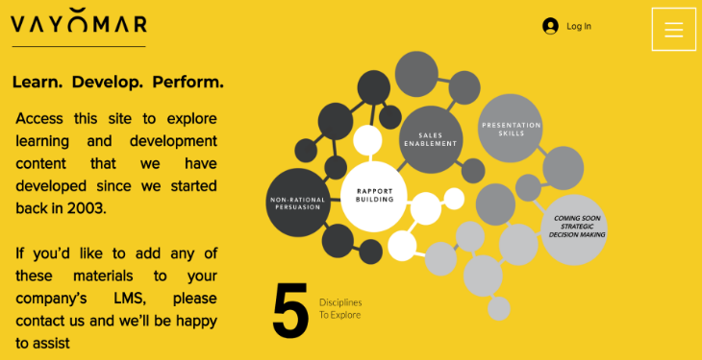
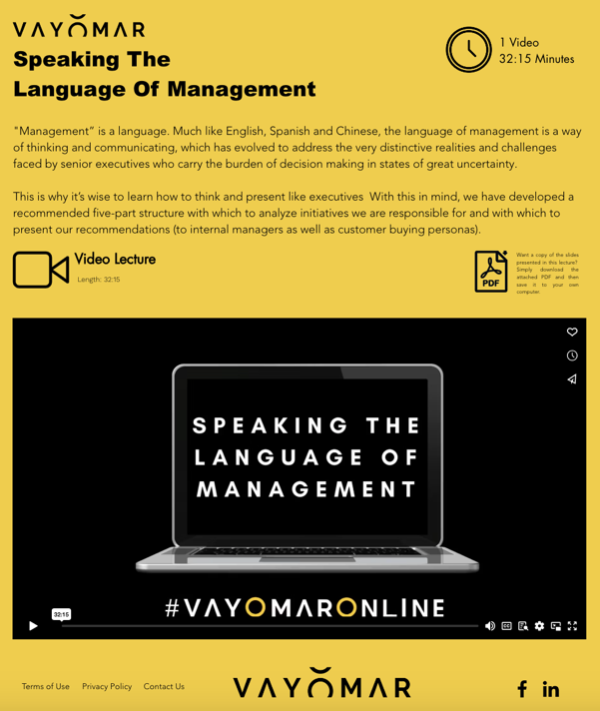
PROGRAM SESSION STRUCTURE
Vayomar Online Users
Each participant will be granted three months of access to Vayomar Online, our online learning platform, which contains a rich library of short training videos.
The participants will be able to access this platform in order to refresh or deepen their understanding of the various methodologies that will be included in this program.
DESIRED OUTCOMES
VAYOMAR GLOBAL

Slide 24

Speaking openly as a pro-Israeli is challenging even in the best of times, and it’s perhaps harder now than ever. On social media and even in professional settings, avoiding the topic can be difficult. In this session, we introduce tools and methodologies that we have developed and refined over the past 20 years, which were also adopted by the Ministry of Foreign Affairs to consuls and ambassadors.
The core principle of this approach is to foster genuine discussions based on persuasion techniques rather than descending into arguments or fact battles. By practicing these tools, you’ll gain the skills to remain composed and engage in respectful conversations that don’t damage relationships, even amidst disagreements—and help others see your perspective a little more clearly..
Lead With Empathy - You can be right and empathetic… just not in that order.
Negotiate Terminology Before Ideology - Avoid the pitfalls of “loaded” language.
The Power of Analogies - Make it understandable and relatable by linking it to your audience’s reference points.
Role Reversal -Shift from speaking to listening. Put your audience in Israel’s shoes and hear them out.
The Palestinian Perspective - Shift from “what Israel’s doing wrong?” to “what would benefit the Palestinian people?”.
Comparative Justice -Zoom out. Discuss the issues at hand from a global point of view.
Cross Referencing - Expose contradictions within a series of individual criticisms voiced frequently against Israel.
7 PRINCIPALES OF EFFECTIVE PRO- ISRAEL DIALOG

Slide 25
The Digital Revolution has brought an exponential increase in the rate of global innovation, and with it, a rise in the number of startups seeking investment capital.
For investors, finding the right opportunity to invest in has become like finding a needle in a haystack Harder, perhaps!
Therefore, the strategic importance of knowing how to effectively introduce your startup to investors has become a “do or die” skill set for entrepreneurs.
Having assisted thousands of startups around the world (directly and via over two dozen incubators and accelerators), we have distilled a perfect structure for investor presentations, that will help you deliver a Stellar session that will get your points across in a memorable way.
BUILDING A WINNING INVESTOR PRESENTATION

Slide 26
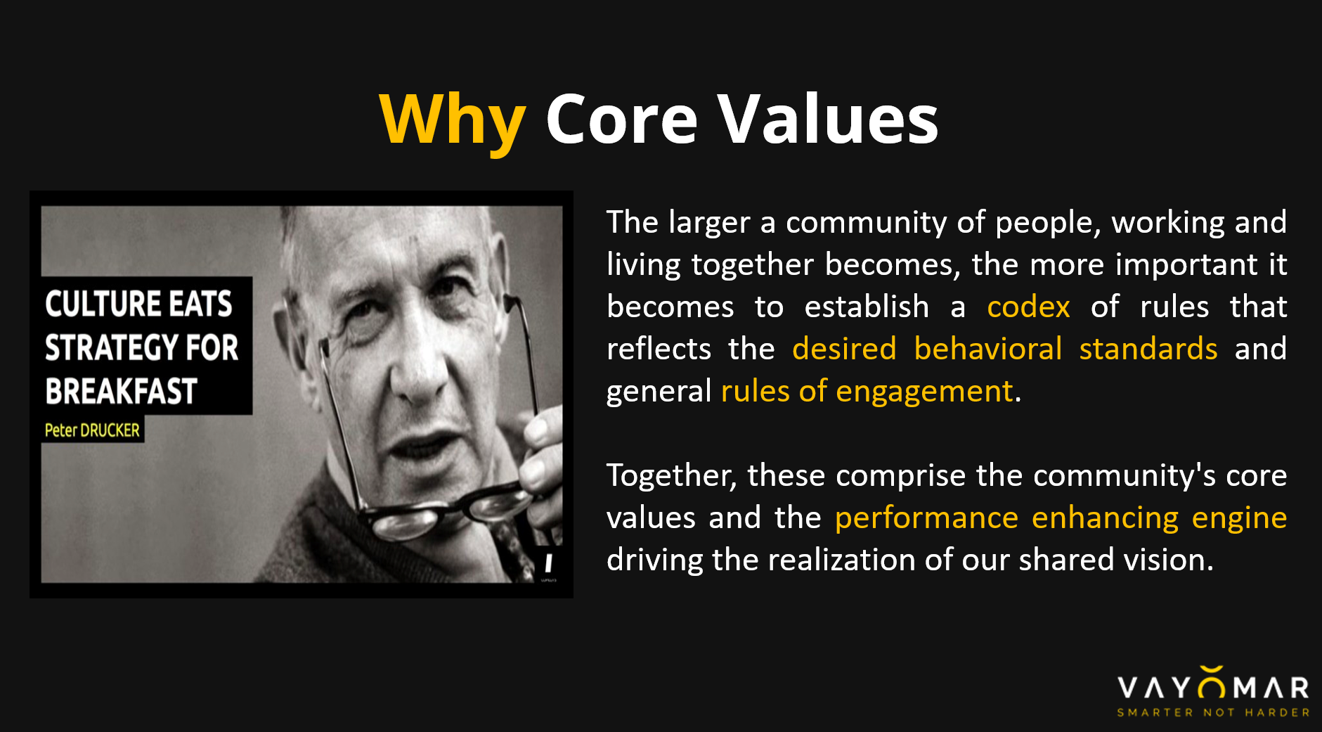
In order to create a resilient yet fast-paced mindset, we have to ensure that our most important asset: our employees, are full owners of their own and our excellency. Towards this end, HR, Management and Culture will receive ongoing support from Vayomar in regards to aligning everyone to the desired internal Values.
Company Values are a codex of rules (written and unwritten) that reflects the desired behavioral standards and general rules of engagement within a community of people, working and living together. If it is active nurtured, It can:
Support the vision
Shape the culture
Reflect the company's essential identity (beyond the functional value the company creates)
Help establish cross organizational alignment
Support decision making processes
Establish a sense of unity and belonging beyond the company's inner team to include its clients, partners, suppliers - or in short, the entire echo-system created by the company.
CULTURE AND CORE VALUES

Slide 27
Innovation, for all of its promise, is effectively a synonym for the word “Change”. While most of us celebrate innovation, we deeply fear and resist change. This is due to the natural human condition of seeking certainty and the comfort of a known reality.
In this workshop, we will discuss the nature of innovation and resistance to change what lays at the core of this resistance, and explore best practices for communicating and leading change effectively – with an emphasis on current changed the organization is undergoing.
EMBRACING CHANGE

Slide 28
Our approach to empowering Executive Leadership Teams (ELTs) focuses on addressing and overcoming the common pitfalls that can limit their effectiveness. Whether known as the ELT or SLT, this group of leaders is the CEO’s closest circle and is central to driving the company's strategic success. Yet, many ELTs struggle to operate as a cohesive “mega-brain” capable of managing the overwhelming complexity and uncertainty facing today’s organizations.
Drawing on our experience with dozens of ELTs worldwide, across different industries and growth stages, we’ve identified four recurring challenges and developed tailored strategies to help these teams transform into a unified, high-performing force that leads with confidence and clarity.
4 WEAKNESSES OF ELT’S

Slide 29
Its getting harder to respond quickly enough to changing market conditions or even to the arrival of new innovations.
This may be why more organizations are rethinking the traditional paradigms of hierarchical control, and look at how to decentralize decision making, so that the organization can ultimately reach a state of “Swarm Intelligence” allowing it to respond to, and even benefit from, rapidly changing market conditions, and even Black Swan events (such as Covid 19).
When everyone on the team, or throughout the company and within the ecosystem, understands and embraces four specific framework components, they are more likely to make the right day to day decisions.
This allows a more decentralized approach to daily decision making, enabling the organization, regardless of its size, to move and respond faster, seize valuable opportunities, and reduce the response time to changing market conditions
FREEDOM WITHIN THE FRAME

Slide 30
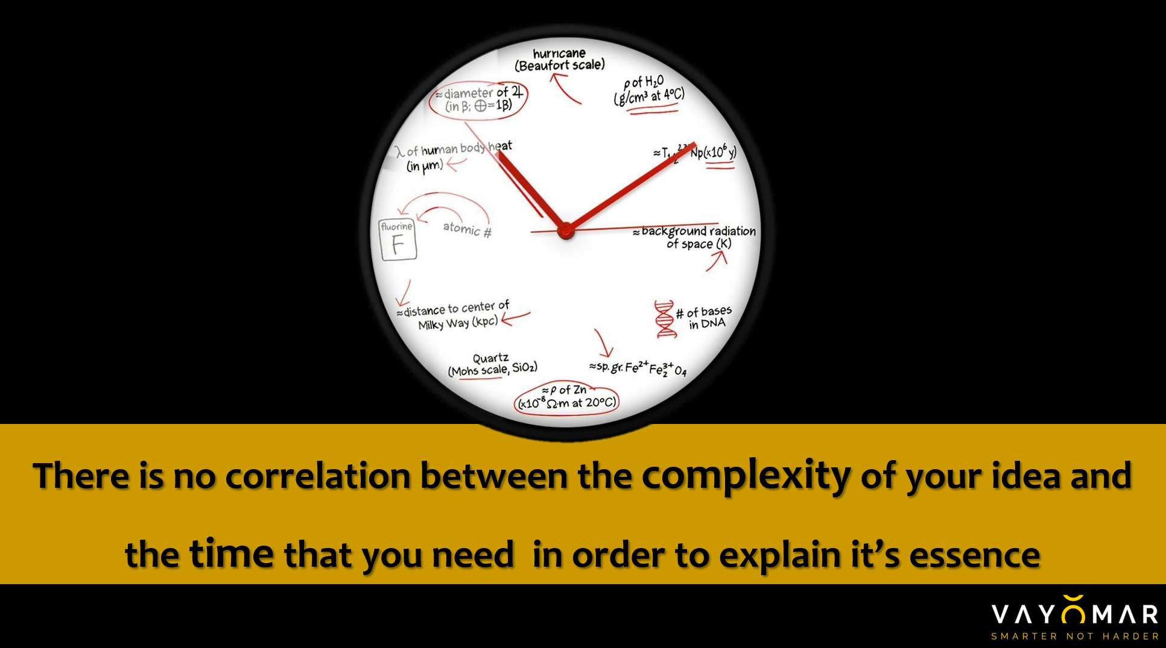
Delivering a winning Pitch with limited time to an influential person is hard, what can you say to increase the chances of getting your message across or perhaps arranging a follow up meeting?
In order to do it well you need to prepare in advance!, Vayomar’s “From 0 To Value In 60 Seconds” is a tried an tested approached that helped hundreds of entrepreneurs and business owner to successfully pitch their initiatives.
In this session we will cover the methodological tools to build the 4 elements of successful pitch:
Teaser – stimulus to listen and to create initial interest in the message and the messenger.
The essence – the idea you want to present, what is it? What’s new about it? What's is the Value of the idea?.
Traction – What have we already achieved? What recourses do we already have for the execution of the idea (technology, infrastructure, knowledge)? Who are the team members and their capabilities?.
Call to action – What are the necessary next steps to develop the idea, what am I asking my audience?
FROM 0 TO VALUE IN 60 SECONDS

Slide 31
Many top-talents get promoted based on their skills, achievements and performance history… but often, once promoted, these all-stars seem to hit an invisible wall in their new managerial role. They are now expected to lead teams and exhibit managerial traits that they had never learned or been taught and which were not required in their previous roles.
They now need to shift gears and become stars in an entirely different way. It’s no longer about how fast they run, or their ability to score the winning shot. Rather, it's up to them to be the motivating coach who inspires others to run fast and score.
Simply put: for these top talents, what got them “here” won't take them “there". In fact, some of the very things that made them shine as top players, may very well now serve as significant blockers to their success as managers. Successful transition from being a star player to being a star coach is the result of following a set of methodic guidelines, techniques and mindset shifts that can and should be discussed, learned, practiced, and monitored.
At VAYOMAR, we have put together a program that maps out 10 such guidelines which are discussed and analyzed with your managers, after which customized actionable insights are harvested:
FROM STAR PLAYER TO STAR COATCH
CATEGORIES OF BEHAVIOUR (From-To)
Reactive to Proactive Permission to Forgiveness Doing to Enabling Responsibility to Accountability Functional to Symbolic Force-Adding to Multiplying Intuition to Methodology Execution to Decision-Making Silo to Cross Instant to Delayed Gratification
6-POINT REFRAMING
Definition Score us in the present state Several scenarios Desired behavior Obstacles to adopting/ implementing desired behavior How to overcome these obstacles

Slide 32

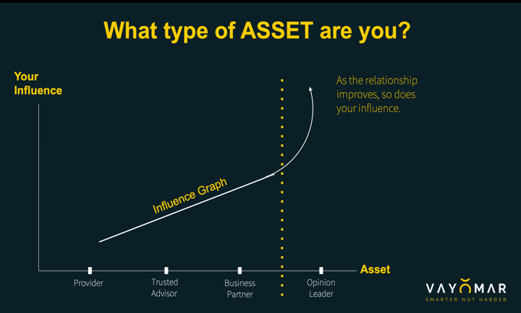
KEY STAKEHOLDER MANAGEMENT
Key Stakeholder Management - The Science of Relationship Management- This model applies project management thinking to professional relationship management with.
When applied within the enterprise, this model can help improve interface management, promoting better flow and cross-organizational collaboration (increasing efficiency and productivity).
For sales/marketing people it can help improve the way they interact with customers and advance overall quality of relationships (driving sales and extending the “life time value” of a client). This model promises to improve overall customer experience and result in longer lasting and higher quality customer retention.

Slide 33

"Manager as a Coach” is a highly interactive and engaging
program designed to deliver participants a practical skill set they
can put into practice by the end of the training. The training
sessions will be a dynamic mix of:
• Front training
• Breakout groups
• Simulation
• Individual activities
• Out-of-session components**
**optional. In main, out-of-session activities revolve around
participants starting to coach their reports and using in-session
time to share experiences and develop strategies to progress.
Simulations will be aided by VIDAS (‘Vayomar’s Integrated Digital
Assist Simulator’)
Conducting a drop-in session 6 weeks post training in order to
review how coaching is being implemented and to address
challenges.
MANAGER AS COACH

Slide 34
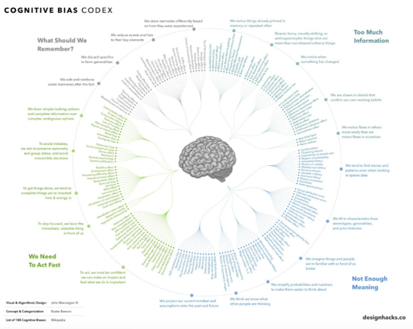
One person. Two operating systems. This is perhaps one of the most meaningful findings in the past 50 years pertaining to how we all make decisions in our daily lives.
Based on the research of Nobel laureate Daniel Kahneman (and his life long academic college Professor Amos Tversky, this session will introduce a select number of Cognitive Biases that have a continuous and meaningful impact on how we engage with people around us and with the information and arguments brought to our attention and explore methods to use and/or mitigate their effects:
The Endowment Affect
Confirmation Bias
Outcome Bias / Resulting
The Availability Heuristic
The Expert & Scientific Heuristic
Managing Our Cognitive Biases

Slide 35
When tend to look at the shortcomings we experience in the modern workplace problems like miscommunication, misalignments, silo culture and constant escalation and associate them to our company’s culture or specific employees, were in reality it is a wide speared phenomena that actually as a different root cause
Although we have come a long way as a civilization over the past
5,000 years, three major historical trends have continuously
chipped away at one of the most significant human emotions: empathy.
In this broad-picture keynote lecture, we review these three
historical trends and conclude with simple things (“back to basics”)
that each and every one of us can do in order to elevate the
place of empathy in our working environment – especially as it
pertains to cross-departmental collaboration
OUT OF SIGHT OUT OF SYNC

Slide 36
Cross-department collaboration and overall execution alignment have become one of the greatest challenges faced by mid-to-large-sized
sized organizations. The matrix management system, remote teams and even local teams turning remote with the shift to hybrid work model, all are making collaboration and alignment ever more difficult.
Using the relay race metaphor, where so much is dependent on the passing of the baton from one runner to the next, we have developed an interactive workshop for crossfunctional teams that share critical operational dependencies.
Using real-life, day-to-day situations/scenarios that we will harvest in advance from your team the workshop’s participants and their managers, an interactive discussion is held with the participants with a focus on perfecting the “hand-offs” between them (hence “Passing The Baton”).
PASSING THE BATON

Slide 37

Peer To Peer Learning
Peer To Peer Learning- format that would actually focus on harvesting and consolidating their individual respective experiences into knowledge that can be shared by the entire group.
Periodical peer-to-peer knowledge sharing sessions (we recommend 2-3 per quarter) will:
Provide your people with the most relevant and relatable knowledge for dealing with challenges that are highly specific to your organization's unique reality (customer types, project types, company culture and DNA, etc).
Develop/enhance the internal professional network among these peers, likely getting them to support one another on a regular basis, well beyond the boundaries of the P2P knowledge sharing sessions.
Will provide you with invaluable information about the “field sentiment” and about the key challenges being faced by your people on a regular basis. This is the fuel of continuous improvement and at times, groundbreaking innovation.
Enable your organization to retain valuable knowledge even after the people who provided it have left.

Slide 38
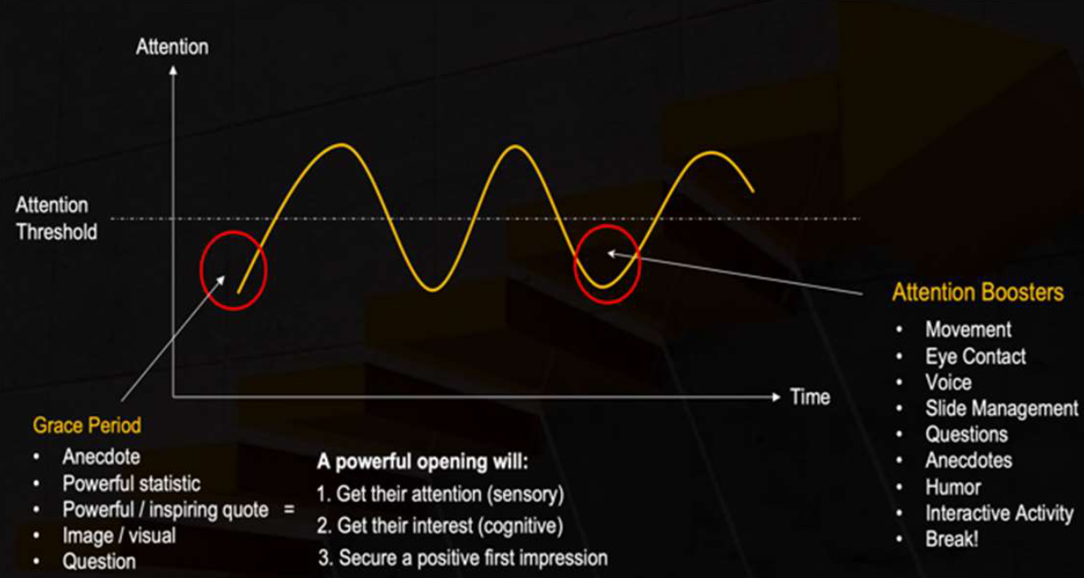
Presentation skills are crucial for getting ideas across and influencing others, as well as inspiring confidence in the speaker’s capabilities. They help convey complex information in a clear and engaging way, making it easier for audiences to understand and retain the message.
Our approach to Presentation Skills cover the four key building blocks of a great presentation:
Content Selection:
How to ensures the information shared is relevant, focused, and
impactful, reinforcing the key message.
Logical Sequence:
How to helps the audience follow, comprehend and retain the
message.
Delivery Style:
How to capture audience attention, conveys confidence, and
enhances the impact of the message, making the presentation
more engaging and memorable.
Speaker Confidence :
How to stand before an audience despite discomfort with public
speaking, allowing speakers to manage anxiety, project
composure, and deliver their message effectively.
PRESENTATION SKILLS

Slide 39
Although working remotely, with people from different times zones (and cultures!) is not new and has been one of the defining marks of the Digital Revolution, Covid-19 has radically accelerated this challenge to the extreme, leaving even the most well managed companies with a massive adaptation challenge.
With the office corridor abandoned, your people no longer have the same kind of opportunities to have spontaneous and informal interactions which are so critical to rapport and trust building between people who must work together in order to achieve the company’s goals.
For sales organizations, Covid-19 has completely pulled the rug from under their feet. No longer can prospects be engaged with at industry events as an opportunity to kick off a sales process. No longer can your sales people extend a hand shake or informally relate to their customer’s working environment as a way of breaking the ice.
With the new work from home (WFH) reality, many people need to be given new guidelines, methodological tips and tools pertaining to how to optimize their remote communication skills, with an emphasis on the following categories:
Breaking the ice
Effective use of the camera
Leveraging non-verbal communication
Optimal framing
“Name Calling”
How to use screen sharing
Following up (maintaining positive momentum)
REMOTE RAPPORT BUILDING

Slide 40
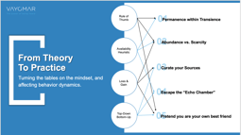


Although the Homo Sapiens-Sapiens have proven to be a super-resilient species over the past hundreds of thousands of years, it seems that our even greater ability to innovate has led to a dangerous imbalance between our ability to innovate and our ability to adapt.
Emotional and psychological resilience was already a serious issue as a result of the unprecedented impact of the Digital Revolution. But with the arrival of Covid-19, it seems humanity’s ability to “bounce back” is now truly being put to the test.
In this inspirational and practical session we will review several ways in which each one of us can boost our individual resilience (and that of people around us) on a day to day bases. We will look at tried and proven methodologies that can do more than help us bounce back. That can help up bounce forward!
Resilience

Slide 41
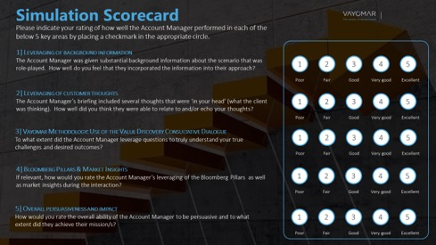
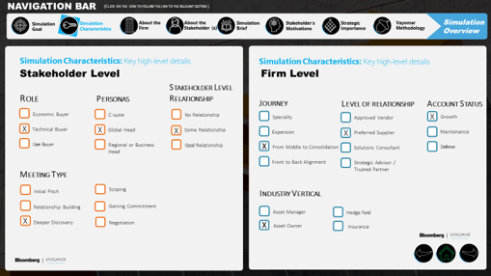
Our simulation-based learning program offers customized, professional kits that immerse participants in realistic, “Your world”, role-specific scenarios, allowing them to practice essential skills in a controlled environment. Each simulation is goal-oriented, guiding participants to apply specific strategies, and includes specialized methodological tools—such as persuasion techniques—to empower the participants’ skills and abilities.
Participants can also be evaluated and scored, providing an “X-ray vision” assessment of their abilities and traits, which helps identify strengths and areas for targeted improvement.
SIMULATION BASED LEARNING
Example: a Vayomar post-simulation scorecard. This one is customized to assess the participant’s ability to leverage background information, but it could also may be fitted to assess a specific communication technique or behavior

Slide 42
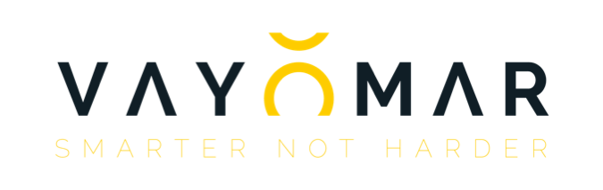

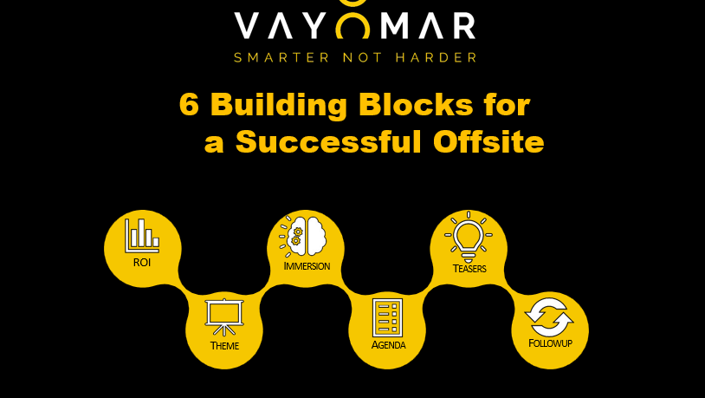
SIX BUILDING BLOCKS OF
A WINNING OFFSITE
When produced properly, offsites and other multi-day company gatherings are among the most powerful formats for driving change. There is simply no substitute for extensive and intensive, in-person interaction, conducted away from daily operational distractions. Having assisted with the structuring and facilitation of countless Offsite events such as executive offsites, annual SKOs, Company kickoff events and leadership summits and other type of events, we have developed an Offsite design methodology comprised of 6 building blocks:
• Having a clearly defined and relevant ROI.
• Leveraging the power of a Theme.
• Leveraging the power of Total Immersion.
• Building the most impactful Agenda.
• Using witty, intriguing Teaser Campaign prior to the offsite.
• Conducting a thorough & consistent Follow-up.

Slide 43
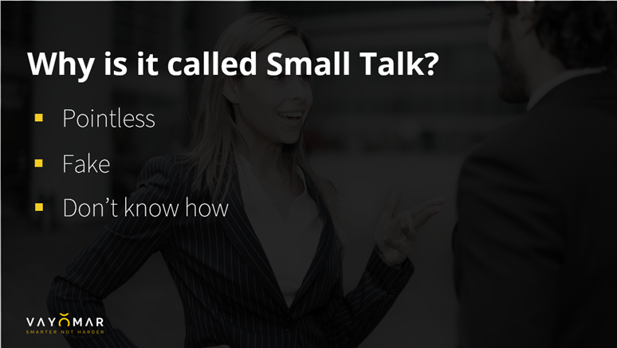
Many people don’t enjoy “small talk” and feel that it’s a waste of
time—just a meaningless stage on the path to a “real” conversation.
They couldn’t be more wrong! Small talk is vital in building trust, and it can have a significant impact on the outcome of a meeting, as well as becoming an important foundation for longer-term relationships.
“BIG Talk” is the phase in which people, unknowingly, evaluate the level of chemistry they have with one another, and it’s a critical foundation for their future interactions.
BIG Talk is an example of “Social Evolution”: the phenomenon of
humanity moving from living in communities of individuals to being part of a global community of billions. In today’s world, knowing how to prepare for and manage a BIG Talk “session” is a powerful skill.
SMALL TALK HOW ABOUT BIG TALK

Slide 44
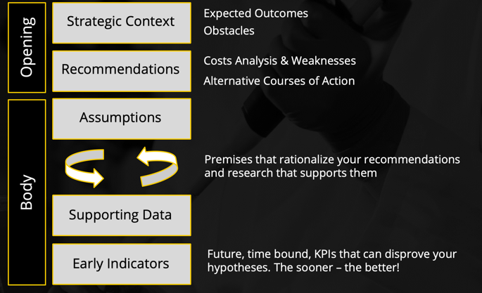
"Management" is a language. Much like English, Spanish and Chinese, the language of management is a way of thinking and communicating which has evolved to address the very distinctive realities and challenges faced by senior executives responsible for carrying the burden of decision making in states of great uncertainty.
Therefore, when we are called to communicate with, and present to, senior executives, we must understand that, the measurement of success, or the ROI on these encounters, comes down to a simple question: did they see you as an ASSET or a BURDEN at the end of your presentation? This in turn will be predominately determined by a single factor: the degree of uncertainty that you removed from their "shoulders".
To this end, we must learn how to think and present like executives who wish to improve strategic decision making, rather than like someone who has come to further drain the organization from its already limited resources. With this in mind, we have developed a recommended five-part structure with which to analyze initiatives we are responsible for and with which to present our recommendations (to internal managers as well as customer buying personas).
SPEAKING THE LANGUAGE OF MANAGMENT

Slide 45
Storytelling Placeholder
Storytelling

Slide 46
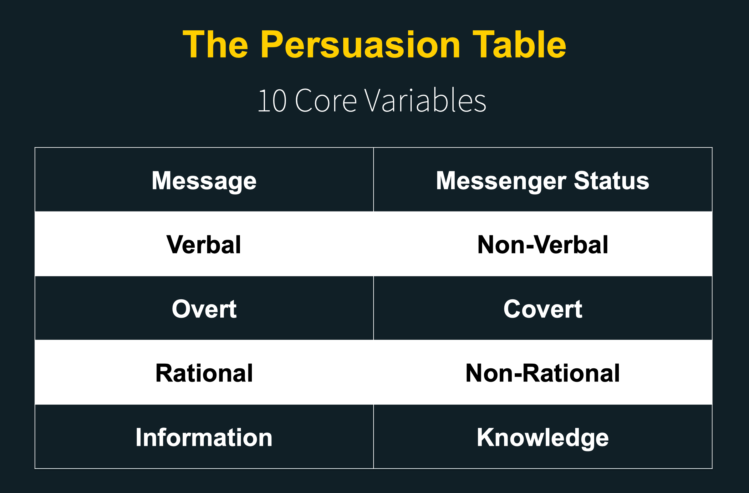
When people interact with each other, there are countless intervening variables impacting the stimuli-response dynamic between them. Nearly all of these variables are circumstantial and only a few of them can be anticipated and prepared for.
THE PERSUATION TABLE
However, there are 10 core variables that are always present in any human interaction and which outweigh the cumulative impact of the circumstantial variables.
By learning about each of these variables, we can identify and manage them in a wide range of scenarios and improve our ability to shape their outcomes.

Slide 47
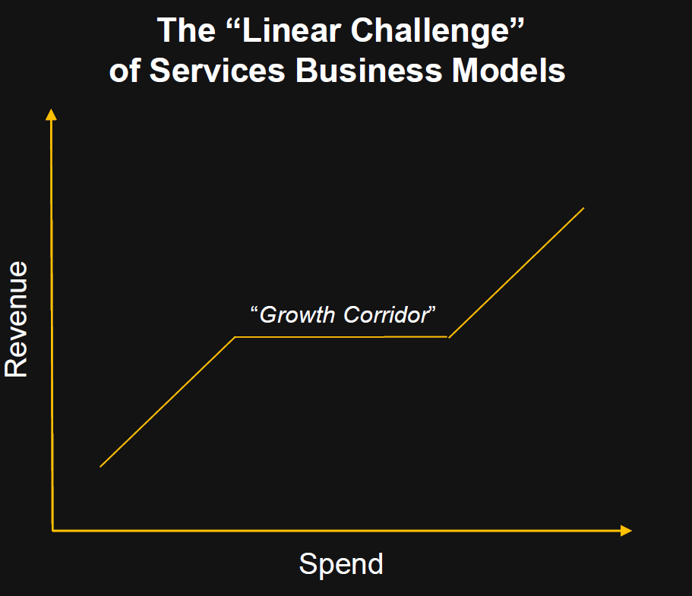
“The Anatomy of a Services Business” is a comprehensive professional development course intended for anyone seeking to, or already running, a Services/knowledge based business (i e a business which is based on generating revenue through the sales of knowledge and expertise), providing the right approach tools and methodologies to mange the business.
Examples of knowledge based businesses:
• Legal and accounting firms
• Home or office improvement firms (electricians, plumbers, interior designers)
• Therapists
• Training and consulting firms
• Architects
• PR and advertising firms
• Digital marketing firms
• Graphic and web designers
• Translation services
• Software development firms, etc
THE ANATOMY OF A SERVICES BUISNESS MODEL

Slide 48
The Digital Revolution has transformed the landscape of buying and selling, bringing about fundamental changes in the way products and services are offered, and the methods use to engage with customers.
We in VAYOMAR outlined this profound impact on enterprise sales, through four key paradigm shifts that are reshaping the new world of sales.
Navigating this new landscape requires organizations to understand these shifts and align their strategies accordingly. To support this transition, we have developed a comprehensive approach focused on five critical areas to drive success:
1. Smarter hiring of salespeople
2. Smarter onboarding of salespeople
3. Smarter sales and customer facing upskilling
4. Customer journey management
5. Everybody Sells Values program
THE NEW WORLD OF SALES

Slide 49
In his book Outliers Malcolm Gladwell describes the 10,000 hour rule, according to which it takes 10,000 hours to become really good at something and master a skill.
How then do the world's best fighter pilots get qualified after less than 500 hours of flight time?
The answer is that for every hour of flight time, pilots also go through at least another hour of debriefing, analyzing every aspect of their sortie ( in addition simulations and other performance enhancing training).
In this session, we will go over the art of conducting debriefings and how to learn as much as we can from projects that we have completed be them the most successful or those that maybe fall a little short.
THE POWER OF DEBRIEFING

Slide 50
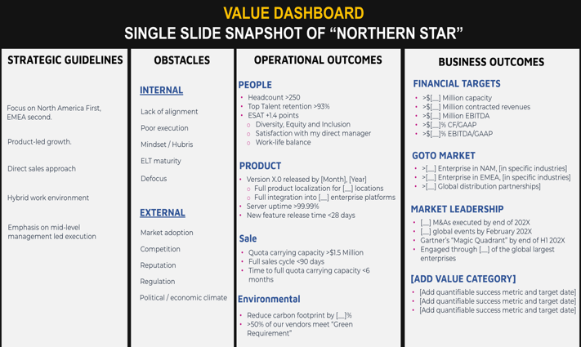
Value Orientation is both a mindset and a skillset. It's about proactively maintaining a strategic (rational) outlook, in spite of the endless stimulations and interruptions that relentlessly bombard our senses. The more complex the reality – the more valuable this structured and disciplined way of thinking is.
Fit for internal strategic processes as well as for external key stakeholder management (sales!), this highly counter-intuitive approach actually increases our chances of influencing key stakeholders and achieving ours, as well as their business and operational goals.
The practical manifestation of this methodology is the Value Dashboard: a single-slide display of our customer’s strategic reality.
VALUE ORIENTATION

Slide 51
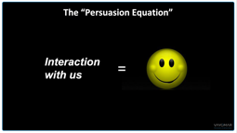
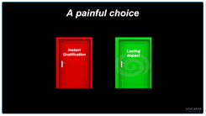
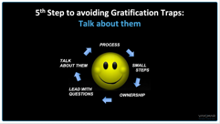
Today’s world can be ultra high-paced, but what if moving slower actually increased your chances of getting what you want?
The delaying of gratification is perhaps the most important variable in your ability to successfully influence people. It engenders trust and openness to collaboration, creating more opportunities for you to make a lasting impact on others and enhance your persuasion skills.
This interpersonal communication model is based on principles that can vastly improve your ability to influence people’s behavior with little to no dependency on formal authority.
The key is knowing how to identify and avoid the “Gratification Traps” that are frequently present in multi-participant discussions, and in dealing with volatile topics or high-intensity environments.
YOU’RE NOT MOVING SLOW ENOUGH

Slide 52





PROGRAM
PRICING
As discussed, below please find the proposed project pricing:
DESIRED OUTCOMES
Phase | Units | Price (USD)
Total proposed pricing |  | $40,000
Prices do not include VAT. as may be required by law.
Payment schedule: On monthly basis, for work completed.
This proposal is valid for 30 days.
Proposed By: Approved By:
Ariel Halevi
<ABN>
Print Name
Print Name
Co-founder & CEO
<ABT>
Title
Title
<DATE>
<DATE>
Date
Date
Signed on behalf of VAYOMAR
Signed on behalf of <COMPANY>
VAYOMAR GLOBAL

