Slide 1
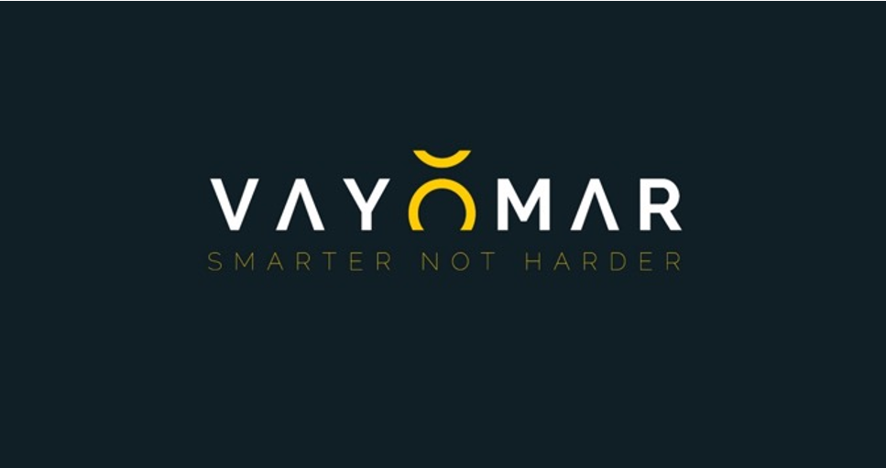
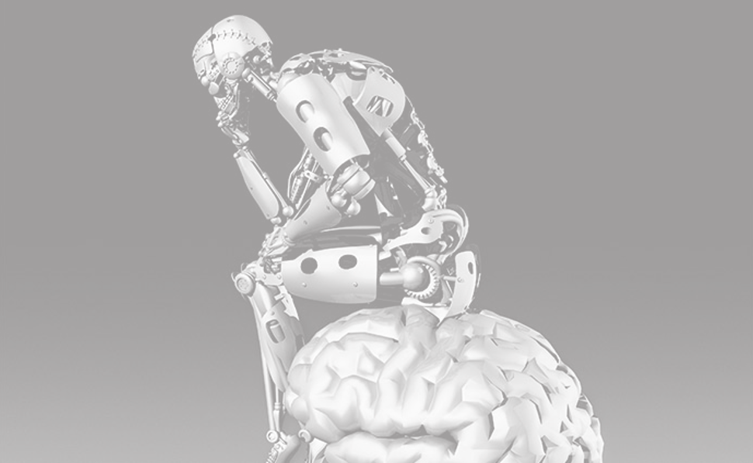
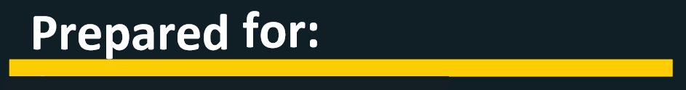

<TITLE>
<CUSTOMER_LINE_1>
<CUSTOMER_LINE_2>
<CUSTOMER_LINE_3>
<CUSTOMER_LINE_4>
<CUSTOMER_EMAIL_1>
<CUSTOMER_EMAIL_2>
<CUSTOMER_EMAIL_3>

Slide 2


<INTRO>
BACKGROUND
<BACKGROUND>
VAYOMAR GLOBAL

Slide 3

DESIRED OUTCOMES
<DESIRED_OUTCOMES>
VAYOMAR GLOBAL

Slide 4


PROGRAM SESSION STRUCTURE
<PROGRAM_STRUCTURE>
DESIRED OUTCOMES
VAYOMAR GLOBAL

Slide 5
PROGRAM SESSION STRUCTURE
Academy (MBA style learning):
The Academy component serves as the foundational stage for equipping participants with the essential mindset, theoretical tools, methodological best practices and knowledge, necessary for their respective roles. The Academy can be taken as a stand alone component of the program with the other components added in a later time should the company wish to embrace this program in a multiphase approach.
As part of the Academy, participants will engage in a dynamic learning format that combines interactive lectures, case studies, breakout sessions and group discussions. We will guide participants through a range of relevant topics which will be curated in the first phase of this engagement.
To enhance the learning experience and promote practical application, we will incorporate specific use-cases and scenarios into the program. These real-life examples will be carefully selected and developed in collaboration with your team and select stakeholders of your choice, to ensure their relevance and alignment with the participants' roles and challenges. Overall, the Academy component offers a robust foundation for participants to build upon throughout their careers.
We provide an immersive and transformative learning experience that equips mid-level managers with the necessary skills and knowledge to excel in their roles and contribute to the overall success of their organizations.
DESIRED OUTCOMES
VAYOMAR GLOBAL

Slide 6
PROGRAM SESSION STRUCTURE
Individual Development Plan (IDP):
Designed to help individuals identify their development needs and career objectives an IDP typically include:
Career objectives: The individual identifies their long-term career goals. These could be things like becoming a manager, mastering a specific skill, transitioning to a different role or industry, or achieving a particular certification or qualification.
Skills assessment: The individual, often in consultation with their manager, identifies their current skills and knowledge, and how these align with their career objectives. This can involve identifying both strengths and areas for improvement.
Development activities: Based on the career objectives and skills assessment, the individual identifies specific activities to undertake to achieve their goals. This could involve things like training courses, reading books, on-the-job learning, mentoring, or attending conferences.
Timeline: The individual establishes a timeline for completing their development activities. This helps to provide structure and motivation.
Review and update: The IDP is not a static document. It should be reviewed and updated regularly (typically annually, but this can vary depending on the individual and the company) to ensure it remains relevant as the individual's skills, knowledge, and career objectives evolve. The benefits of an IDP for the individual include increased self-awareness, motivation, and career satisfaction. For the company, benefits can include increased employee engagement and retention, as well as improved performance and productivity.
DESIRED OUTCOMES
VAYOMAR GLOBAL

Slide 7
PROGRAM SESSION STRUCTURE
PODS:
he main objective of the PODs (is to provide participants with real-world learning experiences that allow them to implement theoretical tools and best practices from the sessions.
Participants will be divided into smaller PODs, each focusing on a specific stakeholder or business unit they work with and a current use case. These PODs will meet between sessions to collaborate, think critically, and apply the tools and methodologies to their unique case scenarios.
To ensure effective incorporation of the methodologies, each POD will receive a coaching session from Vayomar. This will help guide their application of the concepts and ensure they are effectively integrated into their daily practices. Additionally, every session will include time for PODs to present their work and progress. This approach not only reinforces learning and foster accountability but also creates actual usable work product .
DESIRED OUTCOMES
VAYOMAR GLOBAL

Slide 8
PROGRAM SESSION STRUCTURE
Project Based Learning (Practicum):
The main objective of the Practicum is to provide participants with a real-world learning experience that allows them to implement the theoretical tools and best practices learned in the Academy.
By engaging in project-based learning, participants will have the chance to apply their knowledge to practical situations that will be curated around current needs and challenges most relevant to the company’s current road map, thus fostering a deeper understanding of the concepts and enhancing their problem-solving and decision-making skills. These activities will be facilitated in a way that is closely linked to your company’s cultural and operational realty.
The projects undertaken during the Practicum will focus on cross-organizational focus areas that do not have a specific owner within the company. This approach encourages collaboration and interdepartmental cooperation, allowing participants to gain insights into different aspects of the organization and develop a broader perspective. We advise that each project be assigned an executive sponsor from within the company. These sponsors will provide guidance, resources and will help the work-groups navigate potential challenges and ensure the successful execution of their projects. Importantly, the projects developed during the Practicum will adhere to a “return on investment (ROI) within the first year” guideline.
This focus on tangible outcomes ensures that the projects are not only valuable learning experiences but also contribute to the organization's overall success in a way that justifies the significant investment in this program.
DESIRED OUTCOMES
VAYOMAR GLOBAL

Slide 9
PROGRAM SESSION STRUCTURE
Scenario Harvesting
At Vayomar, we have learned that “One Size” does not fit all. In spite of the vast and comprehensive list of insights that we have gathered in over two decades of our work with countless organizations across the globe, and which do have a universal truth at their base, we have learned that in order for our programs to be well-received and our methodologies truly internalized by the people we train/consult, they must be anchored in examples and delivered using language and terminology that is “native” to them.
Therefore, during this phase of the engagement we work with you (and specific individuals of your choice from within the company) to collect real-life examples of daily situations that the program’s participants encounter and find challenging. We then incorporate these examples into our workshops and into the examples we provide on how to most practically use the tools and methodologies we are sharing with the program participants. By using “their world” scenarios, we avoid coming across as “ivory tower” or “generically” academics and are perceived as “one of them” in terms of our real understanding of their difficulties and needs.
DESIRED OUTCOMES
VAYOMAR GLOBAL

Slide 10
PROGRAM SESSION STRUCTURE
Scoping and design:
A series of meetings with your team and key stakeholders, during which specific desired outcomes for the program will be determined, as well as define the specific content that will be introduced in the program. During this phase we will harvest relevant use cases and scenarios that will be introduced in the program’s Academy component as “your world” examples to apply to the theoretical tools. In case you elect to include the practicum element of the program we will also define with you the practicum’s projects constraints (program’s intensity, executive sponsorship involvement etc.).
DESIRED OUTCOMES
VAYOMAR GLOBAL

Slide 11
PROGRAM SESSION STRUCTURE
Scoping and design:
A series of meetings with your team and key stakeholders, during which specific desired outcomes for the program will be determined, as well as define the specific content that will be introduced in the program. During this phase we will harvest relevant use cases and scenarios that will be introduced in the program as “your world” examples to apply to the theoretical tools.
DESIRED OUTCOMES
VAYOMAR GLOBAL

Slide 12
PROGRAM SESSION STRUCTURE
Steering Committee:
To ensure the program achieves its intended outcomes, the committee will oversee continuous monitoring of the program's progress throughout its duration. The committee will be able to suggest real-time adjustments when necessary, guided by insights gained from sessions and feedback provided by participants and Vayomar’s trainers. Committee members, selected by you, may include members of your team, representatives from the participant pool, or their respective managers.
DESIRED OUTCOMES
VAYOMAR GLOBAL

Slide 13
PROGRAM SESSION STRUCTURE
Scoping & Design Sessions
During these series of calls/meetings, we will work with you to define clear and measurable desired outcomes that this engagement is intended to service. Some of these outcomes may be strategic in nature, looking at the broader business and operational objectives currently driving the company and others will relate more tactically to the project’s short terms KPIs. We will further work with you to explore possible or expected obstacles that we will need to wisely mitigate in order to ensure that the above-mentioned desired outcomes and KPIs are successfully driven by this engagement.
In addition, we will work with you to gain knowledge about this program’s participants as well as their current mental and emotional states of mind alongside the more objective circumstances of their operational environments. This is meant to help us use language and examples in our sessions with them, that are less generic and more relatable to them.
DESIRED OUTCOMES
VAYOMAR GLOBAL

Slide 14
PROGRAM SESSION STRUCTURE
1-on-1 Interviews
These interviews can be an extension to the Scoping & Design process and are often used in preparation for executive level offsites or more lengthy training programs. In such cases, we like to meet with several individuals that are expected to be participants in our program and ask them the following questions:
What would you consider to be a successful outcome from this program?
What are some potential forces that may work against our ability to secure this successful outcome?
What “theme” would you select for this program, that you feel best encapsulates its essence?
What advice do you have for “me” (“me” = Vayomar Trainer/Facilitator)?
DESIRED OUTCOMES
VAYOMAR GLOBAL

Slide 15
PROGRAM SESSION STRUCTURE
1-on-1 Coaching Sessions
During these sessions, we place a high focus on personalization to the individual we are coaching. Based on the initial Scoping & Design of this engagement, we begin by aligning expectations with the coachee around the process and methodological components that we will be bringing into the coaching process. Sometimes, these components will have been defined ahead of time (during the Scoping & Design phase) and in other times, they are decided upon with the coachee.
DESIRED OUTCOMES
VAYOMAR GLOBAL

Slide 16
PROGRAM SESSION STRUCTURE
Role-playing Kits
True upskilling often required practice. That’s why, in addition to our highly interactive workshops and training sessions (which often include break-out sessions in which participants can grapple with practical exercises), we offer a more robust role-playing component that is based on more advanced case-studies that are created ahead of the workshops.
Working with selected individuals of your choice, we collect information about key stakeholders (internal and/or external) which whom the program participants must learn to interact more effectively with. We also collect information about the internal processes within which these interactions take place (i.e. – customer facing sale cycles, internal project life-cycles, ect). When we are done creating these kits, they are shared with the program participants and they are expected to have read through them thoroughly ahead of their next role-playing session with us.
During the role-playing sessions, participants can either participate in the role-playing as themselves or as the persona around which a specific kit was built around. As they roleplay, other participants are asked to apply “active listening” by answering specific questions in a form that is given to them. When the role-playing part is complete (15-30 minutes on average), a discussion is conducted, in which the role play is reflected upon and feedback is given to the individuals who were in it. This feedback is given by the fellow participants as well as by our trainer/facilitator.
DESIRED OUTCOMES
VAYOMAR GLOBAL

Slide 17
PROGRAM SESSION STRUCTURE
At the end of each feedback round, the person playing themselves in the role-play received a scorecard which contains the feedback from their fellow participants as well as from our trainer/facilitator. In cases where programs are long enough to allow a single participant to participate in several role-playing rounds, meaningful insights can be derived from their accumulated feedback forms.
These insights pertain to their learning graph, strengths and ongoing weaknesses and can prove valuable to their ongoing individual development plan (IDP).
[We will need a couple of images/visuals that show parts of the simulation kit]
DESIRED OUTCOMES
VAYOMAR GLOBAL

Slide 18
PROGRAM SESSION STRUCTURE
Kickoff Sessions
In this session, participants will be introduced to the context of the program as well as its intended desired outcomes and the program sponsor’s overall expectations of them. This session may also include:
Logistical information about the program’s length, schedule and contents
The estimated overall time and effort that each participant will be required to put in
Q&A
Inspirational content from Vayomar
.
DESIRED OUTCOMES
VAYOMAR GLOBAL

Slide 19
PROGRAM SESSION STRUCTURE
Steering Committee Calls
To ensure the program achieves its intended outcomes, the committee will oversee continuous monitoring of the program's progress throughout its duration. The committee will be able to suggest real-time adjustments, when necessary, guided by insights gained from sessions and feedback provided by participants and Vayomar’s trainers. Committee members, selected by you, may include members of your team, representatives from the participant pool, or their respective managers.
DESIRED OUTCOMES
VAYOMAR GLOBAL

Slide 20
PROGRAM SESSION STRUCTURE
Pod Coaching Sessions
To ensure the program achieves its intended outcomes, and that its participants are able to practically apply the tools and methodologies taught to them in their daily routines, this MBA-like program component will require them to work in smaller groups on a selected case study (longer programs may include multiple case studies). The types of case studies from which each Pod will be able to select can be determined in advance, during the Scoping & Design phase of this engagement.
Each Pod will be expected to convene several times between their training sessions with Vayomar, in order to develop their selected case study and be ready to share their progress in the next group session with Vayomar. To assist them, each Pod will receive a 30-minute virtual coaching session with a Vayomar trainer.
DESIRED OUTCOMES
VAYOMAR GLOBAL

Slide 21
PROGRAM SESSION STRUCTURE
Program Debrief Sessions
Following the completion of this engagement, we will conduct several virtual calls with you, during which we will conduct a structured debriefing process about every phase of this program. The goal of this phase is to harvest meaningful learning and actionable insights that may inform the design of potential extensions of this program or pre-defined next phases as well as potential future programs of a similar nature.
DESIRED OUTCOMES
VAYOMAR GLOBAL

Slide 22
PROGRAM SESSION STRUCTURE
Teaser Campaign
Given the limited amount of time we will have with the participants of this program, we’d like to ensure that no time is waisted in the earlier parts, but helping the participants “hit the ground running”. This can be done by building up their curiosity and excitement about their upcoming sessions with us, using short and catchy teasers that are designed in context of the program’s desired outcomes, structure and selected content. These teasers are normally shared in the weeks leading up to the program, often on a cadence of once or twice a week. They often include a very short (and intriguing) texts, alongside a stimulation and curious visual.
[We will need a couple of images/visuals that show parts of the simulation kit]
DESIRED OUTCOMES
VAYOMAR GLOBAL

Slide 23
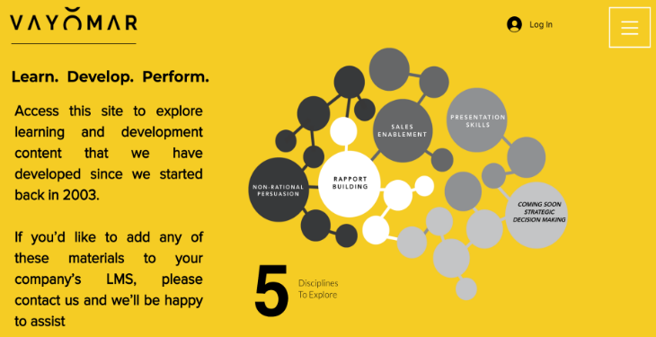
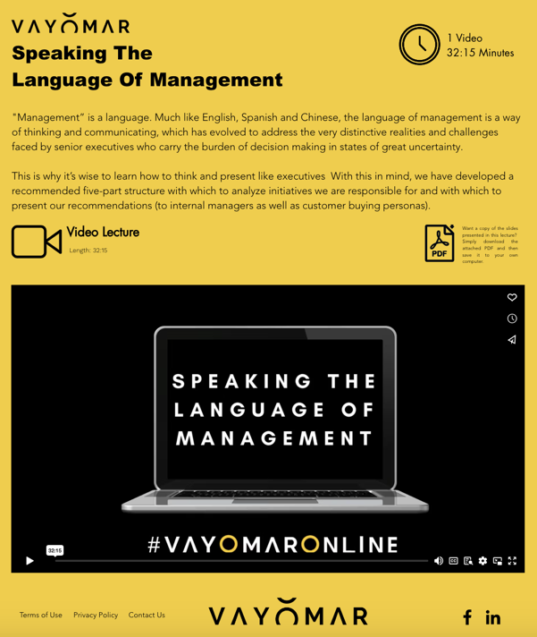
PROGRAM SESSION STRUCTURE
Vayomar Online Users
Each participant will be granted three months of access to Vayomar Online, our online learning platform, which contains a rich library of short training videos.
The participants will be able to access this platform in order to refresh or deepen their understanding of the various methodologies that will be included in this program.
DESIRED OUTCOMES
VAYOMAR GLOBAL

Slide 24

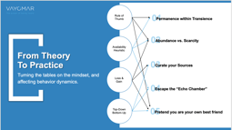


Although the Homo Sapiens-Sapiens have proven to be a super-resilient species over the past hundreds of thousands of years, it seems that our even greater ability to innovate has led to a dangerous imbalance between our ability to innovate and our ability to adapt.
Emotional and psychological resilience was already a serious issue as a result of the unprecedented impact of the Digital Revolution. But with the arrival of Covid-19, it seems humanity’s ability to “bounce back” is now truly being put to the test.
In this inspirational and practical session, we will review several ways in which each one of us can boost our individual resilience (and that of people around us) on a day-to-day bases. We will look at tried and proven methodologies that can do more than help us bounce back. That can help up bounce forward!
BUILDING RESILIENCE WITH COGNITIVE DICIPLINE
VAYOMAR GLOBAL

Slide 25
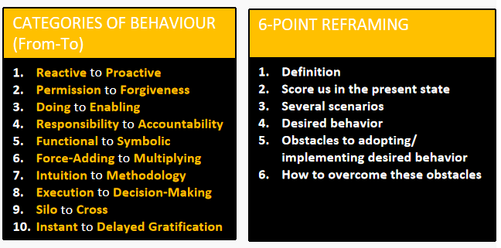
Many top-talents get promoted based on their skills, achievements and performance history… but often, once promoted, these all-stars seem to hit an invisible wall in their new managerial role. They are now expected to lead teams and exhibit managerial traits that they had never learned or been taught and which were not required in their previous roles.
They now need to shift gears and become stars in an entirely different way. It’s no longer about how fast they run, or their ability to score the winning shot. Rather, it's up to them to be the motivating coach who inspires others to run fast and score.
Simply put: for these top talents, what got them “here” won't take them “there". In fact, some of the very things that made them shine as top players, may very well now serve as significant blockers to their success as managers. Successful transition from being a star player to being a star coach is the result of following a set of methodic guidelines, techniques and mindset shifts that can and should be discussed, learned, practiced, and monitored.
At VAYOMAR, we have put together a program that maps out 10 such guidelines which are discussed and analyzed with your managers, after which customized actionable insights are harvested:
FROM STAR PLAYER TO STAR COACH
VAYOMAR GLOBAL

Slide 26
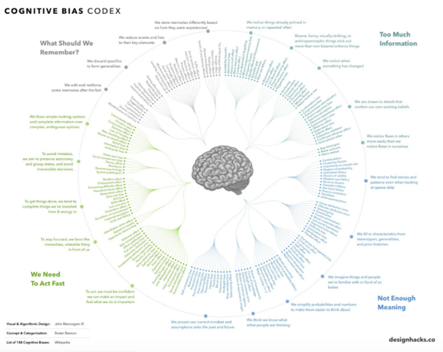
One person. Two operating systems. This is perhaps one of the most meaningful findings in the past 50 years pertaining to how we all make decisions in our daily lives.
Based on the research of Nobel laureate Daniel Kahneman (and his life long academic college Professor Amos Tversky, this session will introduce a select number of Cognitive Biases that have a continuous and meaningful impact on how we engage with people around us and with the information and arguments brought to our attention and explore methods to use and/or mitigate their effects:
The Endowment Affect
Confirmation Bias
Outcome Bias / Resulting
The Availability Heuristic
The Expert & Scientific Heuristic
Managing Our Cognitive Biases
VAYOMAR GLOBAL

Slide 27

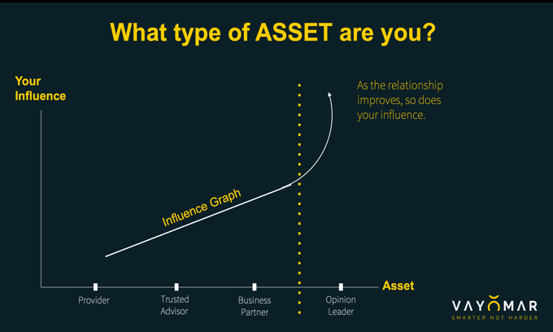
The key-stakeholder management and influence without authority tools within this methodology are aimed at leading to clearer, more productive (and even friendlier!) interactions with customers, in turn, drive higher levels of efficiency and enhanced customer satisfaction down the line.
When applied within the enterprise, this model can help improve interface management, promoting better flow and cross-organizational collaboration, thereby increasing efficiency and productivity.
At the heart of this methodology are six (6) relationship key performance indicators that make it possible to adhere to the following four foundational guidelines:
1. Focus on giving value before getting it from others.
2. Great working relationships are win-win.
3. Professional relationships can and should be measured.
4. These relationships should be proactively managed.
VALUE ORIENTATION
VAYOMAR GLOBAL

Slide 28
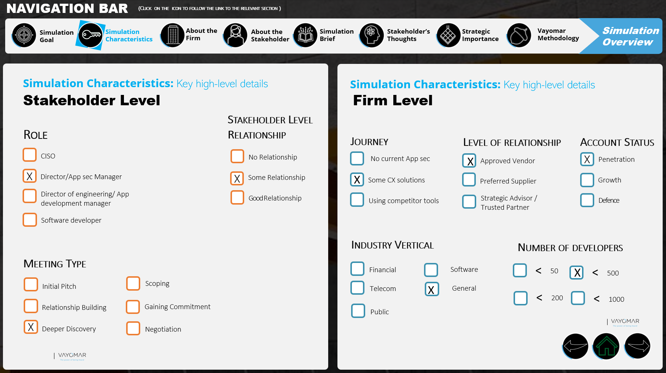
Our professional simulation-based learning program ensures that all enablement activities are practical and relevant to each of your salespeople and their most specific needs to meet their quota targets.
Our team will build robust scenarios for the Simulations that are tailored specifically to your company, designed to represent the participants' day to day reality and challenges.
Each simulation incorporates specific goals that emphasize either challenge or the company strategy in of itself.
Simulations are built as an OpenWorld playground to allow participants to practice and deepen their knowledge and application of the Vayomar methodologies they first learned in the general training sessions, and then implemented by the participants in simulation.
SIMULATION BASED LEARNING
VAYOMAR GLOBAL

Slide 29
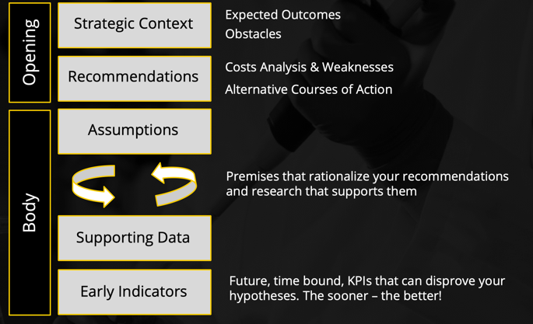
"Management" is a language. Much like English, Spanish and Chinese, the language of management is a way of thinking and communicating which has evolved to address the very distinctive realities and challenges faced by senior executives responsible for carrying the burden of decision making in states of great uncertainty.
Therefore, when we are called to communicate with, and present to, senior executives, we must understand that, the measurement of success, or the ROI on these encounters, comes down to a simple question: did they see you as an ASSET or a BURDEN at the end of your presentation? This in turn will be predominately determined by a single factor: the degree of uncertainty that you removed from their "shoulders".
To this end, we must learn how to think and present like executives who wish to improve strategic decision making, rather than like someone who has come to further drain the organization from its already limited resources. With this in mind, we have developed a recommended five-part structure with which to analyze initiatives we are responsible for and with which to present our recommendations (to internal managers as well as customer buying personas).
SPEAKING THE LANGUAGE OF MANAGMENT
VAYOMAR GLOBAL

Slide 30
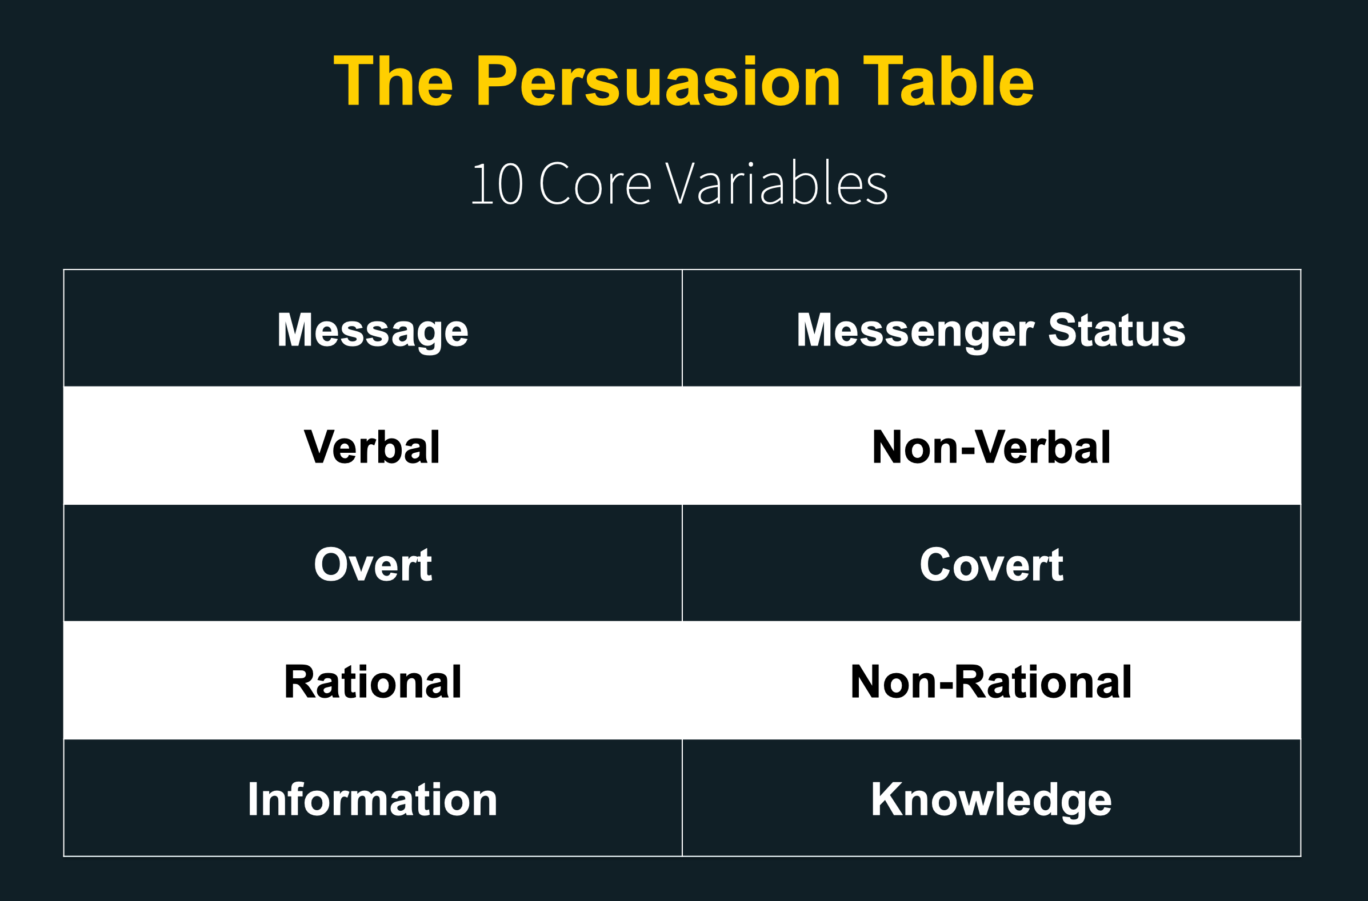
When people interact with each other, there are countless intervening variables impacting the stimuli-response dynamic between them. Nearly all of these variables are circumstantial and only a few of them can be anticipated and prepared for.
THE PERSUATION TABLE
However, there are 10 core variables that are always present in any human interaction and which outweigh the cumulative impact of the circumstantial variables.
By learning about each of these variables, we can identify and manage them in a wide range of scenarios and improve our ability to shape their outcomes.
VAYOMAR GLOBAL

Slide 31
This model provides the participants with the practical tools to get a better understanding of their clients and to discover the desired outcomes they are trying to achieve allowing them to position us as the right partner in achieving them.
This structured and disciplined way of thinking allows us to see our client through 4 key variables:
·
Resources that are required to execute a course of action usually budget and manpower.
Solutions Any course of action that can eliminate or bypass one or more of the obstacles standing in your way and lead to the desired outcomes (i.e. product or service)
Obstacles Any course of action that can eliminate or bypass one or more of the obstacles standing in your way and lead to the desired outcomes. (i.e. compliance, competitors, cyber attacks)
Desired outcomes A specific desired outcome which justifies the investment (risk) taken to get there (i.e. market share, new market and such).
As clients share information with us they are usually focused on the specific solution or recourse (i.e. we want service X and/or we need to decrease costs), it is up to us to elevate the conversation by discovering the real obstacles the client is facing and the desired outcomes they are trying to achieve and than to frames every question, communication or action in context of the desired outcomes.
Understanding and using this model allows us to become proactive and It is the basis for the shift from transactional (technology centric) conversation/selling to a consultative dialogue (customer/impact
centric).
VALUE ORIENTATION
VAYOMAR GLOBAL

Slide 32
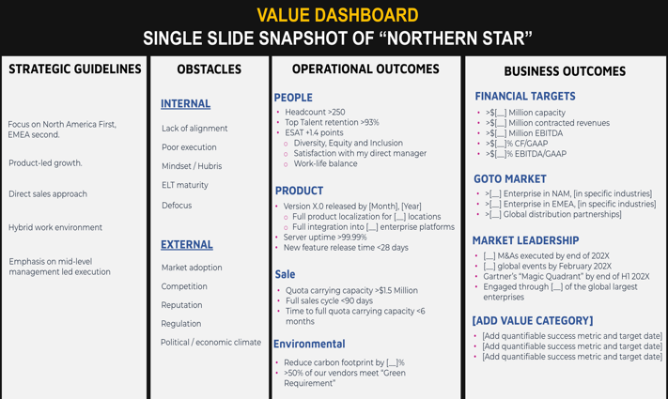
Value Orientation is both a mindset and a skillset. It's about proactively maintaining a strategic (rational) outlook, in spite of the endless stimulations and interruptions that relentlessly bombard our senses. The more complex the reality – the more valuable this structured and disciplined way of thinking is.
Fit for internal strategic processes as well as for external key stakeholder management (sales!), this highly counter-intuitive approach actually increases our chances of influencing key stakeholders and achieving ours, as well as their business and operational goals.
The practical manifestation of this methodology is the Value Dashboard: a single-slide display of our customer’s strategic reality.
VALUE ORIENTATION
VAYOMAR GLOBAL

Slide 33
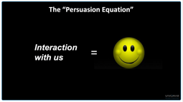
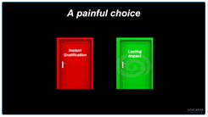
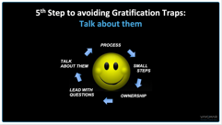
Today’s world can be ultra high-paced, but what if moving slower actually increased your chances of getting what you want?
The delaying of gratification is perhaps the most important variable in your ability to successfully influence people. It engenders trust and openness to collaboration, creating more opportunities for you to make a lasting impact on others and enhance your persuasion skills.
This interpersonal communication model is based on principles that can vastly improve your ability to influence people’s behavior with little to no dependency on formal authority.
The key is knowing how to identify and avoid the “Gratification Traps” that are frequently present in multi-participant discussions, and in dealing with volatile topics or high-intensity environments.
YOU’RE NOT MOVING SLOW ENOUGH
VAYOMAR GLOBAL

Slide 34





PROGRAM
PRICING
As discussed, below please find the proposed project pricing:
DESIRED OUTCOMES
Phase | Units | Price (USD)
Total proposed pricing |  | $40,000
Prices do not include VAT. as may be required by law.
Payment schedule: On monthly basis, for work completed.
This proposal is valid for 30 days.
Proposed By: Approved By:
Ariel Halevi
Print Name
Print Name
Co-founder & CEO
Title
Title
<DATE>
Date
Date
Signed on behalf of VAYOMAR
Signed on behalf of <COMPANY>
VAYOMAR GLOBAL

