Slide 1

Elasticsearch
By Mr.Burin Panchat Software engineering

Slide 2
Agenda
1. What Is Elasticsearch?
2. Why Elasticsearch?
3. Elasticsearch Advantages
4. Elasticsearch Installation

Slide 3
1.
What Is Elasticsearch?

Slide 4
What Is Elasticsearch?
Open Source
Lucene
Developed in Java
Supports full-text search
Real time distributed
Single Page Application
Real time analytics
RESTful API

Slide 5
2.
Why Elasticsearch?

Slide 6
Why Elasticsearch?
Query
Analyze

Slide 7
3.
Elasticsearch Advantages

Slide 8
Elasticsearch Advantages
Scalability
Fast performance
Multilingual
Document Oriented
Autocompletion & Instant Search
Schema Free

Slide 9
4.
Elasticsearch Installation

Slide 10
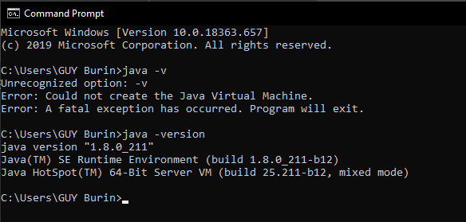
Elasticsearch Installation
1. Install the latest Java Version
Or If already have Java Installed
Then check for its version

Slide 11
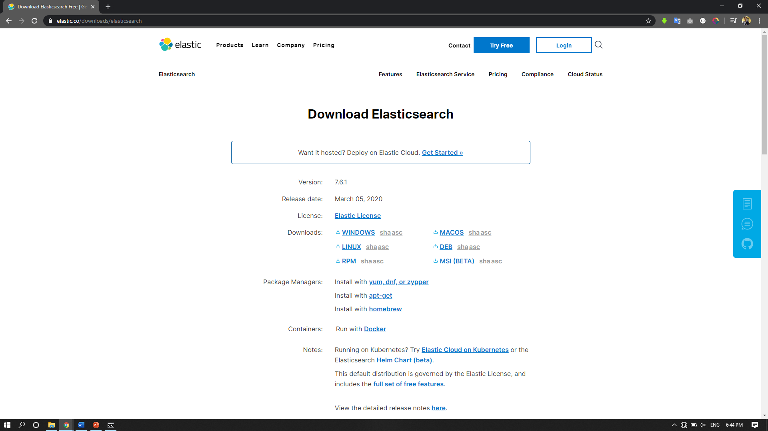
Elasticsearch Installation
2. Go to https://www.elastic.co/ downloads/elasticsearch
3. Click download

Slide 12
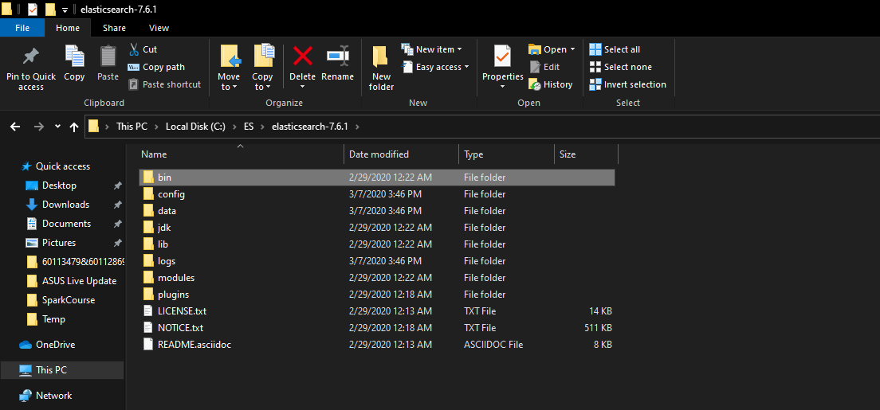
Elasticsearch Installation
4. Unzip file
5. Go to bin folder in Elasticsearch
folder

Slide 13
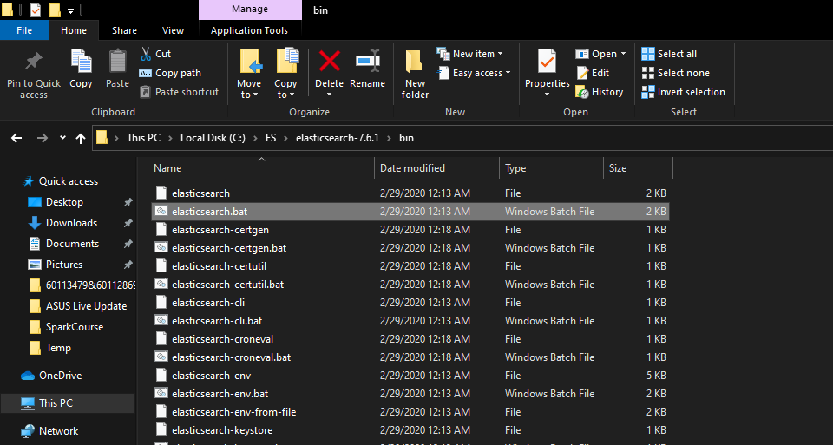
Elasticsearch Installation
6. Double click on elasticsearch.bat file

Slide 14
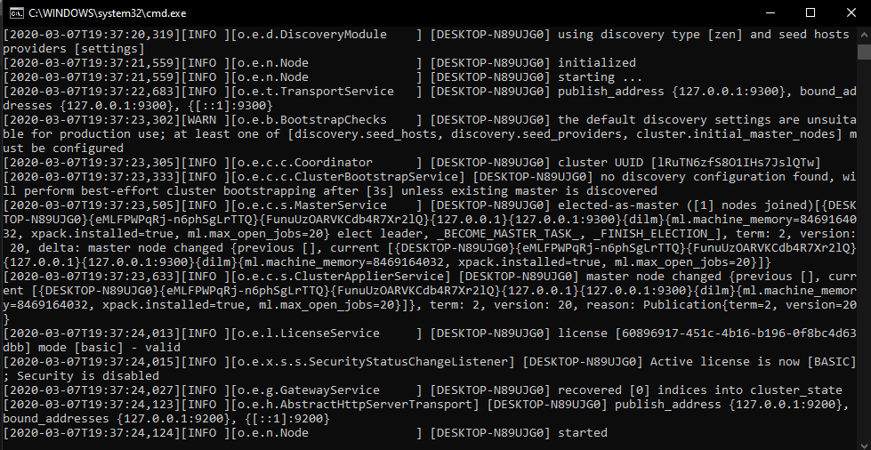
Elasticsearch Installation
7. Wait for Elasticsearch start

Slide 15
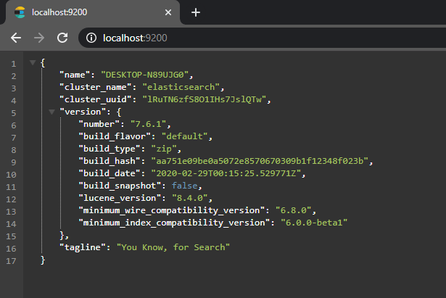
Elasticsearch Installation
8. Open browser and Url: Localhost:9200
9. If you can see this message on the browser that means your Elasticsearch is up and running

Slide 16

Elasticsearch Installation
+

Slide 17
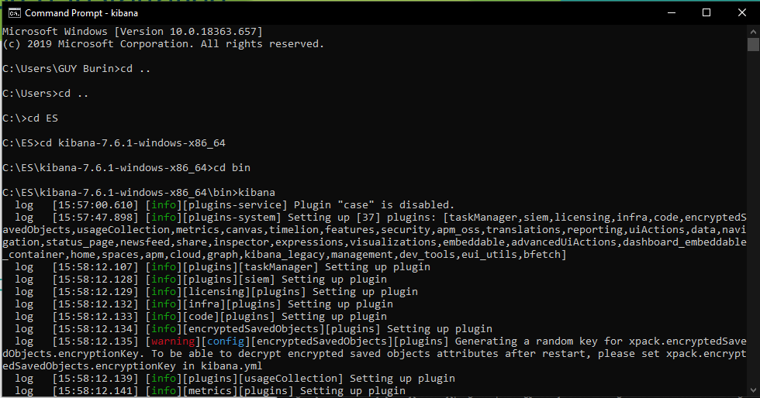
Elasticsearch Installation
Use terminal and run commend kibana in bin

Slide 18
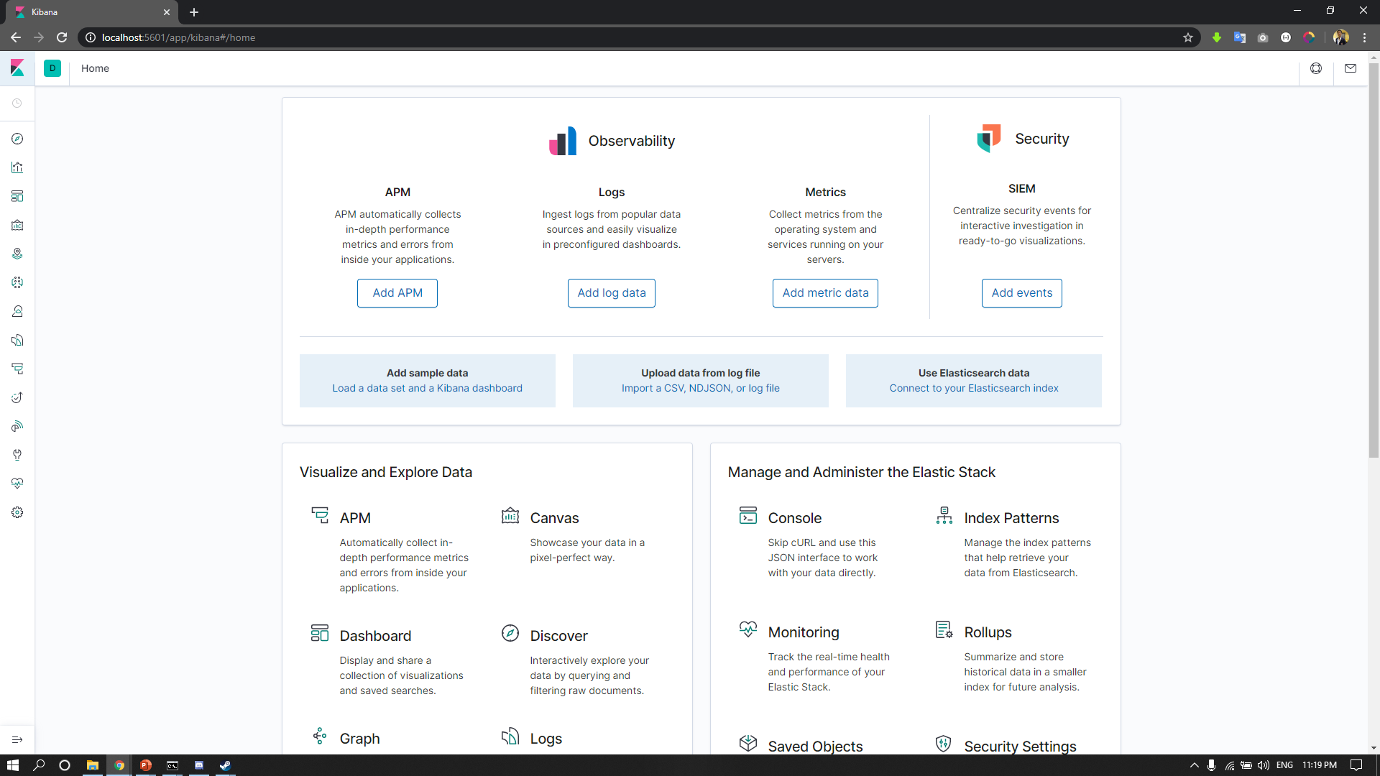
Elasticsearch Installation

Slide 19
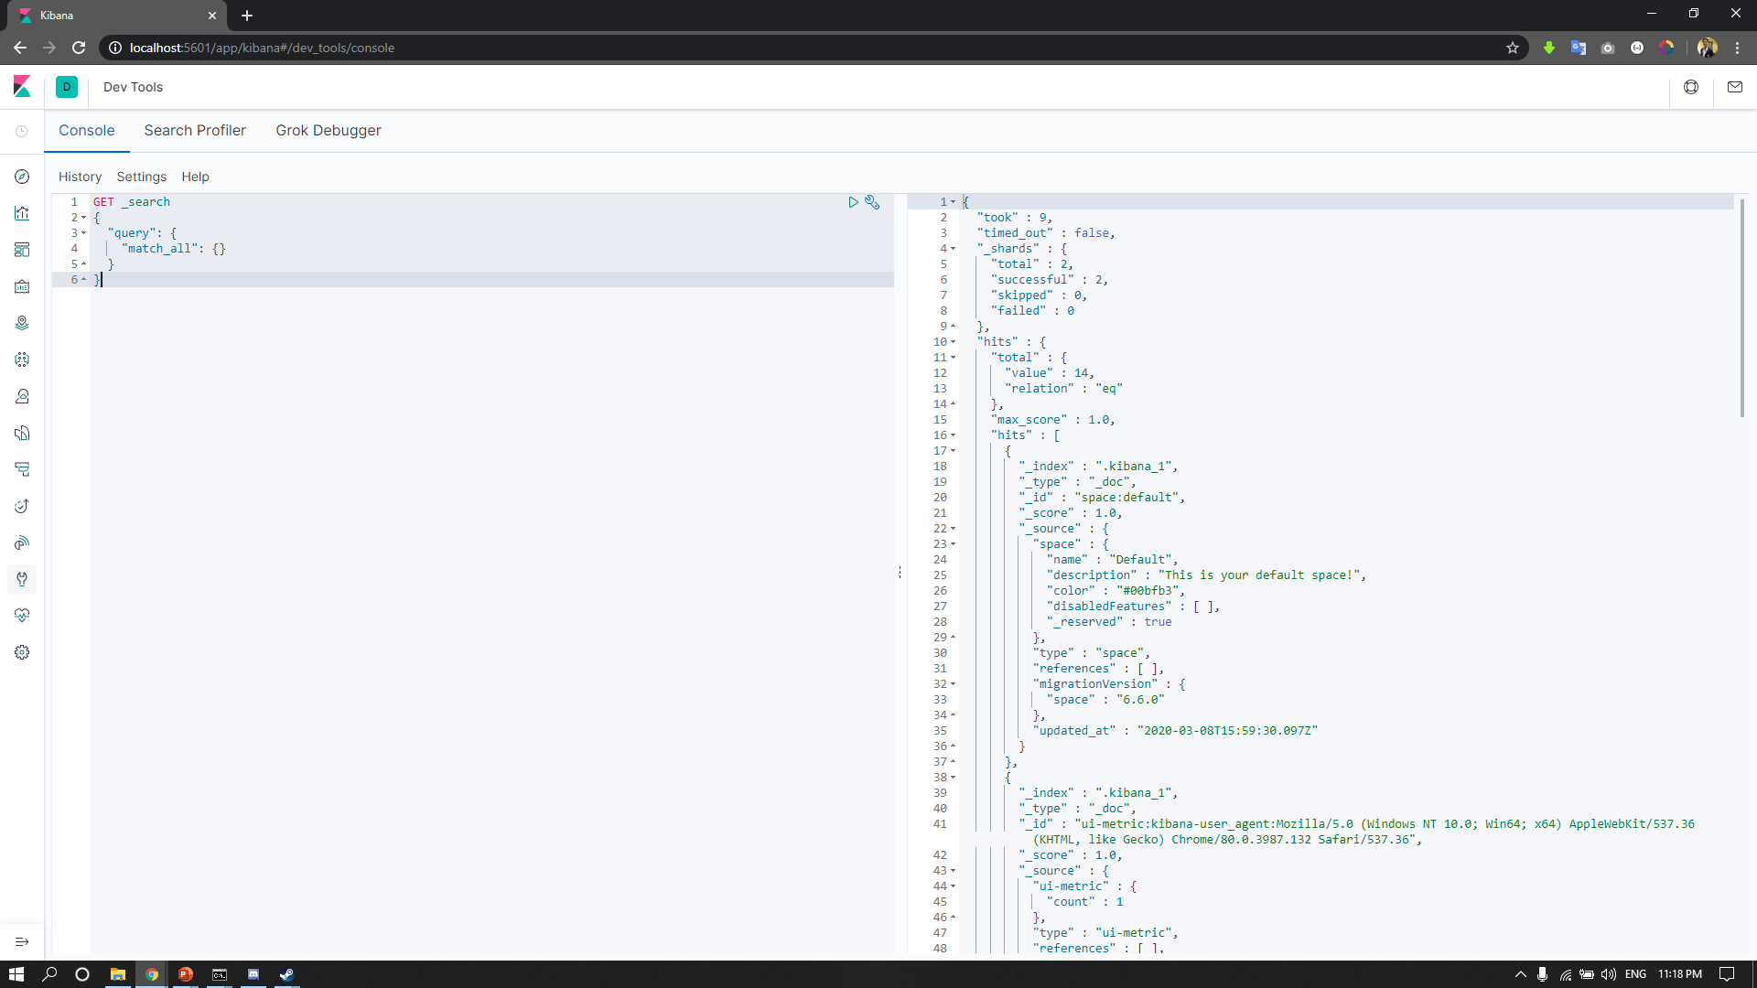
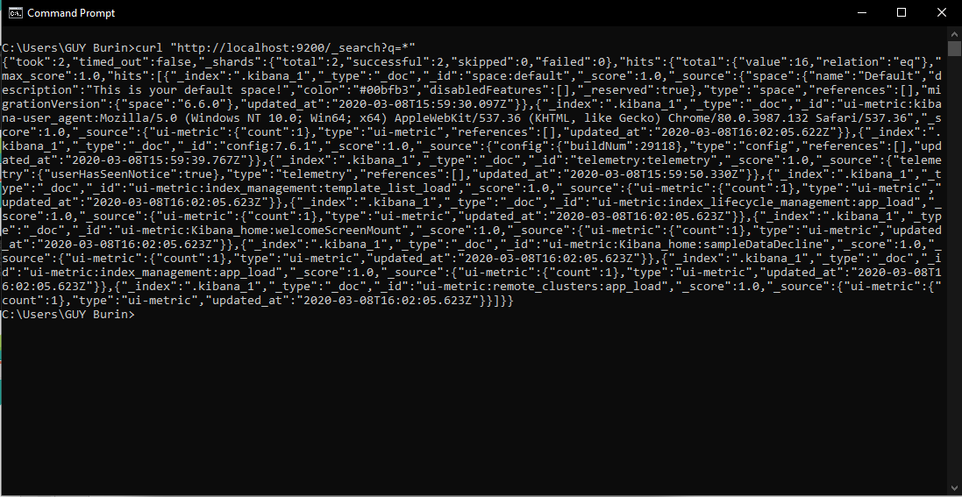
EX. Data

Slide 20
Reference
Edureka.(2019). ELK Stack Training & Certification.02/03/2020. retrieved from https://www.edureka.co/
Shay Banon.(2020).Elastic Training.02/03/2020. retrieved from https://www.elastic.co/

Slide 21

Advisor of project
Asst.Prof.Dr.Putthiporn Thanathamathee
Software Engineering,School of Informatics, Walailak University
E-mail: putthiporn.th@wu.ac.th

Slide 22
Thank you
Q&A

