Slide 1
SentiMerge: Combining Sentiment Lexicons in a Bayesian Framework
Guy Emerson
Thierry Declerck
LG-LP, 2014

Slide 2
Motivation
Sie zeichnet sich durch wunderbare Melodien

Slide 3
Motivation
Sie zeichnet sich durch wunderbare Melodien

Slide 4
Motivation
Sie zeichnet sich durch wunderbare Melodien

Slide 5
Motivation
Lemma | Sentiment
wunderbar | +
falsch | -
Angst | -
Frieden | +
unantastbar | +

Slide 6
Motivation
Lemma | Sentiment
wunderbar | 1.0
falsch | -0.9
Angst | -0.8
Frieden | 0.9
unantastbar | 0.6

Slide 7
Motivation
Lemma | Sent. 1 | Sent. 2 | Sent. 3
wunderbar | 1.0 | 0.4 | 0.8
falsch | -0.9 | -0.3 | -0.9
Angst | -0.8 | -0.4 | -1.0
Frieden | 0.9 | 0.5 | 1.0
unantastbar | 0.6 | 0.3 | -0.7

Slide 8
Outline
Data Sources
Normalising Scores
Combining Scores
Evaluation

Slide 9
Data Sources
Clematide and Klenner (C&K)
SentimentWortschatz
GermanSentiSpin
GermanPolarityClues
MLSA corpus (for evaluation)

Slide 10
Data Sources
 | vergöttern, V
C&K | 1.000
PolarityClues | 0.333
SentiWS | 0.004
SentiSpin | 0.245

Slide 11
Normalising Scores
Intuitively: if a source has small scores, increase them; if
large scores, decrease them
Formally: minimise the square difference between sources (under a suitable constraint)

Slide 12
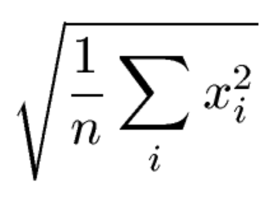
Normalising Scores
Consider words in the overlap between two sources
For each source, divide the scores by the root mean square

Slide 13
Normalising Scores
For each pair of sources, calculate the root mean squares in the overlap
Average for each source

Slide 14
Normalising Scores
Lexicon | Root mean square
C&K | 0.845
PolarityClues | 0.608
SentiWS | 0.267
SentiSpin | 0.560

Slide 15
Normalised Data Sources
 | vergöttern, V
C&K | 1.183
PolarityClues | 0.547
SentiWS | 0.015
SentiSpin | 0.438

Slide 16
Combining Scores
Assume true polarity values distributed normally
Assume each source independently introduces a linear error term, also normal

Slide 17
Combining Scores
 | Variance
Prior | 0.528
C&K | 0.328
PolarityClues | 0.317
SentiWS | 0.446
SentiSpin | 0.609

Slide 18
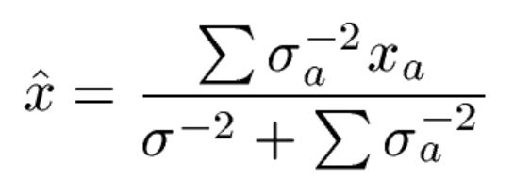
Combining Scores

Slide 19
Combined Data Sources
 | vergöttern, V
C&K | 1.183
PolarityClues | 0.547
SentiWS | 0.015
SentiSpin | 0.438
SentiMerge | 0.509

Slide 20
Evaluation Data
Content words in MLSA
  Sentiment from 2nd layer
  Lemma and PoS from 3rd layer (with manual correction)
1001 types, 1424 tokens
378 positive, 399 negative

Slide 21
Discretisation
Test data polarities are simply positive or negative
Need a threshold to convert from numerical scores

Slide 22
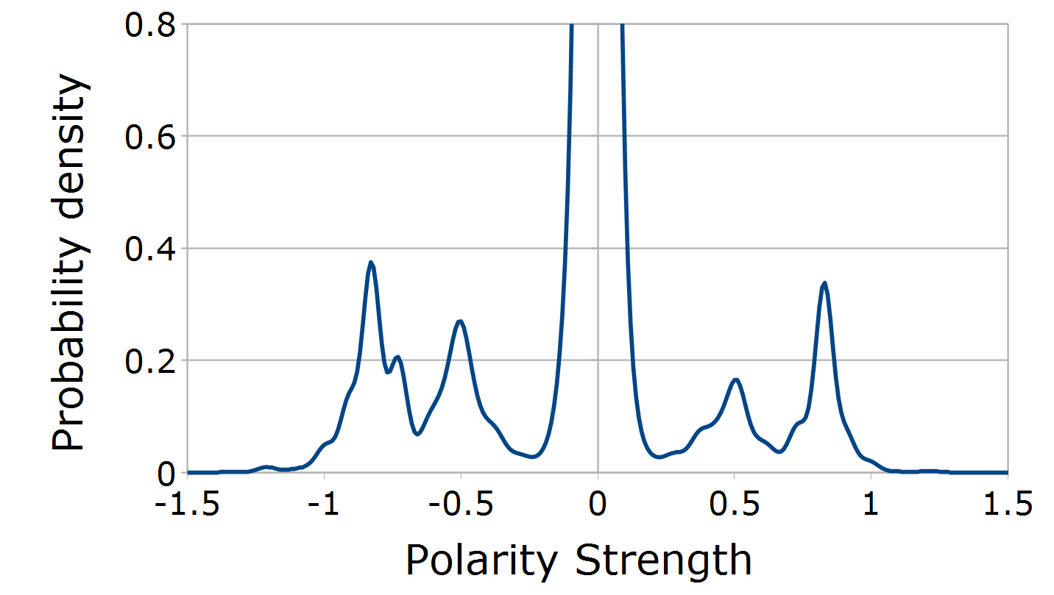
Discretisation

Slide 23
Evaluation
Lexicon | Precision | Recall | F-score
C&K | 0.754 | 0.733 | 0.743
PolarityClues | 0.705 | 0.564 | 0.626
SentiWS | 0.803 | 0.513 | 0.621
SentiSpin | 0.557 | 0.668 | 0.607
Majority vote | 0.548 | 0.898 | 0.679
SentiMerge | 0.708 | 0.815 | 0.757

Slide 24
Conclusion
Bayesian combination outperformed original sources, as well as a baseline method
Merged resource being published as part of LLOD

