Slide 1

Introducing computational thinking
Belinda Weaver

Slide 2
Learning objectives
Identify the steps involved in computational thinking
Break a problem down into more manageable parts
Develop a series of steps to solve a problem
Generalise important detail to make steps re-usable

Slide 3
Computational thinking is …
“… the mental activity in formulating a problem to admit a computational solution. The solution can be carried out by a human or machine, or … by combinations of humans and machines.”

Slide 4

Is computational thinking the same thing as programming or coding?

Slide 5
.
Programming | Computational thinking
instructs a computer to carry out a sequence of steps in a particular order. | is the process to help decide what those steps will be, i.e. what the computer will be told to do.

Slide 6

A problem …
You are ocean sailing with friends when a huge storm blows up.
Your boat overturns.
You are cast up alone on a deserted island.
There is no sign of any of your friends.
There is no sign of the boat.
You have nothing but the clothes you are wearing.

Slide 7
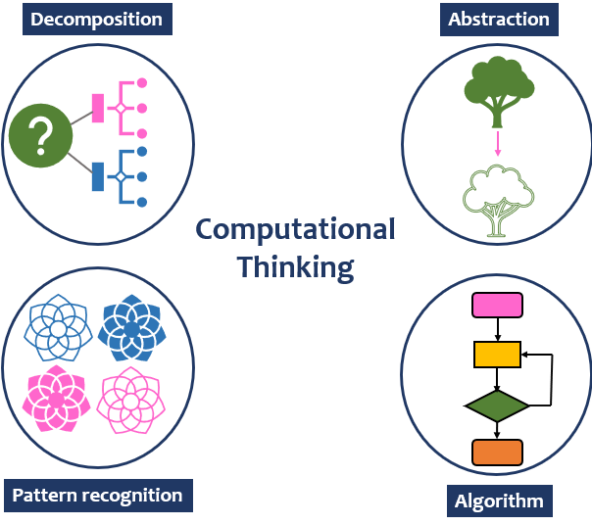

Slide 8
The four components of computational thinking
Decomposition – breaking a problem down into manageable parts.
Pattern recognition – looking for similarities within a problem or with other problems.
Algorithms – developing step-by-step solutions.
Abstraction – generalising detail to make a solution reusable.

Slide 9
Exercise
Let’s use computational thinking to add up all the numbers between 1 and 200 in our heads, i.e. 1 + 2 + 3 + 4 + 5 + 6 and so on.
We should be able to do this in less than a minute.

Slide 10
Decomposition – add first & last number, add second & second last number …
Pattern recognition – all pairs add up to 201!
Algorithm
calculate number of pairs by dividing the number to be added by two -> (200/2 = 100)
multiply sum of single pair (201) by number of pairs (100) -> (201 * 100 -> 20,1000 (the right answer)
Abstraction – if x is the original number, then reusable algorithm to get the sum of all the numbers between 1 and x is x divided by two multiplied by the sum of a single pair of numbers, i.e. (x / 2) * (x + 1)

Slide 11
Practice
Use the same steps to add up all the numbers between
1 and 24
1 and 50
1 and 800

Slide 12

Structure diagrams
Help plan problem breakdown visually
Main objective at the top
High level considerations go next
Break these down into smaller and smaller steps

Slide 13
Shipwrecked!
What is the top objective of our shipwrecked sailor?

Slide 14
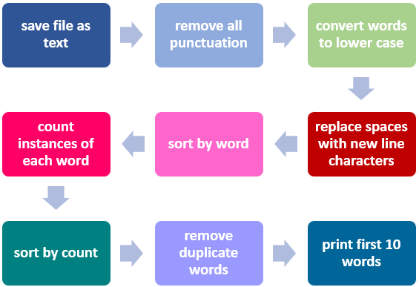
Decomposition
Finding the 10 most commonly used words in a text
Notes:
This is a linear process. Once the steps are coded, it could be re-used on any number of different texts. Also the parameters could change –least used, top five, etc.

Slide 15
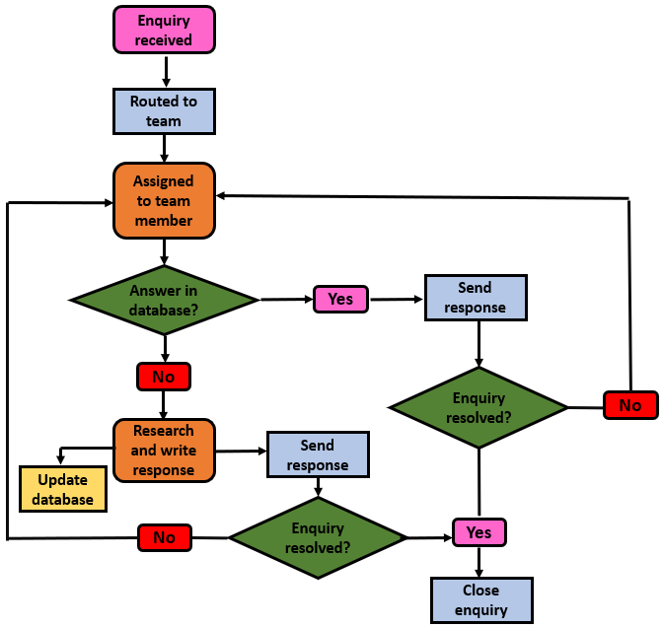
Branching
Notes:
Coding is rarely so linear. Usually code branches depending on conditions such as ‘yes/no’. If yes, do this, if no, do that.

Slide 16

Rescued!
Create a structure diagram of the planning needed to mitigate another such disaster.

Slide 17
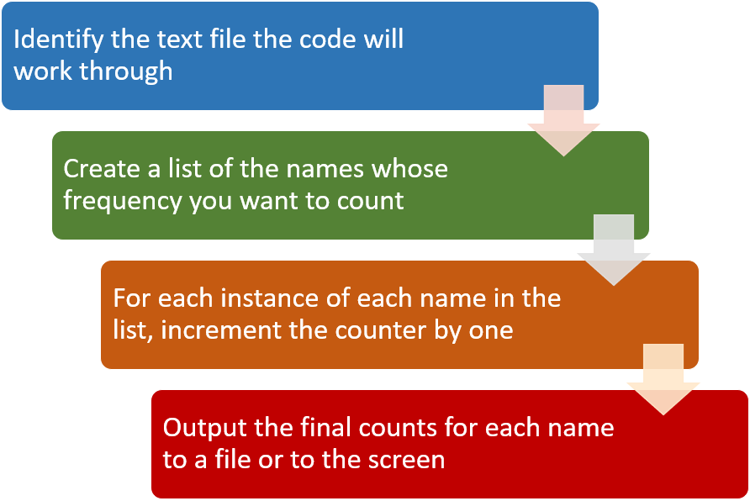
Pseudocode
Notes:
This an example of word counting pseudocode. We will look at three different books of the the Lord of the Rings series and count name frequency to see if the female character got less page time than the males. I then ran some shell scripts here to demonstrate that the only thing I need to change each time is the input file,

Slide 18
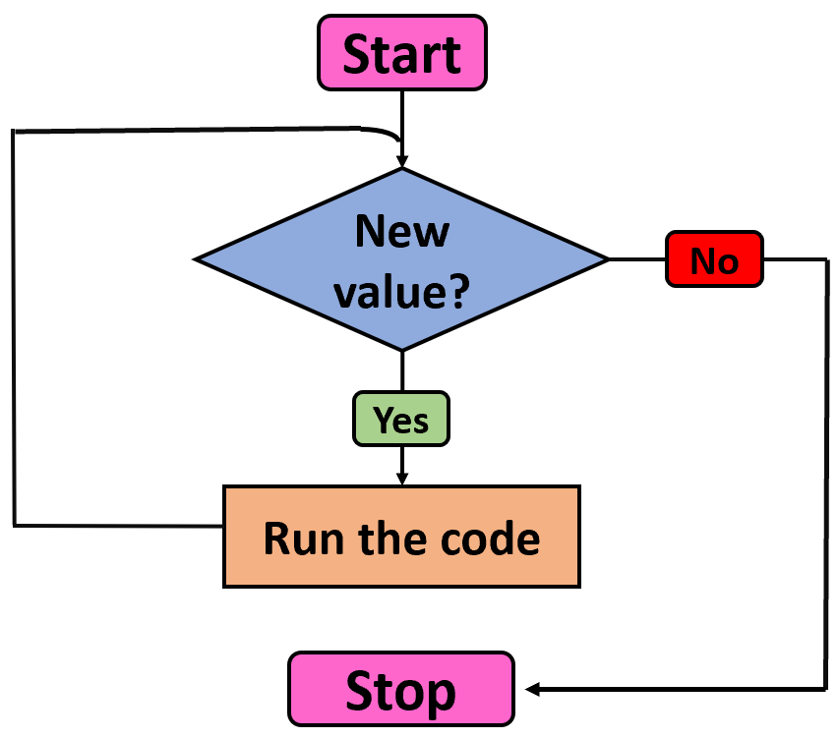
Loops
Notes:
Explain how loops work and how helpful they are for boring, repetitive tasks. Explain computer does not get bored or distracted and can execute these loops very fast.

Slide 19
Practice 1
In a folder, we have 250 image files for which we want to create individual backup copies before we process the images for archiving.
Write some pseudocode of how you might automate this process.

Slide 20
Practice 2
You have a large folder of files from a project that is now finished. The files are all in one folder.
You want to archive the project and its files, so you need to create folders by file type, e.g., .pdf, .jpg, .docx.
New folders need to be created and the different files moved into them en masse by file type.
Write some pseudocode of how you might automate this process.

