Slide 1
PITCH D · INTERTWINED · STRATEGY EARNS A PRODUCT LINE · CUT LATER
Kalpi / קלפי
Free digital collect-only TCG of the 2026 lists. Pack = bait. Smart vote + show-up = goal.
Game never picks a side. You may. Election 27 Oct. Lists 9 Sept. Threshold 3.25%. 120 / 61.
No battles, lore, or IAP. Equal 8-card skeleton. Server pulls. Client displays.
C = civic story. This deck = product a room can cut from. Notes are longer than the slides.
Kalpi · pitch D
1 / 22

Slide 2
STRATEGY · WHAT WE CAN PROVE · WHY THIS COHORT
46.7% of 18–24s vs 74.9% of 65–74s · ~600k first-timers
Knesset RIC after 2021. National 2022: 70.6%. A 28-point age gap — persistent, not a collapse.
Lavi & Adler: youth vote more than young Europeans; still far below older Israelis.
595–640k first-timers (18–22). ~8.7% of the roll. On the order of six seats. Points / IDI / CBS.
Still the target: lowest turnout, largest new bloc, weakest list-knowledge. Older voters already show up.
This group can move six seats without knowing slots 1–20. Lists 9 Sept. Election 27 Oct. Virality needs weeks.
Kalpi · pitch D
2 / 22

Slide 3
STRATEGY · SURVEYS ARE NOT TURNOUT · TWO JOBS
80–95% intend. That is not a forecast.
IDI May 2026, n=576 first-timers: 80–95% intend.
Same institute, 2013: ~88% intended, ~92% later said they voted, official 67.8%.
18–22 already most likely to stay home (17.7% / ~15% after) vs 7–9% older. Overreport is known.
Assume 2026 youth turnout stays low vs older adults — even if a few points above 46.7%.
Two jobs: get them there, and make the slip informed. Feed is #1 source; most do not seek.
No invented “X% cannot name three parties.” Say: they do not know the list.
Kalpi · pitch D
3 / 22

Slide 4
STRATEGY + PRODUCT · THEY DO NOT KNOW WHO · SO THE PRODUCT…
“Bennett is a bro.” Lived. Not a fake knowledge %.
Me — a vibe is not a platform. Little brother — does not know. Hadar Muchtar — same room.
NEW VOTERS → teach lists + the booth. Do not assume they know.
PARENT DEFAULT → facts without a family fight. Not “rebel against home.”
DON’T CARE (war, load) → 90-second rip. Dopamine first. Lecture never.
TIKTOK / FAKE NEWS as civics → sourced backs + commons. Knowledge, not clip-by-clip.
AFRAID TO SHOW AN OPINION → in-game faction is anonymous (tile, not a name).
Kalpi · pitch D
4 / 22

Slide 5
STRATEGY · WHY NOT PARENTS · WHY LITERACY · JAM GOALS
Rebellion. They are invested. Solution: literacy.
A parent lecture is the wrong teacher. Parents already decided — that is a fight, not a syllabus.
אוריינות פוליטית: teach a smart vote without a parent, a party ad, or a TikTok. They chose to flip.
Fake news supports this: if they know the list, a fake has less room. We do not fact-check clip-by-clip.
Jam: knowledge (backs/quiz/commons) · socials (share/tally/trade) · encourage voting (habit to 27 Oct).
Taking a choice (faction, survey pack, then a real slip) · literacy = north star · young audience.
Kalpi · pitch D
5 / 22

Slide 6
STRATEGY + PRODUCT · TRAIT → THIS FORMAT, WHY NOW
If the product is a lecture, we already lost this age.
47s focus, median 40 (Gloria Mark) → rip under 90s. Not a PDF.
Variable rewards → the rip is the habit engine, on purpose.
Feed politics → lesson on the card back + commons + quiz.
Afraid to speak → anonymous faction. Viral or invisible → share the 1/1.
Pocket (~150M / ~$1.3B y1) → daily pack, ritual, binder, screenshot. Not battles.
State Makers sold out a 98-card Israeli history set. Collectr: TCG sales +107% in 2025.
Digital + free = reach, speed, no pay-to-win, no civic/money fight. Hit it now — lists 9 Sept.
Kalpi · pitch D
6 / 22

Slide 7
STRATEGY + PRODUCT · LOCAL PROOF
State Makers / יוצרים מדינה — do not compress to “cards work.”
Piece of History. 98 cards. Packs of 8. Holos. First edition sold out.
People paid to collect — and learned the country’s story. The format teaches here.
We point that at this election: digital, free, equal lists, no till. Our pack is 6 — faster than their 8.
They are cardboard / history-as-hobby. Next: why digital, and the global wave.
pieceofhistory.com/statemakers
Kalpi · pitch D
7 / 22

Slide 8
STRATEGY + PRODUCT · POCKET’S FIVE · WHAT WE REFUSE
Daily pack. Ritual. Sets. Screenshot. Quick session.
1 Clock, not a pile — one free pack / 24h. (8h drops parked, more hostile, not Alpha.)
2 Tear / pause — addictive on purpose. A fade-to-grid is not a collectible.
3 Binder hole — collect sets, not a duel. Missing well = missing fact.
4 Rarity you screenshot — that is the virality. Social is show, not chat.
5 Under 90 seconds. Earlier digital Pokémon skipped collecting and stalled.
Take the door. Refuse shop, hourglasses, Wonder-Pick paid rewind, battles.
Why not a quiz app? Quiz apps are not a daily habit for this age. Pocket showed what is.
Kalpi · pitch D
8 / 22

Slide 9
STRATEGY · THE IRON IS HOT · WINDOW IS SEPTEMBER
The format left Pokémon. Subject is not the limiter.
Pokémon still ~65% of tracked hobby. Pocket (30 Oct 2024) is the digital daily-pack proof.
One Piece: nothing in 2022, hobby #2 (~17%) now. A new IP can become a collect giant fast.
Riftbound (LoL, 31 Oct 2025): fastest 30-day move Cardlogs tracked. Cyberpunk TCG: ~$27M KS.
Sports never left. Life TCG prints holos to animal population — we invert that to list slot.
US politics cards exist (Decision 2024; Politic Packs). State Makers = best Israeli analog, not worldwide.
Collectr: tracked sales +107% in 2025. Direction, not a random market-size $. Hit it now.
Kalpi · pitch D
9 / 22

Slide 10
PRODUCT · THEREFORE KALPI · BAIT VS GOAL
Pack is bait. Smart vote + show-up is the goal.
Free digital collect-only TCG of the lists. Teach them well enough that they know the list at the kalpi.
Card back is ONE lesson. Same job: quiz, commons, party pack, trading a dupe, real-life party work.
A rip with no learning beat fails. Extra pack = quiz. Not spend. Not in-game faction.
No battles, lore, IAP, client-trusted pulls, live polls in our voice, “Kalpi recommends,” outing a camp, cash Alpha.
Equal 8-card skeleton + 4 commons. PoC: Likud · Democrats · Ra'am (map spread) = 28 sourced cards.
Kalpi · pitch D
10 / 22

Slide 11
PRODUCT · COLLECTIBLE MUSTS · KNOWLEDGE ON TOP
Essence of a collectible. Learning bound to progression.
Rip ritual → hold → flip the back. ~1.5s Alpha; 3s is the idea (too hostile to launch). Never skip the back as default.
Timer 1/24h. No hourglass shop. Pity after 3 dry packs = new knowledge. Duplicates still show the back.
Printed mix 3C / 2U / 1R-or-H. Hidden odds are a loot-box tell. Card lands in a hole = missing fact.
Screenshot the 1/1. Date can caption a holo; slot-number is the chase. Extra pack = quiz on a pulled card.
New lists after 9 Sept. Pulse later = CEC facts only — never horse-race polls.
Kalpi · pitch D
11 / 22

Slide 12
PRODUCT · CORE LOOP · PACK RULES · ALPHA
login → rip 6 → hold → flip back → binder → share / quiz / tally
Session: 5s to pack, 20–30s rip, 20–40s flip, 10–15s binder. Default under 90s. Deep browse optional.
Printed mix. Pity. Prefer an incomplete set. Commons every other pack. Server creates; client displays.
Alpha: guest, daily pack, rip, flip, binder %, share image. Server pulls from day one.
Designed later: quiz, faction, volunteer bundle, survey pack, streaks, numbered holos, trading, boards.
No paid rerolls. Pledge does not grant a pack. Energy does not exist.
Kalpi · pitch D
12 / 22

Slide 13
PRODUCT · QUIZ ON PULLED CARDS
You only get asked what you already ripped. Prefer the last pack.
Popup: that same face + name. Swipe role / known-for (from the back). Swipe list. 3–4 options. 5:00.
Both right → one extra pack. Wrong or timeout → show the back. One win per day. New popup later if they fail.
Cannot farm a card you never pulled. Dismissible. Never blocks the daily pack. No “who is good.”
Commons quiz 120 / 3.25% / closed list / CEC date the same way. Login = habit. Learning = bonus pack.
Kalpi · pitch D
13 / 22

Slide 14
PRODUCT · THREE CHOICE MECHANICS · ENERGY IS DEAD
Do not mix these. There is no currency.
1 IN-GAME FACTION: pick a list. Each pack +1 on a public tally. Scoreboard, not a poll. No extra pack. Anonymous. Switch ok. Unfactioned still play. Tiles same size; order = CEC letter, not polls.
2 REAL-LIFE PARTY WORK: verified HQ / campaign / kalpi. Best way to learn. Pays a PACK BUNDLE. Does not auto-join the faction.
3 SURVEY → PARTY PACK: issue survey, published table, same questions. Pack of matched-list politicians only. Tool, not endorsement. Never hides the binder. Never auto-factions.
Kalpi · pitch D
14 / 22

Slide 15
PRODUCT · LIST-SLOT NUMBERED HOLOS · LIFE TCG INVERT
Print run means something real. We print to official list slot.
Slot 1 → 1/1. Slot 2 → 1/2 · 2/2. Slot 3 → 1/3 · 2/3 · 3/3. Slot n → 1/n … n/n.
Likud 1, Democrats 1, Ra'am 1 are all 1/1. Teach order, not poll share. Never seats. Never “importance.”
Life TCG prints holos to wild population. We steal the idea and invert it for neutrality.
Server assigns the number. Symbol / platform / quote / commons are not slot-numbered.
Separate: a holo can carry the date as a screenshot caption. Slot-number is the chase.
Kalpi · pitch D
15 / 22

Slide 16
CONTENT · WHAT IS ON A CARD · VOICE
Member. Symbol. Platform. Quote. Commons.
Per list: 4 members · 1 symbol · 2 platform · 1 quote. Same rarity math. Same art weight. No cool party.
Commons: Knesset 120 · closed list · threshold 3.25% (since 2015) · CEC 9 September.
Back: who / role / one vote-useful fact. Quote labeled + dated + sourced. Source on the card.
Hebrew when we ship. Tired 19-year-old voice. No campaign “we.” No slogans as facts.
Pulse later: CEC calendar only. Never live polls or “X is leading” in our voice. Civic objects, not press faces.
Kalpi · pitch D
16 / 22

Slide 17
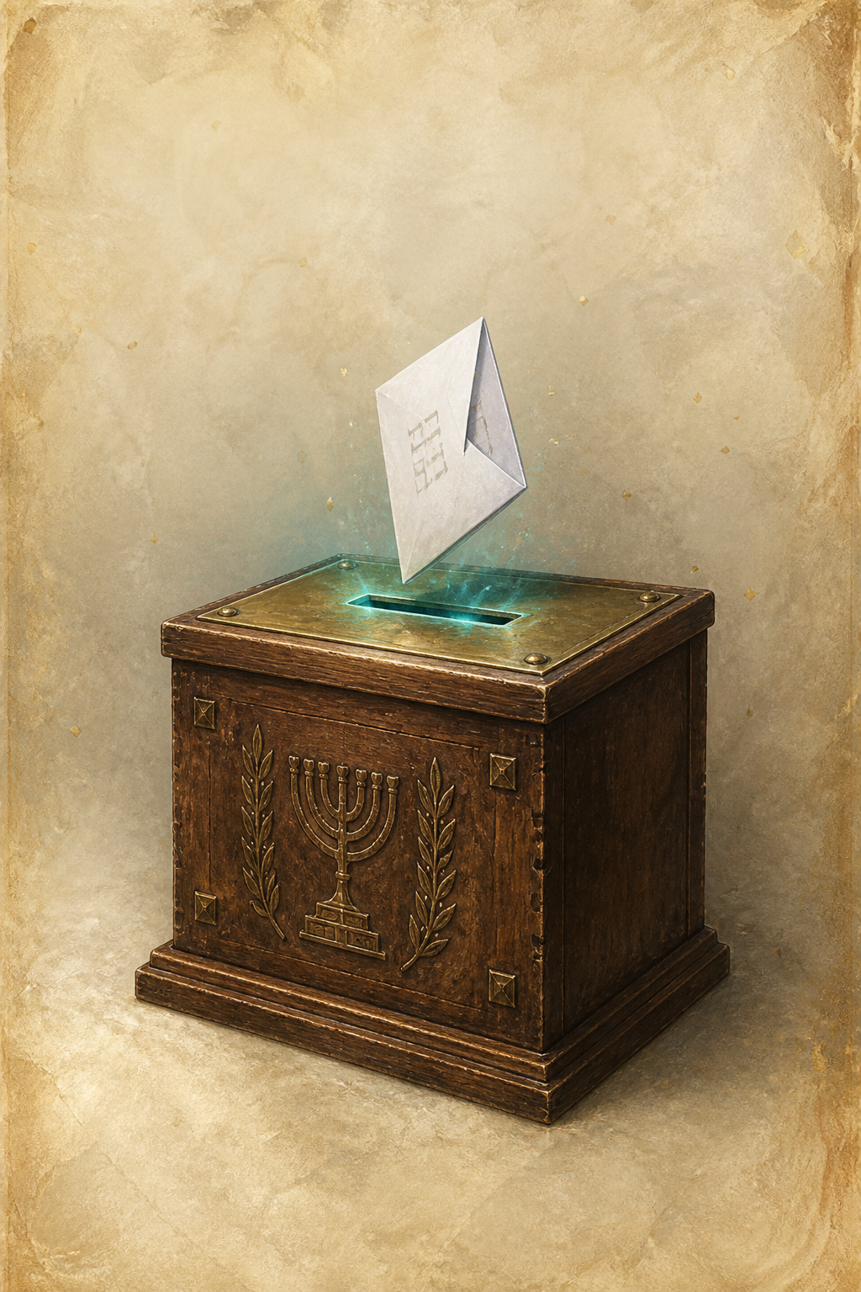


DESIGN · PLAY IT · TOKENS
Paper, ink, foil. Party color = 8px pip only — never a wash. Shared chrome so no list is the hero.
Date stamp on the holo. מחל = letters in the booth. Alpha: pack, flip, binder. Server pulls.
Flip hero-cards.html · phone wireframes · visual system already locked.
Kalpi · pitch D
17 / 22

Slide 18
PRODUCT · WHY THEY STAY · METRICS
Faction + cash are not enough.
ALPHA: daily clock, pity, binder %, share image.
DESIGNED: quiz extra pack, faction tally (no reward), real-life bundle, survey party pack, trading (no paid gate),
slot 1/1 + date stamp, streaks 3/7, commons-complete badge, country board / leagues / set race.
10k NIS first-set = pitch concept, legal later. Not Alpha.
Metrics (deck, not Alpha): D1/D7 · % flipped to the back · quiz accuracy · extra packs from learning vs login · set %.
Vanity (pulls, holos shared) only as leading indicators of the learning loop.
Kalpi · pitch D
18 / 22

Slide 19
GROWTH · HOW IT LEAVES THE ROOM · OUTBID INVERT
Share the rare. Seed where they are. Nobody pays for rank.
Screenshot the 1/1. TikTok / Instagram / WhatsApp. Influencers: their 18–24 is ours. Hebrew as soon as the rip works.
Weavy / Figma Weave: stills, rip films, promo. Generate, then cut. Same deadline argument as AI art.
outbid.lol (19 Aug 2026): pay-to-rank. Founder-reported ~1M visits, six-figure bids, top spot ~$13–17k.
Proof people pay for a ladder. We invert — civic race, nobody pays. Treat dollars as founder-reported if picky.
Lists 9 Sept. Virality needs weeks. Leave the room only if it can be live in September — free, Hebrew, seeded.
Kalpi · pitch D
19 / 22

Slide 20
IMPLEMENTATION · HTML FIRST · SERVER OWNS LUCK
Open a URL. Server pulls. Client displays.
HTML first. No store. No framework tax. Tokens locked. Skills: frontend-design + kalpi-frontend.
POST /packs/daily → clock / pity → RNG → persist inventory → six ids. Never POST { cards } as a pull.
Quiz grade (owned ids), faction tally, volunteer bundle, party-pack match, streaks: server-side.
Rate-limit: one daily pack, one quiz-pack per day. Guest ok; bind later.
Weavy for motion. Civic objects, not scraped press faces. Artist pass if funded. Do not wait.
Kalpi · pitch D
20 / 22

Slide 21

DESIGN · THE ENDS JUSTIFY THE MEANS
Empty of lore. Full of cause.
Jams reward heart in the fiction. We shipped dopamine on purpose — rips, AI art, a faction board, no story bible.
Civic goal is the message. Lists 9 Sept. Hand-painting every member of every list is how you miss October.
Same psychology as gacha — and floors: no spend, short sessions, pity, extra packs only when they learn.
Prior jams: guygir.itch.io — emptiness is a choice, not a missing soul.
Kalpi · pitch D
21 / 22

Slide 22
27 OCTOBER 2026 · ONE LINE
Assume the gap. Give them a pack they will open.
Live in September. Free. Hebrew. Seeded where 18–24 already are.
Civic story only: present C. This room was the product.
Forbidden: IDI-as-forecast. Invented knowledge %. “Kalpi helps the Democrats.” Notes only.
Kalpi · pitch D
22 / 22

