Slide 1
ISRAELI ELECTIONS 2026
Who does not reach the kalpi.
And why a pack of cards is the way to get them there — knowing who they are voting for.
Kalpi · pitch
1 / 23

Slide 2
1 · VOTING % · THE BACKGROUND
46.7%
of 18–24s voted after 2021.
74.9%
of 65–74s did.
Knesset Research and Information Center. National turnout in 2022: 70.6%.
Kalpi · pitch
2 / 23

Slide 3
WHY THAT NUMBER MATTERS
A 28-point age gap. Not a vibe.
Young Israelis vote more than young Europeans, and the youth rate has been rising. They still vote far less than older Israelis. That is the issue we are in the room for.
Kalpi · pitch
3 / 23

Slide 4
WHY IT MATTERS THIS YEAR
~600k
first-timers. About six seats.
595–640 thousand people aged 18–22. 8.7% of the roll. Election day 27 October 2026.
Kalpi · pitch
4 / 23

Slide 5
“BUT THEY SAY THEY WILL VOTE”
80–95% intend to. That is not a forecast.
IDI, May 2026. In 2013 the same institute saw ~88% intend, ~92% later say they voted — official turnout was 67.8%. Ages 18–22 were already the most likely to stay home.
Kalpi · pitch
5 / 23

Slide 6
WORKING ASSUMPTION
Youth turnout will still be low.
Even if 2026 is a few points above 46.7%, it is still low versus older adults. And even the ones who show up often do not know the list. Two jobs: get them there, make the slip informed.
Kalpi · pitch
6 / 23

Slide 7
2 · THEY DO NOT KNOW WHO TO VOTE FOR
“Bennett is a bro.”
That was me. A vibe is not a platform. My little brother does not know who to vote for. Hadar Muchtar — same room. This is not a survey. This is the product.
Kalpi · pitch
7 / 23

Slide 8
THE YOUNG-VOTER PROBLEM
Default to parents. Or don’t care. Or the feed decides.
War. Load. Enough already. TikTok is full of viral fake news. Some are afraid to show an opinion — at least on one side. A lot of new voters. Not a PDF audience.
Kalpi · pitch
8 / 23

Slide 9
WHY NOT “ASK YOUR PARENTS”
Rebellion. And they are invested.
A parent lecture is the wrong teacher for this age. Parents are emotional and already decided. That is not a syllabus. That is a fight.
Kalpi · pitch
9 / 23

Slide 10
THE SOLUTION
Political literacy. A smart vote.
How do you teach them to vote properly — without a parent, a party ad, or a TikTok? Knowledge they chose to flip. Fake news is another reason this is the job: if they know the list, a fake has less room.
Kalpi · pitch
10 / 23

Slide 11
WHY THEY ARE STILL THE TARGET
Lowest turnout. Largest new bloc. Weakest list-knowledge.
If anyone can move six seats without knowing who sits in slots 1–20, it is this group. Older voters already show up. This group does not — and when they do, the feed is their civics class.
Kalpi · pitch
11 / 23

Slide 12
WHAT CHARACTERIZES THEM
47 seconds. Dopamine. Viral or invisible.
Gloria Mark: average screen focus is 47 seconds, median 40. Age of wars and TikTok. If it is not a daily loop, it is a lecture they will not finish.
Kalpi · pitch
12 / 23

Slide 13
3 · LOCAL PROOF — CARDS ALREADY TEACH ISRAEL
State Makers / יוצרים מדינה
Piece of History. 98-card Israeli history set. Packs of 8. Holos. First edition sold out. People paid to collect — and learned the country’s story. We point that format at this election, digital and free. pieceofhistory.com/statemakers
Kalpi · pitch
13 / 23

Slide 14
WHY THE DIGITAL MANEUVER WORKS — POKÉMON TCG POCKET
Five things we take. Not the shop.
1 Daily timed pack — they come back. 2 The rip is a ritual — addictive. 3 Collecting sets is the progression. 4 Rarity is a screenshot — that is the virality. 5 Built for a quick session.
Kalpi · pitch
14 / 23

Slide 15
STRATEGY · THE IRON IS HOT
Not only Pokémon. The format is spreading.
Tracked TCG sales doubled in 2025. One Piece, Riftbound, Cyberpunk. Sports never left. US politics already has cards. State Makers is the best local proof. Hit it now.
Kalpi · pitch
15 / 23

Slide 16
TRAIT → GAME
90-second rip. Daily pack. Card back. Anonymous pledge. Share the pull.
The rip is bait. Extra packs come from a 5-minute swipe. A survey can unlock a party pack. Show-up is the outcome.
Kalpi · pitch
16 / 23

Slide 17
THEY ALREADY PAY FOR A LADDER
outbid.lol — fame for whoever pays more.
Companies spent five figures to sit on top of a public board. ~1M visits. Proof people will waste a lot of money to go viral. This time the spectacle is for a civic cause. Nobody pays. outbid.lol · outbid.lol/about
Kalpi · pitch
17 / 23

Slide 18
THEREFORE
Kalpi.
A free digital collect-only TCG of the lists. No battles. No lore. No paywall. Equal sets. The game never picks a side — you may, anonymously. One free pack a day.
Kalpi · pitch
18 / 23

Slide 19
PRODUCT · BAIT VS GOAL
The pack is bait. The goal is a smart vote.
Teach Israeli politics well enough that they show up knowing the list. The card back is one lesson — not the only one. Quiz, commons, a party pack: same job. Progression is bound to learning.
Kalpi · pitch
19 / 23

Slide 20
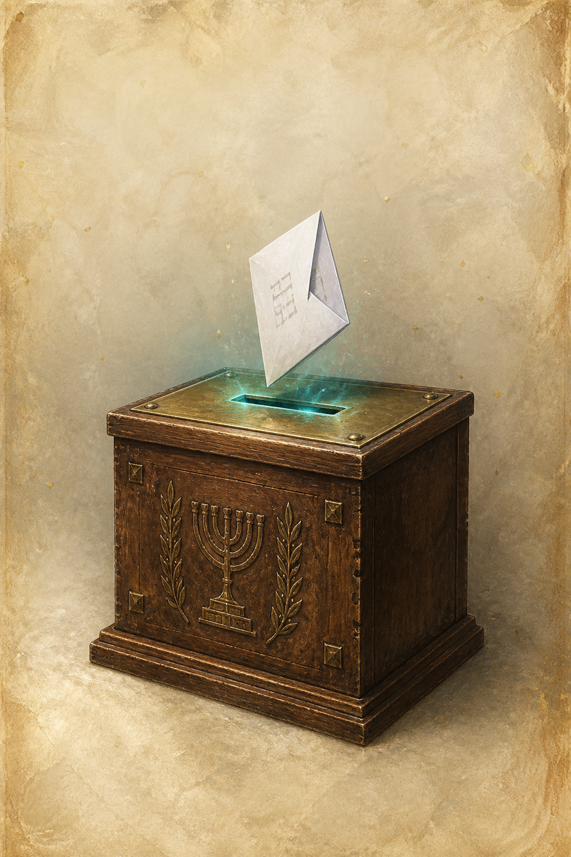


PLAY IT
Alpha: pack, flip, binder. 28 sourced cards. Server pulls the pack — the player does not invent it.
Kalpi · pitch
20 / 23

Slide 21
PROGRESSION IS LEARNING
Image. Name. Two swipes. Five minutes.
What do they do? Which list? Both right → extra pack. Optional survey → a pack of that party’s politicians. Daily rip is habit. Literacy is how you get ahead.
Kalpi · pitch
21 / 23

Slide 22
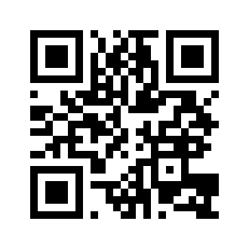
THE ENDS JUSTIFY THE MEANS
Empty of lore. Full of cause.
Jams usually reward heart in the fiction. This is viral on purpose. The civic goal is the message. Prior jams: guygir.itch.io
Kalpi · pitch
22 / 23

Slide 23
27 OCTOBER 2026
Assume the gap. Give them a pack they will open.
If this should leave the room, it needs to be live in September — free, Hebrew, seeded where 18–24 already are.
Kalpi · pitch
23 / 23

