Slide 1
VERSION B · THE STORY
Who does not reach the kalpi.
And a pack of cards that might change that before 27 October.
Kalpi · story v2
1 / 14

Slide 2
THE LAST OFFICIAL NUMBER
46.7%
of 18–24s voted after 2021.
74.9%
of 65–74s did.
Knesset Research and Information Center, 2022.
Kalpi · story v2
2 / 14

Slide 3
THAT IS THE ISSUE
Not a vibe. A 28-point age gap.
National turnout in 2022 was 70.6%. Young adults are a different electorate. The youth rate has been rising, and they vote more than young Europeans. The gap with older Israelis is still the fact.
Kalpi · story v2
3 / 14

Slide 4
THIS YEAR
~600k
first-timers. About six seats.
595–640 thousand people aged 18–22. 8.7% of the roll. Election day 27 October 2026.
Kalpi · story v2
4 / 14

Slide 5
THE HEADLINE YOU WILL HEAR
“This year they say they will vote.”
IDI, May 2026: 80–95% of first-timers intend to. Hold that number. It is not a forecast.
Kalpi · story v2
5 / 14

Slide 6
BECAUSE SURVEYS ALWAYS LOOK LIKE THAT
2013: 88% intended. 92% later said they voted. 67.8% actually did.
Same institute (IDI). Ages 18–22 were already the most likely to stay home. Vote questions run hot. Official counts do not.
Kalpi · story v2
6 / 14

Slide 7
WORKING ASSUMPTION
Youth turnout will still be low.
Even if 2026 is a few points above 46.7%, it is still low versus older adults. Then the second job: the slip has to be informed.
Kalpi · story v2
7 / 14

Slide 8
THE AUDIENCE
18–24. First-timers. Feed politics.
Social is their #1 political source. Most do not seek it. They distrust parties. They do not live in manifesto PDFs.
Kalpi · story v2
8 / 14

Slide 9
WHAT CHARACTERIZES THEM
47 seconds. Dopamine. Viral or invisible.
Gloria Mark: average screen focus is 47 seconds, median 40. Age of wars and TikTok. If it is not a daily loop, it is a lecture they will not finish.
Kalpi · story v2
9 / 14

Slide 10
WHAT ALREADY WORKS
They already collect cards.
Pokémon TCG Pocket is collection-first, global, daily rips. State Makers sold out a 98-card Israeli history set. We point that format at this election.
Kalpi · story v2
10 / 14

Slide 11
THEREFORE
Kalpi.
A free digital collect-only TCG of the lists. Daily pack. The rip is bait. The back is the lesson. Show up on 27 October.
Kalpi · story v2
11 / 14

Slide 12
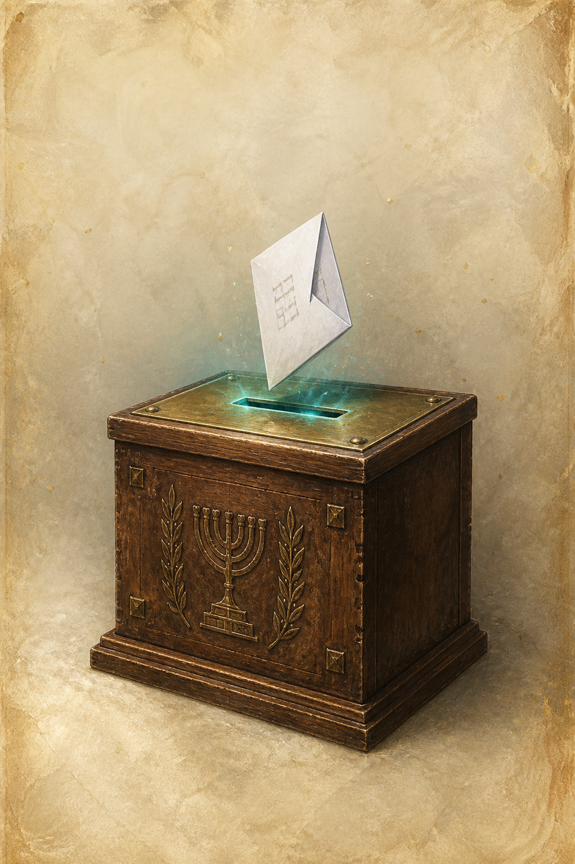
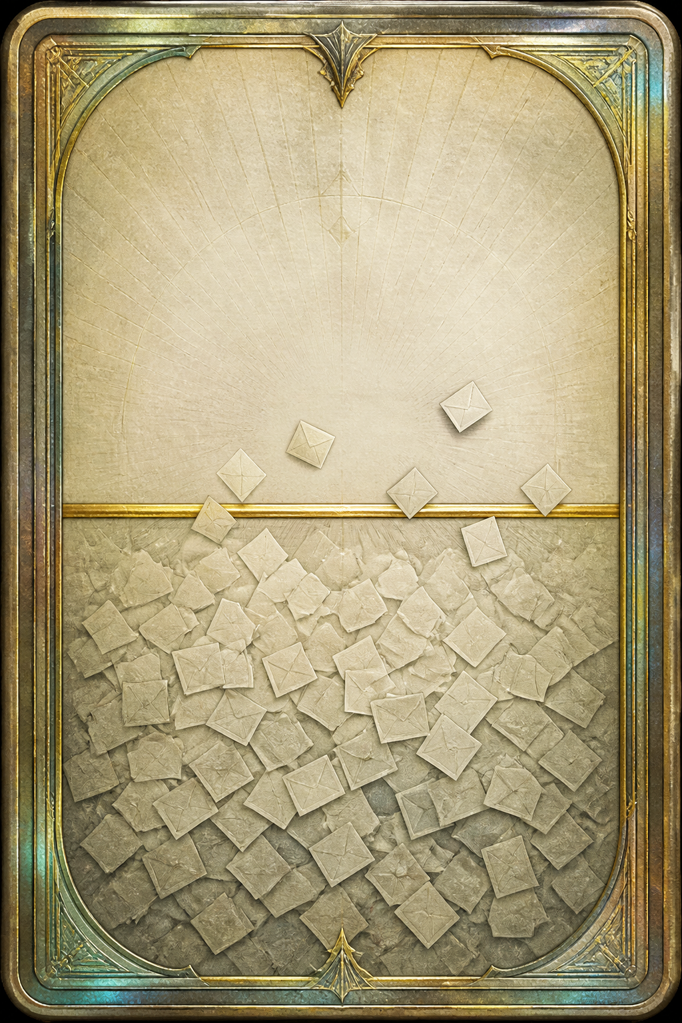

THE RIP
Collect only. Equal sets. No lore. No battles. Flip the back — that beat is the product.
Kalpi · story v2
12 / 14

Slide 13
ON THE ART
Yes, it is AI. The election is in eight weeks.
This community often prefers hand-made art. We are not claiming AI is more original. Lists file 9 September. Virality needs weeks. Hand-painting every member of every list is how you miss October. The cause is the deadline.
Kalpi · story v2
13 / 14

Slide 14
27 OCTOBER 2026
Assume the gap. Then give them a pack they will open.
Official youth turnout has been 46.7%. Surveys will always say 90. Free. Equal. Informed slip. Then show up.
Kalpi · story v2
14 / 14

