Slide 1

Cloth Simulation
CSE169: Computer Animation
Instructor: Steve Rotenberg
UCSD, Winter 2005

Slide 2
Cloth Simulation
Cloth simulation has been an important topic in computer animation since the early 1980’s
It has been extensively researched, and has reached a point where it is *basically* a solved problem
Today, we will look at a very basic method of cloth simulation. It is relatively easy to implement and can achieve good results. It will also serve as an introduction to some more advanced cloth simulation topics.

Slide 3
Cloth Simulation with Springs
We will treat the cloth as a system of particles interconnected with spring-dampers
Each spring-damper connects two particles, and generates a force based on their positions and velocities
Each particle is also influenced by the force of gravity
With those three simple forces (gravity, spring, & damping), we form the foundation of the cloth system
Then, we can add some fancier forces such as aerodynamics, bending resistance, and collisions, plus additional features such as plastic deformation and tearing

Slide 4
Cloth Simulation
•
•
•
•
Particle
•
•
•
Spring-damper
•
•
•

Slide 5


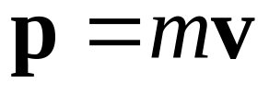
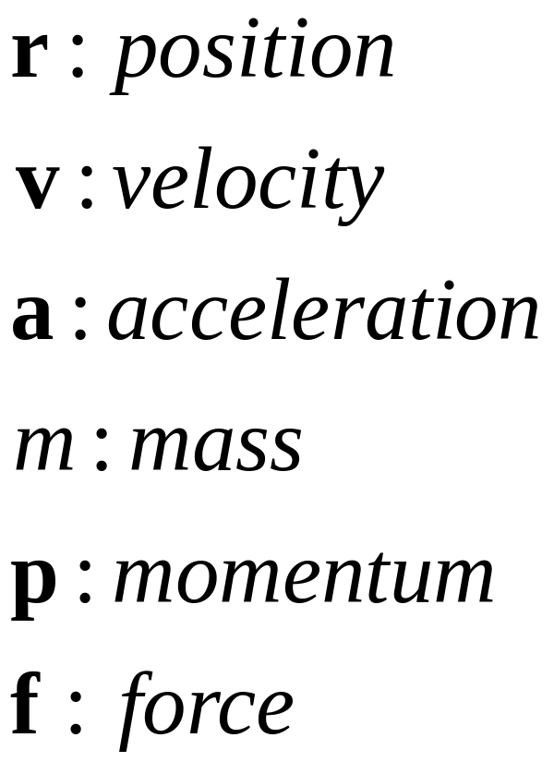
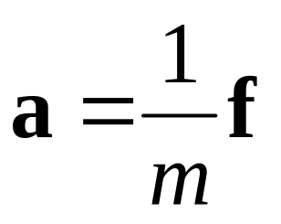
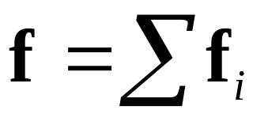
Particle
•

Slide 6
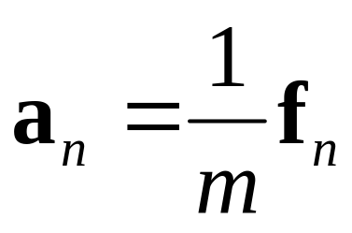
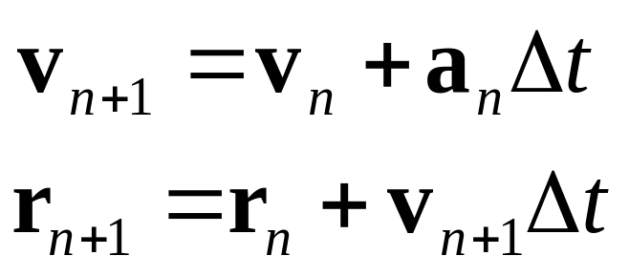
Euler Integration
Once we’ve computed all of the forces in the system, we can use Newton’s Second Law (f=ma) to compute the acceleration
Then, we use the acceleration to advance the simulation forward by some time step Δt, using the simple Euler integration scheme

Slide 7
Physics Simulation
General Physics Simulation:
1. Compute forces
2. Integrate motion
- Repeat

Slide 8
Cloth Simulation
1. Compute Forces
For each particle: Apply gravity
For each spring-damper: Compute & apply forces
For each triangle: Compute & apply aerodynamic forces
2. Integrate Motion
For each particle: Apply forward Euler integration

Slide 9
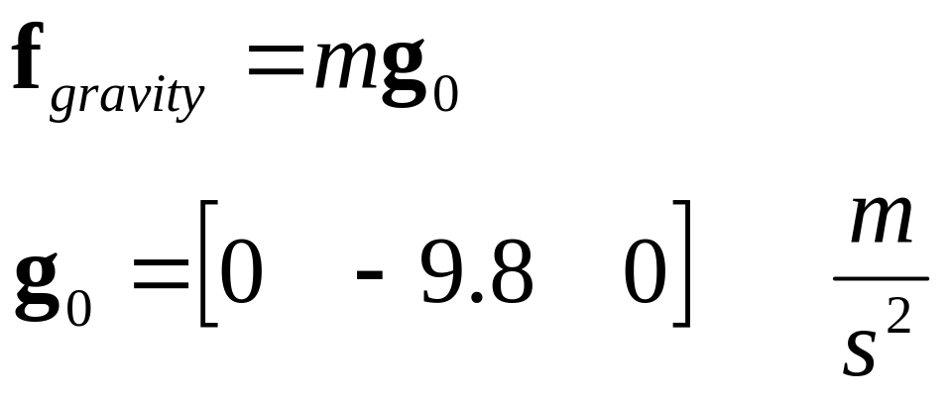
Uniform Gravity

Slide 10

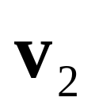

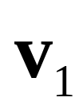
Spring-Dampers
The basic spring-damper connects two particles and has three constants defining its behavior
  Spring constant: k_{s}
  Damping factor: k_{d}
  Rest length: l₀
•
•

Slide 11
Spring-Damper
A simple spring-damper class might look like:
class SpringDamper {
float SpringConstant,DampingFactor;
float RestLength;
Particle *P1,*P2;
public:
void ComputeForce();
};

Slide 12
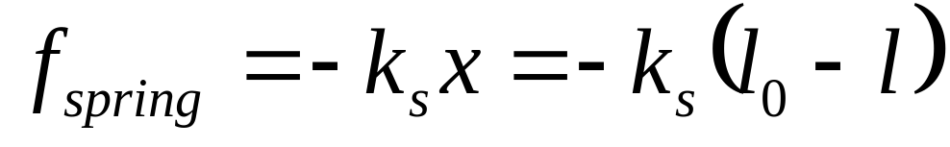
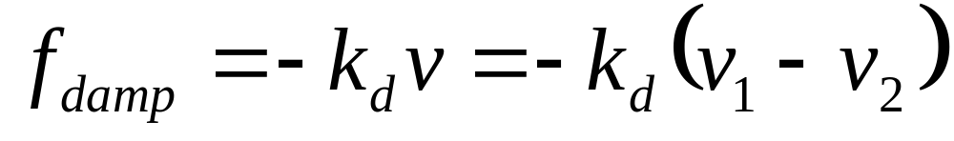
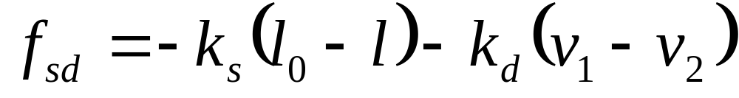
Spring-Dampers
The basic linear spring force in one dimension is:
The linear damping force is:
We can define a spring-damper by just adding the two:

Slide 13
Spring-Dampers
To compute the forces in 3D:
  Turn 3D distances & velocities into 1D
  Compute spring force in 1D
  Turn 1D force back into 3D force

Slide 14
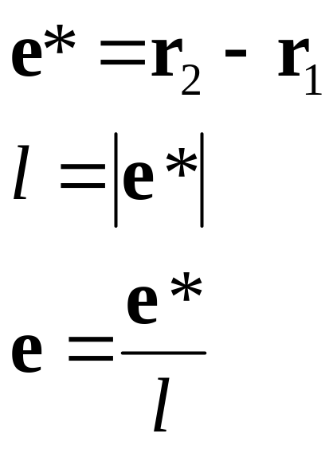


Spring-Damper Force
We start by computing the unit length vector e from r₁ to r₂
We can compute the distance l between the two points in the process
•
•

Slide 15
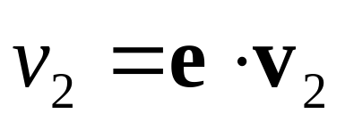
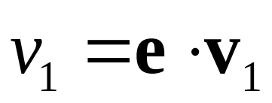
Spring-Dampers
Next, we find the 1D velocities
•
•

Slide 16
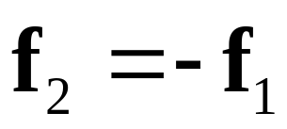
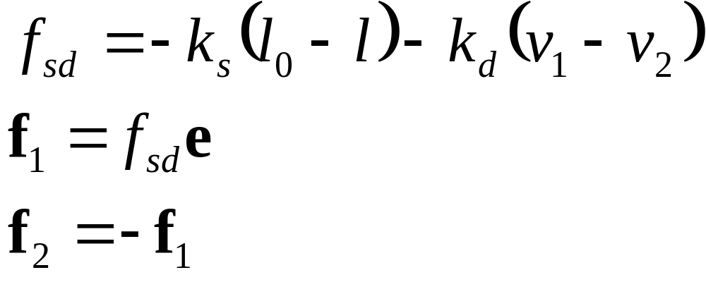
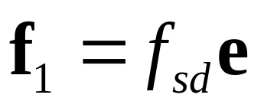
Spring-Dampers
Now, we can find the 1D force and map it back into 3D
•
•

Slide 17
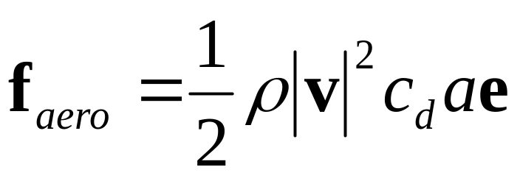
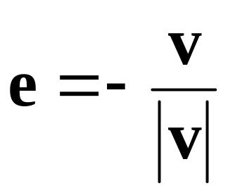
Aerodynamic Force
In the last lecture, we defined a simple aerodynamic drag force on an object as:
ρ: density of the air (or water…)
c_{d}: coefficient of drag for the object
a: cross sectional area of the object
e: unit vector in the opposite direction of the velocity

Slide 18
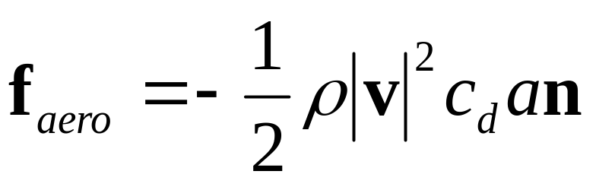
Aerodynamic Force
Today we will extend that to a simple flat surface
Instead of opposing the velocity, the force pushes against the normal of the surface
Note: This is a major simplification of real aerodynamic interactions, but it’s a good place to start

Slide 19

Aerodynamic Force
In order to compute the aerodynamic forces, we need surfaces to apply it to
We will add some triangles to our cloth definition, where each triangle connects three particles

Slide 20
Aerodynamic Force
In order to compute our force:
we will need find the velocity, normal, and area of the triangle (we can assume that ρ and c_{d} are constants)

Slide 21

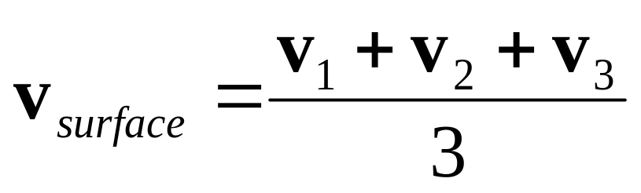
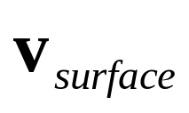
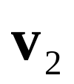
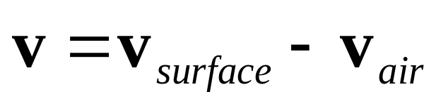
Aerodynamic Force
For the velocity of the triangle, we can use the average of the three particle velocities
We actually want the relative velocity, so we will then subtract off the velocity of the air

Slide 22
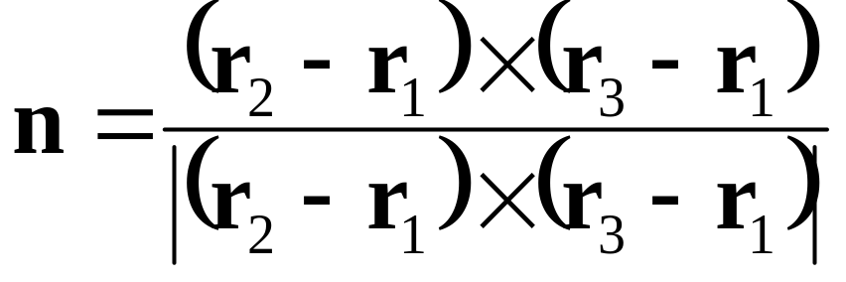

Aerodynamic Force
The normal of the triangle is:

Slide 23
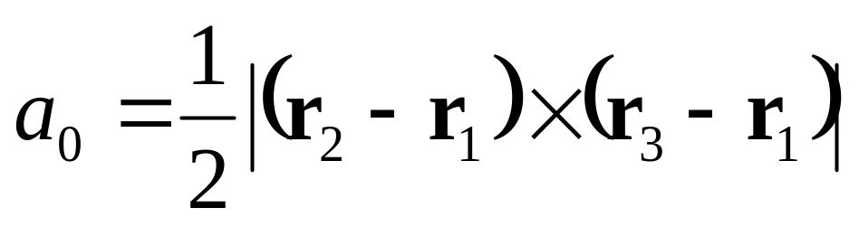
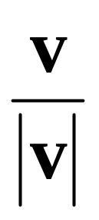
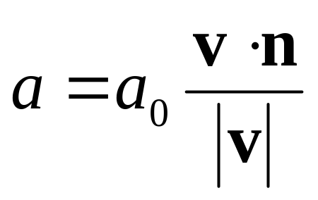
Aerodynamic Force
The area of the triangle is:
But we really want the cross-sectional area (the area exposed to the air flow)

Slide 24
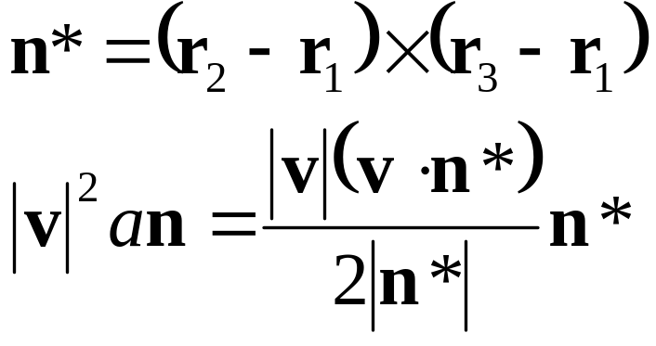
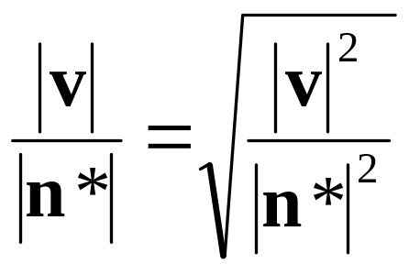
Aerodynamic Force
As the final equation requires |v|²an, we can reduce the math a little bit:
Also, notice that:

Slide 25
Aerodynamic Force
The final aerodynamic force is assumed to apply to the entire triangle
We can turn this into a force on each particle by simply dividing by 3, and splitting the total force between them

Slide 26
Bending Forces
If we arrange our cloth springs as they are in the picture, there will be nothing preventing the cloth from bending
This may be find for simulating softer cloth, but for stiffer materials, we may want some resistance to bending
•
•
•
•
•
•
•
•
•

Slide 27
Bending Forces
A simple solution is to add more springs, arranged in various configurations, such as the one in the picture
The spring constants and damping factors of this layer might need to be tuned differently…
•
•
•
•
•
•
•
•
•

Slide 28
Collisions
We will talk about collision detection & response in the next lecture…
In the mean time, here’s a very basic way to collide with a y=y₀ plane
If(r.y < y₀) {
r.y= y₀ - r.y;
v.y= - elasticity * v.y;
v.x= (1-friction) * v.x; // cheezy
v.z= (1-friction) * v.z; // cheezy
}

Slide 29
Plastic Deformation
An elastic deformation will restore back to its un-deformed state when all external forces are removed (such as the deformation in a spring, or in a rubber ball)
A plastic deformation is a permanent adjustment of the material structure (such as the buckling of metal)

Slide 30
Plastic Deformation
We can add a simple plastic deformation rule to the spring-dampers
We do so by modifying the rest length
Several possible rules can be used, but one simple way is to start by defining an elastic limit and plastic limit
The elastic limit is the maximum deformation distance allowed before a plastic deformation occurs
If the elastic limit is reached, the rest length of the spring is adjusted so that meets the elastic limit
An additional plastic limit prevents the rest length from deforming beyond some value
The plastic limit defines the maximum distance we are allowed to move the rest length

Slide 31
Fracture & Tearing
We can also allow springs to break
One way is to define a length (or percentage of rest length) that will cause the spring to break
This can also be combined with the plastic deformation, so that fracture occurs at the plastic limit
Another option is to base the breaking on the force of the spring (this will include damping effects)
It’s real easy to break individual springs, but it may require some real bookkeeping to update the cloth mesh connectivity properly…

Slide 32
Ropes & Solids
We can use this exact same scheme to simulate ropes, solids, and similar objects
•
•
•
•
•
•
•
•
•
•
•
•
•

Slide 33
System Stability

Slide 34
Conservation of Momentum
As real springs apply equal and opposite forces to two points, they obey conservation of momentum
Our simple spring-damper implementation should actually guarantee conservation of momentum, due to the way we explicitly apply the equal and opposite forces
(This assumes that everything says within reasonable floating point ranges and we don’t suffer from excessive round-off)

Slide 35
Conservation of Energy
True linear springs also conserve energy, as the kinetic energy of motion can be stored in the deformation energy of the spring and later restored
The dampers, however are specifically intended to remove kinetic energy from the system
Our simple implementation using Euler integration is not guaranteed to conserve energy, as we never explicitly deal with it as a quantity

Slide 36
Conservation of Energy
If we formulate the equations correctly and take small enough time steps, the system will hopefully conserve energy approximately
In practice, we might see a gradual increase or decrease in system energy over time
A gradual decrease of energy implies that the system damps out and might eventually come to rest. A gradual increase, however, it not so nice…

Slide 37
Conservation of Energy
There are particle schemes that conserve energy, and other schemes that preserve momentum (and/or angular momentum)
It’s possible to conserve all three, but it becomes significantly more complicated
This is important in engineering applications, but less so in entertainment applications
Also, as we usually want things to come to rest, we explicitly put in some energy loss through controlled damping
Still, we want to make sure that our integration scheme is stable enough not to gain energy

Slide 38
Simulation Stability
If the simulation ‘blows up’ due to artificial energy gains, then it is said to be unstable
The basic Euler integration scheme is the simplest, but can easily become unstable and require very small time steps in order to produce useful results
There are many other integration schemes that improve this behavior
We will only briefly mention these now, but might go over them in more detail in a future lecture

Slide 39
Integration
There are many methods of numerical integration. Some examples are:
  Explicit Euler
  Implicit Euler
  Midpoint (Leapfrog)
  Crank-Nicolson
  Runge-Kutta
  Adams-Bashforth, Adams-Moulton
  etc…

Slide 40
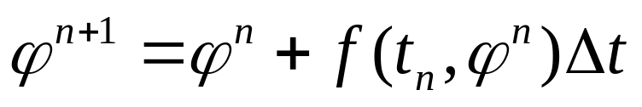
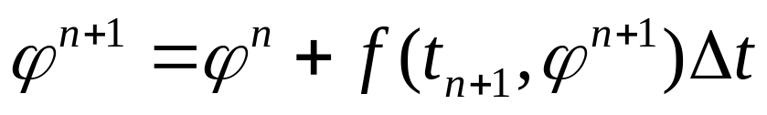
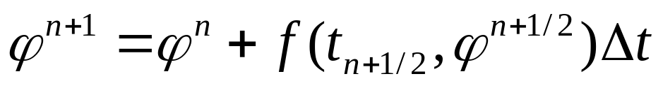
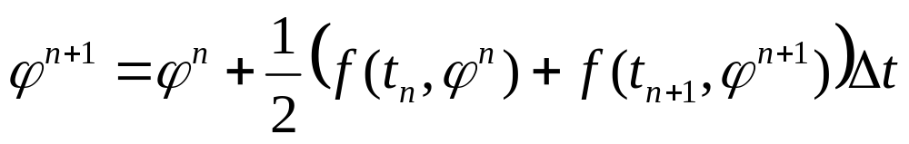
Two-Level Integration Methods
Explicit Euler:
Implicit Euler
Midpoint (Leapfrog):
Crank-Nicolson:

Slide 41
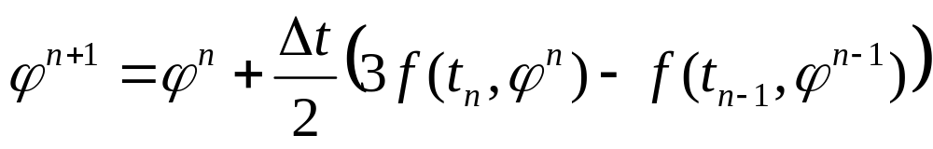
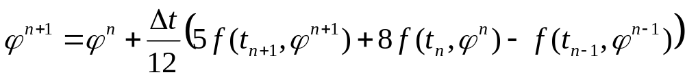
Multipoint Methods
Multipoint methods fit a polynomial to several values in time. Adams-Bashforth methods use only previous values, while Adams-Moulton combine these with implicitly computed future points.
Second order Adams-Bashforth:
Third order Adams-Moulton:

Slide 42
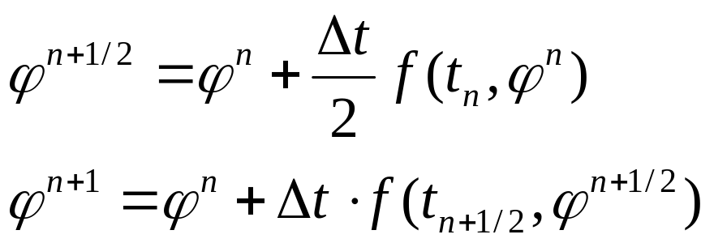
Runge-Kutta Methods
The Runge-Kutta integration methods compute the value at step n+1 by computing several partial steps between n and n+1 and then constructing a polynomial to get the final value at n+1
Second order Runge-Kutta:

Slide 43
Cloth Stability
To make our cloth stable, we should choose a better integration scheme (such as adaptive time-step fourth order Runge-Kutta)
It’s actually not quite as bad as it sounds
But, in the mean time, some other options include:
  Oversampling: For one 1/60 time step, update the cloth several times at smaller time steps (say 10 times at 1/600), then draw once
  Tuning numbers: High spring constants and damping factors will increase the instability. Lowering these will help, but will also make the cloth look more like rubber…

Slide 44
Advanced Cloth

Slide 45
Continuum Mechanics
Real cloth simulation rarely uses springs
Instead, forces are generated based on the the deformation of a triangular element
This way, one can properly account for internal forces within the piece of cloth based on the theory of continuum mechanics
The basic process is still very similar. Instead of looping through springs computing forces, one loops through the triangles and computes the forces
Continuum models account for various properties such as elastic deformation, plastic deformation, bending forces, anisotropy, and more

Slide 46
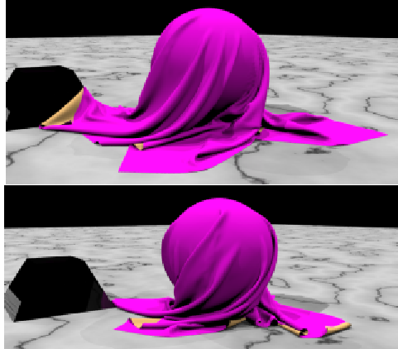
Collision Detection & Response
Cloth colliding with rigid objects is tricky
Cloth colliding with itself is even trickier
There have been several published papers on robust cloth collision detection and response methods

Slide 47
Integration
Nobody uses forward Euler integration for cloth in the real world
Modern systems use adaptive time steps, high order interpolation, and implicit integration schemes

