Slide 1
Dataset overview
October IDHP update (2021.1 – 2022.9) |  | November IDPH update (2020.4 – 2022.11)
EMresourcesdata_WW_surveilance.csv | CovidRegionID,Hospital_name,reported_date,TotalBeds,TotalBedsAvailable,TotalBedsInUse,TotalBedsByCOVID,TotalBedsByNonCOVID,NonICUCovidPatients,ICUCapacity,ICUAvail,ICUBedsNONCOVID,ICUBedsCovidPatients,VentsCapacity,VentsAvail,VentsInUse,VentsCovidPatients | EMResource_hosp_WW_byzip.csv | Region,Empty_Adult_ICU,Total_Adult_ICU_Beds, …Total_Avail,Confirmed COVID Pt's in ICU:,Confirmed COVID Pt's on Vents:,Suspected COVID Pt's in ICU:,Suspected COVID Pt's on Vents:,Confirmed COVID Deaths Prev 24 hrs,COVID or PUI in non-ICU beds
Admissions_WW_surveilance.csv | date,CovidRegionID,count_rolling_7day_mean | Cases_WW_2022_11_10.csv | Admission data can be derived from the sensitive line-listed data based on zipcode; however, there is no COVID-like illness information.

Slide 2
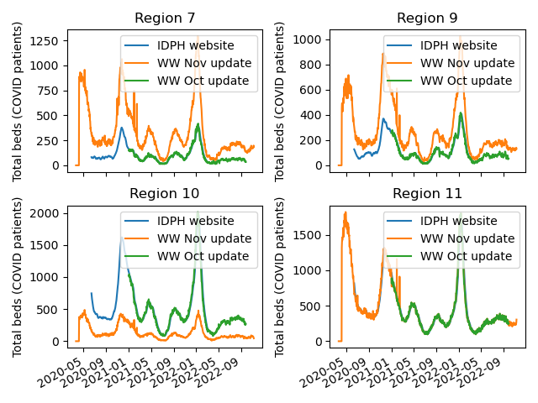
 | Oct update | Nov update
Region 7 | Kankakee, Will | SouthwestSuburbsHospitals
Region 9 | Lake, McHenry | NorthwestSuburbsHospitals
Region 10 | Cook | NortheastSuburbsHospitals
Region 11 | Chicago | Chicago

Slide 3
Questions about the datasets
Which dataset is divided based on the covid regions / EM regions?
Based on our knowledge, the difference between the covid regions and the EM regions is how the collar Cook Counties are classified as part of Cook County. Which classification contains the collar Cook Counties?
For the Nov. updates, are there data available for each hospital in addition to the aggregated regional data?
For the Nov. updates, is there corresponding COVID-like illness admission data available for each region?

