Slide 1
RS232 to GUI Connect Manual(BRN)
GUI.exe Run as administrator
Comport Check in Divice Manager

Slide 2
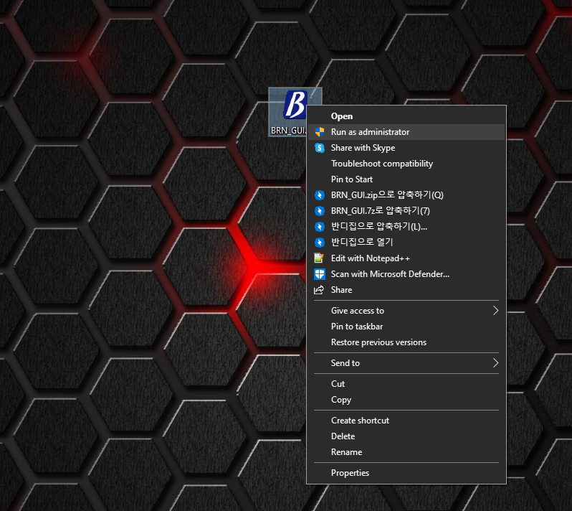
RS232 to GUI Connect Manual(BRN)
GUI.exe Run as administrator
Run GUI as administrator
(Operation may fail depending on Windows settings.
Run the first time as an administrator.)

Slide 3
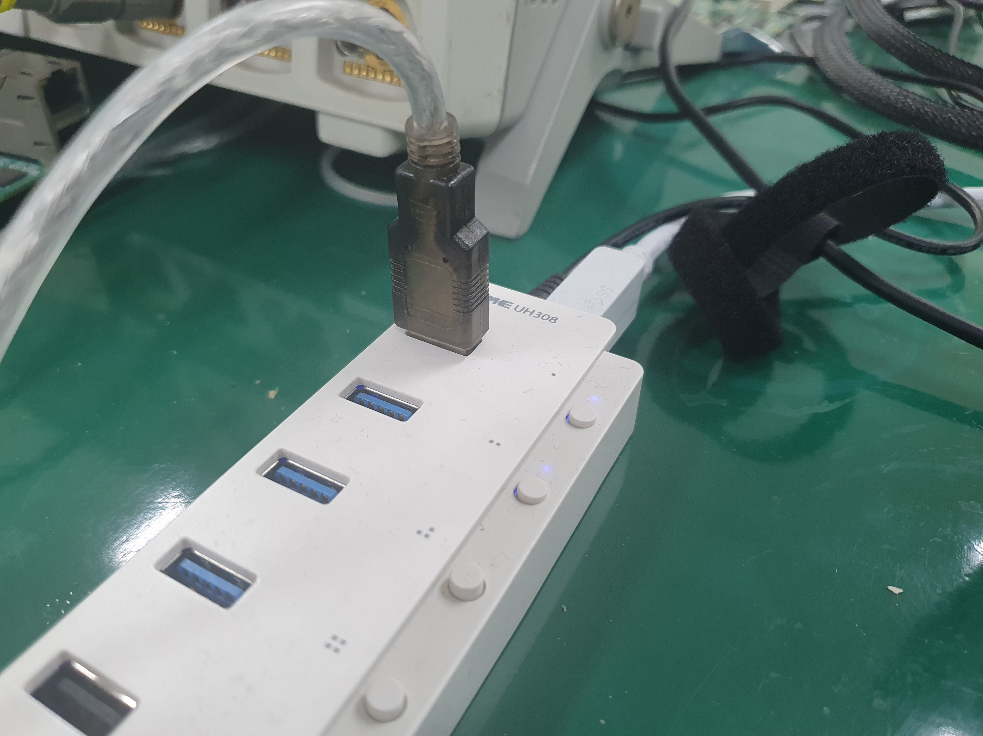
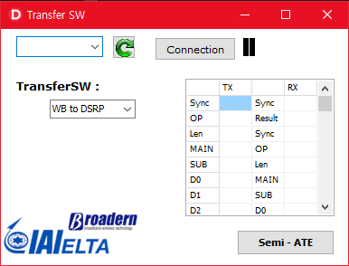
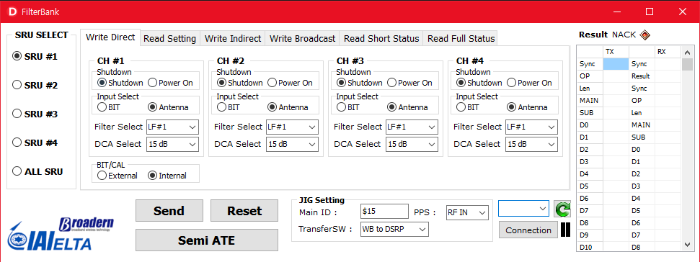
RS232 to GUI Connect Manual(BRN)
2. Comport Check and Divice Manager
1. Cable(KW-825) Connect Check
2. click (Refresh) Button
3. Scroll Combo Box
If you can't check the Comport, you need to check with the device manager.

Slide 4
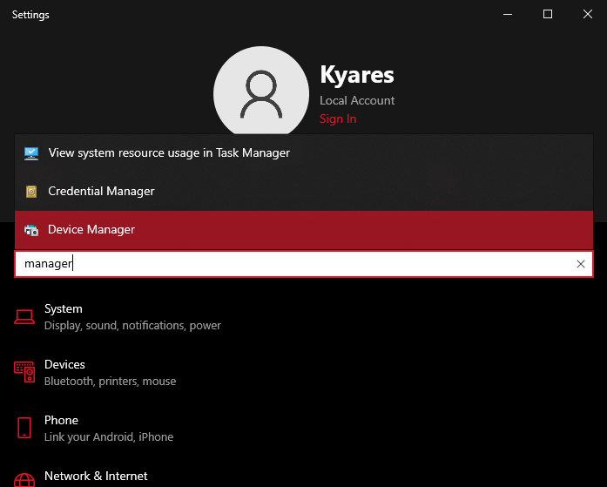
RS232 to GUI Connect Manual(BRN)
2. Comport Check and Divice Manager
Run Device Manager
(May be rebooted!!! Please check saving other programs)

Slide 5
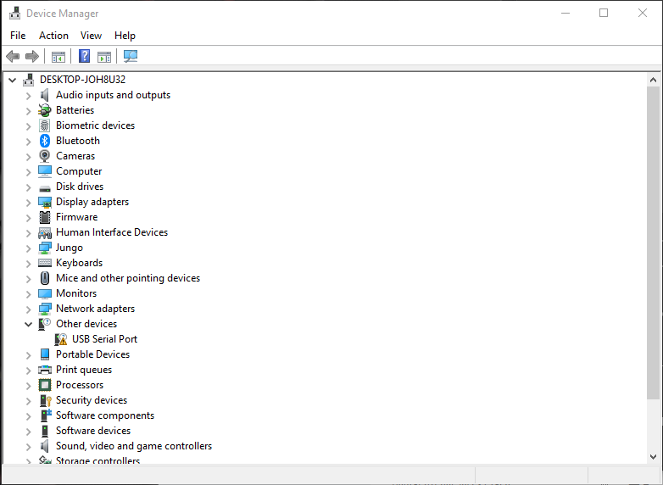

RS232 to GUI Connect Manual(BRN)
2. Comport Check and Divice Manager
If it is not connected, it looks like the following picture.
Should install the cable driver
(If it looks like the following example, go to Page 15)
example :
can be different(ComXX)

Slide 6
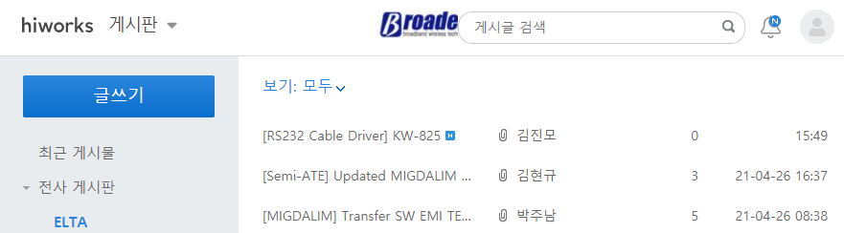
RS232 to GUI Connect Manual(BRN)
2. Comport Check and Divice Manager
Download Cable Driver

Slide 7
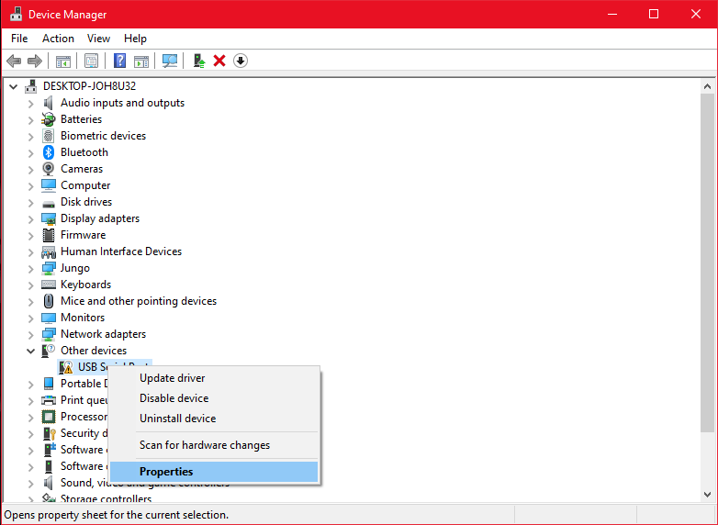
RS232 to GUI Connect Manual(BRN)
2. Comport Check and Divice Manager
Go back to the device manager
Open the properties

Slide 8
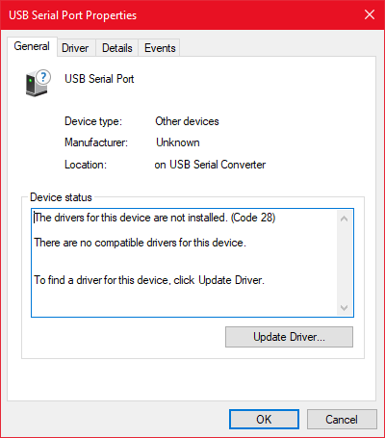
RS232 to GUI Connect Manual(BRN)
2. Comport Check and Divice Manager
Click Update Driver

Slide 9
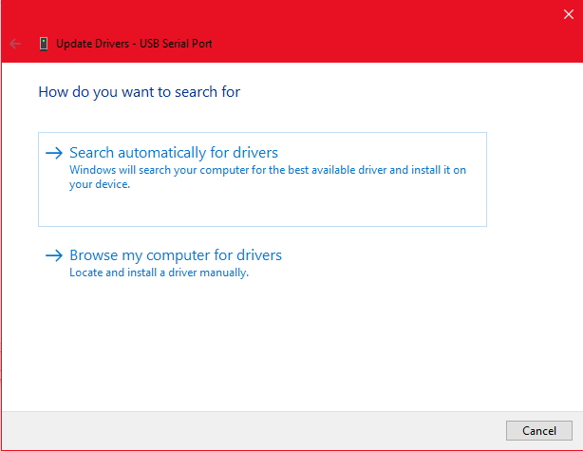
RS232 to GUI Connect Manual(BRN)
2. Comport Check and Divice Manager
Click
→Browse my computer for drivers

Slide 10
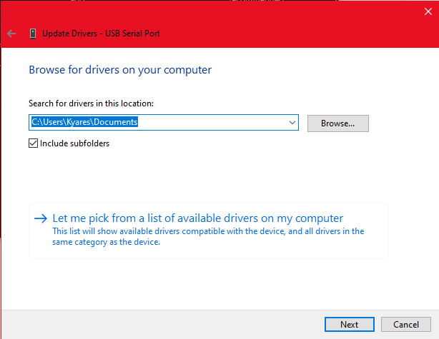
RS232 to GUI Connect Manual(BRN)
2. Comport Check and Divice Manager
Click Browse…

Slide 11
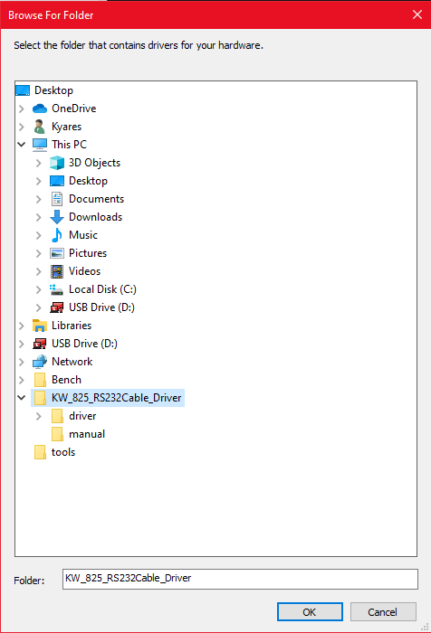
RS232 to GUI Connect Manual(BRN)
2. Comport Check and Divice Manager
Select Setup Folder
Click OK

Slide 12
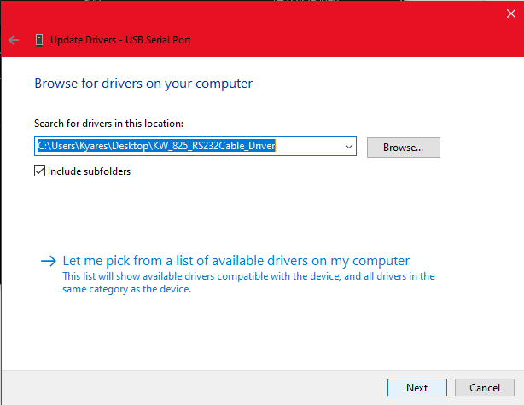
RS232 to GUI Connect Manual(BRN)
2. Comport Check and Divice Manager
Check folder path
Click Next Button

Slide 13
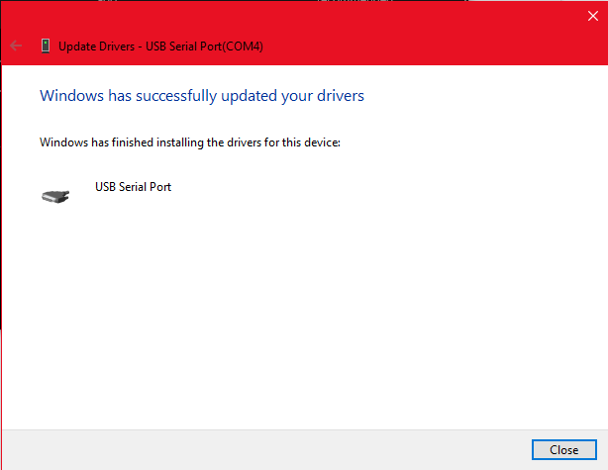
RS232 to GUI Connect Manual(BRN)
2. Comport Check and Divice Manager
Confirm driver installation
Click Close

Slide 14
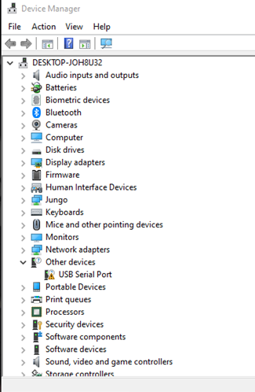
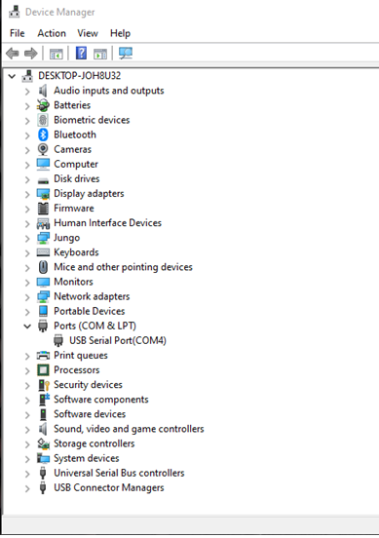
RS232 to GUI Connect Manual(BRN)
2. Comport Check and Divice Manager
Go back to the device manager
USB connection check
Before
After

Slide 15
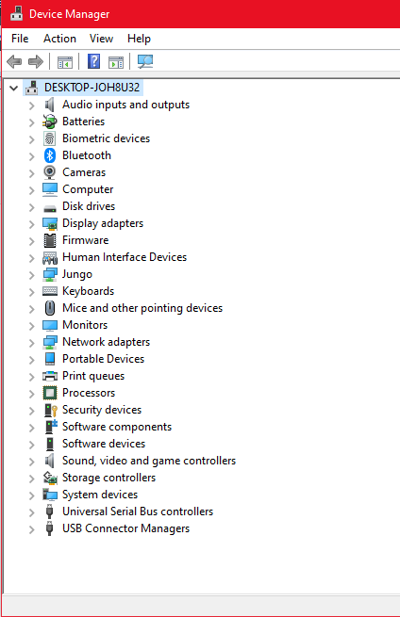
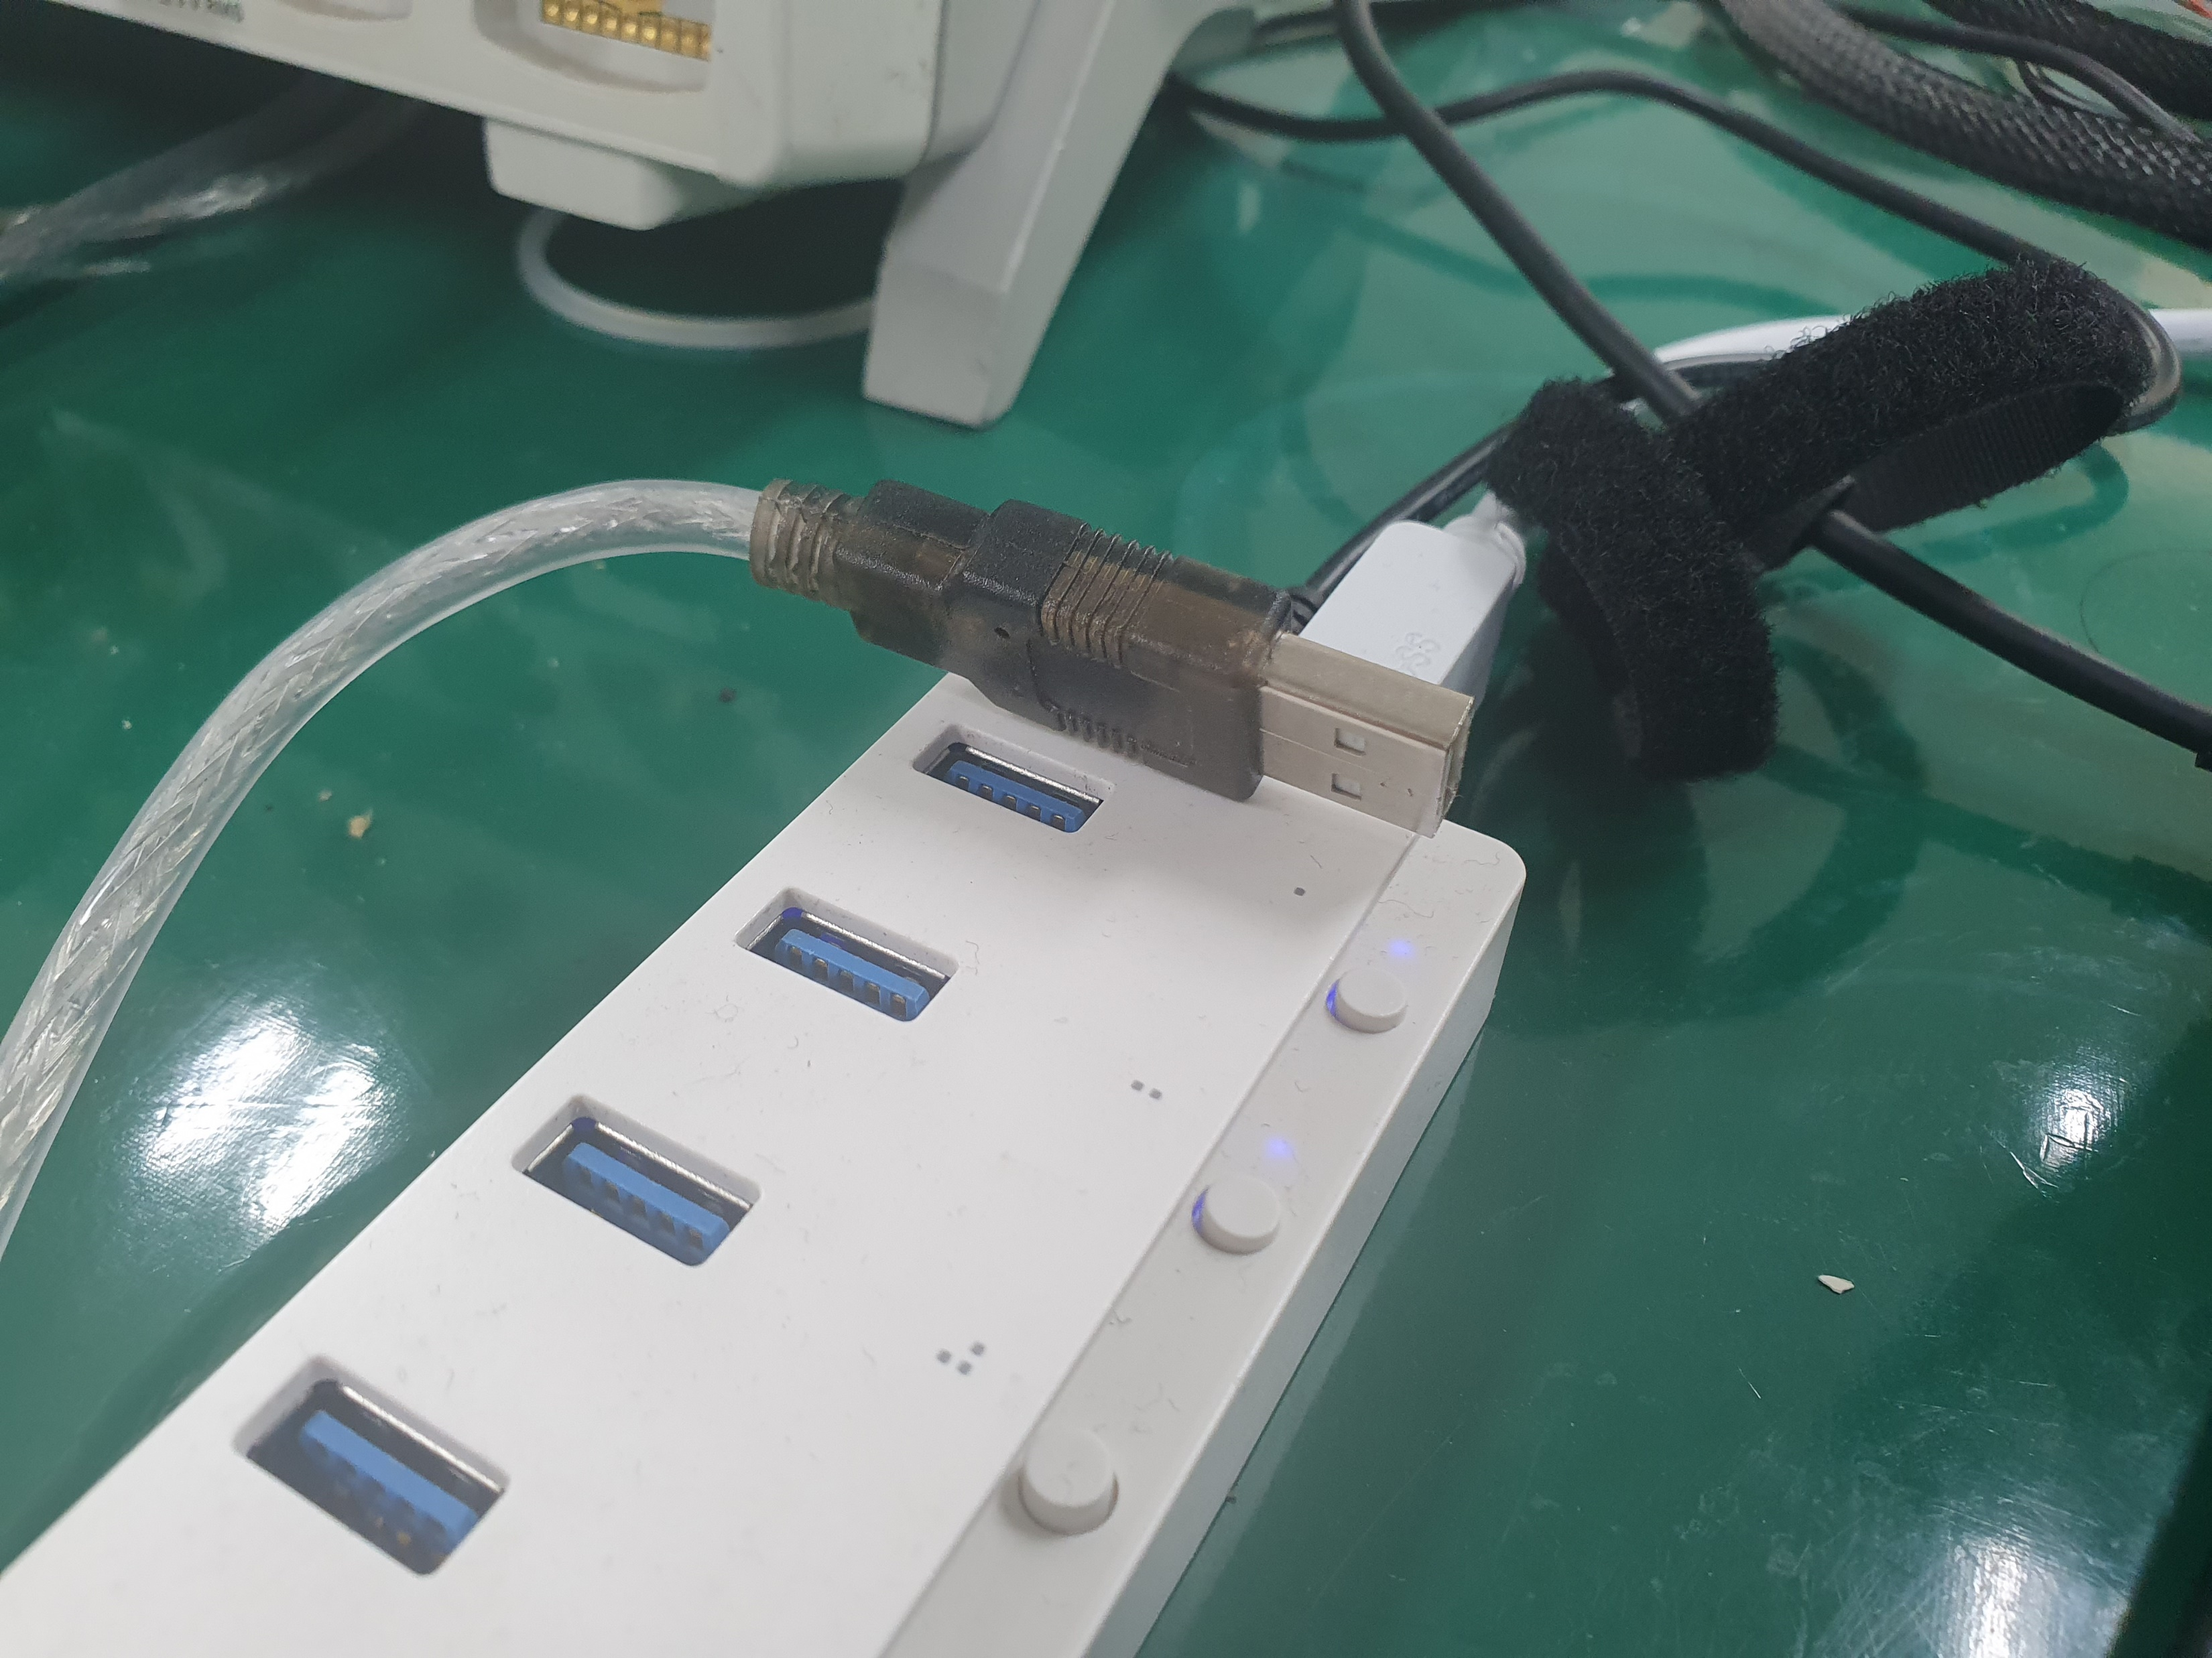

RS232 to GUI Connect Manual(BRN)
2. Comport Check and Divice Manager
Check if the USB
?

Slide 16
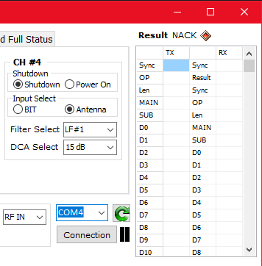
RS232 to GUI Connect Manual(BRN)
2. Comport Check and Divice Manager
Please Check your USB Comport Number
Communication is possible only when the USB ComPort number displayed in Device Manager is the same.
Same

Slide 17
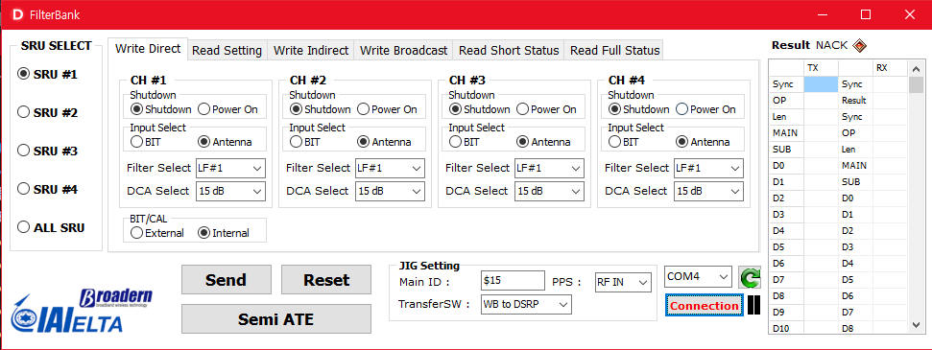
RS232 to GUI Connect Manual(BRN)
2. Comport Check and Divice Manager
Communication confirmation
You can see that it is connected. That's it. thank you

