Slide 1
Batch Whitening
For NLP

Slide 2
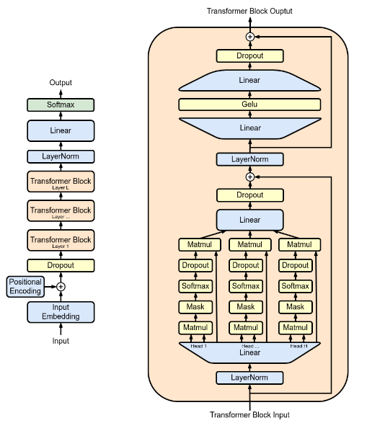
GPT 2 Architecture
https://en.m.wikipedia.org/wiki/File:Full_GPT_architecture.png
Multi-layer perceptron /
MLP
Multi-head masked attention / CausalSelfAttention

Slide 3
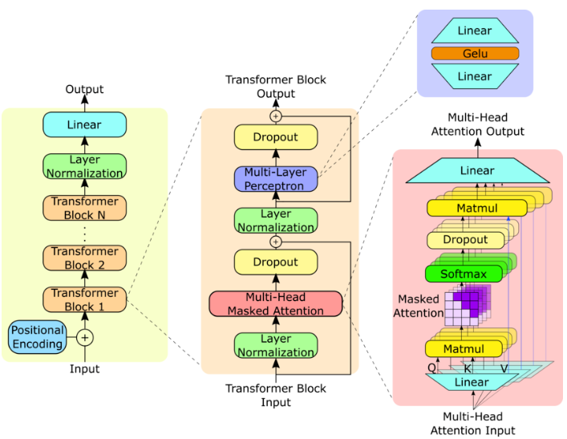
Similar
https://www.researchgate.net/figure/GPT-2-model-architecture-The-GPT-2-model-contains-N-Transformer-decoder-blocks-as-shown_fig1_373352176

Slide 4
Mean and STD Dimensions
Efficient net:
Convolution [B, C, H, W] : mean/std over C,H,W (shape=[1, C, 1, 1])
Fully connected [B, W] : mean/std oved B (shape=[1, W])
GPT:
[B, T, C] (batch, time/seq, channel/embedding size): mean/std over C (shape=B,T,1)
Example with LayerNorm for nano GPT2:
Input.shape = [64, 256, 384] (64 batch size, 256 seq/context size, 384 embedding)
F.layer_norm is called with normalized_shape=(384,), i.e. dim=1

