Slide 1

Household income prediction
based on the attributes of families
組員: 107590016 楊宗洺
107590020 朱柏霖
107590023 李承紘
107590037 應耀德
2020 / 12 / 28
Notes:
1

Slide 2
CONTENT
About the data
Preprocessing
Baseline (Logistic Regression)
Models (Decision Tree, Random Forest, MDC, KNN, SVM, XGBoost, SOM + XGBoost)
Evaluation
Conclusion
Notes:
2

Slide 3
ABOUT DATA
Type of file: A csv file
Source: Kaggle
Data provider: The Philippine Statistics Authority
Size:
21.61MB
60 columns
41544 rows
Each column represents:
one household attribute
Each row represents:
one household
https://www.kaggle.com/grosvenpaul/family-income-and-expenditure
Notes:
3

Slide 4
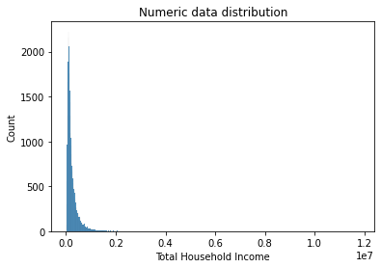
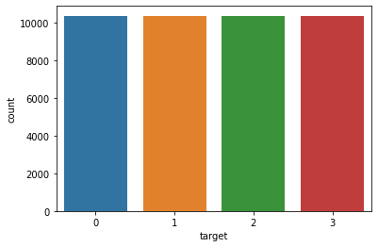
ABOUT DATA
Target: Split Total Household Income into 4 parts
Category 1
(11284.999, 104895.0] - (< 25% of the distribution)
Category 2
(104895.0, 164079.5] - (25%-50% of the distribution)
Category 3
(164079.5, 291138.5] - (50%-75% of the distribution)
Category 4
(291138.5, 11815988.0] - (> 75% of the distribution)
https://www.kaggle.com/grosvenpaul/family-income-and-expenditure
Notes:
4

Slide 5
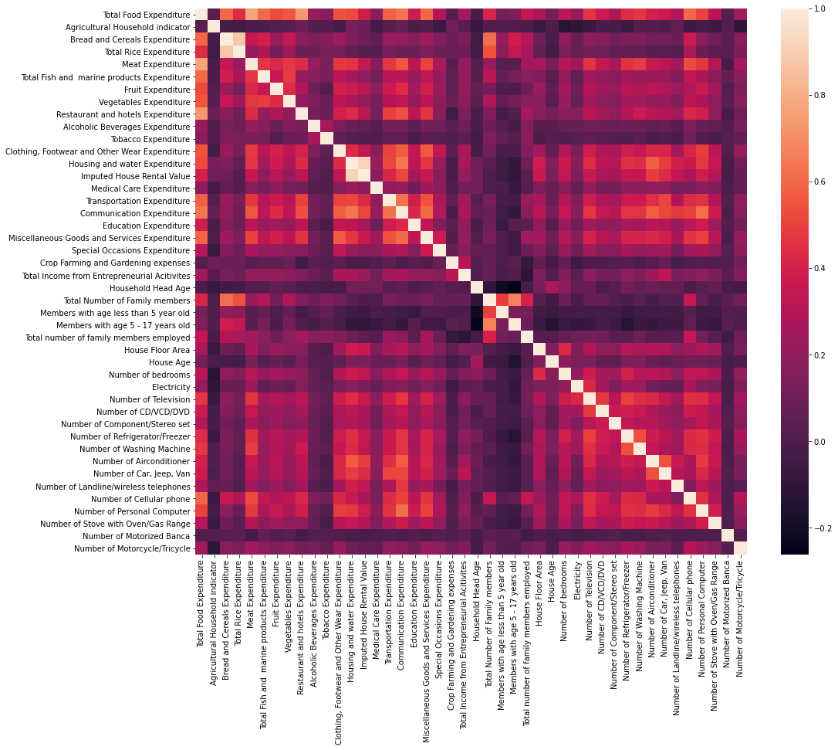
Features
Continuous attributes Total Household Income Total Food Expenditure Bread and Cereals Expenditure Bread and Cereals Expenditure Meat Expenditure Total Fish and marine products Expenditure Fruit Expenditure Vegetables Expenditure Restaurant and hotels Expenditure Alcoholic Beverages Expenditure Tobacco Expenditure Clothing, Footwear and Other Wear Expenditure | Housing and water Expenditure Imputed House Rental Value Medical Care Expenditure Transportation Expenditure Communication Expenditure Education Expenditure Miscellaneous Goods and Services Expenditure Special Occasions Expenditure Crop Farming and Gardening expenses Total Income from Entrepreneurial Activities House Floor Area
Notes:
5

Slide 6
Features
Discrete attributes Agricultural Household indicator Household Head Age Total Number of Family members Members with age less than 5 years old Members with age 5 - 17 years old Total number of family members employed House Age Number of bedrooms Number of Television Number of CD/VCD/DVD Number of Component/Stereo set Number of Refrigerator/Freezer Number of Washing Machine Number of Air conditioner Number of Car, Jeep, Van Number of Landline/wireless telephones Number of Cellular phone Number of Personal Computer Number of Stove with Oven/Gas Range Number of Motorized Banca | Number of Motorcycle/Tricycle Binary attributes Household Head Job or Business Indicator Electricity Nominal attributes Main Source of Water Supply Toilet Facilities Tenure Status Household Head Occupation Household Head Marital Status Region Household Head Sex Main Source of Income Household Head Highest Grade Completed Household Head Class of Worker Type of Household Type of Building/House Type of Roof Type of Walls
Notes:
6

Slide 7
Preprocessing
Data Cleaning
Data Integration
Label-Encoder - Target
One-Hot Encoder
Split data into train, validation, test
Data Normalization – MinMaxScaler
Feature selection
Notes:
7

Slide 8
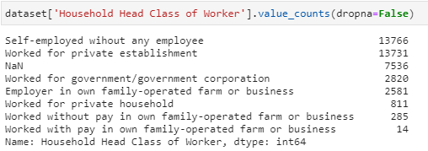
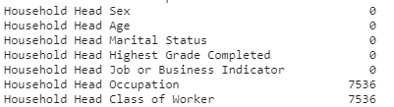
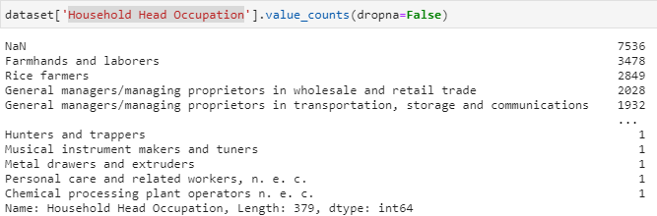
Preprocessing
Data Cleaning – Null Value & Fill N/A


Notes:
8

Slide 9
Preprocessing
Data Integration
Categorical attributes: 15
Numeric attributes: 43
One Hot Encoding – Categorical attributes
(15 → 134)
Main Source of Water Supply
Toilet Facilities
Tenure Status
Household Head Occupation
Household Head Marital Status
Region
Household Head Sex
Main Source of Income
Household Head Highest Grade Completed
Household Head Class of Worker
Type of Household
Type of Building/House
Type of Roof
Type of Walls
Label Encoding - Target
Target: Split Total Household Income into 4 parts
Category 1 #0
(11284.999, 104895.0] - (< 25% of the distribution)
Category 2 #1
(104895.0, 164079.5] - (25%-50% of the distribution)
Category 3 #2
(164079.5, 291138.5] - (50%-75% of the distribution)
Category 4 #3
(291138.5, 11815988.0] - (> 75% of the distribution)
Notes:
9

Slide 10
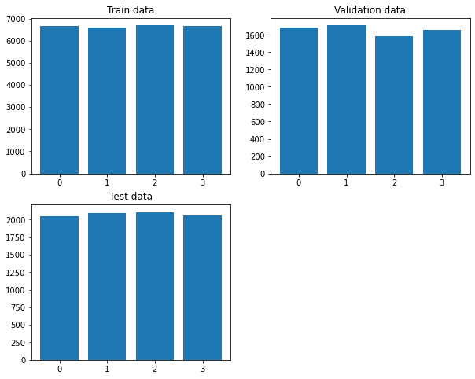
Preprocessing
Split data into train, validation, test subset
Train: 64%
Validation: 16%
Test: 20%
Data Normalization – MinMaxScaler
X_std = (X - X.min(axis=0)) / (X.max(axis=0) - X.min(axis=0))
X_scaled = X_std * (max - min) + min
Notes:
10

Slide 11
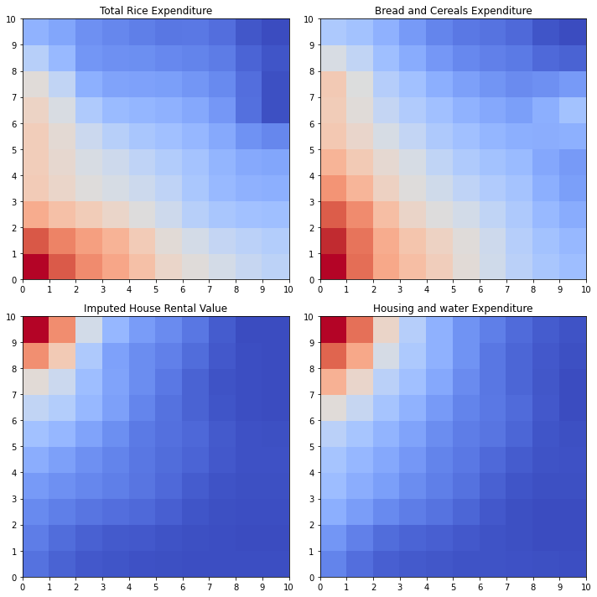
Feature Selection
Visual-based feature selection
Notes:
11

Slide 12
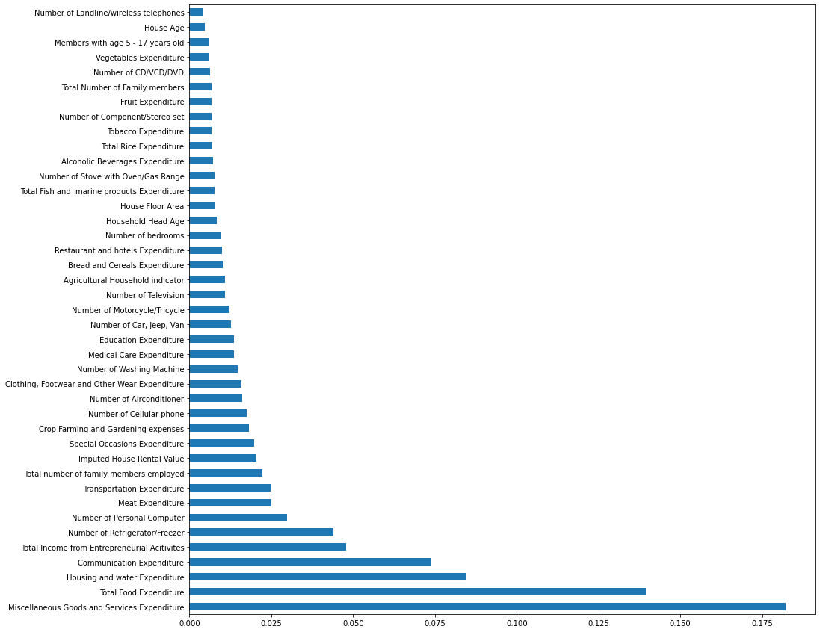
Feature Selection








(# of features: 177 – 2 = 175)
Notes:
12

Slide 13
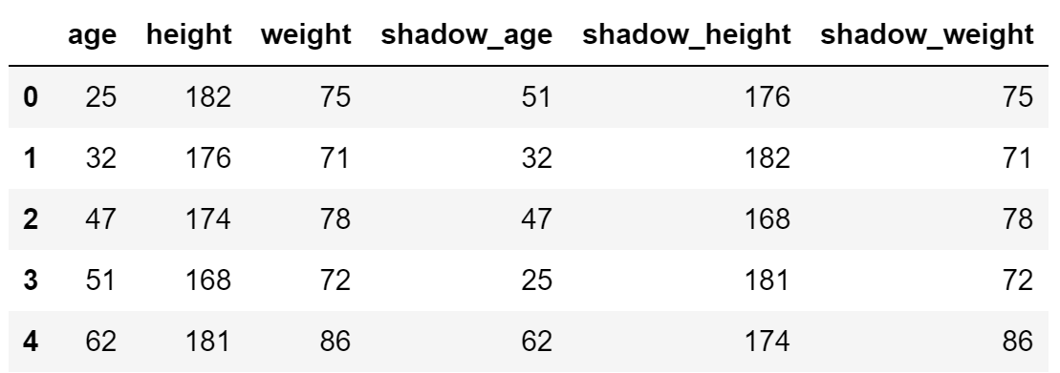
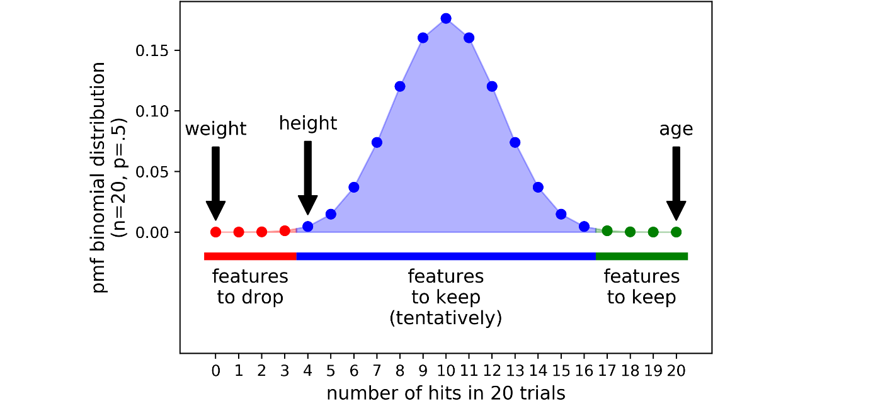
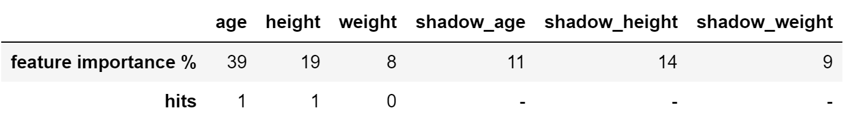
Feature Selection
Boruta Algorithm – based on Random Forest
1. Shadow data
2. Binomial distribution
Paper:
https://www.researchgate.net/publication/280138095_Feature_Selection_with_Boruta_Package
Notes:
13

Slide 14
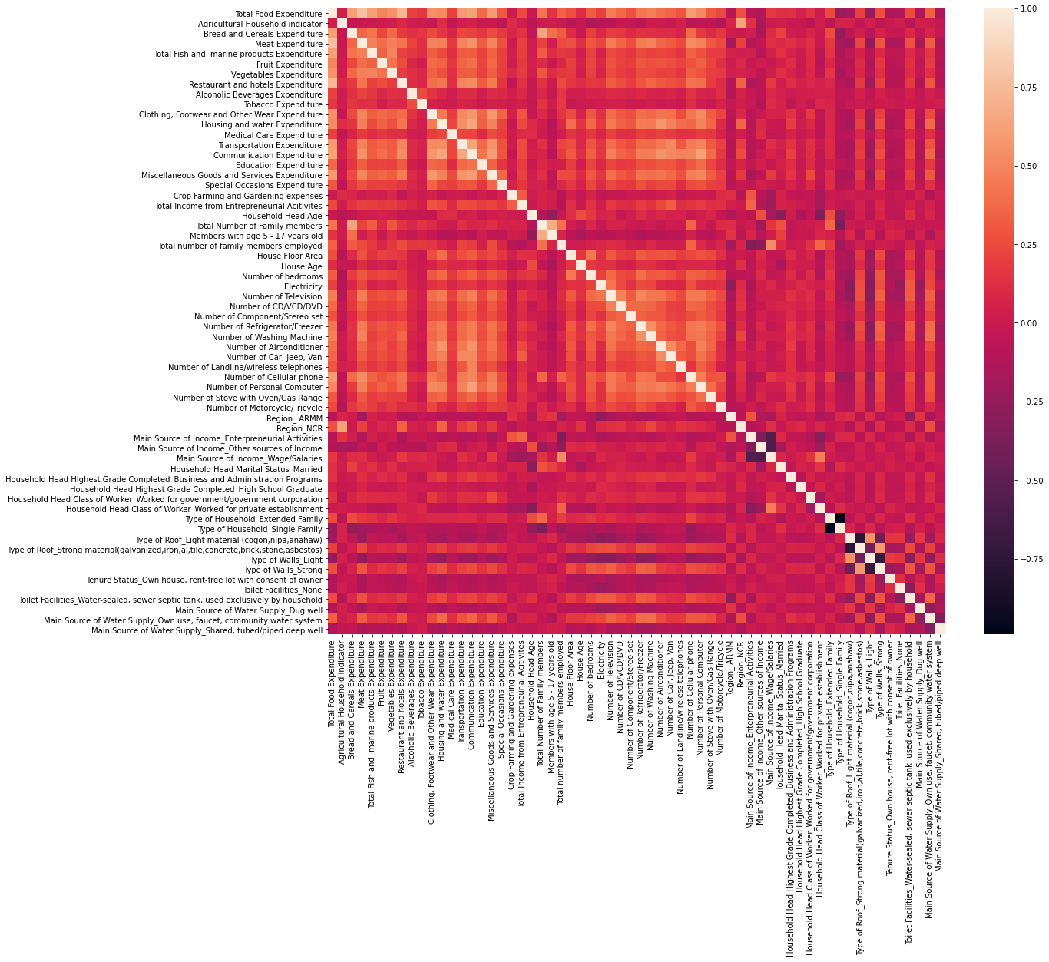
Feature Selection
# of features: 175 → 62 (max_depth=5)
Notes:
14

Slide 15
Selected Features
Total Food Expenditure Agricultural Household indicator Bread and Cereals Expenditure Meat Expenditure Total Fish and marine products Expenditure Fruit Expenditure Vegetables Expenditure Restaurant and hotels Expenditure Alcoholic Beverages Expenditure Tobacco Expenditure Clothing, Footwear and Other Wear Expenditure Housing and water Expenditure Medical Care Expenditure Transportation Expenditure Communication Expenditure Education Expenditure Miscellaneous Goods and Services Expenditure Special Occasions Expenditure Crop Farming and Gardening expenses Total Income from Entrepreneurial Acitivites Household Head Age Total Number of Family members Members with age 5 - 17 years old Total number of family members employed House Floor Area House Age Number of bedrooms Electricity Number of Television Number of CD/VCD/DVD Number of Component/Stereo set | Number of Refrigerator/Freezer Number of Washing Machine Number of Airconditioner Number of Car, Jeep, Van Number of Landline/wireless telephones Number of Cellular phone Number of Personal Computer Number of Stove with Oven/Gas Range Number of Motorcycle/Tricycle Region_ ARMM Region_NCR Main Source of Income_Enterpreneurial Activities Main Source of Income_Other sources of Income Main Source of Income_Wage/Salaries Household Head Marital Status_Married Household Head Highest Grade Completed_Business and Administration Programs Household Head Highest Grade Completed_High School Graduate Household Head Class of Worker_Worked for government/government corporation Household Head Class of Worker_Worked for private establishment Type of Household_Extended Family Type of Household_Single Family Type of Roof_Light material (cogon,nipa,anahaw) Type of Roof_Strong material(galvanized,iron,al,tile,concrete,brick,stone,asbestos) Type of Walls_Light Type of Walls_Strong Tenure Status_Own house, rent-free lot with consent of owner Toilet Facilities_None Toilet Facilities_Water-sealed, sewer septic tank, used exclusively by household Main Source of Water Supply_Dug well Main Source of Water Supply_Own use, faucet, community water system Main Source of Water Supply_Shared, tubed/piped deep well
Notes:
15

Slide 16
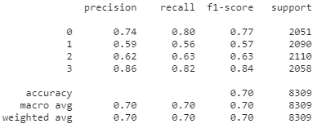
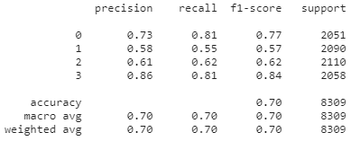
Baseline
LogisticRegression – All features
Train score: 0.7089288400782308
Cross-validation score: 0.6943352914502243
Validation score: 0.7009177072363473
Test score:
LogisticRegression – Selected features
Train score: 0.702572589137957
Cross-validation score: 0.6932449600198842
Validation score: 0.6982097186700768
Test score:

Slide 17
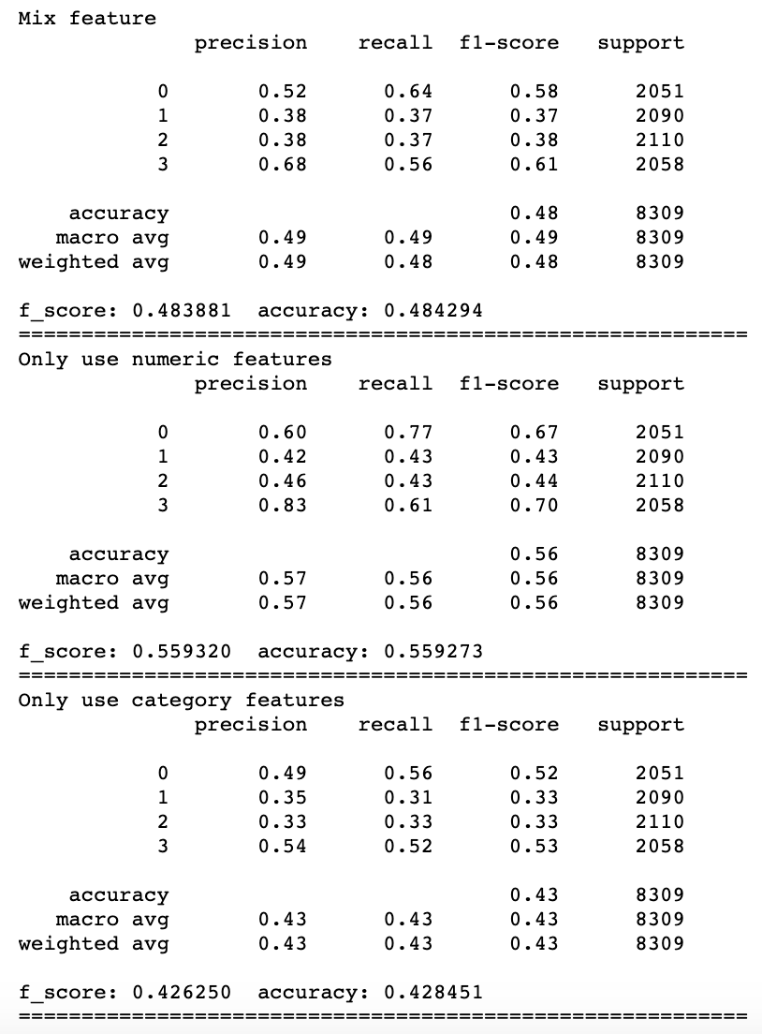
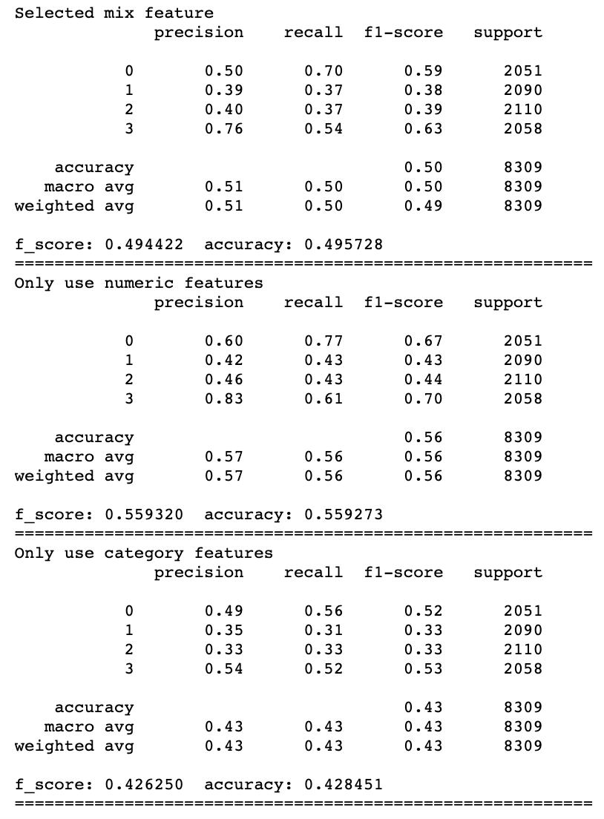
KNN
17

Slide 18
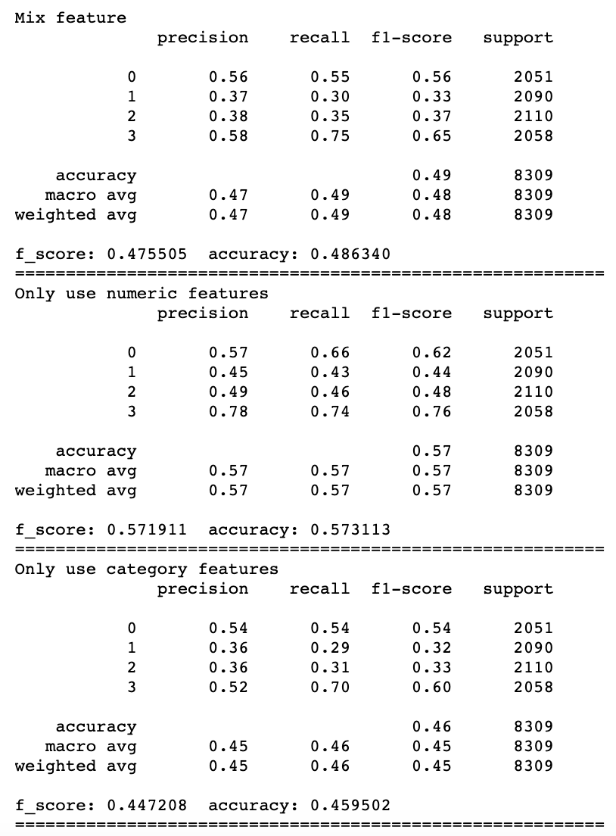
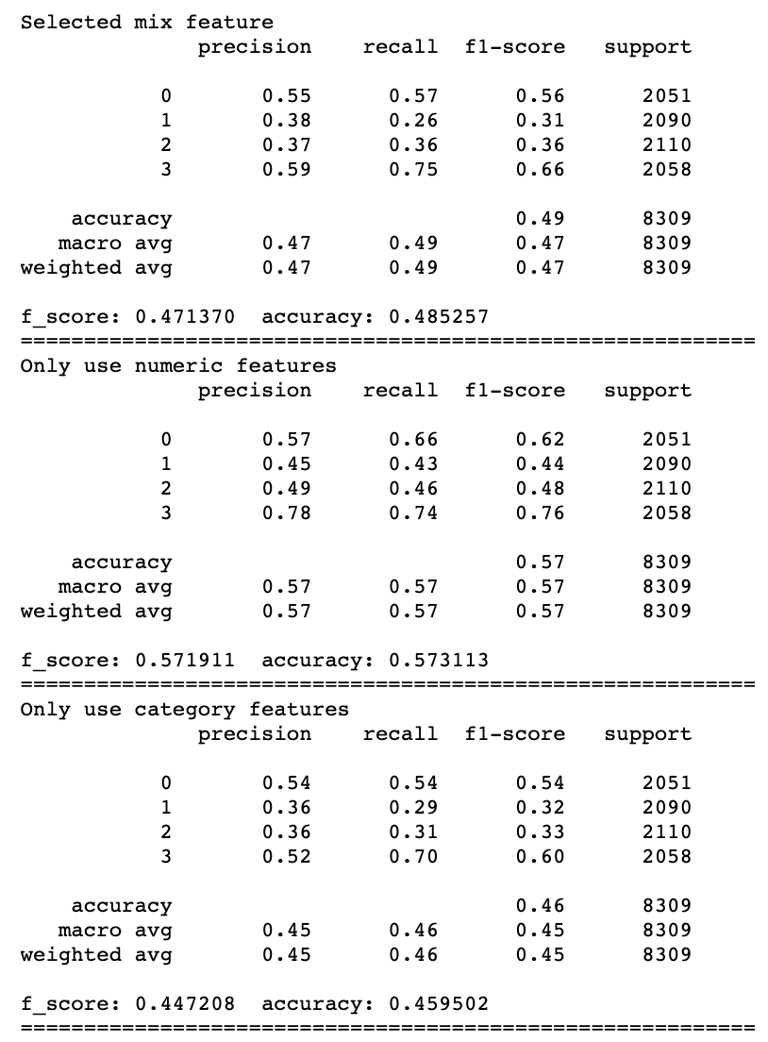
MDC
Numeric features make more sense to the KNN and MDC model
18

Slide 19
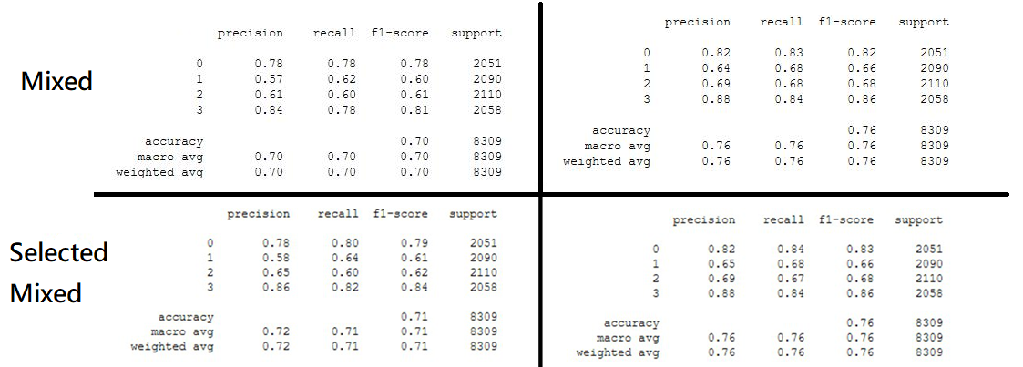
DecisionTree&
RandomForest
19

Slide 20
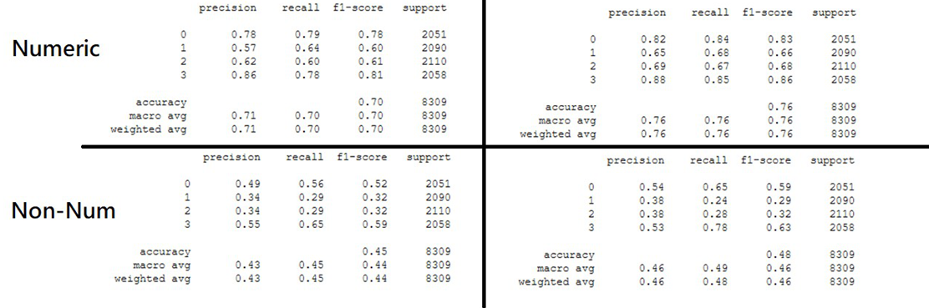
DecisionTree&
RandomForest
20

Slide 21
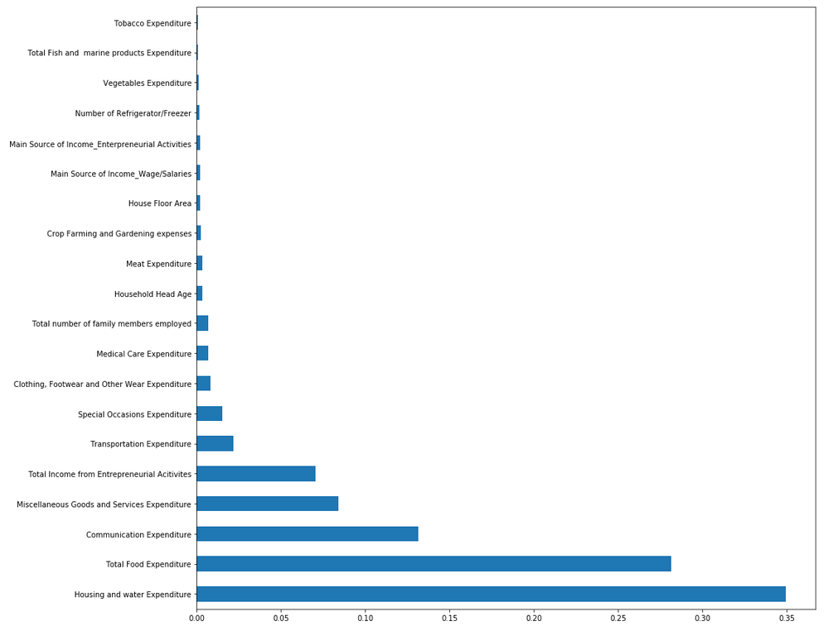
DecisionTree
Top-5 important features
Housing and water Expenditure
Total Food Expenditure
Communication Expenditure
Miscellaneous Goods and Services Expenditure
Total Income from Entrepreneurial Activities
21

Slide 22
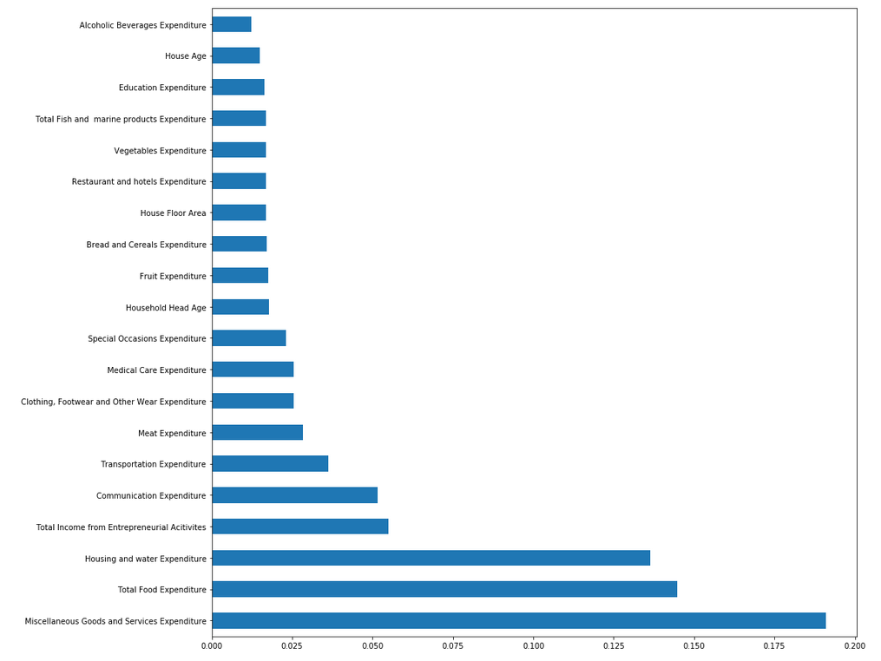
RandomForest
Top-5 important features
Miscellaneous Goods and Services Expenditure
Total Food Expenditure
Housing and water Expenditure
Total Income from Entrepreneurial Activities
Communication Expenditure
22

Slide 23
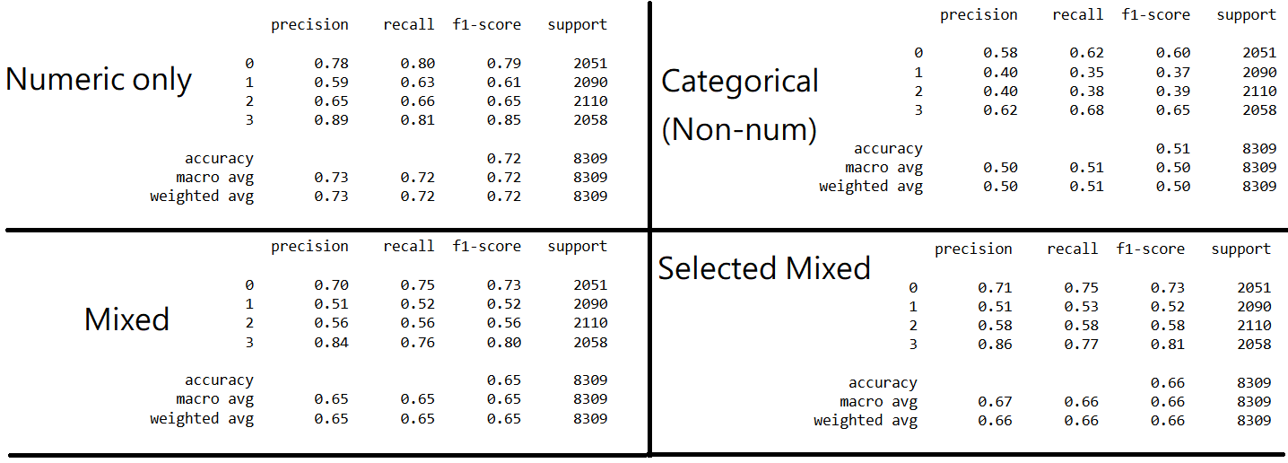
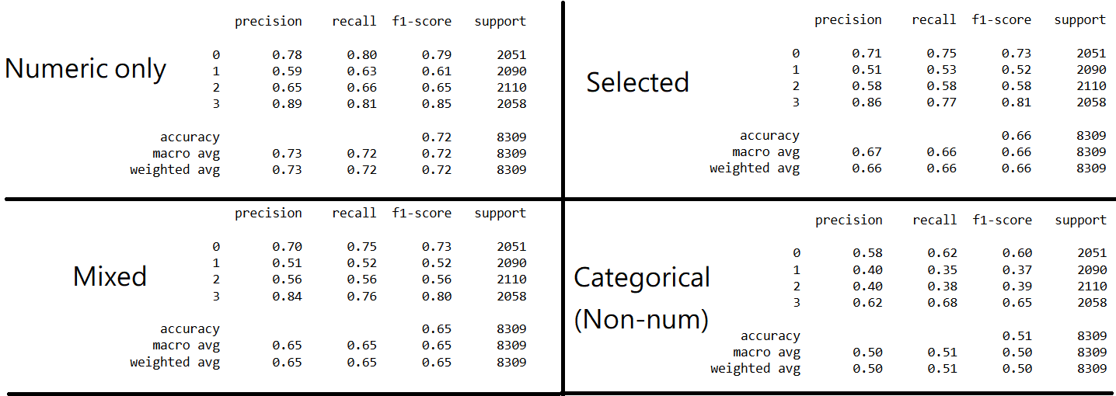
SVM
23

Slide 24
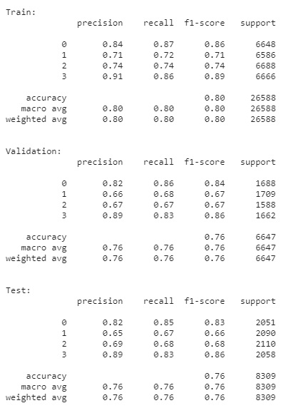
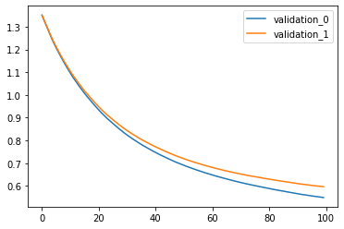
XGBoost
XGBoost – All features
n_estimators=100,
max_depth=6,
learning_rate=0.04,
objective=‘multi:softmax’,
booster=‘gbtree’,
reg_alpha=2.0,
reg_lambda=2.5,
gamma=0.5,
min_child_weight=2.0,
colsample_bytree=0.7,
subsample=0.5
24

Slide 25
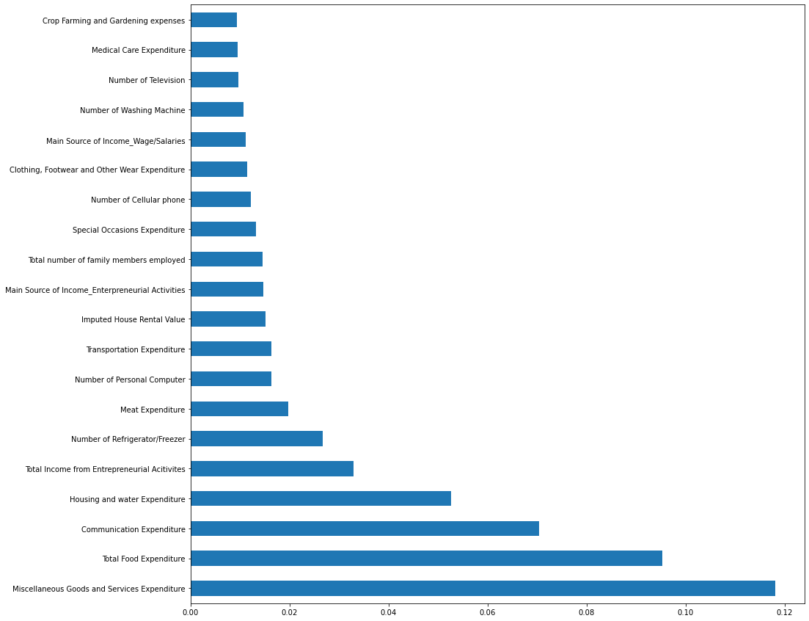
XGBoost
Top-5 important features
Miscellaneous Goods and Services Expenditure
Total Food Expenditure
Communication Expenditure
Housing and water Expenditure
Total Income from Entrepreneurial Activities
25

Slide 26
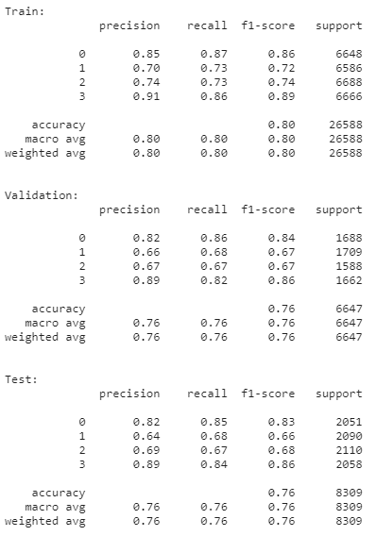

XGBoost
XGBoost – Selected features
n_estimators=100,
max_depth=6,
learning_rate=0.04,
objective=‘multi:softmax’,
booster=‘gbtree’,
reg_alpha=2.0,
reg_lambda=2.5,
gamma=0.5,
min_child_weight=2.0,
colsample_bytree=0.7,
subsample=0.5
26

Slide 27
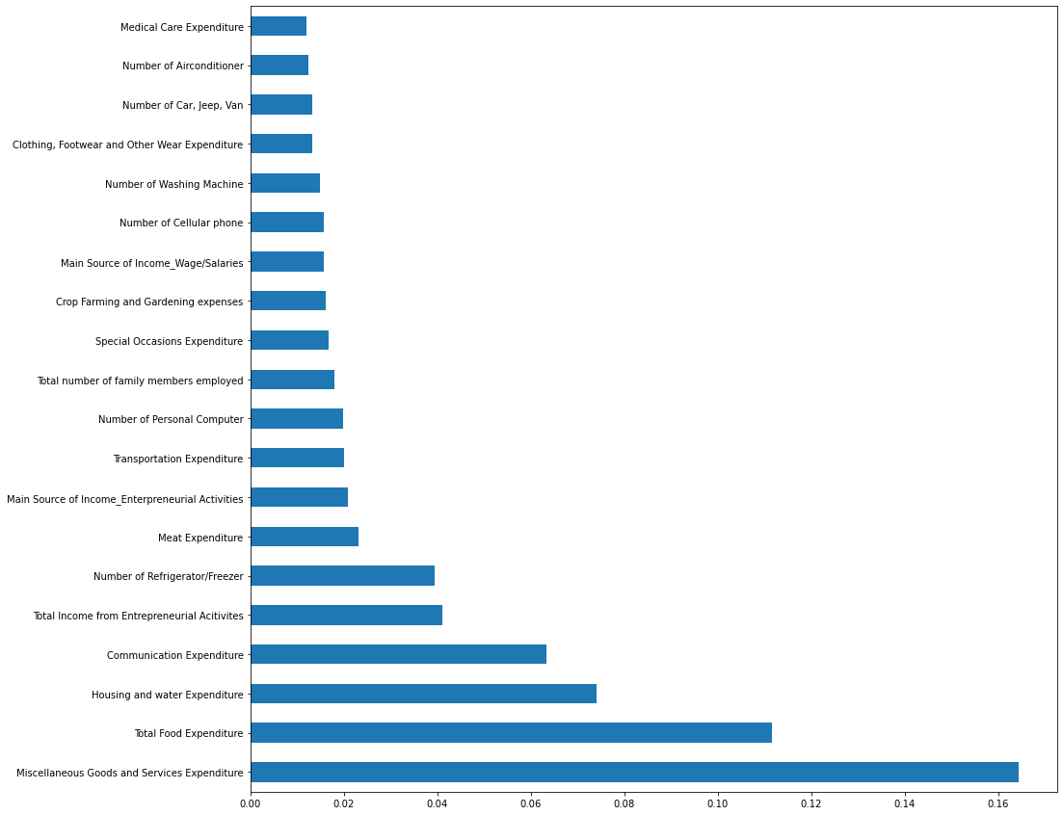
XGBoost
Top-5 important features
Miscellaneous Goods and Services Expenditure
Total Food Expenditure
Housing and water Expenditure
Communication Expenditure
Total Income from Entrepreneurial Activities
27

Slide 28
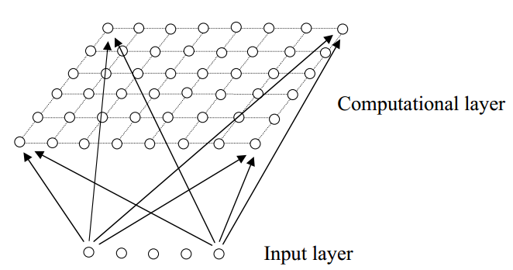
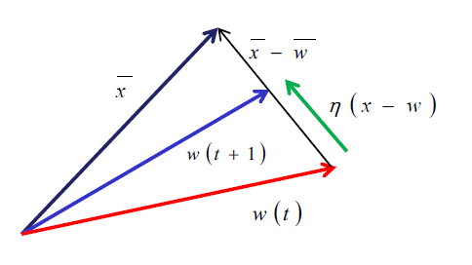
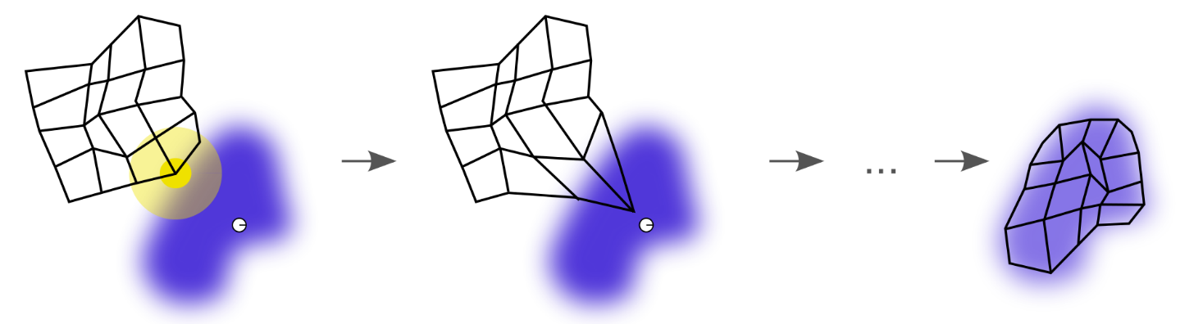

SOM+XGBoost
What is SOM ?
Gamma, Learning_rate
28

Slide 29
SOM+XGBoost
Input
SOM(2*2)
Split a problem into multiple small problems
Divide and Conquer
Calculate weighted average f1_score and accuracy
based on (# of data in cluster / total # of data)
XGBoost
XGBoost
SOM model
size_x=2,
size_y=2,
len(features),
sigma=1, learning_rate=1.2, neighborhood_function='triangle'
XGBoost
n_estimators=100,
max_depth=6,
learning_rate=0.04,
objective=‘multi:softmax’,
booster=‘gbtree’,
reg_alpha=2.0,
reg_lambda=2.5,
gamma=0.5,
min_child_weight=2.0,
colsample_bytree=0.7,
subsample=0.5
XGBoost
XGBoost
29

Slide 30
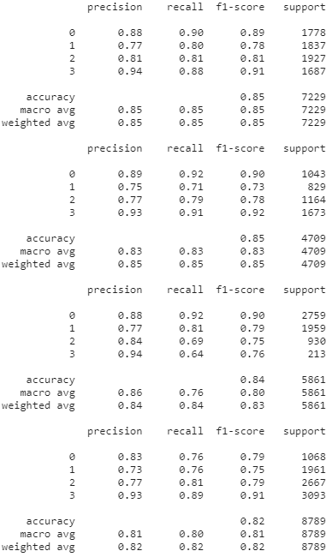
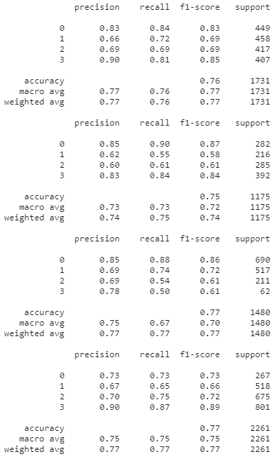
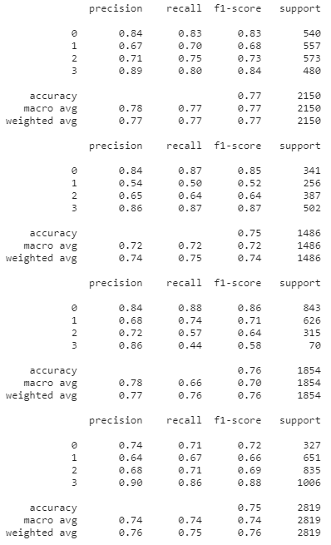
All features
SOM+XGBoost
weighted avg f_score: 0.8362633198800108
weighted avg accuracy: 0.8362419136452535
weighted avg f_score: 0.7616251247579151
weighted avg accuracy: 0.7622987814051453
weighted avg f_score: 0.7584503520165833
weighted avg accuracy: 0.7588157419665424
Train
Validation
Test
30

Slide 31
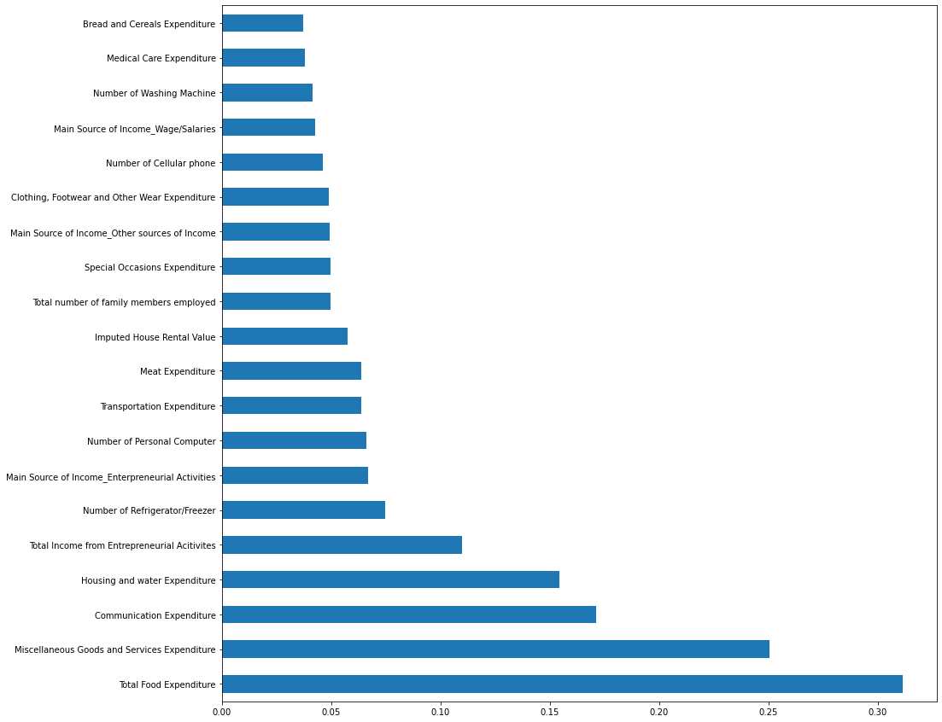
SOM+XGBoost
Top-5 important features
Total Food Expenditure
Miscellaneous Goods and Services Expenditure
Communication Expenditure
Housing and water Expenditure
Total Income from Entrepreneurial Activities
31

Slide 32
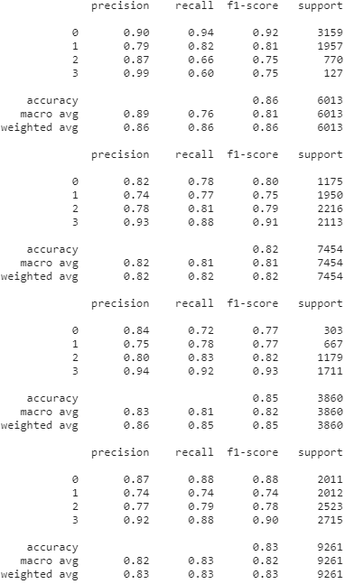
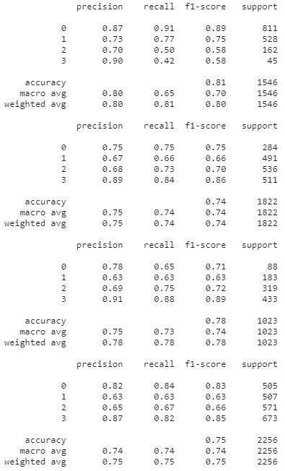
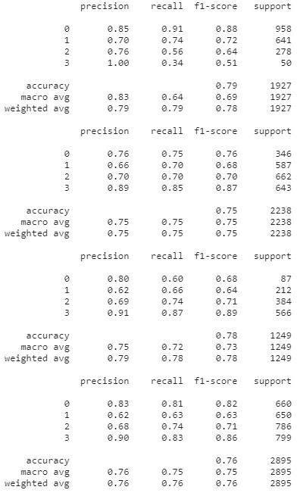
Selected features
SOM+XGBoost
weighted avg f_score: 0.8353064361614327
weighted avg accuracy: 0.8353016398375207
weighted avg f_score: 0.7634193207879316
weighted avg accuracy: 0.763953663306755
weighted avg f_score: 0.765380433404814
weighted avg accuracy: 0.7655554218317489
Train
Validation
Test
32

Slide 33
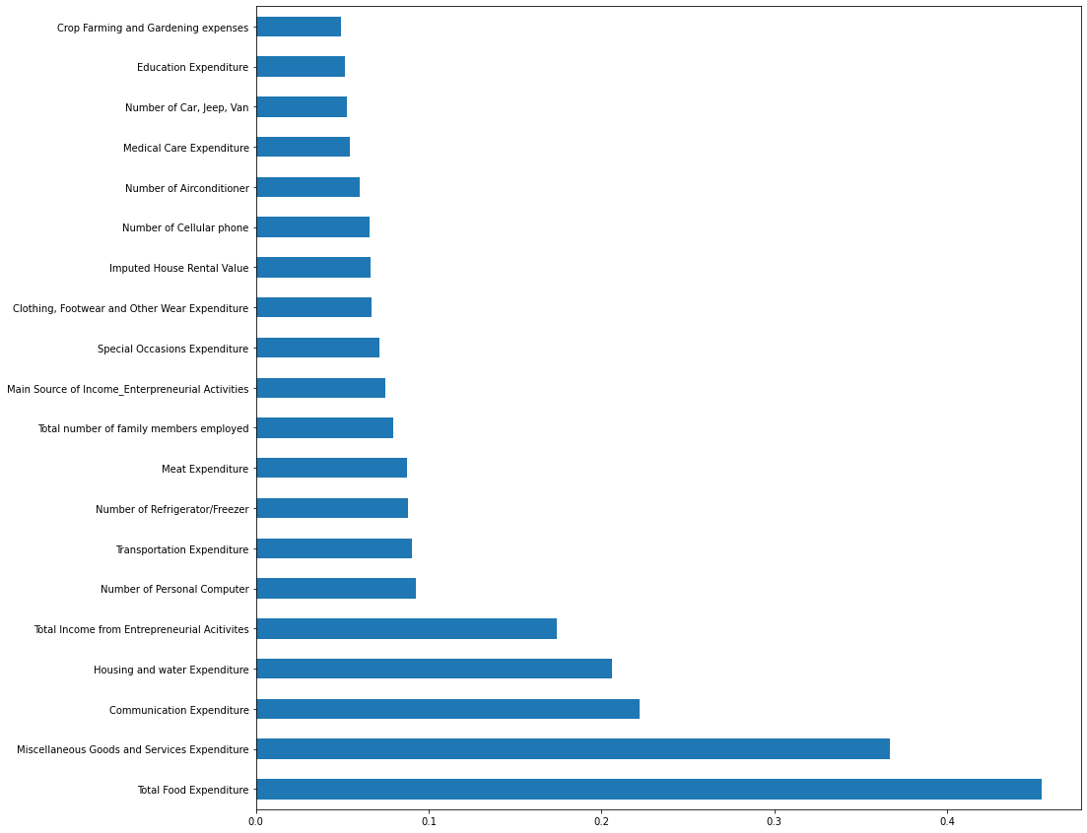
SOM+XGBoost
Top-5 important features
Total Food Expenditure
Miscellaneous Goods and Services Expenditure
Communication Expenditure
Housing and water Expenditure
Total Income from Entrepreneurial Activities
33

Slide 34
F1 - score
Evaluation
Decision Tree
Random Forest
SVM
KNN
MDC
SOM
SOM + XGBoost
Non-Selected
0.7
0.76
0.65
0.4827
0.4724
0.76
0.7588
Selected
0.7
0.76
0.66
0.4918
0.4696
0.76
0.7653
Notes:
34

Slide 35
Accuracy
Evaluation
Decision Tree
Random Forest
SVM
KNN
MDC
SOM
SOM + XGBoost
Non-Selected
0.7
0.76
0.65
0.4833
0.4830
0.76
0.7584
Selected
0.71
0.76
0.66
0.4936
0.4832
0.76
0.7653
Notes:
35

Slide 36
Evaluation
F1-Score
Decision
Tree
60%
Random
Forest
100%
100%
SVM
Minimum
Distance
Classifier
100%
100%
78%
KNN
yanshifu
Notes:
36

Slide 37
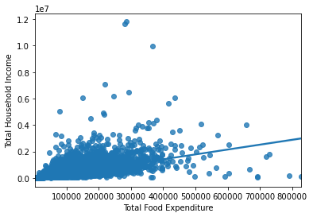
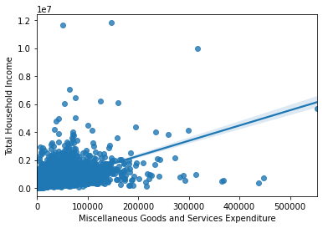
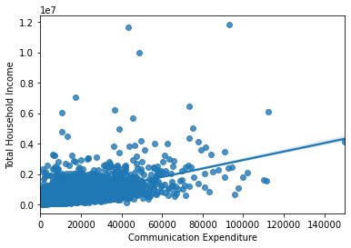
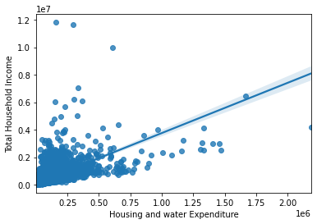
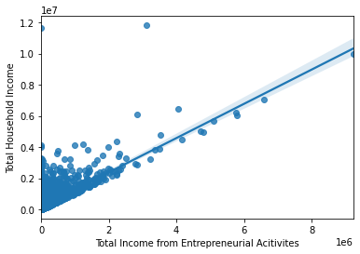
Conclusion
Top-5 important features
Total Food Expenditure
Miscellaneous Goods and Services Expenditure
Communication Expenditure
Housing and water Expenditure
Total Income from Entrepreneurial Activities

Slide 38
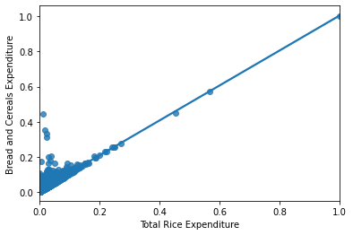
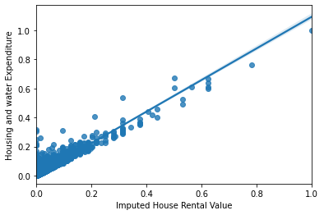
Conclusion
38

Slide 39
Have A Nice Day
39
yanshifu
Notes:
39

