Slide 1
GPU 購物小幫手
B2C Website 與 Report Security
資工四 107590037 應耀德 (主講人)
資工四 107590012 陳志榮

Slide 2
B2B 資安系統架構設計
GPUbot-A
keyA
API-A
Data
Access
Object
GPUbot-B
keyB
Identity-
Aware
Proxy
API-B
Firestore
App Engine
GPUbot-C
keyC
API-C
Hacker

Slide 3



B2B API Gateway 設計
API Gateway
API Services
Users
Path: /users/{userId}
Products
Path: /products/{productId}
Orders
Path: /orders/{orderId}
.
.
.
Client
.
.
.

Slide 4
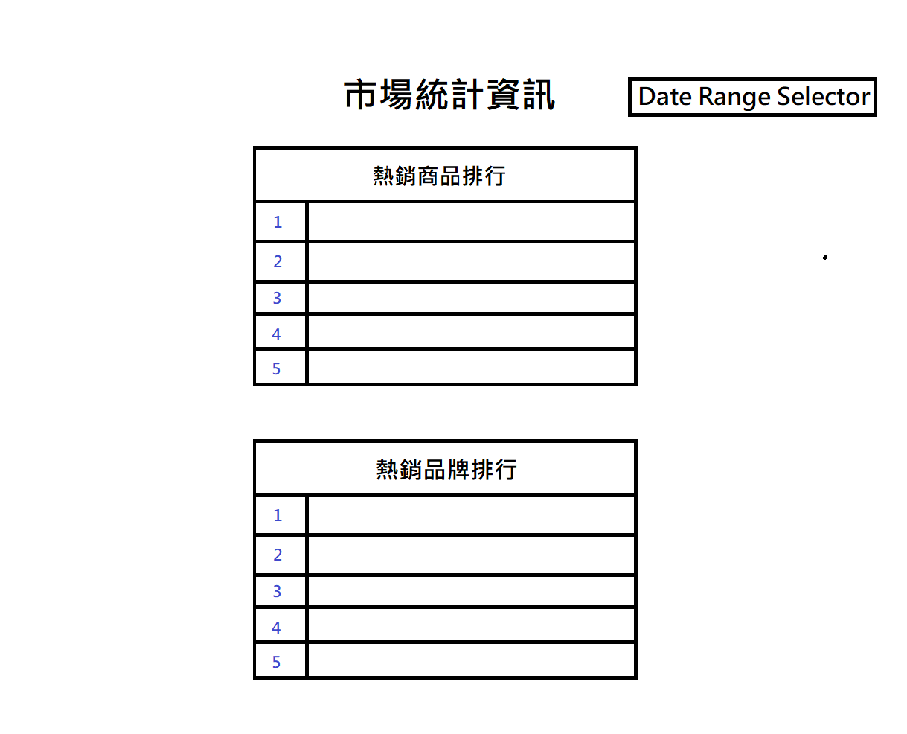
Report 內容設計：Anonymous、Customer

Slide 5
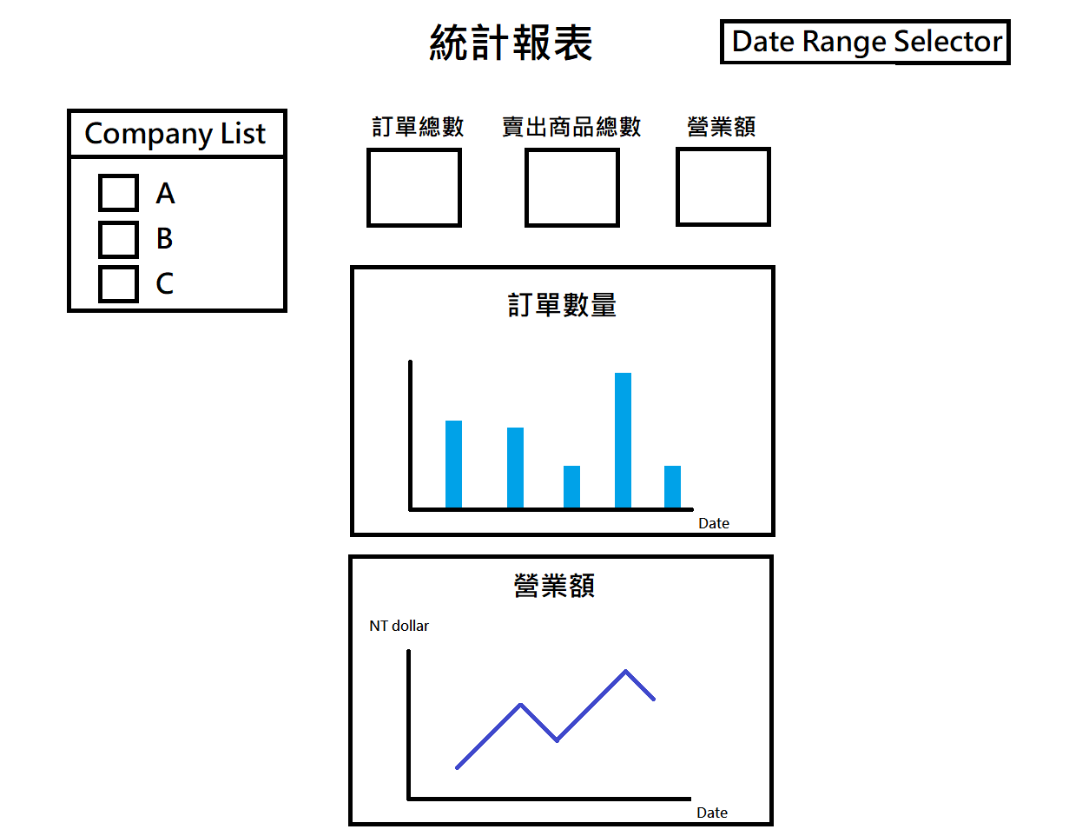
Report 內容設計：Seller、Admin

