Slide 1

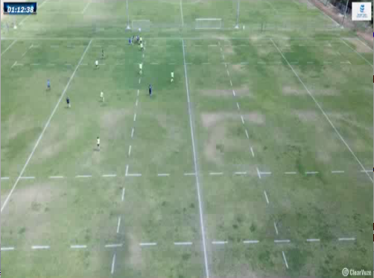
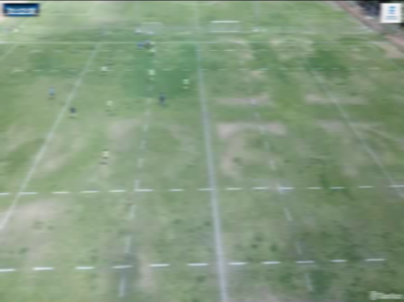
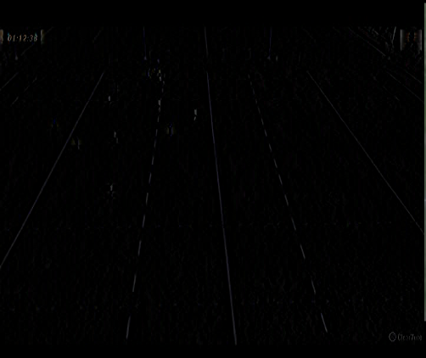
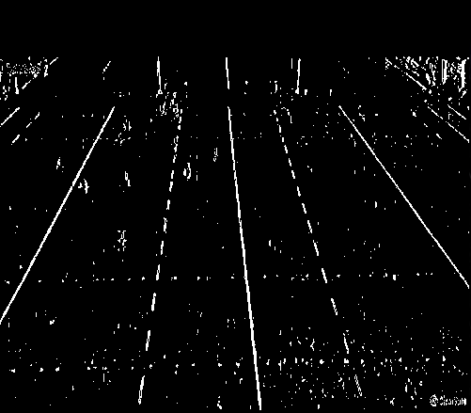
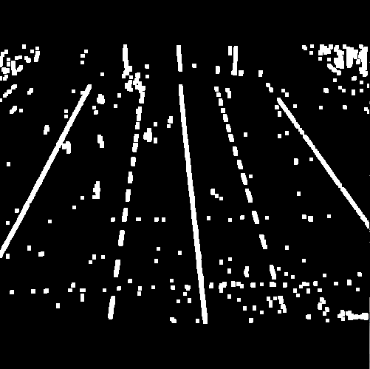
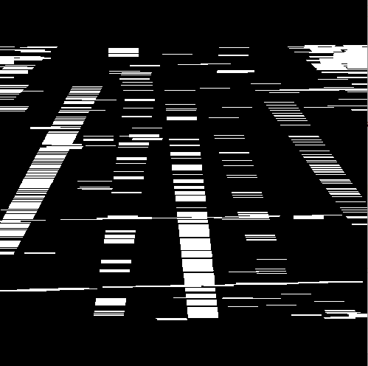

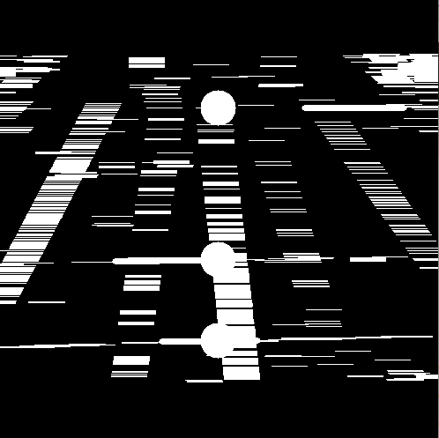
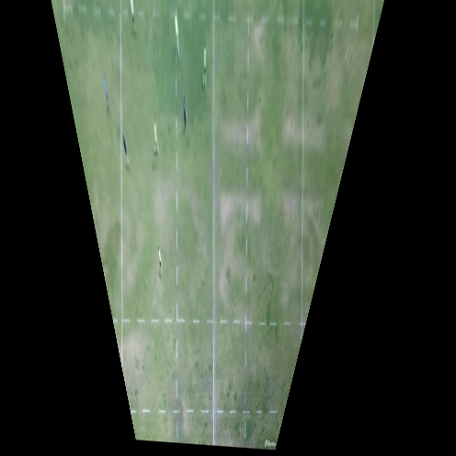
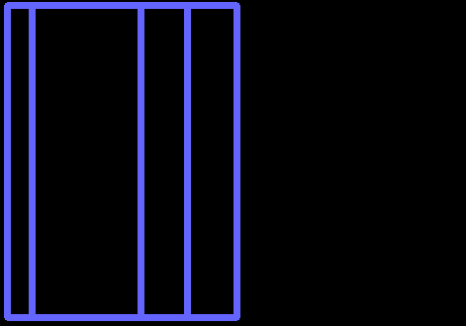
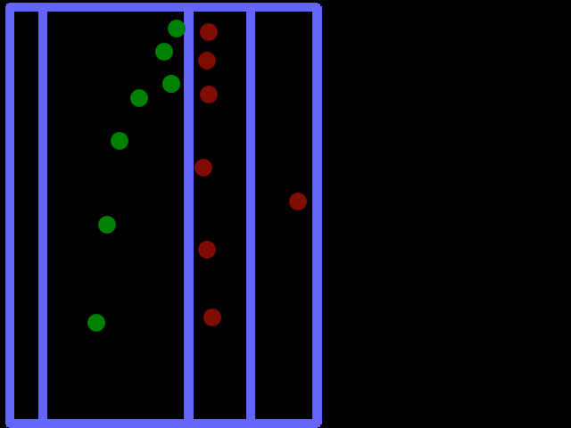
SPORTS ANALYSIS WITH COMPUTER VISION
Authors: Guy Matisis
Among all the fields that AI has influenced, professional sports is also making use of AI. AI is used to analyze film of games and trainings. It is able to recognize certain plays, evaluate players, and more. A large part of this the data that sports AI requires is based on video, which needs to be processed before it can be analyzed. Computer vision techniques make it possible for player recognition, tracking, and field recognition. This project completes the first task required for AI analysis: field recognition. Recognizing the field requires recognizing the lines that comprise the field and creating an accurate 2d model of the field itself. This project used video from a drone that filmed a rugby practice. The Field's dimensions were known and used to translate the film from the drone to an accurate 2d model.
1.Image Preparation
The first step in the process of line discovery to blur the image with a Gaussian blur, and then subtract the original image by the blurred image. This will deliver the pixels that were distinct from their surroundings. In our case it rendered the lines of the field, players,and some surrounding structures. In order to refine the image further a BGR filter was used. Surprisingly, most of the lines had a blue tinge, and the filter was able to distinguish the lines from other anomalies in the field based upon this color.
1. Starting Image of a field.
2. ‘Blur’ the field with a Gaussian kernel.
3. subtract the original image from the blurred image. (look closely and you will see faint lines
4. filter the third image on the BGR scale. The filter used here was [7,0,0]-[40,40,40].
2. Dilation and Erosion
3.Line Detection
To further enhance the lines a few different kernels were used to dilate and erode the image. Specifically, different sets of kernels were used for vertical lines, horizontal lines, and horizontal line while the camera is moving left and right.
Hough’s line algorithm was used to detect the lines. Different parameters were used for horizontal and vertical lines. In particular the vertical lines had a large minimum line length to keep out small stray lines, while the horizontal image had maximum line gap of 0 to deter vertical lines being detected.
Vertical lines are made more distinct
Horizontal lines are made more distinct
Lines were highlighted in white and a circle was drawn on the line’s lope in the middle of the picture
4. Line Tracking and Homography
5. Next Step: Player Detection and Tracking
After lines were detected they had to be verified, tracked, and identified. Verifying included determining if the line was a ‘stray’ line or an actual line of the field. Tracking involved following the line’s movements across the screen while the camera was moving. Identification was the process of taking known information of the lines and comparing it to the lines that were detected in order to identify the line seen as the correct line on the field itself. After four lines were detected it was possible to construct a homography using the known actual coordinates of the lines. Afterwards we are able to construct our own field according to what is seen on the video at that moment.
The next step in order to implement an AI for sports analytics is to detect players on the field, identify them, and track their movements. After their paths are calculated we can start to store analytics on them such as distance traveled, speed, positioning in relation to the field and many other statistics.

