Slide 1
Layered Comms Profile in SysML v1
Orientation – Tour - Examples

Slide 2
SPDX Info
For this presentation
SPDX-License-Identifier: CC-BY-4.0
SPDX-FileCopyrightText: Copyright 2026 Guy Meador
SPDX-FileType: DOCUMENTATION
The MeadorTech logo(s) are trademarks of Meador Technologies, LLC, are used by special permission, and are not licensed as a part of this document or the licenses identified on this page. Derivative works are not authorized or licensed to use these logos.
Other Copyrights as noted on individual slides
For any SysML representations
SPDX-License-Identifier: Apache-2.0
SPDX-FileCopyrightText: Copyright 2026 Guy Meador
SPDX-FileType: SysML

Slide 3
Layered Protocols Primer

Slide 4
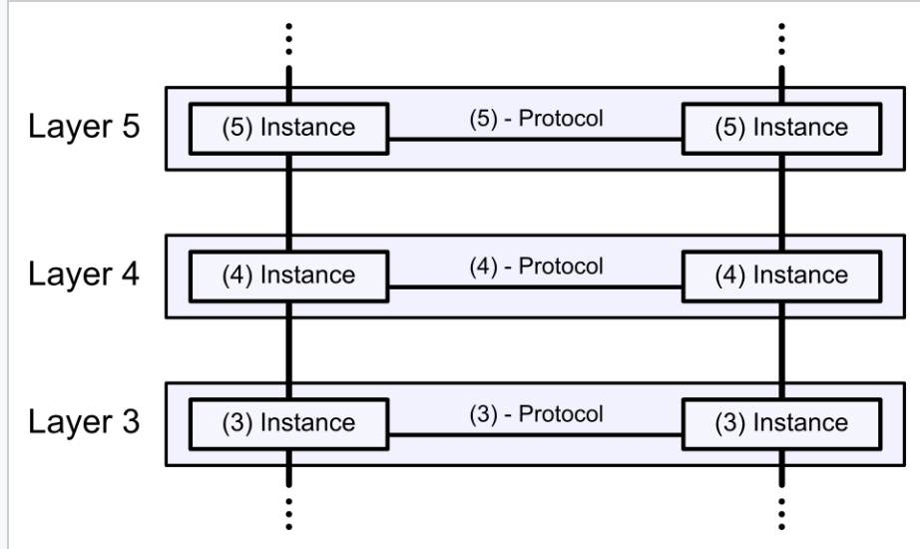
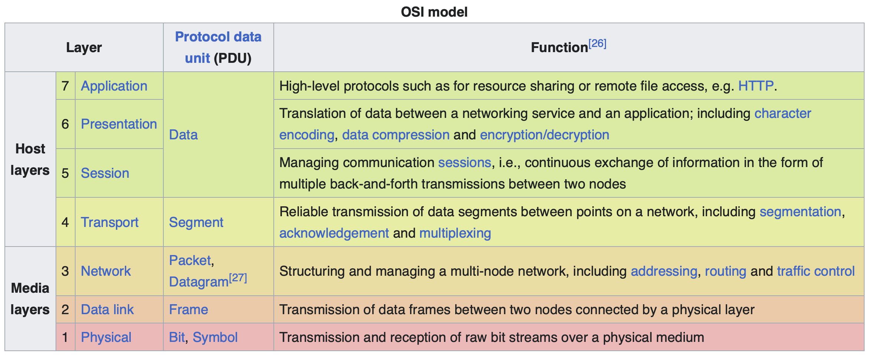
OSI Model Summarized
The information below is from Wikipedia page https://en.wikipedia.org/wiki/OSI_model that carries the following statement “Text is available under the Creative Commons Attribution-ShareAlike 4.0 License; additional terms may apply. By using this site, you agree to the Terms of Use and Privacy Policy. Wikipedia® is a registered trademark of the Wikimedia Foundation, Inc., a non-profit organization.”
The Open Systems Interconnection (OSI) model is a reference model developed by the International Organization for Standardization (ISO)
the components of a communication system are distinguished in seven abstraction layers
Data processing by two communicating OSI-compatible devices proceeds as follows:
The data to be transmitted is composed at the topmost layer of the transmitting device (layer N) into a protocol data unit (PDU).
The PDU is passed to layer N−1, where it is known as the service data unit (SDU).
At layer N−1 the SDU is concatenated with a header, a footer, or both, producing a layer N−1 PDU. It is then passed to layer N−2.
The process continues until reaching the lowermost level, from which the data is transmitted to the receiving device.
At the receiving device the data is passed from the lowest to the highest layer as a series of SDUs while being successively stripped from each layer's header or footer
until reaching the topmost layer, where the last of the data is consumed.

Slide 5
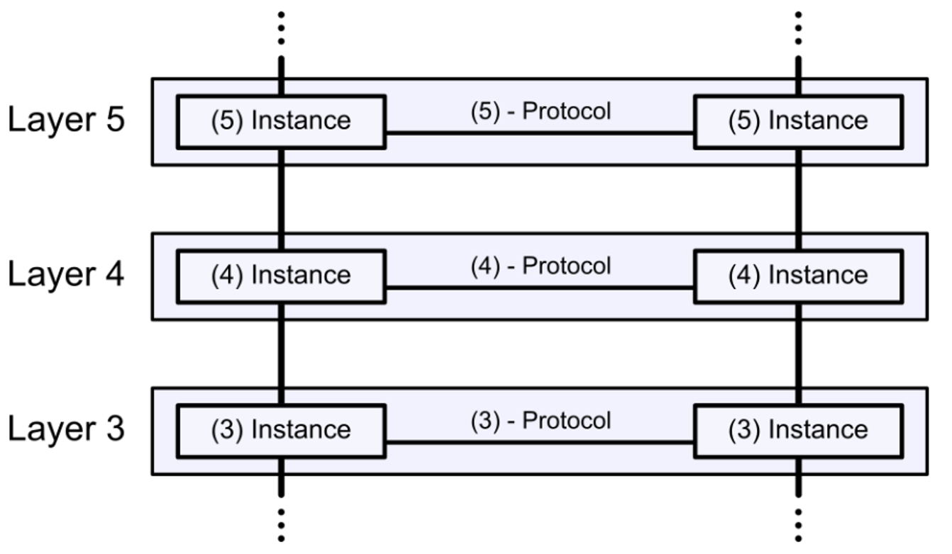
Key Concepts

Slide 6
Key Concepts
Host 1
Host 2
Hosts participating in a layered comms pattern
Each protocol is represented by a protocol entity in each host
Protocol Entity
Protocol Entity
Protocol Entity
Protocol Entity
Protocol Entity
Protocol Entity

Slide 7
Key Concepts
Host 1
Host 2
Within each host, a protocol entity offers its services to other protocol entities via a Service Access Point (SAP)
Service Data Units are exchanged between protocol entities in the protocol stack on the host
SAP
SAP
Protocol Entity
Protocol Entity
SDUs
SDUs
SAP
SAP
Protocol Entity
Protocol Entity
SDUs
SDUs
SAP
SAP
Protocol Entity
Protocol Entity

Slide 8
Key Concepts
Host 1
Host 2
SDU Links are the connector type between stacked protocol entities within a host
Protocol Entities in one layer depend on the services of one or more protocols in the next lower layer.
SAP
SAP
Protocol Entity
Protocol Entity
SDUs
SDU Link
SDU Link
SDUs
SAP
SAP
Protocol Entity
Protocol Entity
SDUs
SDU Link
SDU Link
SDUs
SAP
SAP
Protocol Entity
Protocol Entity

Slide 9
Key Concepts
Host 1
Host 2
Protocol entities in different hosts exchange Protocol Data Units (PDUs) of the protocol.
PDU Link is the connector type between such protocol entities
SAP
PDU Link
SAP
Protocol Entity
Protocol Entity
SDUs
SDU Link
PDUs
SDU Link
SDUs
SAP
PDU Link
SAP
Protocol Entity
Protocol Entity
SDU Link
PDUs
SDU Link
SDUs
SDUs
SAP
PDU Link
SAP
Protocol Entity
Protocol Entity
PDUs

Slide 10
Key Concepts
Host 1
Host 2
The PDU Link connector is between the PDU Ports on each Protocol Entity within a given protocol.
PDU Links of a protocol in one layer may depend on PDU Links of a protocol in the next lower layer
The «Over» relationship is used to represent this relationship (not shown).
PDU Ports
SAP
PDU Link
SAP
Protocol Entity
Protocol Entity
SDUs
SDU Link
PDUs
SDU Link
SDUs
SAP
PDU Link
SAP
Protocol Entity
Protocol Entity
SDU Link
PDUs
SDU Link
SDUs
SDUs
SAP
PDU Link
SAP
Protocol Entity
Protocol Entity
PDUs

Slide 11
Layered Comms Profile in SysML v1
com.meadortech.LayeredCommsProfile

Slide 12
Purpose
Provides a profile and library model elements to assist system model creation following the layered comms principles
Provides
Stereotypes
Building block model elements (ex. ProtocolEntity, PDUPort, SAP, etc.)
A pre-fabricated protocol package (a.k.a. ”Pre-Fab”) to leverage for modeling a protocol
Copy & paste into your user model and rename a few things
Add protocol-specific aspects (ex. protocol state machine, other behaviors, specific PDU and SDU types, etc.)

Slide 13
Provided Base Model Elements and Stereotypes
Abstract library elements to be specialized by user models defining new protocols.
Includes stereotypes also to be applied when using a defined protocol (and/or defining one).

Slide 14
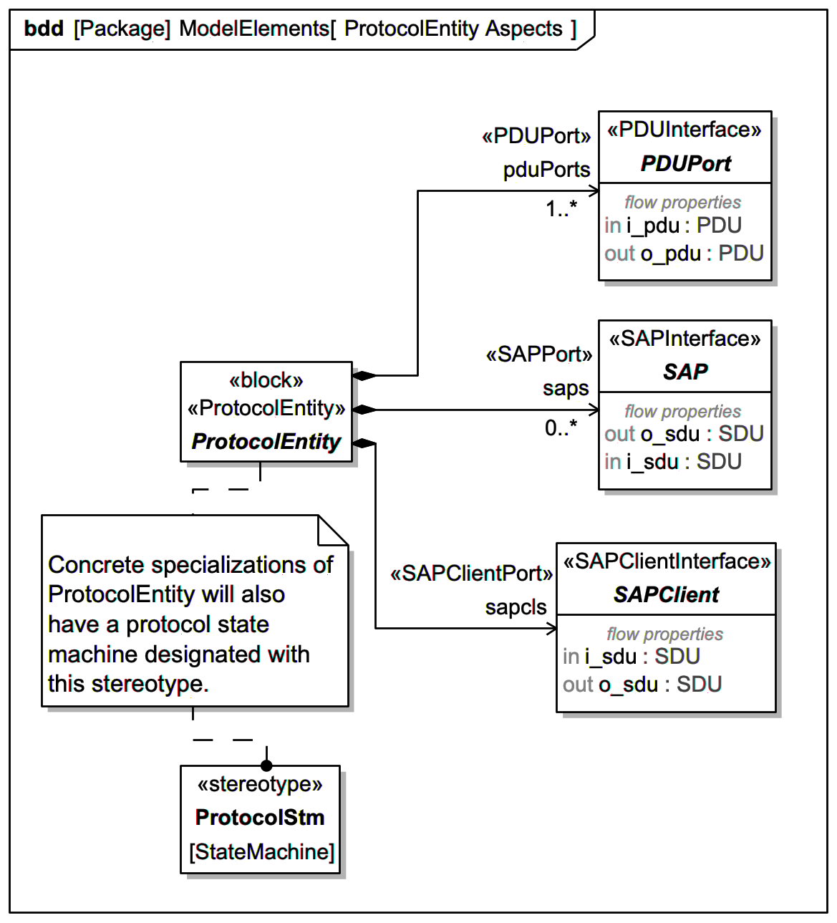
Protocol Entity Aspects
The pattern for protocol entities
Specific protocols defined in user models will specialize each of these elements
Stereotypes are used for many aspects of the pattern and should be applied consistently in user models
Interfaces have appropriate flow properties
Protocol Entities have a Protocol State Machine marked by a supplied stereotype
Not the same as UML protocol state machine

Slide 15
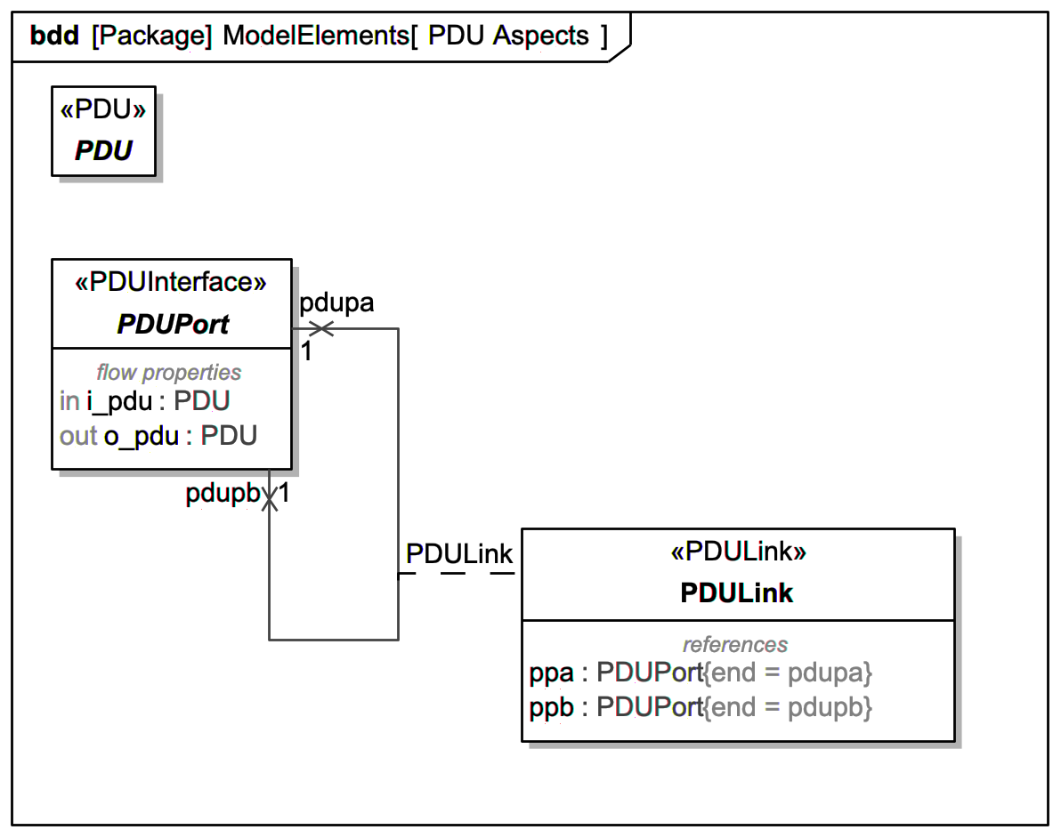
PDU Aspects
Protocol Data Units are exchanged by Protocol Entities on different hosts
PDU based on SysML signal with «PDU» stereotype
PDULink types connectors between PDUPorts
Represented as Association Blocks so internal structure and behavior can be added at need in the concrete protocol
Also note «PDULink» stereotype should be applied
Provides mechanism to assert compatibility between the interface types within a protocol
Specific protocols defined in user models will specialize each of these elements and apply the appropriate stereotypes for the pattern

Slide 16
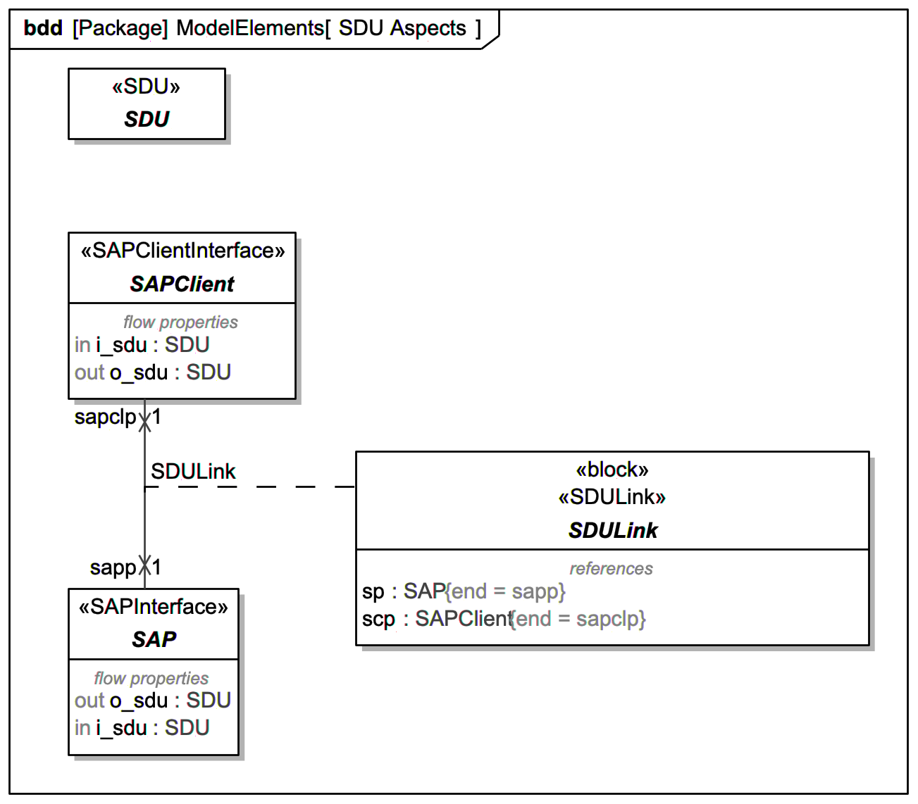
SDU Aspects
Service Data Units are exchanged by Protocol Entities on the same host participating in the protocol stack
SDU based on SysML signal with «SDU» stereotype
SDULink types connectors between SAP and SAPClient ports
Represented as Association Blocks so internal structure and behavior can be added at need in the concrete protocol
Also note «SDULink» stereotype should be applied
Provides mechanism to assert compatibility between these interface types between protocol entities of different protocols
Specific protocols defined in user models will specialize each of these elements and apply the appropriate stereotypes for the pattern

Slide 17
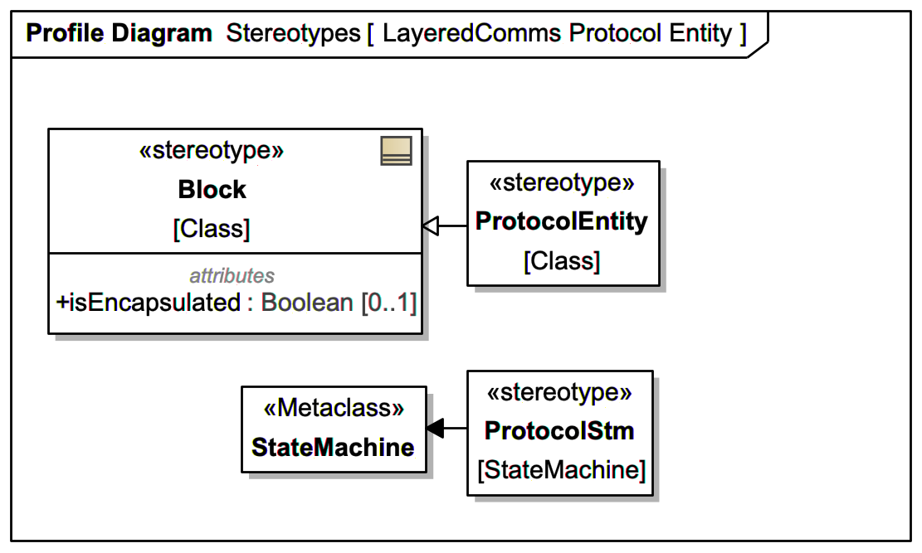
Stereotypes – Protocol Entity
All ProtocolEntity blocks should have that stereotype applied
All protocol state machines of a protocol entity should have that stereotype applied.
The above statements are true even when specializing the library elements shown earlier

Slide 18
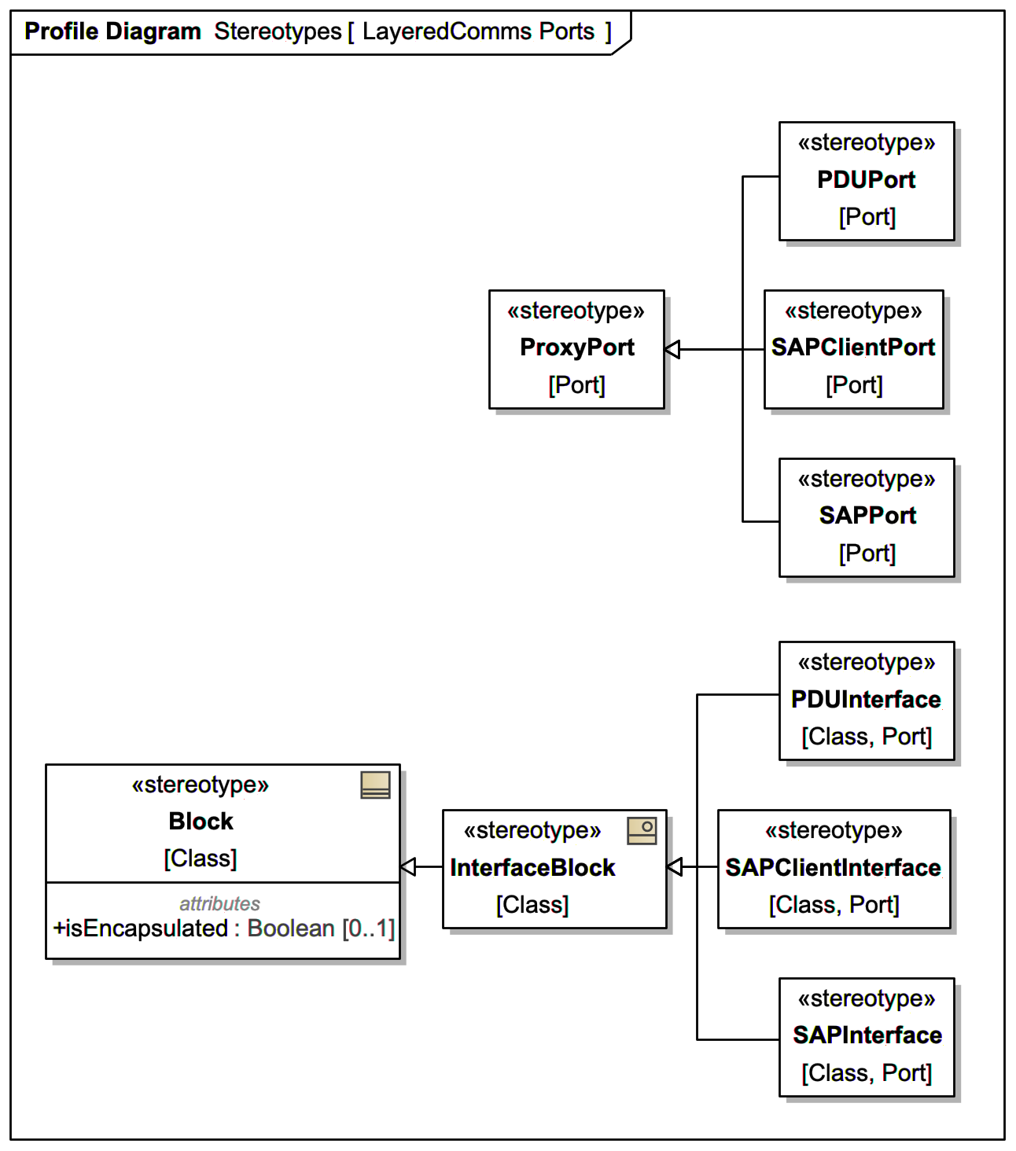
Stereotypes – Ports
All ports and interfaces should have appropriate stereotype applied
Note separate stereotypes for ports vs interfaces
The above statements are true even when specializing the library elements shown earlier

Slide 19
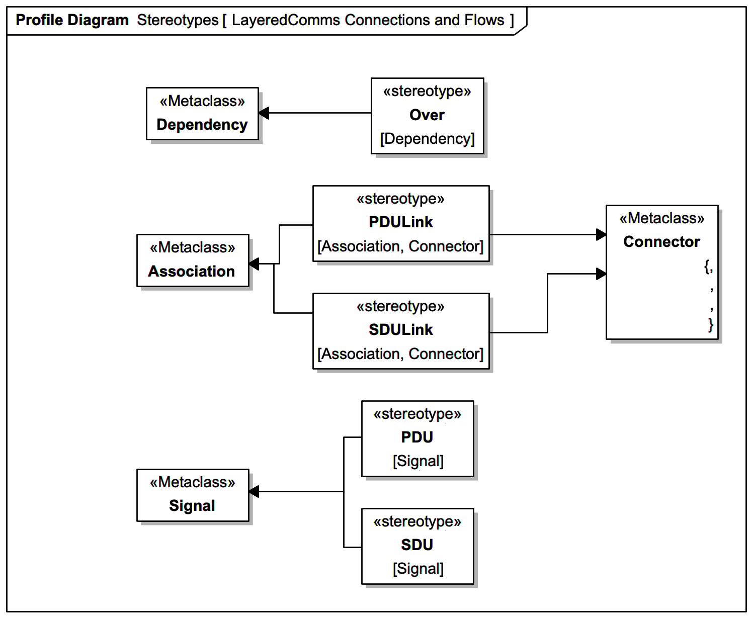
Stereotypes – Connections and Flows
All model elements using the pattern should have appropriate stereotype applied
Even when specializing the library elements shown earlier
Note the same stereotypes for association and connector

Slide 20
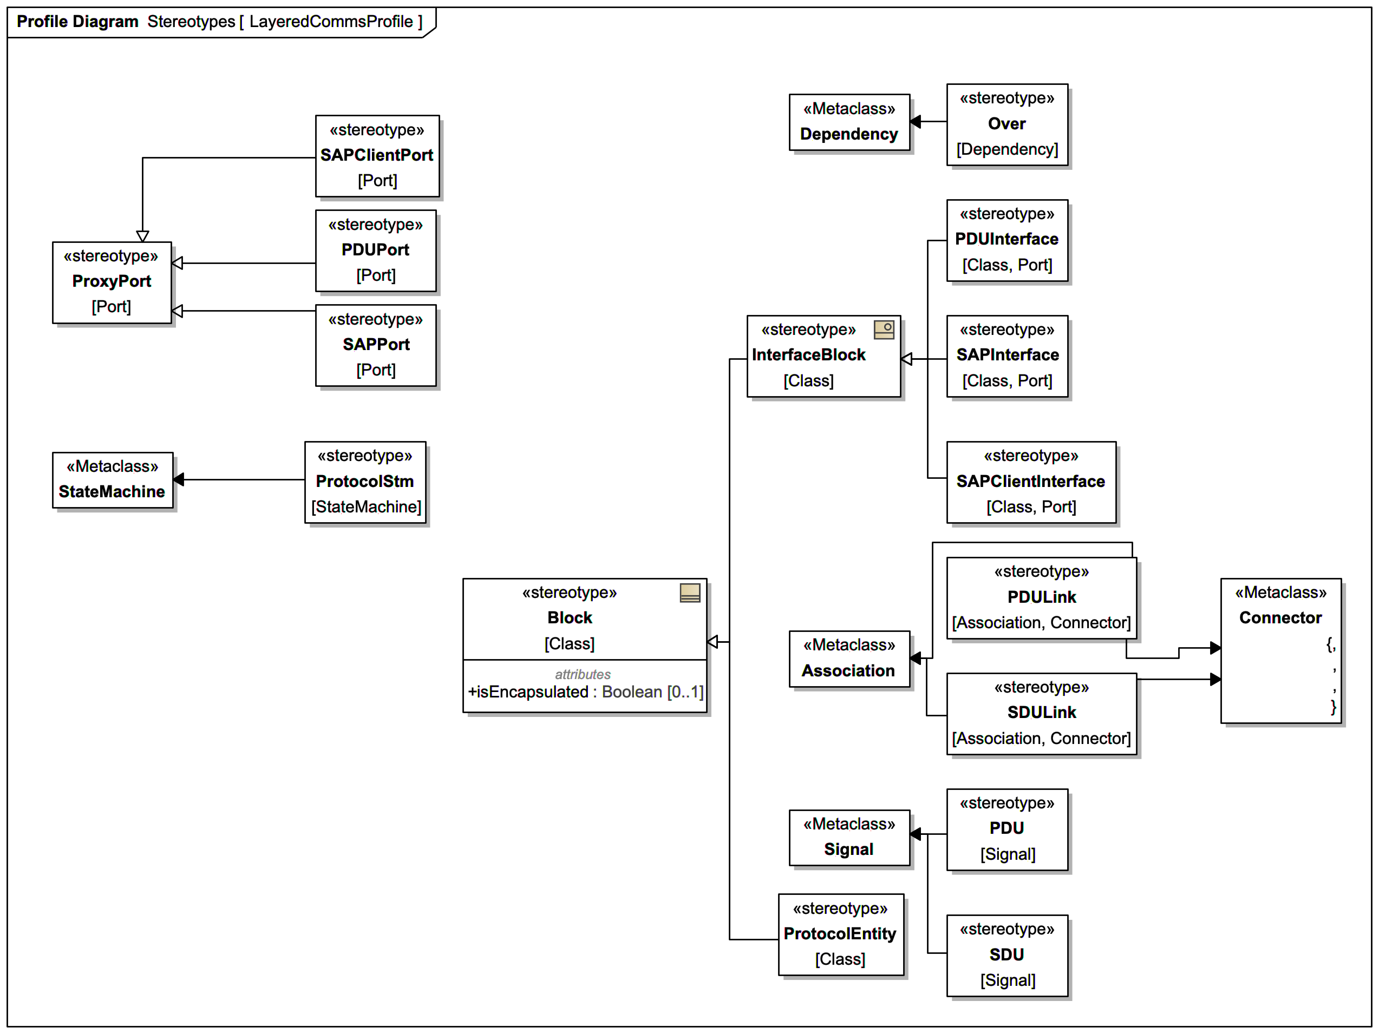
Stereotypes – Complete Set
Reminders
These stereotypes are applied to mark the aspects of the Layered Comms pattern aspect being used
Assists in human readability and tool support for creation and tool checking/queries
Remember to apply the appropriate stereotypes in user models, even when using specialization from the supplied library elements

Slide 21
Layered Comms Protocol Definition “Pre-Fab”
Available to bootstrap a user model package that defines a protocol model.
Copy from the profile library; Paste into the user model; Rename things; Augment

Slide 22
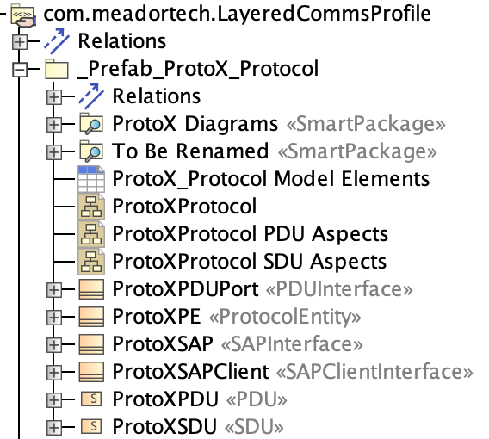
The Protocol Model Pre-Fab
Defining a protocol using the Layered Comms profile has many aspects
The _Prefab_ProtoX_Protocol package is a good starting point to assist in that task
To get started, copy that package and paste into your user model and rename it according to the protocol to be defined
ProtoX is the name of the protocol
Library elements from the profile are specialized (with applied stereotypes) for the ProtoX protocol
Recommended diagrams are also present
The package named To Be Renamed is a smart package having the elements that need to be renamed (find&replace “protox” with your protocol name).
Afterwards, delete the To Be Renamed package.

Slide 23
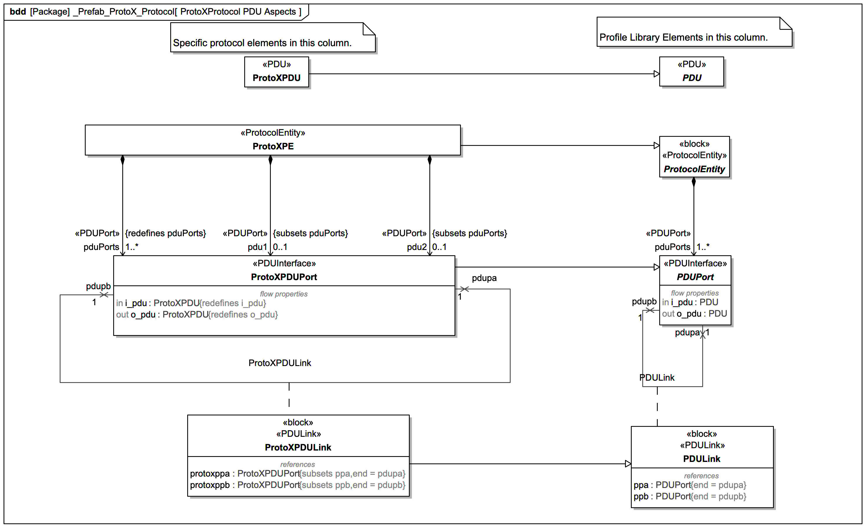
ProtoX from the Pre-Fab – PDU Aspects
Specific protocol elements already specialize profile model elements
Stereotypes are already applied

Slide 24
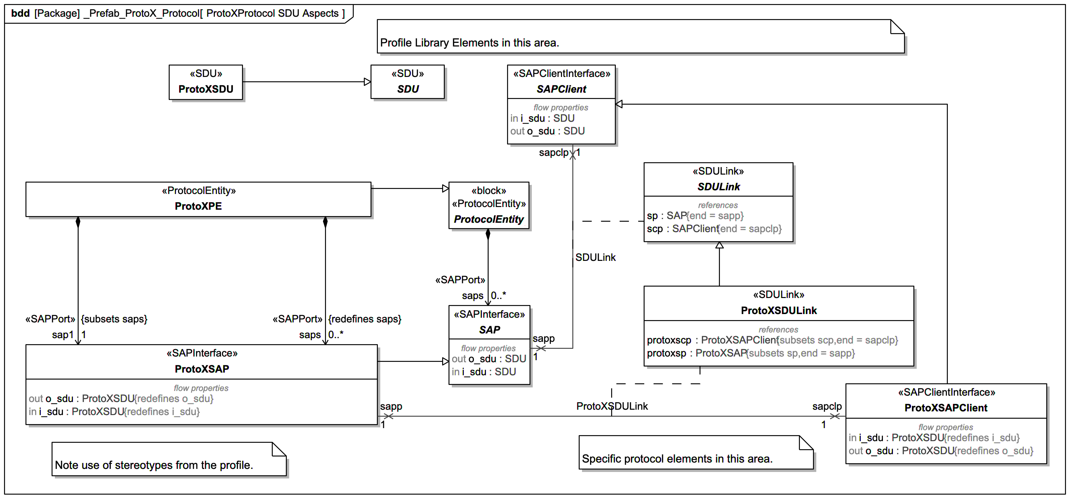
ProtoX from the Pre-Fab – SDU Aspects
Specific protocol elements already specialize profile model elements
Stereotypes are already applied

Slide 25
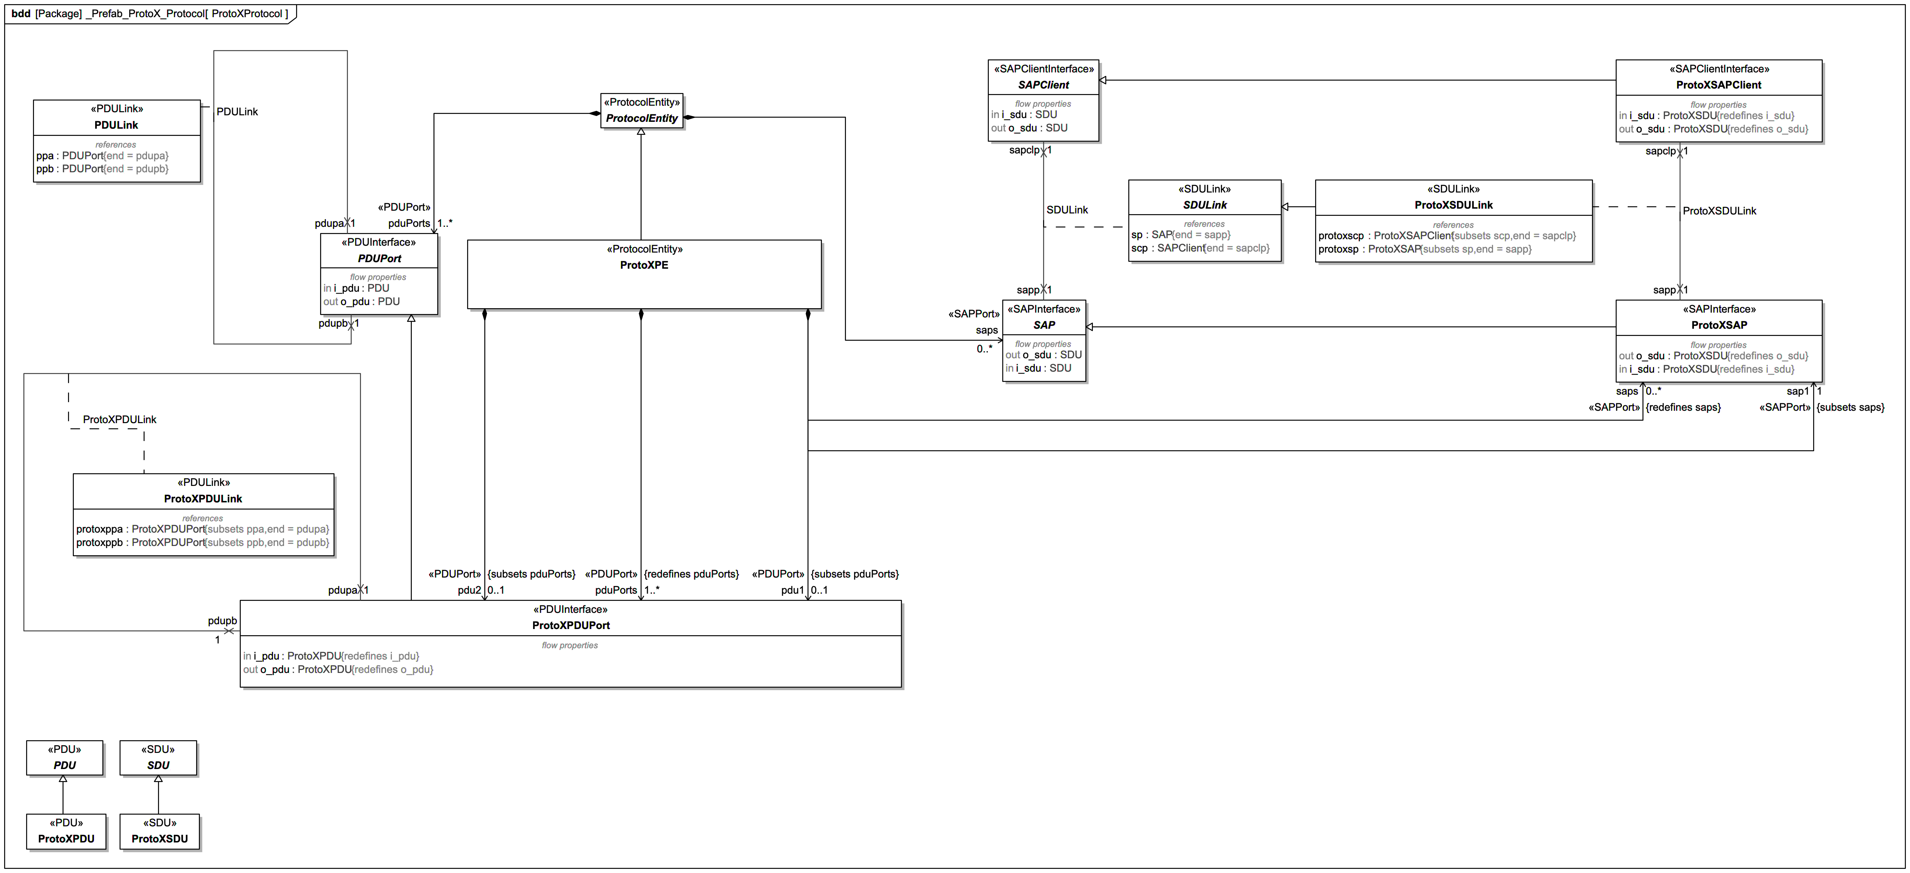
ProtoX from the Pre-Fab: All

Slide 26
Example: Using Already-Define Protocols to Model Two Hosts Communicating with a Layered Protocol Stack
com.meadortech.ExampleLayeredComms001.mdzip

Slide 27
Example Layered Comms Stack
SAP
nn1 : NetNode
nn2 : NetNode
Two network nodes participate in a layered comms relationship.
The Datagram protocol is over the Network protocol, which is over the Datalink protocol.
PDU Ports
SAP
PDU Link
SAP
Datagram PE
Datagram PE
SDUs
SDU Link
PDUs
SDU Link
SDUs
SAP
PDU Link
SAP
Network PE
Network PE
SDU Link
PDUs
SDU Link
SDUs
SDUs
SAP
PDU Link
SAP
Datalink PE
Datalink PE
PDUs

Slide 28
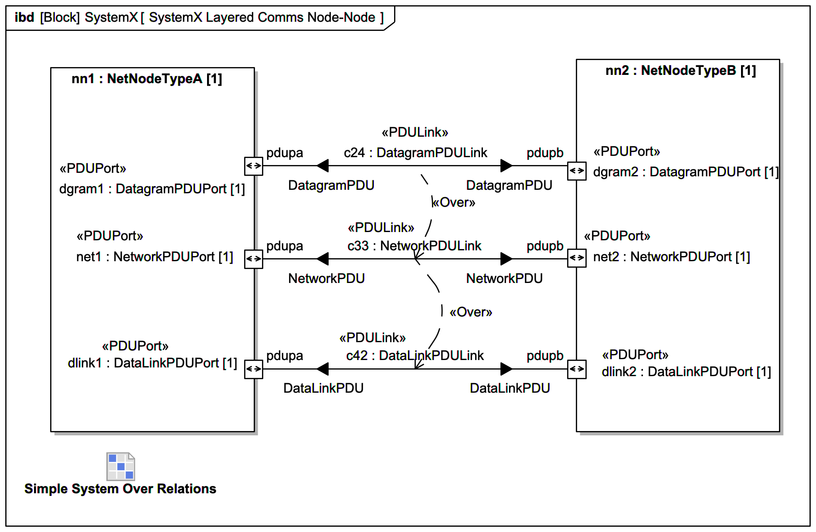
Layered Interconnections
Layered Comms Black Box View
3 protocols
Each protocol
PDU Ports
PDU Link Connector
PDU Item Flows
Layering of connectors noted using the “Over” stereotype

Slide 29
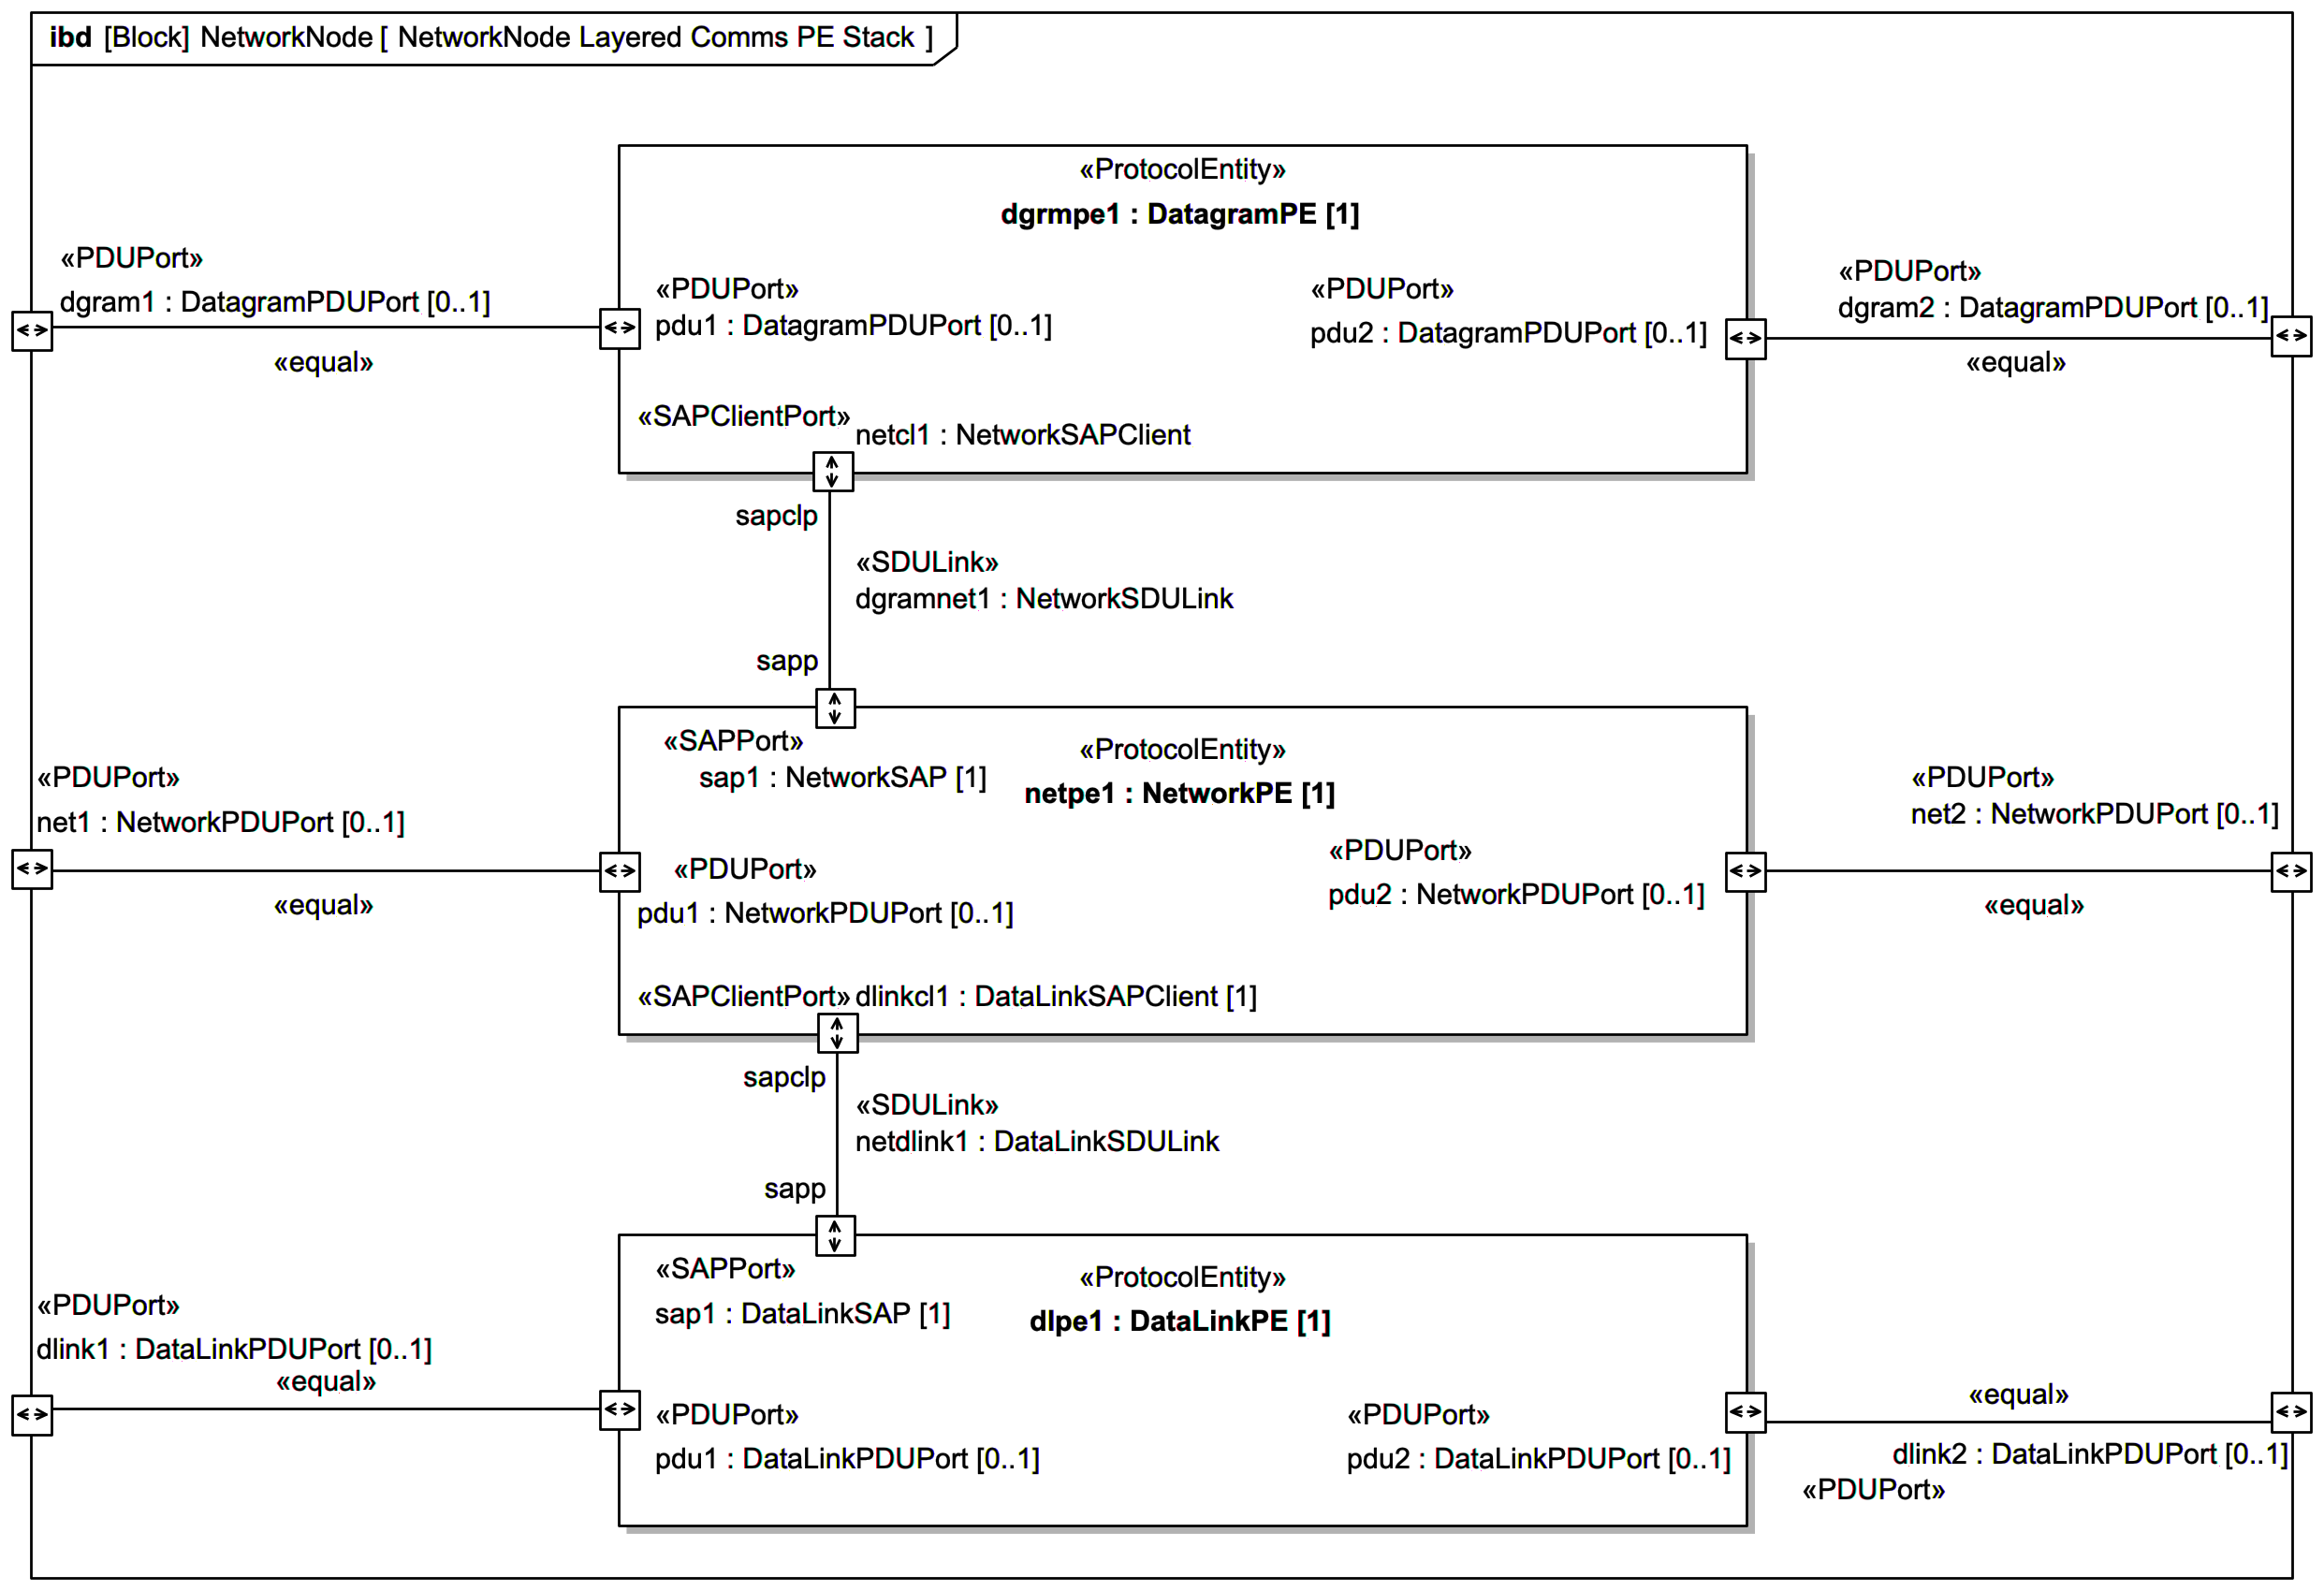
Layered Protocol Entities within Network Node
Parent Block with optionality on PDU ports
Binding connectors between inner/outer PDU Ports
Layered protocol entities within the NetworkNode
SAP Ports
SAP Clients
SDU Link connectors
SDU item flows not shown

Slide 30
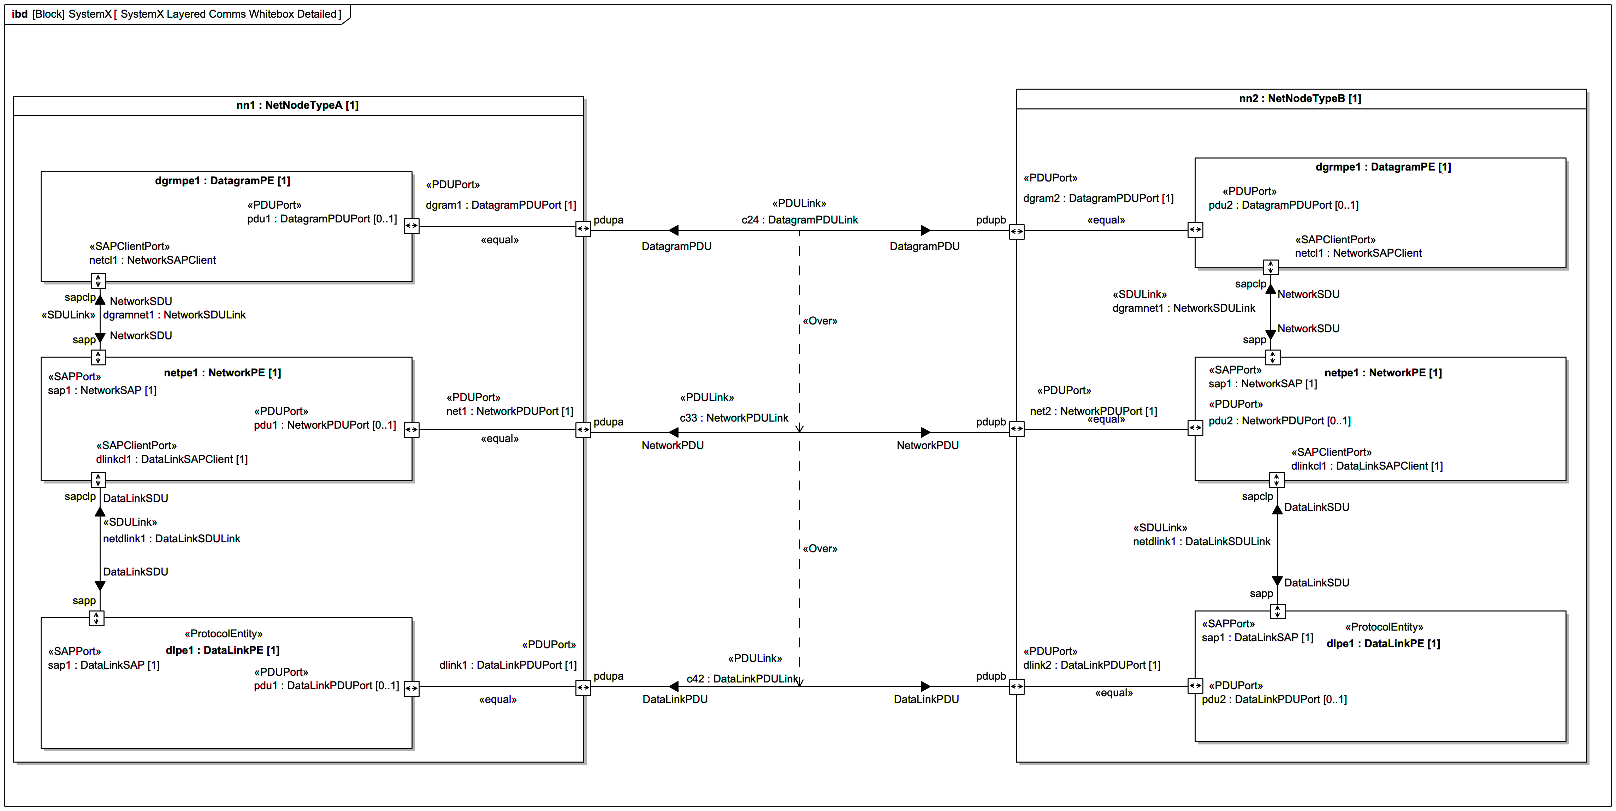
SystemX White Box Layered Comms

Slide 31
Related Work
Inspired by…
SysML v2 LayeredComms library https://github.com/guymeador/usm
Open-licensed repository
“Useful System Models”
README
From the repository above
Applies to the SysML v2 library for LayeredComms and other work on DataFields, too.
Also, thank you to to the Layered Interface pattern subgroup and Russell Peak for their review and encouragement for the SysML 1 work described in this presentation.
SysML v1 MDZIP is available
The profile and example provided in this presentation is available at the above link.
Download and open to explore the profile and example more deeply
Use it to impress your friends!
Provide feedback to make it better!
Thank you to the OMG System Modeling Community User WG’s Layered Interface Pattern subgroup members listed below. Your perspectives, wise counsel, feedback, advice, review, discussion, and patience have made this work all the better!
Sanford Friedenthal
Hans Peter de Koning
Andrew Muxen
Austin Roberts
Peter Shames
Separate feedback was also received from others listed here. Thank you!:
Vince Molnar
Juozas Vaicenavicius
Simas Vaitekicius
Other Resources
2015-2016 Original INCOSE papers and model
Peter M. Shames, Marc A. Sarrel, Sanford Friedenthal
http://www.omgsysml.org/A_modeling_pattern_for_layered_system_interfaces-INCOSE%20IS15_presentation-sarrel-shames.pdf
http://www.omgsysml.org/A_modeling_pattern_for_layered_system_interfaces-INCOSE%20IS15_paper-sarrel-shames.pdf
http://www.omgsysml.org/INCOSE_IS_2016_paper_Application-of-a-Layered-Interface-Modeling-Pattern.pdf
OMG System Modeling Community (Please join to participate)
Systems Modeling Community | Object Management Group
Users Working Group
Layered Interface Pattern Working Group
Advanced the examples from the above papers using SysML 2
Updates to the original SysML v1 model from the above papers to express in SysML v2
Other related papers and information available in the OMG SMC

