Slide 1
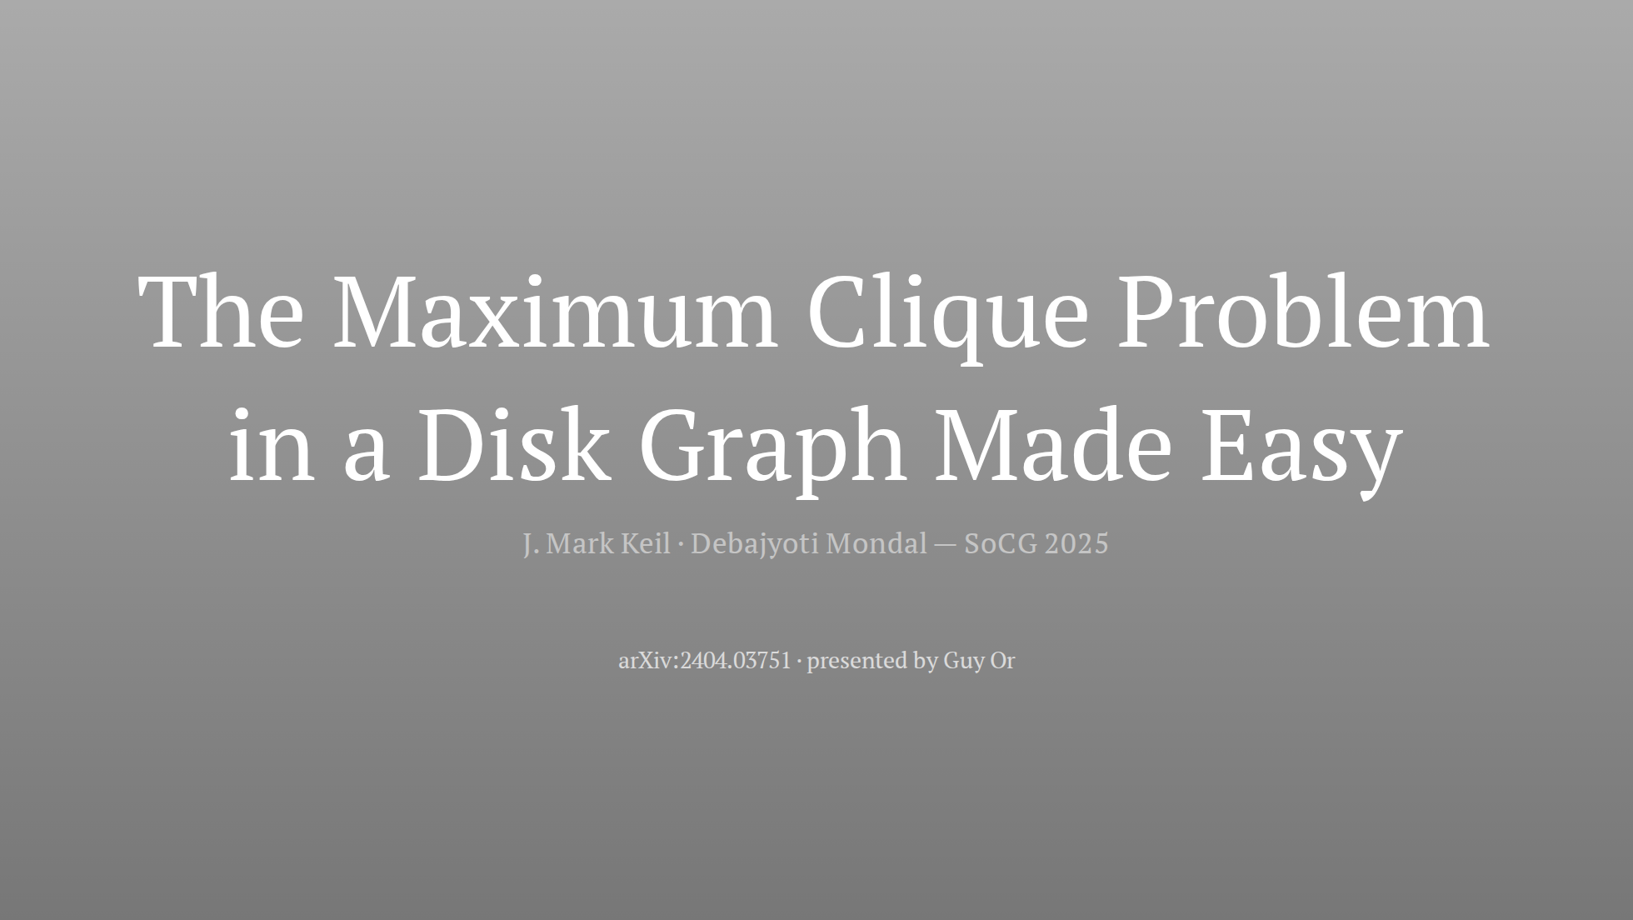
Notes:
~30s. Say the title, the venue, and one sentence: "a 35-year-old open
problem, solved with high-school geometry — the story is why nobody found
it sooner."

Slide 2
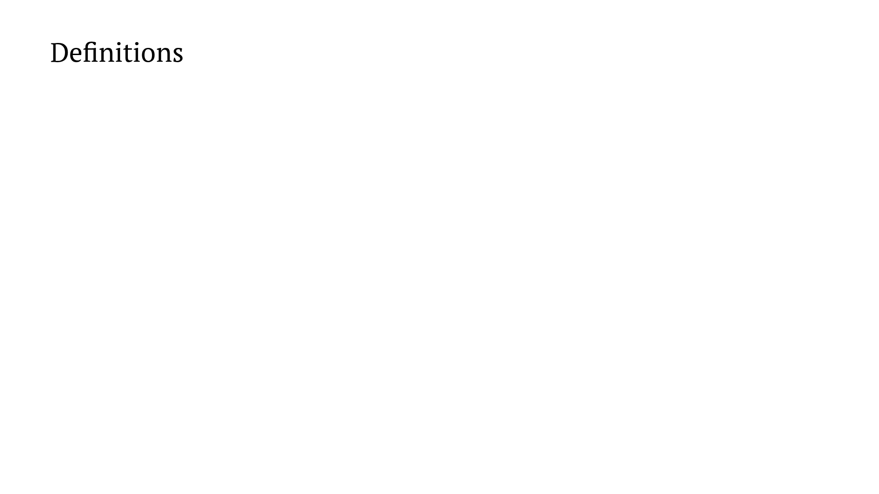
Notes:
~1.5 min. Stress the iff: every adjacency claim later is secretly a
distance claim. The graph forgets the geometry — the disk representation is
part of the input.

Slide 3
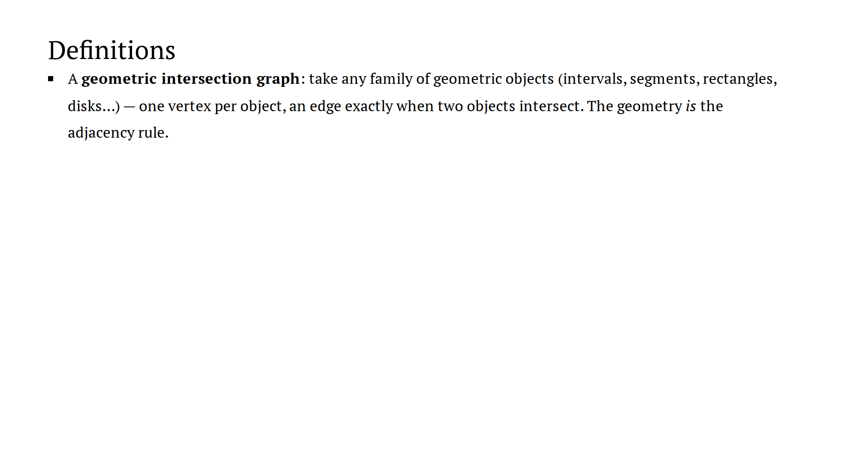
Notes:
~1.5 min. Stress the iff: every adjacency claim later is secretly a
distance claim. The graph forgets the geometry — the disk representation is
part of the input.

Slide 4
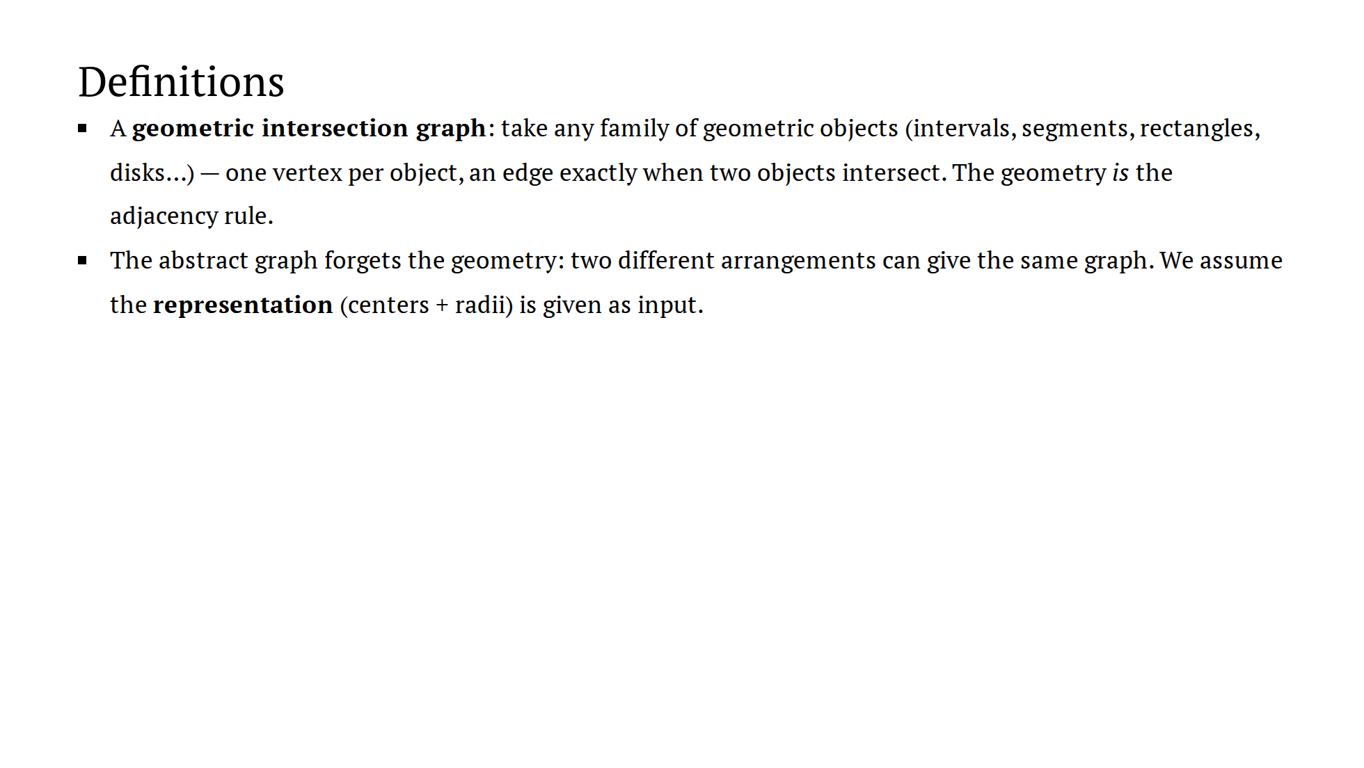
Notes:
~1.5 min. Stress the iff: every adjacency claim later is secretly a
distance claim. The graph forgets the geometry — the disk representation is
part of the input.

Slide 5
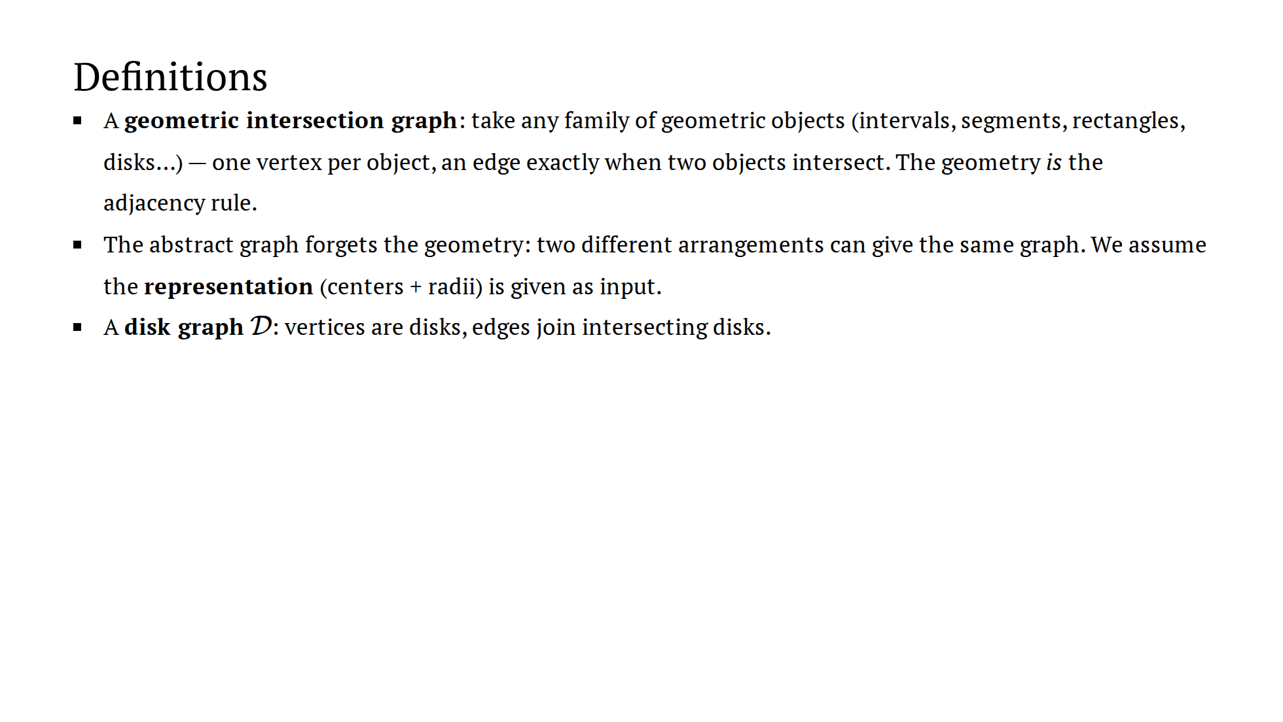
Notes:
~1.5 min. Stress the iff: every adjacency claim later is secretly a
distance claim. The graph forgets the geometry — the disk representation is
part of the input.

Slide 6
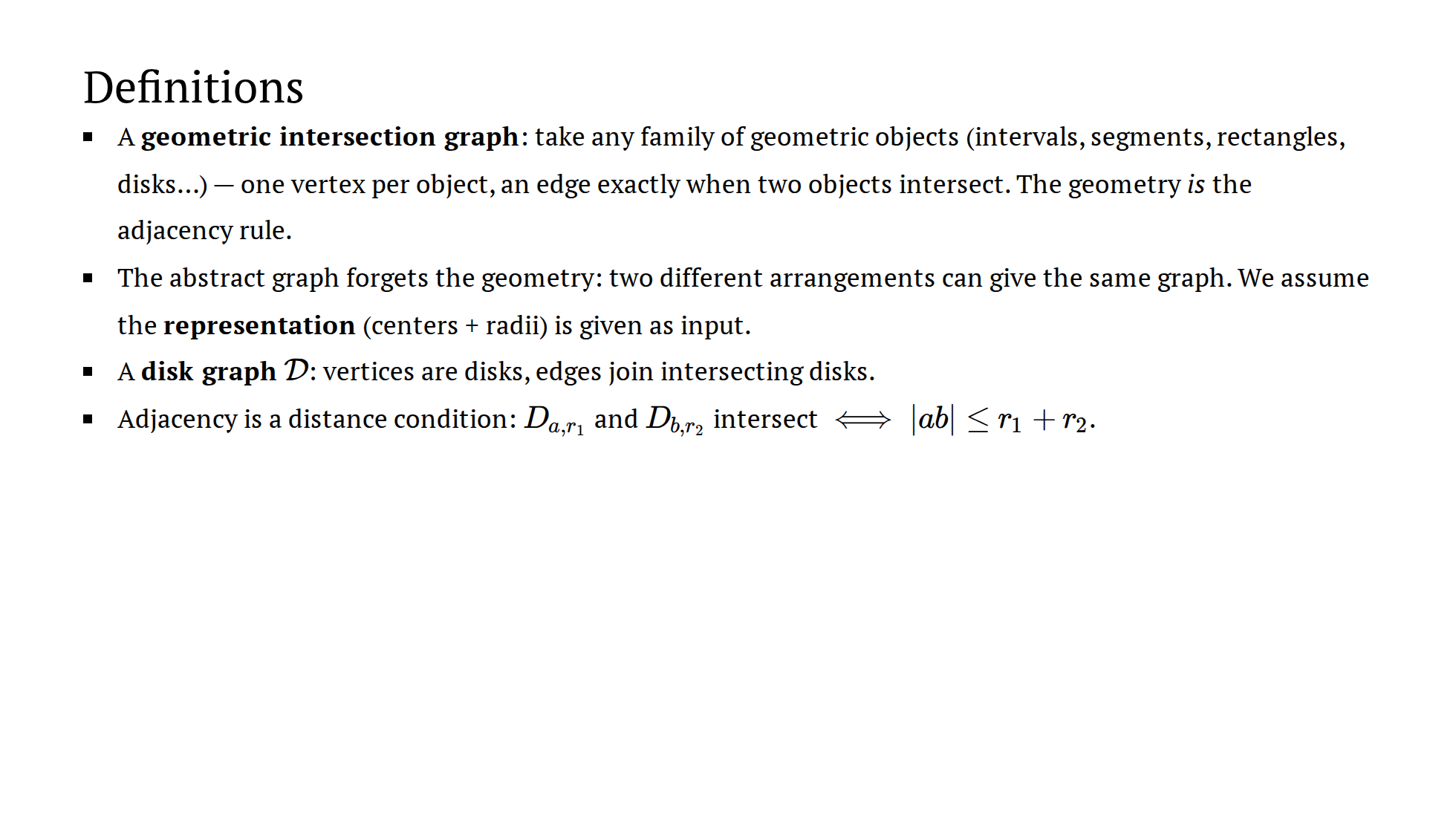
Notes:
~1.5 min. Stress the iff: every adjacency claim later is secretly a
distance claim. The graph forgets the geometry — the disk representation is
part of the input.

Slide 7
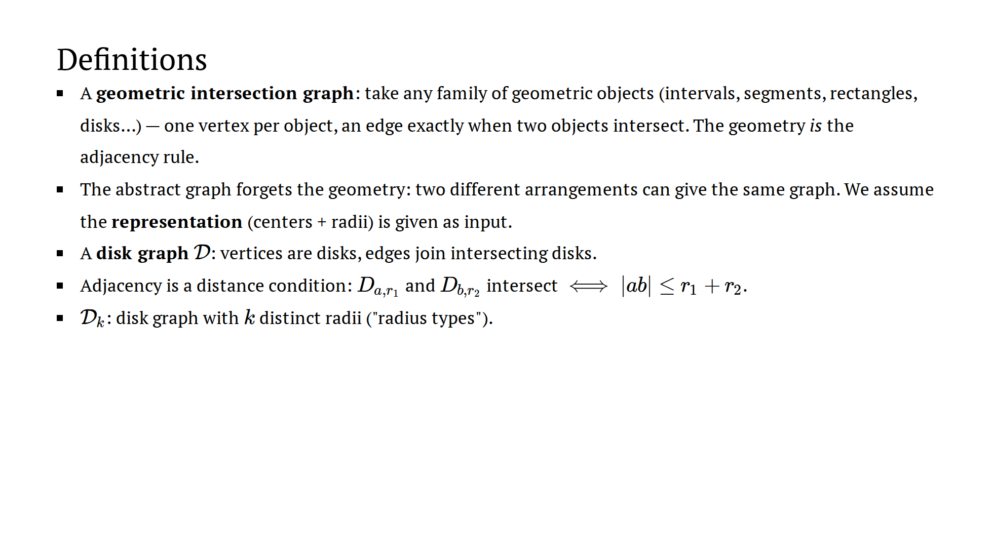
Notes:
~1.5 min. Stress the iff: every adjacency claim later is secretly a
distance claim. The graph forgets the geometry — the disk representation is
part of the input.

Slide 8
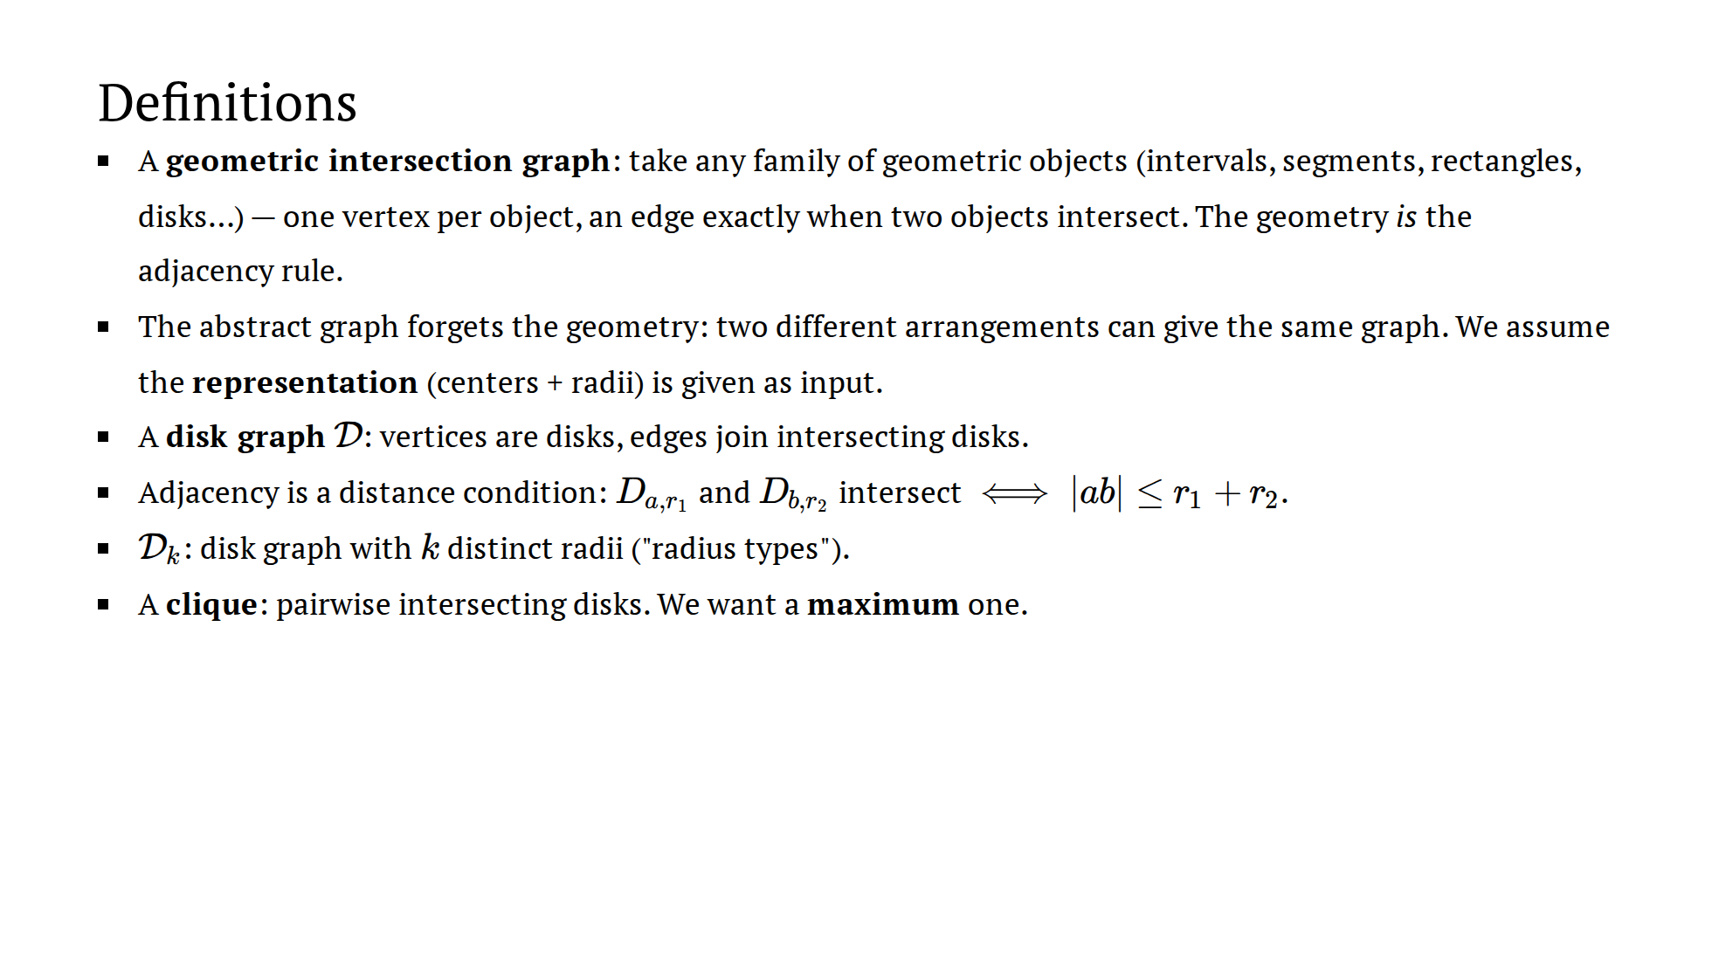
Notes:
~1.5 min. Stress the iff: every adjacency claim later is secretly a
distance claim. The graph forgets the geometry — the disk representation is
part of the input.

Slide 9
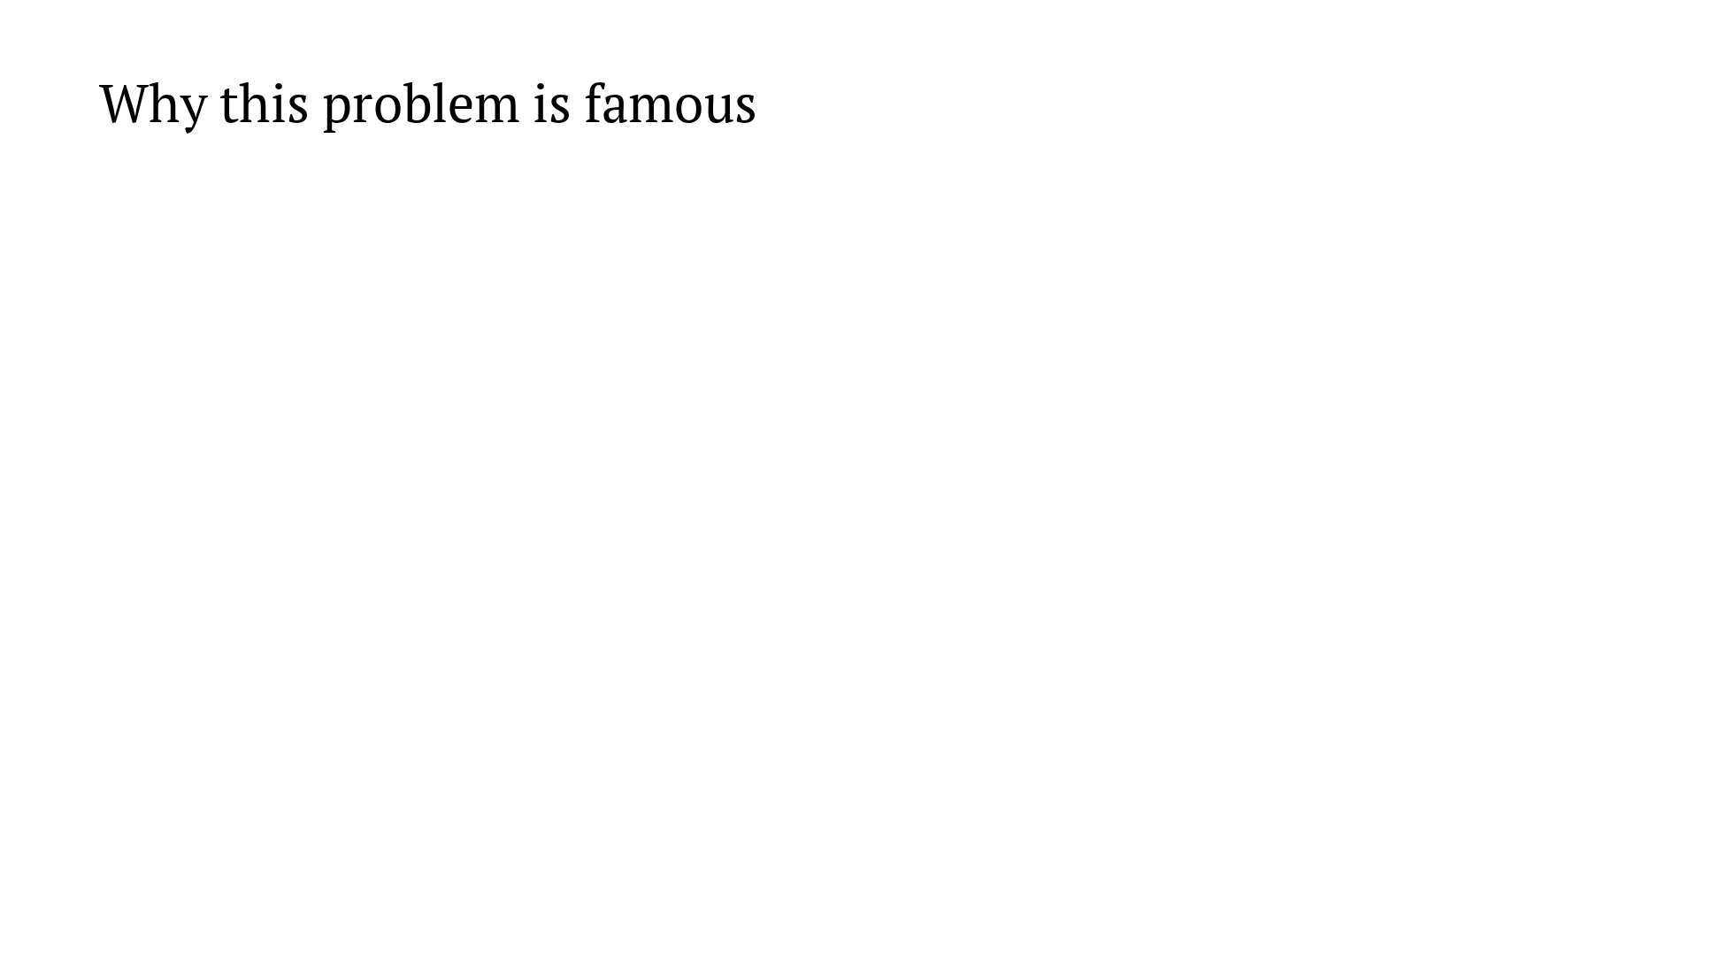
Notes:
~2 min. The stakes slide. Don't explain CCJ, just name it. The last
line is the promissory note for the epilogue.

Slide 10
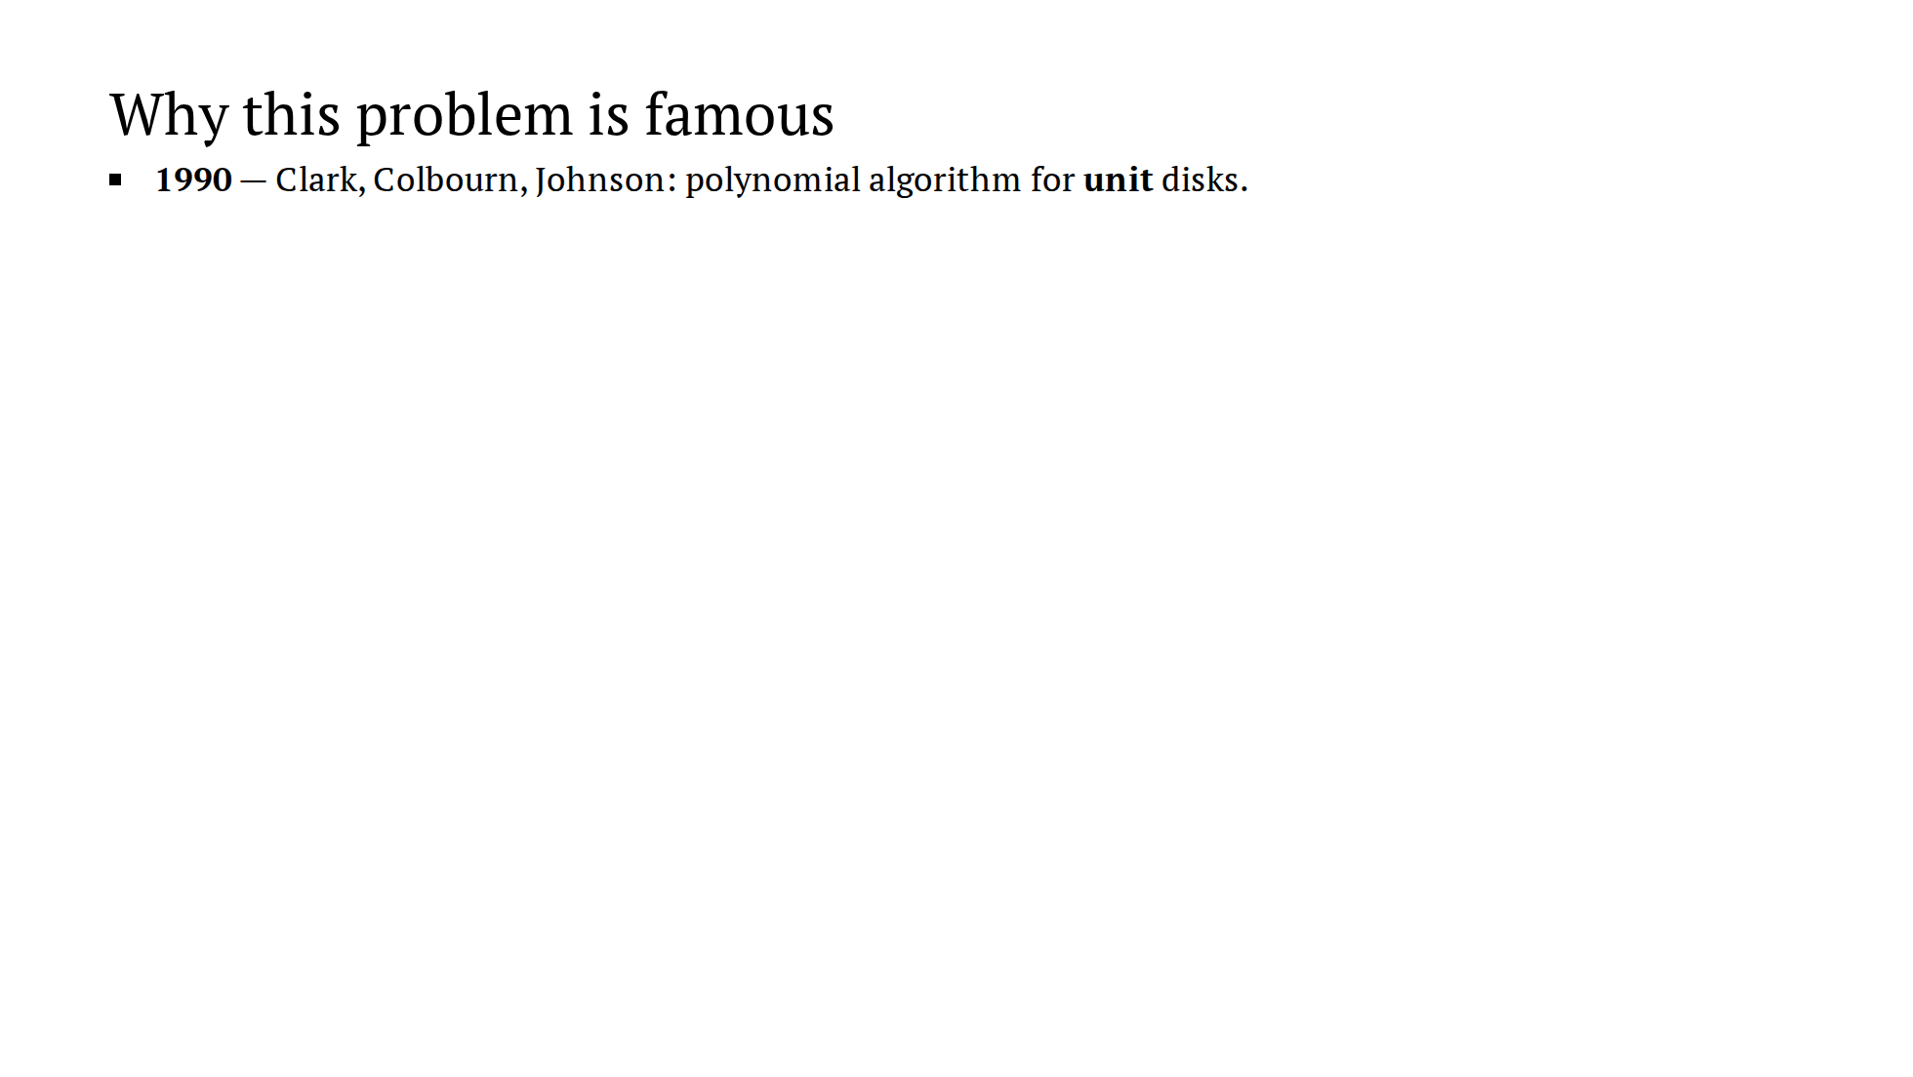
Notes:
~2 min. The stakes slide. Don't explain CCJ, just name it. The last
line is the promissory note for the epilogue.

Slide 11
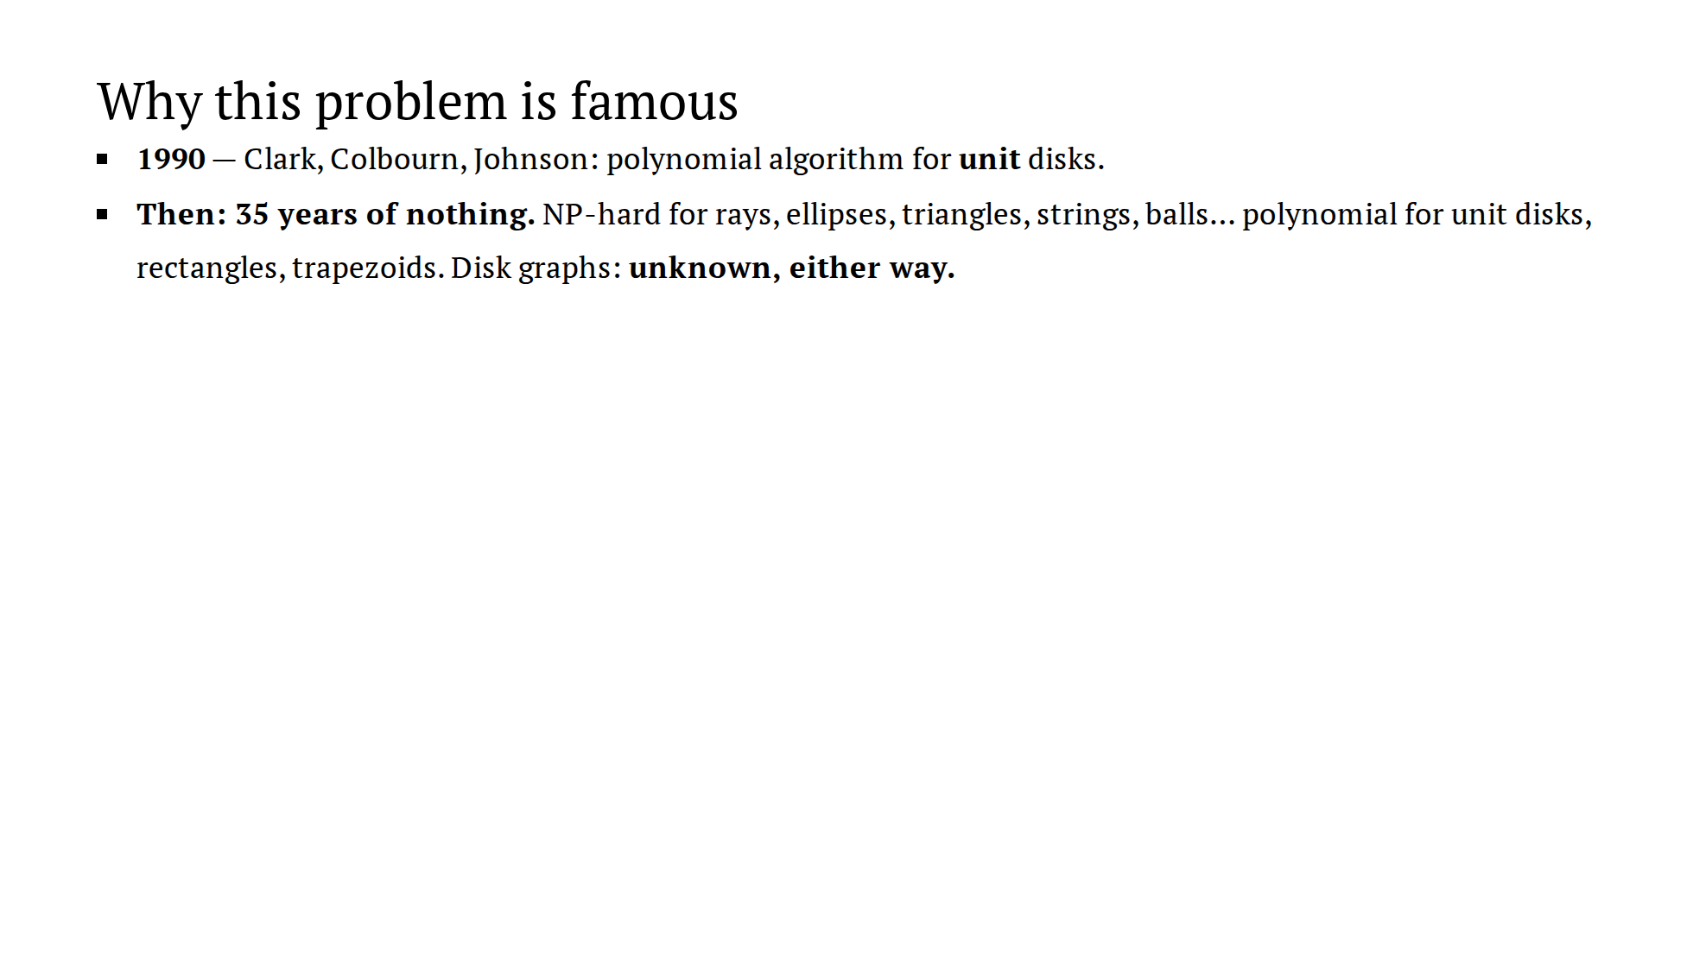
Notes:
~2 min. The stakes slide. Don't explain CCJ, just name it. The last
line is the promissory note for the epilogue.

Slide 12
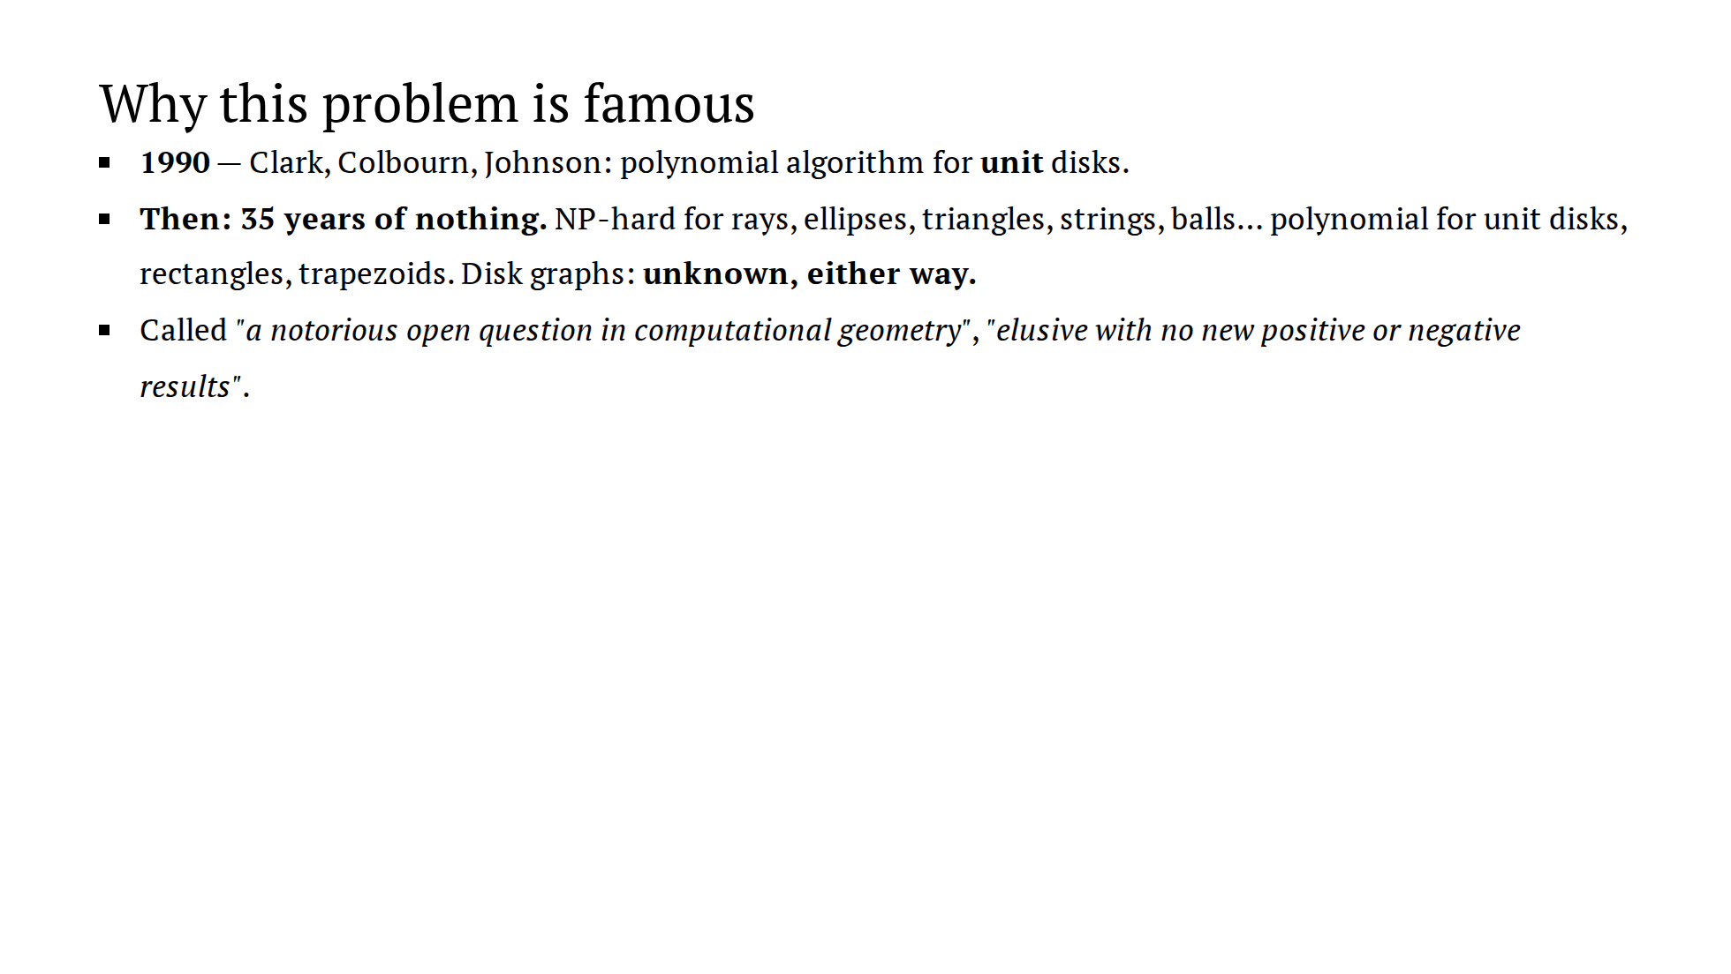
Notes:
~2 min. The stakes slide. Don't explain CCJ, just name it. The last
line is the promissory note for the epilogue.

Slide 13
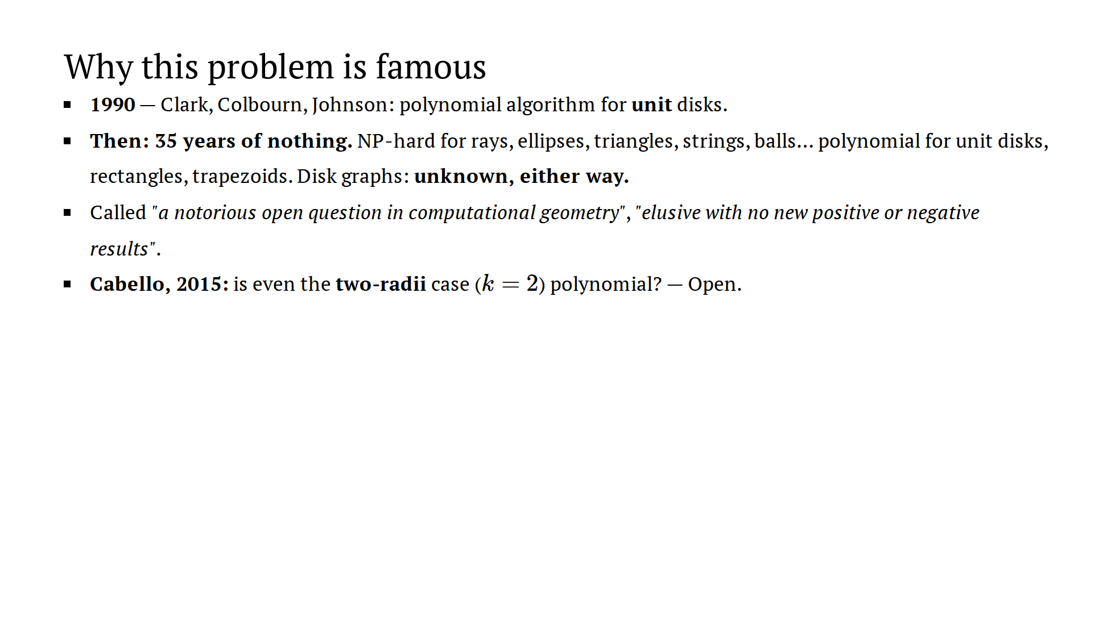
Notes:
~2 min. The stakes slide. Don't explain CCJ, just name it. The last
line is the promissory note for the epilogue.

Slide 14
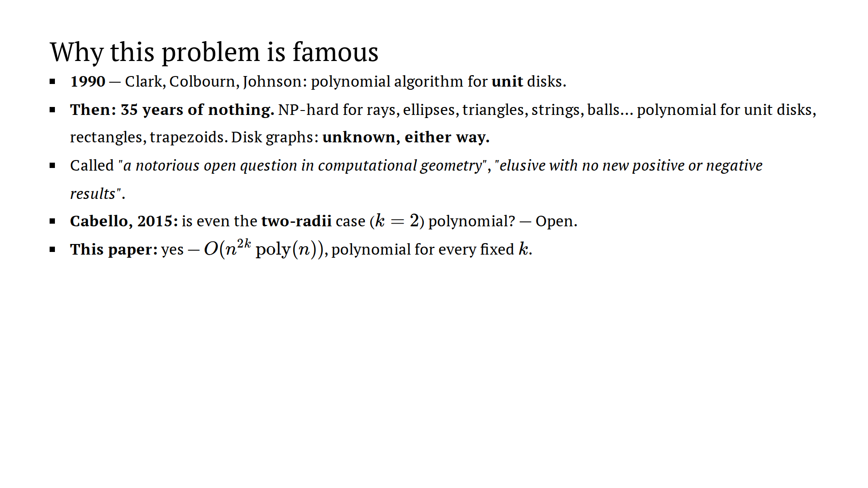
Notes:
~2 min. The stakes slide. Don't explain CCJ, just name it. The last
line is the promissory note for the epilogue.

Slide 15
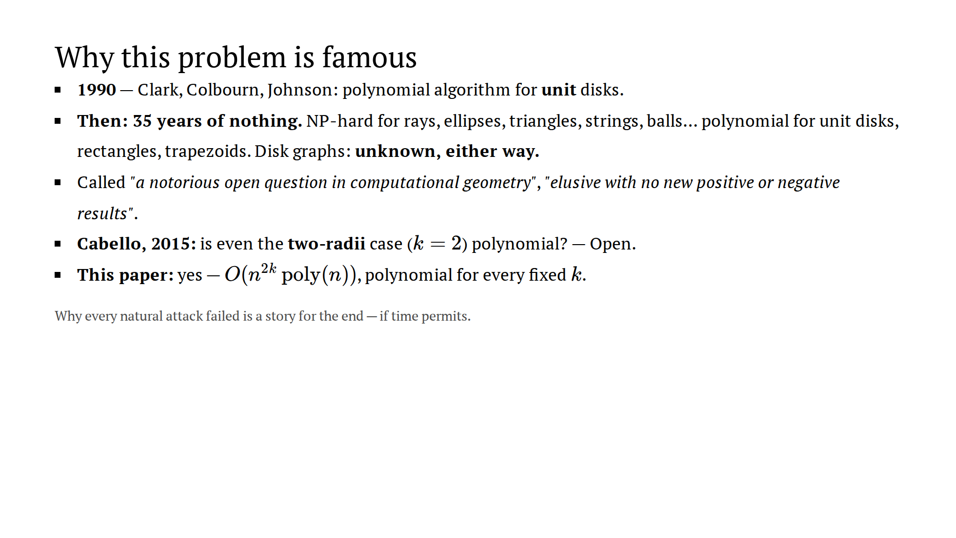
Notes:
~2 min. The stakes slide. Don't explain CCJ, just name it. The last
line is the promissory note for the epilogue.

Slide 16
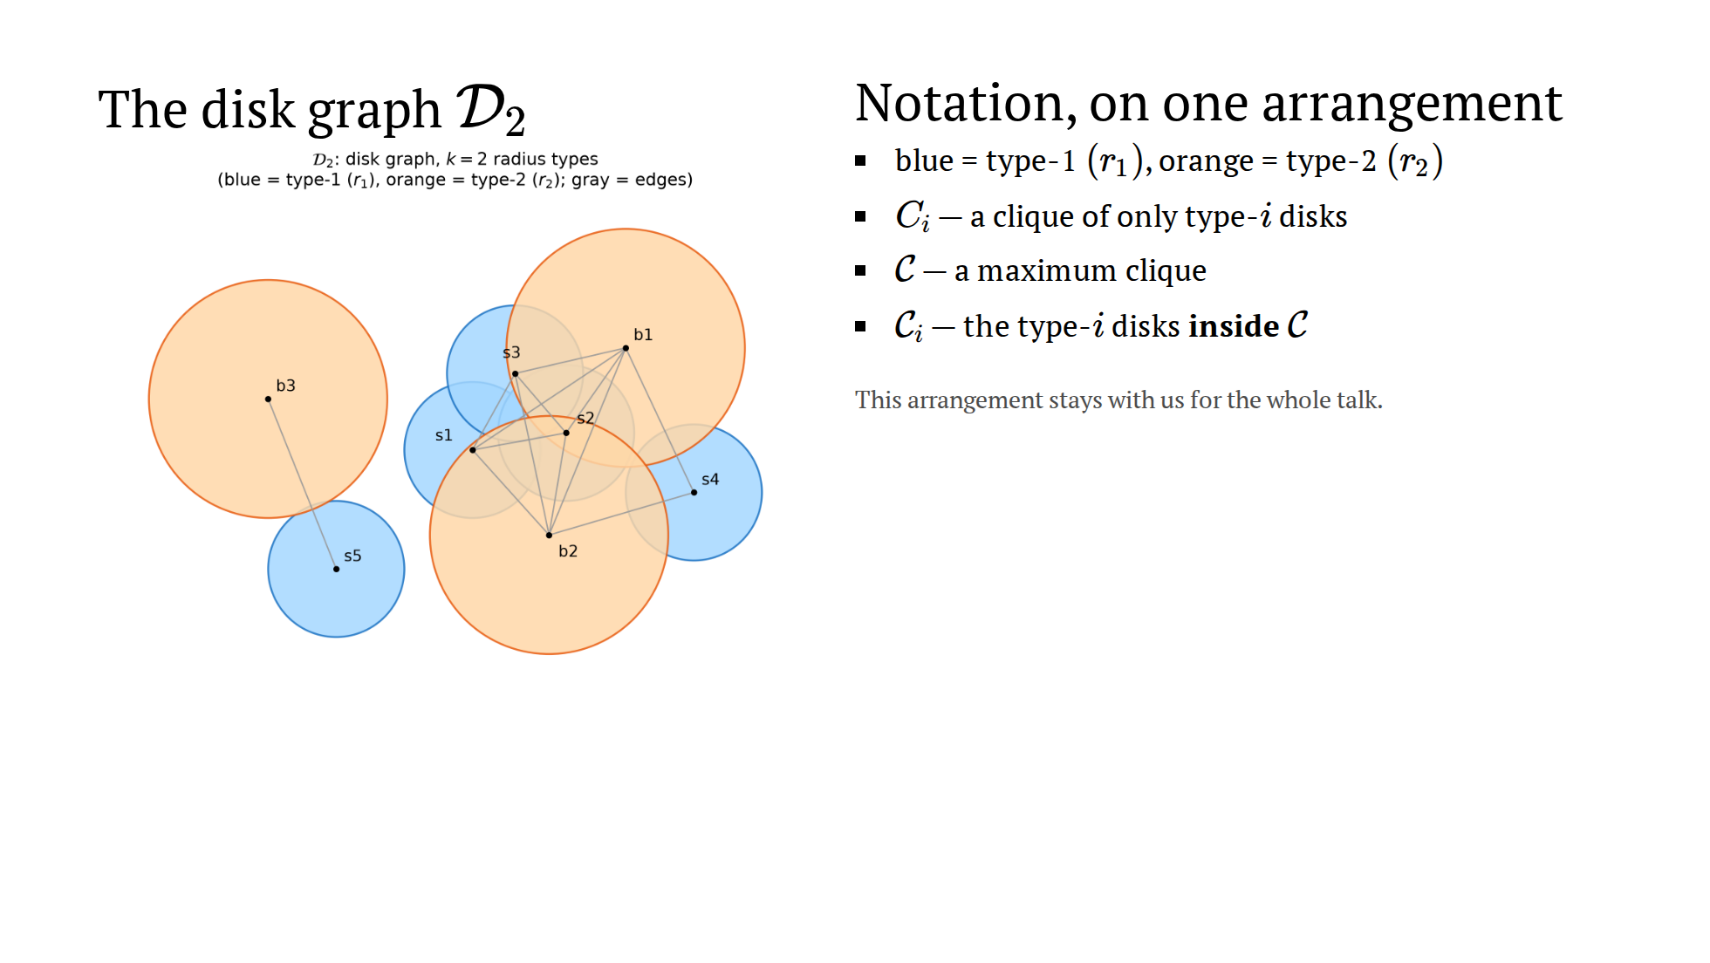
Notes:
~1.5 min. Introduce the cast once. C_i vs calligraphic C_i distinction:
any single-type clique vs the type class of THE maximum clique.

Slide 17
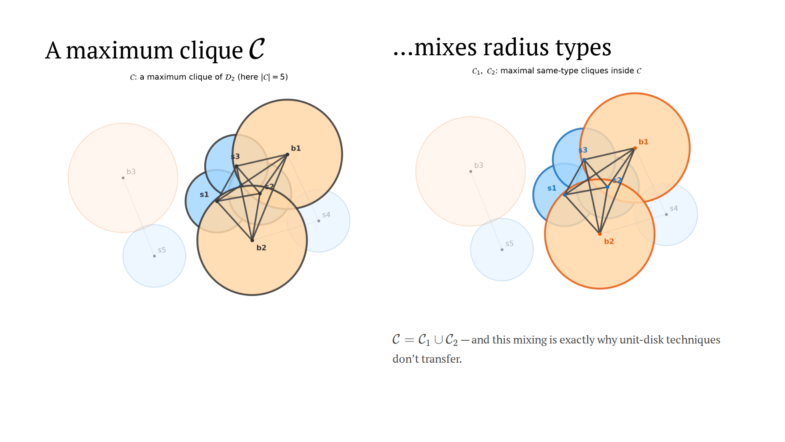
Notes:
~1.5 min. "Why can't we solve each radius type separately and glue?"
Because the maximum clique mixes types; the per-type maxima can live in
different corners of the arrangement.

Slide 18
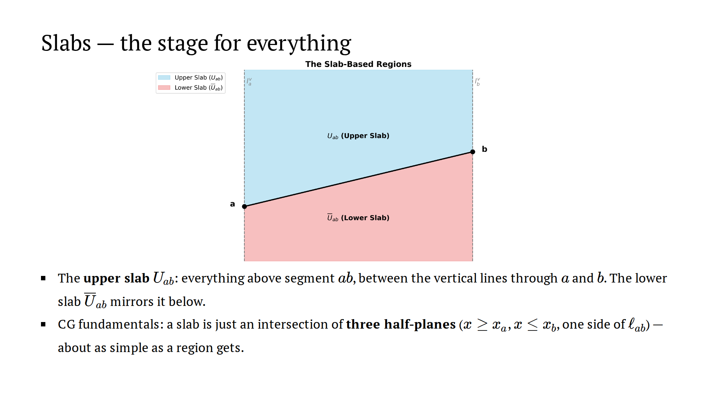
Notes:
~1 min. Plant the contrast for the epilogue: prior work used lenses
(curved, pair-dependent); this paper's entire innovation fits in three
half-planes.

Slide 19
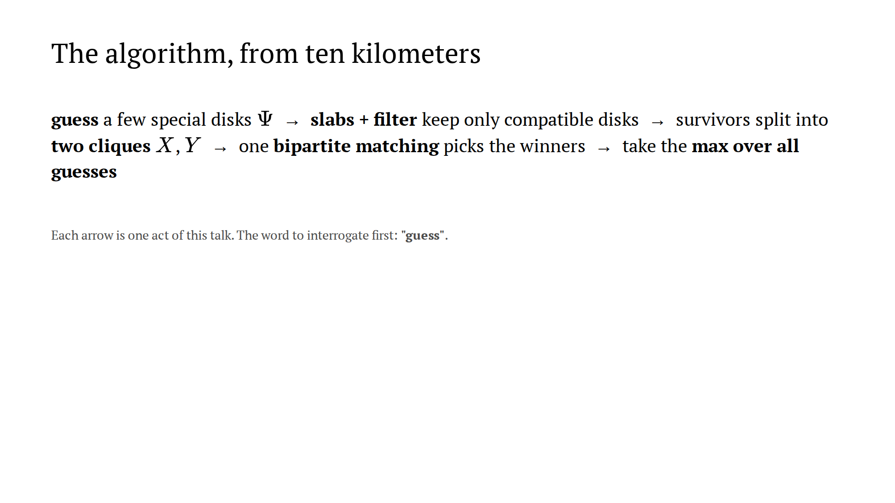
Notes:
~1.5 min. The roadmap; echo it before each act. Everything hard hides
inside the word "guess".

Slide 20
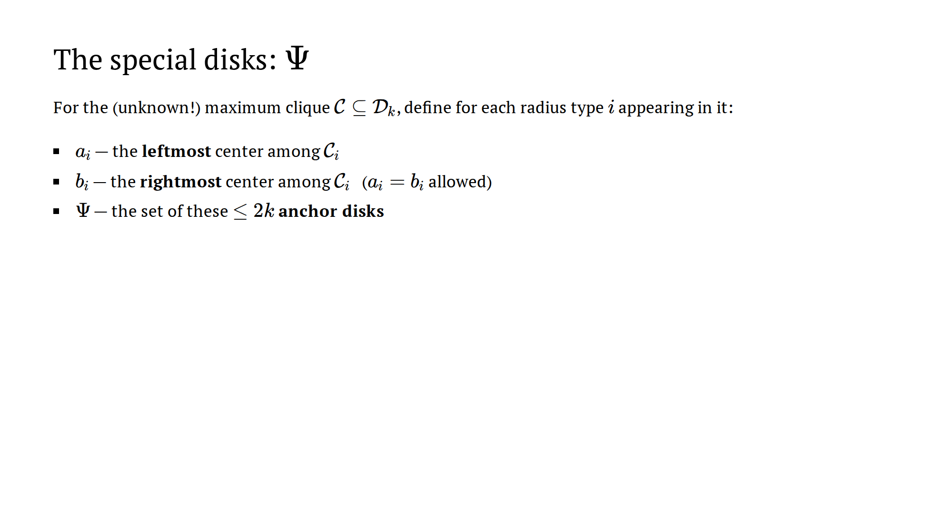
Notes:
~1 min. Deadpan the last line and advance immediately to the trap. The
word "unknown" in the first sentence is the seed — don't stress it yet, let
the next slide detonate it.

Slide 21
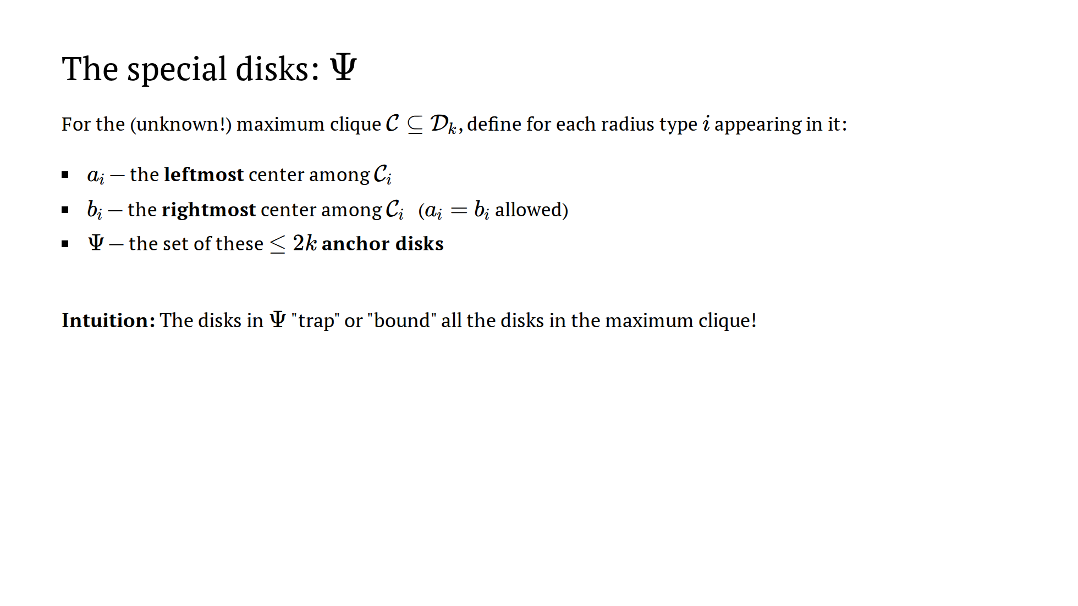
Notes:
~1 min. Deadpan the last line and advance immediately to the trap. The
word "unknown" in the first sentence is the seed — don't stress it yet, let
the next slide detonate it.

Slide 22
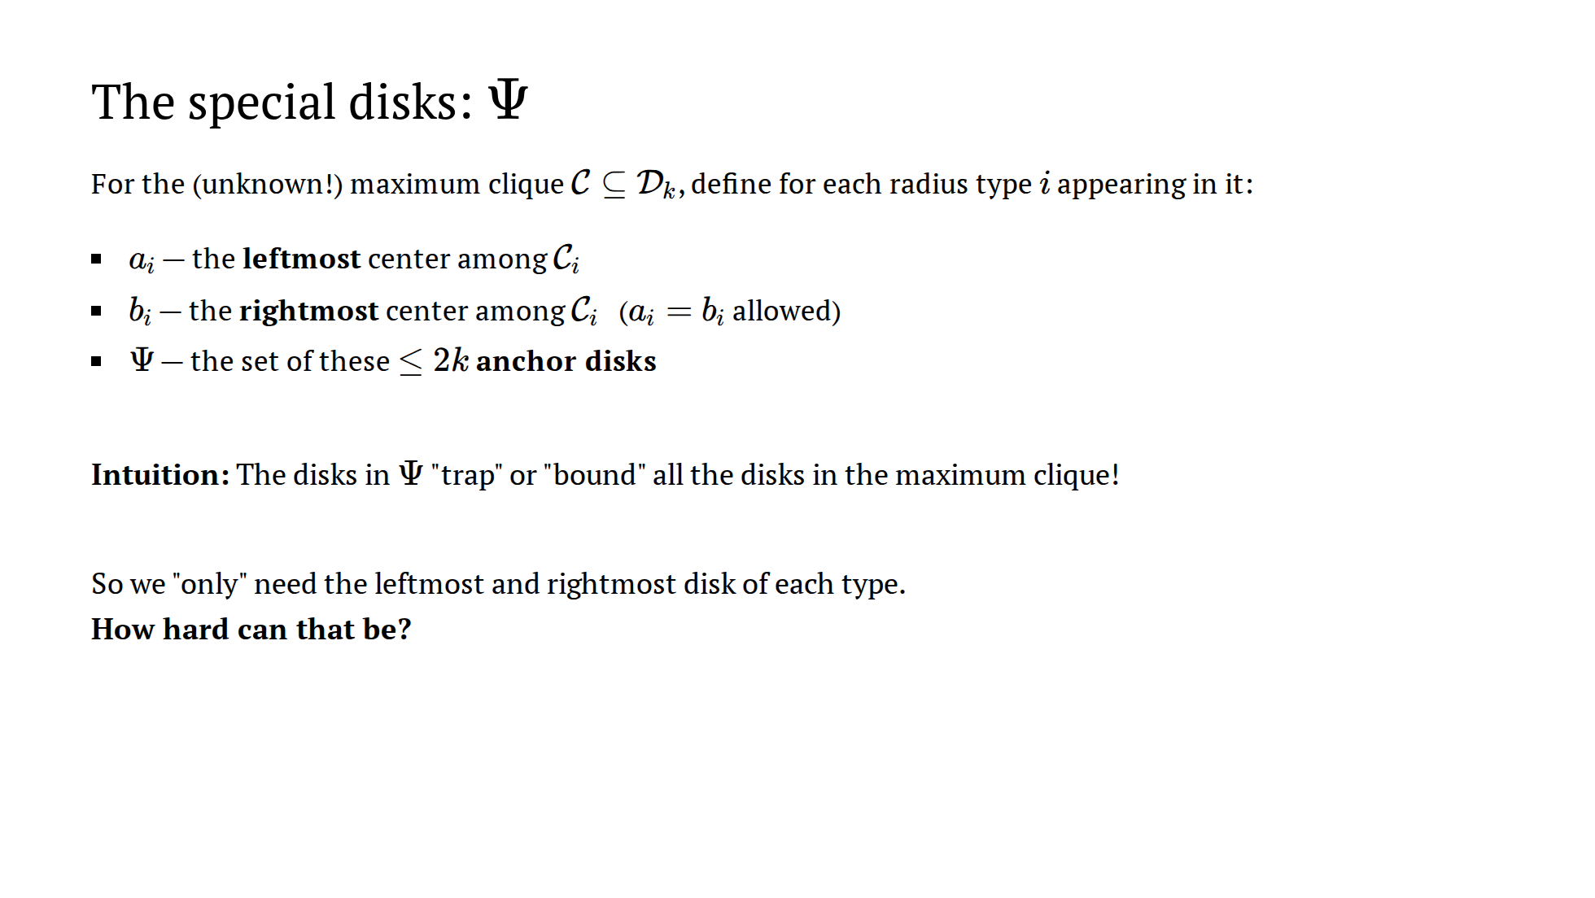
Notes:
~1 min. Deadpan the last line and advance immediately to the trap. The
word "unknown" in the first sentence is the seed — don't stress it yet, let
the next slide detonate it.

Slide 23
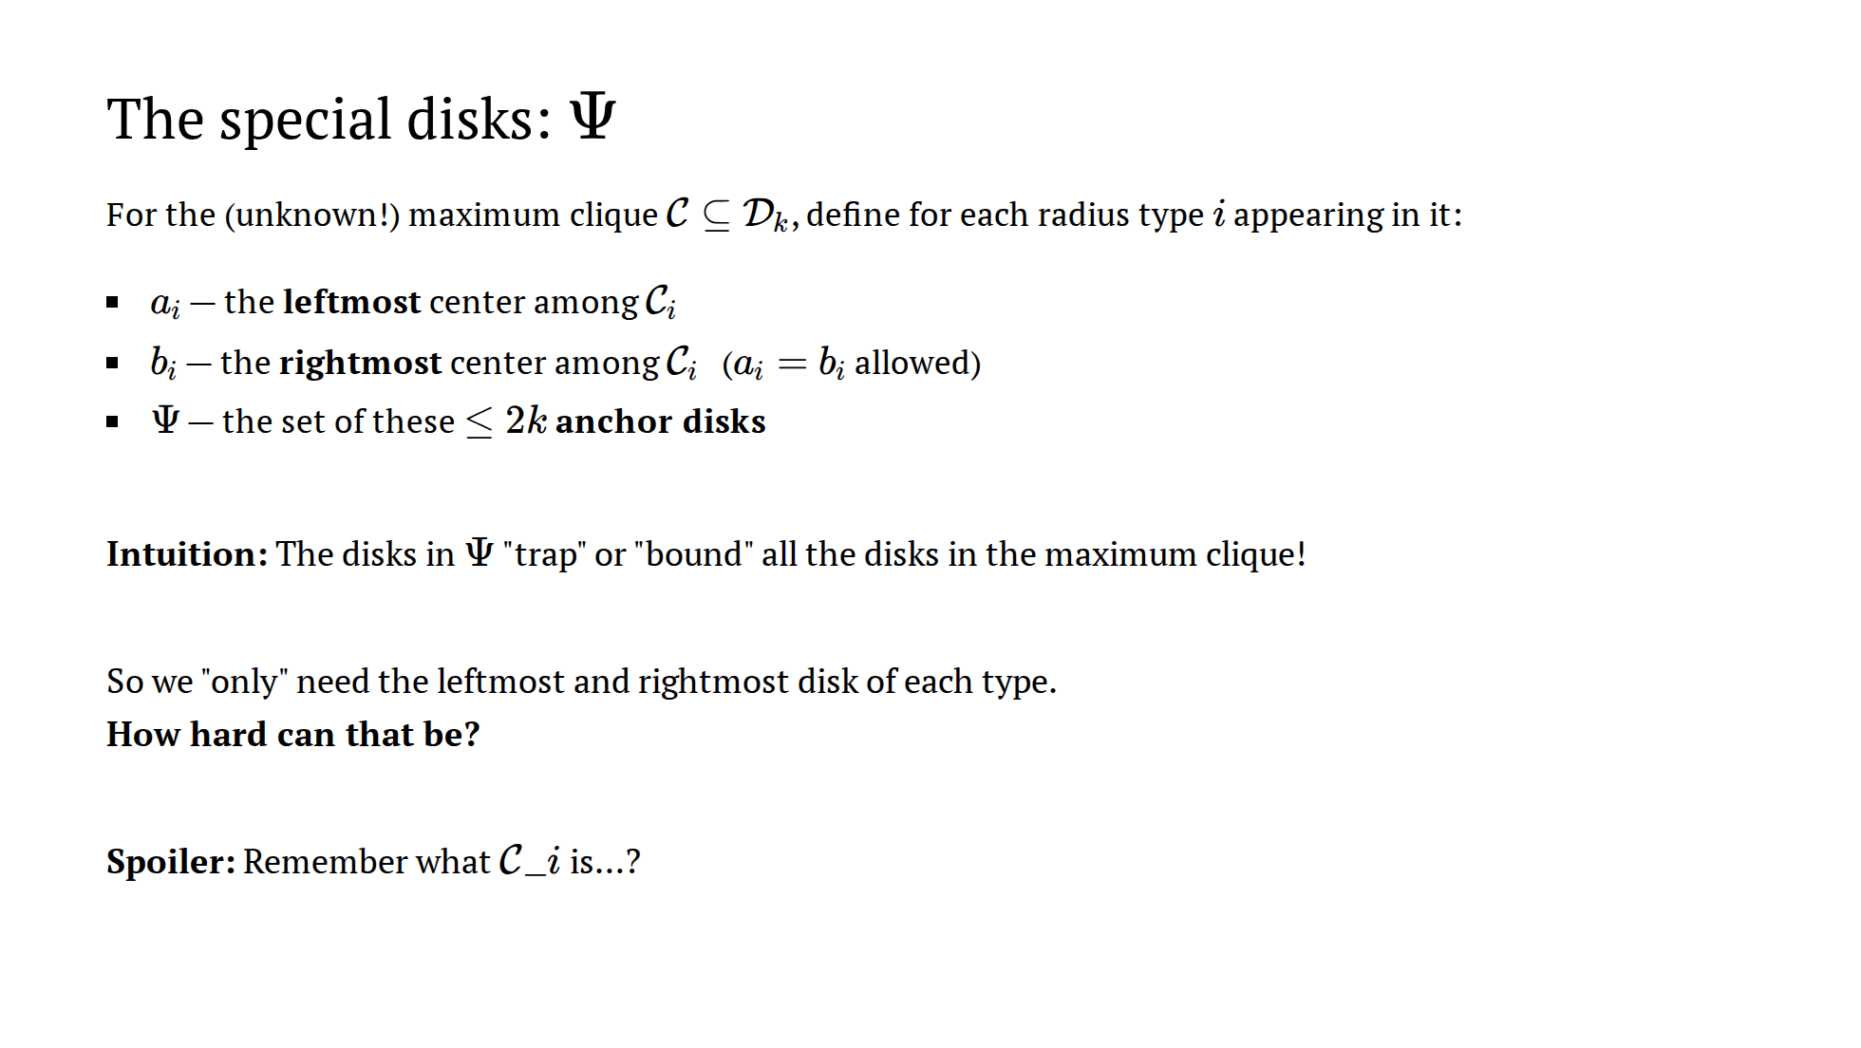
Notes:
~1 min. Deadpan the last line and advance immediately to the trap. The
word "unknown" in the first sentence is the seed — don't stress it yet, let
the next slide detonate it.

Slide 24
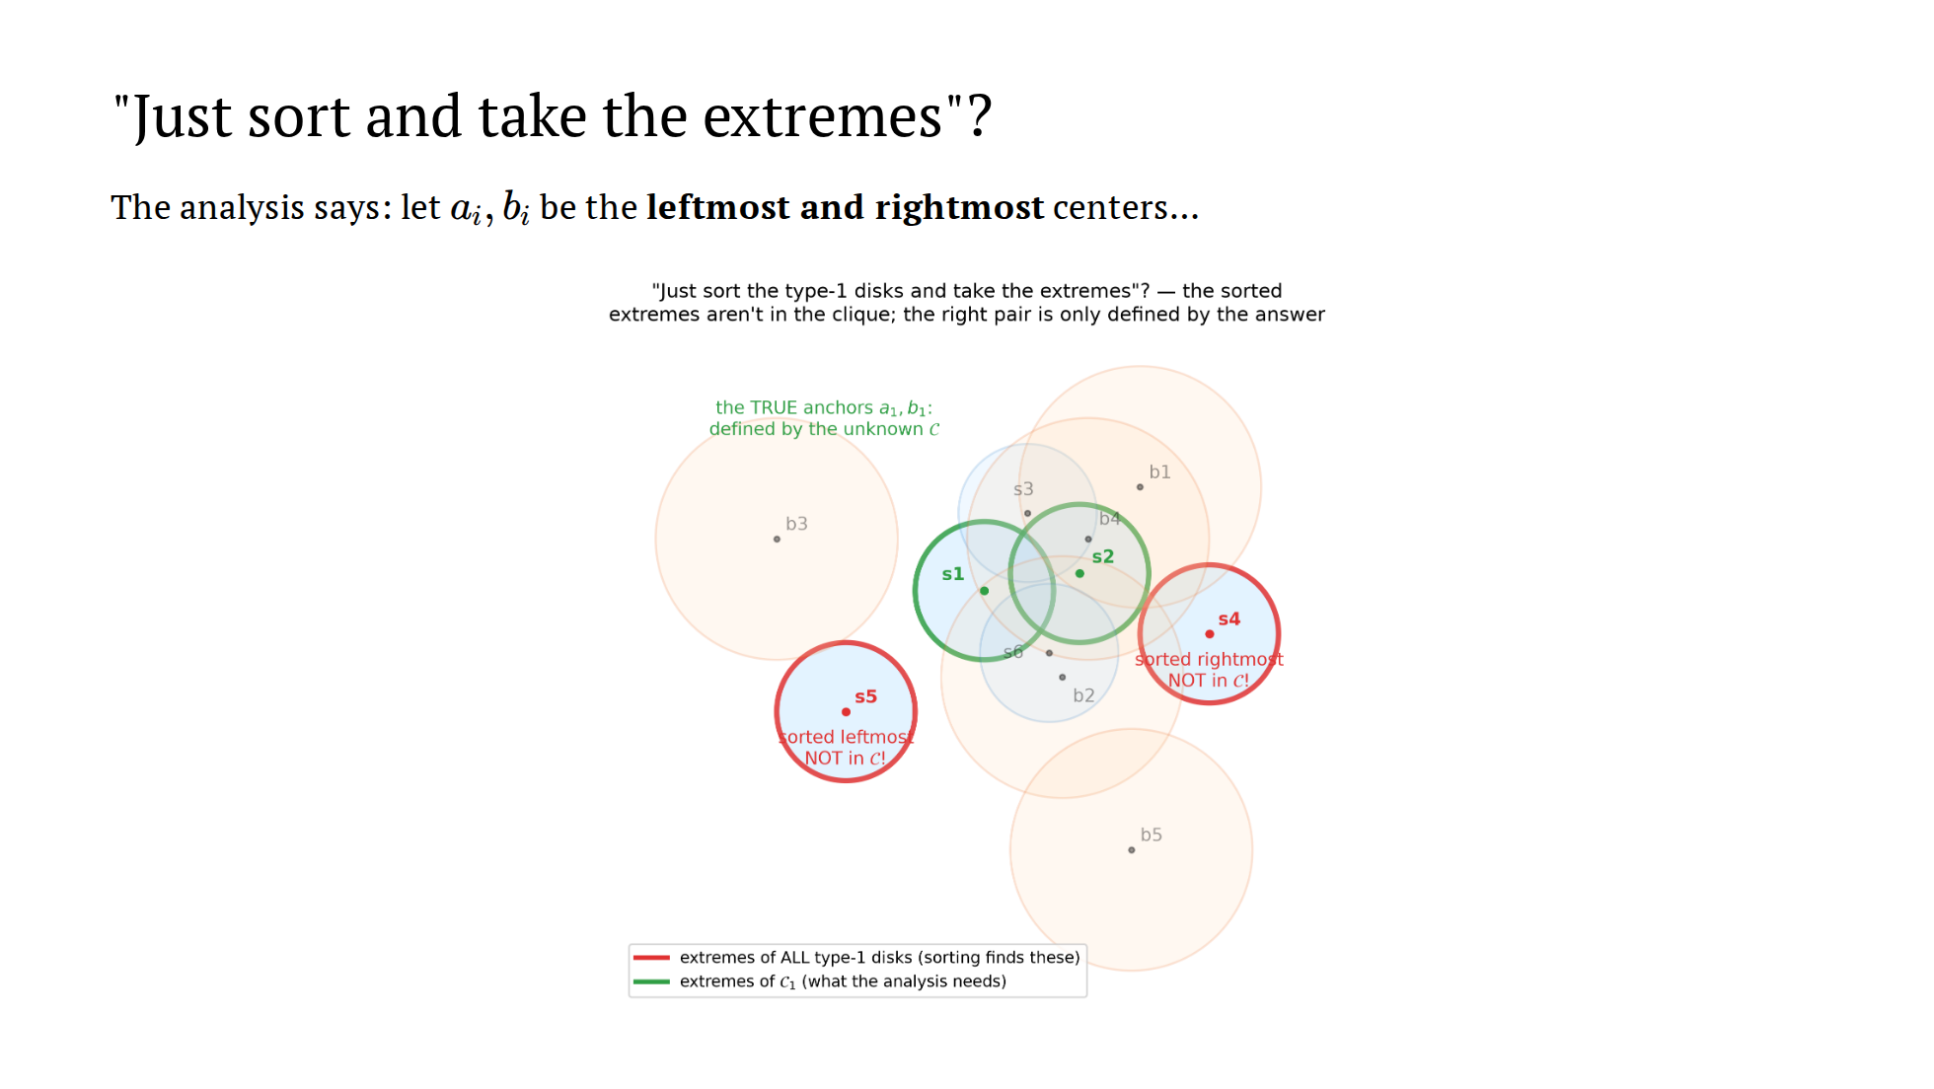
Notes:
~1.5 min. Let them feel the temptation, then the trap: the sorted
extremes of the type-1 disks (s5, s4) are not even IN the maximum clique.
The extremes we need are extremes OF C_1 — a set nobody knows.

Slide 25
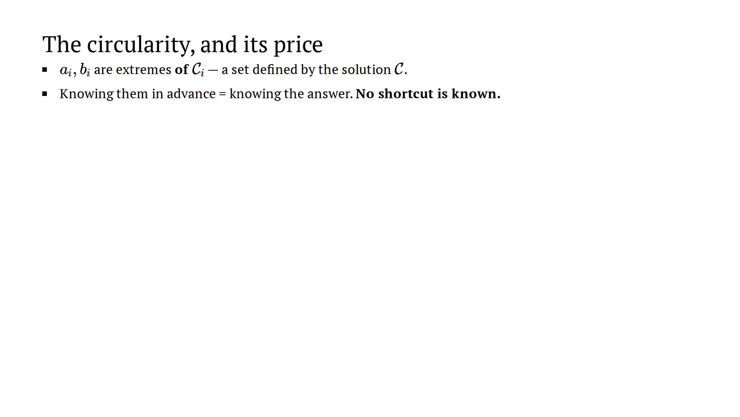
Notes:
~1.5 min. THE conceptual slide. n^{2k} is the price tag on circular
information. If they get this, the rest of the construction is bookkeeping.
If asked "what's a witness?": a witness (or certificate) is a small piece
of side information that makes a hard problem easy — once you hold it, the
full solution can be reconstructed and verified in polynomial time. Here the
witness is the 2k anchor disks: holding the correct anchors, the slabs +
filter + matching rebuild the entire maximum clique, however large it is. The
algorithm doesn't receive the witness; it BUYS it by enumeration — which is
why witness SIZE is everything: size 2k costs n^{O(k)}; a witness of size
Θ(|C|) would cost exponential time and the approach would be worthless.

Slide 26
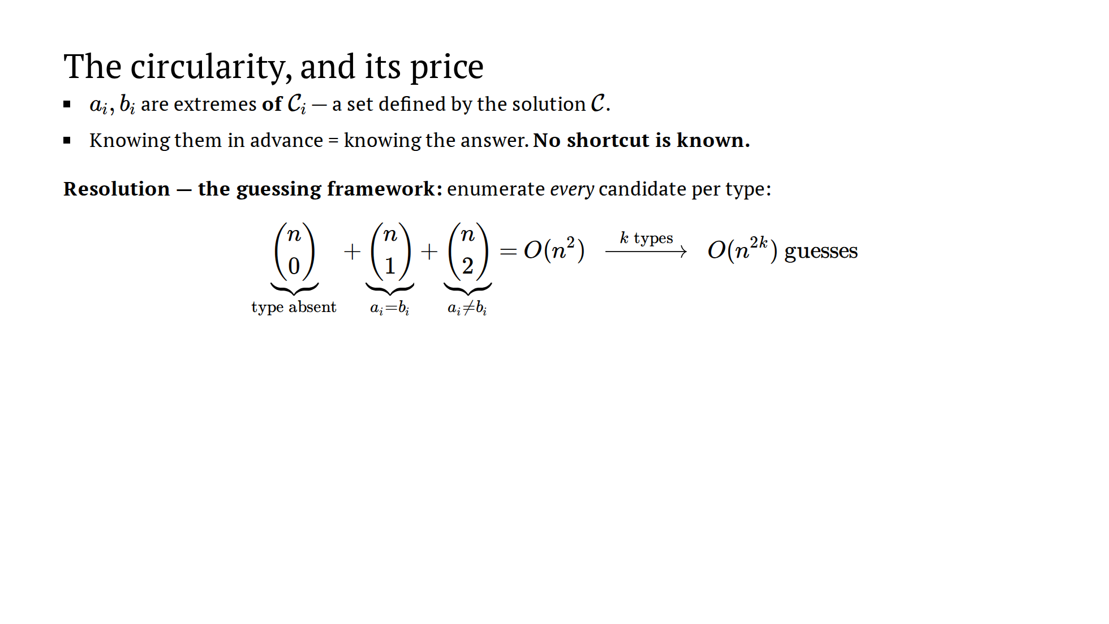
Notes:
~1.5 min. THE conceptual slide. n^{2k} is the price tag on circular
information. If they get this, the rest of the construction is bookkeeping.
If asked "what's a witness?": a witness (or certificate) is a small piece
of side information that makes a hard problem easy — once you hold it, the
full solution can be reconstructed and verified in polynomial time. Here the
witness is the 2k anchor disks: holding the correct anchors, the slabs +
filter + matching rebuild the entire maximum clique, however large it is. The
algorithm doesn't receive the witness; it BUYS it by enumeration — which is
why witness SIZE is everything: size 2k costs n^{O(k)}; a witness of size
Θ(|C|) would cost exponential time and the approach would be worthless.

Slide 27
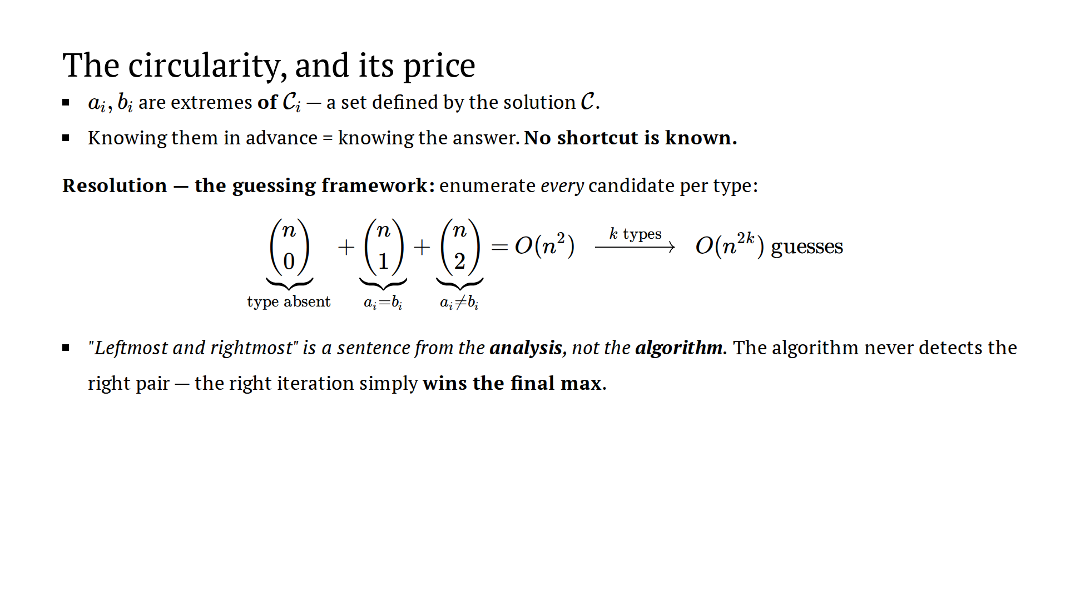
Notes:
~1.5 min. THE conceptual slide. n^{2k} is the price tag on circular
information. If they get this, the rest of the construction is bookkeeping.
If asked "what's a witness?": a witness (or certificate) is a small piece
of side information that makes a hard problem easy — once you hold it, the
full solution can be reconstructed and verified in polynomial time. Here the
witness is the 2k anchor disks: holding the correct anchors, the slabs +
filter + matching rebuild the entire maximum clique, however large it is. The
algorithm doesn't receive the witness; it BUYS it by enumeration — which is
why witness SIZE is everything: size 2k costs n^{O(k)}; a witness of size
Θ(|C|) would cost exponential time and the approach would be worthless.

Slide 28
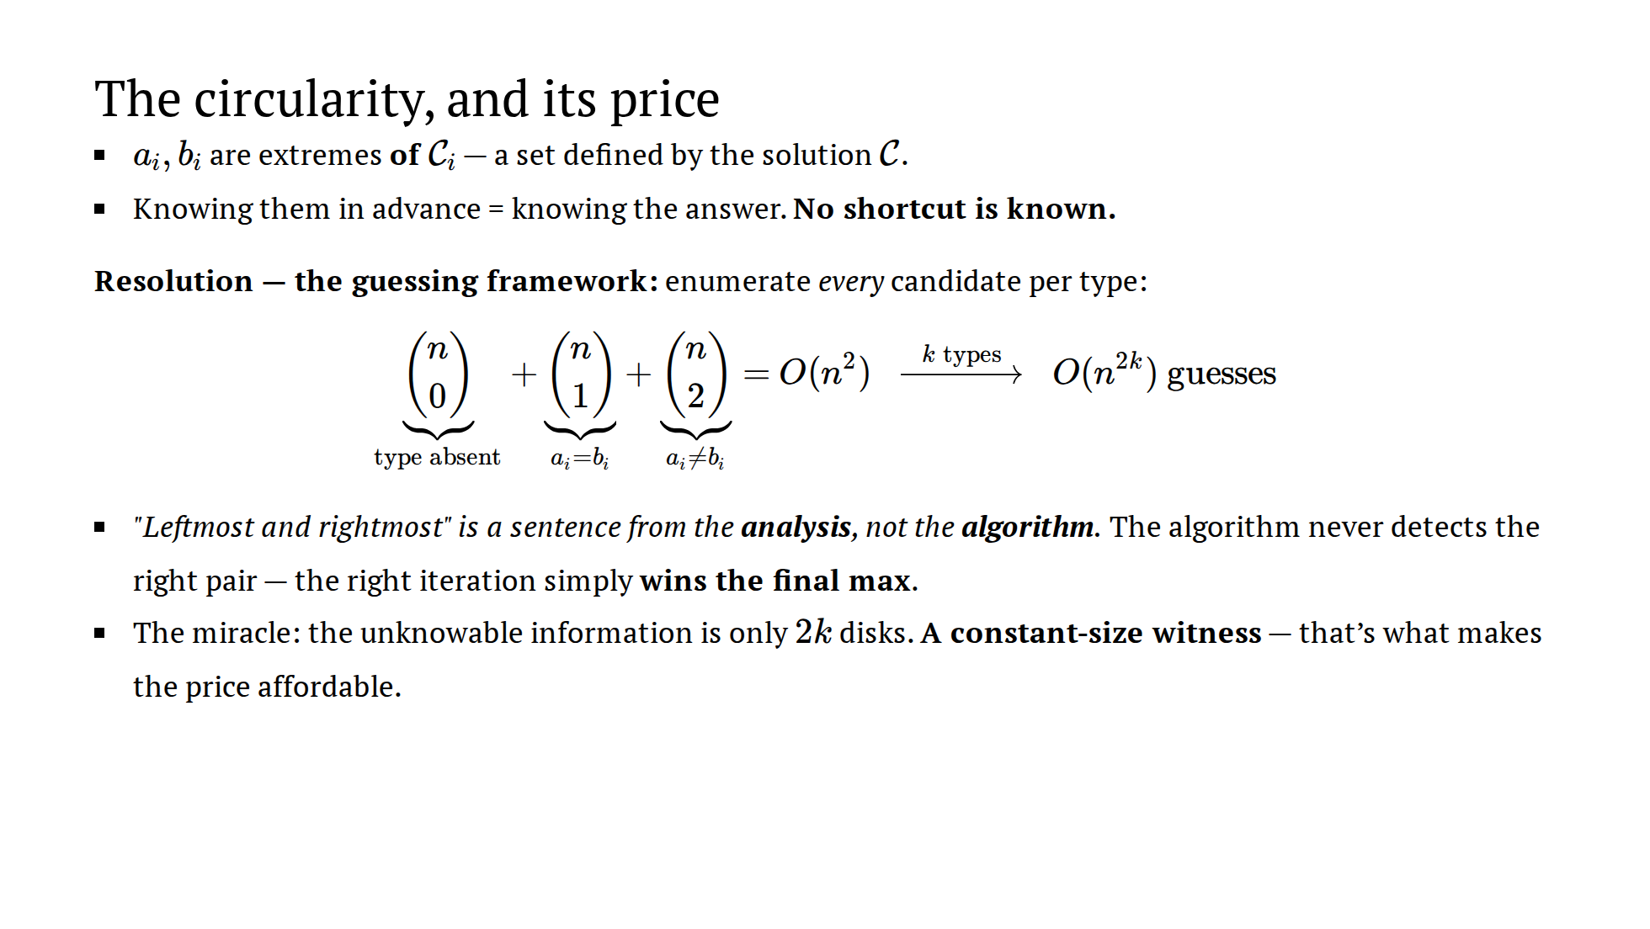
Notes:
~1.5 min. THE conceptual slide. n^{2k} is the price tag on circular
information. If they get this, the rest of the construction is bookkeeping.
If asked "what's a witness?": a witness (or certificate) is a small piece
of side information that makes a hard problem easy — once you hold it, the
full solution can be reconstructed and verified in polynomial time. Here the
witness is the 2k anchor disks: holding the correct anchors, the slabs +
filter + matching rebuild the entire maximum clique, however large it is. The
algorithm doesn't receive the witness; it BUYS it by enumeration — which is
why witness SIZE is everything: size 2k costs n^{O(k)}; a witness of size
Θ(|C|) would cost exponential time and the approach would be worthless.

Slide 29
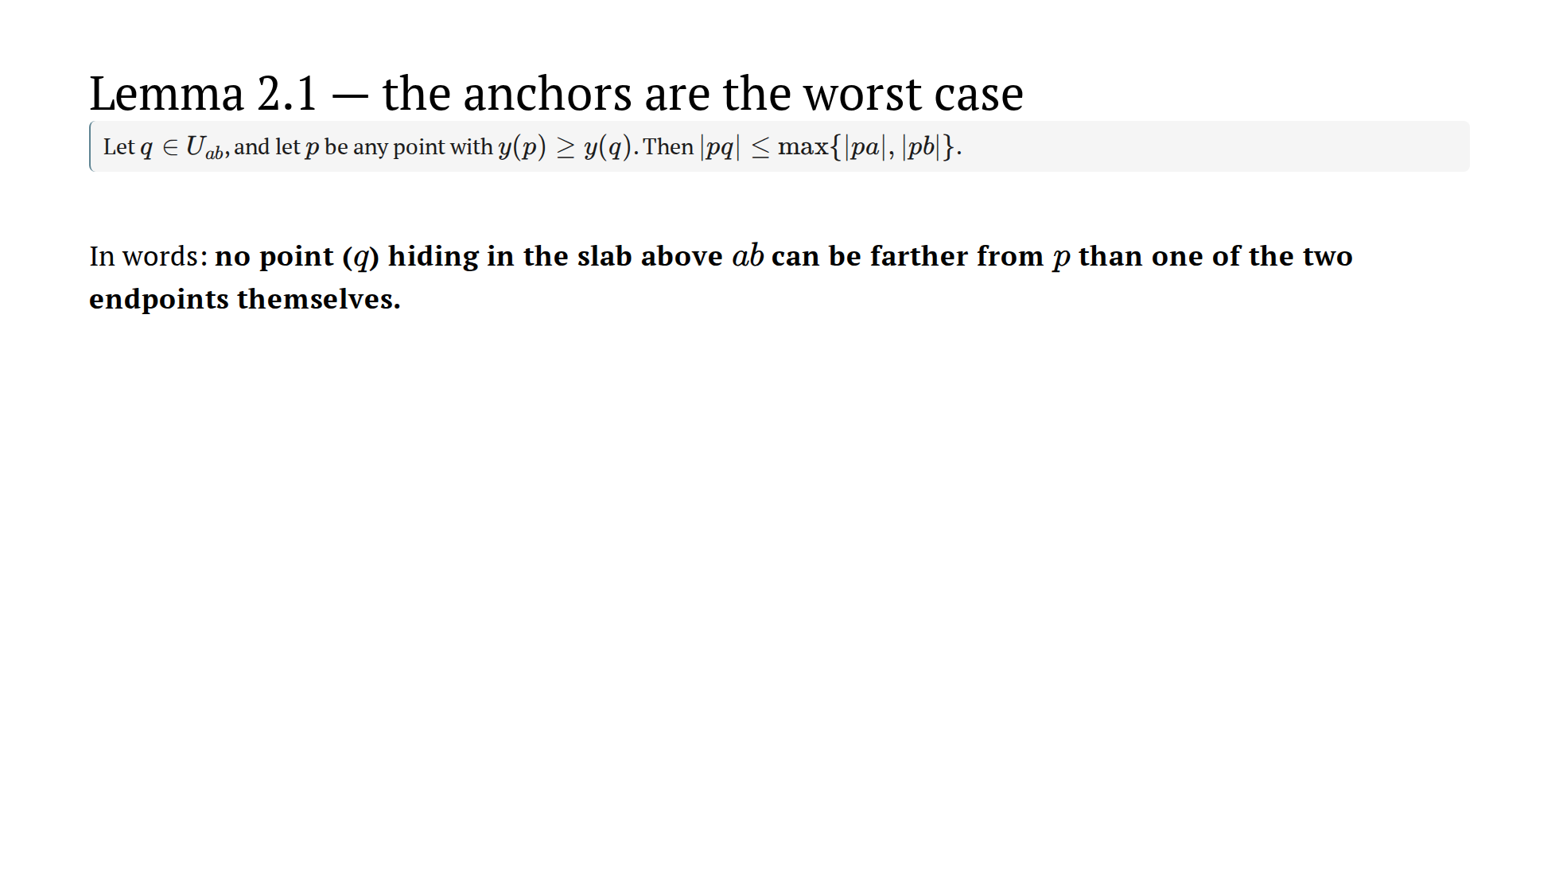
Notes:
~1.5 min. State it in words before symbols. The hypothesis y(p) >= y(q)
is load-bearing: it guarantees the ray exits, and powers the slide-down.

Slide 30
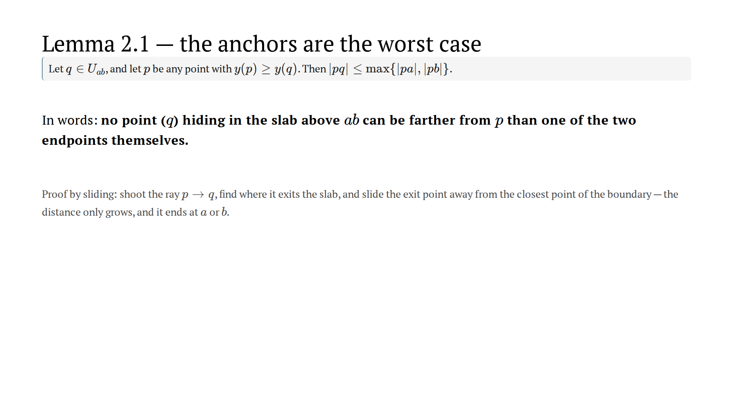
Notes:
~1.5 min. State it in words before symbols. The hypothesis y(p) >= y(q)
is load-bearing: it guarantees the ray exits, and powers the slide-down.

Slide 31
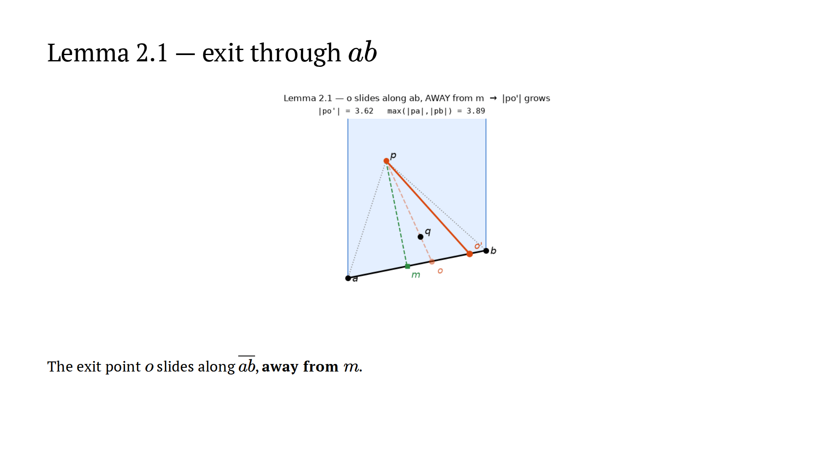
Notes:
~1 min + pause. Freeze at the start and ask: "why must o move AWAY
from m?" — moving away from the closest point of a line monotonically
increases distance. That sentence IS the proof.

Slide 32
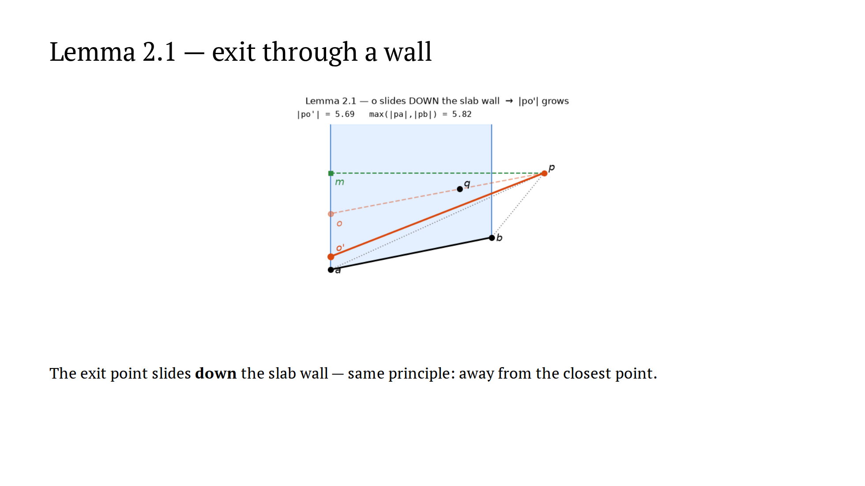
Notes:
~1 min. Here y(p) >= y(q) is used again: p sits above the exit, so
down = away.

Slide 33
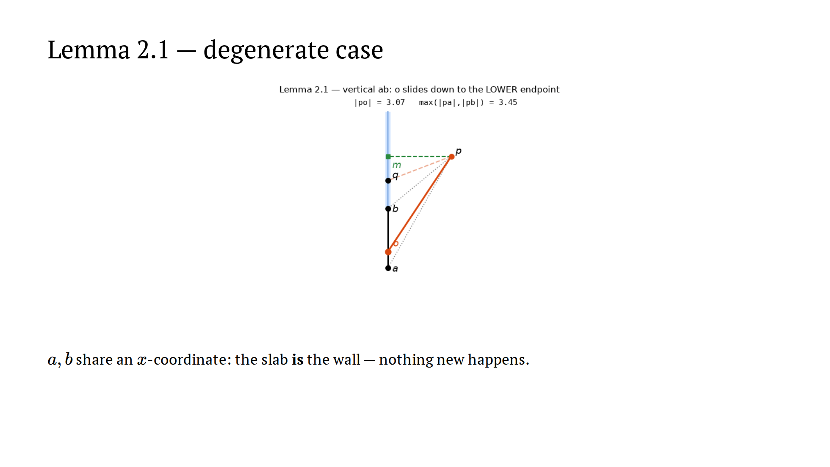
Notes:
~1 min total for this slide, can compress. Unification: in all three
cases o slides away from the point nearest p and lands on an endpoint.

Slide 34
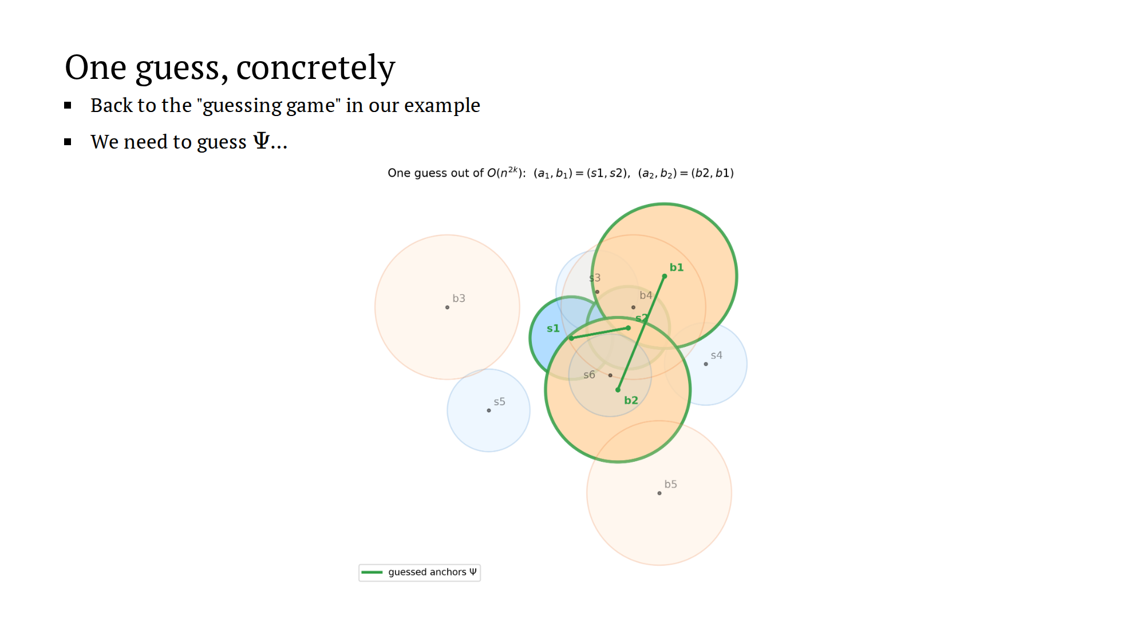
Notes:
~1 min. One iteration of the O(n^{2k}): anchors per type, Psi = the
2k guessed disks. This happens to be the CORRECT guess — the algorithm
doesn't know that.

Slide 35
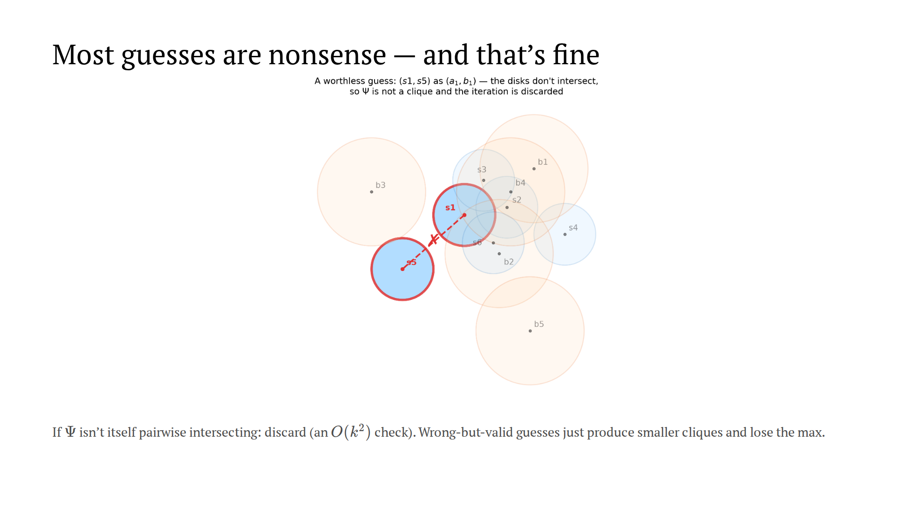
Notes:
~1 min, cuttable. Soundness in one breath: no guess can output a
non-clique; the correct guess is never detected, only out-competed for.

Slide 36
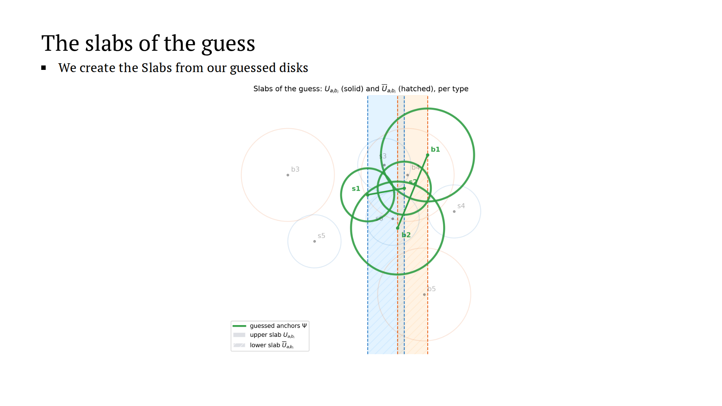
Notes:
~1 min. For the correct guess, every disk of C has its center in its
own type's slab — that's what "leftmost/rightmost of C_i" MEANS.

Slide 37
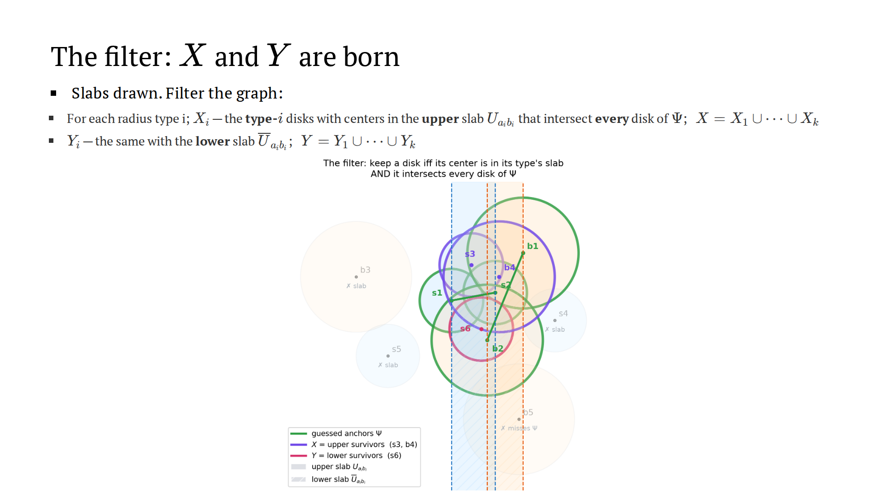
Notes:
~1.5 min. Keep a disk iff center in its type's slab AND intersects
every disk of Psi. Upper survivors X (violet), lower Y (magenta). Read the
discard reasons aloud: slab misses, Psi misses.

Slide 38
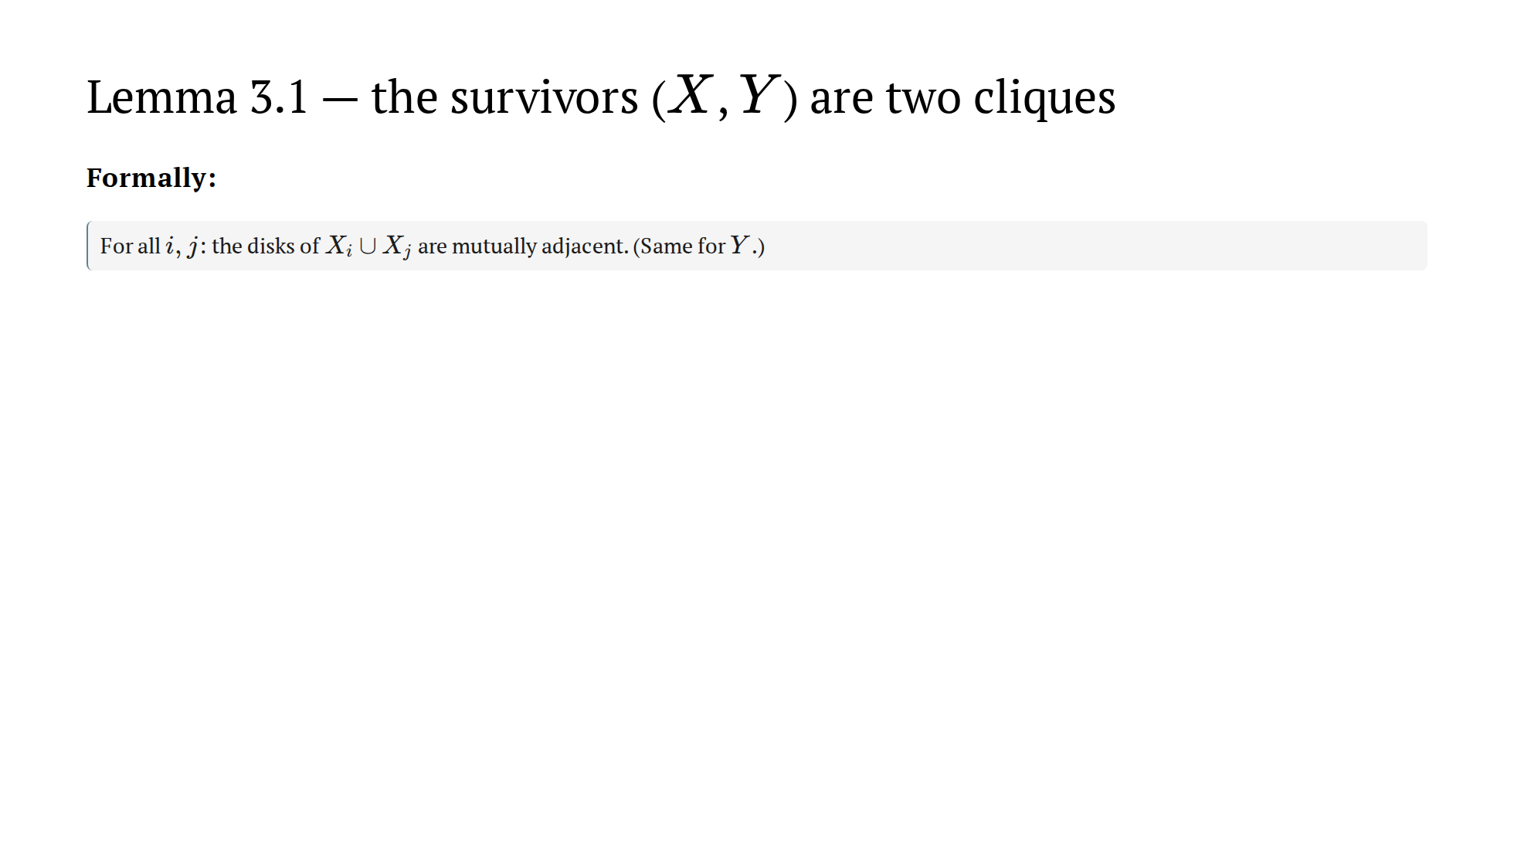
Notes:
~2 min. The relay: geometry (2.1) hands off to filtering (Psi
distances). The bound produced is always exactly the bound needed. Note
what the proof DOESN'T use: that the guess is correct. That's soundness.

Slide 39
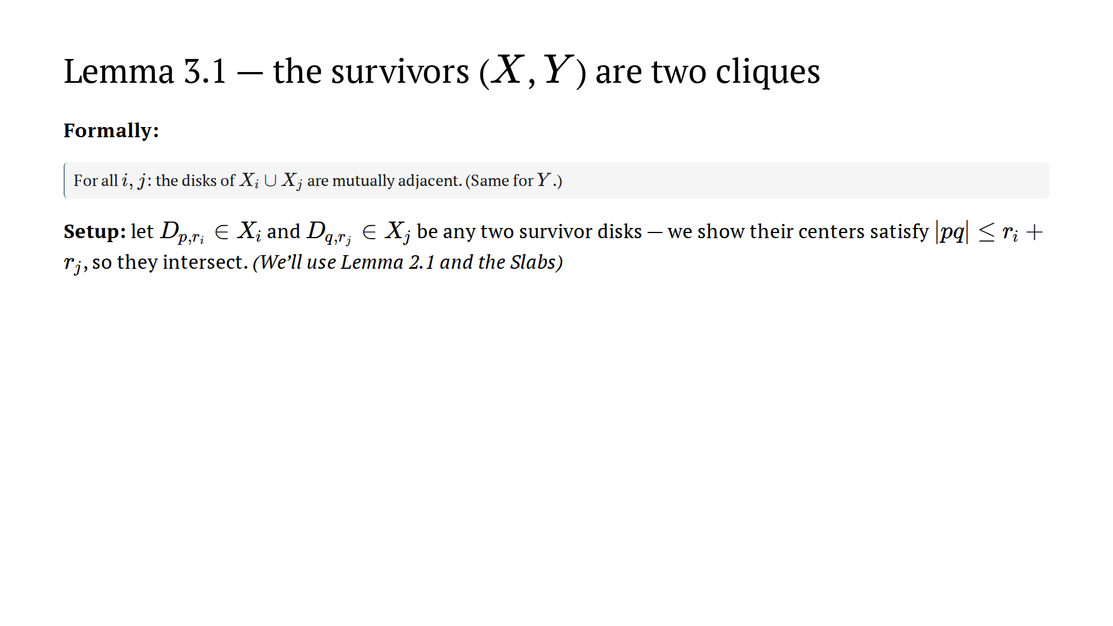
Notes:
~2 min. The relay: geometry (2.1) hands off to filtering (Psi
distances). The bound produced is always exactly the bound needed. Note
what the proof DOESN'T use: that the guess is correct. That's soundness.

Slide 40
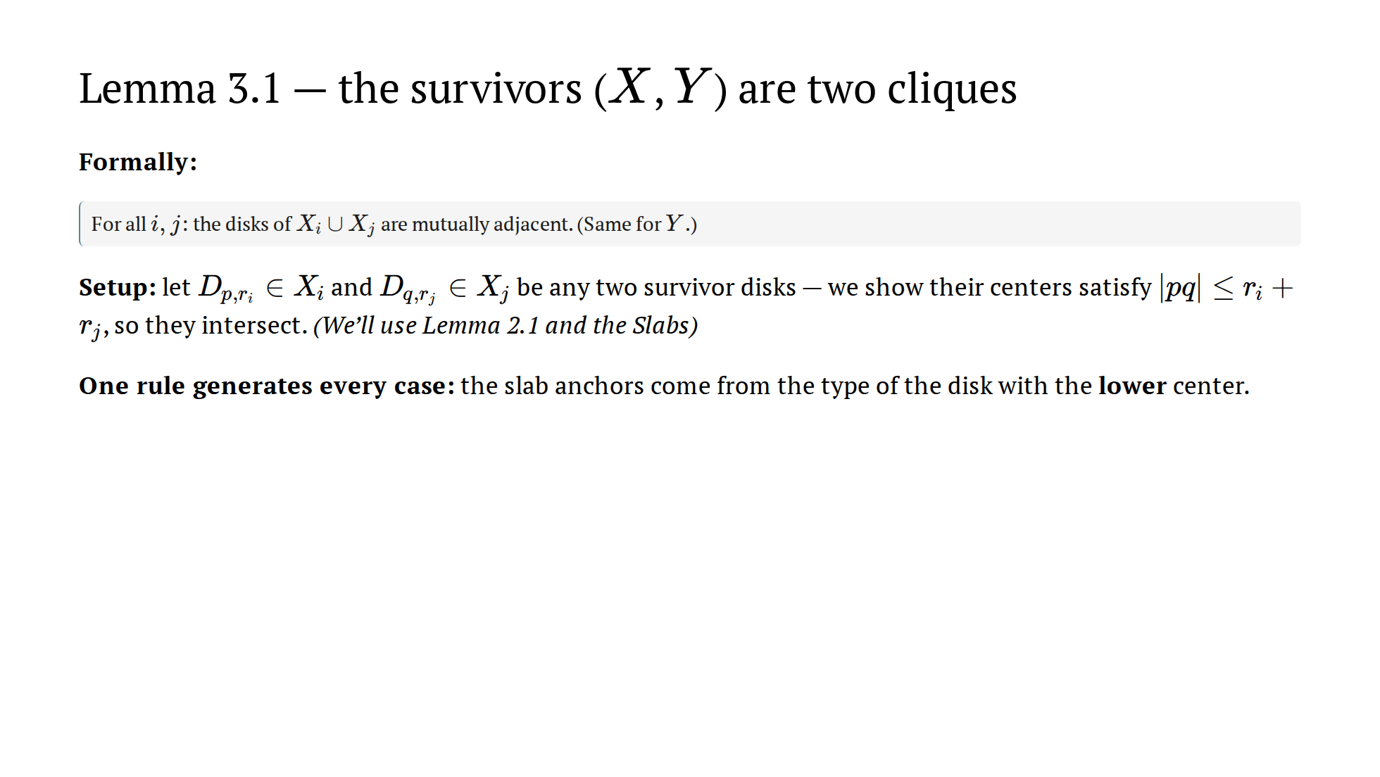
Notes:
~2 min. The relay: geometry (2.1) hands off to filtering (Psi
distances). The bound produced is always exactly the bound needed. Note
what the proof DOESN'T use: that the guess is correct. That's soundness.

Slide 41
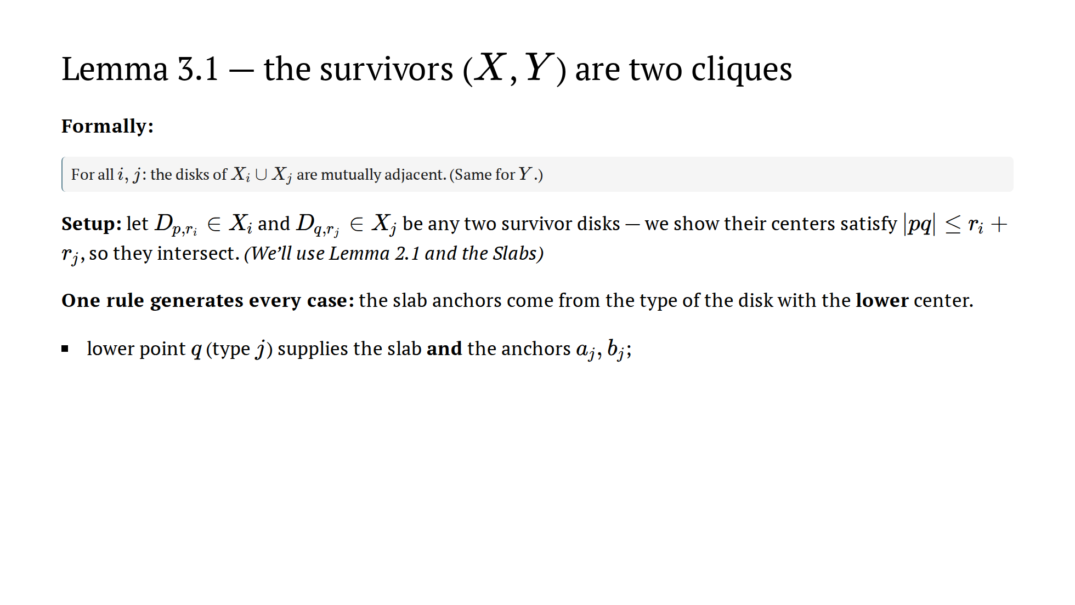
Notes:
~2 min. The relay: geometry (2.1) hands off to filtering (Psi
distances). The bound produced is always exactly the bound needed. Note
what the proof DOESN'T use: that the guess is correct. That's soundness.

Slide 42
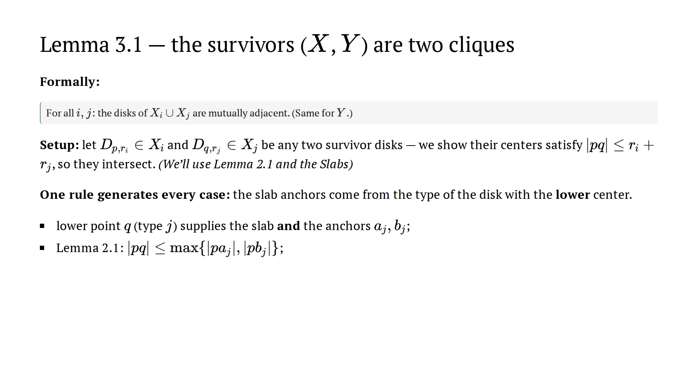
Notes:
~2 min. The relay: geometry (2.1) hands off to filtering (Psi
distances). The bound produced is always exactly the bound needed. Note
what the proof DOESN'T use: that the guess is correct. That's soundness.

Slide 43
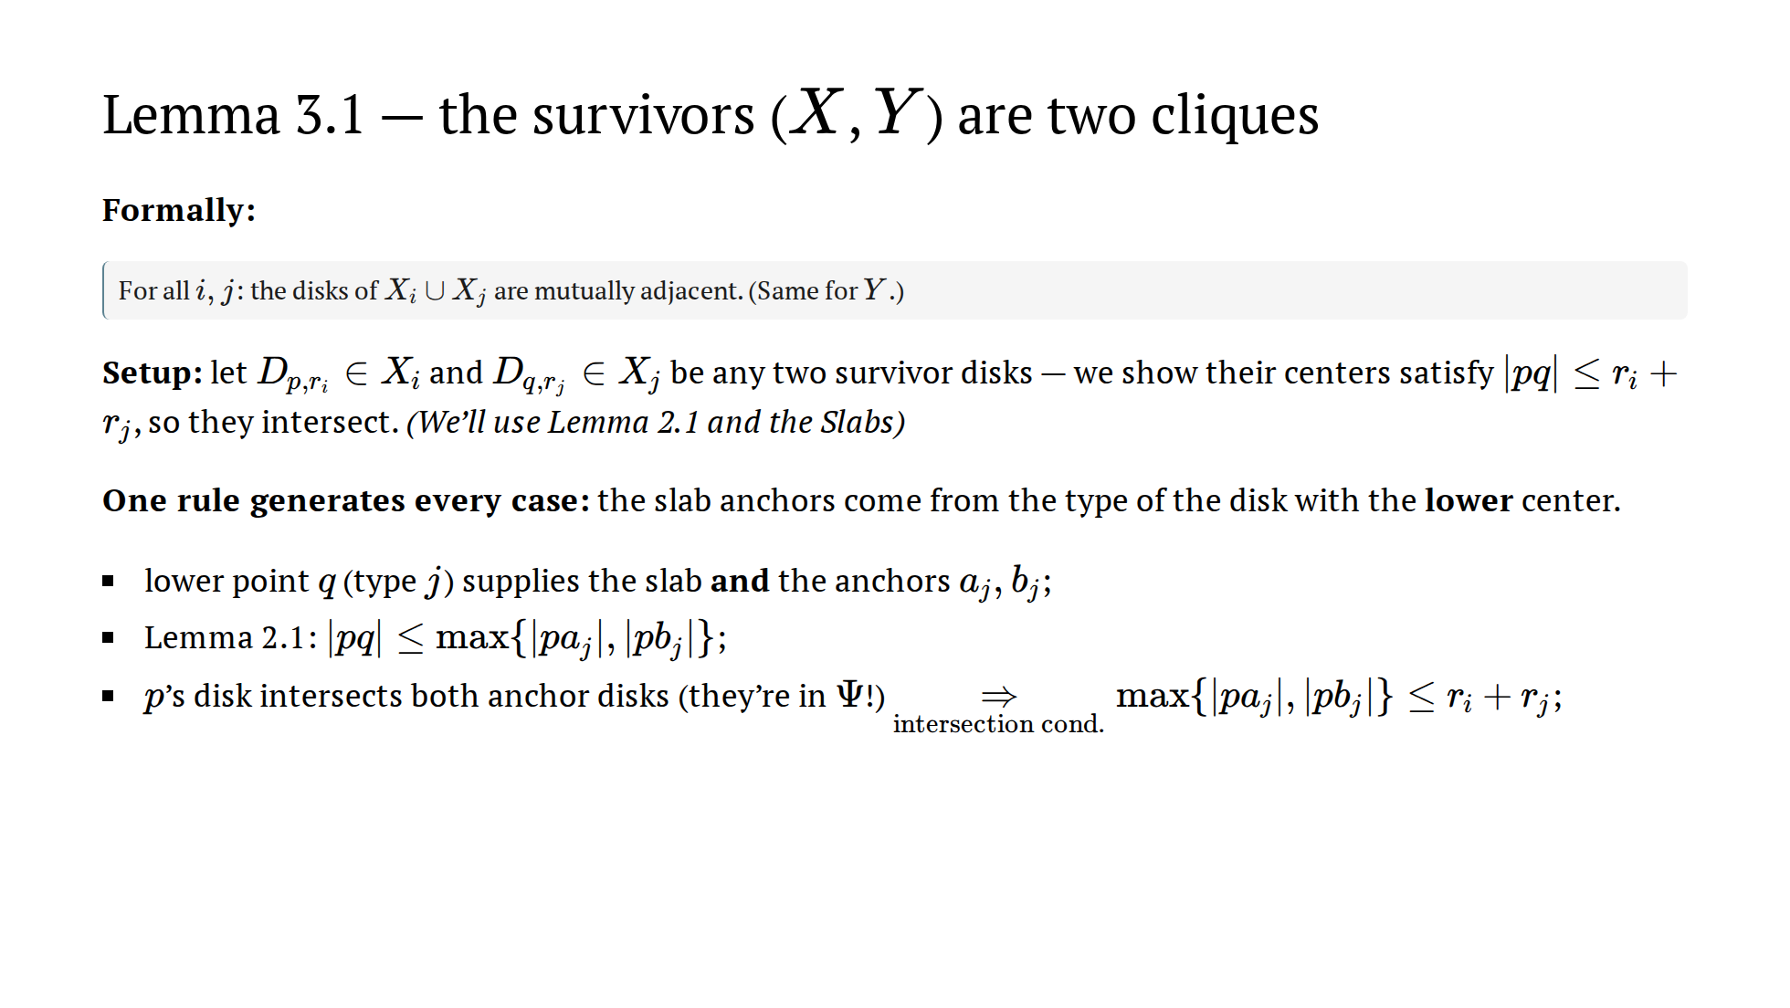
Notes:
~2 min. The relay: geometry (2.1) hands off to filtering (Psi
distances). The bound produced is always exactly the bound needed. Note
what the proof DOESN'T use: that the guess is correct. That's soundness.

Slide 44
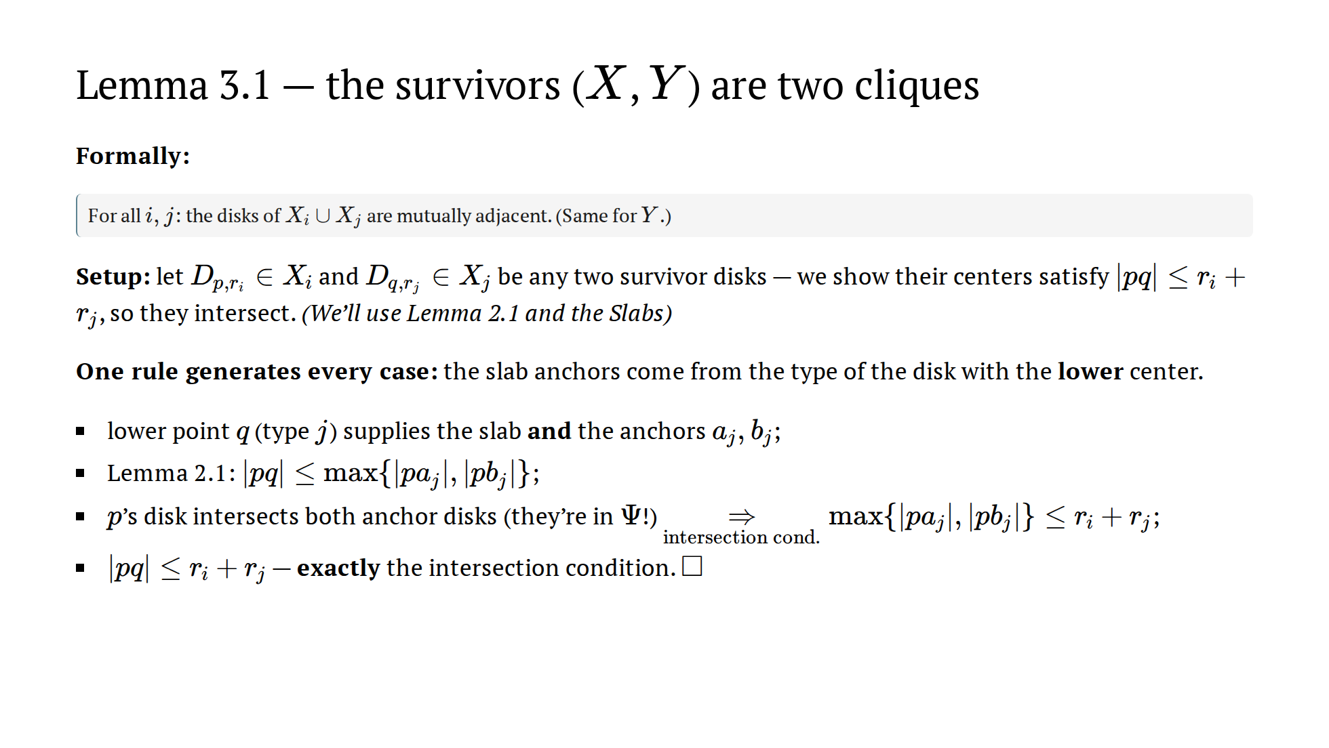
Notes:
~2 min. The relay: geometry (2.1) hands off to filtering (Psi
distances). The bound produced is always exactly the bound needed. Note
what the proof DOESN'T use: that the guess is correct. That's soundness.

Slide 45
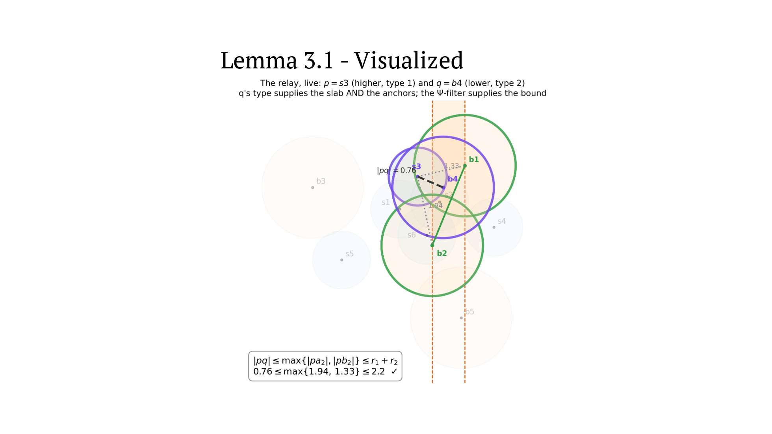

Slide 46
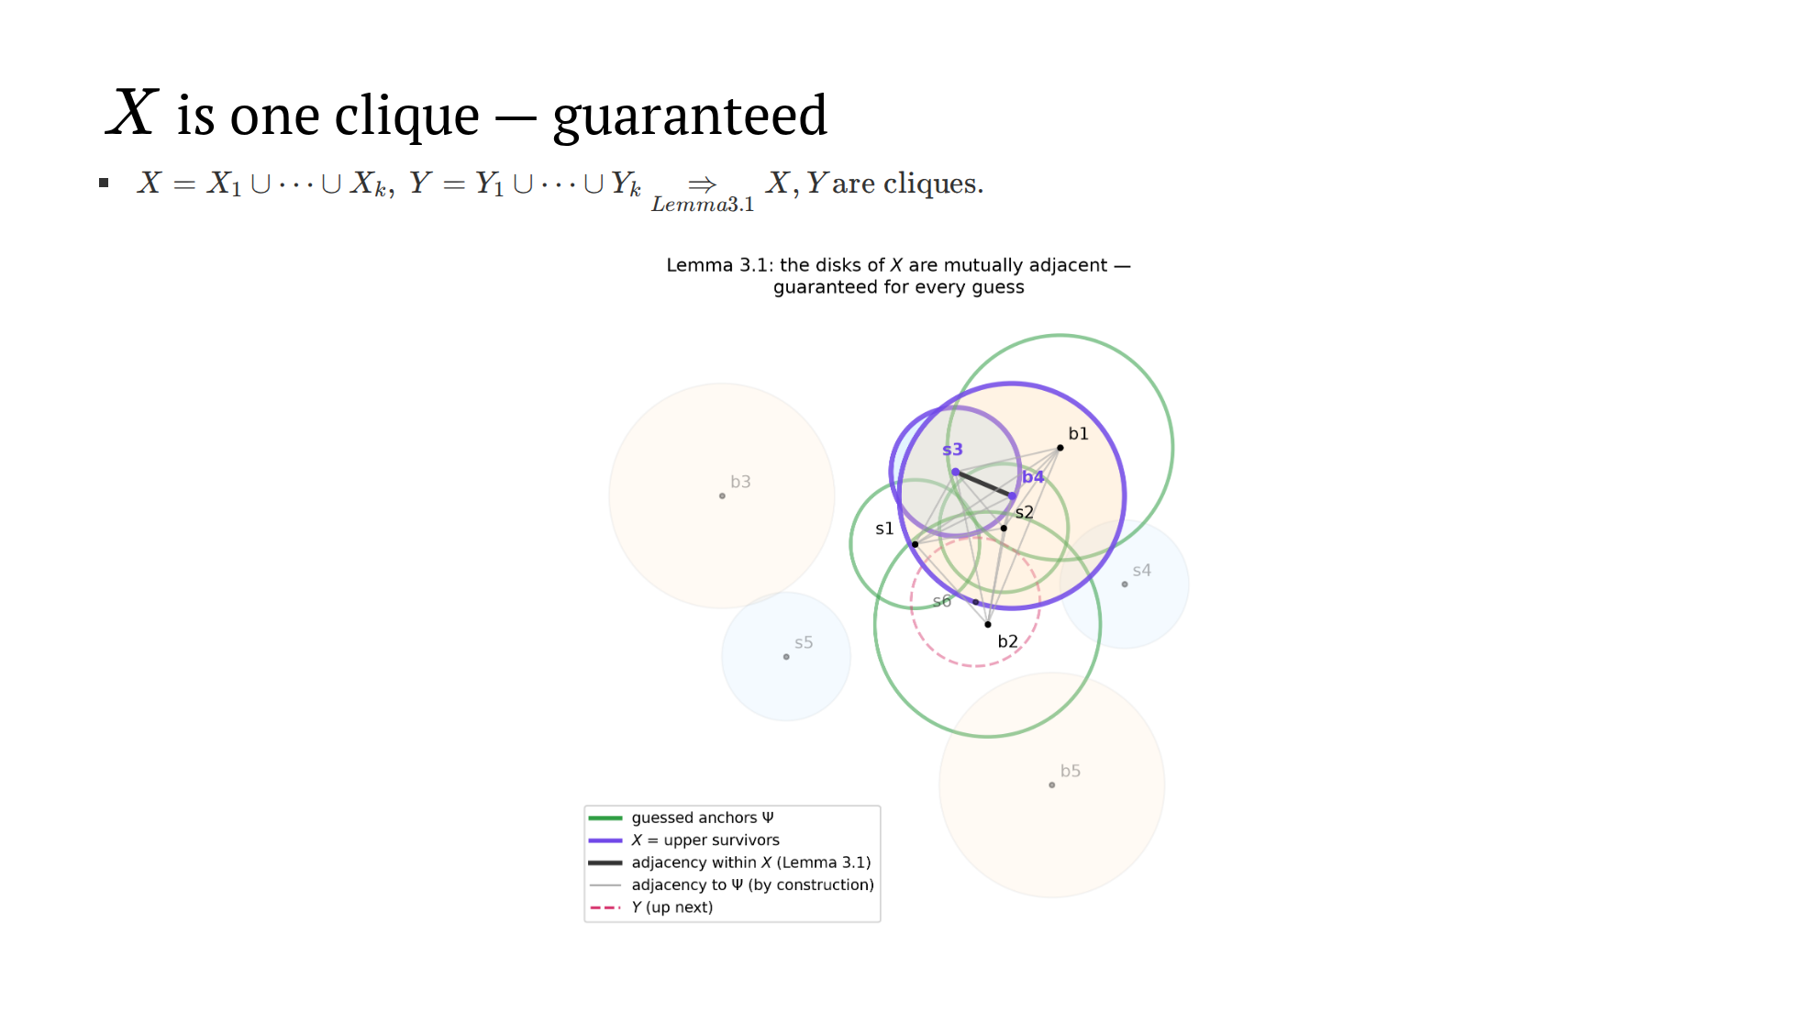
Notes:
~1 min. Bold edge: within X. Thin gray: to Psi, by construction. Holds
for EVERY valid guess, not just the correct one.

Slide 47
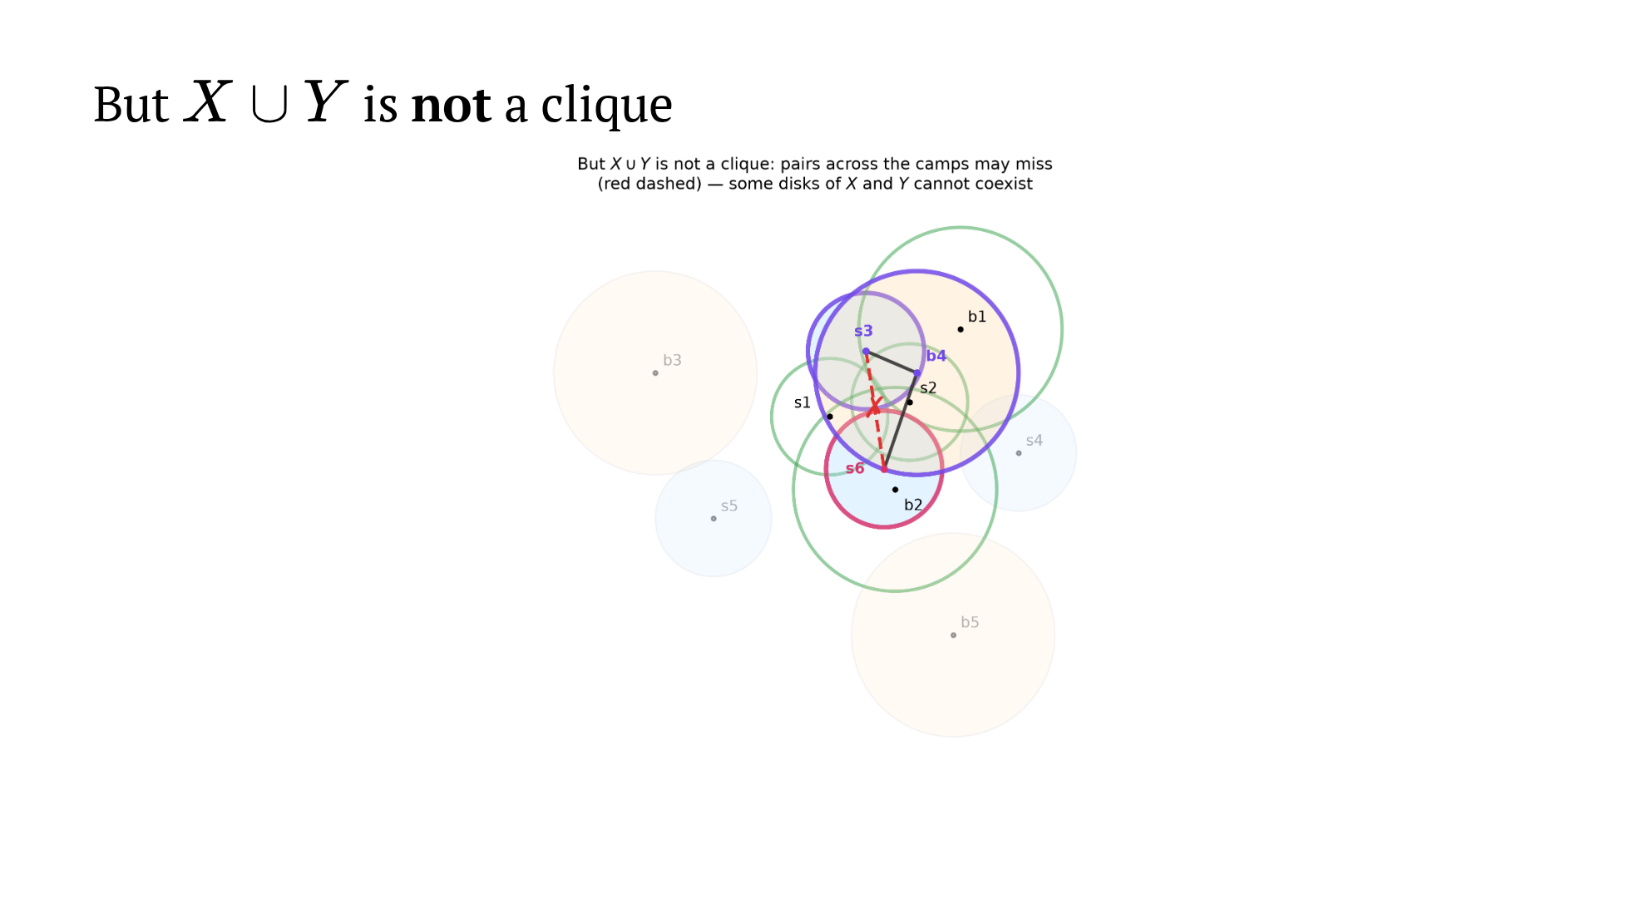
Notes:
~1 min. s3 and s6 both survived, but can't coexist. Also note: s6 is in
the union but NOT in C — the containment C ⊆ Psi∪X∪Y is strict. This gap
is exactly why one more step exists.

Slide 48
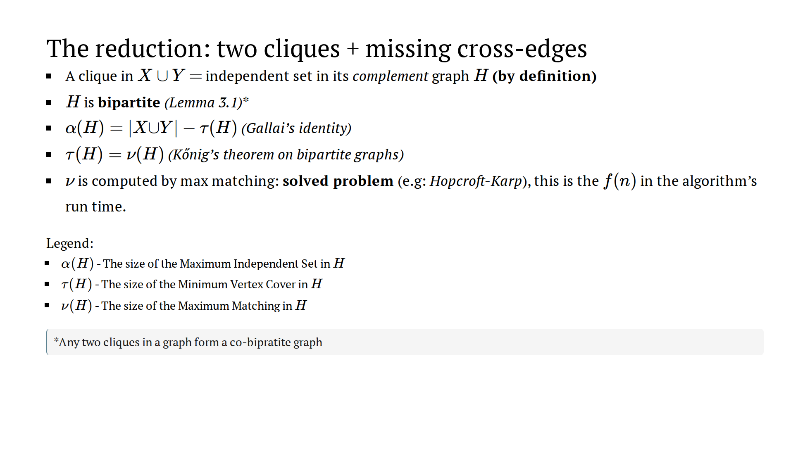

Slide 49
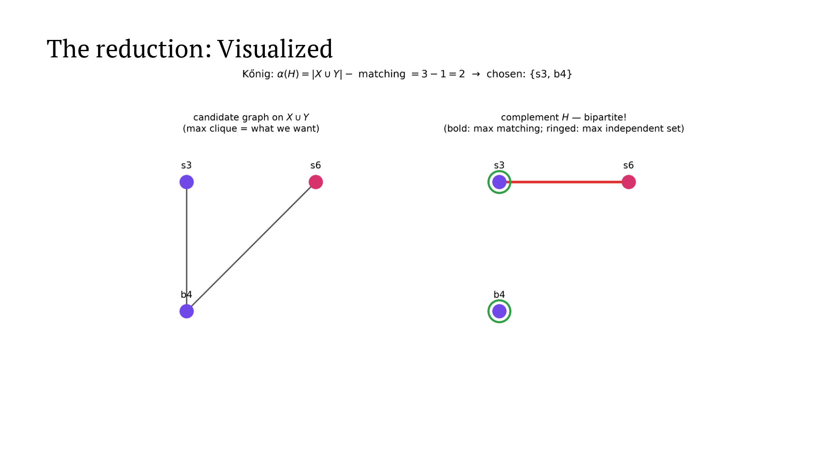
Notes:
~2.5 min. Do the arithmetic aloud: 3 - 1 = 2, chosen {s3, b4}. The
chain is stated, the computation black-boxed. If asked "how does the
matching give the clique": Gallai then Konig — NEVER "take the larger
side" (false in general; see Q&A notes).

Slide 50
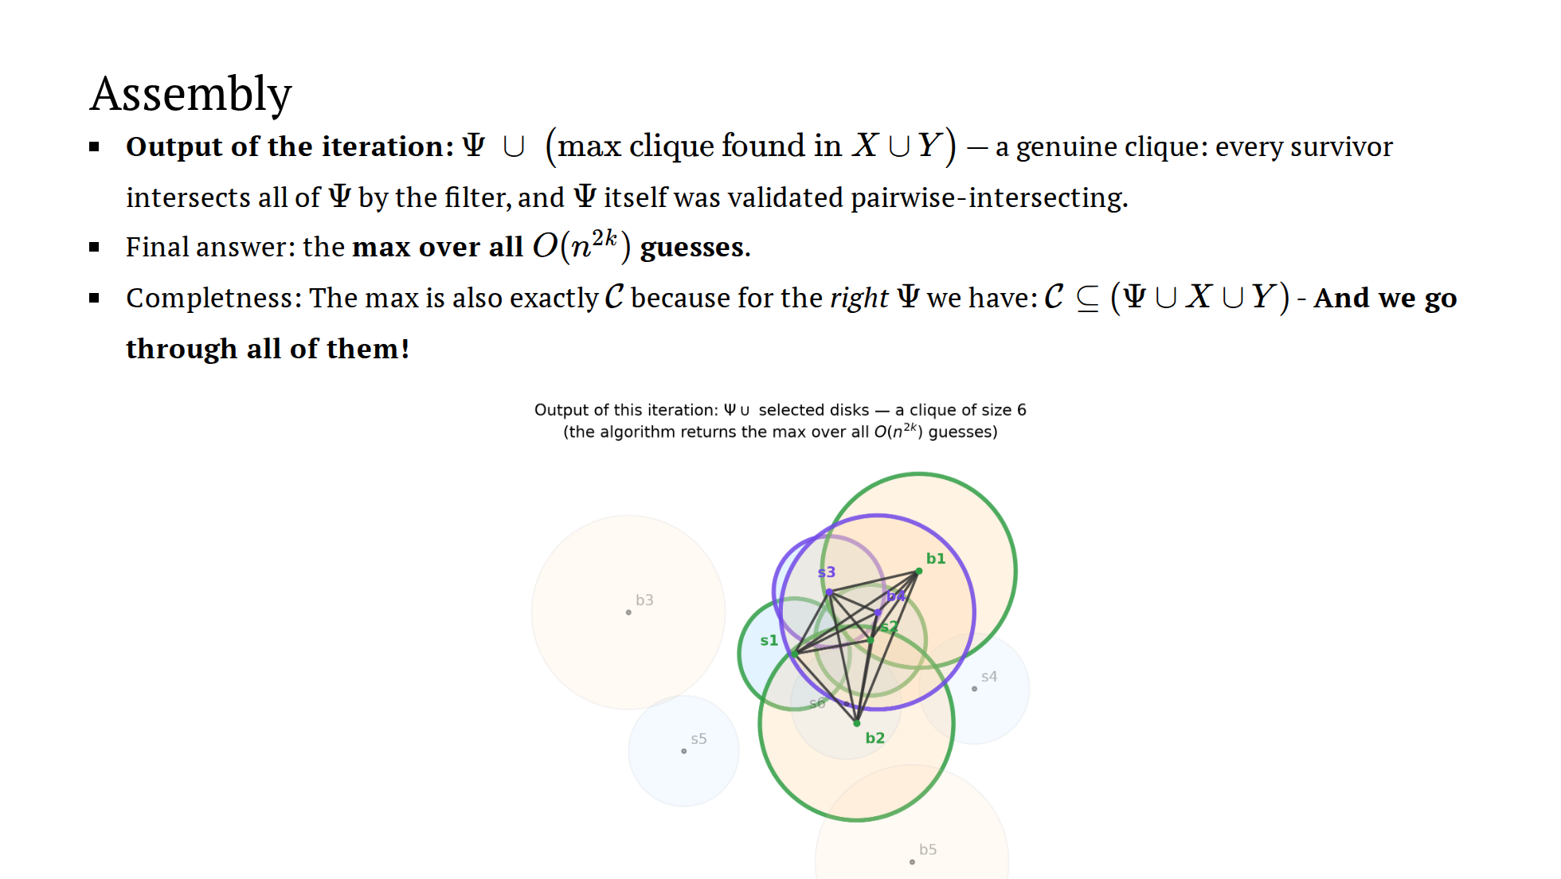
Notes:
~1 min. Output = Psi ∪ chosen: a genuine clique (everything meets
Psi; Psi validated). Take the max over all O(n^{2k}) iterations. For the
correct guess the output has size >= |C|; soundness caps it at |C|.

Slide 51

Notes:
~2 min. The n^{2k} IS the guessing. Inside each guess everything is
cheap. The "each disk once" beat: no k·n double count.

Slide 52

Notes:
~1 min. If asked about the extensions: "they reuse the same slab idea
in preprocessing / 3D settings; I chose to spend our time owning the core
result — happy to point you to Sections 4–5." Do NOT improvise details.

Slide 53

Notes:
~1 min. If asked about the extensions: "they reuse the same slab idea
in preprocessing / 3D settings; I chose to spend our time owning the core
result — happy to point you to Sections 4–5." Do NOT improvise details.

Slide 54

Notes:
~1 min. If asked about the extensions: "they reuse the same slab idea
in preprocessing / 3D settings; I chose to spend our time owning the core
result — happy to point you to Sections 4–5." Do NOT improvise details.

Slide 55

Notes:
~1.5 min. Vocabulary matters here: XP not FPT. Don't speculate on
NP-hardness. The witness-size framing ties back to the misconception
slide: difficulty = how much solution-defined information you must buy.

Slide 56

Notes:
Transition. If short on time: skip to Thank You, tell them the
epilogue is in the slides.

Slide 57

Notes:
~2.5 min. CCJ's recipe in our color grammar: guess the farthest pair
(green), members live in the lens, the line through the pair splits it
into two guaranteed cliques — cross edges sometimes missing — matching.
Sound familiar? Same skeleton. Companion figure: the equilateral-triangle
lens split (chapter2 lens_geometry) if asked how the split is proven.

Slide 58


Slide 59

Notes:
~2.5 min. Two radii, same recipe: small-lens split still works, but
u1, u2 — same side, both legal — miss each other. Each extra guess makes
more slices adjacent; you always feel ONE guess away. That's why 35 years:
the lens seduces. The fix wasn't more guessing — it was a different split.

Slide 60

Notes:
~1 min. The closing beat. Land the last sentence and stop talking.

Slide 61


