Slide 1
Review based product adviser
Guy Parsdanov

Slide 2
A Pitch
Do you also have this lost feeling while browsing through the see of products on multiple platforms wasting time to go through all the bullet points and reviews and Q&A and then having the recognition frustration and acceptance phases that you can’t find anything? We have a solution for you.
A “Review based product adviser” will collect all reviews done per product per category and write you an article collected from users reviews and experience with a product of your choice on multiple marketplaces. Or alternatively will suggest you best product of the category on a specific marketplace of your choice based user experience with the product.

Slide 3
Introduction
We are going to use several models for that project to work together as one
Logistic Regression model for customer reviews classification (negative, positive, neutral)
K-Means Clustering for category clustering
Use a pre trained GPT-2 Large with fine tuning model for article generation
Each model quality performance depends on each other
By processing reviews classification in to 3 sentiments we create a dataset for the model fine tuning to differentiate the reviews to get the best product
By processing the category clustering we will give precise product vs category classification
In the end we create a quality dataset for the last model to create the articles
Design of one models affect each other to provide the best quality performance for the training set for the model eventually performing the product articles
Now that you have seen our super cool product and know why this matters, let me show how we did it!

Slide 4
Preprocessing of data
Fro reviews classification we have used the following preprocessing strategy
Removing stop words
Removing special characters
Change high case to low
For category clustering we have used the following preprocessing strategy
Removing special characters
Removing empty rows
Removing duplicates
Change high case to low

Slide 5
Model 1
To classify customer reviews into positive, negative, or neutral categories
We used a logistic regression and got very good results straight away with 92% accuracy and decided not to proceed with other strategies in order to save time for the most time consuming last model fine tuning

Slide 6
Model 1 - Evaluation
Customer reviews into positive, negative, or neutral classification
Challenges
When removing the stop words the in some cases the classification went wrong because of combination of words like “ I was not disappointed in a product” classifying the review as negative.
By adopting the stop words library that has solved the issue

Slide 7
Model 2
Cluster product categories into just 4-6 of them
By clustering the the categories we decided to use the K-Means model and back it up with the ELBOW K-Means
After processing with both models we didn't achieve better performance
And decided to stay with K-Means basic model.
We performed with Silhouette Score: 0.76 in both models

Slide 8
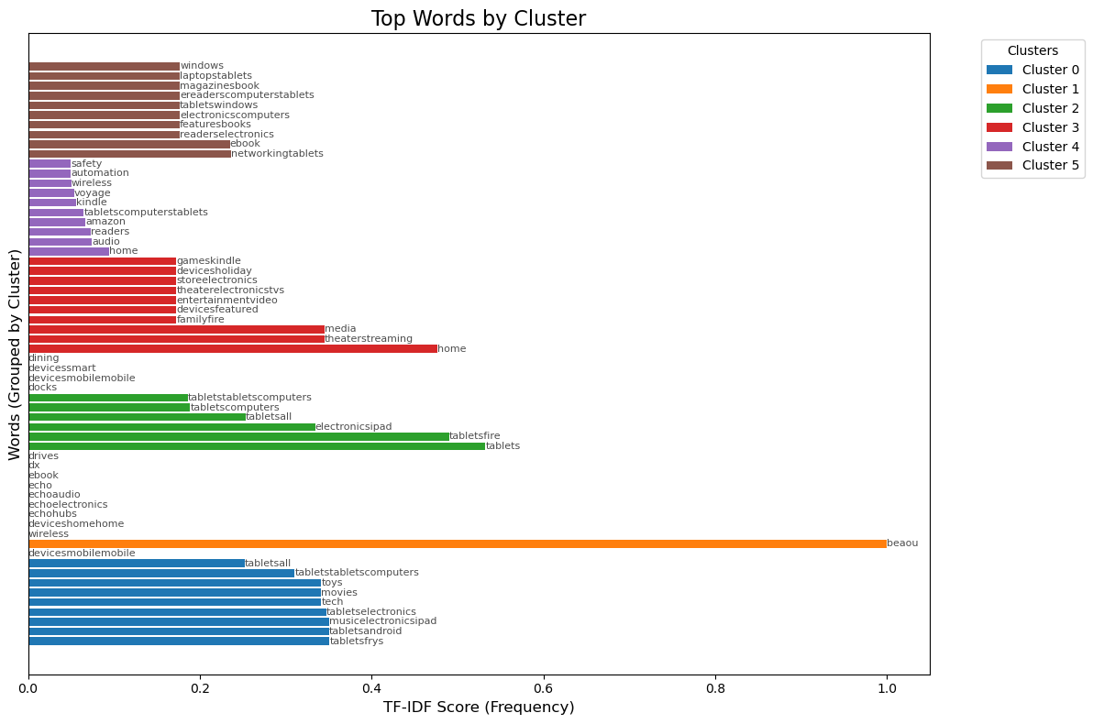
Model 2 - Evaluation
Cluster product categories into just 4-6 of them
After going through the results of clustering we decided to use in the future different approach of not using the clustering model for category clustering either using the original category of the product.

Slide 9
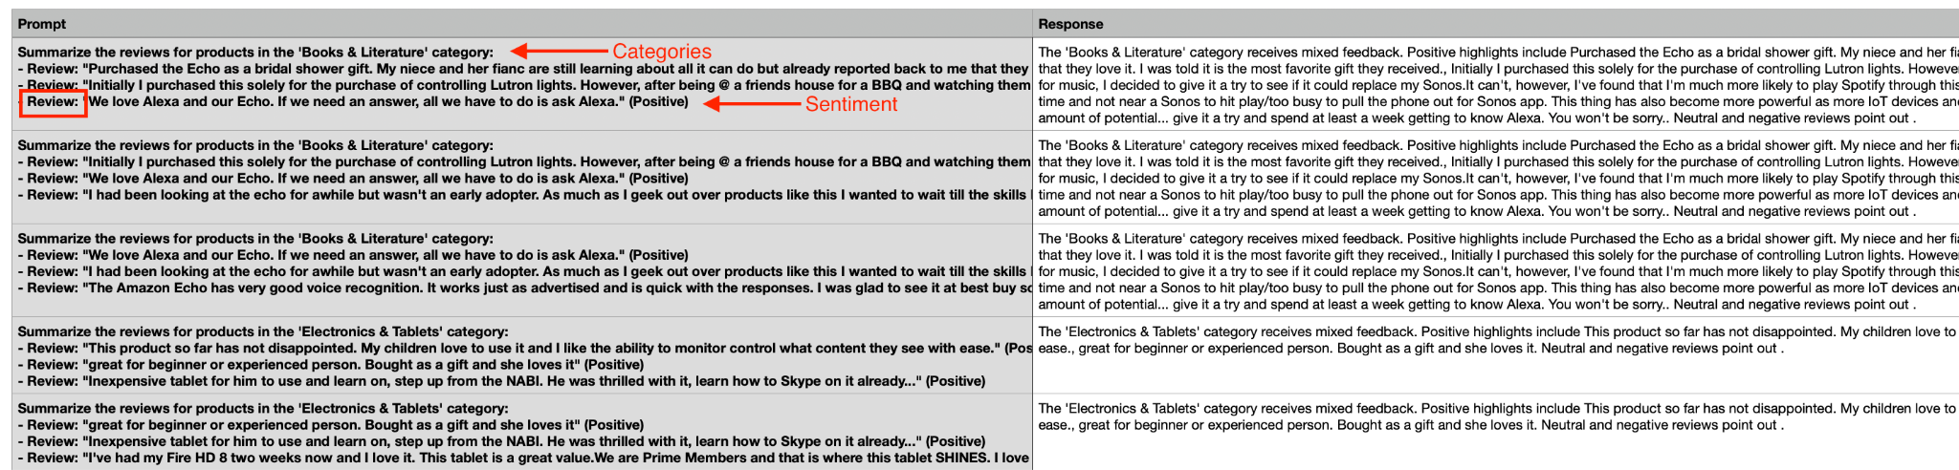
Generated DataSet sample for model fine tuning from reviews classification and category clustering
We have generate 65K of samples for fine tuning

Slide 10
Model 3
Use Generative AI to summarize reviews into an article which recommends the top products for each category
Challenges:
One of the challenges was to find a pre trained model that is not too big for fine tuning as of time and resource consumption for large models can be massive.
We have tried several models
GTP Neox 20B
Llama 2 8B
GTP - 2 large model
Eventually we took a decision to stay with GTP - 2 large model as a reason of time and resources were pressuring but also after fine tuning should improve the model performance.

Slide 11
Model 3 - Evaluation
As we wanted to get the best performance of the pre trained model to write the Product articles we are still in the process to fine tune the model but already getting good results
More of this is coming in a few days as we finish the fine tuning of the model

Slide 12
Takeaway
All in all we are positive to get the best results of this project
It was very challenging to cluster the categories where we decided that this is not needed to get best results
One of the main challenges we experienced is to get the best results of a fine tuning of a pre trained model. This takes lots of time efforts and understanding in the fine tuning process.

