Slide 1
Which Dimensions of Child Deprivation
Does the Scottish Child Payment Reduce?
Evidence from Double Machine Learning Difference-in-Differences
Guy Pigott | University of Manchester | June 2026
Data: HBAI (2016/17–2023/24) | Methods: DML-DiD
Notes:
Welcome. 20 minutes. No completed work required — I'll cover: the question and why it matters, data, methodology, initial descriptives, next steps, and anticipated issues.

Slide 2
Motivation & Research Question
Why This Matters
Research Question
SCP pays £25/week per child to low-income Scottish families — the largest devolved social security innovation since 2016
Official government evaluation (Scottish Government, 2024) based on self-reported perceptions — explicitly calls for objective causal evidence via data linkage
Evaluations exist (CASE/LSE 2025) but use composite deprivation outcomes and linear covariate controls
No study has asked: does the choice of hardship measure affect the estimated treatment effect?
Which dimensions of child material deprivation does the Scottish Child Payment reduce, and are these effects robust to flexible covariate adjustment?
Two contributions:
Item-level decomposition of Child Material Deprivation (MDCH – 10 binary indicators)
DML-DiD vs. linear DiD robustness check
Measurement error framework: do composite vs. item-level outcomes give systematically different causal estimates?
Notes:
The key gap: Stewart et al. (CASE 2025) found 8-9pp reduction in composite material deprivation. But composite scores mask which items drive the effect. And their linear controls can't capture non-linear relationships between income, family structure and deprivation trends.

Slide 3
Policy Background: The Scottish Child Payment
Feb 2021
Apr 2022
Nov 2022
2024–25
SCP Introduced
Doubled to £20
Major Expansion
£26.70/week
£10/week per child under 6
UC & legacy benefits
~100,000 children
Payment doubles
Eligibility unchanged
Extended to all under-16s
Increased to £25/week
~300,000 children
Uprated with inflation
Scotland gap vs. England
widens further
(Currently £27.15)
Key identification feature: staggered rollout creates quasi-experimental variation. Scotland (treated) vs. England (control) — same UK macroeconomic environment, same HBAI survey, different treatment assignment.
Notes:
The staggered rollout is important: the 2021 introduction (under-6s) and 2022 expansion (under-16s) create two treatment cohorts. My main analysis focuses on the 2022 expansion since it's more substantial and affects the full child sample.

Slide 4
Existing Literature
SCP Evaluations
Hardship Measurement
Causal DiD Methods
Scottish Government (2024): Five Family Payments evaluation — positive self-reported impacts on food insecurity and material deprivation.
Stewart et al. (CASE, 2025): DiD on HBAI data
Nesom, Stewart & Tominey (IFS, 2025): DiD on FRS data — SCP did not reduce labour supply.
Gap: no study decomposes effects by deprivation item or tests robustness to flexible covariate adjustment.
Townsend (1979): Motivates material deprivation items beyond income.
Almada, McCarthy & Tchernis (2015): Benefit misreporting biases treatment effects.
Manski (1990): Nonparametric bounds on treatment effects
Roth et al. (2023): Synthesis of modern DiD
Sant’Anna & Zhao (2020): Doubly robust DiD
Chernozhukov et al. (2018) + Chang (2020): DML-DiD for valid inference under flexible ML adjustment.
Notes:
The gap I'm filling: Stewart et al. is the closest paper, but uses linear controls and a composite outcome. No paper combines DML with DiD for UK child deprivation, and no paper decomposes SCP effects across individual deprivation items.
SCP Evaluations
Scottish Government (2024): Five Family Payments evaluation — positive self-reported impacts on food insecurity and material deprivation. Perception-based; explicitly calls for objective causal evidence.
Stewart et al. (CASE, 2025): DiD on HBAI data — 8–9pp reduction in composite MDCH and food insecurity. Linear controls.
Nesom, Stewart & Tominey (IFS, 2025): DiD on FRS data — SCP did not reduce labour supply. Confirms policy operates as intended; no cliff-edge effect for most families.
Gap: no study decomposes effects by deprivation item or tests robustness to flexible covariate adjustment.
Hardship Measurement
Townsend (1979): Poverty as relative deprivation — inability to participate in society’s customary activities. Motivates MDCH items beyond income.
Almada, McCarthy & Tchernis (2015): Benefit misreporting biases treatment effects — IV estimates exceed nonparametric bounds by 200%+ when misreporting ignored.
Manski (1990): Nonparametric bounds on treatment effects — partial identification when classical ME assumptions fail; frames our robustness checks.
Causal DiD Methods
Roth et al. (2023): Synthesis of modern DiD — staggered adoption, conditional parallel trends, pre-testing caution. The methodological landscape for this paper.
Sant’Anna & Zhao (2020): Doubly robust DiD — combines outcome regression and IPW under conditional parallel trends. Direct foundation for our DML extension.
Chernozhukov et al. (2018) + Chang (2020): DML-DiD for valid inference under flexible ML adjustment.

Slide 5
Data: HBAI Individual Microdata
Source & Coverage
MDCH Indicators (10 binary)
Households Below Average Income harmonised individual-level microdata
Covering 2016/17–2024/25 in constant 2023/24 prices
One observation per child — unit of analysis is child-year
Survey weight: GS_INDCH (official HBAI child weight)
Material basics (bed, coat, school kit), social participation (celebrations, holidays, trips, play) and diet (fruit & veg)
Outcomes / Validation
FOODSEC (food security, 3-level), LOWINCMDCH (low income + deprivation), mdch_any, mdch_severe
Sample Restrictions
Scotland (GVTREGN = 12) and England only — Wales and NI excluded
Children aged 16 and under (SCP eligibility)
2020/21 excluded — COVID survey disruption
Years: 2016/17 to 2023/24 (7 survey years) – Exclude 2024/25
DML Covariates (20)
Demographics, disability, income, benefits, housing costs & earnings — plus tenure, employment status, region and year fixed effects
Notes:
Note: ethnicity is NOT available in UKDS public-access HBAI (safe room only). The CASE paper included ethnicity as a control — this is a limitation I acknowledge. S_OE_AHC and the family type/tenure variables need to be added to the prep script before the DML stage.

Slide 6
Deprivation Variables: 10 Binary MDCH Indicators
Child Material Deprivation Module — HBAI individual files (2010/11–2023/24)
Bed/bedroom
Celebrations
Warm coat
School equip.
MDCH_BED
MDCH_CEL
MDCH_COAT
MDCH_EQP
Holiday
Indoor play
Outdoor play
Fresh fruit/veg
MDCH_HOL
MDCH_PLAY
MDCH_PLY
MDCH_TEA
Trips/outings
Vegetables
MDCH_TRP
MDCH_VEG
Coding: 1 = has item → 0 (not deprived) | 2 = lacks due to cost → 1 (deprived) | 3 / –9 = N/A → NaN
Notes:
The recoding fix was important — the raw TAB file codes 1=has item (not deprived) and 2=lacks item (deprived), opposite to what the original script assumed. Prevalence rates will be shown once the corrected script has been run. Official HBAI stats suggest ~15% material deprivation for all UK children, higher for low-income families.

Slide 7
Sample Statistics
50,967
99,157
6,090
44,877
Child-year
observations
MDCH module
observed
Scotland
observations
England
observations
2016/17–2023/24
excl. 2020/21
children with full
12-item deprivation data
across 7 survey years
(treated group)
across 7 survey years
(control group)
Characteristic | Scotland | England
Child material deprivation | 0.15 | 0.205
Food insecure households | 0.135 | 0.151
Larger families (3+ children) | 0.252 | 0.32
Lone parent households | 0.225 | 0.224
Young head of household | 0.031 | 0.022
Female head of household | 0.427 | 0.41
Disabled household | 0.365 | 0.34
White households | 0.918 | 0.766
N | 6090 | 44877
Notes:
Scotland is notably smaller than England — important for power calculations in the DML stage. The 2022/23 England figure is larger due to survey design changes that year. The MDCH module ~99k is the subset with full deprivation data (not all children are asked all items depending on year and eligibility).

Slide 8
Methodology: Three-Stage Design
Benchmark → Extension → Decomposition
1
Benchmark DiD
2
Double ML DiD
3
Item-Level Decomposition
Linear DiD replicating Stewart et al. (2025) on composite outcomes.
Same outcomes, ML-flexible covariate adjustment (Chang 2020).
DML-DiD on each of 12 MDCH items, with FDR correction.
Notes:
The three stages build on each other. Stage 1 validates. Stage 2 tests robustness of Stage 1 to flexible adjustment. Stage 3 is where the original policy insight comes from — no existing paper has done this.

Slide 9
Stage 1: Benchmark DiD
Empirical Specification
Identifying Assumption
$$Y_{it}=α+δ\left(Scotland_{i} x Post_{t}\right)+βX_{it}+γ_{t}+ϵ_{it}$$
Parallel trends: absent SCP, Scotland and England track together. Testable pre-2022. See next slide.
$δ$= treatment effect of interest | Post = 1 after Nov 2022 expansion | $y_{t}$ = year fixed effects
Y & Controls ($X_{it}$) — linear in benchmark:
Outcome Y: any deprivation, deprivation count, severe deprivation, and the official MDCH flag — each modelled separately
Income, family type, tenure, number of children, age
Year fixed effects — absorb common UK macro shocks
Clustered SEs at regional level (Bertrand, Duflo & Mullainathan 2004). Wild Bootstrap used due to low number of clusters.
Why This Is a Valid Quasi-Experiment
SCP is Scotland-only — England has no equivalent payment
Same HBAI survey both countries — no measurement discontinuity
Staggered rollout (2021, 2022) gives two waves of variation
Notes:
The parallel trends assumption is the key one to verify. The pre-2022 years are 2016/17, 2017/18, 2018/19, 2019/20 and 2021/22. We have 5 pre-treatment years to test this. Best Start Foods (Scotland only, introduced 2019) is a potential confounder — it provides food vouchers to low-income families, which could affect both food security and material deprivation trends independently of SCP.

Slide 10
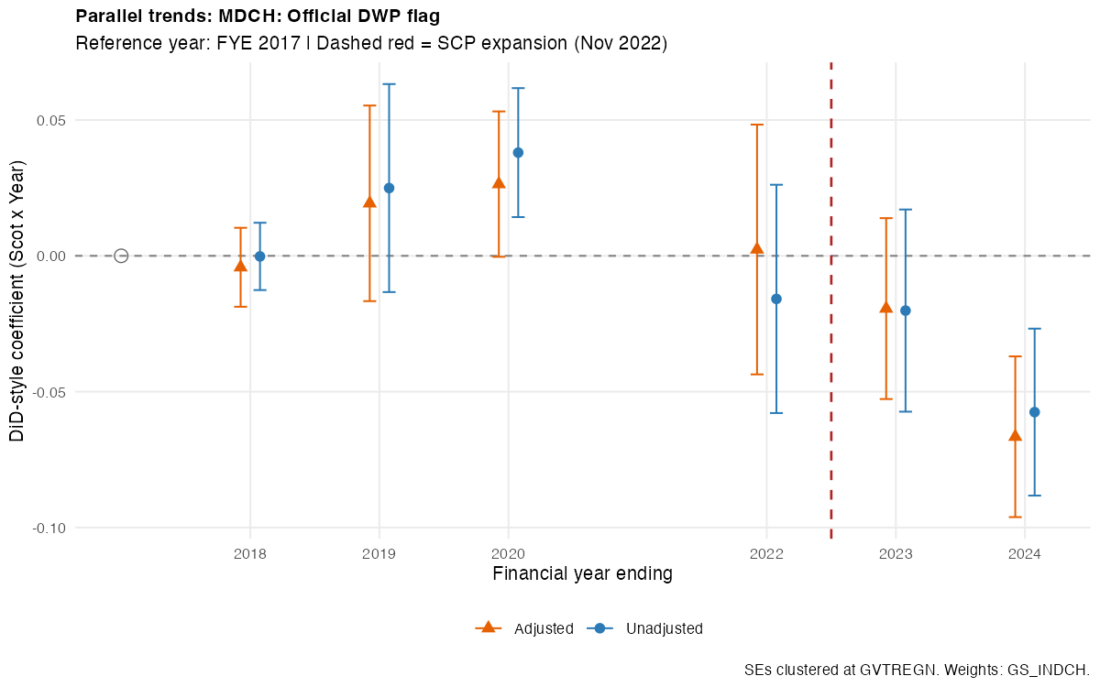
Pre-Treatment Parallel Trends
MDCH: Official DWP flag — Scotland vs. England
Year | No Controls | Controls
2017/18 | −0.000 (0.005) | −0.004 (0.006)
2018/19 | 0.025 (0.017) | 0.019 (0.016)
2019/20 | 0.038** (0.010) | 0.026 (0.012)
2021/22 | −0.016 (0.019) | 0.002 (0.020)
2022/23 | −0.020 (0.016) | −0.019 (0.015)
2023/24 | −0.058** (0.014) | −0.067*** (0.013)
Joint pre-trend Wald test: unadj. p=0.004, adj. p=0.034 (BH-adj. 0.005/0.040) — flagged.
How we deal with this
Once covariates are added, none of the individual pre-2022 year coefficients are significant on their own — only 2024, after the expansion, remains significant in both specifications. The joint test is still marginally flagged (adj. p=0.034, BH-adj. 0.040), a residual caveat rather than a clear violation. We report the adjusted model as preferred (Abadie, 2005), disclose the test rather than hide it, and note ~6,000 Scottish vs ~45,000 English households make these joint tests underpowered by construction (Roth, 2022).

Slide 11
Benchmark DiD: Initial Results
Stage 1a/1b — unadjusted and covariate-adjusted, year FE, SEs clustered by region
Outcome | Unadjusted | Adjusted (with controls)
Any deprivation (mdch_any) | −0.0387*** (0.0090) | −0.0506*** (0.0095)
Deprivation count (mdch_count) | −0.0613** (0.0207) | −0.0839*** (0.0226)
Severe deprivation (mdch_severe) | −0.0002 (0.0053) | −0.0024 (0.0050)
Official MDCH flag | −0.0480*** (0.0075) | −0.0516*** (0.0075)
What This Shows
SCP is associated with significant reductions in any deprivation (mdch_any: −5.1pp adjusted) and the official DWP MDCH flag (−5.2pp) — consistent with Stewart et al.’s (CASE 2025) −8 to −9pp range for composite deprivation.
Deprivation count (mdch_count) also falls significantly, but severe deprivation (3+ items) shows no effect — SCP appears to move families out of mild/moderate deprivation, not severe deprivation.
Covariate adjustment increases the mdch_any/mdch_count magnitude but leaves the official flag estimate almost unchanged — controls aren’t simply picking up compositional differences between Scotland and England.
All significant effects hold at the 1% level. Sample: N=46,941 (item outcomes), N=50,964 (official flag).
Notes:
The CASE paper results are our anchor. If our Stage 1 estimate replicates theirs, that validates our data pipeline. The key question then is whether Stage 2 (DML) differs and what the item-level decomposition shows. Scripts need to be run to fill in TBC cells — priority for the next two weeks.

Slide 12
Stage 2: Double Machine Learning DiD
Why DML over linear DiD?
Procedure (Chang 2020 DML-DiD)
Linear controls assume additive, separable effects — likely wrong for income × family type interactions
DML estimates nuisance functions f(X) and g(X) flexibly using ML
Valid inference despite using ML: Neyman orthogonality + cross-fitting eliminate regularisation bias
Directly comparable to Stage 1 — same data, same outcome, different adjustment
1
Split data
K=5 folds for cross-fitting
2
Partial out outcome
Ỹ = Y − f̂(X) lasso + random forest
3
Partial out treatment
Chang (2020); Sant’Anna & Zhao (2020) doubly-robust extension
D̃ = D − ĝ(X) same learners
Implementation: R doubleml package (Bach et al. 2022)
4
Estimate δ
OLS of Ỹ on D̃ — yields orthogonal, low-bias ATT estimate
Notes:
The key insight of DML: by partialling out the effect of X on both Y and D before estimating the treatment effect, we remove confounding from X regardless of how complex that relationship is. The cross-fitting prevents overfitting bias. With ~99k observations and 5 folds, each fold has ~20k — adequate for ML learners with our covariate set.

Slide 13
Stage 3: Item-Level Decomposition
Why Item-Level?
Multiple-Testing Risk
Our Approach: BH-FDR
Directly answers the research question: does SCP reduce every dimension of deprivation, or concentrate on some?
Composite outcomes (Stages 1–2) can mask effects that differ item by item
DML-DiD re-estimated separately for each of the 10 MDCH items
10 simultaneous item-level tests, not one confirmatory test
≈0.6 false positives expected by chance alone at 5%, uncorrected
Screening across items needs a false-discovery-rate control, not a flat per-test threshold
Benjamini-Hochberg: rank the 10 item p-values
Flag significant only if p ≤ (rank / 10) × α
Controls the expected share of false discoveries across the whole screen — the right error rate for discovery, not a single pre-registered test
A secondary lens — measurement error: Composites partly cancel measurement noise by averaging; item-level results don't. If effects appear on objective items (coat, bed) but not subjective ones (food security), that may reflect a reporting-behaviour "awareness effect" (Meyer et al. 2015) rather than only real hardship change — this design can't confirm that story on its own.

Slide 14
Anticipated Issues
Low
BSG & Best Start Foods bundling
Moderate
Staggered rollout (2021 vs 2022)
BSG becomes automatic alongside SCP from Nov 2022. Fix: restrict sample to ages 6–15, outside BSG/Best Start Foods eligibility.
~100k under-6s already treated before Nov 2022, contaminating the pre-period. Fix: restrict to ages 6–15; Callaway-Sant’Anna explored as an extension.
Low
MDCH question revision in 2023/24
Moderate
Multiple testing & labour market
DWP revised MDCH questions in 2023/24 — verified non-differential across countries (χ²=0.84, p=0.36), but shrinks the FYE2024 item-level sample.
Multiple testing (12 items): addressed via BH-FDR correction.
Labour market: UC-exit effects — no aggregate effect found (Nesom et al. 2025).
Pre-trends: some covariates diverge pre-2022 — addressed via covariate adjustment.
Notes:
The biggest substantive issue is the staggered rollout — do I use just the 2022 expansion (cleaner but loses 2021 variation) or try to use both cohorts (more complex, needs Callaway-Sant'Anna)? My plan is to use 2022 as the main analysis and have the staggered version as a robustness check if time allows.
I've upgraded the fourth card to "Moderate" risk because the pre-treatment diagnostics (previous slide) turned up real pre-existing divergence on most covariates. I'm treating it as a known limitation rather than a fatal flaw: the covariate-adjusted specification is my preferred estimate for exactly this reason, and the small-sample power caveat is a legitimate, literature-grounded response to a reviewer who pushes on it.

Slide 15
SUMMARY
Question
Which specific dimensions of child material deprivation does the £25/week SCP reduce?
Data
HBAI individual microdata, 2016/17–2023/24, ~50,000 child-year observations with 10 binary MDCH items
Method
Three-stage: benchmark linear DiD → DML-DiD (Chang 2020) → item-level decomposition with FDR correction
Contribution
First item-level causal decomposition of SCP effects on 12 MDCH dimensions; robustness test of linear vs. DML covariate adjustment; measurement error framework for hardship outcome choice
Status
Literature reviewed; empirical strategy designed; HBAI data sourced; analysis pipeline built and ready to run.
Notes:
Close by emphasising: (1) the data is clean and ready to run, (2) the methodology is established and well-referenced, (3) the contribution is clear and differentiated from the existing literature. The item-level decomposition is the genuinely new thing — no existing paper has asked which deprivation dimensions £25/week affects.

