Slide 1
MSc Economics Dissertation
Which Dimensions of Child Deprivation
Does the Scottish Child Payment Reduce?
Evidence from Double Machine Learning Difference-in-Differences
Guy Pigott | University of Manchester | June 2026
Data: HBAI UKDA-5828 (2016/17–2023/24) | Methods: DML-DiD | 20 minutes
Notes:
Welcome. 20 minutes. No completed work required — I'll cover: the question and why it matters, data, methodology, initial descriptives, next steps, and anticipated issues.

Slide 2
Motivation & Research Question
Why This Matters
Research Question
SCP pays £25/week per child to low-income Scottish families — the largest devolved social security innovation since 2016
Official government evaluation (Scottish Government, 2024) based on self-reported perceptions — explicitly calls for objective causal evidence via data linkage
Academic evaluations (CASE/LSE 2025) use composite deprivation outcomes and linear covariate controls — no item-level decomposition
No study has asked: does the choice of hardship measure affect the estimated treatment effect?
Which dimensions of child material deprivation does the Scottish Child Payment reduce, and are these effects robust to flexible covariate adjustment?
Two contributions:
Item-level decomposition of MDCH (12 binary indicators)
DML-DiD vs. linear DiD robustness check
Measurement error framework: do composite vs. item-level outcomes give systematically different causal estimates?
Notes:
The key gap: Stewart et al. (CASE 2025) found 8-9pp reduction in composite material deprivation. But composite scores mask which items drive the effect. And their linear controls can't capture non-linear relationships between income, family structure and deprivation trends.

Slide 3
Policy Background: The Scottish Child Payment
Feb 2021
Apr 2022
Nov 2022
2024–25
SCP Introduced
Doubled to £20
Major Expansion
£26.70/week
£10/week per child under 6
UC & legacy benefits
~30,000 children
Payment doubles
Eligibility unchanged
~55,000 children
Extended to all under-16s
Doubled again to £25/week
~300,000 children
Uprated with inflation
Scotland gap vs. England
widens further
Key identification feature: staggered rollout creates quasi-experimental variation. Scotland (treated) vs. England (control) — same UK macroeconomic environment, same FRS/HBAI survey, different benefit generosity.
Notes:
The staggered rollout is important: the 2021 introduction (under-6s) and 2022 expansion (under-16s) create two treatment cohorts. My main analysis focuses on the 2022 expansion since it's more substantial and affects the full child sample.

Slide 4
Existing Literature
SCP Evaluations
Hardship Measurement
Causal DiD Methods
Scottish Government (2024): Five Family Payments evaluation — positive self-reported impacts on food insecurity and material deprivation. Perception-based; explicitly calls for objective causal evidence.
Stewart et al. (CASE, 2025): DiD on HBAI data — 8–9pp reduction in composite MDCH and food insecurity. Linear controls, composite outcomes.
Gap: no study decomposes effects by deprivation item, uses flexible ML covariate adjustment, or provides objective causal evidence on material deprivation outcomes.
Townsend (1979): Poverty as relative deprivation — inability to participate in society’s customary activities. Motivates MDCH items beyond income.
Almada, McCarthy & Tchernis (2015): Benefit misreporting biases treatment effects — IV estimates exceed nonparametric bounds by 200%+ when misreporting ignored.
Manski (1990): Nonparametric bounds on treatment effects — partial identification when classical ME assumptions fail; frames our robustness checks.
Roth et al. (2023): Synthesis of modern DiD — staggered adoption, conditional parallel trends, pre-testing caution. The methodological landscape for this paper.
Sant’Anna & Zhao (2020): Doubly robust DiD — combines outcome regression and IPW under conditional parallel trends. Direct foundation for our DML extension.
Chernozhukov et al. (2018) + Chang (2020): DML-DiD for valid inference under flexible ML adjustment.
Notes:
The gap I'm filling: Stewart et al. is the closest paper, but uses linear controls and a composite outcome. No paper combines DML with DiD for UK child deprivation, and no paper decomposes SCP effects across individual deprivation items.

Slide 5
Data: HBAI Individual Microdata
Source & Coverage
LCA Indicators (12 binary)
UKDA-5828: HBAI harmonised individual-level microdata
Three stacked TAB files covering 2016/17–2023/24 in constant 2023/24 prices
One observation per child — unit of analysis is child-year
Survey weight: GS_INDCH (official HBAI child weight)
Material basics (bed, coat, school kit), social participation (celebrations, holidays, trips, play) and diet (fruit & veg)
Outcomes / Validation
FOODSEC (food security, 3-level), LOWINCMDCH (low income + deprivation), mdch_any, mdch_severe
Sample Restrictions
Scotland (GVTREGN = 12) and England only — Wales and NI excluded
Children aged 16 and under (SCP eligibility)
2020/21 excluded — COVID survey disruption
Years: 2016/17 to 2023/24 (7 survey years)
DML Covariates (20, kitchen-sink)
Demographics, disability, income, benefits, housing costs & earnings — plus tenure, employment status, region and year fixed effects
Notes:
Note: ethnicity is NOT available in UKDS public-access HBAI (safe room only). The CASE paper included ethnicity as a control — this is a limitation I acknowledge. S_OE_AHC and the family type/tenure variables need to be added to the prep script before the DML stage.

Slide 6
Sample Description
251,867
99,157
28,299
222,008
Child-year
observations
MDCH module
observed
Scotland
observations
England
observations
2016/17–2023/24
excl. 2020/21
children with full
12-item deprivation data
across 7 survey years
(treated group)
across 7 survey years
(control group)
[Summary statistics table — to be inserted after running 02_hbai_summary_stats.py]
Notes:
Scotland is notably smaller than England — important for power calculations in the DML stage. The 2022/23 England figure is larger due to survey design changes that year. The MDCH module ~99k is the subset with full deprivation data (not all children are asked all items depending on year and eligibility).

Slide 7
Deprivation Variables: 12 Binary MDCH Indicators
Child Material Deprivation Module — HBAI individual files (2010/11–2023/24)
Activities
Bed/bedroom
Celebrations
Warm coat
MDCH_ACT
MDCH_BED
MDCH_CEL
MDCH_COAT
School trips, clubs
Own bed
Birthday, festivals
Suitable coat
School equip.
Holiday
Leisure
Indoor play
MDCH_EQP
MDCH_HOL
MDCH_LES
MDCH_PLAY
Books, uniform
Away from home
Hobby activities
Games/toys
Outdoor play
Fresh fruit/veg
Trips/outings
Vegetables
MDCH_PLY
MDCH_TEA
MDCH_TRP
MDCH_VEG
Play area
Daily portions
Day trips
Regular vegetables
Coding: 1 = has item → 0 (not deprived) | 2 = lacks due to cost → 1 (deprived) | 3 / –9 = N/A → NaN
Composite: mdch_count = sum(12 items) | mdch_any = any deprivation | mdch_severe = 3+ items | Prevalence rates: TBC after script run
Notes:
The recoding fix was important — the raw TAB file codes 1=has item (not deprived) and 2=lacks item (deprived), opposite to what the original script assumed. Prevalence rates will be shown once the corrected script has been run. Official HBAI stats suggest ~15% material deprivation for all UK children, higher for low-income families.

Slide 8
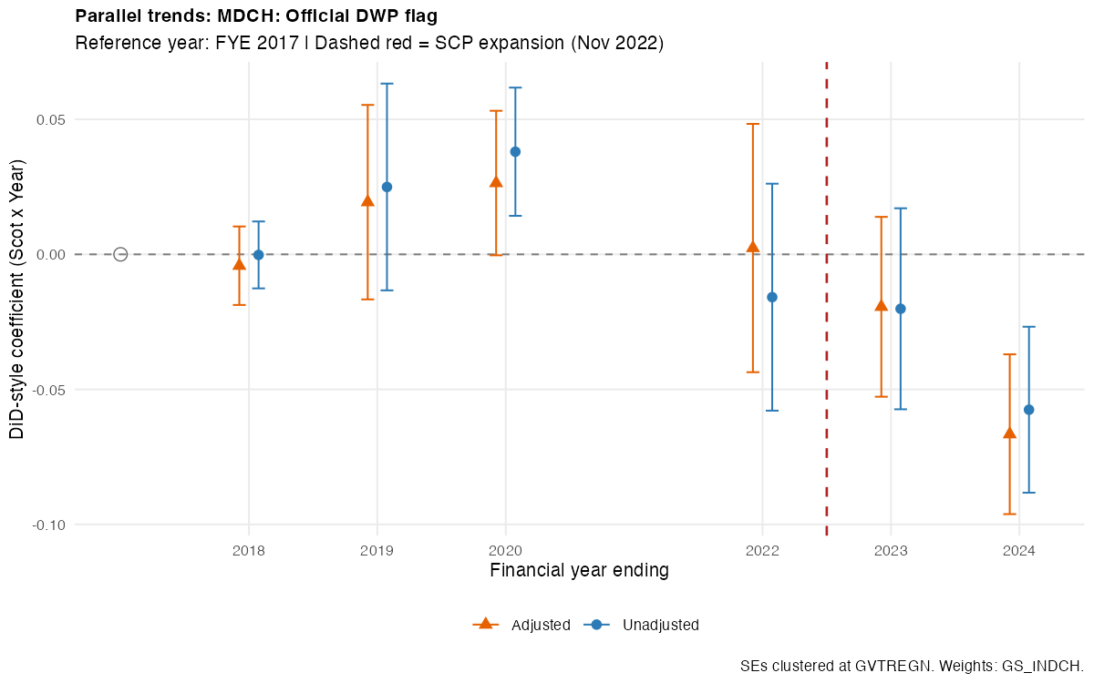
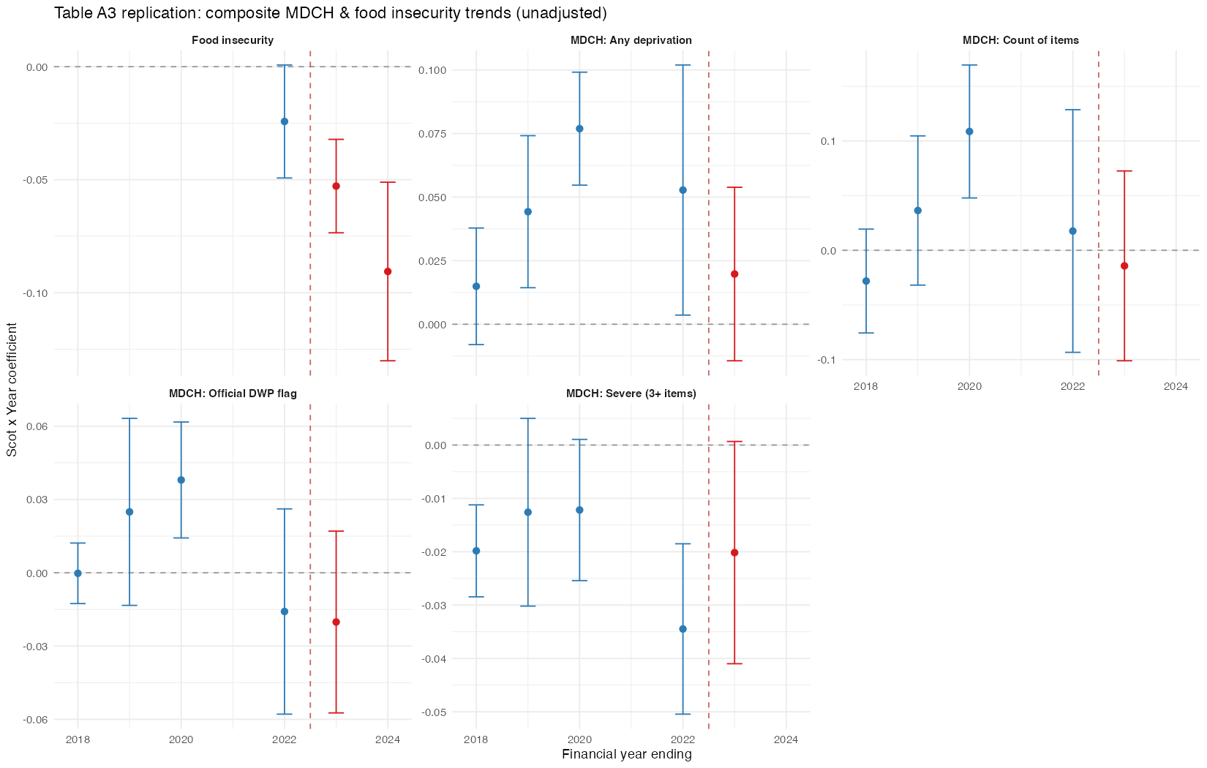
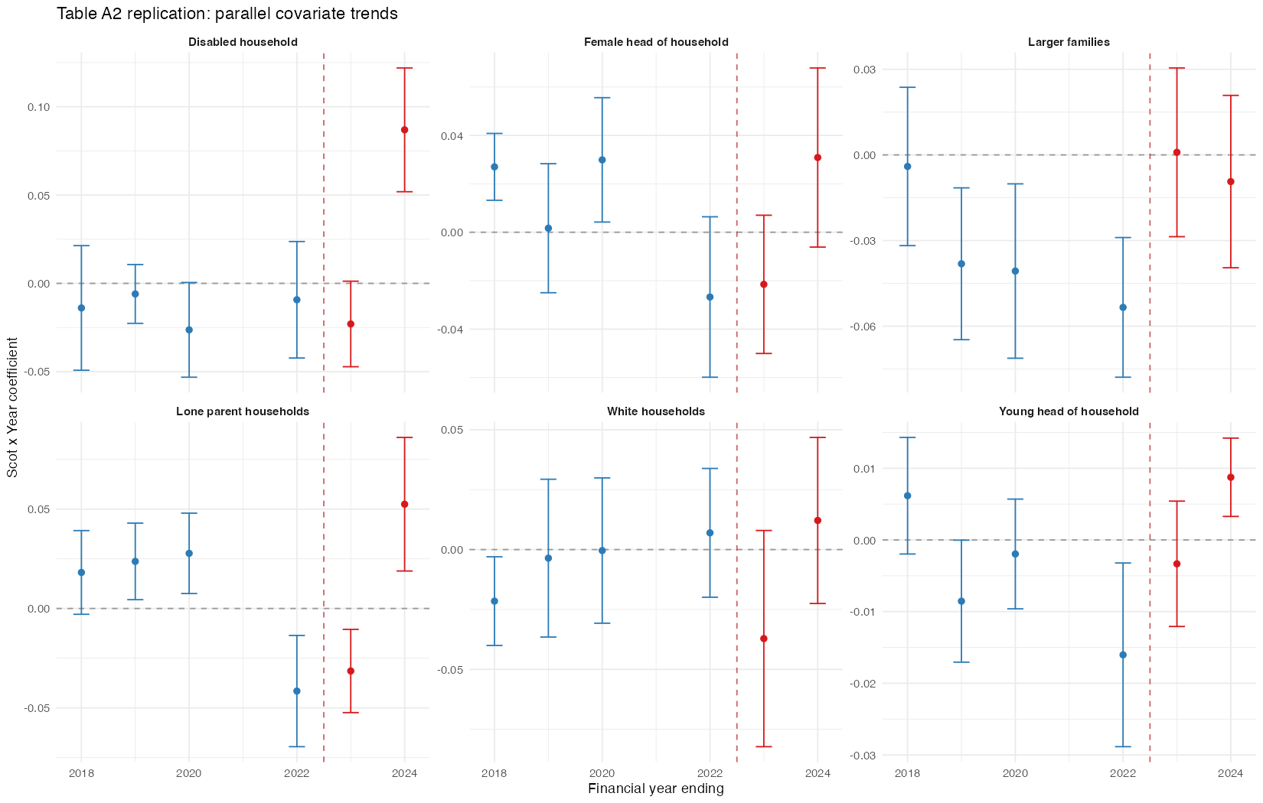
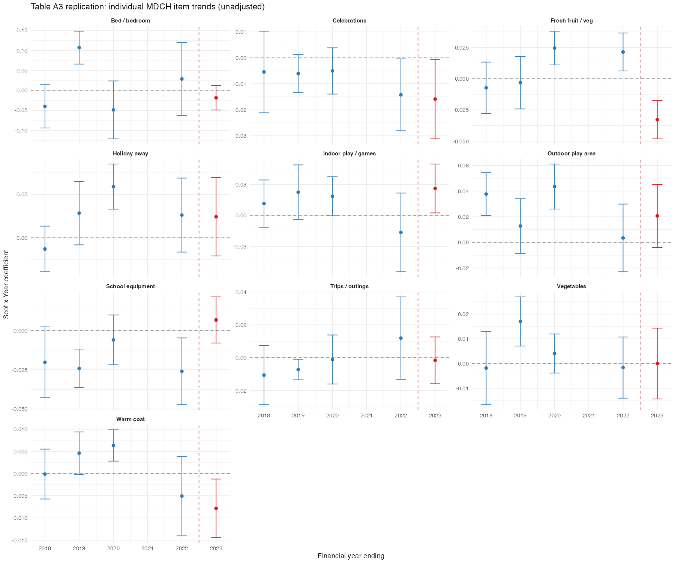
Pre-Treatment Parallel Trends
MDCH: Official DWP flag — Scotland vs. England
FYE | Unadjusted β (SE) | Adjusted β (SE)
FYE 2018 | −0.000 (0.005) | −0.004 (0.006)
FYE 2019 | 0.025 (0.017) | 0.019 (0.016)
FYE 2020 | 0.038** (0.010) | 0.026 (0.012)
FYE 2022 | −0.016 (0.019) | 0.002 (0.020)
FYE 2023 | −0.020 (0.016) | −0.019 (0.015)
FYE 2024 | −0.058** (0.014) | −0.067*** (0.013)
Joint pre-trend Wald test: unadj. p=0.004, adj. p=0.034 (BH-adj. 0.005/0.040) — flagged.
How we deal with this
Once covariates are added, none of the individual pre-2022 year coefficients are significant on their own — only 2024, after the expansion, remains significant in both specifications. The joint test is still marginally flagged (adj. p=0.034, BH-adj. 0.040), a residual caveat rather than a clear violation. We report the adjusted model as preferred (Abadie, 2005), disclose the test rather than hide it, and note ~6,000 Scottish vs ~45,000 English households make these joint tests underpowered by construction (Roth, 2022).
Notes:
This is the headline pre-trend test: the DWP's official MDCH flag. In the unadjusted specification, 2020 shows a real, statistically significant divergence -- 3.8 percentage points, p<0.05 -- two years before the SCP expansion. That's the raw finding, and it's exactly the kind of pattern a clean parallel-trends story should not show.
But look at what happens once I add covariates -- the adjusted column in the table. Every single pre-2022 year loses its significance: 2018, 2019, 2020, 2022, 2023 are all statistically indistinguishable from zero once household composition is controlled for. Only 2024, after the expansion actually happened, is significant in both specifications, which is what you'd want to see for a genuine treatment effect. That's conditional parallel trends doing real work here, not just a theoretical fix (Abadie, 2005).
I'm still not going to overclaim it. The joint Wald test across all pre-2022 years is still flagged even in the adjusted specification -- p=0.034, or p=0.040 after Benjamini-Hochberg correction -- so there's a residual signal the individual-year coefficients don't fully capture. I disclose that rather than bury it. And the honest caveat, in the box at the bottom: with only about 6,000 Scottish households against 45,000 English ones, these joint tests are underpowered by construction (Roth, 2022), so a marginal flag here is a real limitation to name, not one that invalidates the design on its own. A formal HonestDiD breakdown-value analysis is the natural next step, just not one I can fit into the next three days.

Slide 9
Methodology: Three-Stage Design
Benchmark → Extension → Decomposition
1
Benchmark DiD
2
Double ML DiD
3
Item-Level Decomposition
Linear DiD replicating Stewart et al. (2025) on composite outcomes.
Same outcomes, ML-flexible covariate adjustment (Chang 2020).
DML-DiD on each of 12 MDCH items, with FDR correction.
Notes:
The three stages build on each other. Stage 1 validates. Stage 2 tests robustness of Stage 1 to flexible adjustment. Stage 3 is where the original policy insight comes from — no existing paper has done this.

Slide 10
Empirical Strategy: Benchmark DiD
Empirical Specification
Identifying Assumption
Y_it = α + δ (Scotland_i × Post_t) + β X_it + γ_t + ε_it
Parallel trends: absent SCP, Scotland and England track together. Testable pre-2022. See next slide.
δ = treatment effect of interest | Post = 1 after Nov 2022 expansion | γ_t = year fixed effects
Controls (X_it) — linear in benchmark:
Why This Is a Valid Quasi-Experiment
Income (S_OE_AHC), family type, tenure, number of children, age
Year fixed effects — absorb common UK macro shocks
Clustered SEs at country level (Bertrand, Duflo & Mullainathan 2004)
SCP is Scotland-only — England has no equivalent payment
Same HBAI survey both countries — no measurement discontinuity
Staggered rollout (2021, 2022) gives two waves of variation
Notes:
The parallel trends assumption is the key one to verify. The pre-2022 years are 2016/17, 2017/18, 2018/19, 2019/20 and 2021/22. We have 5 pre-treatment years to test this. Best Start Foods (Scotland only, introduced 2019) is a potential confounder — it provides food vouchers to low-income families, which could affect both food security and material deprivation trends independently of SCP.

Slide 11
Stage 2: Double Machine Learning DiD
Why DML over linear DiD?
Procedure (Chang 2020 DML-DiD)
Linear controls assume additive, separable effects — likely wrong for income × family type interactions
DML estimates nuisance functions f(X) and g(X) flexibly using ML
Valid inference despite using ML: Neyman orthogonality + cross-fitting eliminate regularisation bias
Directly comparable to Stage 1 — same data, same outcome, different adjustment
1
Split data
K=5 folds for cross-fitting
2
Partial out outcome
Ỹ = Y − f̂(X) lasso + random forest
3
Partial out treatment
Chang (2020); Sant’Anna & Zhao (2020) doubly-robust extension
D̃ = D − ĝ(X) same learners
Implementation: Python doubleml package (Bach et al. 2022)
4
Estimate δ
OLS of Ỹ on D̃ — yields orthogonal, low-bias ATT estimate
Notes:
The key insight of DML: by partialling out the effect of X on both Y and D before estimating the treatment effect, we remove confounding from X regardless of how complex that relationship is. The cross-fitting prevents overfitting bias. With ~99k observations and 5 folds, each fold has ~20k — adequate for ML learners with our covariate set.

Slide 12
Stage 3: Addressing Measurement Error
The Problem
The Risk
Our Approach (Stage 3)
Binary hardship outcomes measured with error in household surveys (Bound et al. 2001)
Classical ME in outcome Y attenuates DiD estimates: δ̂ = δ · (1 − λ) where λ is noise-to-signal ratio
Composite indices (mdch_any) average over 12 items — measurement error partially cancels
SCP may change how recipients self-report hardship — “awareness effect” (Meyer et al. 2015)
If reporting bias differs Scotland vs. England post-2022, DiD captures attitude change not true hardship change
Kreider et al. (2012): partial identification approach to bound effects under non-classical ME
Run DML-DiD separately on all 12 MDCH items, not just the composite
Compare attenuation across items with different ME properties — subjective (food security) vs. objective (bed, coat)
BH-FDR correction controls false discoveries; consistent effects across items support real change, scattered effects flag a reporting artefact
What is BH-FDR? Benjamini-Hochberg ranks the 12 item-level p-values and flags a result significant only if p ≤ (rank ⁄ 12) × α — controlling the expected share of false positives across the 12 simultaneous tests, at some cost in power vs. single-test significance.

Slide 13
Benchmark DiD: Initial Results
Stage 1a/1b — unadjusted and covariate-adjusted, year FE, SEs clustered by region
Outcome | Unadjusted | Adjusted (with controls)
Any deprivation (mdch_any) | −0.0387*** (0.0090) | −0.0506*** (0.0095)
Deprivation count (mdch_count) | −0.0613** (0.0207) | −0.0839*** (0.0226)
Severe deprivation (mdch_severe) | −0.0002 (0.0053) | −0.0024 (0.0050)
Official MDCH flag | −0.0480*** (0.0075) | −0.0516*** (0.0075)
What This Shows
SCP is associated with significant reductions in any deprivation (mdch_any: −5.1pp adjusted) and the official DWP MDCH flag (−5.2pp) — consistent with Stewart et al.’s (CASE 2025) −8 to −9pp range for composite deprivation.
Deprivation count (mdch_count) also falls significantly, but severe deprivation (3+ items) shows no effect — SCP appears to move families out of mild/moderate deprivation, not severe deprivation.
Covariate adjustment increases the mdch_any/mdch_count magnitude but leaves the official flag estimate almost unchanged — controls aren’t simply picking up compositional differences between Scotland and England.
All significant effects hold at the 1% level. Sample: N=46,941 (item outcomes), N=50,964 (official flag).
Notes:
The CASE paper results are our anchor. If our Stage 1 estimate replicates theirs, that validates our data pipeline. The key question then is whether Stage 2 (DML) differs and what the item-level decomposition shows. Scripts need to be run to fill in TBC cells — priority for the next two weeks.

Slide 14
Anticipated Issues
Low
BSG & Best Start Foods bundling
Moderate
Staggered rollout (2021 vs 2022)
BSG becomes automatic alongside SCP from Nov 2022. Fix: restrict sample to ages 6–15, outside BSG/Best Start Foods eligibility.
~100k under-6s already treated before Nov 2022, contaminating the pre-period. Fix: restrict to ages 6–15; Callaway-Sant’Anna explored as an extension.
Low
MDCH question revision in 2023/24
Moderate
Multiple testing & labour market
DWP revised MDCH questions in 2023/24 — verified non-differential across countries (χ²=0.84, p=0.36), but shrinks the FYE2024 item-level sample.
Multiple testing (12 items): addressed via BH-FDR correction.
Labour market: UC-exit effects — no aggregate effect found (Nesom et al. 2025).
Pre-trends: some covariates diverge pre-2022 — addressed via covariate adjustment.
Notes:
The biggest substantive issue is the staggered rollout — do I use just the 2022 expansion (cleaner but loses 2021 variation) or try to use both cohorts (more complex, needs Callaway-Sant'Anna)? My plan is to use 2022 as the main analysis and have the staggered version as a robustness check if time allows.
I've upgraded the fourth card to "Moderate" risk because the pre-treatment diagnostics (previous slide) turned up real pre-existing divergence on most covariates. I'm treating it as a known limitation rather than a fatal flaw: the covariate-adjusted specification is my preferred estimate for exactly this reason, and the small-sample power caveat is a legitimate, literature-grounded response to a reviewer who pushes on it.

Slide 15
Summary
Question
Which specific dimensions of child material deprivation does the £25/week SCP reduce?
Data
HBAI individual microdata, 2016/17–2023/24, ~99k child-year observations with 12 binary MDCH items
Method
Three-stage: benchmark linear DiD → DML-DiD (Chang 2020) → item-level decomposition with FDR correction
Contribution
First item-level causal decomposition of SCP effects on 12 MDCH dimensions; robustness test of linear vs. DML covariate adjustment; measurement error framework for hardship outcome choice
Status
Literature reviewed; empirical strategy designed; HBAI data sourced (UKDA-5828); analysis pipeline built and ready to run.
Thank you — questions welcome
Notes:
Close by emphasising: (1) the data is clean and ready to run, (2) the methodology is established and well-referenced, (3) the contribution is clear and differentiated from the existing literature. The item-level decomposition is the genuinely new thing — no existing paper has asked which deprivation dimensions £25/week affects.

