Slide 1
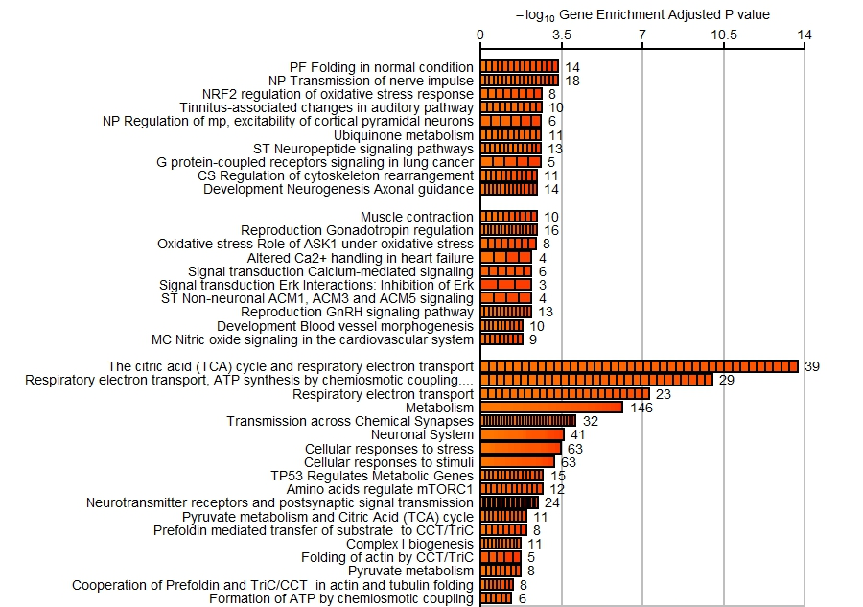
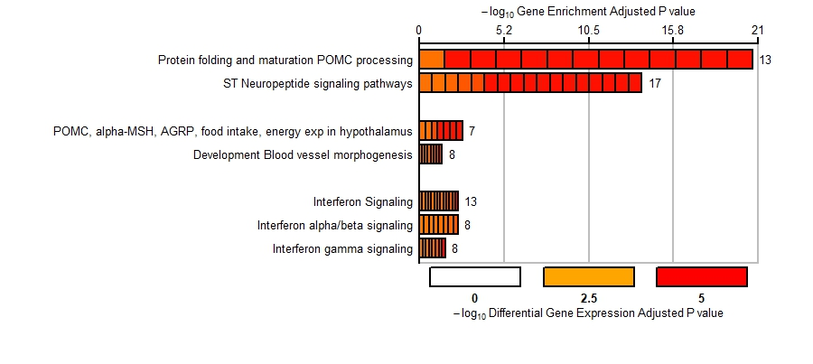
Process Networks
Pathway Maps
Brain Bank
Reactome
Process Networks
Target ALS
Pathway Maps
Reactome

