Slide 1
DNAScanLong Pipeline

Slide 2
Agenda
Introduction
Methodology
Bench Marking
Appendix

Slide 3
Please Interrupt me and Provide Feedback Throughout the Presentation

Slide 4
Introduction

Slide 5
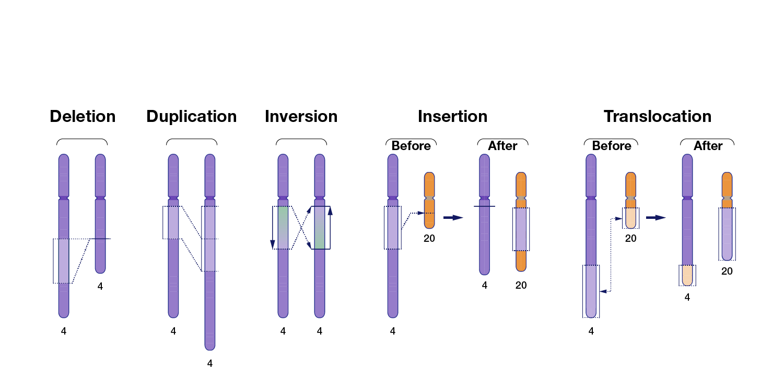
Introduction – Structural Variants

Slide 6
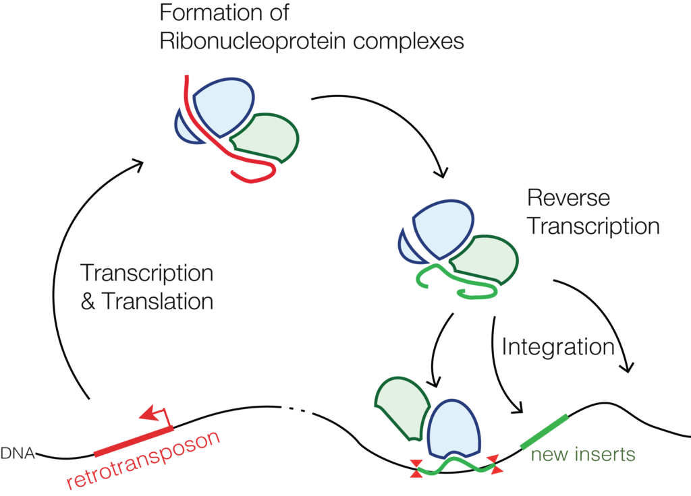
Introduction – Transposons

Slide 7
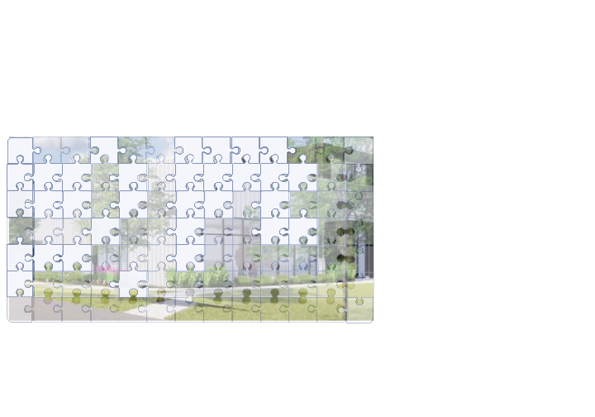

Introduction
Short-Read Sequencing (SRS)
Long-Read Sequencing (LRS)

Slide 8
Introduction – Pipeline Aims
Identifies structural variants
Particular transposable elements
From Long Read DNA Seq
Be transferable across DNA Seq technologies e.g. Nanopore, PacBio etc

Slide 9
Introduction – Pipeline Aims
Identifies structural variants
Particular transposable elements
From Long Read DNA Seq
Be transferable across DNA Seq technologies e.g. Nanopore, PacBio etc

Slide 10
Introduction – Pipeline Aims
Identifies structural variants
Particular transposable elements
From Long Read DNA Seq
Be transferable across DNA Seq technologies e.g. Nanopore, PacBio etc

Slide 11
Methodology

Slide 12
Methodology – Functional Architecture
Data Input
Quality Control
Read Filtering & Trimming
Assembly and Error Correction
Alignment
Variant Analysis
Variant Annotation
Report Generation

Slide 13
Methodology – Functional Architecture
Data Input
Quality Control
Read Filtering & Trimming
Assembly and Error Correction
Alignment
THIS TAKES SEVERAL HOURS AND IS TECHNICAL OPTIONAL
THIS TAKES ~24-48 HOURS AND IS OPTIONAL
Variant Analysis
Variant Annotation
Report Generation

Slide 14
Methodology – Functional Architecture
Variant Analysis
Variant Analysis
Single Nucleotide
Polymorphisms
Repeat
Expansions
Structural
Variants
Transposable
Elements
Methylation
Mitochondrial
Variants

Slide 15
Methodology – Technical/Functional Architecture
Data Input
FastQC
Quality Control
Read Filtering &
Trimming
PoreChop
Nanofilt
Assembly & Error
Correction
Flye
assembly-stats
Alignment
Minimap2
samtools

Slide 16
Methodology – Functional Architecture
Variant Analysis
Variant Analysis
Single Nucleotide
Polymorphisms
Repeat
Expansions
Structural
Variants
Transposable
Elements
Methylation
Mitochondrial
Variants
NanoCaller*
TRiCoLOR
CombiSV*
TLDR*
Megalodon*
Mutserve2*
ANNOVAR
AnnotSV
EWAS Catalog
Mutserve2?
Variant Annotation

Slide 17
Methodology – Functional Architecture Justification
Software | Step | Justification
PoreChop | Read Filtering & Trimming | Recommended by tutorial
Nanofilt
Flye | Assembly & Error Correction | Improves genome assembly at long and highly repetitive regions by constructing an assembly graph from concatenated disjoint genomic segments
Minimap2 | Alignment | Runs much faster than other long-read aligners
FastQC | Quality Control | Recommended by tutorial
assembly-stats |  | Recommended by tutorial
samtools |  | Well established

Slide 18
Methodology – Functional Architecture Justification
Software | Variant Calling Step | Justification
NanoCaller | Single Nucleotide Polymorphisms | Good performance in complex genomic regions which cannot be reliably called on short-read data
TRiCoLOR | Repeat Expansions | Best in Benchmarking Study
CombiSV | Structural Variants | Best in Benchmarking Study
TrEMOLO | Transposable Elements | Best in Benchmarking Study
Megalodon | Methylation | Best in benchmarking study particularly in the more challenging areas including repetitive regions and discordant non-singletons, also as it predicts more CpG sites
MitoBAM | Mitochondrial | Best in Benchmarking Study

Slide 19
Methodology – Functional Architecture Justification
Software | Variant Annotation Step | Justification
ANNOVAR | Single Nucleotide Polymorphisms | Well established for short read DNA seq data
 | Repeat Expansions
AnnoteSV | Structural Variants | Well established for short read DNA seq data
 | Transposable Elements
EWAS Catalog | Methylation | Olivia recommended this one and it was one of the few I could find
mvTool | Mitochondrial | ?

Slide 20
Methodology – Selling Points
First end to end pipeline that does TEs
Highly parralised

Slide 21
Methodology – Structural Variant Tools
Function | Component | Installed? | Notes
Structural Variant Analysis | Sniffles and Survivor | Y | Survivor is used to reduce the false positive rate
 | combiSV* |  | Combines several structural variant tools.
Transposable Element Analysis | xTea |  | Works on both long and short read DNA seq.
 | TDLR |  | Allows the partial detection, assembly and annotation of non-reference TE insertions
 | TrEMOLO* |  | Combines assembly- and mapping-based approaches to detect genetic elements called transposable elements
 | TELR |  | Relies on the detection of abnormally mapped reads upon the reference genome that can be linked to a TE
 | Temp2 |  | Detection of germline TEs
* Ranked top in benchmarking studies

Slide 22
Bench Marking

Slide 23

Bench Marking – Structural Variants
Manually curated Genome in a Bottle (HG002) indel list

Slide 24
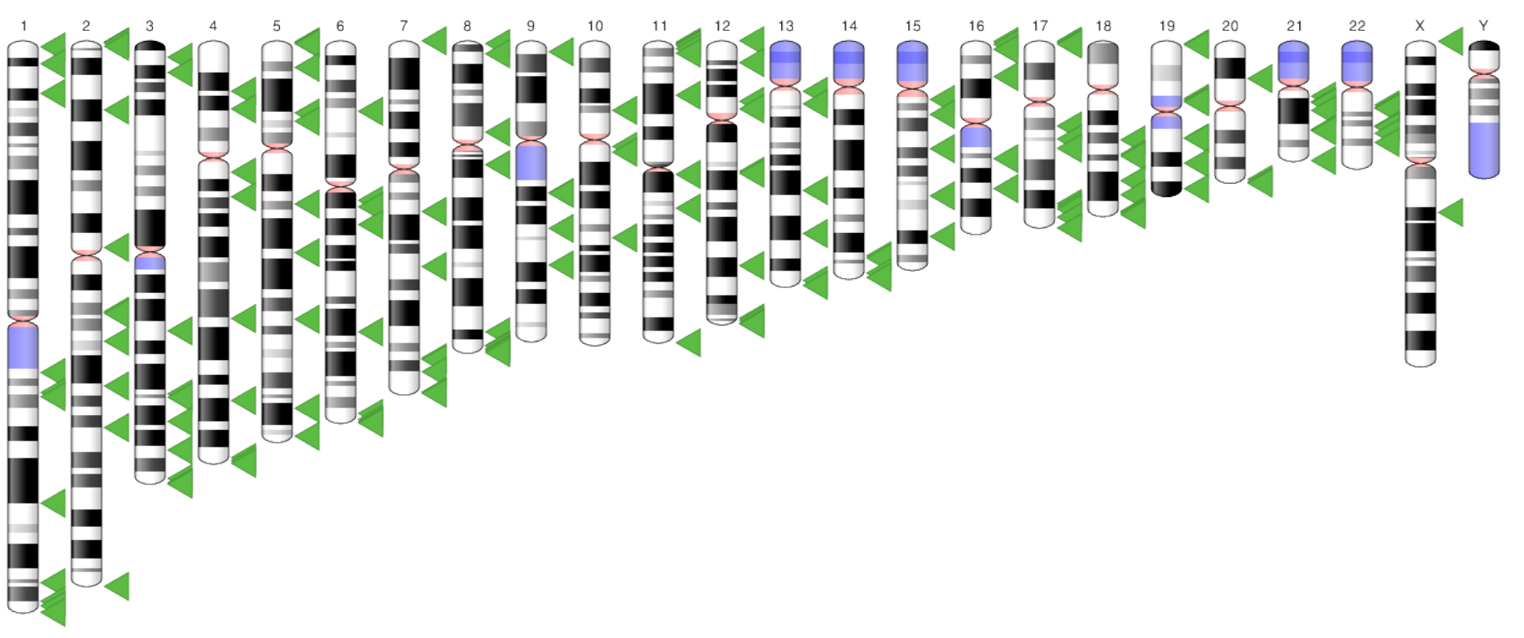
Bench Marking – Structural Variants
Manually curated Genome in a Bottle (HG002) indel list
HG38 with selected reference transposable elements removed
Simulated DNA seq data with perturbed references transposable elements

Slide 25
Bench Marking – Notes
Removal of reference TEs from HG38 is to evaluate the tools sensitivity and precision
Reference TE loci can be obtained through the UCSC table browser
The results from each tool from 50 WGS were compared to identify agreement
Memory usage and time taken for each tool to run on a single WGS sample was tested

Slide 26
Appendix

Slide 27
Comparison to Other Pipelines

Slide 28
Comparison to Other Pipelines
Pipeline Step | Kimberley Billingsley's Pipeline | Alish Palmos' Pipeline | Our Pipeline
Quality Control (QC) |  | FastQC, nanoStat, nanoPlot | FastQC
Read Filtering & Trimming |  |  | PoreChop and Nanofilt
Assembly | Shasta |  | Flye
Assembly Error Correction |  |  | Racon and Pilon
Assembly QC |  |  | dnadiff
Alignment |  | Minimap2 | Minimap2
Structural Variant Analysis | Sniffles2 and Survivor | Sniffles | combiSV, TDLR, xTea and AnnotSV
Diploid Assembly | Hapdup
Small Variant Analysis | PEPPER-Margin-DeepVariant
Diploid Structural Variant Analysis | hapdiff
Diploid Structural Variant Phasing | Margin

Slide 29
Bench Marking

Slide 30
Bench Marking – Structural Variants
Manually curated Genome in a Bottle (HG002) indel list

Slide 31
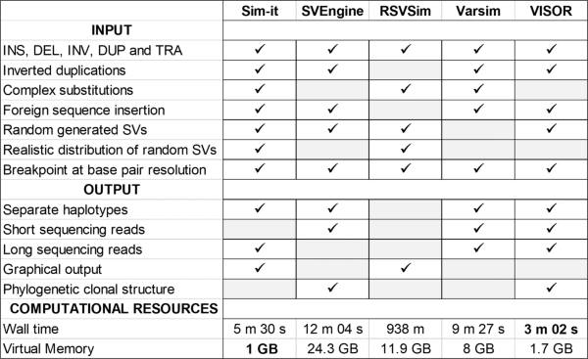
Bench Marking – Structural Variants
Manually curated Genome in a Bottle (HG002) indel list
Artificially created DNA sequences with more complex structural variants (duplications, inversions and translocations)

Slide 32

Bench Marking – Transposable Elements
Renata’s HERV insertions from short read DNA seq

Slide 33

Bench Marking – Transposable Elements
Renata’s HERV insertions from short read DNA seq
MELT or xTEA analysis from short read DNA seq

Slide 34
Bench Marking – Transposable Elements
Renata’s HERV insertions from short read DNA seq
MELT or xTEA analysis from short read DNA seq
Artificially created DNA sequences using these methods

Slide 35
Bench Marking – Transposable Elements
Renata’s HERV insertions from short read DNA seq
MELT or xTEA analysis from short read DNA seq
Artificially created DNA sequences using these methods
Hg38 with known TEs removed

Slide 36
Decisions

Slide 37
Decisions
Should we include the “Read Filtering & Trimming” step for pacbio as well?
Not a priority
Should we convert haploid long read assemblies into a diploid assemblies using Hapdup?
Ask kim
Do we want to perform small variant calling? e.g. using PEPPER-Margin-DeepVariant?
Yes

Slide 38
Meeting Notes
Keep files gzipped to reduce space
Save reads that are above 100,000 in a separate file
Trim reads that are below a certain quality score (look up what quality score is good for ONT)
In WorkFlow add annotation as a new step
Add post alignment quality checks such as SAMtools depth etc
Look at Australia paper and what steps they included
If I keep getting errors run on temp directory
Plan on running all benchmarking tools
For TEs we could remove TEs from reference and then predict them from normal reference file
Think about using short read seq to confirm small variants
See if we can use methylation arrays from short reads to validate methylation data in long reads?
Set up a call with Kim and Oxford Nanopore
Set up bench marking framework

Slide 39
Appendix

Slide 40
Appendix – Functional Architecture
Input
Quality Control (QC)
Read Filtering & Trimming
Assembly
Assembly Error Correction
Alignment
Variant Analysis

Slide 41
Appendix – Technical/Functional Architecture
Input
FastQC
Quality Control
Read Filtering &
Trimming
PoreChop
Nanofilt
Minimap2
Assembly
assembly-stats
& dnadiff
Miniasm
Racon
Assembly Error
Correction
Pilon
Alignment
Minimap2
Variant Calling
combiSV
xTea
TDLR
AnnotateSV

Slide 42
Appendix – Assembly
Component | Notes
Minimap2 and Miniasm | Outputs unitigs not contigs. Unitigs are unique parts in the assembly graph. This means all reads in your data “agree” on this part of the assembly. One could say they are high-confidence contigs. In contrast, contigs may include regions with ambiguous read information, depending on the algorithm used. As a result unitigs can be shorter and the miniasm assemblies more fragmented
Flye | Flye also produces a polished consensus sequence for the assembly which significantly reduces the error rate. But is very slow!
Shasta | Very fast run-time that produces contigs but I encounter memory issues.

Slide 43
Appendix – Assembly Error Correction
Component | Notes
Racon | Written specifically to improve minimap2/miniasm assemblies
Minipolish | Minipolish was written with a focus on cirular replicons, e.g., bacterial genomes, plasmids and plastids, which it tries to cleanly circularize, if possible.
Pilon | Can be run after Racon to further improve assembly quality by correcting Insertion/Deletion (Indel) errors as well as Single Nucleotide Polymorphisms (SNPs).

Slide 44
Appendix
Function | Component | Notes
Structural Variant Analysis | Sniffles and Survivor | Survivor is used to reduce the false positive rate
 | combiSV* | Combines several structural variant tools.
Transposable Element Analysis | xTea | Works on both long and short read DNA seq.
 | TDLR | Allows the partial detection, assembly and annotation of non-reference TE insertions
 | TrEMOLO* | Combines assembly- and mapping-based approaches to detect genetic elements called transposable elements
 | TELR | Relies on the detection of abnormally mapped reads upon the reference genome that can be linked to a TE
* Ranked top in benchmarking studies

