Slide 1
VAMDC technology
Guy Rixon
Innsbruck, February 2013

Slide 2
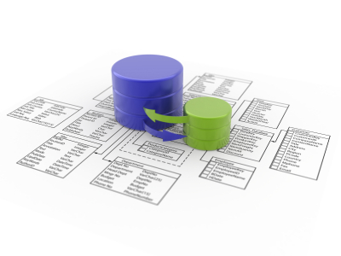
VAMDC
infrastructure
Data
Application
Notes:
The VAMDC infrastructure is an intermediary: a device for getting data from databases to applications in an interoperable way. VAMDC provides neither the databases or the applications. The infrastructure imposes a number of standards on the data flow.

Slide 3



Plan A
Dump each database into a file and put on web.
WWW
×1
Pro:
  “The simplest thing that could possibly work”
  Everything you can get has its own URL
Con:
  Data-sets too large (up to 10GB)
  No easy way to make data extracts

Slide 4
Plan B
Pre-compute all possible data extracts and dump on web
WWW
×∞
Pro:
  Selection now easy
  One URL for each possible extract
Con:
  Impossible to implement!

Slide 5

Plan C
Compute data extracts on demand
but
index them on the web as if pre-computed
WWW
×1
Pro:
  Implementation now feasible
  Still have a URL for every data-extract
Con:
  Some assembly required
  Need to define standards for services, queries etc.

Slide 6
The core standards
Data node
VAMDC-TAP
Application
XSAMS
VSS2 + VAMDC dictionary
XSAMS processor
XSAMS-consumer
(diverse output)
XSAMS
Registry
IVOA registry interface
VOResource + VAMDC capability
XQuery
Notes:
One group of standards for each type of web service. Each data node gives access to one database; VSS2 is the query language, the dictionary states the terms to use in the query, and XSAMS is the data format for the result. Note that VAMDC gives out data extracts resulting from queries, not entire or pre-prepared data-sets. The XSAMS processors transform XSAMS documents into other forms. The registry lists the locations and details of the other services.

Slide 7
Data URLs
The address of the service
(this one for CDMS)
http://cdms.ph1.uni-koeln.de:8090/DjCDMS/tap/sync?REQUEST=doQuery&LANG=VSS2&FORMAT=XSAMS
&QUERY=SELECT+ALL+WHERE+MoleculeStoichiometricFormula+%3D+%27CO%27
The data to be extracted
Call these with HTTP GET
Notes:
Our service protocol embeds the query language which in turn embeds terms from the dictionary. This lets us form a URL for an data extract. These URLs are easy to use - HTTP GET or POST - so we don’t need libraries to implement the protocol.

Slide 8
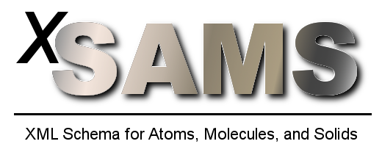
XSAMS
“XML schema for Atoms, Molecules & Solids”
Developed by IAEA & VAMDC:
  Proposed 2003, at IAEA DCN meeting
  First versions by (IAEA, NIST, ORNL U. Pierre & Marie Curie, OPM, RFNC-VNIITF)
  Subsequent development by VAMDC
See http://www-amdis.iaea.org/xsams/
See also http://www.vamdc.org/documents/standards/#data-model

Slide 9
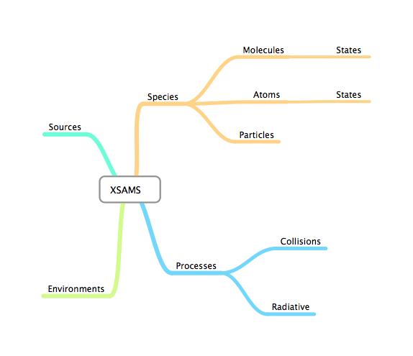
XSAMS structure: top

Slide 10
XSAMS structure: bottom
All quantities have units
All values can have associated uncertainties
All values can have a source reference
XML ⇒ no encoding issues for numbers

Slide 11
XSAMS for molecules
“Case-by-case” XSAMS:
Separate, additional schema for each class of molecule:
1. Diatomic closed shell (dcs): CO, N2, NO+
2. Hund’s case (a) diatomics (hunda): NO, OH [for low J]
3. Hund’s case (b) diatomics (hundb): O2, OH [for high J]
4. Closed-shell, linear triatomic molecules (ltcs): CO2, HCN
...etc up to at least 12 cases

Slide 12
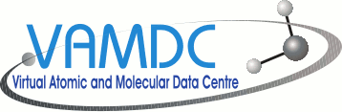
Adapted application
Application
VAMDC library
XSAMS
Registry
Data node
Data node
Data node
Notes:
Normally, a science code is run on a user’s own computer. It is possible to use VAMDC facilities with these codes by writing a wrapper script, which can be a simple shell script or a small program in, e.g., Python. All VAMDC services can be called easily from scripts.
Narrow arrows represent commands, broad arrows represent data flows.

Slide 13
Wrapped application
Wrapper script
Application
XSAMS
Registry
Data node
Processor
Data node
Data node
Notes:
Normally, a science code is run on a user’s own computer. It is possible to use VAMDC facilities with these codes by writing a wrapper script, which can be a simple shell script or a small program in, e.g., Python. All VAMDC services can be called easily from scripts.

Slide 14

Portal, nodes & processors
Application
http://portal.vamdc.eu/
Portal
Registry
XSAMS
Data node
Processor
Data node
Data node
Data node
Data node
http://registry.vamdc.eu/
Notes:
VAMDC provides a web portal as a proxy for a connected application. The user drives the portal with a web browser and forms the queries interactively, typically routing the results to a processor for transformation into a desired format. The results are saved on disc and then offered to a local application.
In a system, there is one portal, many data nodes and many processors, all on different sites.

Slide 15

Taverna; code as service
+
Taverna
Registry
XSAMS
Data node
Processor
code as service
Data node
Data node
Notes:
Science codes can be wrapped as web-services and run using the Taverna workflow-system.
These services would not be part of the VAMDC system itself, but Taverna can compose calls to VAMDC services with call to the the code; it needs a VAMDC plug-in for this and that plug-in is a released, VAMDC product.

Slide 16
So how do I make a node?
(And will it hurt?)

Slide 17
Node = database + web server + node software

Slide 18
Node software in Python
Custom
code
for DB
Reusable
node
software
Provided by WP4,
with help from
WP7
From VAMDC WP7;
code in GitHub;
docs on vamdc.eu site
Django
MySQL
Python
httpd/
WSGI
Readily available;
usually as optional
package in Linux
distro

Slide 19
Node software in Java
Custom
code
for DB
Reusable
node
software
Provided by WP4,
with help from
WP7
From VAMDC WP7;
code in GitHub;
docs on vamdc.eu site
MySQL
Java
Tomcat/
JEE
Readily available;
usually as optional
package in Linux
distro

Slide 20
Node example: Chianti
RHEL
Chianti DB
Re-ingested for VAMDC
Apache httpd
settings.py
Connects Django to Chianti DB.
Written for Chianti DB; 38 lines
MySQL server
vamdctap
Implements VAMDC-TAP protocol.
Provided by WP7; ~2400 lines
Python 2.7
models.py
Describes DB schema to Python.
Written for Chianti DB; 48 lines
Django etc.
dictionaries.py
Describes DB schema to VAMDC generator.
Written for Chianti DB; 48 lines
queryfunc.py
Converts from VSS to Django objects.
Adapted from WP7 original; 205 lines

Slide 21
Chianti example (cont.)
Ingest DB
Y
Working?
N
???
Code Python modules
Test with portal
Test with internal server + Firefox
Register
Working?
Deploy on server
Y
N
Tweakable?
Y
(Data provided by DAMPT, Cambridge;
ingestion and node set-up by IoA, Cambridge;
eventual hosting by MSSL)
Re-evaluation
N

Slide 22
System versions
System version defined by standards version
Three so far:
  11.05 (withdrawn)
  11.12 (current, released)
  12.07 (in preparation, to be released in 2013)
Expect one new version per year from now on
new standards ⇒ new deployments on new URLs

Slide 23
Annual updates of standards
Update VAMDC standards
~ + 3 months
Redeploy
nodes
t = 0
Redeploy
registry
t ~+4 weeks
Update
node software,
portal, registry
Test!
Redeploy
portal
~ + 3 months
t ~+2 weeks
t ~+6 weeks
Redeploy
processors
Announce
new URLs
to users
Notes:
The times for the transitions between stages are the approximate minimum times.
“Redeploy xxx” includes local testing, particularly by the owners of nodes.
The “test” box at the right is general integration-testing of the system.

Slide 24
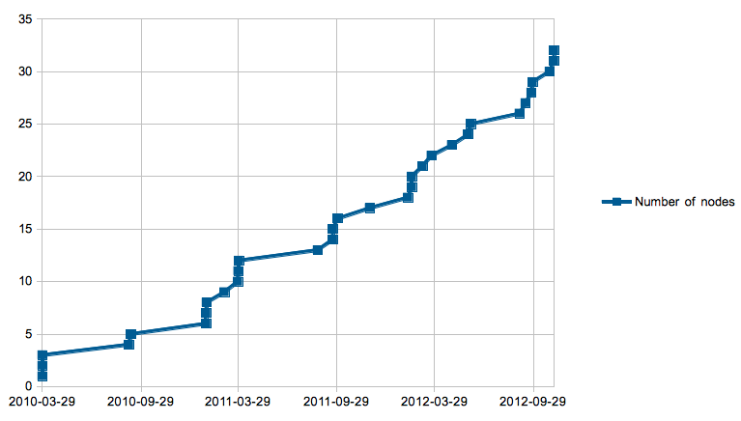
Timeline of node registrations
Nodes complete as per original, VAMDC proposal

