Slide 1

Restaurant Review Dataset
Chase Maschinot and Guysnove Lutumba

Slide 2
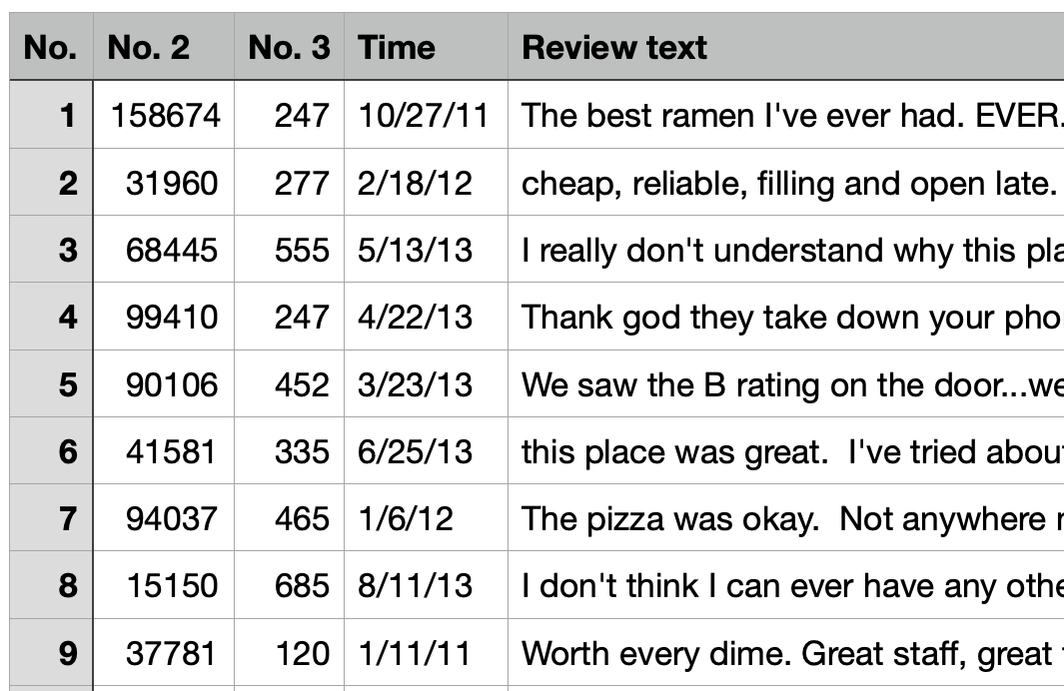
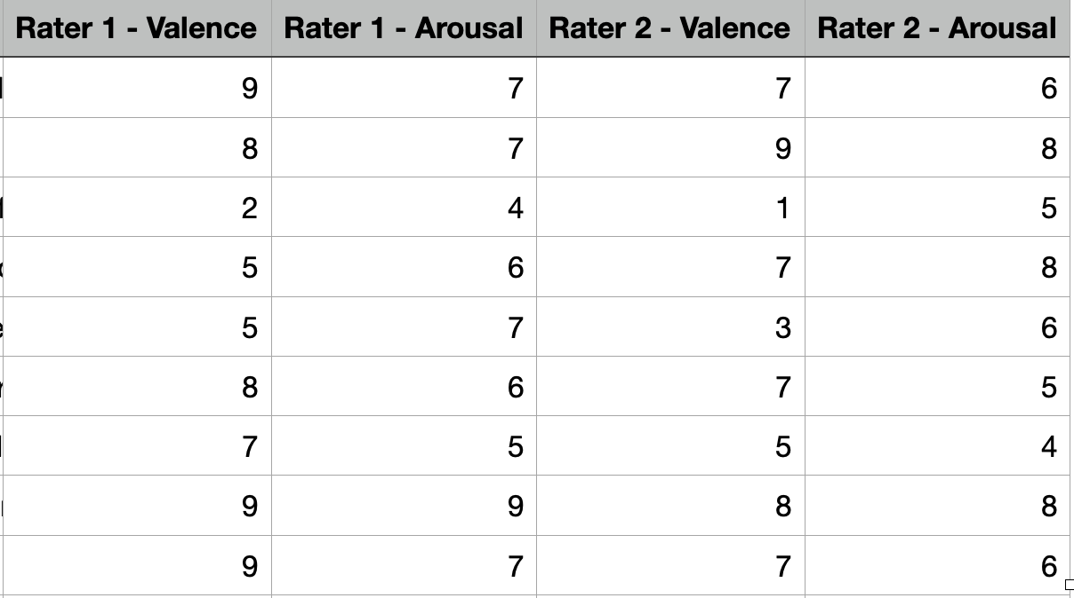
The Dataset

Slide 3
Dataset Explained
“No. 2” – Row counter from the original dataset
“No. 3” – The restaurant number from where the review came from
“Time” – When the review was provided
“Review text” – The review itself in the form of text
Valence – The pleasantness from the experience
Arousal – The excitement from the experience
Ratings by two different raters for each Valence and Arousal

Slide 4

The Problem
Sample from a large dataset of reviews without any ratings
Contains all the other information
Hired individuals to rate the reviews for the sample
Develop a model or models to accurately predict whether a review is positive or negative
Is there a pattern to how the reviews are written, that a model could identify?

Slide 5
Preprocessing
Dropped the “No.2”, “No. 3”, and the “Time” attributes
Removed:
Punctuation
Multiple Whitespaces
Numbers
Stopwords (and, the, a, etc.)
Short words (less than three letters)
Stem the words (removes the ending)

Slide 6
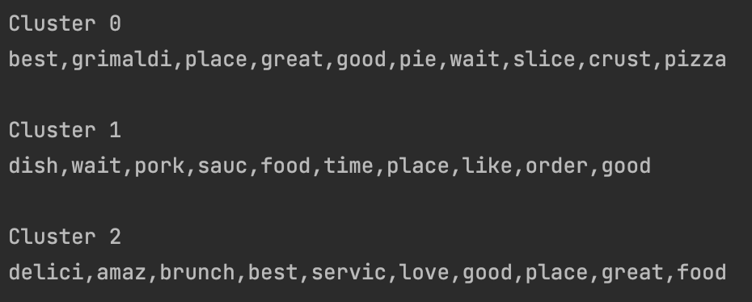
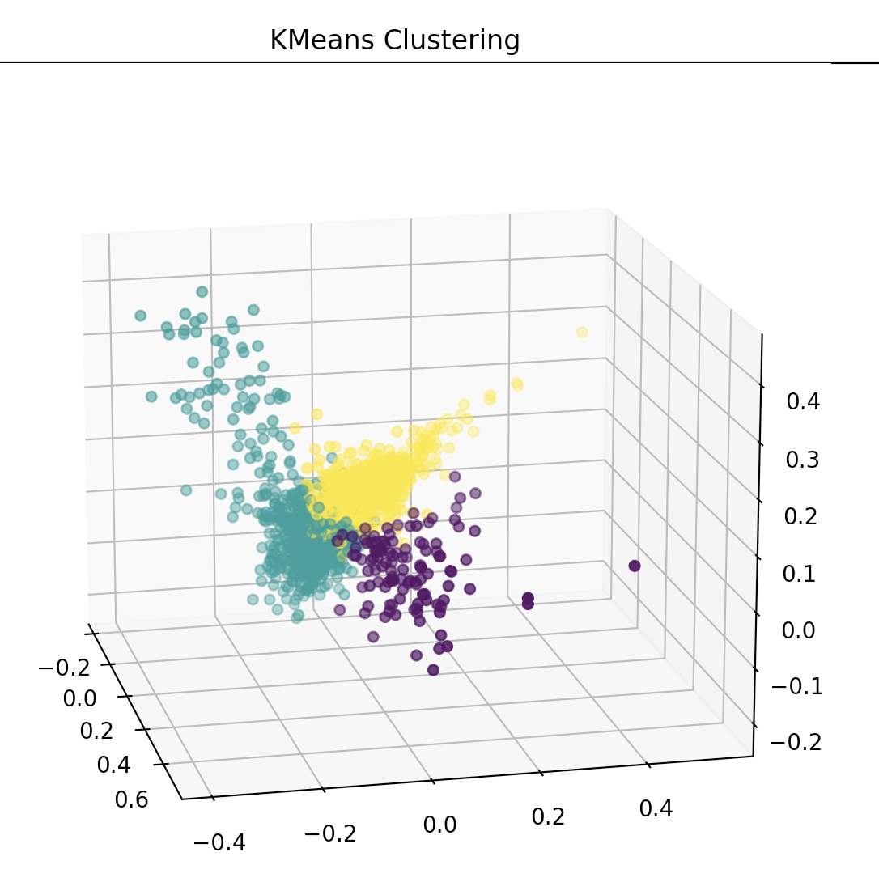
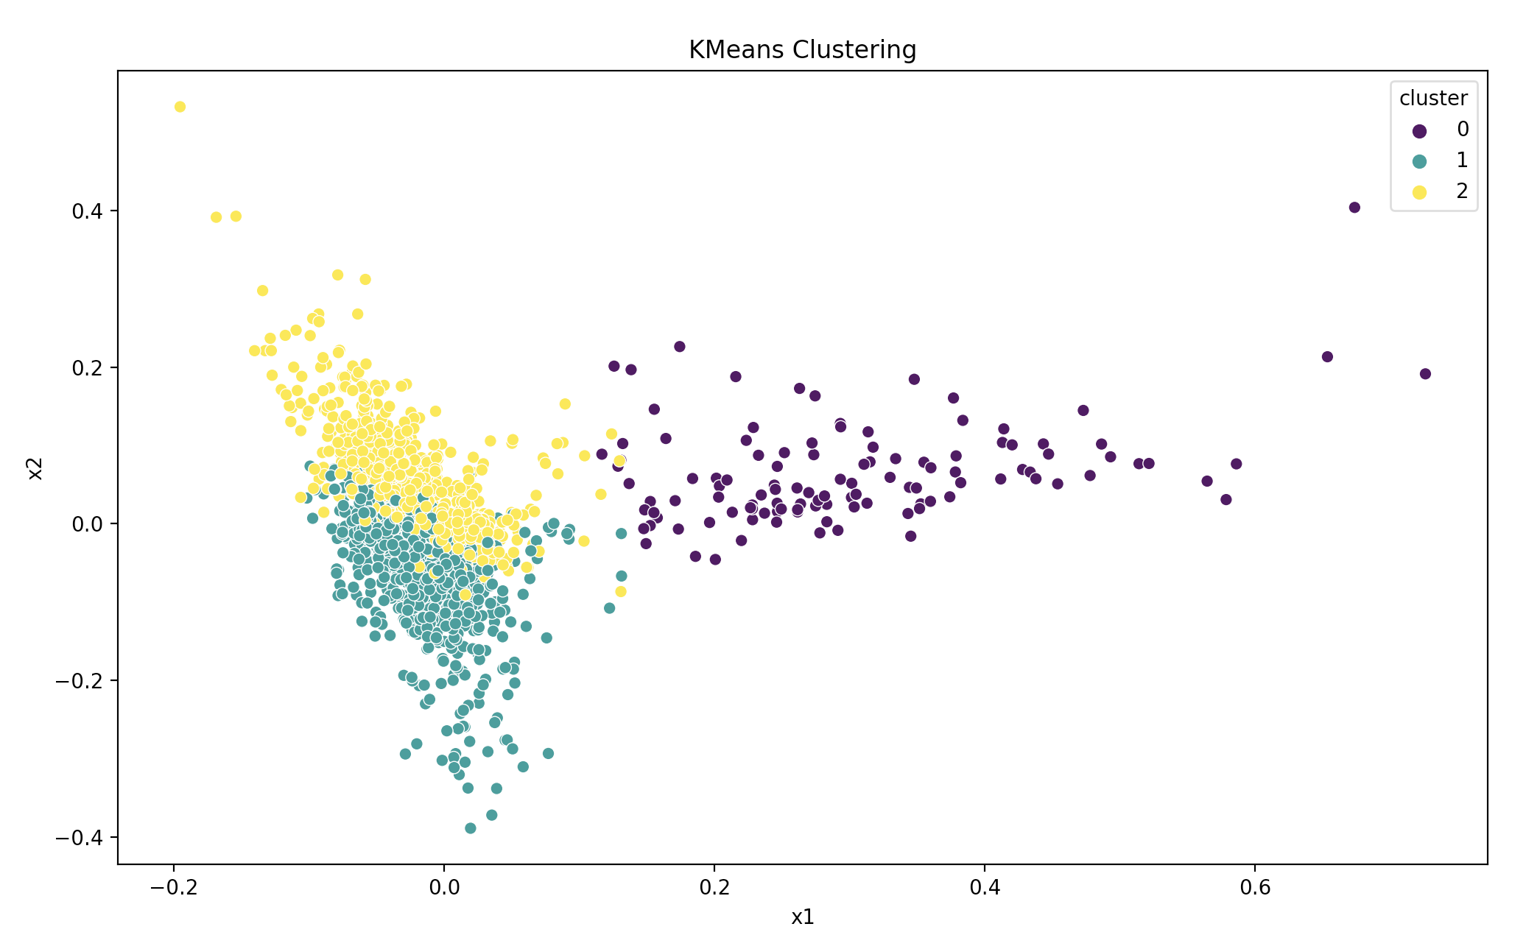
Clustering

Slide 7
Models used with Given Ratings
The ratings were not manipulated
Multinomial Naïve Bayes
Stochastic Gradient Descent Classifier (SGDClassifier)
Support Vector Machine

Slide 8
Multinomial Naïve Bayes
Calculates the likelihood of class based off the given attributes
Conditional Probabilities
“Naïve” – Order does not matter
Performed poorly
An average cross validation accuracy of around 0.33

Slide 9
Support Vector Machine
Finds the most optimal placement of decision boundary
Separate different classes
Maximize the margin
Took longer than others
Did not do cross validation
Accuracy around 0.29

Slide 10
SDGClassifier
Stochastic Gradient Descent Classifier
Linear classifier like SVM with SGD training
SGD is the optimization method to minimize/maximize loss function
Uses a single sample, other versions use batches, updates the model along the way (decrease learning rate)
Accuracy around 0.29

Slide 11
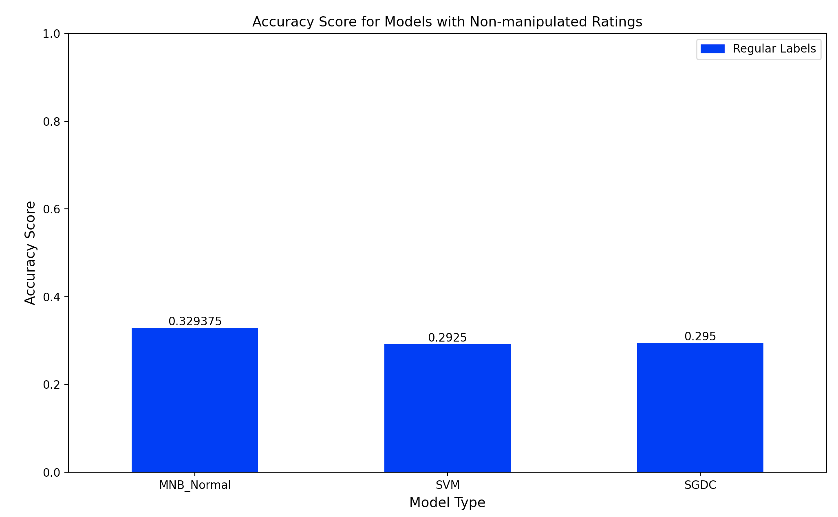
Notes:
Chase last slide

Slide 12
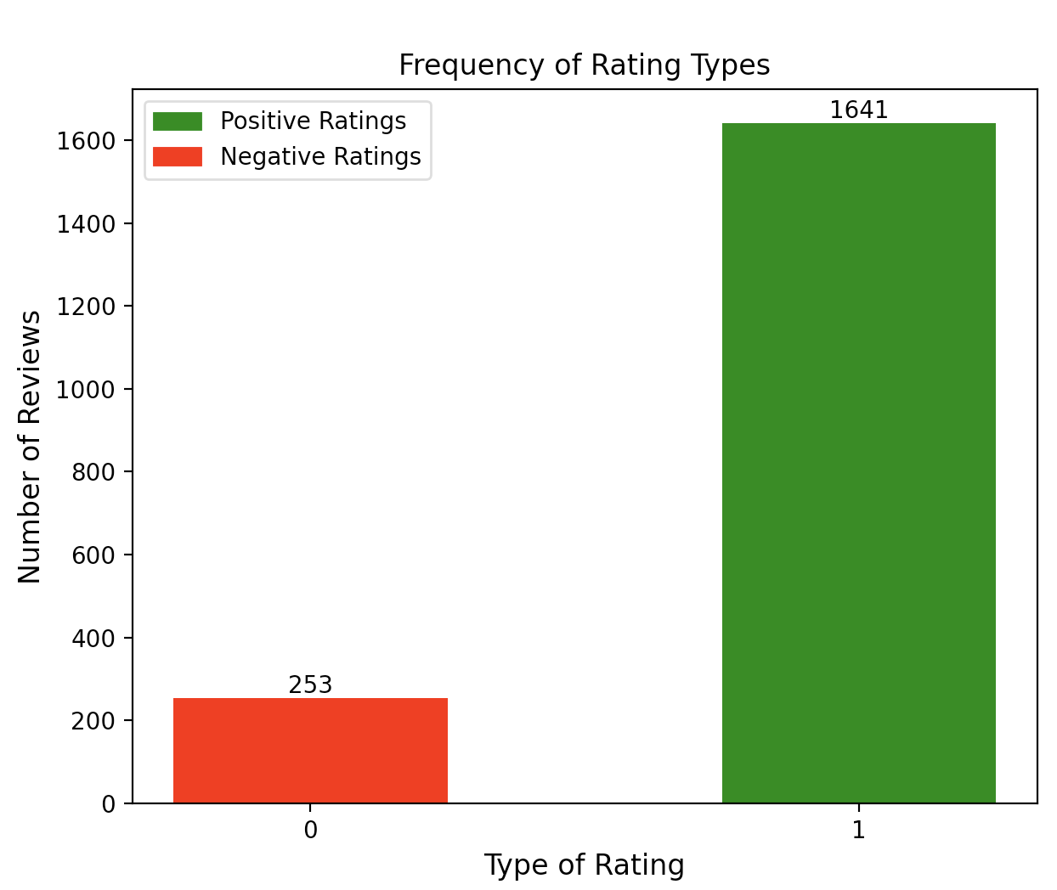
Manipulate the Classes
Instead of 1-10 ratings, reduce to 0 or 1
0 for “negative” rating (rating < 5)
1 for “positive” rating (rating > 5)
Drop “neutral” ratings (rating = 5)
Notes:
Guysnove first slide

Slide 13
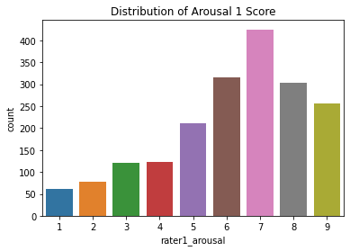
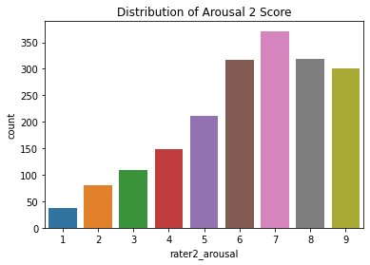
Distribution of ratings

Slide 14
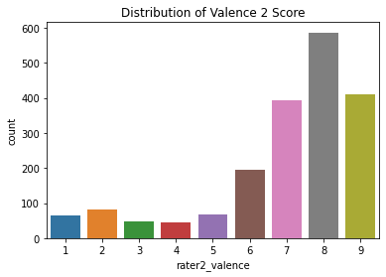
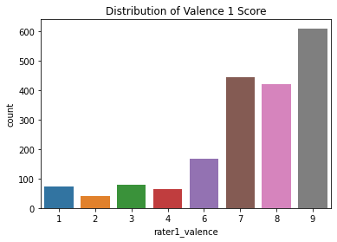
Distribution of Ratings Cont.

Slide 15
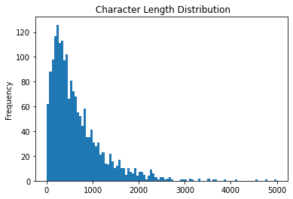
How verbose are the reviews?

Slide 16
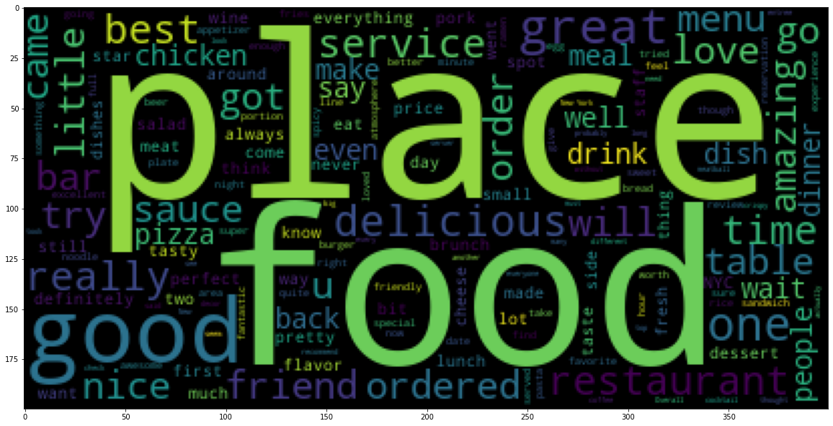
Positive Word Cloud

Slide 17
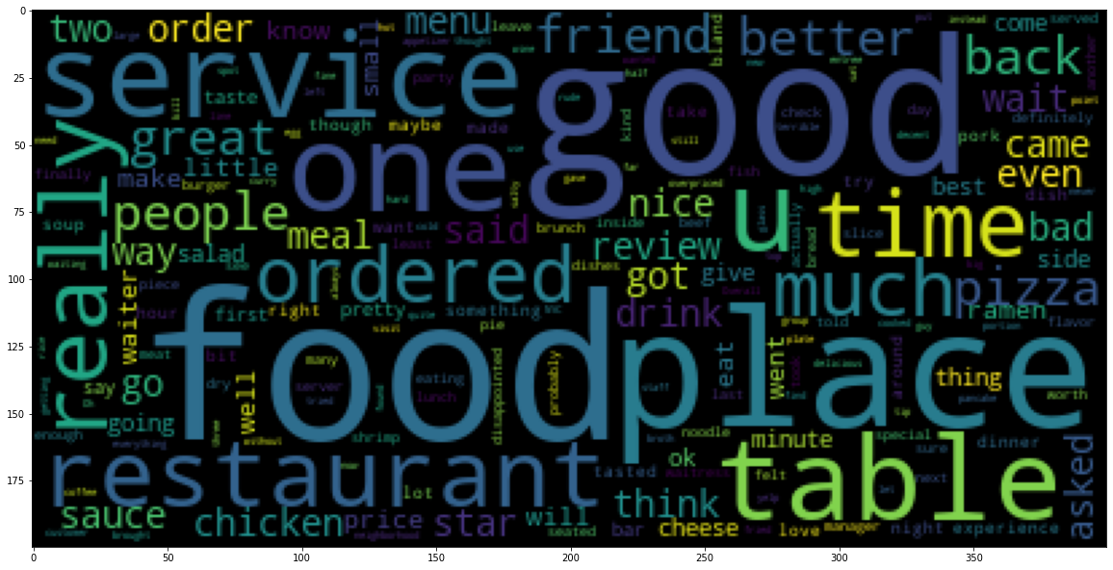
Negative Word Cloud

Slide 18
Models used with Manipulated Ratings
Two different Logistic Regressions
Different parameters
Multinomial Naïve Bayes
Multi-Layer Perceptron Classifier (MLPClassifier)

Slide 19
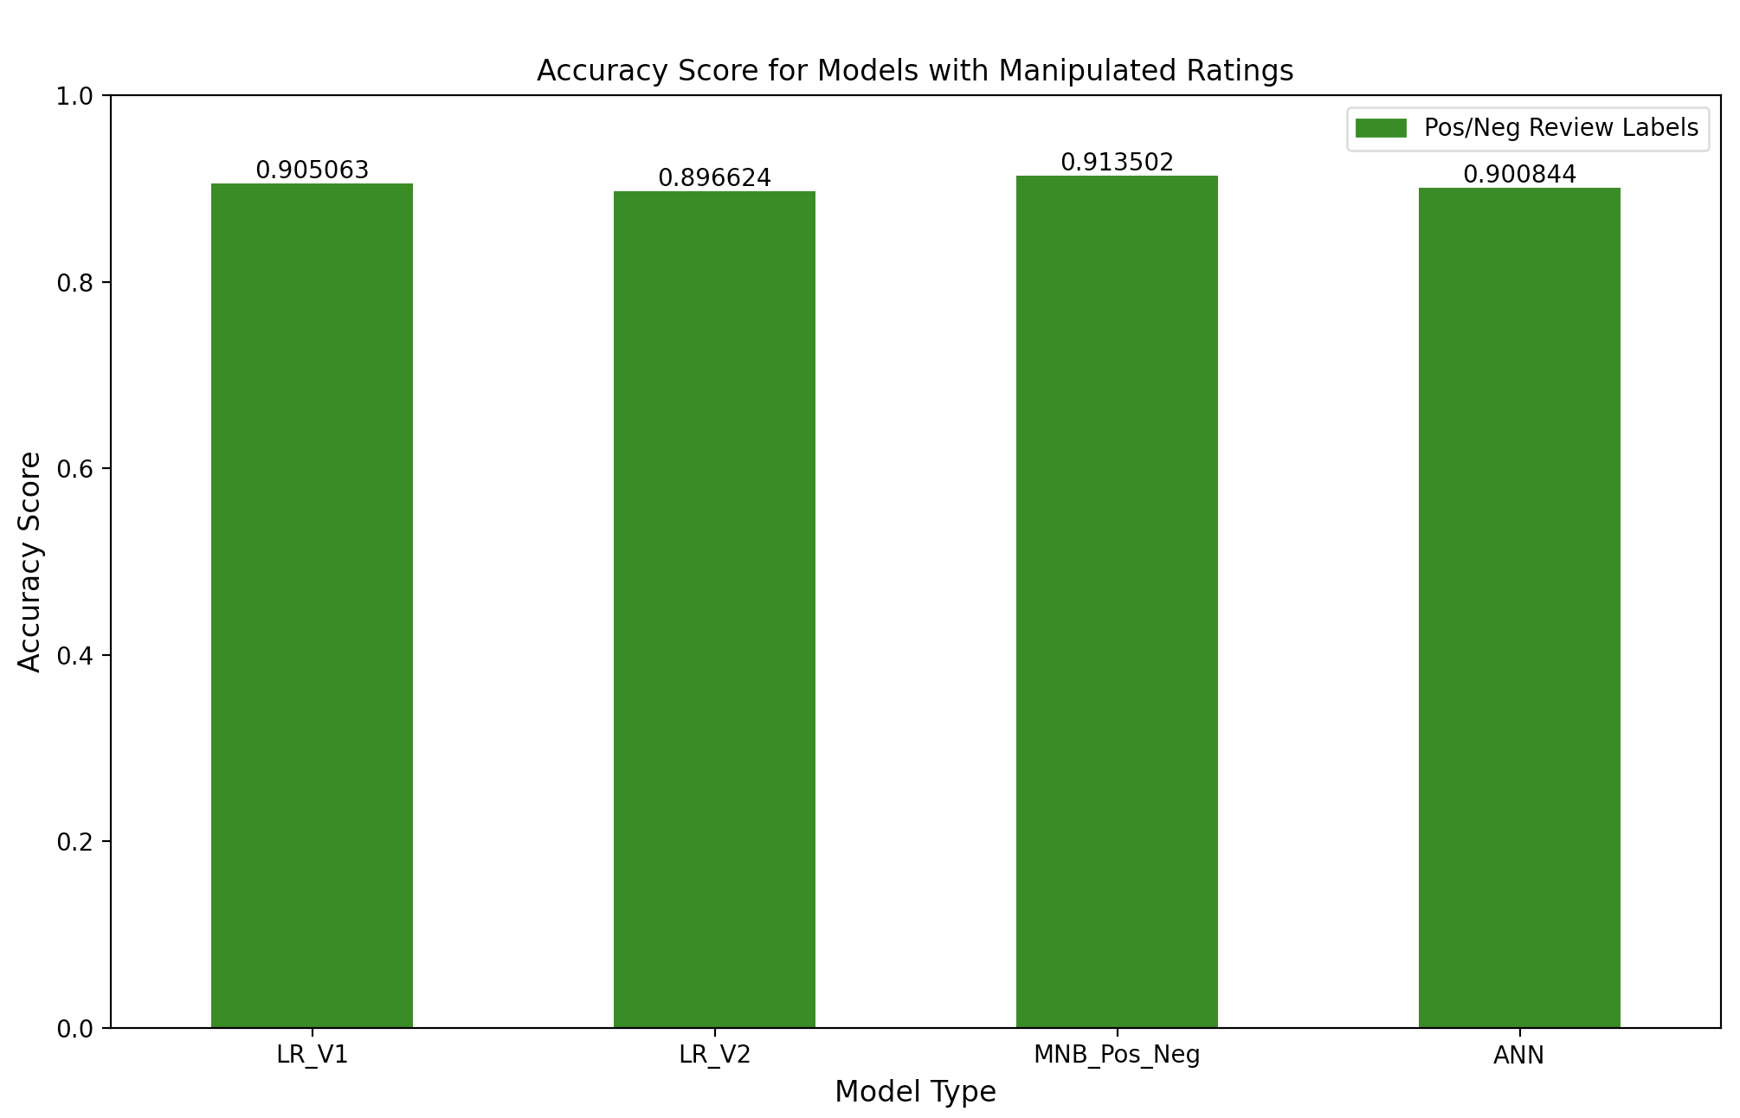

Slide 20
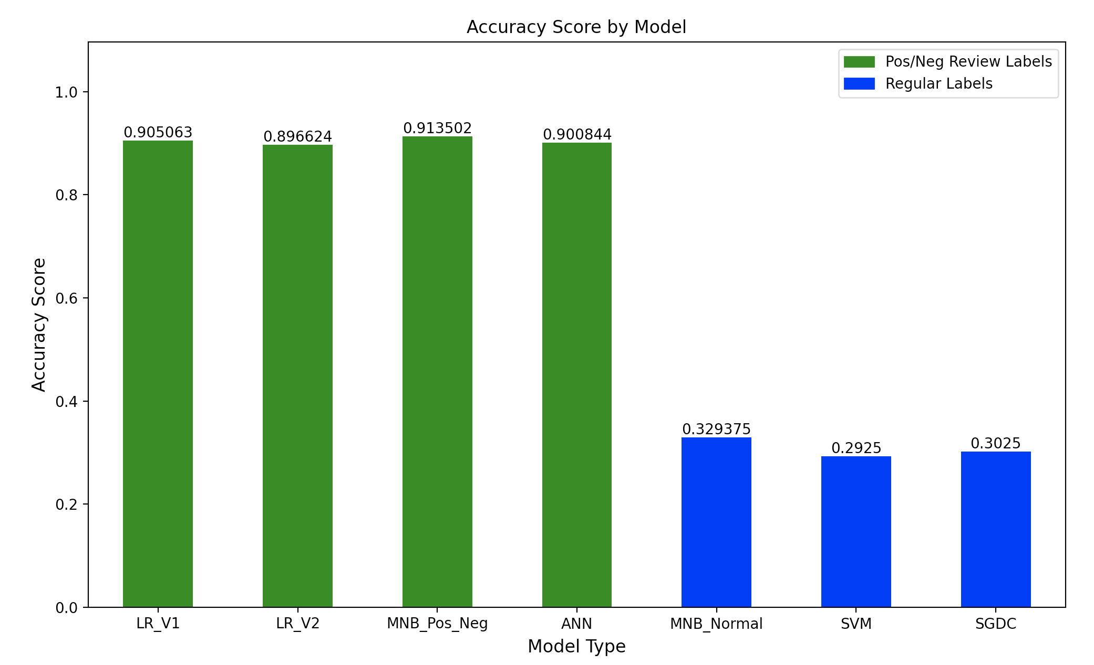

Slide 21

Conclusion
Results are significant for any model that has a binary class.
Specifically, the Multinomial Naïve Bayes is slightly better
Just under 0.01
More than 80% of customers have a positive view on the restaurant.

Slide 22
Lessons Learned
Higher number of classes, then manipulate them if possible
1
Turn into smaller number of problems at one time
Use different models to improve the accuracy.
2

