Slide 1
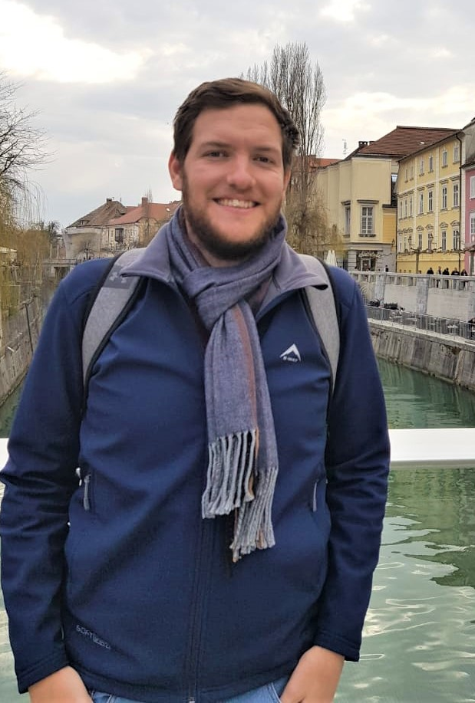
Who am I?
Guy Sutton
Research Entomologist
Centre for Biological Control @ Rhodes University
Interests:
Biological control (surprise)
Grasses,
Plant-insect interactions,
Statistics (not a Statistician!)
R
Contact me: g.sutton@ru.ac.za

Slide 2
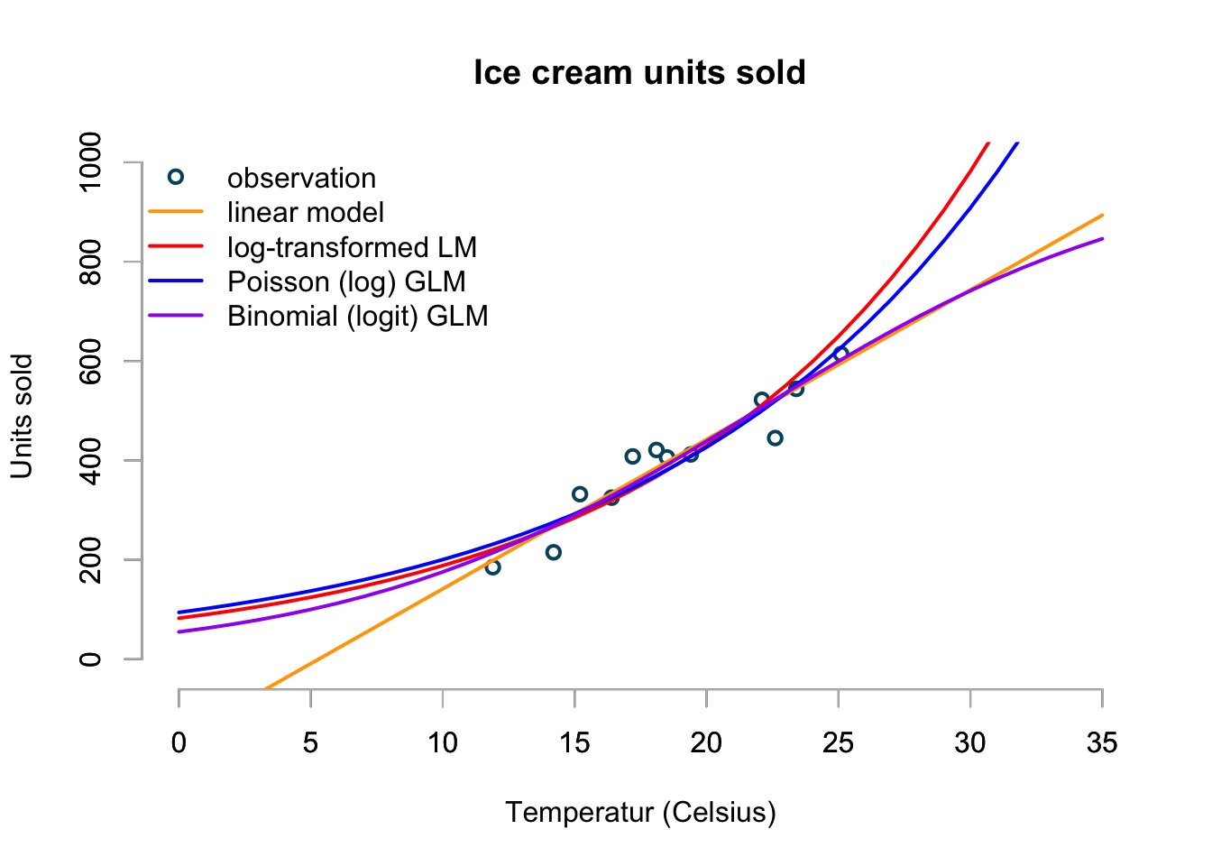
Why use GLM’s?
Markus Gesmann’s blog: https://magesblog.com/post/2015-08-04-generalised-linear-models-in-r/

