Slide 1
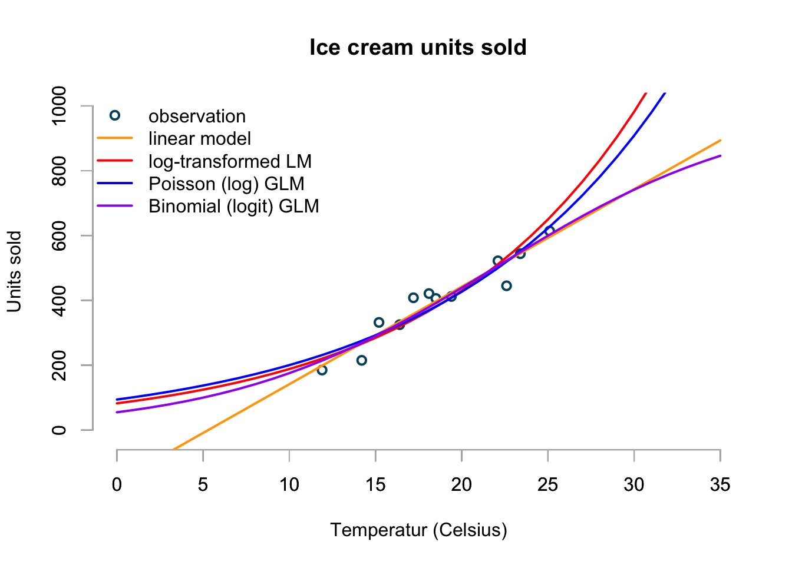
Why do we need GLM’s?
Markus Gesmann’s blog: https://magesblog.com/post/2015-08-04-generalised-linear-models-in-r/

