Slide 1

Restaurant Database

Slide 2
Schemas
ACCOUNTS(ID, EMPLOYEE_ID, USER_ID)
EMPLOYEE(EMPLOYEE_ID, EMPLOYEE_TYPE_ID, FIRST_NAME, LAST_NAME)
EMPLOYEE_TYPE(ID, TYPE)
INGREDIENTS(ID, NAME, DESCRIPTION, INGREDIENT_TYPE_ID)
ITEM_TYPE(ID, TYPE)
MENU_INGREDIENTS(ID, INGREDIENT_ID, MENU_ITEM_ID)
MENU_ITEMS(ID, NAME, ITEM_TYPE_ID, DESCRIPTION, ALCOHOLIC)
ORDERS(ID, EMPLOYEE_ID, PAID, TABLE_NUM_ID)
PREFERENCES(ID, PREFERENCE, DESCRIPTION)
PREFERENCE_INGREDIENTS(ID, INGREDIENT_ID, PREFERENCE_ID)
TABLE_NUMS(ID, NUM, MAX_SEATS, TYPE)
TABLE_ORDERS(ID, ORDER_ID, MENU_ITEM_ID, SPECIAL INSTRUCT)

Slide 3
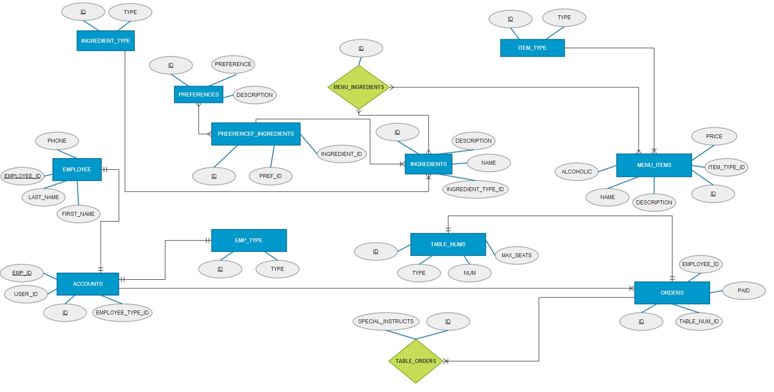
ER Diagram

Slide 4
Table DDL
ACCOUNTS
CREATE TABLE IF NOT EXISTS ACCOUNTS(
ID int(11) NOT NULL AUTO_INCREMENT,
EMPLOYEE_ID int(11) NOT NULL,
USER_ID int(11) NOT NULL,
EMPLOYEE_TYPE_ID int(11) NOT NULL,
PRIMARY KEY (ID),
UNIQUE KEY EMPLOYEE_ID (EMPLOYEE_ID,USER_ID),
KEY EMPLOYEE_TYPE_ID (EMPLOYEE_TYPE_ID),
KEY USER_ID (USER_ID)
)
EMPLOYEE
CREATE TABLE IF NOT EXISTS EMPLOYEE (
EMPLOYEE_ID int(11) NOT NULL AUTO_INCREMENT,
LAST_NAME varchar(255) NOT NULL,
FIRST_NAME varchar(255) NOT NULL,
PHONE varchar(20) DEFAULT NULL,
EMPLOYEE_TYPE_ID int(11) NOT NULL,
PRIMARY KEY (EMPLOYEE_ID),
KEY EMPLOYEE_TYPE_ID (EMPLOYEE_TYPE_ID)
)

Slide 5
EMPLOYEE_TYPE
CREATE TABLE IF NOT EXISTS EMPLOYEE_TYPE (
ID int(11) NOT NULL AUTO_INCREMENT,
TYPE varchar(255) NOT NULL,
PRIMARY KEY (ID)
)
INGREDIENTS
CREATE TABLE IF NOT EXISTS INGREDIENTS (
ID int(11) NOT NULL AUTO_INCREMENT,
NAME varchar(255) NOT NULL,
DESCRIPTION varchar(255) NOT NULL,
INGREDIENT_TYPE_ID int(11) NOT NULL,
PRIMARY KEY (ID),
KEY INGREDIENT_TYPE_ID (INGREDIENT_TYPE_ID)
)
INGREDIENT_TYPE
CREATE TABLE IF NOT EXISTS INGREDIENT_TYPE (
ID int(11) NOT NULL AUTO_INCREMENT,
TYPE varchar(255) NOT NULL,
PRIMARY KEY (ID),
UNIQUE KEY TYPE (TYPE)
)

Slide 6
ITEM_TYPE
CREATE TABLE IF NOT EXISTS ITEM_TYPE (
ID int(11) NOT NULL AUTO_INCREMENT,
TYPE varchar(255) NOT NULL,
PRIMARY KEY (ID),
UNIQUE KEY TYPE (TYPE)
)
MENU_INGREDIENTS
CREATE TABLE IF NOT EXISTS MENU_INGREDIENTS (
ID int(11) NOT NULL AUTO_INCREMENT,
INGREDIENT_ID int(11) NOT NULL,
MENU_ITEM_ID int(11) NOT NULL,
PRIMARY KEY (ID),
KEY INGREDIENT_ID (INGREDIENT_ID),
KEY MENU_ITEM_ID (MENU_ITEM_ID)
)
MENU_ITEMS
CREATE TABLE IF NOT EXISTS MENU_ITEMS (
ID int(11) NOT NULL AUTO_INCREMENT,
NAME varchar(255) NOT NULL,
DESCRIPTION varchar(255) NOT NULL,
PRICE int(11) NOT NULL,
ITEM_TYPE_ID int(11) NOT NULL,
ALCOHOLIC tinyint(1) NOT NULL,
PRIMARY KEY (ID),
KEY ITEM_TYPE_ID (ITEM_TYPE_ID)
)

Slide 7
ORDERS
CREATE TABLE IF NOT EXISTS ORDERS (
ID int(11) NOT NULL AUTO_INCREMENT,
TABLE_NUM_ID int(11) NOT NULL,
EMPLOYEE_ID int(11) NOT NULL,
PAID varchar(255) NOT NULL,
PRIMARY KEY (ID),
UNIQUE KEY TABLE_NUM_ID_2 (TABLE_NUM_ID),
KEY TABLE_NUM_ID (TABLE_NUM_ID),
KEY EMPLOYEE_ID (EMPLOYEE_ID)
)
PREFERENCES
CREATE TABLE IF NOT EXISTS PREFERENCES (
ID int(11) NOT NULL AUTO_INCREMENT,
PREFERENCE varchar(255) NOT NULL,
DESCRIPTION varchar(255) NOT NULL,
PRIMARY KEY (ID)
)
PREFERENCE_INGREDIENTS
CREATE TABLE IF NOT EXISTS PREFERENCE_INGREDIENTS (
ID int(11) NOT NULL AUTO_INCREMENT,
PREFERENCE_ID int(11) NOT NULL,
INGREDIENT_ID int(11) NOT NULL,
PRIMARY KEY (ID),
KEY PREFERENCE_ID (PREFERENCE_ID),
KEY INGREDIENT_ID (INGREDIENT_ID)
)

Slide 8
TABLE_NUMS
CREATE TABLE IF NOT EXISTS TABLE_NUMS (
ID int(11) NOT NULL AUTO_INCREMENT,
NUM int(11) NOT NULL,
TYPE varchar(255) NOT NULL,
MAX_SEATS int(11) NOT NULL,
PRIMARY KEY (ID)
)
TABLE_ORDERS
CREATE TABLE IF NOT EXISTS TABLE_ORDERS (
ID int(11) NOT NULL AUTO_INCREMENT,
ORDER_ID int(11) NOT NULL,
MENU_ITEM_ID int(11) NOT NULL,
SPECIAL_INSTRUCT varchar(255) NOT NULL,
PRIMARY KEY (ID),
KEY MENU_ITEM_ID (MENU_ITEM_ID),
KEY ORDER_ID (ORDER_ID)
)

Slide 9
DML Statements
INSERT INTO ITEM_TYPE (ID, TYPE) VALUES
(5, 'adult beverages'),
(1, 'appetizer'),
(4, 'beverages'),
(3, 'dessert'),
(2, 'entree')
DELETE FROM TABLE_ORDERS WHERE ORDER_ID = 1
UPDATE
EMPLOYEE
SET
EMPLOYEE_TYPE_ID = 1
WHERE
EMPLOYEE_ID = EMP_ID

Slide 10
Trigger
updates if a guest orders a glass of the house wine
Function
totals the bill for the table
Procedure
changes an employee's type to manager when promoted
View
query for menu

Slide 11
Normalization – BCNF
reduced risk of redundancy
  foreign keys
  bridge tables
attributes dependent on a primary key

Slide 12
Referential Integrity Enforcement
CASCADE
ALTER TABLE ACCOUNTS
ADD CONSTRAINT emTypeID FOREIGN KEY (EMPLOYEE_TYPE_ID) REFERENCES EMPLOYEE_TYPE (ID) ON DELETE CASCADE ON UPDATE CASCADE,
ADD CONSTRAINT empID FOREIGN KEY (EMPLOYEE_ID) REFERENCES EMPLOYEE (EMPLOYEE_ID) ON DELETE CASCADE ON UPDATE CASCADE
If an update or delete happens in one table, it will cascade the changes to tables with foreign key relationships.
NO ACTION
ALTER TABLE INGREDIENTS
ADD CONSTRAINT ingredientTypeID FOREIGN KEY (INGREDIENT_TYPE_ID) REFERENCES INGREDIENT_TYPE (ID) ON UPDATE CASCADE
A delete is restricted on these tables. Updates will cascade.

Slide 13
Isolation Level
InnoDB storage engine
Atomic
All statements will execute successfully or all will fail
Consistent
FK relations valid before and after a transaction
Isolated
Two users do something, but transactions are treated completely separate of each other
Durable
Data is permanently stored

