Slide 1


DOTS: Decoupling Operation and Topology in Differentiable Architecture Search
Yu-Chao Gu¹, Li-Juan Wang¹, Yun Liu¹, Yi Yang²,
Yu-Huan Wu¹, Shao-Ping Lu¹, Ming-Ming Cheng¹
¹Nankai University
²Zhejiang University

Slide 2















Introduction
Revisit DARTS
$$C_{k−1}$$
$$C_{k−2}$$
$$C_{k−1}$$
$$C_{k−2}$$
$$N_{0}$$
$$N_{0}$$
$$N_{1}$$
Maxpool
Avgpool
Skip-Connection
SepConv 3$×$3
SepConv 5$×$5
DilConv 3$×$3
DilConv 5$×$5
None
Architecture Prune
$$N_{1}$$
1. Operation prune
2. Edge prune
$$N_{2}$$
$$N_{2}$$
$$N_{3}$$
$$N_{3}$$
sep conv 5*5
$$C_{k}$$
$$C_{k}$$
Edge: Mixed-Operation
Edge: Single-Operation
Figure 1. Derive the cell structure in DARTS

Slide 3
Introduction
Problems in DARTS
1) Select edge based on operation weight (coupling operation and topology search)
2) Handcraft policy of edge numbers (fix to 2)
Operation Weight
Edge Importance
Searched cell
Op1 | Op2 | Op3 | Op4 | Op5 | Op6 | Op7 | Op8
0.02 | 0.1 | 0.1 | 0.3 | 0.2 | 0.01 | 0.07 | 0.2
0.02 | 0.01 | 0.4 | 0.1 | 0.1 | 0.02 | 0.05 | 0.3
0.22 | 0.01 | 0.2 | 0.1 | 0.1 | 0.02 | 0.05 | 0.3
0.22 | 0.01 | 0.1 | 0.1 | 0.05 | 0.02 | 0.45 | 0.05
Edge 1:
0.3
Edge 2: | Op3
Edge 4: | Op7
Edge 2:
0.4
Edge 3:
0.3
Edge 4:
0.45
Figure 2. Architecture search via continuous relaxation

Slide 4
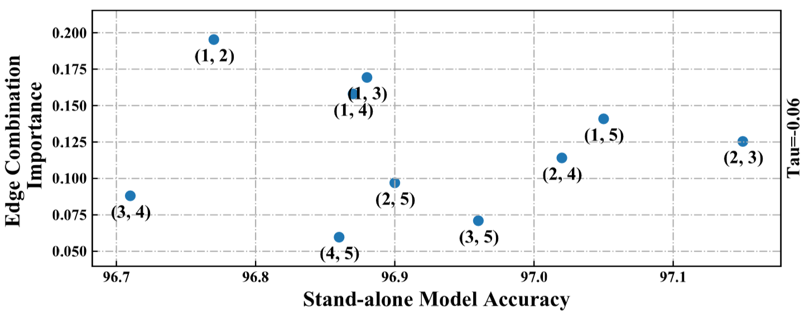
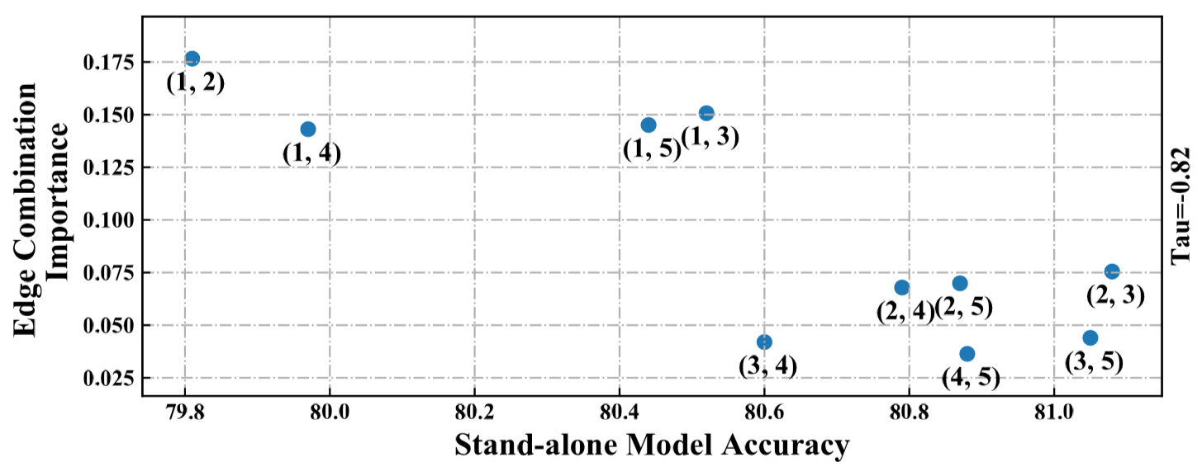
Introduction
Can operation weight represents the edge importance?
Figure 3. Correlation between edge importance and stand-alone accuracy in DARTS (Left: CIFAR10, Right: CIFAR100)

Slide 5
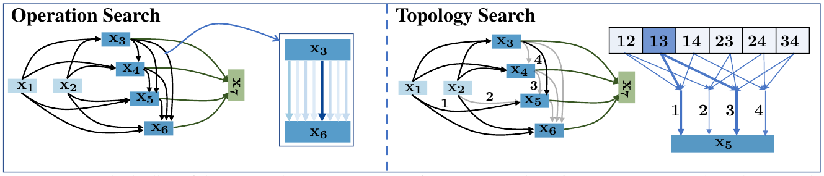
Method
Decouple operation and topology search
Decouple the topology representation from operation weight
Relax combinatorial edge selection into continuous
Decouple the search process
Incorporate previous cell-based into operation search
Group-based operation search

Slide 6


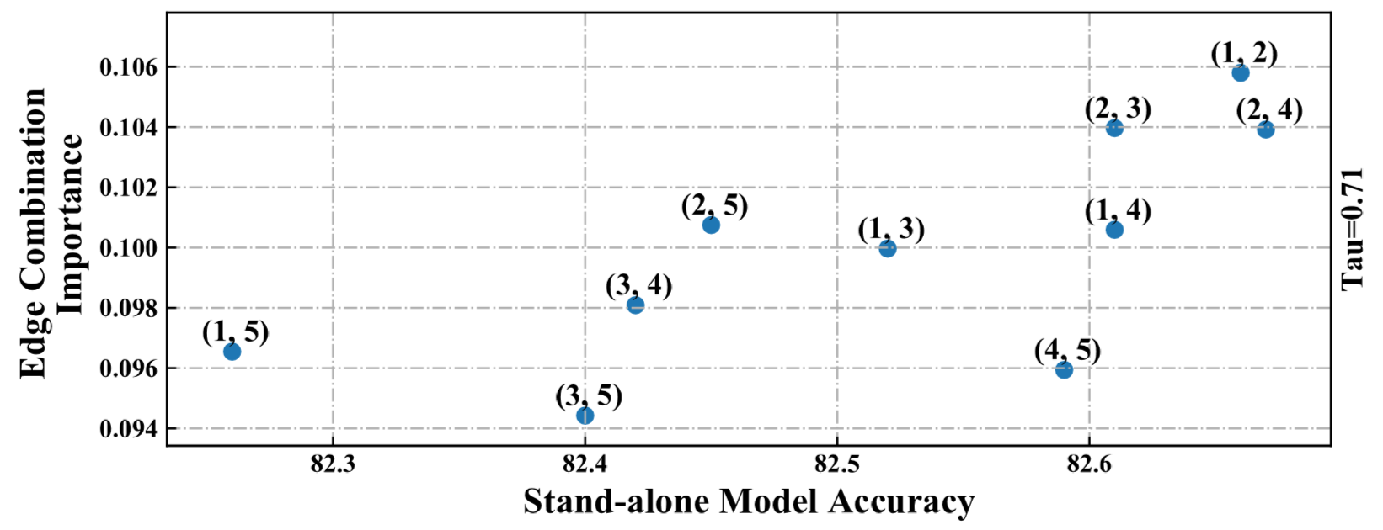
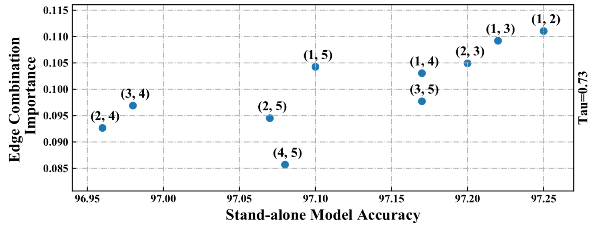
Method - topology search
1. Define topology search space + continuous relaxation
Two edges (follow DARTS)
Any number of edges
2. Correlation analysis
Figure 4. Correlation between edge importance and stand-alone accuracy in DOTS (Left: CIFAR10, Right: CIFAR100)

Slide 7
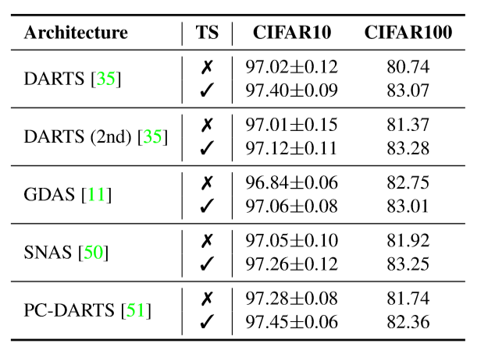
Method - operation search
Method 1: Incorporate existing cell-based operation search
Operation Weight
Op1 | Op2 | Op3 | Op4 | Op5 | Op6 | Op7 | Op8
0.02 | 0.1 | 0.1 | 0.3 | 0.2 | 0.01 | 0.07 | 0.2
0.02 | 0.01 | 0.4 | 0.1 | 0.1 | 0.02 | 0.05 | 0.3
0.22 | 0.01 | 0.2 | 0.1 | 0.1 | 0.02 | 0.05 | 0.3
0.22 | 0.01 | 0.1 | 0.1 | 0.05 | 0.02 | 0.45 | 0.05
Edge 1:
Edge 2:
Edge 3:
Edge 4:
Edge 1: | Op4
Edge 2: | Op3
Edge 3: | Op8
Edge 4: | Op7
Intermediate results for further topology search :
Table 1. Improve cell-based NAS by topology search

Slide 8
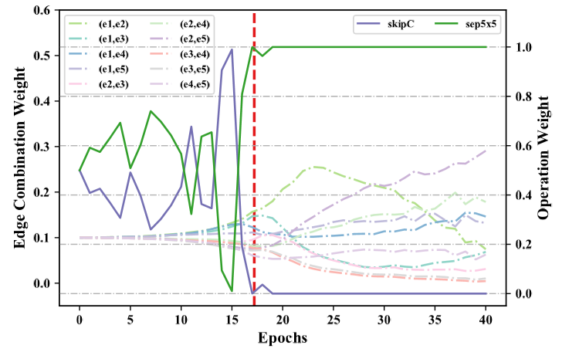
Method - operation search
Method 2: Group-based operation search
Group Criterion: Parameterized Op: Op1-Op4
Non-Parameterized Op: Op5-Op8
Op1 | Op2 | Op3 | Op4 | Op5 | Op6 | Op7 | Op8
0.2 | 0.1 | 0.4 | 0.3 | 0.5 | 0.1 | 0.2 | 0.2
0.1 | 0.5 | 0.1 | 0.3 | 0.1 | 0.3 | 0.2 | 0.4
0.1 | 0.2 | 0.2 | 0.5 | 0.1 | 0.2 | 0.1 | 0.6
0.4 | 0.1 | 0.3 | 0.2 | 0.2 | 0.2 | 0.45 | 0.15
Edge 1:
Edge 2:
Edge 3:
Edge 4:
Operation Weight
Edge 1: | Op3 | Op5
Edge 2: | Op2 | Op8
Edge 3: | Op4 | Op8
Edge 4: | Op1 | Op7
Intermediate results for further topology search :
Figure 5. Decouple the grouped operation in topology search by annealing

Slide 9
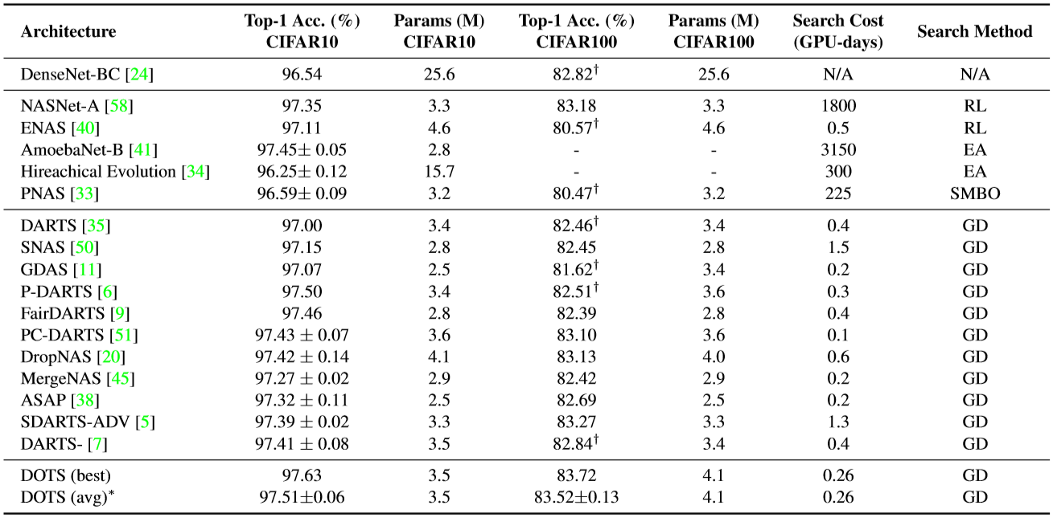
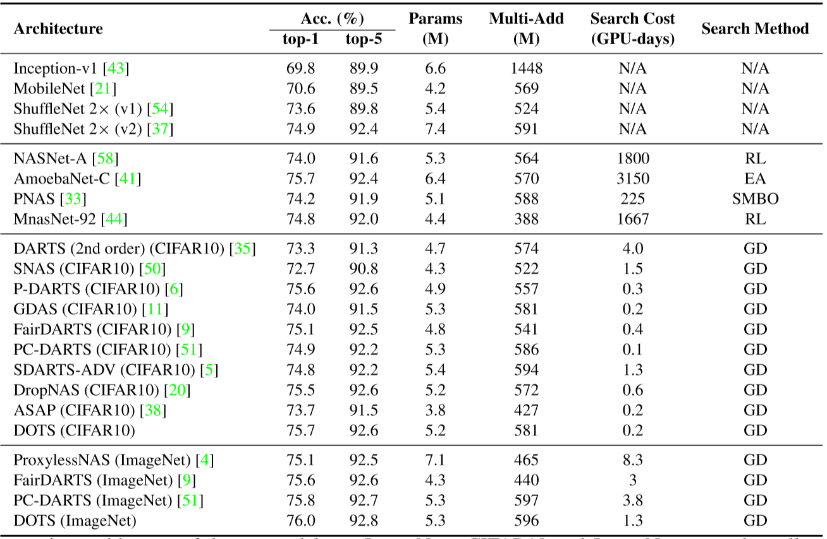
Experiments
Comparison with state-of-the-art models on CIFAR/ImageNet
Table 2. Benchmark Results on CIFAR10/100
Table 3. Benchmark Results on ImageNet

Slide 10
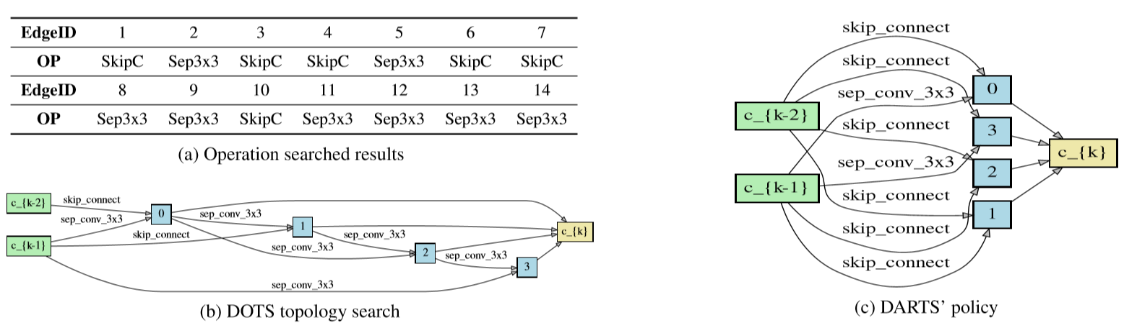
Experiments
DOTS: 25% skip-connection CIFAR100: 83.07% top-1 Acc
DARTS: 75% skip-connection CIFAR100: 80.74% top-1 Acc
Figure 6. Comparison between DARTS and DOTS topology derivation on the same operation results

Slide 11
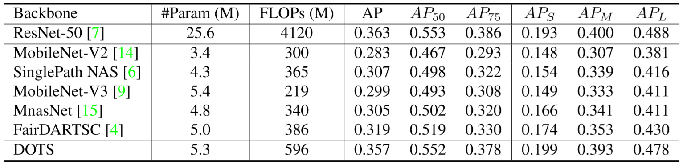
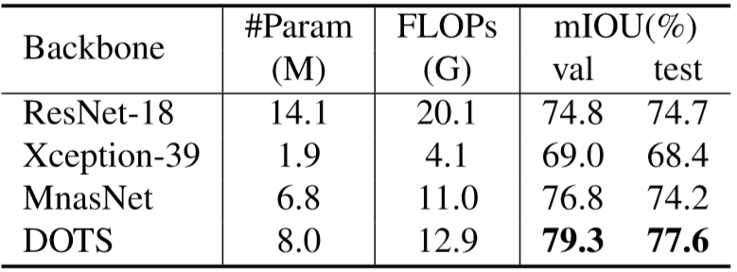
Experiments
Transfer to downstream tasks
Table 4. Evaluation of object detection on the MS-COCO 2017 dataset
Table 5: Evaluation of semantic image segmentation on the Cityscapes dataset

