Slide 1
This Lecture
Introduction to Biostatistics and Bioinformatics
Hypothesis Testing I
By Judy Zhong
Assistant Professor
Division of Biostatistics
Department of Population Health
Judy.zhong@nyumc.org

Slide 2
Statistical Methods
Statistical
Methods
Descriptive
Statistics
Inferential
Statistics
Hypothesis
Others
Estimation
Testing
Notes:
5

Slide 3
Hypothesis testing
Research hypotheses are conjectures or suppositions that motivate the research
Statistical hypotheses restate the research hypotheses to be addressed by statistical techniques.
Formally, a statistical hypothesis testing problem includes two hypothesis
  Null hypothesis (H0)
  Alternative hypothesis (Ha, H1)
In statistical hypothesis testing, we start off believing the null hypothesis, and see if the data provide enough evidence to abandon our belief in H0 in favor of Ha

Slide 4

What’s a Hypothesis?
A Belief about a population parameter
  Parameter is population mean, proportion, variance
  Hypothesis must be stated before analysis
I believe the mean birth weight in the general population is 120 oz
© 1984-1994 T/Maker Co.

Slide 5
Birth Weight Example
Average birth weight in the general population is 120 oz.
You take a sample of 100 babies born in the hospital you work at (that is located in a low-SES area), and find that the sample mean birth weight is 115 oz.
You wonder:
  is this observed difference merely due to chance OR
  is the mean birth weight of SES babies indeed lower than that in the general population?
Notes:
Suppose we want to test the hypothesis that mothers with low socioeconomic status (SES) deliver babies whose birthweights are lower than “normal”.

Slide 6
Null Hypothesis
Parameter interest: the mean birth weight of SES babies, denoted by μ
Begin with the assumption that the null hypothesis is true
  E.g. H₀ : the mean birth weight of SES babies is equal to that in the general population
  Similar to the notion of innocent until proven guilty
H₀: μ = 120
Could even has inequality sign: ≤ or ≥ (more complex tests)

Slide 7
Alternative Hypothesis
Is set up to represent research goal
Opposite of null hypothesis
  E.g. H_{a} : the mean birth weight of SES babies is lower than that in the general population
H_{a}: μ < 120
Always has inequality sign: ≠, <, or >
  ≠ will lead to two-sided tests
  < , > will lead to one-sided tests

Slide 8
One-Sided vs Two-Sided Hypothesis Tests
One-sided:
  H₀: μ = 0 or H₀: μ = 0
  H_{a}: μ < 0 H_{a}: μ > 0
Two-sided:
H₀: μ = 3
H_{a}: μ ≠ 3
It is very important to remember that hypothesis statements are about populations and NOT samples. We will never have a hypothesis statement with either xbar or p-hat in it.

Slide 9
Making Decisions—four possible scenarios
Fail to reject H₀ when in fact H₀ is true (good decision)
Fail to reject H₀ when in fact H₀ is false (an error)
Reject H₀ when in fact H₀ is true (an error)
Reject H₀ when in fact H₀ is false (good decision)

Slide 10
Errors in
Making Decision
Type I Error
  Reject null hypothesis H₀ when H₀ is true
  Has serious consequences
  Probability of type I error is α (alpha)
    Called level of significance
Type II Error
  Do not reject H₀ when H₀ is false (H₀ is true)
  Probability of type II error is β (beta)

Slide 11
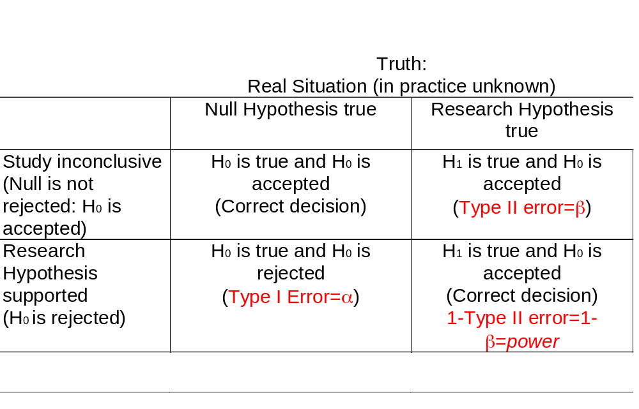
Possible Outcomes in Hypothesis Testing

Slide 12
Type I & II Error Relationship
Type I and Type II errors cannot happen at
the same time
  Type I error can only occur if H₀ is true
  Type II error can only occur if H₀ is false
If Type I error probability (α) , then
Type II error probability (β)

Slide 13

α & β Have an
Inverse Relationship
Can’t reduce both errors simultaneously: trade-off!
β
α

Slide 14


Hypothesis Testing
I believe the population mean age is 50 (hypothesis).
Reject
hypothesis! Not close.
Population
☺
☺
☺
☺
☺
☺
Random
sample
☺
Mean
‾X = 20
☺
☺

Slide 15
Basic Idea: CLT
Sampling Distribution of Sample Mean (Xbar)
μ
= 50
Sample Mean
H0

Slide 16
Basic Idea
Sampling Distribution
It is unlikely that we would get a sample mean of this value ...
20
μ
= 50
Sample Mean
H0

Slide 17
Basic Idea
Sampling Distribution
It is unlikely that we would get a sample mean of this value ...
... if in fact this were
the population mean
20
μ
= 50
Sample Mean
H0

Slide 18
Basic Idea
Sampling Distribution
It is unlikely that we would get a sample mean of this value ...
But, how unlikely is unlikely, is there a rule?
... if in fact this were
the population mean
20
μ
= 50
Sample Mean
H0

Slide 19
Rejection Region
Def: the range of values of the test statistics xbar for which H₀ is rejected
We need a critical (cut-off) value to decide if our sample mean is “too extreme” when null hypothesis is true.
Designated α (alpha)
  Typical values are .01, .05, .10
  selected by researcher at start
  α= P(Rejecting H₀ when H₀ is true)
  = P(xbar<c, when H₀ is true)

Slide 20
Rejection Region
(One-Sided Test)
Sampling Distribution
Level of Confidence
Rejection
Region
1 - α
α
Nonrejection
Region
Ho
Sample Statistic
Critical
Value
Value
Notes:
Rejection region does NOT include critical value.

Slide 21

Rejection Region
(One-Sided Test)
Sampling Distribution
Level of Confidence
Rejection
Region
1 - α
α
Nonrejection
Region
Ho
Sample Statistic
Sample Statistic
Critical
Value
Value
Observed sample statistic
Notes:
Rejection region does NOT include critical value.

Slide 22

Rejection Region
(One-Sided Test)
Sampling Distribution
Level of Confidence
Level of Confidence
Rejection
Region
1 - α
1 - α
α
Nonrejection
Region
Ho
Sample Statistic
Critical
Value
Value
Notes:
Rejection region does NOT include critical value.

Slide 23
Rejection Regions
(Two-Sided Test)
Sampling Distribution
Level of Confidence
Rejection
Region
Rejection
Region
1 - α
1/2 α
1/2 α
Nonrejection
Region
Ho
Sample Statistic
Critical
Value
Critical
Value
Value
Notes:
Rejection region does NOT include critical value.

Slide 24

Rejection Regions
(Two-Sided Test)
Sampling Distribution
Level of Confidence
Rejection
Region
Rejection
Region
1 - α
1/2 α
1/2 α
Nonrejection
Region
Ho
Critical
Value
Critical
Value
Value
Observed sample statistic
Notes:
Rejection region does NOT include critical value.

Slide 25
Rejection Regions
(Two-Tailed Test)
Sampling Distribution
Level of Confidence
Rejection
Region
Rejection
Region
1 - α
1/2 α
1/2 α
Nonrejection
Region
Ho
Critical
Value
Critical
Value
Value
Notes:
Rejection region does NOT include critical value.

Slide 26
Rejection Regions
(Two-Tailed Test)
Sampling Distribution
Level of Confidence
Rejection
Region
Rejection
Region
1 - α
1/2 α
1/2 α
Nonrejection
Region
Ho
Critical
Value
Critical
Value
Value
Notes:
Rejection region does NOT include critical value.

Slide 27
Hypotheses Testing Steps
State H₀
State H_{a}
Choose α
Choose n
Choose test
Set up critical values
Collect data
Compute test statistic
Make statistical decision
Express decision

Slide 28
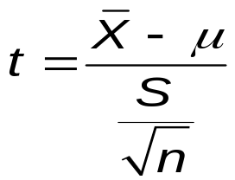
Test for Mean
(σ Unknown)
Assumptions
  Population Is normally distributed
  If Not Normal, only slightly skewed & large sample (n ≥ 30) taken
T test statistic
Use T table

Slide 29

Two-Sided t Test
Example
You work for the FTC. A manufacturer of detergent claims that the mean weight of detergent is 3.25 lb.
You take a random sample of 64 containers. You calculate the sample average to be 3.238 lb. with a standard deviation of .117 lb.
At the .01 level, is the manufacturer correct?
3.25 lb.
Notes:
Allow students about 10 minutes to finish this.

Slide 30
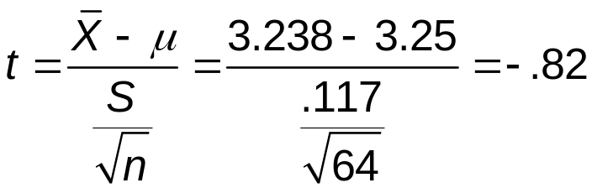
Two-Tailed t Test
Solution*
H0: μ = 3.25
Ha: μ ≠ 3.25
α = .01
df = 64 - 1 = 63
Critical Value(s):
Test Statistic:
Decision:
Conclusion:
Do not reject at α = .01
Reject H0
Reject H0
.005
.005
There is no evidence average is not 3.25
-2.6561
0
2.6561
t

Slide 31
p-Value
Probability of obtaining a test statistic as extreme or more extreme than actual sample value given H₀ is true
Called observed level of significance
  Smallest value of α H₀ can be rejected
Used to make rejection decision
  If p-value ≥ α, do not reject H₀
  If p-value < α, reject H₀

Slide 32
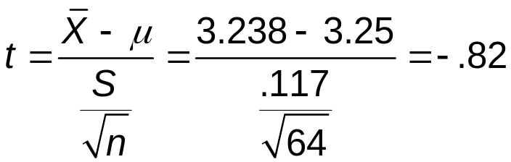
Two-sided test:
1. T value of sample statistic (observed)
-0.82
0
0.82
T63

Slide 33
Two-sided test:
2. From T Table 3
p-value is P(T ≤ -.82 or T ≥ .82) = .2*2
1/2 p-Value=.2
1/2 p-Value=.2
-.82
0
.82
T

Slide 34
Test statistic is in ‘Do not reject’ region
(p-Value = .4) ≥ (α = .01); Do not reject.
1/2 p-Value = .2
1/2 p-Value = .2
Reject
Reject
1/2 α = .005
1/2 α = .005
-.82
0
.82
T

Slide 35
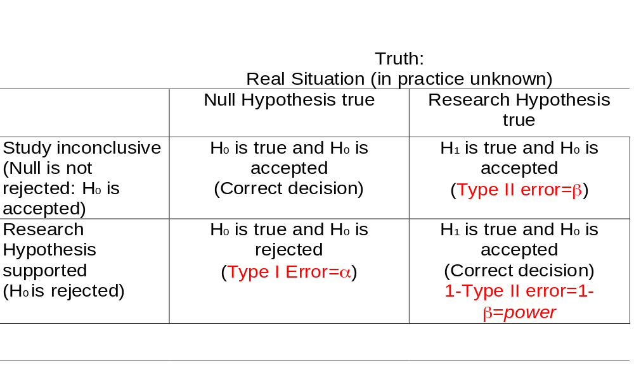
Power of Test
Probability of rejecting false H₀ (Correct Decision)

Slide 36
Power of Test
Used in determining test adequacy
Affected by
  True value of population parameter
  1−β increases when difference with hypothesized parameter increases
  Significance level α
  1−β increases when α increases
  Standard deviation
  1−β increases when σ decreases
  Sample size n
  1−β increases when n increases

Slide 37
What we learned today..
Hypotheses testing concepts
Decision making risks:
  Type I error, Type II error and Power
P-value method
Two-tailed t-test of mean (sigma unknown)
One-tailed t-test of mean (sigma unknown)
Power of a test
Notes:
As a result of this class, you will be able to ...

