Slide 1
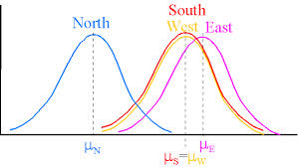
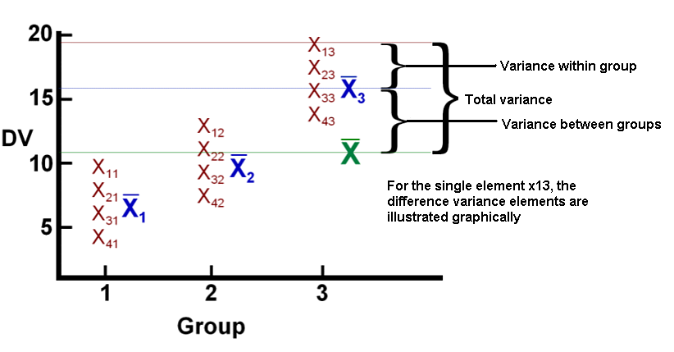
Previous Lecture: Analysis of Variance

Slide 2
This Lecture
Categorical Data Methods
Judy Zhong Ph.D.

Slide 3
Outline
Categorical data
Definition
Contingency table
Example
Pearson’s χ² test for goodness of fit
χ² test for two population proportions
(Z test to compare two proportions)
χ² test of independence in a contingency table
Fisher’s exact test –small sample size

Slide 4
Categorical data
Definition: refers to observations that are only classified into categories so that the data set consists of frequency counts for the categories.
Example:
Blood type (O, A,B,AB)
A shipment of assorted nuts (walnuts, hazelnuts, and almonds)
Gender (male, female)

Slide 5
Example 1. Two population Proportions
In a random sample, 120 Females, 12 were left handed; 180 Males, 24 were left handed
Gender | Hand Preference
 | Left | Right | total
Female | 12 | 108 | 120
Male | 24 | 156 | 180
Total | 36 | 264 | 300

Slide 6
Example 2:Independent Samples classified in Several categories:
The meal plan selected by 200 students is shown below:
Class Standing | Number of meals per week |  |  | Total
 | 20/week | 10/week | none
Fresh. | 24 | 32 | 14 | 70
Soph. | 22 | 26 | 12 | 60
Junior | 10 | 14 | 6 | 30
Senior | 14 | 16 | 10 | 40
Total | 70 | 88 | 42 | 200

Slide 7
Contingency Tables
Contingency Tables
Useful in situations involving multiple population proportions
Used to classify sample observations according to two or more characteristics
Also called a cross-classification table.

Slide 8
Pearson’s χ² test: for two population propotions(example 1)
Sample results organized in a contingency table:
sample size = n = 300:
Gender | Hand Preference
 | Left | Right
Female | 12 | 108 | 120
Male | 24 | 156 | 180
 | 36 | 264 | 300
120 Females, 12 were left handed
180 Males, 24 were left handed

Slide 9
χ² Test for the Difference Between Two Proportions
H₀: p₁ = p₂ (Proportion of females who are left handed is equal to the proportion of males who are left handed)
H₁: p₁ ≠ p₂ (The two proportions are not the same – Hand preference is not independent of gender)
If H₀ is true, then the proportion of left-handed females should be the same as the proportion of left-handed males
The two proportions above should be the same as the proportion of left-handed people overall

Slide 10
The Chi-Square Test Statistic
The Chi-square test statistic is:
where:
O = observed frequency in a particular cell
E = expected frequency in a particular cell if H₀ is true
χ² for the 2 x 2 case has 1 degree of freedom
(Assumed: each cell in the contingency table has expected frequency of at least 5)

Slide 11
Computing the Average Proportion
The average proportion is:
120 Females, 12 were left handed
180 Males, 24 were left handed
Here:
i.e., the proportion of left handers overall is 0.12, that is, 12%

Slide 12
Finding Expected Frequencies
To obtain the expected frequency for left handed females, multiply the average proportion left handed (p) by the total number of females
To obtain the expected frequency for left handed males, multiply the average proportion left handed (p) by the total number of males
If the two proportions are equal, then
P(Left Handed | Female) = P(Left Handed | Male) = .12
i.e., we would expect (.12)(120) = 14.4 females to be left handed
(.12)(180) = 21.6 males to be left handed

Slide 13
Observed vs. Expected Frequencies
Gender | Hand Preference
 | Left | Right
Female | Observed = 12 Expected = 14.4 | Observed = 108 Expected = 105.6 | 120
Male | Observed = 24 Expected = 21.6 | Observed = 156 Expected = 158.4 | 180
 | 36 | 264 | 300

Slide 14
The Chi-Square Test Statistic
Gender | Hand Preference
 | Left | Right
Female | Observed = 12 Expected = 14.4 | Observed = 108 Expected = 105.6 | 120
Male | Observed = 24 Expected = 21.6 | Observed = 156 Expected = 158.4 | 180
 | 36 | 264 | 300
The test statistic is:

Slide 15
Decision Rule
Decision Rule:
If χ² > 3.841, reject H₀, otherwise, do not reject H₀
Here,
χ² = 0.7576 < χ²_{U} = 3.841,
so we do not reject H₀ and conclude that there is not sufficient evidence that the two proportions are different at α = 0.05
α
0
χ²
Do not
reject H₀
Reject H₀
χ²_{U}=3.841

Slide 16
Test for Association for RxC Contingency Tables
Similar to the χ² test for equality of more than two proportions, but extends the concept to contingency tables with r rows and c columns
H₀: The two categorical variables are independent
(i.e., there is no association between them)
H₁: The two categorical variables are dependent
(i.e., there is association between them)

Slide 17
χ² Test of Independence
The Chi-square test statistic is:
where:
O = observed frequency in a particular cell of the r x c table
E = expected frequency in a particular cell if H₀ is true
χ² for the r x c case has (r-1)(c-1) degrees of freedom
Assumed:
1. No cell has expected value < 1
2. No more than 1/5 of the cells have expected values < 5

Slide 18
Expected Cell Frequencies
Expected cell frequencies:
Where:
row total = sum of all frequencies in the row
column total = sum of all frequencies in the column
n = overall sample size

Slide 19
Decision Rule
The decision rule is
If χ² > χ²_{U}, reject H₀, otherwise, do not reject H₀
Where χ²_{U} is from the chi-square distribution with (r – 1)(c – 1) degrees of freedom

Slide 20
Example
The meal plan selected by 200 students is shown below:
Class Standing | Number of meals per week |  |  | Total
 | 20/week | 10/week | none
Fresh. | 24 | 32 | 14 | 70
Soph. | 22 | 26 | 12 | 60
Junior | 10 | 14 | 6 | 30
Senior | 14 | 16 | 10 | 40
Total | 70 | 88 | 42 | 200

Slide 21
Example: Expected Cell Frequencies
(continued)
Observed:
Class Standing | Number of meals per week |  |  | Total
 | 20/wk | 10/wk | none
Fresh. | 24 | 32 | 14 | 70
Soph. | 22 | 26 | 12 | 60
Junior | 10 | 14 | 6 | 30
Senior | 14 | 16 | 10 | 40
Total | 70 | 88 | 42 | 200
Expected cell frequencies if H₀ is true:
Class Standing | Number of meals per week |  |  | Total
 | 20/wk | 10/wk | none
Fresh. | 24.5 | 30.8 | 14.7 | 70
Soph. | 21.0 | 26.4 | 12.6 | 60
Junior | 10.5 | 13.2 | 6.3 | 30
Senior | 14.0 | 17.6 | 8.4 | 40
Total | 70 | 88 | 42 | 200
Example for one cell:

Slide 22
Example: The Test Statistic
(continued)
The test statistic value is:
χ²_{U} = 12.592 for α = 0.05 from the chi-square distribution with (4 – 1)(3 – 1) = 6 degrees of freedom

Slide 23
Example: Decision and Interpretation
(continued)
Decision Rule:
If χ² > 12.592, reject H₀, otherwise, do not reject H₀
Here,
χ² = 0.709 < χ²_{U} = 12.592,
so do not reject H₀
Conclusion: there is not sufficient evidence that meal plan and class standing are related at α = 0.05
α
0
χ²
Do not
reject H₀
Reject H₀
χ²_{U}=12.592

Slide 24
Fisher’s exact test
An alternative test comparing two proportions
compute exact probability of the observed frequencies in the contingency table
Under H₀, it is assumed that there is no association between the row and column classifications and that the marginal totals remain fixed
Valid for tables with small expected cell values where the usual χ² test is not applicable.
At least one cell<5
The exact test and the χ² test will give similar results where the use of the χ² test is appropriate.

Slide 25
Fisher’s exact test
Example 10.17 in Rosner (p. 402)
Cause of death | High salt | Low salt | Total
Non-CVD | 2 | 23 | 25
CVD | 5 | 30 | 35
Total | 7 | 53 | 60

Slide 26
Fisher’s exact test in R
> table.CVD<-matrix(c(2,23,5,30), nrow=2,byrow=T)
> table.CVD
[,1] [,2]
[1,] 2 23
[2,] 5 30
>fisher.test(table.CVD)
Fisher's Exact Test for Count Data
data: table.CVD
p-value = 0.6882
alternative hypothesis: true odds ratio is not equal to 1
95 percent confidence interval:
0.04625243 3.58478157
sample estimates:
odds ratio
0.527113

Slide 27
Summary
Categorical data
Contingency table
Pearson’s χ² test for goodness of fit
χ² test for two population proportions
χ² test of independence in a contingency table
Fisher’s exact test –small sample size

Slide 28
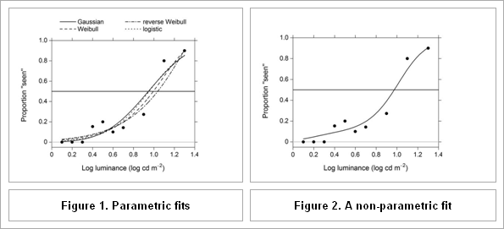
Next Lecture: Nonparametric Methods

