Slide 1
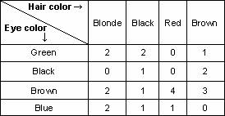
Previous Lecture: Categorical Data Methods

Slide 2
This Lecture
Nonparametric Methods
Judy Zhong Ph.D.

Slide 3
Nonparametric statistical methods
Previously, the data were assumed to come from some underlying distribution (e.g. normal distribution).
We will consider methods for statistical inference which do not depend upon knowledge of the functional form of the underlying probability distributions.
They are “distribution-free”, no assumptions about the sample populations.
Methods based on such assumptions are called parametric methods.

Slide 4
Nonparametric methods
Do not require normality
Use if
Sample size small
Data with outliers (strong deviations from normality)
Two types of tests:
Permutation test
Rank-based tests

Slide 5
Ranks
Sometimes we wish to test a null hypothesis about a population mean, but if the sample size is small and we have non-normally distributed variables, the t-test may not be appropriate.
A powerful distribution-free tool is the use of ranks.
The ranks of an observations is the relative position of an observation’s magnitude compared to the rest of the sample.
When two or more observations have the same value (ties), the rank is assigned by computing the average of the ranks that would have been assigned to tied values and using this average as the common rank shared by each of the tied values.
Notes:
Obstetricians sometimes order tests for estriol levels from 24-hour urine specimens taken from pregnant women who ar near term, because level of estriol has been found to be related to infant birthweight. The test can provide indirect evidence of an abnormally small fetus.

Slide 6
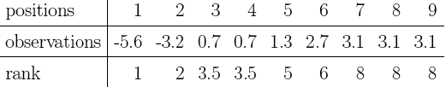
Example
The ordered observations and ranks are as follows:
If we consider only continuous distributions (to avoid ties), the distribution of ranks does not depend on the particular continuous distribution of the sample.
In other words, rank based procedures are distribution-free.
Notes:
Obstetricians sometimes order tests for estriol levels from 24-hour urine specimens taken from pregnant women who ar near term, because level of estriol has been found to be related to infant birthweight. The test can provide indirect evidence of an abnormally small fetus.

Slide 7
Rank-based Tests
Types
Wilcoxon Signed Rank Test
one-sample or paired samples
Wilcoxon Rank Sum Test
two independent samples
Good for:
Small n
Ordinal data
Data with outliers (strong deviations from normality)

Slide 8
Rank-based Tests
Cardinal data: data are on a scale
e.g., weight, height, blood pressure, body temperature
Can compute means, variances, etc
Ordinal data: data can be ordered, but do not have specific values
e.g., high school, college, post graduate degree.
Convenient to use ranks instead of numerical statistics

Slide 9
Wilcoxon Signed Rank Test
Types:
One sample
Paired samples

Slide 10
Wilcoxon Signed Rank Test
Paired sample example: wages of paired tall and short men
Steps:
For each of n sample items, compute the difference, D_{i}, between two measurements
Ignore + and – signs and find the absolute values, |D_{i}|
Omit zero differences, so sample size is n’
Assign ranks R_{i} from 1 to n’ (give average rank to ties)
Reassign + and – signs to the ranks R_{i}
Compute the Wilcoxon test statistic W as the sum of the positive ranks

Slide 11
Wilcoxon Signed Rank Test
x | 25.4 | 27.7 | 30.1 | 30.6 | 32.3 | 33.3 | 34.7 | 38.8 | 40.3 | 55.5
y | 25.7 | 26.4 | 24.5 | 31.6 | 25.0 | 28.0 | 37.4 | 43.8 | 35.8 | 60.9
d = x-y | -0.3 | 1.3 | 5.6 | -1.0 | 7.3 | 5.3 | -2.7 | -5.0 | 4.5 | -5.4
|d| | 0.3 | 1.3 | 5.6 | 1.0 | 7.3 | 5.3 | 2.7 | 5.0 | 4.5 | 5.4
Rank | 1 | 3 | 9 | 2 | 10 | 7 | 4 | 6 | 5 | 8
Signed rank | -1 | 3 | 9 | -2 | 10 | 7 | -4 | -6 | 5 | -8
W1 = Sum of positive ranks: 34
W2 = Sum of negative ranks: 21

Slide 12
Wilcoxon Signed Ranks Test Statistic
The Wilcoxon signed ranks test statistic is the sum of the positive (or negative) ranks:

Slide 13
Wilcoxon Signed Rank Test: exact p-values
For small n’, can compute exactly:
p-value = 2 * P(W1 ≥ W1_{obs})
= 2 * P(W2 ≤ W2_{obs})
Can use R
Can use Table 11 in the Appendix
> x<-c(25.4,27.7,30.1,30.6,32.3,33.3,34.7,38.8,40.3,55.5)
> y<-c(25.7,26.4,24.5,31.6,25.0,28.0,37.4,43.8,35.8,60.9)
> wilcox.test(x, y, paired=TRUE)
Wilcoxon signed rank test
data: x and y
V = 34, p-value = 0.5566
alternative hypothesis: true location shift is not equal to 0

Slide 14
Wilcoxon Rank Sum Test
for
Two independent samples

Slide 15
Wilcoxon Rank-Sum Test for Differences in 2 Medians
Test two independent population medians
Populations need not be normally distributed
Distribution-free procedure
Used for small samples, ordinal data, data with outliers, skewed data

Slide 16
Wilcoxon Rank-Sum Test: Small Samples
Assign ranks to the combined n₁ + n₂ sample observations
Smallest value rank = 1, largest value rank = n₁ + n₂
Assign average rank for ties
Sum the ranks for each sample: R₁ and R₂

Slide 17
Wilcoxon Rank-Sum Test: Small Sample Example
Sample data are collected on the capacity rates (% of capacity) for two factories.
Are the median operating rates for two factories the same?
For factory A, the rates are
71, 82, 77, 94, 88
For factory B, the rates are
85, 82, 92, 97
Test for equality of the population medians at the 0.05 significance level

Slide 18
Wilcoxon Rank-Sum Test: Small Sample Example
(continued)
Ranked
Capacity
values:
Capacity |  | Rank
Factory A | Factory B | Factory A | Factory B
71 |  | 1
77 |  | 2
82 |  | 3.5
 | 82 |  | 3.5
 | 85 |  | 5
88 |  | 6
 | 92 |  | 7
94 |  | 8
 | 97 |  | 9
Rank Sums: |  | 20.5 | 24.5
Tie in 3rd and 4th places

Slide 19
Wilcoxon Rank-Sum Test: Small Sample Example
(continued)
R₁ = 24.5
R₂ = 20.5
The sample sizes are:
n₁ = 4 (factory B)
n₂ = 5 (factory A)
The level of significance is α = .05
Critical values from Table 12
Conclusion: NS
> a<-c(71,82,77,94,88)
> b<-c(85,82,92,97)
> wilcox.test(a, b, paired=F)
Wilcoxon rank sum test with continuity correction
W = 5.5, p-value = 0.3252
alternative hypothesis: true location shift is not equal to 0

Slide 20
Summary: Nonparametric Tests
Do not require normality
Use if sample sizes small, ordinal data and/or data with outliers
Rank-based tests
one sample, paired samples:
Wilcoxon Signed Rank Test
two independent samples:
Wilcoxon Rank Sum Test
based on ranks of observations

Slide 21
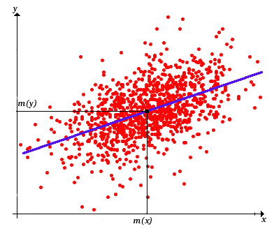
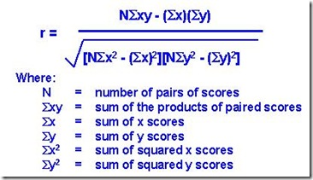
Next Lecture: Regression and Correlation

