Slide 1
Regression and Correlation Methods
Judy Zhong Ph.D.

Slide 2
Learning Objectives
In this chapter, you learn:
Introduction to linear regression models
How to use regression analysis to predict the value of a dependent variable based on an independent variable
The meaning of the regression coefficients β₀ and β₁
Inferences of linear regression models
To estimate and make inferences about the slope and correlation coefficient
Assessing assumptions of linear regression models
How to evaluate the assumptions of regression analysis and know what to do if the assumptions are violated

Slide 3
Introduction to linear regression models
When to use a simple linear regression
How to determine a simple linear regression - estimate b0 and b1
How to interpret a simple linear regression - interpret b0 and b1

Slide 4
Example: Kalama Children
How do children grow?
Measure the heights Y (in centimeters) of 161 children in Kamala, an Egyptian village, each month from 18 to 29 months of age (X):
Age X Height Y Age X Height Y
18 76.1 24 79.9
19 77.0 25 81.1
20 78.1 26 81.2
21 78.2 27 81.8
22 78.8 28 82.8
23 79.7 29 83.5
Consider the relationship between the two variables X and Y, is it linear?

Slide 5
Types of Relationships
Linear relationships
Curvilinear relationships
Y
Y
X
X
Y
Y
X
X

Slide 6
Types of Relationships
(continued)
Strong relationships
Weak relationships
Y
Y
X
X
Y
Y
X
X

Slide 7
Types of Relationships
(continued)
No relationship
Y
X
Y
X

Slide 8
Simple Linear Regression

Slide 9
Simple Linear Regression
A simple linear regression model is a summary of the relationship between a dependent variable (or response variable) Y and an independent variable (or covariate variable) X.
Y is assumed to be a random variable while, even if X is a random variable, we condition on it (assume it is fixed). Essentially, we are interested in knowing the behavior of Y given we know X=x.

Slide 10
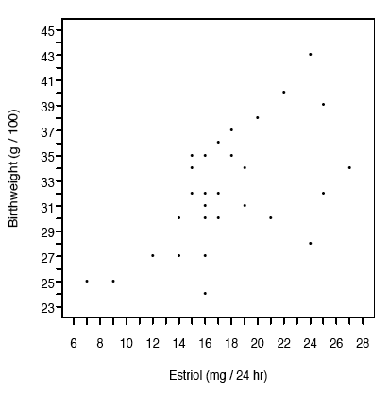
This line is the population regression line.
is the y-intercept of the line is the slope of the line.
It gives the change in the mean value of Y that corresponds to a one unit increase in X.
If >0 , the mean increases as X increases; if <0, the mean decreases as X increases.
Notes:
Y is increasing with X
To describe this relationship, define
Note even if the population regression line accurately describes the relationship between the two variables, individual measurements of these variables will not necessarily fall on that line.

Slide 11
The Full Linear Regression Model
Population Y intercept
Population Slope Coefficient
Independent Variable
Random Error term
Dependent Variable
Linear component
Random Error
component
Given a data set (x_{i}, y_{i}), i = 1, …, 31
How do we get estimates of β₀ and β₁?
We would like the line to be as close to the data as possible.
Notes:
Note even if the population regression line accurately describes the relationship between the two variables, individual measurements of these variables will not necessarily fall on that line.
Y is the sum of two parts: a linear part and the random noise part

Slide 12
Summary of assumptions
The outcomes of Y are normally distributed (independent) random variables with mean and variance
Homoscedasticity: is the same for all x.
Errors (ε) have mean 0 and are independent, I.e., errors are random Normal (0, σ²)
The underlying relationship between the x and the y variable is linear.
Notes:
The relationship between y and x is described by the stright line

Slide 13
Scatter Plot Examples
(continued)
Small σ²
Big σ²
y
y
x
x
y
y
x
x

Slide 14
Scatter Plot Examples
(continued)
β₁=0
y
x
y
x

Slide 15
Simple Linear Regression Model
Y
Observed Value of Y for X_{i}
ε_{i}
Slope = β₁
Predicted Value of Y for X_{i}
Random Error for this x_{i} value
Intercept = β₀
X_{i}
X

Slide 16
Regression Analysis
Regression Analysis is used to
describe the relationship between dependent variables (response variables) and independent variables (regressors, explanatory variable).
make predictions (i.e. predict the value of a dependent variable based on the value(s) of one or more independent variable(s))
explain the impact of changes in an independent variable on the dependent variable
estimate and test the unknown parameters of the model based on data, make inference about the model in general

Slide 17
Estimating the population regression line

Slide 18
Prediction Line
The simple linear regression equation provides an estimate of the population regression line
Estimated (or predicted) Y value for observation i
Estimate of the regression intercept
Estimate of the regression slope
Value of X for observation i

Slide 19
Least Squares Method
We would like the line to be as close to the data as possible.
Consider measuring the distance from the data point to the line
Find β₀ and β₁ that minimize the sum of the squared differences
To find them, we solve the linear equations:

Slide 20
The Least Squares Equation
:called estimated regression coefficients

Slide 21
Interpretation of the Slope and the Intercept
is the estimated average value of y when the value of x is zero
is the estimated change in the average value of y as a result of a one-unit change in x
Once estimates and have been computed, the predicted value of yi given xi is obtained from the estimated regression line,
where is the prediction of the true value yi for observation i.

Slide 22
Inferences of linear regression models
Correlation -- measuring the strength of the association
Inference about the slope

Slide 23
Decomposition of Total SS
Total SS = Regression SS + Residual SS

Slide 24
Measures of Variation
Total variation is made up of two parts:
Total Sum of Squares
Regression Sum of Squares
Error Sum of Squares
where:
= Average value of the dependent variable
Y_{i} = Observed values of the dependent variable
_{i} = Predicted value of Y for the given X_{i} value

Slide 25
Measures of Variation
(continued)
Total SS = total sum of squares
Measures the variation of the Y_{i} values around their mean Y
Reg SS = regression sum of squares
Explained variation attributable to the relationship between X and Y
Res SS = Residual sum of squares
Variation attributable to factors other than the relationship between X and Y

Slide 26
Measures of Variation
(continued)
Y
Y_{i}
∧
∧
Res SS = ∑(Y_{i} - Y_{i} )²
Y
_
Total SS = ∑(Y_{i} -Y)²
∧
Y
_
∧
_
Reg SS = ∑(Y_{i} - Y)²
_
Y
Y
X
X_{i}

Slide 27
Correlation Coefficient: r²
The r² is the portion of the total variation in the dependent variable that is explained by variation in the independent variable

Slide 28
Examples of Approximate r² Values
Y
r² = 1
Perfect linear relationship between X and Y:
100% of the variation in Y is explained by variation in X
X
r² = 1
Y
X
r² = 1

Slide 29
Examples of Approximate r² Values
Y
0 < r² < 1
Weaker linear relationships between X and Y:
Some but not all of the variation in Y is explained by variation in X
X
Y
X

Slide 30
Examples of Approximate r² Values
r² = 0
Y
No linear relationship between X and Y:
The value of Y does not depend on X. (None of the variation in Y is explained by variation in X)
X
r² = 0
Notes:
r measures the extent of linear association
r tends to be close to zero if there is no linear association between x and y

Slide 31
Pearson correlation coefficient
r is the squared root of r²
A measure of the correlation between the two variables
Linear regression allows for prediction, correlation coefficient quantifies the association strength

Slide 32
r = 0.7

Slide 33
r = 0.4

Slide 34
r = 0

Slide 35
Estimating σ

Slide 36
Estimating σ
The standard deviation (σ) of observations around the regression line is estimated by
Where
Res SS = Residual sum of squares
n = sample size

Slide 37
Comparing Standard Errors
S_{YX} is a measure of the variation of observed Y values from the regression line
Y
Y
X
X
The magnitude of S_{YX} should always be judged relative to the size of the Y values in the sample data
i.e., S_{YX} = $41.33K is moderately small relative to house prices in the $200 - $300K range

Slide 38
Inferences About the Slope and Intercept
The standard errors of the regression slope coefficient (β₁) and intercept (β₀ ) are estimated by
where:
= estimate of σ

Slide 39
Comparing Standard Errors of the Slope
is a measure of the variation in the slope of regression lines from different possible samples
Y
Y
X
X

Slide 40
Inference about the Slope: t Test
t test for a population slope
Is there a linear relationship between X and Y?
Null and alternative hypotheses
H₀: β₁ = 0 (no linear relationship)
H₁: β₁ ≠ 0 (linear relationship does exist)
Test statistic
where:
= regression slope
coefficient
β₁₀ = hypothesized slope
= standard
error of the slope

Slide 41
Example 2: Kalama Children
(continued)
H₀: β = 0
H₁: β ≠ 0
H₀: β₁= 0
H₁: β₁≠ 0
Test Statistic: t = 127.71
d.f. = 12-2 = 10
Decision:
Conclusion:
Reject H₀
α/2=.025
α/2=.025
There is sufficient evidence that Children grow over time ☺
Reject H₀
Do not reject H₀
Reject H₀
-t_{α/2}
t_{α/2}
0
-2.228
2.228
127.71

Slide 42
Assessing the Goodness of Fit of Regression Lines

Slide 43
Assumptions of Regression
Use the acronym LINE:
Linearity
The underlying relationship between X and Y is linear
Independence of Errors
Error values are statistically independent
Normality of Error
Error values (ε) are normally distributed for any given value of X
Equal Variance (Homoscedasticity)
The probability distribution of the errors has constant variance

Slide 44
Residual Analysis
The residual for observation i, e_{i}, is the difference between its observed and predicted value
Check the assumptions of regression by examining the residuals
Examine for linearity assumption
Evaluate independence assumption
Evaluate normal distribution assumption
Examine for constant variance for all levels of X (homoscedasticity)
Graphical Analysis of Residuals
Can plot residuals vs. X

Slide 45
1. Residual Analysis for Linearity
Y
Y
x
x
residuals
x
x
residuals
Not Linear
✓
Linear

Slide 46
2. Residual Analysis for Independence
Not Independent
✓
Independent
residuals
X
residuals
X
residuals
X

Slide 47
3. Residual Analysis for Normality
A normal probability plot of the residuals can be used to check for normality:
NormalPercent
100
0
-3 -2 -1 0 1 2 3
Residual

Slide 48
3. Checking Normality Assumption

Slide 49
3. Checking Normality Assumption

Slide 50
4. Residual Analysis for Equal Variance
Y
Y
x
x
residuals
x
x
residuals
✓
Non-constant variance
Constant variance

Slide 51
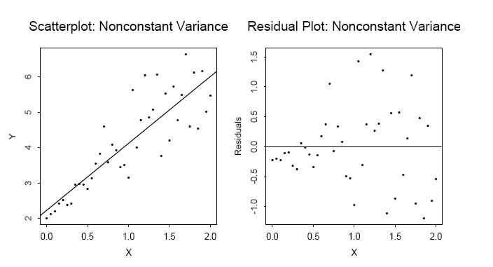
4. Residual Analysis for Equal Variance

Slide 52
Ideal Residual Plot

Slide 53
Outliers and Influential Points

Slide 54
Strategies for Avoiding the Pitfalls of Regression
Start with a scatter diagram of X vs. Y to observe possible relationship
If there is no evidence of assumption violation, estimate regression coefficients
Test for the significance of the regression line (F-test or t-test)
Examine residual plots to check the model assumption
Avoid making predictions or forecasts outside the relevant range

Slide 55
Transformations
What if one or more of the underlying assumptions of regression analysis are not satisfied?
Two options:
Use different method of analysis (nonlinear least-squares, weighted least squares, etc)
Transform x and y into new variables for which linear regression assumptions are satisfied

Slide 56
Transformations
Goals:
To stabilize the variance of Y
To normalize Y
To linearize the regression model
Examples of transformations:
The log transformation: Y’ = log(Y), X’ = log(X)
The square-root transformation: Y’ = srqt(Y)
The reciprocal transformation: Y’ = 1/Y
etc

Slide 57
Summary
Introduction to linear regression models
When to use a simple linear regression
How to determine a simple linear regression - estimate b0 and b1
How to interpret a simple linear regression - interpret b0 and b1
Inferences of linear regression models
Correlation -- measuring the strength of the association
Inference about the slope
Assessing assumptions of linear regression models

