Slide 1
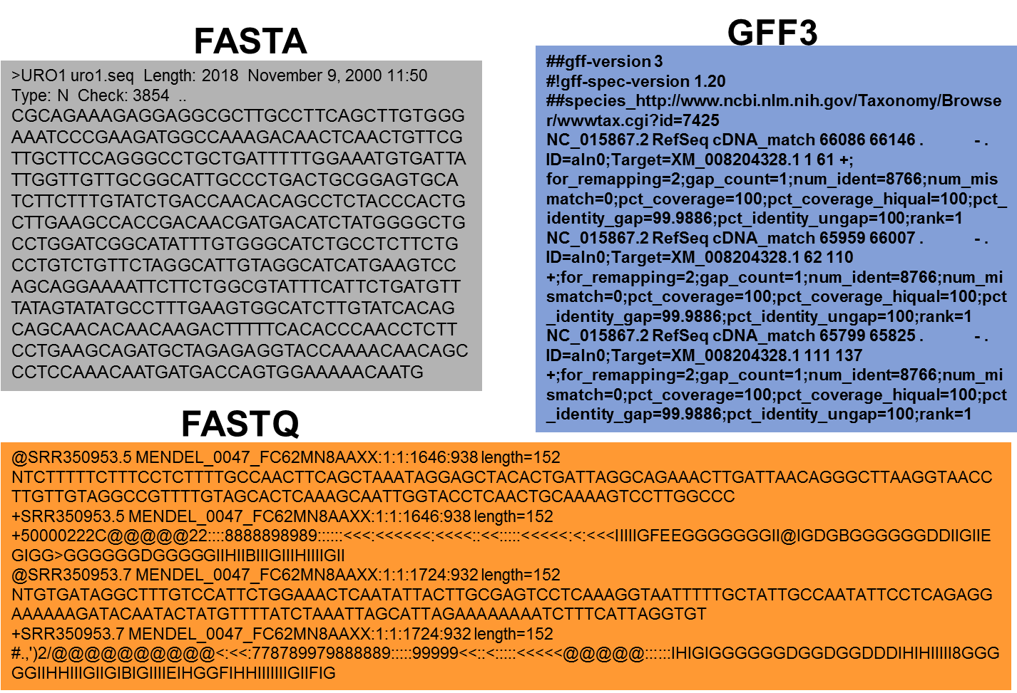
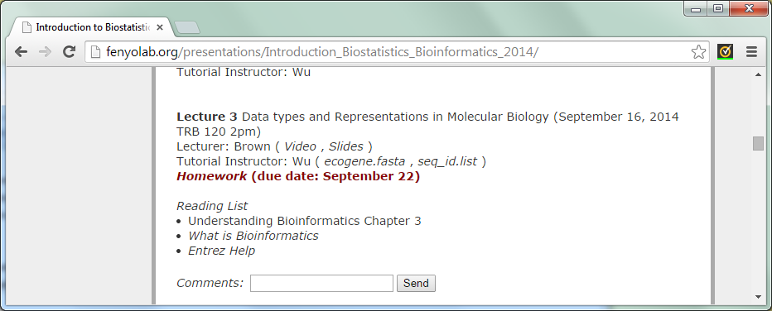
Previous Lecture: Data types and
Representations in Molecular Biology
Notes:
<number>

Slide 2
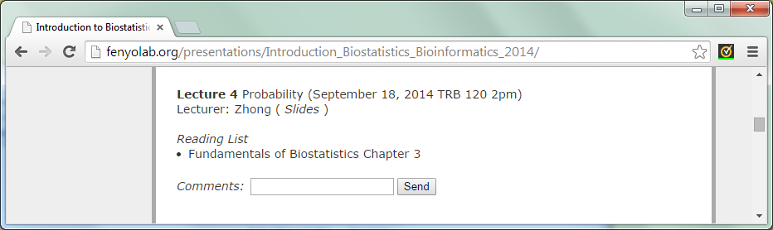
This Lecture
Introduction to Biostatistics and Bioinformatics
Probability
By Judy Zhong
Assistant Professor
Division of Biostatistics
Department of Population Health
Judy.zhong@nyumc.org
Notes:
<number>

Slide 3
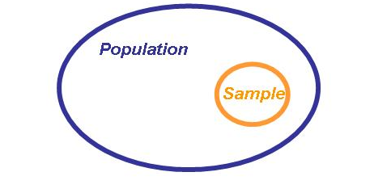
Beyond descriptive statistics
When we have a data set, we usually want to do more with the data than just describe them
Keep in mind that data are information of a sample selected or generated from a population, and our goal is to make inferences about the population
Notes:
<number>

Slide 4
Research question: center of a population
Population
Mean
Notes:
<number>

Slide 5
Research question: center of a population
Random sample 1 ➔
Random sample 2 ➔
.
.
.
Random sample n ➔
Population
Mean
Sample is representative of the population
Notes:
<number>

Slide 6
Research question: center of a population
Random sample 1 ➔
Random sample 2 ➔
.
.
.
Random sample n ➔
Sample mean 1
Sample mean 2
.
.
.
Sample mean n
Population
Mean
Sample is representative of the population
Notes:
<number>

Slide 7
Research question: center of a population
Random sample 1 ➔
Random sample 2 ➔
.
.
.
Random sample n ➔
Sample mean 1
Sample mean 2
.
.
.
Sample mean n
Population
Mean
How to describe the uncertainty in sample means?
Notes:
<number>

Slide 8
Sample Population
To make inferences about population mean (or something else), we need to assess the degree of accuracy to which the sample mean represent the population mean
Therefore:
Our goal: from sample to population (statistics)
To begin with: from population to sample (probability)
Notes:
<number>

Slide 9
Randomness
Things may happen randomly, for examples
Comparison of treatment effects in clinical trials
Calculation of the risk of breast cancer
Notes:
<number>

Slide 10
Randomness
Things may happen randomly, for examples
Comparison of treatment effects in clinical trials
Calculation of the risk of breast cancer
Probability
Study of randomness
Language of uncertainty
Notes:
<number>

Slide 11
Probability theory
Probability of an event = the likelihood of the occurrence of an event
What is a natural way to estimate the probability of an outcome?
Notes:
<number>

Slide 12
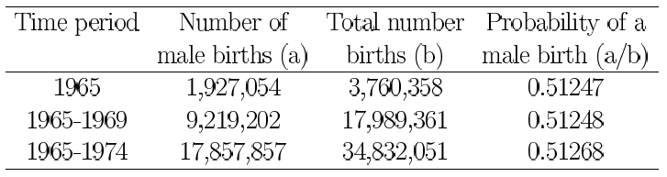
Example: the probability of a male birth
Notes:
<number>

Slide 13
Example: the probability of a male birth
frequency of occurrences
frequency of all possible occurrences
Probability =
0 ≤ Probability ≤ 1
Notes:
<number>

Slide 14
Basic probability concepts
Study of Randomness
Notes:
<number>

Slide 15
Random experiment
An experiment for which the outcome cannot be predicted with certainty
But all possible outcomes can be identified prior to its performance
And it may be repeated under the same conditions
Notes:
<number>

Slide 16
The probability of an event is the relative frequency of this set of outcomes over an indefinitely large number of trials
Notes:
<number>

Slide 17
The probability of an event is the relative frequency of this set of outcomes over an indefinitely large number of trials
In real life, experiments cannot be conducted in infinite number of times
Therefore, probabilities of events are estimated from the empirical probabilities obtained from large samples
Notes:
<number>

Slide 18
Notation
The set of all possible outcomes of a random experiment is called the sample space, denoted by Ω
Let A denote a subset of the sample space, A ⊂ Ω
A is called an event
{ } is often used to denote an event
Notes:
<number>
Brace

Slide 19
Basic definition
Let Ω denote the set comprised of the totality of all elements in our space of interest
A null set A = ∅ has no elements
If A ⊂ Ω , Ā (complement of A) is the set of all elements of which do not belong to A
Notes:
<number>

Slide 20
Basic definition
For two sets A and B,
A ∪ B : Union of A and B is the set of all elements which belong to at least one of A and B
A ∩ B : Intersection of A and B is the set of all elements that belong to each of the sets A and B
A ⊂ B : A is a subset of B, each element of a set A is also an element of a set B
Notes:
<number>

Slide 21
Example
Let A = {1, 2, 3} and B = {3, 4, 5}
A ∩ B = {3}
Notes:
<number>

Slide 22
Example
Let A = {1, 2, 3} and B = {3, 4, 5}
A ∩ B = {3}
Let Ω = {1, 2, 3, 4, 5, 6, 7, 8, ...}: the positive integers, and let A = {2, 4, 6, 8, . . .}
Ā = {1, 3, 5, 7, 9, . . .}
Notes:
<number>

Slide 23
Example
Let A = {1, 2, 3} and B = {3, 4, 5}
A ∩ B = {3}
Let Ω = {1, 2, 3, 4, 5, 6, 7, 8, ...}: the positive integers, and let A = {2, 4, 6, 8, . . .}
Ā = {1, 3, 5, 7, 9, . . .}
A = {1, 2, 3} and B = {1, 2, 3, 4}
A ⊂ B
A = {1, 2, 3} and B = {3, 4, 5}
A ∪ B = {1, 2, 3, 4, 5}
Notes:
<number>

Slide 24
Laws of probability
Let Ω be the sample space for a probability measure P
0 ≤ P(A) ≤ 1, for all events A
P(Ω) = 1
P(∅) = 0
Notes:
<number>

Slide 25
Laws of probability
Let Ω be the sample space for a probability measure P
0 ≤ P(A) ≤ 1, for all events A
P(Ω) = 1
P(∅) = 0
If A⊂ B ⊂ Ω, P(A) ≤ P(B)‏
P(Ā) =1 − P(A)‏
Notes:
<number>

Slide 26
Mutually exclusive events
Events that cannot occur at the same time
Let A₁, A₂, A₃, . . . , A_{k} be k subsets of Ω
A_{i} ∩ A_{j} = Ø for all pairs (i, j) such that i ≠ j
Notes:
<number>
Cannot both happen at the same time

Slide 27
Example
Blood type:
Let A be the event that a person has type A blood, B event having type B blood, C having type AB blood and D having type O blood
A, B, C & D are mutually exclusive
Notes:
<number>

Slide 28
Independent events
Knowing the outcome of one event provides no further information on the outcome of the other event
Notes:
<number>

Slide 29
Independent events
Knowing the outcome of one event provides no further information on the outcome of the other event
Two events A and B are called independent events if P(A ∩ B) = P(A) × P(B)‏
Notes:
<number>

Slide 30
Dependent events
Knowing the outcome of one event increases the knowledge of the outcome of another event
Two events A and B are dependent events if P(A ∩ B) ≠ P(A) × P(B)‏
Notes:
<number>

Slide 31
Multiplication law of probability
Let A₁,A₂, . . . , A_{k} be mutually independent events
P(A₁∩ A₂ ∩. . . ∩ A_{k}) = P(A₁) × P(A₂) × . . . × P(A_{k})‏
Notes:
<number>

Slide 32
Addition law of probability
For any events A and B,
P(A ∪ B) = P(A) + P(B) − P(A ∩ B)‏
Notes:
<number>

Slide 33
Addition law of probability
For any events A and B,
P(A ∪ B) = P(A) + P(B) − P(A ∩ B)‏
If two events A and B are mutually exclusive,
P(A ∪ B) = P(A) + P(B) − ∅ = P(A) + P(B)
Notes:
<number>

Slide 34
Addition law of probability
For any events A and B,
P(A ∪ B) = P(A) + P(B) − P(A ∩ B)‏
If two events A and B are mutually exclusive,
P(A ∪ B) = P(A) + P(B)‏
If two events A and B are independent,
P(A ∪ B) = P(A) + P(B) − P(A) × P(B)‏
Notes:
<number>

Slide 35
Mutually exclusive versus mutually independent
?
A=“It rained on Tuesday” and B=“It didn’t rain on Tuesday”
?
A=“It rained on Tuesday” and B=“My chair broke at work”
Notes:
<number>
If event A happens, then event B cannot, vice versa. The two events are mutually exclusive
Tie outcome of event A has no effect on the outcome of event B

Slide 36
Mutually exclusive versus mutually independent
Mutually exclusive
A=“It rained on Tuesday” and B=“It didn’t rain on Tuesday”
Mutually independent
A=“It rained on Tuesday” and B=“My chair broke at work”
Notes:
<number>
If event A happens, then event B cannot, vice versa. The two events are mutually exclusive
Tie outcome of event A has no effect on the outcome of event B

Slide 37
Note
If P(A ∪ B) ≠ P(A)+P(B), A and B are NOT mutually exclusive
If P(A ∩ B) ≠ P(A) × P(B), A and B are NOT mutually independent
Notes:
<number>

Slide 38
Note
If P(A ∪ B) ≠ P(A)+P(B), A and B are NOT mutually exclusive
If P(A ∩ B) ≠ P(A) × P(B), A and B are NOT mutually independent
Mutually independent and mutually exclusive are not equivalent
A: It rained today & B: I left my umbrella at home
Is it mutually independent or mutually exclusive?
Notes:
<number>

Slide 39
Syphilis Example
Define the following events:
A={Doctor 1 makes a positive diagnosis}
B={Doctor 2 makes a positive diagnosis}
Doctor 1 diagnoses 10% of all patients as positive: P(A)=0.1
Doctor 2 diagnoses 17% of all patients as positive: P(B)=0.17
Both doctors diagnose 8% of all patients as positive: P(A ∩ B)=0.08
Are the events A and B independent?
Notes:
<number>
This makes sense because their diagnoses should be similar

Slide 40
Solution
P(A ∩ B)=0.08
P(A) × P(B)=0.1 × 0.17=0.017
P(A ∩ B) ≠ P(A) × P(B)‏
A and B are dependent events
Notes:
<number>
This makes sense because their diagnoses should be similar

Slide 41
If A and B are independent we can write
P(A ∪ B)
= P(A) + P(B) − P(A ∩ B)
= P(A) + P(B) − P(A) × P(B)‏
Notes:
<number>

Slide 42
If A and B are dependent, how can we compute P(A ∩ B)?
Notes:
<number>
This makes sense because their diagnoses should be similar

Slide 43
If A and B are dependent, how can we compute P(A ∩ B)?
Conditional probability
Notes:
<number>
This makes sense because their diagnoses should be similar

Slide 44
The conditional probability of A given B is denoted
P(A|B) = P(A ∩ B)/P(B)‏
The conditional probability of B given A is denoted
P(B|A) = P(A ∩ B)/P(A)‏
Equivalently,
P(A ∩ B) = P(A) P(B|A)‏
P(A ∩ B) = P(B) P(A|B)‏
Notes:
<number>

Slide 45
If A and B are independent,
Notes:
<number>

Slide 46
If A and B are independent, we have
P(A|B) = P(A ∩ B)/P(B) = [P(A) × P(B)]/P(B) = P(A)‏
P(B|A) = P(A ∩ B)/P(A) = [P(A) × P(B)]/P(A) = P(B)‏
Notes:
<number>

Slide 47
If A and B are independent, we have
P(A|B) = P(A)‏
P(B|A) = P(B)‏
As a result,
If A and B are independent, the event B is not influenced by the event A, and vice versa
Notes:
<number>

Slide 48
Note
If A and B are mutually exclusive, and A occurs, then P(B|A)=0 (if A occurs, B cannot)‏
Notes:
<number>
They cannot occur at the same time

Slide 49
Total probability rule
For any event A & B,
P(B)=P(B|A) × P(A) + P(B|Ā) × P(Ā)
Notes:
<number>

Slide 50
Total probability rule
For any event A & B,
P(B)=P(B|A) × P(A) + P(B|Ā) × P(Ā)
Because
P(B)=P(B ∩ A) + P(B ∩ Ā)‏
P(B)=P(A) ×P(B|A) + P(Ā) ×P(B| Ā)
Notes:
<number>

Slide 51
Example 3.18: Breast Cancer
Physicians recommend that all women over age 50 be screened for breast cancer. The definitive test for identifying breast tumors is a breast biopsy. However, this procedure is too expensive and invasive to recommend for all women over 50. Instead, they are encouraged to have a mammogram every 1 to 2 years. Women with positive mammogram are then tested further with a biopsy
Ideally, the probability of breast cancer among women who are mammogram positive would be 1 and the probability of breast cancer among women who are mammogram negative would be 0. The two events {mammogram positive} and {breast cancer} would then be completely dependent; the results of the screening test would determine the disease state
The opposite extreme is achieved when the events {mammogram positive} and {breast cancer} are completely independent. In this case, the probability of breast cancer would be the same regardless of whether the mammogram is positive or negative, and the mammogram would not be the useful in screening for breast cancer and should not be used
Notes:
<number>

Slide 52
Relative risk
For any two events, the relative risk of B given A is defined as
RR=Pr(B|A)/Pr(B| )
Note that if A and B are independent, then the RR is 1. If two events A and B are dependent, then RR is different from 1. Heuristically, the more the dependence between two events increases, the further the RR will be from 1

Slide 53
Back to the breast cancer example
Suppose that among 100,000 women with negative mammograms 20 will be diagnosed with breast cancer within 2 years, or
Suppose that among 1 woman in 10 with positive mammograms will be diagnosed with breast cancer within 2 years, or Pr(B|A)=0.1.
The two events A and B would be highly dependent, because
In other words, women with positive mammograms are 500 times more likely to develop breast cancer over the next 2 years than are women with negative mammograms
Notes:
<number>

Slide 54
See breast cancer example again
Let A={mammogram+} and B={breast cancer}
In the above example, Pr(B|A)=0.1 and Pr(B|Ā)=0.0002
Suppose that 7% of the general population of women will have positive mammogram. What is the probability of developing breast cancer over the next 2 years among women in the general population?
Using total probability rule:
Pr(B)=Pr(B|A) × Pr(A) + Pr(B|Ā) ×Pr(Ā)
=0.1*0.07+0.002*0.93=0.00719

Slide 55
Exhaustive events
A set of events is jointly or collectively exhaustive if at least one of the events must occur
Their union must cover all the event within the entire sample space
Notes:
<number>

Slide 56
Exhaustive events
A set of events is jointly or collectively exhaustive if at least one of the events must occur
Their union must cover all the event within the entire sample space
For example,
Events A and B are collectively exhaustive if A ∪ B = Ω
A and Ā are collectively exhaustive
Notes:
<number>

Slide 57
Exhaustive events
A set of events A1, …, Ak is exhaustive if at least one of the events must occur
More important,
Assume that events A1, …, Ak are mutually exclusive and exhaustive; that is, as least one of the events must occur and no two events can occur simultaneously. Thus, exact one of the events must occur

Slide 58
Total-probability rule (general version)
Let A1, …, Ak be mutually exclusive and exhaustive events. The unconditional probability of B (Pr(B)) can be written as a weighted average of the conditional probability of B given Ai (Pr(B|Ai)) as follows:
Proof:
Pr(B)=Pr(B∩A1)+…+Pr(B∩Ak), because A1… Ak are mutually exclusive and exhaustive events
Pr(B∩A1)=Pr(A1)*Pr(B|A1), …, Pr(B∩Ak)=Pr(Ak)*Pr(B|Ak), by the definition of conditional probability

Slide 59
Review
<number>
Probability = Study of randomness
0 ≤ P(A) ≤ 1 for any event A
P(Ω) = 1, P(∅) = 0
A’s complement Ā, and P(Ā) = 1 − P(A)
Mutually exclusive
P(A ∩ B) = 0
Mutually independent
P(A ∩ B) = P(A) × P(B)
Notes:
<number>

Slide 60
Review
<number>
Addition law of probability
P(A ∪ B) = P(A) + P(B) − P(A ∩ B)‏
Multiplication law of probability (for mutually independent events, A₁, A₂, . . . , A_{k} )
P(A₁∩ A₂ ∩. . . ∩ A_{k}) = P(A₁) × P(A₂) × . . . × P(A_{k})‏
Notes:
<number>

Slide 61
Review
<number>
Conditional Probability:
If A and B are independent,
P(A|B) = P(A)
P(B|A) = P(B)
For any event A & B,
P(B)=P(B|A) × P(A) + P(B|Ā) × P(Ā)
Notes:
<number>

Slide 62
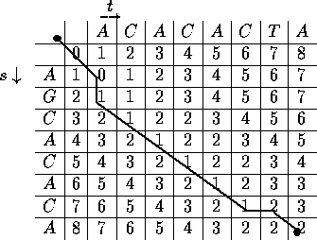
Next Lecture: Sequence Alignment Concepts
Notes:
<number>

