Slide 1

Previous Lecture: Sequence Database Searching

Slide 2
This Lecture
Introduction to Biostatistics and Bioinformatics
Distributions
By Judy Zhong
Assistant Professor
Division of Biostatistics
Department of Population Health
Judy.zhong@nyumc.org

Slide 3
Introduction
Last lecture defined probability and introduced some basic tools used in working with probabilities
This lecture discusses specific probability models
Three specific probability distributions (models)
Binomial distribution
Poisson distribution
Normal distribution

Slide 4
Random variables
A random variable is a function that assigns numeric values to different events in a sample space
NOTE: (1) Randomness; (2) Numeric values
Example 1: Randomly select a student from a class. X=student’s number of siblings. X could be 0, 1, 2 …
Example 2: Randomly select a student from a class. X=student’s height. X could be any value bigger than 0

Slide 5
Two types of random variables
A random variable for which there exists a discrete set of numeric values is a discrete random variable
A random variable whose possible values cannot be enumerated is a continuous random variable

Slide 6
Probability distribution function
A probability distribution function is a mathematical relationship, or rule, that assigns to any possible value r of a discrete random variable X the probability Pr(X=r).

Slide 7
Expected value (expectation) of a discrete random variable
The expected value (expectation) of a discrete random variable is defined as
Where x_i’s are the values the random variable X assumes with positive probability
The sum is over all the R possible values. R may be finite (e.g., binomial distribution) or infinite (e.g., Poisson distribution)
Expectation represents “average” value of the random variable

Slide 8
Variance (population variance) of a discrete random variable
The variance of a discrete random variable is defined by
The standard deviation of a random variable is defined by

Slide 9
An experiment (for binomial distribution)
Common structure for binomial distribution:
A sample of n independent trials
Each trial can have only two possible outcomes, which are denoted as “success” and “failure” (the term “success” is used in a general way, without specific meaning)
The probability of a success at each trial is assumed to be the same, with probability p (hence the probability of failure is 1-p=q)
Let random variable:
X=number of successes among n trails

Slide 10
How to fit a real problem into binomial structure
Here we concentrate on counting the number of neutrophils of 5 white blood cells.
Assume that the probability that a cell is neutrophils is 0.6
number of trials n=5
“success”=“one cell being neutrophils”
Pr(“success”)=p=0.6
X=number of successes among 5

Slide 11
How to calculate the probability of an outcome from binomial structure
There are 5 white cells, each of cell is either neutrophils (N) or other (O). What is the probability that the 2nd and the 5th cells considered will be neutrophils and the remaining cells are non-neutrophils? That is, what is the probability of outcome “ONOON”
Assume that the outcomes for different cells are independent. Using multiplication law of probability,
Think about this question: What is the probability that any 2 cells out of 5 will be neutrophils?

Slide 12
Combination plays an role …
Possible outcomes for 2 neutophils of 5 cells:
NNOOO, ONNOO, …
How many such outcomes?
Then the probability of obtaining 2 neutrophils in 5 cells is:

Slide 13
Binomial distribution
Let X=number of success in n statistically independent trials, where the probability of success is p
The distribution of random variable X is known as the binomial distribution and has probability distribution function given by

Slide 14
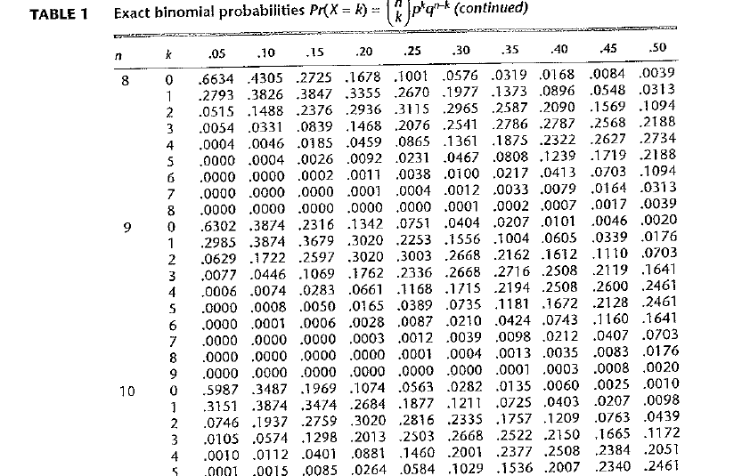
Using binomial tables
Table 1 in the Appendix:
for n=2, 3, …, 20 and p=0.05, 0.10, …, 0.50

Slide 15
Expected value and variance of the binomial distribution
Result: The expected value and the variance of a binomial distribution are np and np(1-p), respectively

Slide 16
Bernoulli distribution
Look at a special case of binomial random variable with n=1 and p. That is, conduct only one trial, X=1 if success and X=0 if failure:
Pr(X = 1) =p
Pr(X = 0) = 1 − p = q
Expectation of X: E(X)=1*p+0*q=p
Variance of X: Var(X)=(1^2*p+0^2*q)-p^2=p*(1-p)=pq

Slide 17
Write binomial random variable in terms of bernoulli random variables
Conduct n independent trials, each trail having outcome either success or failure
For each trail, probability of success is p
X=number of successes among n trials. It is known that the distribution of X is binomial distribution with n and p
Now define the outcome of the ith trial as Xi (Xi=1 if success and Xi=0 if failure), then

Slide 18
Proof of expectation and variable of binomial variable
Fact 1:
Fact 2: For any i, E(Xi)=p and Var(Xi)=pq
Then
(1) , where the first equality always holds
(2) , where the first equality only holds for independent variables

Slide 19
Poisson distribution for rare events
The Poisson distribution is the second most frequently used discrete distribution after the binomial distribution. Poisson distribution is usually associated with rare events (for example, rare diseases)

Slide 20
Examples
number of deaths attributed to typhoid fever over a year
Assuming the probability of a few death from typhoid fever in any one day is vey small and the number of cases reported in any two days are independent random variables, then the number of deaths over a 1-year period will follow a Poisson distribution
number of bacterial colonies growing on an agar plate.
Suppose we have a 100-cm^2 agar plate. The probability of finding any bacterial colonies on a small area is very small, and the events finding bacterial colonies at any two areas are independent. The number of bacterial colonies over the entire agar plate will follow a Poisson distribution

Slide 21
Poisson distribution
The probability of k events occurring for a Poisson distribution with parameter μ is

Slide 22
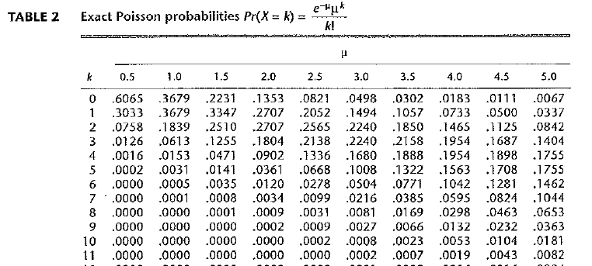
Use Poisson table (Table 2 in the Appendix)
For μ=0.5, 1.0, 1.5, …, 20.0

Slide 23
Expectation and variance of a Poisson random variable
Result: For a Poisson distribution with parameter μ, the mean and variance are both equal to μ

Slide 24
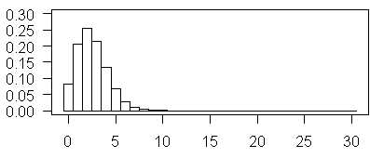
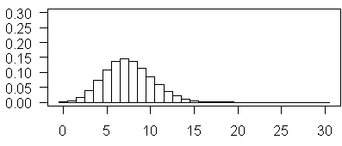
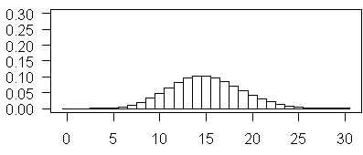
u = 2.5
u = 7.5
u = 15

Slide 25
Binomial when n is large and p is very small
X~bin(n, p)
E(X) = np
Var(X) = np(1-p)=npq
If n is large and p is very small, 1-p = q ≈ 1
Then np ≈ npq
That is, E(X) ≈ Var(X)

Slide 26
Probability that a continuous random variable falls in range [a, b]
For discrete variable, probability distribution gives the probability of each value that the variable takes on. Can we have the same distribution for continuous variable? The answer is: NO
For a continuous DBP, the probabilities of specific blood-pressure measurement values such that 117.341123 are 0, and thus the concept of a probability distribution (probability mass) function cannot be used
Instead, we speak in terms of the probability that blood pressure X falls within a range of values, for examples, ranges 90≤X<100, or a≤X<b

Slide 27
Probability density function
The probability density function (pdf) of the random variable X is a function such that the area under the density function curve between any two points a and b is equal to the probability that the random variable X falls between a and b. Thus, the total area under the density function curve over the entire range of possible values for the random variable is 1
The pdf has large values in regions of high probability and small values in regions of low probability

Slide 28
Some remarks
As discussed earlier, for a continuous random variable X, Pr(X=x)=0 for any specific value x
Generally, a distinction is not made between probabilities such as Pr(X<x) and Pr(X≤x), Pr(a≤X≤b) and Pr(a<X<b) when X is a continuous
The pdf of a continuous random variable X is usually denoted as f(x)
In mathematics, the probability of X in interval [a, b] is equal to the integration (area) of its pdf over [a,b], that is

Slide 29
Expectation and variance
The expectation of a continuous random variable X, denoted by E(X), or μ, is the average value taken on by the random variable
The variance of a continuous random variable X, denoted by Var(X) or , is the average squared distance of each value of the random variable from its expectation, which is given by . The standard deviation, or σ, is the square root of the variance, that is,

Slide 30
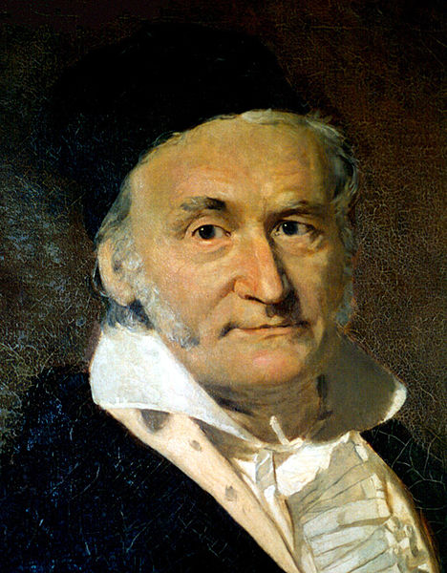
Normal distribution
Normal distribution is also called Gaussian distribution, after the well-known mathematician Karl Gauss (1777-1855, “the Prince of Mathematicians“)
Normal distribution is very useful
Many variables are normally distributed
Many other distributions an be made approximately normal
by transformation
Normal distribution is as approximation of other distribution
such as binomial distribution and Poisson distribution
Most statistical methods considered in this text are based on
normal distribution

Slide 31
The pdf of normal distribution
The normal distribution is defined by its pdf, which is given as
for some parameters μ and σ
μ: Mean
σ: Standard deviation
= 3.14159
e = 2.71828

Slide 32
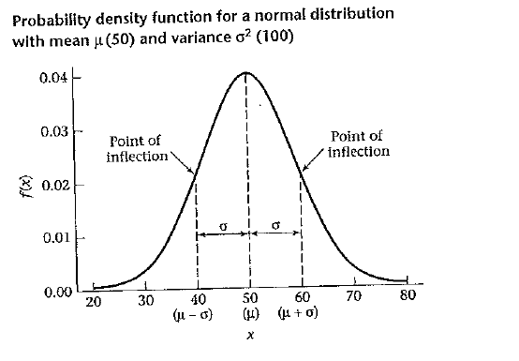
An example of Normal pdf
Bell-shaped, symmetric with mode and center at μ
A point of inflection is a point at which the slope of the curve directions. Image you are skiing on a mountain

Slide 33
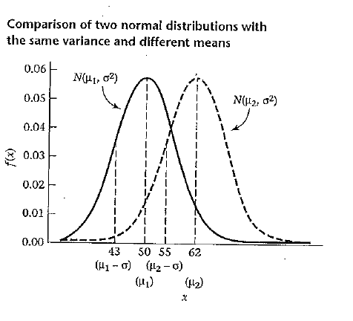
Location is measured by μ
In the graph, μ₂>μ₁

Slide 34
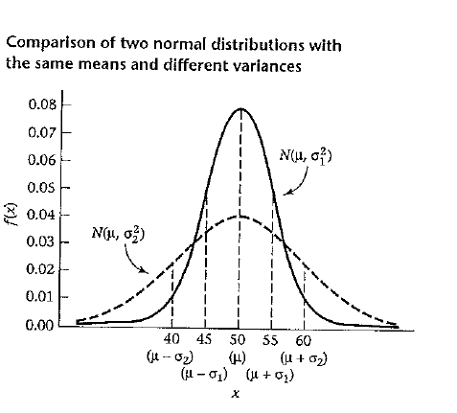
Spread is measured by σ²
In the graph, σ₂>σ₁

Slide 35
Standard normal distribution N(0, 1)
A normal distribution with mean 0 and variance 1 is called a standard normal distribution. Denoted as N(0, 1)
In the following, we will examine the standard normal distribution N(0, 1) in detail
We will see that any information concerning a general normal distribution N(μ, σ²) can be obtained from appropriate manipulations of an N(0,1) distribution

Slide 36
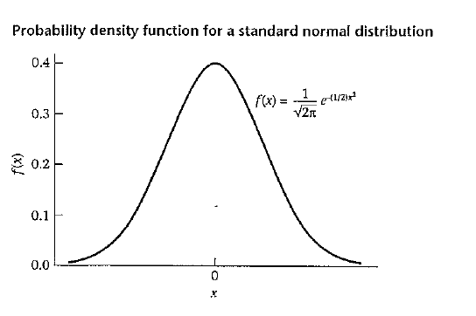
Density of N(0,1)

Slide 37
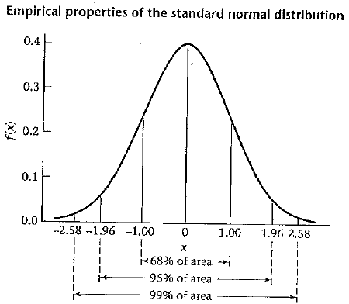
Properties of the standard normal N(0, 1)
It can be shown that about 68% of the area under the standard normal density lies between -1 and +1, about 95% of the area lies between -2 and +2, and about 99% lies between -2.5 and +2.5
NOTE: You will see that, more precisely,
Pr(-1<x<1)=0.6827, Pr(-1.96<X<1.96)=0.95, Pr(-2.576<X<2.576)=0.99

Slide 38
Some notations
The cumulative distribution function (cdf) for a standard normal distribution is denoted by
Φ(x)=Pr(X≤x), where X~N(0,1)
The symbol ~ is used as shorthand for the phase “is distributed as.” Thus X~N(0,1) means that the random variable X is distributed as an N(0,1) distribution
Generally, X~N(μ, σ²) means X is distributed as N(μ, σ²)

Slide 39
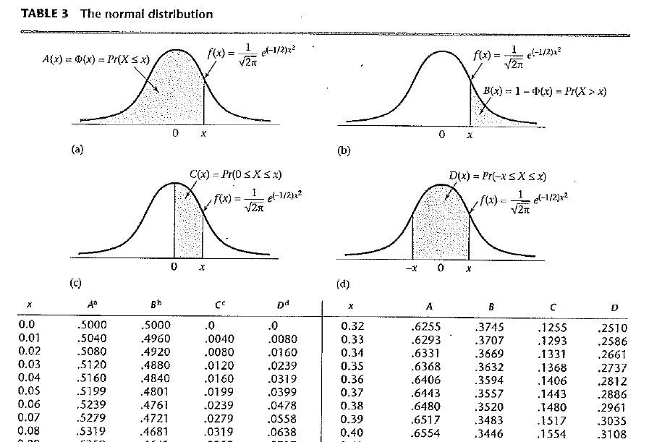
Normal table: Table 3 in Appendix

Slide 40
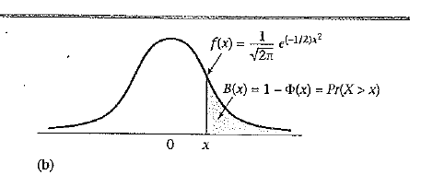
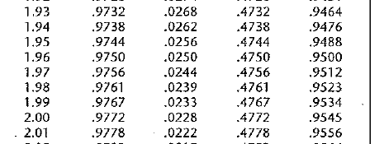
Using symmetry properties of N(0,1)
From the symmetry property of the N(0,1),
Φ(-x)=Pr(X≤-x)=Pr(X≥x)=1-Pr(X≤x)=1-Φ(x)
Example 5.12: Find P(X≤-1.96) if X~N(0,1)

Slide 41
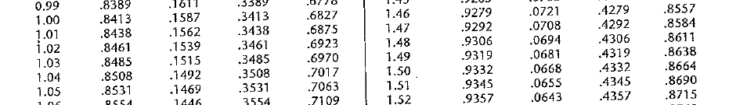
Pr(a≤X≤b)=Pr(X≤b)-Pr(X≤a)
Example 5.13: Find Pr(-1≤X≤1.5) if X~N(0,1)
Solution: Pr(-1≤X≤1.5)
=Pr(X≤1.5)-Pr(X≤-1)
=Pr(X≤1.5)-Pr(X≥1)=0.9332-0.1587=0.7745
(NOTE: The best way to work on such problems is to draw a graph!)

Slide 42
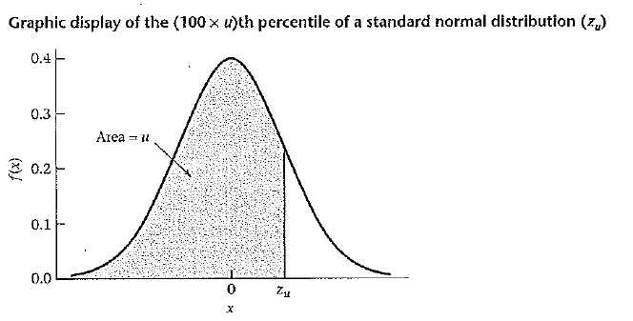
The (100×u)th percentile
The (100×u)th percentile of N(0,1) is denoted by z_{u}
such that, Pr(X< z_{u})=u, where X~N(0,1)

Slide 43
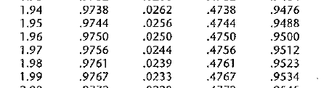
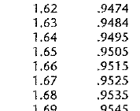
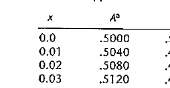
Example of finding percentiles
Example 5.18: Compute z_{0.975} ,z_{0.95} ,z_{0.5} and z_{0.025}
(1) 1.96; (2) 1.645; (3) 0; (4) -1.96

Slide 44
Now: from N(μ, σ²) to N(0,1)
Now we have become familiar with N(0,1), but we want to work on any general normal N(μ, σ²)
Example 5.20 (Hypertension): Suppose a mild hypertensive is defined as a person whose DBP is between 90 and 100 mm Hg inclusive, and the subjects are 35- to 40-year-old men whose blood pressure are normally distributed with mean 80 and variance 144. What is the probability that a randomly selected person from this population will be a mild hypertensive? This question can be stated more precisely: If X~N(80, 144), then what is Pr(90<X<100)?

Slide 45
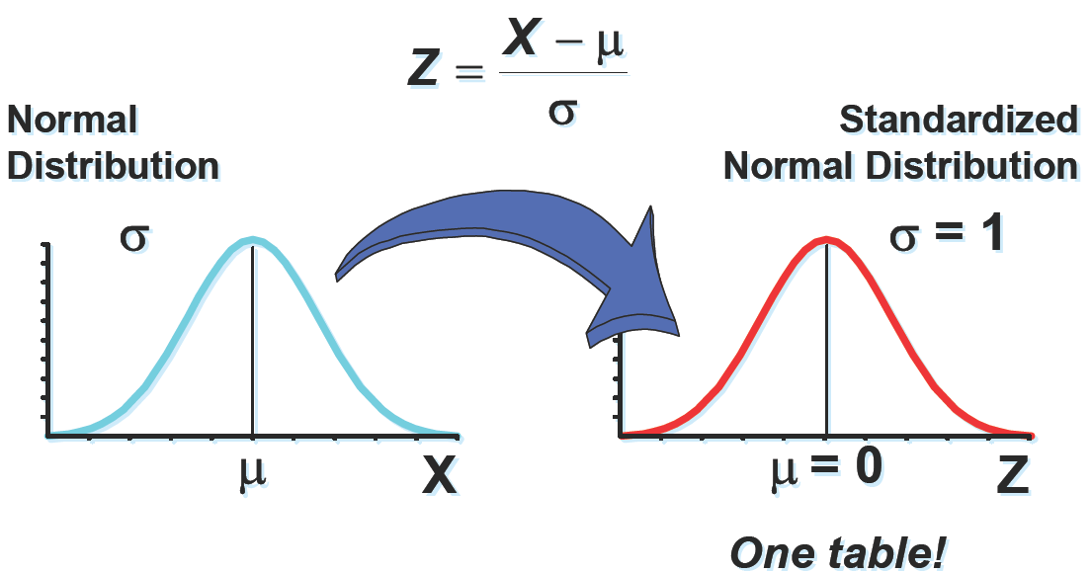
How to standardize the normal distribution?

Slide 46
How to standardize the normal distribution?
Then Z has a standard normal distribution, Z ~ N(0, 1)

Slide 47
Standardization
IF X~ N(μ, σ²) and Z=(X-µ)/σ, then Z~N(0,1)
Then
where the last two terms can be found from column A in normal table

Slide 48
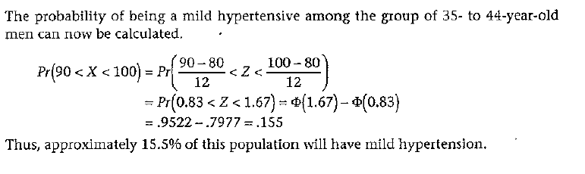
Use standardization for many problems
Example 5.20 (Hypertension example continued): If X~N(80, 12^2), what is Pr(90<X<100)?
Solution:

Slide 49
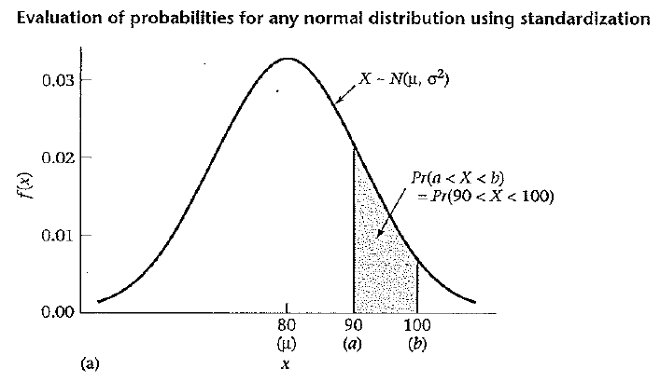
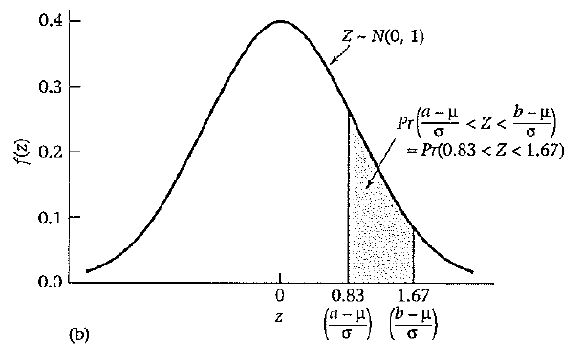
Always draw a graph…

Slide 50
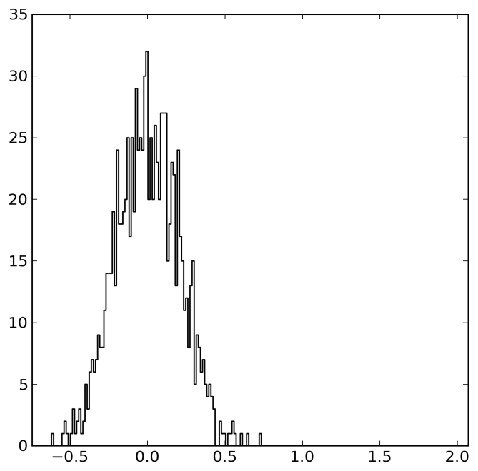
Next Lecture: Estimation I
Point Estimate
Interval Estimate

