Slide 1
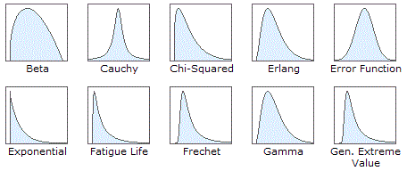
Previous Lecture: Distributions

Slide 2
This Lecture
Introduction to Biostatistics and Bioinformatics
Estimation I
By Judy Zhong
Assistant Professor
Division of Biostatistics
Department of Population Health
Judy.zhong@nyumc.org

Slide 3
Statistical inference
Statistical inference can be further subdivided into the two main areas of estimation and hypothesis
Estimation is concerned with estimating the values of specific population parameters
Hypothesis testing is concerned with testing whether the value of a population parameter is equal to some specific value

Slide 4
Two examples of estimation
Suppose we measure the systolic blood pressure (SBP) of a group of patients and we believe the underlying distribution is normal. How can the parameters of this distribution (µ, σ^2) be estimated? How precise are our estimates?
Suppose we look at people living within a low-income census tract in an urban area and we wish to estimate the prevalence of HIV in the community. We assume that the number of cases among n people sampled is binomially distributed, with some parameter p. How is the parameter p estimated? How precise is this estimate?

Slide 5
Point estimation and interval estimation
Sometimes we are interested in obtaining specific values as estimates of our parameters (along with estimation precise). There values are referred to as point estimates
Sometimes we want to specify a range within which the parameter values are likely to fall. If the range is narrow, then we may feel our point estimate is good. These are called interval estimates

Slide 6
From Sample to Population!
Purpose of inference:
Make decisions about population characteristics when it is impractical to observe the whole population and we only have a sample of data drawn from the population
Population?

Slide 7
Towards statistical inference
Parameter: a number describing the population
Statistic: a number describing a sample
Statistical inference: Statistic → Parameter

Slide 8
Inference Process
Estimates & tests
Population
Sample statistic
Sample

Slide 9
Section 6.5: Estimation of population mean
We have a sample (x1, x2, …, xn) randomly sampled from a population
The population mean µ and variance σ^2 are unknown
Question: how to use the observed sample (x1, …, xn) to estimate µ and σ^2?

Slide 10
Point estimator of population mean and variance
A natural estimator for estimating population mean µ is the sample mean
A natural estimator for estimating population standard deviation σ is the sample standard deviation

Slide 11
Sampling distribution of sample mean
To understand what properties of make it a desirable estimator for µ, we need to forget about our particular sample for the moment and consider all possible samples of size n that could have been selected from the population
The values of in different samples will be different. These values will be denoted by
The sampling distribution of is the distribution of values over all possible samples of size n that could have been selected from the study population

Slide 12
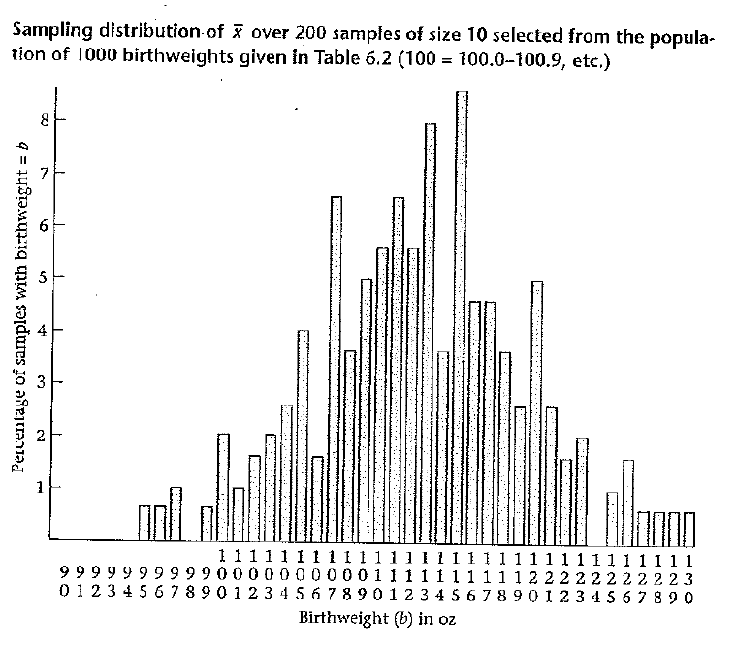
An example of sampling distribution

Slide 13
Sample mean is an unbiased estimator of population mean
We can show that the average of these samples mean ( over all possible samples) is equal to the population mean µ
Unbiasedness: Let X1, X2, …, Xn be a random sample drawn from some population with mean µ. Then

Slide 14
is minimum variance unbiased estimator of µ
The unbiasedness of sample mean is not sufficient reason to use it as an estimator of µ
There are many other unbiasedness, like sample median and the average of min and max
We can show that (but not here): among all kinds of unbiased estimators, the sample mean has the smallest variance
Now what is the variance of sample mean ?

Slide 15
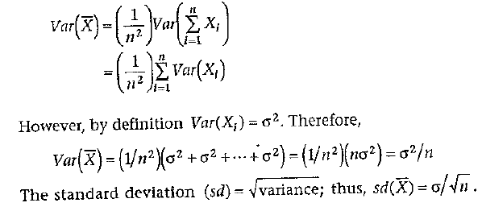
Standard error of mean
The variance of sample mean measures the estimation precise
Theorem: Let X1, …, Xn be a random sample from a population with mean µ and variance . The set of sample means in repeated random samples of size n from this population has variance . The standard deviation of this set of sample means is thus and is referred to as the standard error of the mean or the standard error.

Slide 16
Use to estimate
In practice, the population variance is rarely unknown. We will see in Section 6.7 that the sample variance is a reasonable estimator for
Therefore, the standard error of mean can be estimated by
(recall that )
NOTE: The larger sample size is ➔the smaller standard error is ➔ the more accurate estimation is

Slide 17
An example of standard error
A sample of size 10 birthweights:
97, 125, 62, 120, 132, 135, 118, 137, 126, 118 (sample mean x-bar=117.00 and sample standard deviation s=22.44)
In order to estimate the population mean µ, a point estimate is the sample mean , with standard error given by

Slide 18
Summary of sampling distribution of
Let X1, …, Xn be a random sample from a population with µ and σ² . Then the mean and variance of is µ and σ²/n, respectively
Furthermore, if X1, ..., Xn be a random sample from a normal population with µ and σ² . Then by the properties of linear combination, is also normally distributed, that is
Now the question is, if the population is NOT normal, what is the distribution of ?

Slide 19

The Central Limit Theorem
Let X₁ , X₂ , …, X_{n} denote n independent random variables sampled from some population with mean μ and variance σ²
When n is large, the sampling distribution of the sample mean is approximately normally distributed even if the underlying population is not normal
By standardization:
Notes:
This theorem is very important, because many of the distributions encountered in practice is not normal. In such case, the central limit theorem can often be applied, this lets us perform statistical inference based on the approximate normality of the sample mean, despite the normality of the distribution of individual observation

Slide 20
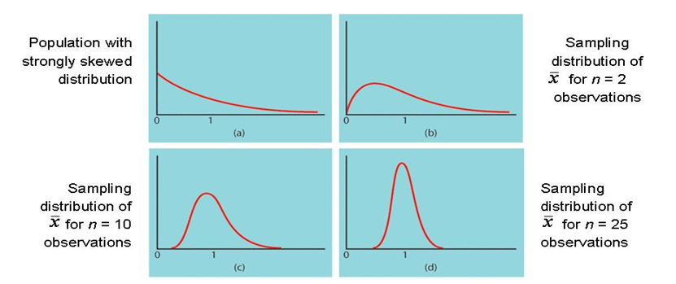
Illustration of Central limit Theorem (CLT)

Slide 21
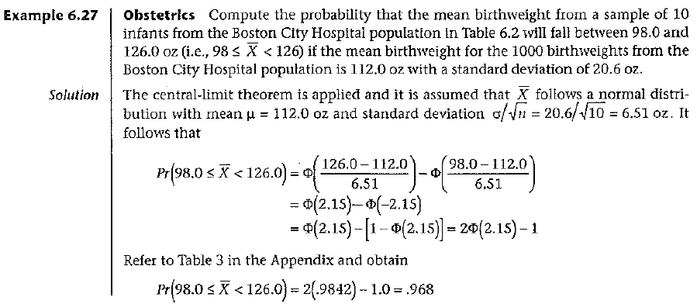
An example of using CLT
Example 6.27 (Obstetrics example continued) Compute the

Slide 22
Interval estimation
Let X₁ , X₂ , …, X_{n} denote n independent random variables sampled from some population with mean μ and variance σ²
Our goal is to estimate µ. We know that is a good point estimate
Now we want to have a confidence interval
such that
Notes:
This theorem is very important, because many of the distributions encountered in practice is not normal. In such case, the central limit theorem can often be applied, this lets us perform statistical inference based on the approximate normality of the sample mean, despite the normality of the distribution of individual observation

Slide 23
Motivation for t-distribution
From Central Limit Theorem, we have
But we still cannot use this to construct interval estimation for µ, because σ is unknown
Now we replace σ by sample standard deviation s, what is the distribution of the following?

Slide 24
T-distribution
If X1, …, Xn ~ N(µ,σ²) and are independent, then
where is called t-distribution with n-1 degrees of freedom

Slide 25
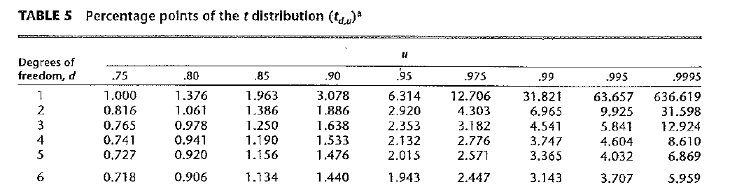
T-table
See Table 5 in Appendix
The (100×u)th percentile of a t distribution with d degrees of freedom is denoted by That is

Slide 26
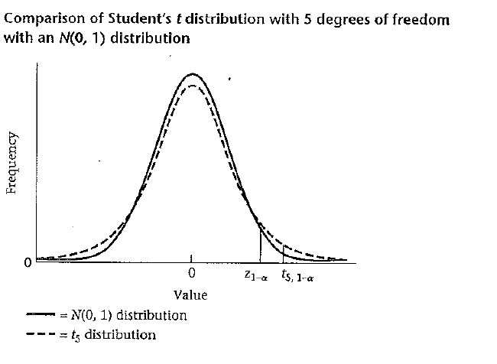
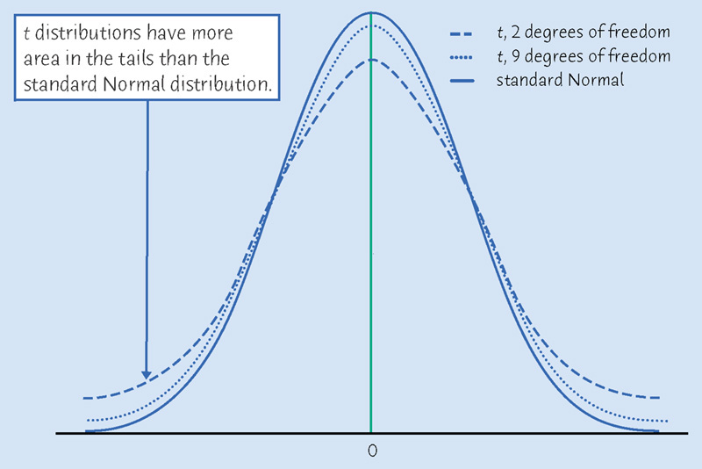
Normal density and t densities

Slide 27
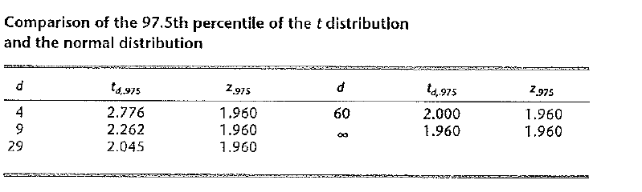
Comparison of normal and t distributions
The bigger degrees of freedom, the closer to the standard normal distribution

Slide 28
100%×(1-α) area
1-α
α/2
α/2
t_{α/2} = -t_{1-α/2}
t_{1-α/2}
Define the critical values t_{1-α/2} and -t_{1-α/2} as follows

Slide 29
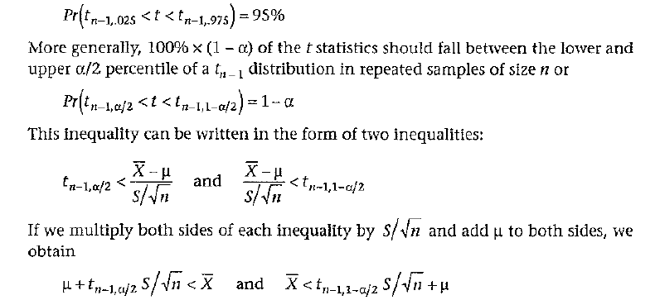
Our goal is get a 95% interval estimation
We start from

Slide 30
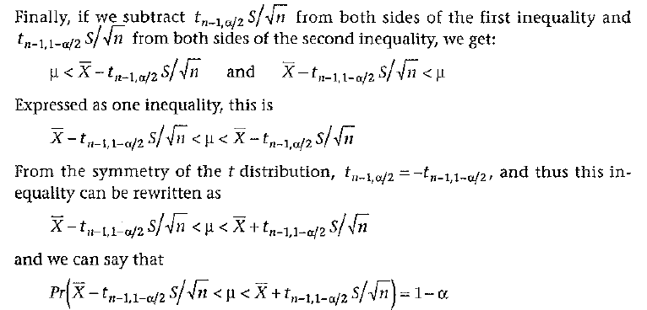
Develop a confidence interval formula

Slide 31
Confidence interval
Confidence Interval for the mean of a normal distribution
A 100%×(1-α) CI for the mean µ of a normal distribution with unknown variance is given by
A shorthand notation for the CI is

Slide 32
Confidence interval (when n is large)
Confidence Interval for the mean of a normal distribution (large sample case)
A 100%×(1-α) CI for the mean µ of a normal distribution with unknown variance is given by
A shorthand notation for the CI is

Slide 33
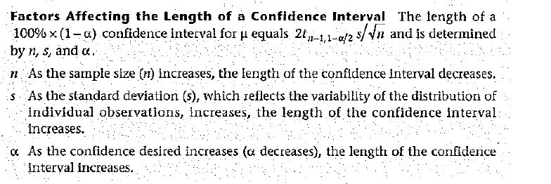
Factors affecting the length of a CI

