Slide 1
This Lecture
Introduction to Biostatistics and Bioinformatics
Estimation II
By Judy Zhong
Assistant Professor
Division of Biostatistics
Department of Population Health
Judy.zhong@nyumc.org

Slide 2
Review
Point estimation, Standard error
Central limit theorem
T-distribution
Confidence interval estimate

Slide 3
Estimating the population proportion
Setting:
X follows binomial distribution Bin(n, p)
Intuition:
Parameter p is unknown population proportion of success
We consider the following sample proportion of success

Slide 4
An example of estimating p
Estimating the prevalence of malignant melanoma in 45- to 54-year-old women in the US. Suppose a random sample of 5000 women is selected from this age group., of whom 28 are found to have the disease
Suppose the prevalence of the disease (population proportion of the disease) in this age group is p. How can p be estimated?

Slide 5
Cancer example continued
Let X be the number of women with the disease among the n women
X can be looked at a binomial random variable with parameters n and p
Recall Chapter 4, we have E(X)=np and Var(X)=npq, where q=1-p

Slide 6
Properties of sample proportion
Sample proportion of the disease among n women:
Its mean:
Thus, the sample proportion is an unbiased estimator for p
Its variance and standard deviation:
Thus, the standard error of the sample proportion is , where can be estimated by , where

Slide 7
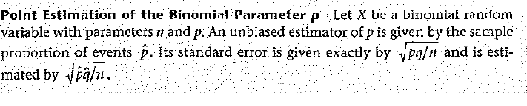
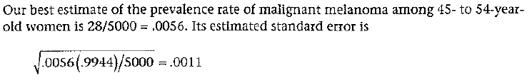
An example of point estimate of p
(Cancer example continued): Estimate the prevalence of malignant melanoma
Solution:

Slide 8
Why sample proportion is best estimator for p
Actually, sample proportion is also sample mean
Actually, population proportion p is also population mean
Recall that the sample mean is minimum variance unbiased estimate of the population mean
Therefore, the sample proportion is also the minimum variance unbiased estimate of the population proportion

Slide 9
Interval estimation for p
We use sample proportion as a point estimate for the population proportion p. We want to go further to construct an interval estimate for p. Let’s see one example first
Suppose we are interested in estimating the prevalence rate of breast cancer among 50- to 54-year-old women whose mothers have had breast cancer.
Suppose that in a random sample of 10,000 such women, 400 are found to have had breast cancer at some point in their lives
We have shown that the best point estimate of the prevalence rate p is given by the sample proportion p_hat=400/10000=0.040. How can an interval estimate of p be obtained?
(Note that in this example, the sample size n=10,000 is large)

Slide 10
Central limit theorem plays an important role
If sample size n is large, use central limit theorem
As discussed earlier, sample proportion is a special case of sample mean
Recall,
We have
that is, sample proportion is approximately normal

Slide 11
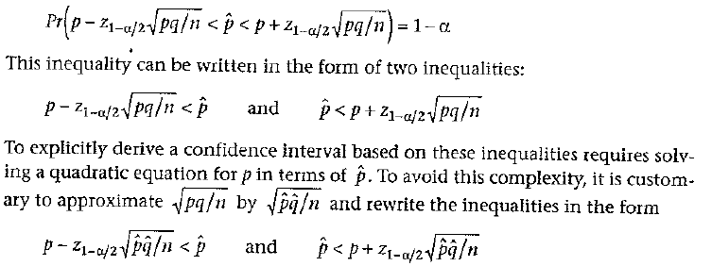
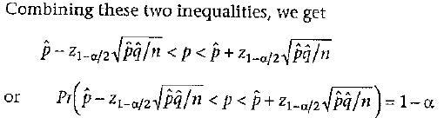
Develop CI formula for p (large sample case)
We start from
Then
Thus

Slide 12
CI for p – Normal theory method
An approximate 100%×(1-α) CI for the binomial parameter p based on the normal approximation is given by

Slide 13
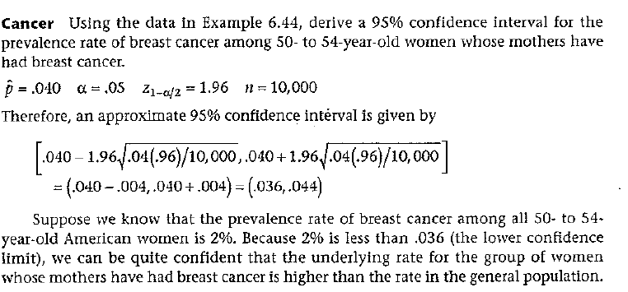
An example of CI for p
Example 6.49 (Cancer example continued)

Slide 14
Summary
Point estimation of population prevalence
Confidence interval estimate

