Slide 1
Exploring Spyder: An IDE for scientific computing
7/9/2015

Slide 2
Outline
Integrated development environment (IDE)
Spyder
Major Components:
IPython Console or Python Console
Editor
Variable Explorer
Object Explorer
File Explorer
Notes:
IPython
Is an enhanced interactive interpreter
is an interactive shell that addresses the limitation of the standard python interpreter, and it is a work-horse for scientific use of python. It provides an interactive prompt to the python interpreter with a greatly improved user-friendliness.
Command history, which can be browsed with the up and down arrows on the keyboard.
Tab auto-completion.
In-line editing of code.
Object introspection, and automatic extract of documentation strings from python objects like classes and functions.
Good interaction with operating system shell.
Support for multiple parallel back-end processes, that can run on computing clusters or cloud services like Amazon EE2.
Spyder is a MATLAB-like IDE
An integrated development environment (IDE) is a software application that provides comprehensive facilities to computer programmers for software development. An IDE normally consists of a source code editor, build automation tools and adebugger. Most modern IDEs have intelligent code completion.
Some IDEs contain a compiler, interpreter, or both, such as NetBeans and Eclipse; others do not, such as SharpDevelop andLazarus.
The boundary between an integrated development environment and other parts of the broader software development environment is not well-defined. Sometimes a version control system, or various tools to simplify the construction of a Graphical User Interface (GUI), are integrated. Many modern IDEs also have a class browser, an object browser, and a class hierarchy diagram, for use in object-oriented software development.
Other IDEs are
Wing IDE
PyCharm
NetBeans Eclipse
for scientific computing with python. It has the many advantages of a traditional IDE environment, for example that everything from code editing, execution and debugging is carried out in a single environment, and work on different calculations can be organized as projects in the IDE environment.

Slide 3
Integrated development environment (IDE)
Software application that provides comprehensive facilities to computer programmers for software development.
Examples:
Spyder
Wing IDE
PyCharm
NetBeans
Eclipse
Visual Studio
Components:
Source code editor
Build Automation
Debugger
Some have :
Interpreter
Compiler
Notes:
Python is an interpreted language, is a programming language for which most of its implementations execute instructions directly, without previously compiling a program into machine-language instructions. The interpreter executes the program directly, translating each statement into a sequence of one or more subroutines already compiled into machine code.

Slide 4
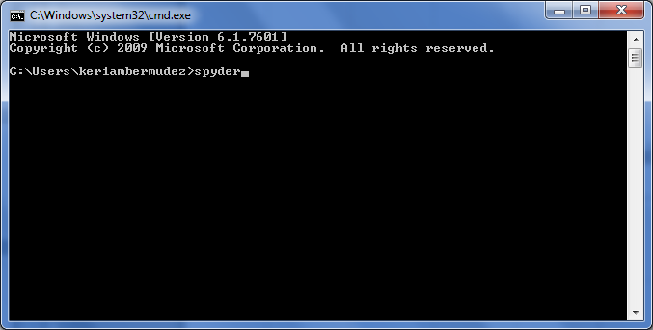
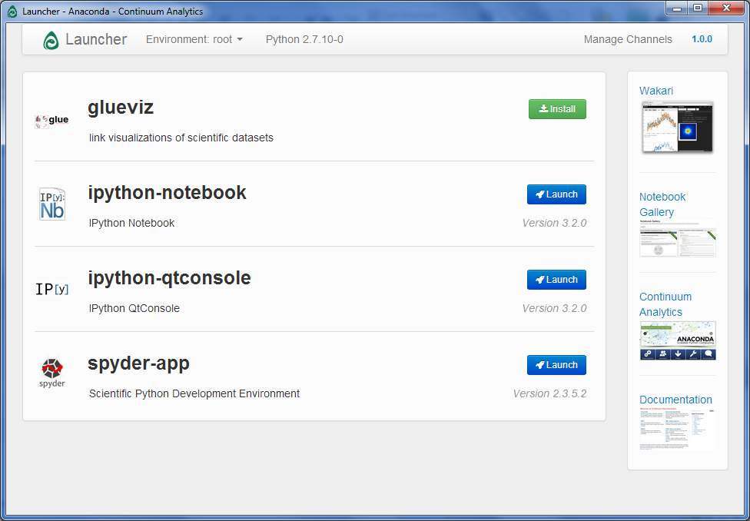
Opening Spyder
Start Menu
Anaconda Launcher
Writing spyder in Bash (Unix shell) or Command Prompt (Windows)
Notes:
Go ahead and open it. While it opens lets explore the components

Slide 5
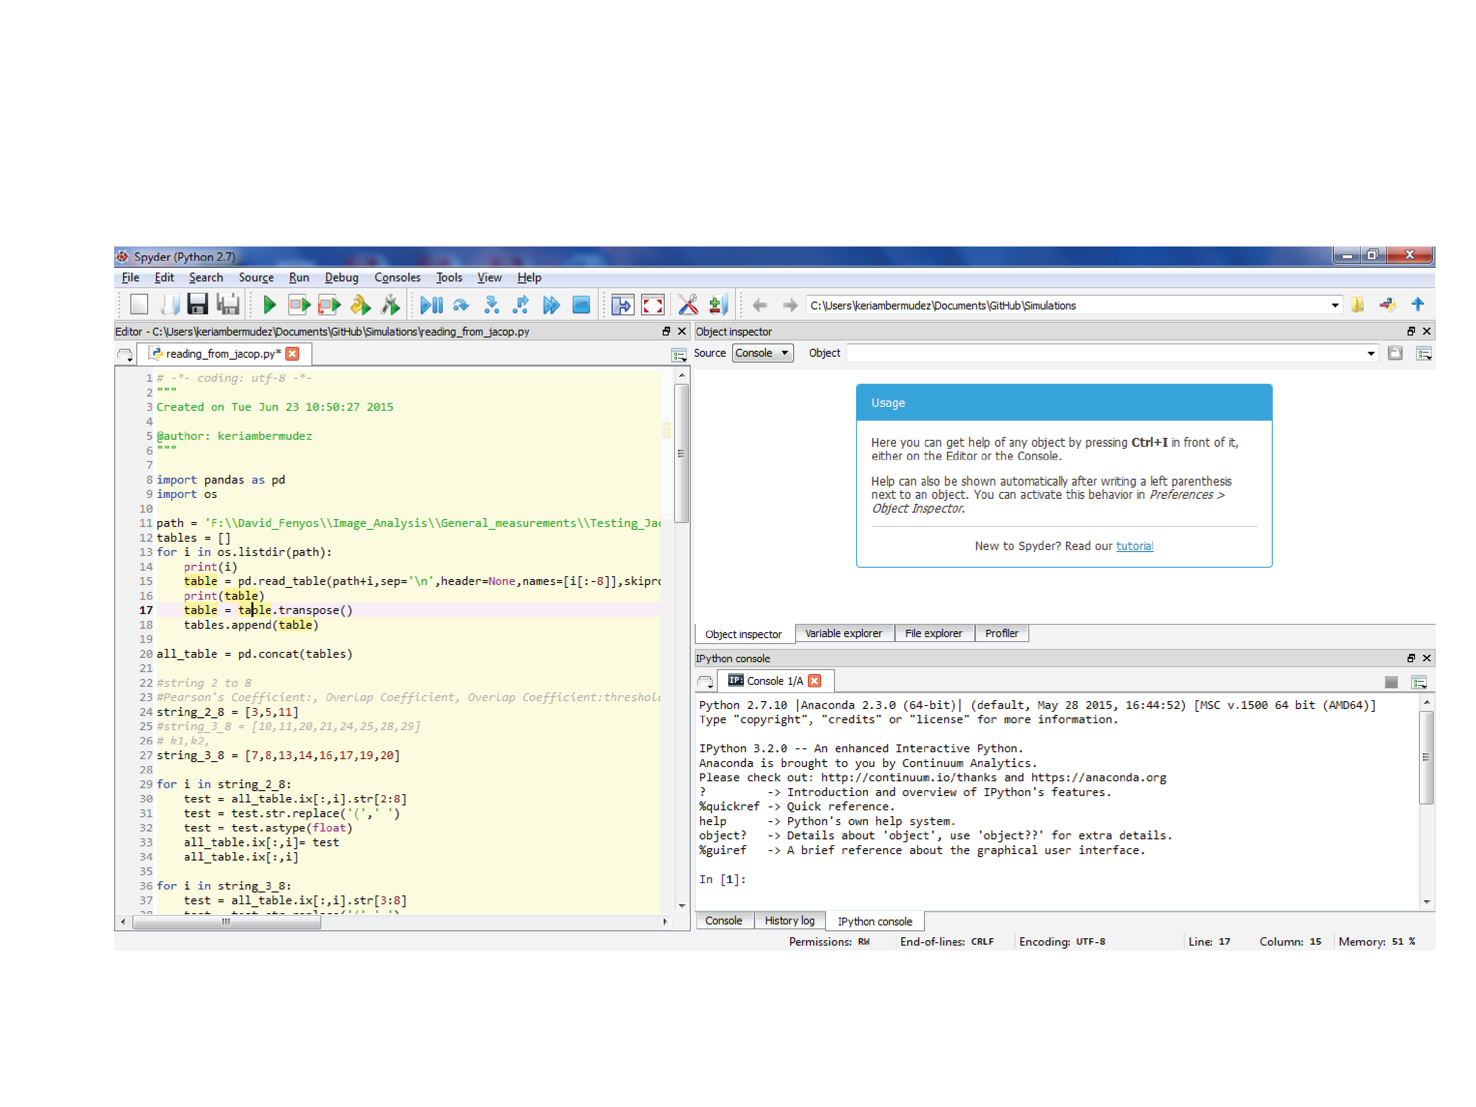
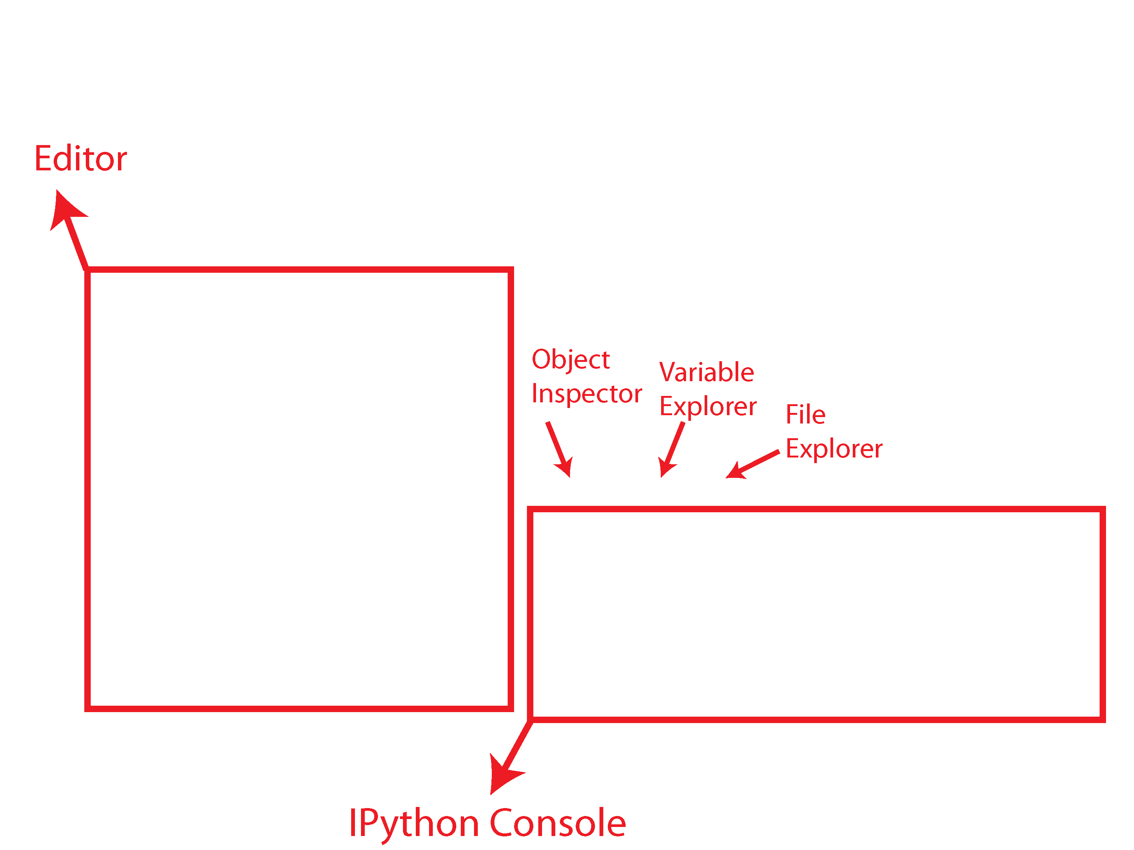
Major Components
Notes:
After opening this is how it looks.
Now I will show you some of the major components of Spyder
The console, which in this case is an Ipyhon console. Briefly, IPythons is an enhanced Python interpreter. Is the same as your Python console but has enhanced functionality. You can work with IPython or open a Python console instead.
You have your editor , which is a text editor with enhanced functionality.
The object explorer which will tell you information about an object. For example if you want to know information about a method.
A variable explorer which will list the variables. It will let you know: the name of the variable, type size,etc
And the file explorer that shows the current directory, you can explore and import files or change the current directory on the top.

Slide 6
IPython
Enhanced python interpreter
To use python console instead of IPython
Go to console tab and Python tab
Go to the menu bar. Consoles< Open a python console
IPython has
Tab completion
Press Up for history
Some useful commands called magic commands (don’t need to add % in front)
%cd to change directory
%pwd current directory
%run to run a python script from here
%reset to delete all variables
%who to find information from variables
You can run any shell command by typing ! in front
to find more info about the commands
https://ipython.org/ipython-doc/dev/interactive/magics.html

Slide 7

Editor
Syntax coloring
Tab completion
To obtain information of method Ctrl+I before parenthesis
Run your script from here F5 or by pressing
Run line or select lines F9
Run cells
#%% (standard cell separator)
# %% (standard cell separator, when file has been edited with Eclipse)
# <codecell> (IPython notebook cell separator)
Run Cell Ctrl + Enter
Run cell and advance Shift + Enter
Find and replace text Ctrl + F

