Slide 1
A Tale about PRO and Monsters
Preslav Nakov, Francisco Guzmán and Stephan Vogel
ACL, Sofia
August 5 2013

Slide 2
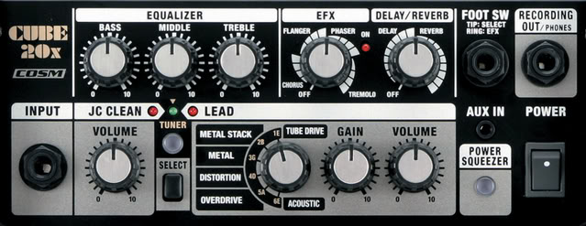

Parameter Optimization
MERT
PRO
rampion
kb
MIRA
Notes:
If we look at MT as a blackbox with many knobs, where we have models, which are regulated by the little knobs, that we call weights or parameters.
Then we use this box to translate some text.
Parameter optimization: evaluate, optimize and generate weights
This has been done traditionally with MERT
More recently, other methods have gained popularity.
But as they are new, they are less well understood.
----- Meeting Notes (8/1/13 16:47) -----
Picture Remove models
simpler

Slide 3
Some Parameter Optimizers for SMT
 | Scales to many parameters? | Fits the typical SMT architecture?
MERT (Och, 2003) | NO | YES: batch
MIRA (Watanabe et al 2007; Chiang et al 2008) | YES | NO: online
PRO (Hopkins & May 2011) | YES | YES: batch
Really?
Simple but effective
Increased stability
Notes:
----- Meeting Notes (8/1/13 16:47) -----
Talk about MIRA
Add years

Slide 4
PRO in a Nutshell
A ranking problem
two translations j and j’
BLEU +1
Model score
According to evaluation score
According to the model
BLEU+1 Score
BLEU+1 Score
j
j
j ’
New weights
j ’
Model Score
Model Score
Notes:
----- Meeting Notes (8/1/13 02:19) -----
Add j j' to graph
Make consistent model score/ evaluation
Find weights or parameters
We want to make the ranking consistent

Slide 5
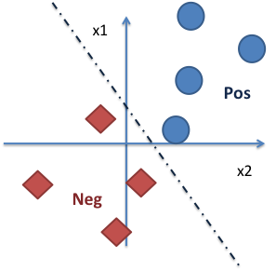
The Original PRO Algorithm
PRO’s steps (1-3 for each sentence separately; 4 – combine all)
Sampling
Randomly sample 5000 pairs (j, j’) from an n-best list
Selection
Choose those whose BLEU+1 diff > 5 BLEU
Acceptance
Accept (at most) the top 50 sentence pairs (with max differences)
Learning
Use the pairs for all sentences to train a ranker
Requires good training examples
Notes:
----- Meeting Notes (8/1/13 02:19) -----
You want to contrast best against worst
----- Meeting Notes (8/1/13 16:31) -----
Extrinsic
----- Meeting Notes (8/1/13 16:47) -----
Maybe no top 50.

Slide 6
A Cautionary Tale

Slide 7
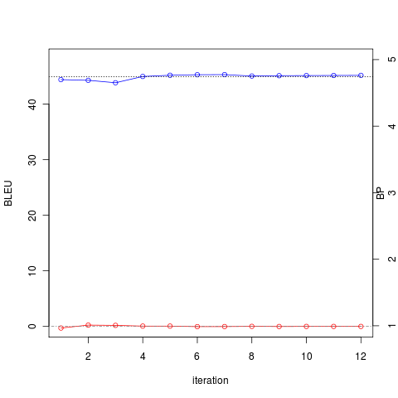
Tuning on Long Sentences …
Tuning BLEU
NIST: Arabic-English
tune on longest 50% of MT06
Length ratio
MERT works just fine.
Notes:
----- Meeting Notes (8/1/13 02:19) -----
Tuning MT06
----- Meeting Notes (8/1/13 16:47) -----
make this

Slide 8
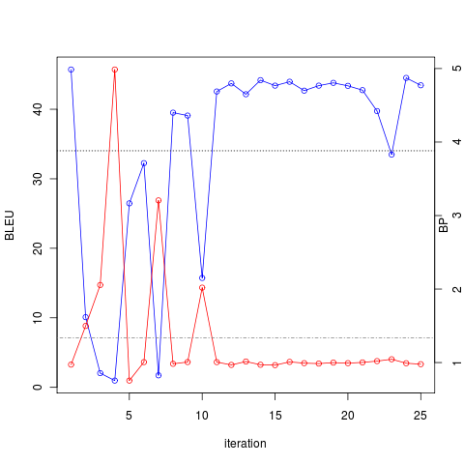
…There is Evidence that…
5x !!!
Tuning BLEU
NIST: Arabic-English
tune on longest 50% of MT06
Monsters also happen
on IWSLT and Spanish-English.
Length ratio
MONSTERS
PRO is unstable.
Notes:
----- Meeting Notes (8/1/13 02:19) -----
Fix yellow thing

Slide 9
…Monsters Exist…
x1
Pos
What?
Bad negative examples
Low BLEU
Too long
Very divergent from positive examples
Not useful for learning
When?
Tuning on longer sentences
Several language pairs
x2
Neg
MONSTERS

Slide 10
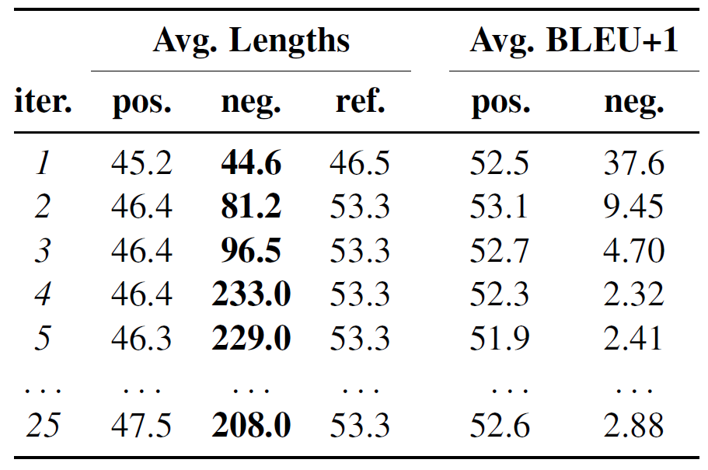
… and Breed…
n-best accumulation ensures monster prevalence across iterations

Slide 11

… to Ruin your Translations…
REF: but we have to close ranks with each other and realize that in unity there is strength while in division there is weakness .
IT1: but we are that we add our ranks to some of us and that we know
that in the strength and weakness in
IT3:, we are the but of the that that the , and , of ranks the the on
the the our the our the some of we can include , and , of to the of we know
the the our in of the of some people , force of the that that the in of the
that that the the weakness Union the the , and
IT4: namely Dr Heba Handossah and Dr Mona been pushed aside because a larger story EU Ambassador to Egypt Ian Burg highlighted 've dragged us backwards and dragged our speaking , never blame your defaulting a December 7th 1941 in Pearl Harbor ) we can include ranks will be joined by all 've dragged us backwards and dragged our $ 3.8 billion in tourism income proceeds Chamber are divided among themselves : some 've dragged us
backwards and dragged our were exaggerated . Al @-@ Hakim namely Dr Heba Handossah and Dr Mona December 7th 1941 in Pearl Harbor ) cases might be known to us December 7th 1941 in Pearl Harbor ) platform depends on combating all liberal policies Track and Field Federation shortened strength as well face several challenges , namely Dr Heba Handossah and Dr Mona platform depends on combating all liberal policies the report forecast that the weak structure
Image:samii69.deviantart.com

Slide 12
…and Only PRO Fears Them…
NIST: Ar-En
test on MT09
tune on longest 50% of MT06
-3BP
*MIRA = batch-MIRA (Cherry & Foster, 2012)
Optimizing for Sentence-Level BLEU+1 Yields Short Translations
(Nakov et al., COLING 2012. )
Notes:
----- Meeting Notes (8/1/13 02:19) -----
Explain longest sentences
Highloght
----- Meeting Notes (8/1/13 02:49) -----
This needs work
----- Meeting Notes (8/1/13 16:34) -----
Hide others
Wrap up in the end.

Slide 13
...but Why?
PRO’s steps
Sampling
Randomly sample 5000 pairs
Selection
Choose those whose BLEU+1 diff > 5 BLEU
Acceptance
Accept the top 50 sentence pairs (with max differences)
Learning
Use the pairs for all sentences to train a ranker
Focuses on large differentials
1: Change selection
2: Accept at random
Selects the TOP differentials
Notes:
----- Meeting Notes (8/1/13 02:19) -----
Fix
Large differentials promote the arrival of monsters

Slide 14

On Slaying Monsters
Selection
Cut-offs
Filter outliers
Stochastic sampling
Acceptance
Random sampling
Image:redbubble.com
Notes:
----- Meeting Notes (8/1/13 02:19) -----
Slaying
----- Meeting Notes (8/1/13 16:47) -----
The template fix

Slide 15
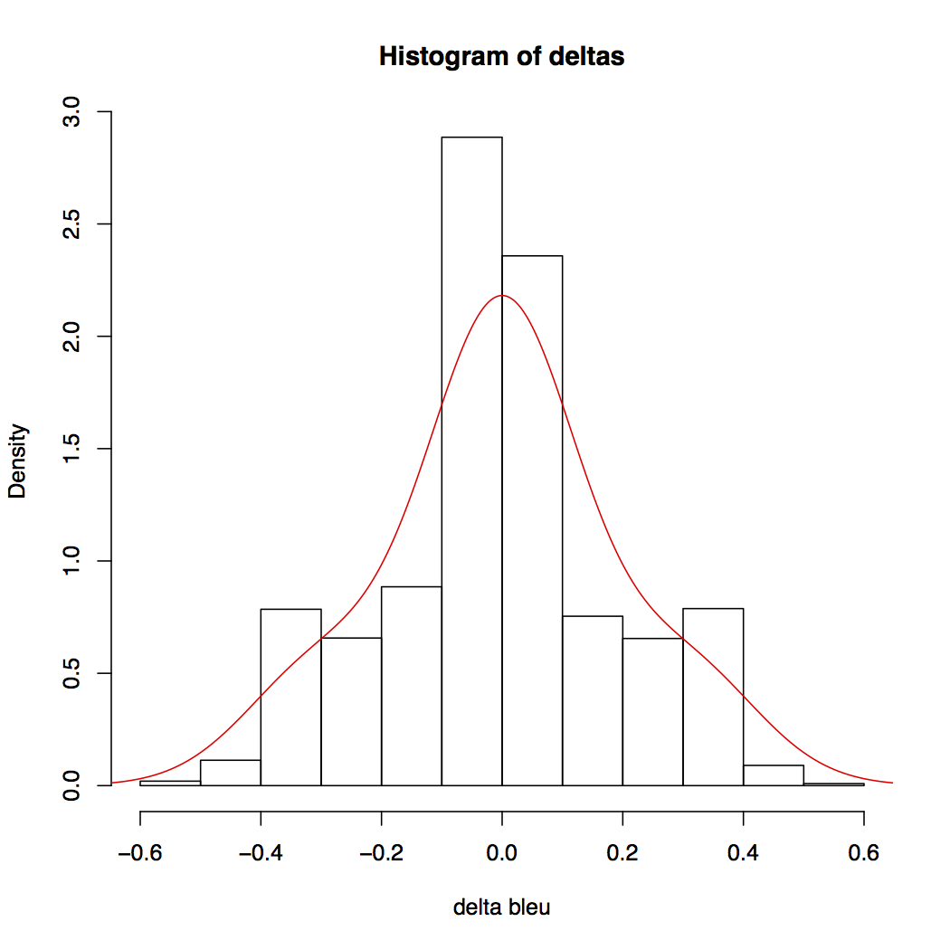
Selection Methods: Cutoffs
BLEU diff
BLEU diff > 5 (default)
BLEU diff < 10
BLEU diff < 20
Length diff
length diff < 10 words
length diff < 20 words
Notes:
----- Meeting Notes (8/1/13 16:32) -----
Need to explain

Slide 16
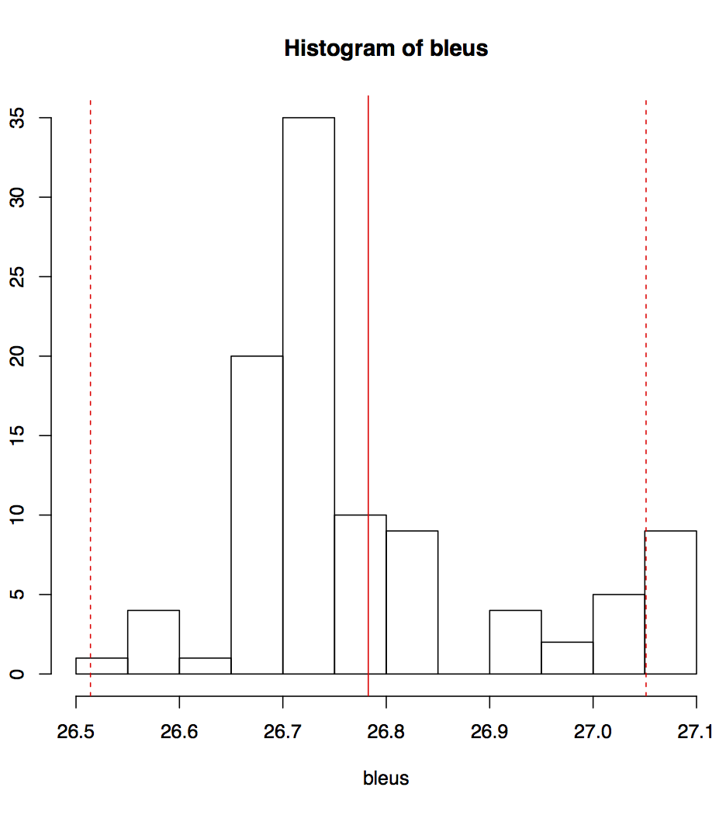
Selection Methods: Outliers
Assume gaussian
Filter outliers that are more than λ times stdev away
λ = 2
λ = 3
outlier
λσ
Outliers

Slide 17

Selection Methods: Stochastic sampling
Generate empirical distribution for (j,j’)
Sample according to it
Select if p_rand <= p(j,j’)
Notes:
Build an empirical distribution, then sample from it

Slide 18
Experimental Setup
NIST Ar-En
TM: NIST 2012 data (no UN)
LM: 5-gram English Gigaword v.5
Tuning: 50% longest MT06
contrast: full MT06
Test: MT09
3 reruns for each experiment!

Slide 19
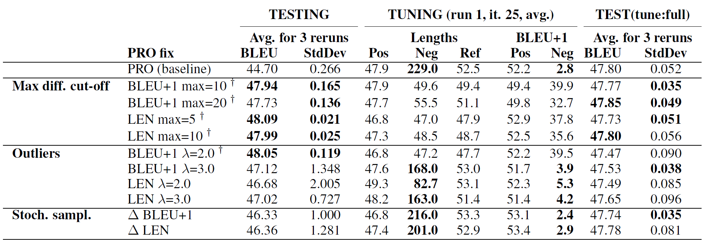
Altering Selection (Tuning on Longest 50% of MT06)
NOTE: We still require at least 5 BLEU+1 points of difference.
Kill monsters

Slide 20
Altering Selection: Testing on Full MT09
NOTE: We still require at least 5 BLEU+1 points of difference.
Tuning on longest 50%
Tuning on all
Kill monsters
Same BLEU,
same or better stability
Outperforms others
Better BLEU,
increased stability
47.72
47.48
Notes:
----- Meeting Notes (8/1/13 16:37) -----
Fix,

Slide 21
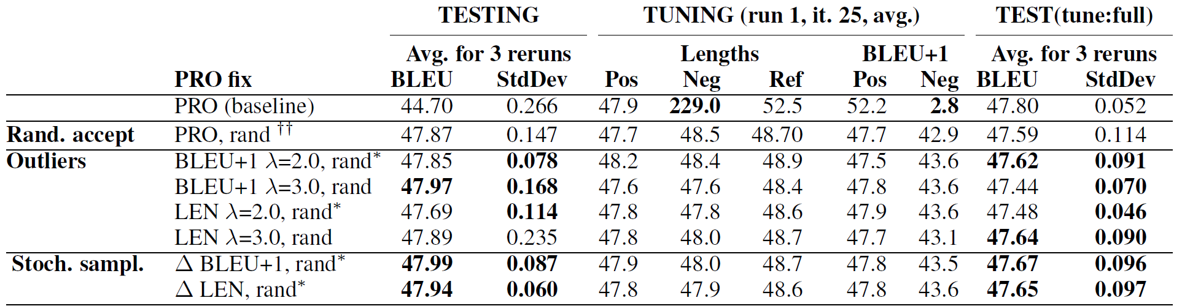
Random Accept (Tuning on Longest 50% of MT06)
NOTE: No minimum BLEU+1 points of difference.
Random accept
kills monsters.

Slide 22
Random Accept: Testing on Full MT09
NOTE: No minimum BLEU+1 points of difference.
Tuning on longest 50%
Tuning on all
worse BLEU,
more unstable
Better BLEU,
increased stability
Outperforms others
47.72
47.48

Slide 23
Summary
Sample based methods
Do not kill monsters
Distributional assumptions
Assume monsters are rare
Random acceptance
Kills monsters
Decreases discriminative power
Lowers test scores on tune:full
Simple cut-offs
Protects against monsters
Do not affect the performance on tune:full
Recommended!
Notes:
----- Meeting Notes (8/1/13 02:19) -----
Monsters are bad training examples that make pro very unstable

Slide 24
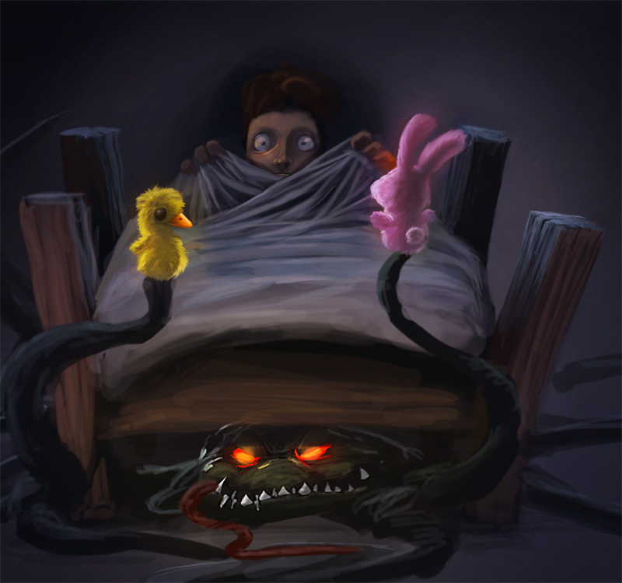
Moral of the Tale
Monsters: examples unsuitable for learning
PRO’s policies to blame:
Selection
Acceptance
Cut-off-slaying monsters gives also:
more stability
better BLEU
If you use PRO you should care!
Would you risk it?
Coming to Moses 1.0 soon!
Notes:
----- Meeting Notes (8/1/13 02:19) -----
Monsters are bad training examples that make pro very unstable

Slide 25
Thank you !
Questions?

