Slide 1
The AMARA Corpus: Building Resources to Translate the Web’s Educational Content
Francisco Guzman, Hassan Sajjad, Stephan Vogel, Ahmed Abdelali
Qatar Computing Research Institute
IWSLT13 - Heidelberg, 6.12.13

Slide 2

Our Mandate
Education
Research
Comm. Devel.
Notes:
We are part of the ALT group in QCRI. So Arabic is at the heart of our work (Research)
But also, one of Qatar Foundation’s main goal is Education, and we feel strongly compelled to
But also, we
We had two motivations.
We are a research institute, in our group

Slide 3
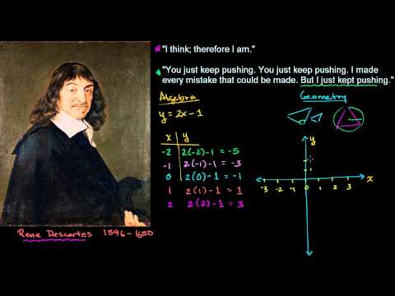

Lecture Translation
TED Talks
Lectures/Education
Notes:
IWSLT vs Education

Slide 4
Massive Online Education
2006 Khan Academy : math, physics, chemistry lectures
2007 ALISON : first MOOC
basic education
workplace skills
2011 Stanford’s AI + Machine Learning courses
Coursera
Udacity
EdX
Thousands of lectures
Notes:
Recently a lot of attention

Slide 5
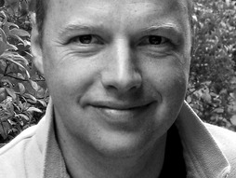
A Recent Boom
“In 50 years, there will be only 10 institutions in the world delivering higher education and Udacity has a shot at being one of them.”
– Sebastian Thrun, Wired Magazine.
March 2012
http://www.wired.com/wiredscience/2012/03/ff_aiclass/3/

Slide 6
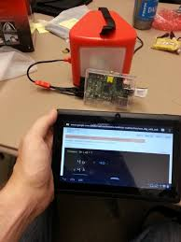
Reaching Marginalized Communities
KA – Pi
Khan Academy on a Raspberry Pi
Small device w/o Internet connection
Create local network
English and Spanish lectures
Remote locations in South America

Slide 7
Limited by Language Barrier
Español
عربية
English
اردو
français

Slide 8
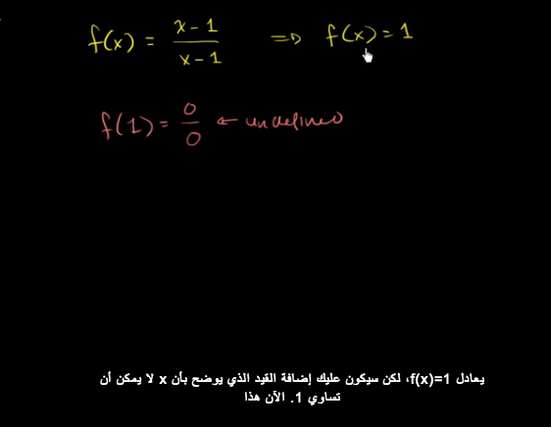
Educational Translation
Allow learning from material in other languages
Educational content within easier reach for non-English speaking students
Source: KhanAcademy

Slide 9
Challenges
Many different topics
E.g. physics, chemistry, finance, computer science, logic, and grammar
Domain-specific challenges
Mathematical equations, chemical formulas, grammar structure representation
Content quality
High quality translation required
Lack of data

Slide 10
Today’s Talk
Harvesting educational resources from a web community of volunteer translators
Questions
Where do we get this data from?
How useful is this data for MT?
What are the characteristics of this data?
How do we share this data?

Slide 11
1 | Where do we get this data from?

Slide 12

The AMARA Platform
Powered by a team of volunteers
Community-driven
Hierarchical structure
Peer-reviewed (Wiki-style)
Continuously updating
Rich in educational content
Khan Academy and Udacity
TED talks
Multilingual
Into more than 109 languages
http://amara.org

Slide 13
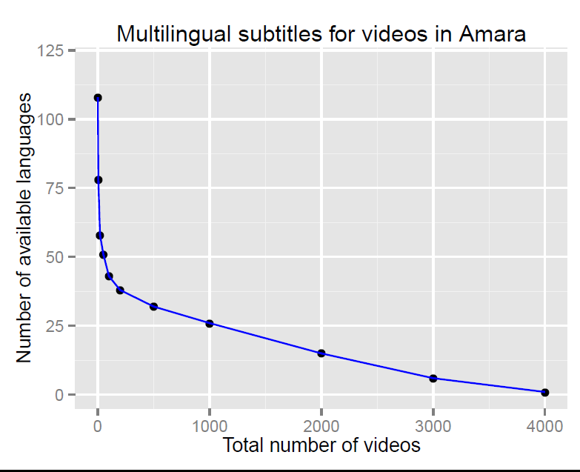
Language Distribution
Few with up to 109 langs
1K into 25 langs
2K into 15 langs
3K into 6 langs
Date: 1 Jul 2013

Slide 14
Focus: English and Arabic
Original Language | Videos in Language | Sub. into Arabic | Sub. into English
English | 135000 | 4463 | 54023
Arabic | 3800 | 494 | 1286
Spanish | 8700 | 33 | 1967
French | 6100 | 38 | 1160
German | 5000 | 11 | 1006
40%
34%
22%
Update: 1 Dec 2013

Slide 15
Crawling and Filtering
Crawling
Data publicly available
Non-intrusive crawler
In collaboration with Amara.org
Total crawled (July 2013):
4338 videos with (Ar-En) subtitles
Filtering
Different organizations (about 45% TED)
Removed TED documents.
After filtering:
2400 videos with ( Ar-En) subtitles

Slide 16
Aligning Segments
ID: 2
00:00:00,710 --> 00:00:03,780
This next optimization problem
that I've been sent seems fun.
ID: 3
00:00:03,780 --> 00:00:07,350
I've actually never seen this
problem before, and so I'm
ID: 4
00:00:07,350 --> 00:00:09,170
even more excited to do it.
ID: 2
00:00:00,710 --> 00:00:03,780
مسألة التحسين التالية هذه التي قد ارسلت إلي تبدو ممتعة
ID: 3
00:00:03,780 --> 00:00:07,350
لم أر هذه المسألة من قبل، ولذلك
ID: 4
00:00:07,350 --> 00:00:09,170
انني متحمس لحلها
75% of all collected segments are already aligned

Slide 17
Unaligned Segments
Different IDs
Different start times
Different end times
Incomplete data
How do we align the segments?

Slide 18
Different Strategies
Strict synchronization
Reject non synchronized segments
Automatic sentence alignment
Hunalign (Varga et al.)
Subtitle synchronization
Opus toolkit (Tiedemann)
Cascaded synchronization
Perform strict synchronization
Obtain parallel alignment + dictionary
Automatic sentence alignment on non-synchronized

Slide 19
Synchronization Results
 | Pairs (K) | Tokens (M) | Types (K)
Strict Sync | 306 | 2.9 | 55.2
Hunalign | 223 | 3.9 | 58.2
Uplug (Cog+Dict) | 221 | 3.9 | 58.2
Cascaded | 382 | 3.6 | 58.2
Comparison to TED (train 2011)
IWSLT11 | 93 | 1.8 | 43.1

Slide 20
2 | How useful is the data for MT?

Slide 21
Experimental Setup
Train
Train TED
IWSLT Train2011 (90.5K)
Train AMARA
Train set (370K)
Tune TED
IWSLT Dev2010 (934)
PRO
Arabic to English
Standard Moses system
Test
Test Sets
IWSLT tst2010 (1.6K)
AMARA13 (3.6K)
Full system description on the paper

Slide 22
How to Use the AMARA Data?
Translation model
Individual
Concatenation
Translation Model Combination
Language model
Individual
Concatenation
Interpolation

Slide 23
Test Perplexity
LM Perprl and oov
 | AMARA 13 |  | IWSLT10
 | Perpl | OOV | Perpl | OOV
AMARA | 107.5 | 1.3 | 116.7 | 1.6
IWSLT | 204.5 | 2.6 | 107.7 | 1.5

Slide 24
Translation Model Results
System | TM | IWSLT10 BLEU | OOV | AMARA13 BLEU | OOV
B1 | IWSLT | 22.97 | 1.9 | 23.26 | 3.9
TM1 | AMARA | 22.40 | 2.4 | 23.66 | 1.7
TM2 | IWSLT+AMARA | 23.41 | 1.2 | 27.63 | 1.8
TM3 | PT(IWSLT,AMARA) | 23.57 | 1.2 | 27.65 | 1.8
LM built on the target side of the IWSLT training data

Slide 25
Language Model Results
System | LM | IWSLT10 BLEU | AMARA13 BLEU
B1 | IWSLT | 22.97 | 23.26
LM1 | AMARA | 22.83 | 24.05
LM2 | IWSLT+AMARA | 23.69 | 25.90
LM3 | Interp(IWSLT,AMARA) | 23.59 | 25.62
LM4 | GW | 24.24 | 24.79
Translation model is build on the parallel IWSLT training data

Slide 26
Combined Usage
System | TM | LM | IWSLT10 BLEU | AMARA13 BLEU
B1 | IWSLT | IWSLT | 22.97 | 23.26
S1 | PT(IWSLT,AMARA) | Interp(IWSLT,AMARA) | 22.83 | 24.05
S2 | IWSLT+AMARA | IWSLT+AMARA | 23.69 | 25.90

Slide 27
Summary
AMARA → High-quality data for machine translation
AMARA and TED share similar style
Reduced OOV and increased translation quality
Notes:
----- Meeting Notes (12/6/13 02:35) -----
remove

Slide 28
3 | What are its characteristics ?

Slide 29
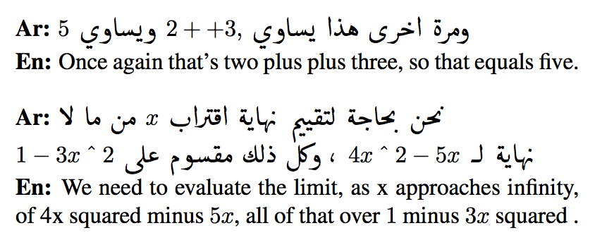
What’s Unique about AMARA
Mathematical quantifiers, numbers and equations

Slide 30
4 | How do we share this data?

Slide 31
One Remaining Problem: Sharing
Not a single source, i.e. different licenses
Not clear if volunteer translations/transcriptions qualifies as derivative work
No clear answer yet
Suggestions are welcome

Slide 32
Conclusion and Future Work
Online educational content requires attention
The AMARA platform provides high quality data for machine translation
Future work:
Prepare multilingual AMARA corpus
Explore the social content of the AMARA platform

Slide 33
ُشكرا
Thank you
The AMARA Corpus: Building Resources to Translate the Web’s Educational Content
Francisco Guzman, Hassan Sajjad, Stephan Vogel, Ahmed Abdelali
Qatar Computing Research Institute
questions?: fguzman@qf.org.qa
IWSLT13 - Heidelberg, 6.12.13

Slide 34


Data: Translation of Educational Content
11K
Partners/Providers
English educational videos
20
languages
Portuguese
English
French
Greek
Spanish
Arabic
Thai
Chinese
Hindi
(QCRI-Amara corpus to be released)

Slide 35
Stats
11K
English educational videos
2.7M TED
(En) IWSLT
100K
1M
13M
Thai words
Arabic words
English words

Slide 36
Parallel segments
157K
120K
17K
English Spanish
English Arabic
Arabic
Hindi
155K TED
(Ar-En) IWSLT

