Slide 1
Preparing your summer internship
Hot Summer/Cool Research Program
V2.0
Francisco Guzman
16- Apr-2015

Slide 2

Our Mandate
Education
Research
Comm. Devel.
?
Mentor Local Students
Notes:
We are part of the ALT group in QCRI. So Arabic is at the heart of our work (Research)
But also, one of Qatar Foundation’s main goal is Education, and we feel strongly compelled to
But also, we
We had two motivations.
We are a research institute, in our group

Slide 3
Hot Summer -Cool Research!
ALT Started it in 2012

Slide 4
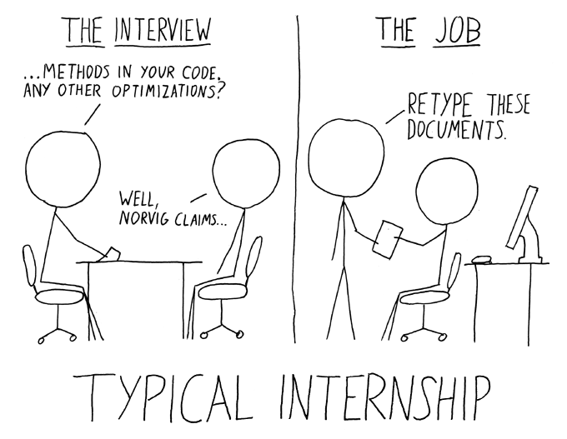
So, you’re getting an intern…
zoitz.com

Slide 5
The Hot Summer/Cool Research program
Intern
Scientist
Gives
Time
Labor
What they get:
Learn a new skill
Practice previous skills
Learn about research
Gives
Time
Planning
Coaching
What you get:
Learn coaching skills
Get some work done
Spread the research spirit

Slide 6
Different levels of development
Them:
You’ll be:
1- Lack of experience, low competence, insecure
2- Some competence, ready to be developed, willing or motivated
3-Increasing competence, potentially able, not fully confident
4- High competence, high commitment, able, willing and motivated
Summer Interns
Directing
Coaching
PhD Students
Supporting
Delegating
Post-Docs

Slide 7
The typical student
May/May not have coding experience
CMU-CS students start coding in yr1 (Python)
Coding restricted to few class projects
Tip: Look for hackathon participation
May/May not have design experience
CMU-IS come stronger in this field (Web)
May/May not have research experience
Only few have read a scientific paper
Even fewer have technical writing skills
Adjust your expectations
Design your plan accordingly

Slide 8
Being HSCR a coach involves…
Planning
Breaking the the goals into bite-sized tasks
Monitoring/Mentoring
Looking out for roadblocks
Helping them to figure out solutions

Slide 9
Planning
What is the goal of the project?
Which questions are going to be solved?
What needs to be done?
Who is going to do it?
When does this need to happen?
How do we know we reached the goal?

Slide 10
8-week program
Week | Sample task
Week 1 | Read and understand Current code . Investigate how it works. Propose architecture for multiplex.
Week 2 | Implement lightweight clients. Design proxy/handshaker
Week 3 | Multi plex client. Multiplex server
Week 4 | Integration with Session management.
Week 5 | Connect multiple clients + stress test. Run language classifier
Week 6 | Implement language classifier on test.
Week 7 | Implement training for language classifier on the fly
Week 8 | Finish Report. Peer Review colleagues reports. Prepare documentation. Prepare final presentation/poster.
Preparation/Warm up
Most of the work
Wrap up
Tip: Ask the students to write a small report each week. This makes it easier to write a final report

Slide 11
Focus
Things work best if you have a final goal in mind
A final report
A poster for ARC is a good goal
A workshop paper
A small demo app
But be realistic!
You only have 8 weeks
Students won’t stick around after the internship
Once school starts, it’s game over!

Slide 12
Monitoring/Mentoring
Daily/Every-other-day quick round of advances
-any complication/problem?
Every week reality check
-are we in track?
Midterm evaluation
-report about the intern performance.
Final evaluation
-report about performance, final presentation

Slide 13
Ideally students should be:
Involved in creative/discovery process.
Encouraged them to solve their own problems
What is the problem?
What are alternatives?
What are pro’s and con’s?
What do they think is the right path?
Own the task/project
Leave legacy, make something useful

Slide 14
Weekly Digest
I recommend to ask the students to produce:
A small report (one page)
A small presentation (one slide)
This makes it easier to detect roadblocks/adjust planning

Slide 15
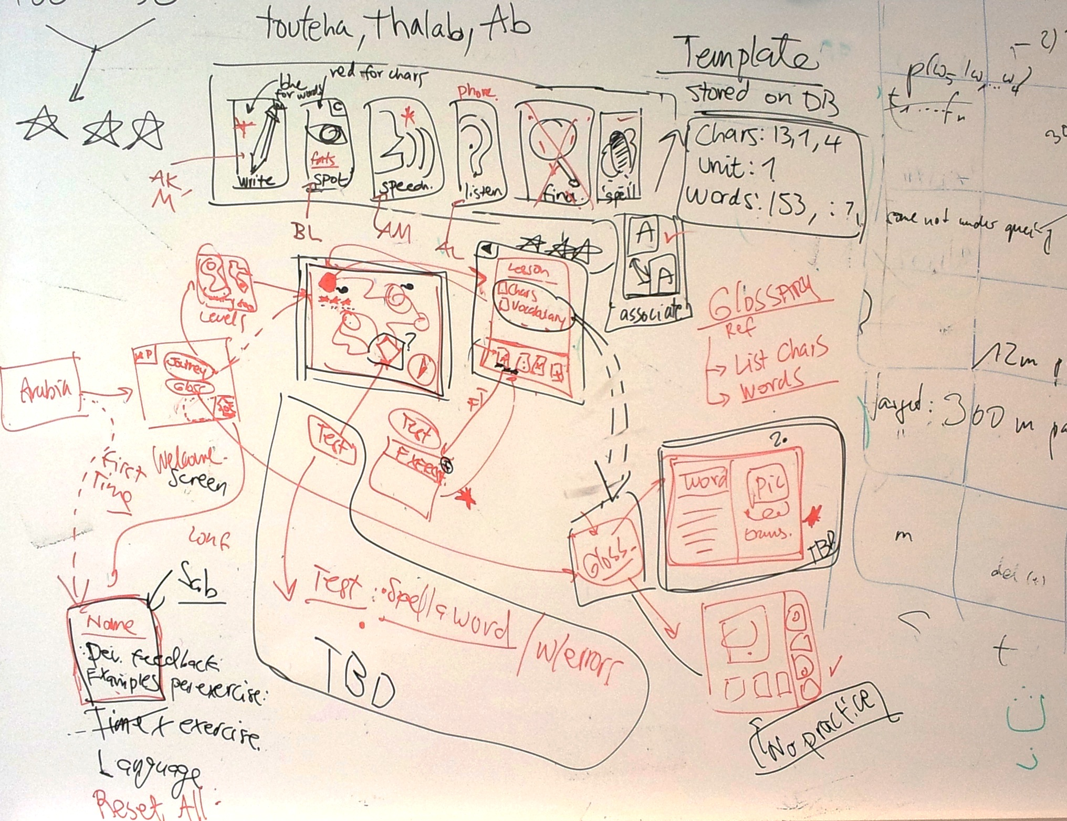
The Process
Things don’t always work as planned
Be flexible!

Slide 16
Dos and Don’ts
Do
Don't
Be selective
We want to have the best students
Plan ahead
Set goals for every week
Be flexible
Encourage team spirit
Set up your project for a group of two or more students
Have interns sit together
Meet regularly with students
Allow students to part-time
Students should be 100% committed to HSCR internship
Allow students to work from home
Hinders team spirit
Micromanage/Be a control freak
Let them come up with their own solutions
Leave students unattended for more than thee days
They get lost easily
If you need to leave, someone needs to cover

Slide 17
Tools – What we use
Skype for communication
Dropbox for sharing documents
Github for archiving files and revision control
Trello for lightweight task management
However
There is no substitute for face-to-face time, and a good ‘ol whiteboard

Slide 18
Thanks
Good luck in you internship projects

