Slide 1
◈ SATELLDEX
SCAN ACTIVE
● LIVE · satelldex.com
SOLANA · MAINNET
FRONTIER HACKATHON 2026
See what the
SATELLDEX // TEST OS · v1.1
blockchain
Test [Version 1.1] (c) Satellbyte Labs 2026. test_OS> run whojeet() Uploading rpc connections ... Loading hodlers ... #### Bots deployed: X #### #### Users found: X #### #### Agents test_OS> scan_ready
is doing.
On-chain holder intelligence for any Solana token. The distributions retail never gets to see.
// PROJECT
// CATEGORY
SatellDex
Consumer · DePIN
// FOUNDER
// LIVE AT
Solo · since 2024
satelldex.com
// 01 / 10 · COVER
HOLDER INTELLIGENCE FOR SOLANA

Slide 2
◈ SATELLDEX
SCAN ACTIVE
● LIVE
// 01 — THE PROBLEM
Every Solana cycle plays out the same way.
T+0
T+1d
T+14d
T+30d
A new token pumps.
"Holders look organic."
Sub-$100 wallets bleed.
Deployer dumps 60%.
Thousands of wallets pile in within minutes. The chart prints green. Twitter wakes up.
Someone posts a screenshot. Nobody verifies. Historical holder data is paywalled.
The candle drips. Plankton exit silently. Nothing on DexScreener shows it.
Retail watches the candle fall. They never knew they could have seen it coming.
The signal was on-chain the whole time — in the holders, not the price. We built the panel that reads it.
// 02 / 10 · HOOK
THE PATTERN REPEATS

Slide 3
◈ SATELLDEX
SCAN ACTIVE
● LIVE
// 02 — THE LANDSCAPE
Three tools. All fail retail.
// CATEGORY 01
// CATEGORY 02
// CATEGORY 03
DexScreener Birdeye
Helius Dune
GMGN Nansen
Price · liquidity · volume. Zero context on who holds the token. A whale can drain the pool and you only see it when the candle collapsed.
They have the data. Historical time-series locked behind $4–10k/month enterprise plans. Unreachable for retail.
Influencer wallets only. Blind to the rest of the cap-table. The loud 1% is tracked — the other 99% never enters the dashboard.
// THE GAP
// THE GAP
// THE GAP
A concentrated token looks the same as an organic one.
Built for funds. Retail gets a price chart.
A whale lens isn't a holder lens.
Result: retail invests blind. 80% of supply can sit in five coordinated wallets — undetectable until the rug.
// 03 / 10 · LANDSCAPE
PRICE-ONLY · GATED · INFLUENCER-CENTRIC

Slide 4
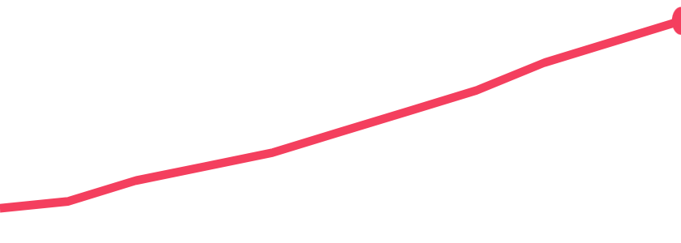
◈ SATELLDEX
SCAN ACTIVE
● LIVE
// 03 — WHAT WE SHOW
Three layers of intelligence.
Price tells you what happened. Holders tell you what's coming. Two metrics nobody else publishes for free.
01
02
03
3 LIVE DISTRIBUTIONS
7 MARINE TIERS
EXITED HOLDERS
Computed daily with deltas at 1D · 7D · 14D · 30D · 60D: ▸ Liquidity — pool + top clusters ▸ USD value — 7 brackets, +$50k → <$100 ▸ Raw amount — 8 log brackets
Wallets bucketed by USD held, with names everyone reads at a glance. Whales-only is a coordinated trade. Whales + dolphins + shrimp is a real community.
Wallets with the ATA alive but balance at zero. The cleanest signal of a token bleeding its base. No price chart shows it.
Pool
Top 1-10
+1,283
Top 11-20
Top 21-50
🐋
🦈
🐬
🐟
🦀
🦐
🦠
Top 51-100
Others
WHALE
SHARK
DOLPHIN
FISH
CRAB
SHRIMP
PLNKTN
// 30D
// 04 / 10 · PRODUCT
3 DISTRIBUTIONS · 7 TIERS · EXIT SIGNAL

Slide 5
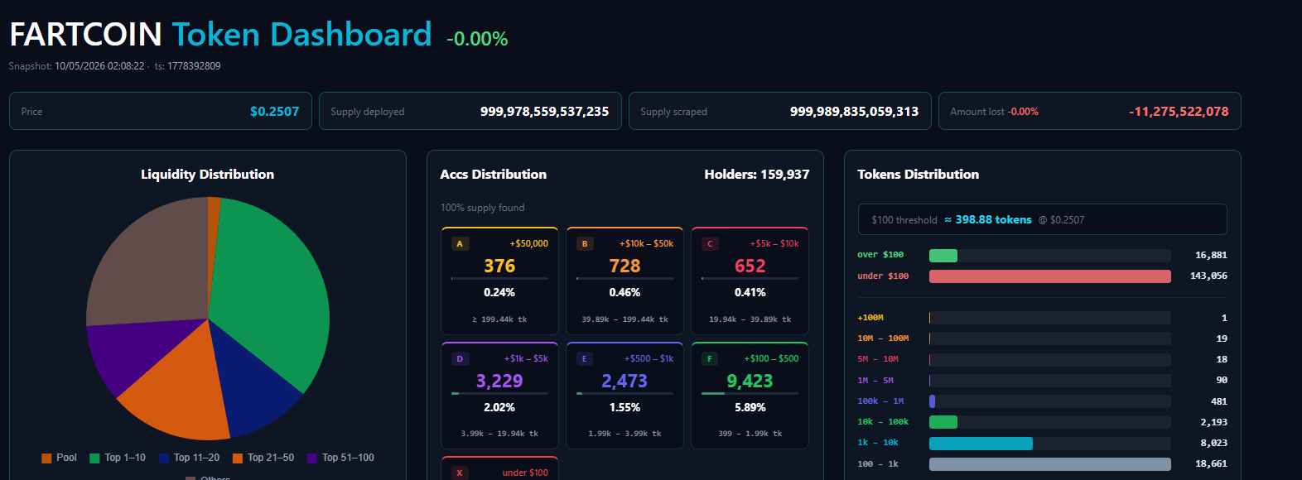
◈ SATELLDEX
SCAN ACTIVE
● LIVE
// 04 — IT'S BUILT · IT'S LIVE
One token, the full picture.
// HEADER
KPIs in one row
Price · supply deployed · scraped · amount lost. Snapshot timestamp + run ID — auditable.
// THREE PIES
Liquidity · Accs · Tokens
Liquidity by cluster · USD brackets A→X (whale → plankton) · raw token brackets +100M → <1k.
// HISTORY
114 snapshots, normalized
Every metric over time. Row-level growth table with [+N] / [−N] deltas per snapshot.
// POOLS + HOLDERS
Main pool · top 100 · all
LAP auto-detected. Top pools ranked by USD across Raydium / Orca / Meteora. Holders with Top 100 / +$100 / All toggles.
// 05 / 10 · LIVE
ACTUAL SCREEN · satelldex.com

Slide 6
◈ SATELLDEX
SCAN ACTIVE
● LIVE
// 05 — SOLANA-NATIVE
Every action, signed.
01
No email. No password.
// SIGNED REQUEST · X-WALLET-*
VERIFIED
Vote a token? Sign. Pay your sub? Sign. ed25519 via wallet-adapter, verified server-side with PyNaCl.
// CANONICAL MESSAGE
02
On-chain payments, validated.
satelldex:POST:/api/payment:1747001432918:a3f1c9e8d72b…d7c
USDC SPL or native SOL . Backend re-parses the tx, verifies the destination ATA owner, checks the amount with 5% drift tolerance. No Stripe.
Pubkey
7Cyq4t…F6Xs
Action
payment
03
Per-request signature.
Signature
7Yz4Q9j8…ed25519
Anti-replay
60s · OK
Each call signs its own canonical message. 60s anti-replay. 10 sigs/min rate limit. Every valid signature logged for audit.
Rate
3 / 10 in last 60s
04
KOL referrals on-chain.
Each KOL gets a slug. ?ref=<slug> overrides the price and links subs to the referrer — verifiable from chain state.
// STACK
Next.js 16
Flask + MySQL 8
Express scraper
Helius
DexScreener
Raydium · Meteora
3 services · 5 sources
front
truth
cron
RPC
pools
liquidity
// 06 / 10 · SOLANA-NATIVE
ED25519 · ON-CHAIN PAYMENTS · NO COOKIES

Slide 7
◈ SATELLDEX
SCAN ACTIVE
● LIVE
// 06 — WHY NOW
Three conditions, finally aligned.
01
02
03
Solana DEX at ATH 2025-26.
Wallet UX is finally usable.
Post-rug retail wants the data.
More new tokens, more rugs, more affected communities. 5-source aggregation is feasible at consumer pricing for the first time.
Three years ago, signing was a friction wall. With Phantom or Solflare, it's one tap . Mobile Wallet Adapter closed the mobile gap.
The people who lost in 2024-25 stopped believing "trust me bro." Cold-traffic users pay $25/month before any paid acquisition.
// 07 / 10 · WHY NOW
ATH · ONE-TAP SIGN · POST-RUG DEMAND

Slide 8
◈ SATELLDEX
SCAN ACTIVE
● LIVE
// 07 — TRACTION
Live in production. Real data. Real subs.
// TOKENS TRACKED
// SNAPSHOTS
// HOLDER ROWS
// PAYING SUBS
19 live
1,797
82M + rows
$25 /mo
Canonical via Targets table. Memes · AI · infra. Hourly cron.
Backfilled history. Every metric over time, downsampled for charts.
In MySQL 8 with proper indexes. Batch 1000 holders / POST.
First subs from cold traffic , before any paid acquisition.
ntokens 19
·
nsnapshots 1,797
·
nwallets 763.5K
·
npools 33.7K
·
tracking days 62
·
migrations 5
3 microservices in production · Docker behind Nginx + TLS · own VPS. Subscription flow live. KOL referral layer shipped. No VC. No grant.
// 08 / 10 · TRACTION
SHIPPED · INDEXED · PAID

Slide 9
◈ SATELLDEX
SCAN ACTIVE
● LIVE
// 08 — BUSINESS MODEL
Free to explore. VIP to see everything.
// FREE
// ALPHA · LIMITED SEATS
Demo Free
// HACKATHON Full VIP — every token panel + global view — unlocked for judges at /hackathonview · /globalhackathon
$0 /mo
// WALLET SIGN ONLY · NO SIGNUP
Demo VIP
✓
Price, supply, amount lost
$25 /mo
✓
Liquidity distribution — pool · top · others
// USDC SPL · NATIVE SOL · ON-CHAIN VALIDATED
✓
Accounts distribution A-X (USD value)
✓
Everything in Free
✓
1 demo token · top 50 holders
✓
Any tracked token, no limit
✓
Global free view — read-only
✓
Main pool + top-ranked pools table
✓
3 historical charts · 60D deltas
✓
Full holders — top 100 / +$100 / all
✓
Cross-token global view (memes · ai · infra)
// SECONDARY REVENUE
KOL referrals. Each KOL gets a slug (?ref=name) + price overrides — subs link back to the referrer. Future: recurring · NFT receipts · token-gated VIP.
// 09 / 10 · BUSINESS
FREEMIUM · ON-CHAIN PAY · KOL REFS

Slide 10
◈ SATELLDEX
SCAN ACTIVE
● LIVE
// 09 — THE BET
Give Solana retail the same tools funds and whales have today.
// CONTACT
Project
SatellDex
Live
satelldex.com
On-chain. Auditable. Without the enterprise plan that today locks them out.
Submission
Colosseum · Solana
Frontier Hackathon 2026
Built solo · no VC · no grant. If users pay the sub, the project lives. No synthetic runway. No board pushing the wrong tradeoff. That's honest, and that's the bet.
Track
Consumer · DePIN
Status
● Shipped · daily
// 10 / 10 · END
◈ SCAN COMPLETE

