Slide 1





İstanbul University
Faculty of Economics
Management Information Systems
JUNE 2026
AI-Based KPI Audit Framework for Promotion Fairness in Human Resources
Presented by:
Supervisor:
İrem YILDIZ
0515220009
Assistant Professor Dr. Waqar BADSHAH
Graduation Project, 2026

Slide 2

Research Problem
Historical HR Decisions
Promotion decisions may not always be fully aligned with measurable employee performance.
Historical HR decisions can include subjective or non-measurable factors.
AI models trained only on past promotion outcomes may reproduce existing bias.
Therefore, AI should be used not only for prediction, but also for auditing fairness and consistency.
Bias / Subjectivity Risk
AI-Based KPI Audit

Slide 3
Aim of the Study
This study aims to develop an AI-based KPI audit framework to evaluate promotion fairness in Human Resources.
Employee KPI Data
AI-Based
Audit Model
Promotion Fairness
Review
Compare KPI-based readiness with historical promotion outcomes
Identify alignment and mismatch cases
Support transparent, evidence-based HR review

Slide 4
Raw Employee Data
Methodology
Strategic KPI Construction
The study follows a KPI-based machine learning audit process.
Employee variables were grouped into four KPI dimensions.
A Random Forest model was trained on KPI-consistent standards.
Predictions were compared with real promotion outcomes.
Results were interpreted through audit categories and SHAP.
Random Forest Model
Real HR Audit Comparison
Audit Categories & SHAP Interpretation

Slide 5
Strategic KPI Construction
Performance KPI
Performance score
Projects handled
Training hours
Efficiency KPI
Work hours
Overtime hours
Attendance score
Commitment KPI
Satisfaction
Years at company
Remote work frequency
Profile KPI
Education level
Age
Resignation status

Slide 6
Audit Framework
Model predictions were compared with actual promotion outcomes to identify three audit categories.
Actual Promotion Outcome
Correct Recognition: KPI-based prediction and actual promotion decision are aligned.
Hidden Talent / Overlooked Employee: the model predicts promotion readiness, but the employee was not promoted.
KPI-Based Model Prediction
Undeserved / Low Merit Promotion: the employee was promoted, but the model does not predict promotion readiness.
Audit Category
Mismatch cases are treated as review signals, not direct proof of unfairness.

Slide 7
Comparison of Audit Results Across Datasets
The KPI-based model showed stronger alignment under KPI-consistent conditions, while mismatch cases became more visible in the real HR dataset.
In the synthetic KPI datasets, most cases fall under Correct Recognition.
In the real HR dataset, Hidden Talent and Low Merit Promotion cases become more visible.
This suggests a measurable gap between KPI-based promotion readiness and historical promotion outcomes.
The model is used as an audit benchmark, not as a final promotion decision-maker.

Slide 8
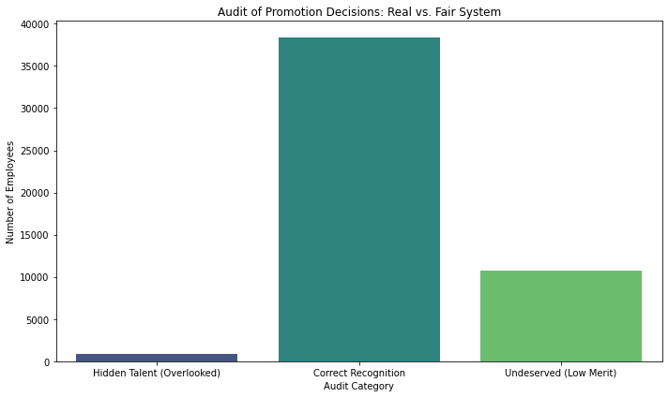
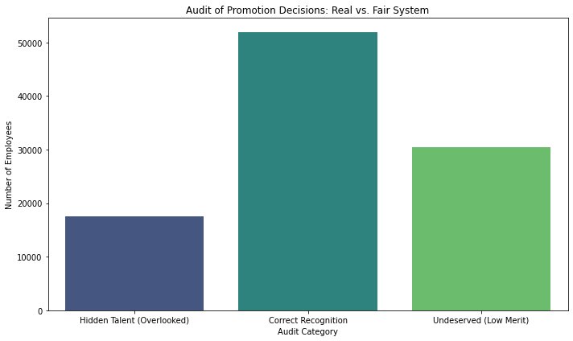
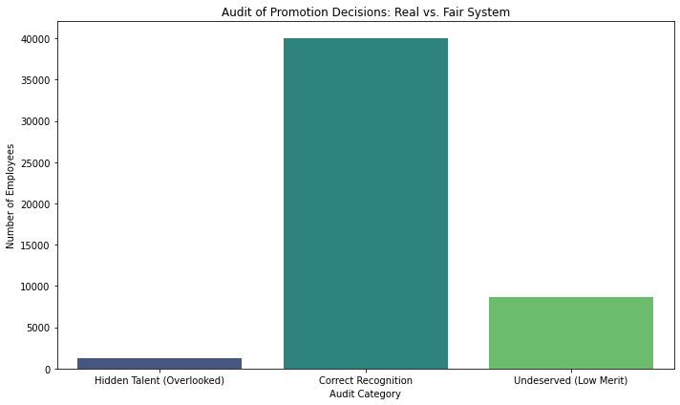
Comparison of Audit Results Across Datasets
Synthetic KPI Dataset 1
Accuracy: 0.77
Mismatch categories indicate cases for further HR review, not direct proof of unfairness.
Real HR Dataset
Accuracy: 0.52
Synthetic KPI Dataset 2
Accuracy: 0.80

Slide 9
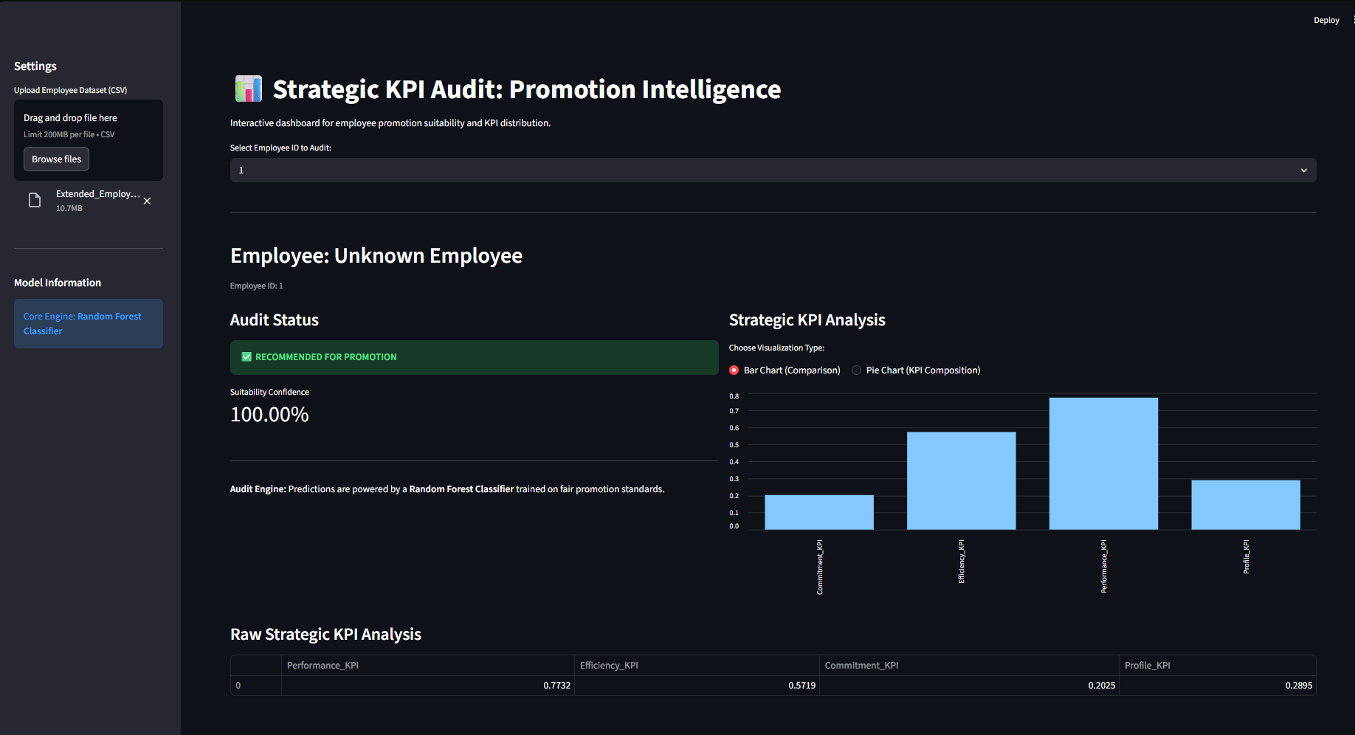
Streamlit Dashboard Prototype

Slide 10

Conclusion
AI can support fairer HR promotion processes when used as an auditing tool.
Identifies alignment and mismatch cases
Treats mismatches as review signals
Supports a human-in-the-loop approach
Improves transparency and evidence-based HR review

Slide 11
Thank You
Questions & Discussion
İrem Yıldız
AI-Based KPI Audit Framework for Promotion Fairness in Human Resources

