Slide 1
BGPSquelch
TEAM: Washif Ahmed (IAA), INSHATH, Adam BINNEWEG (AARNET)

Slide 2
A tool that can………..
List the top X ASNs in a region based on their activity in the MRTdump files
Check the Prefixes are being originated by the rightful AS in WHOIS (origin)
Of those prefixes, derive the percentage that have a matching ROA
E.g. the goal was
./bgpsquelch –country=AU ~/latest-bview
AS1234 30 prefixes 20 ROAs (66%)
AS4321 30 prefixes 25 ROAs (83%)
…
…

Slide 3
Challenges
Tooling! O to apt-get my github life!
Better to beat to death your own IRRd mirror than the public WHOIS
A lot of dead wood (old route objects) in RADB
MRTdumps are binary (one source 50Mb as a gz expands to 650Mb+)
MRTdumps need something like bgpscanner (Isolario on github)
RPKI needs a validator (e.g. FORT) and RTRLIB (client to query the validator)
Programming Foo (efficient algorithms) – 1 MRTdump had >7 million records!

Slide 4
OUTCOMES
Whitenoise?
Learnt heaps
Got to meet Luca (Isolario) – He wrote bgpscanner
DEVOPS MEME (what the customer wanted, how the programmer interpreted it and what the end result was/wasn’t)
GITHUB: https://github.com/guzzim/bgpsquelch.git
Simple perl script that checks the origin AS agrees (from RADB IRR) with the announcements in the MRT dumps for a single prefix.

Slide 5
BGPScanner
$ ./bgpscanner -e 202.6.112.0/24 ~/MTRdump/latest-bview
=|202.6.112.0/24|2914 7575|198.32.176.14|i|||2914:410 2914:1008 2914:2000 2914:3000 7575:1000 7575:2418 7575:3006|198.32.176.14 2914|1580301586|1
=|202.6.112.0/24|14061 6461 7575|198.32.176.147|i|||14061:402 14061:2000 14061:2006 14061:3000 14061:3125|198.32.176.147 14061|1572531500|1
=|202.6.112.0/24|19151 7575|198.32.176.164|i|||7575:1000 7575:2418 7575:3006 19151:3000 19151:63003 19151:65040|198.32.176.164 19151|1580301616|1
=|202.6.112.0/24|7575|198.32.176.177|i|||7575:1000 7575:2418 7575:3006|198.32.176.177 7575|1580301586|1
=|202.6.112.0/24|14907 7575|198.32.176.177|?|||0:10026 14907:3 24115:7575|198.32.176.214 14907|1580823376|1
=|202.6.112.0/24|2497 7575|198.32.176.24|i||||198.32.176.24 2497|1581584737|1
=|202.6.112.0/24|1280 7575|198.32.176.177|i||||198.32.176.3 1280|1581641078|1
=|202.6.112.0/24|6762 7575|198.32.176.177|i|||6762:31 6762:10180|198.32.176.70 6762|1580301586|1

Slide 6
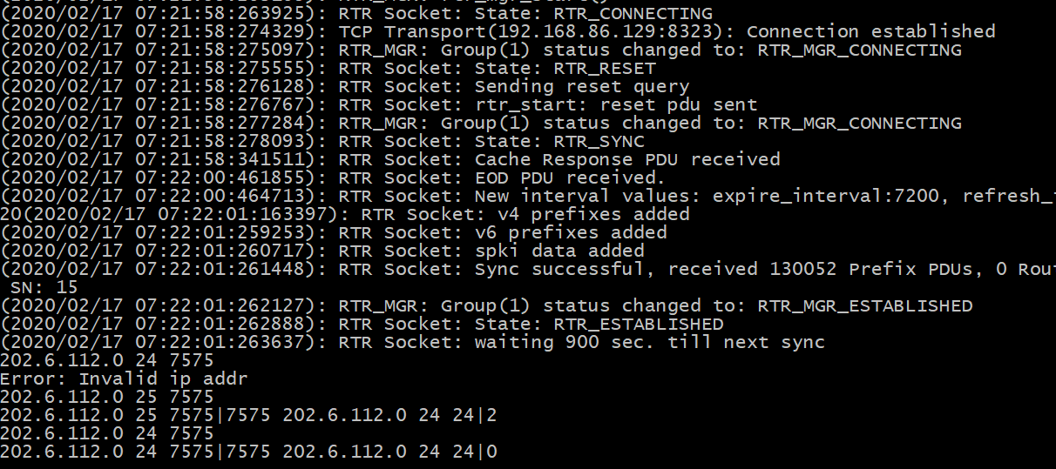
RTRLIB

Slide 7
RTRLIB (rtrclient)
./rtrclient -e -t csv -o /tmp/roa.csv tcp 192.168.86.129 8323
$ head /tmp/roa.csv
1.120.0.0, 13, 13, 1221
1.1.1.0, 24, 24, 13335
1.0.0.0, 24, 24, 13335
1.6.132.240, 29, 29, 9583
1.9.12.0, 24, 24, 65037
1.9.31.0, 24, 24, 65077
1.9.23.0, 24, 24, 65120
1.9.65.0, 24, 24, 24514
1.9.21.0, 24, 24, 24514
1.9.0.0, 16, 24, 4788

