Slide 1
BGPSquelch
TEAM: Washif Ahmed (IAA), INSHATH, Adam BINNEWEG (AARNET)

Slide 2
A tool that can………..
List the top X ASNs in a region based on their activity in the MRTdump files
Check the Prefixes are being originated by the rightful AS in WHOIS (origin)
Of those prefixes, derive the percentage that have a matching ROA
E.g. the goal was
./bgpsquelch –country=AU ~/latest-bview
AS1234 30 prefixes 20 ROAs (66%)
AS4321 30 prefixes 25 ROAs (83%)
…
…

Slide 3
Challenges
Tooling! O to apt-get my github life!
Better to beat to death your own IRRd mirror than the public WHOIS
A lot of dead wood (old route objects) in RADB
MRTdumps are binary (one source 50Mb as a gz expands to 650Mb+)
MRTdumps need something like bgpscanner (Isolario on github)
RPKI needs a validator (e.g. FORT) and RTRLIB (client to query the validator)
Programming Foo (efficient algorithms) – 1 MRTdump had >7 million records!

Slide 4
OUTCOMES
Whitenoise?
Learnt heaps
Got to meet Luca (Isolario) – He wrote bgpscanner
DEVOPS MEME (what the customer wanted, how the programmer interpreted it and what the end result was/wasn’t)
GITHUB: https://github.com/guzzim/bgpsquelch.git
Simple perl script that checks the origin AS agrees (from RADB IRR) with the announcements in the MRT dumps for a single prefix.

Slide 5
BGPScanner
$ ./bgpscanner -e 202.6.112.0/24 ~/MTRdump/latest-bview
=|202.6.112.0/24|2914 7575|198.32.176.14|i|||2914:410 2914:1008 2914:2000 2914:3000 7575:1000 7575:2418 7575:3006|198.32.176.14 2914|1580301586|1
=|202.6.112.0/24|14061 6461 7575|198.32.176.147|i|||14061:402 14061:2000 14061:2006 14061:3000 14061:3125|198.32.176.147 14061|1572531500|1
=|202.6.112.0/24|19151 7575|198.32.176.164|i|||7575:1000 7575:2418 7575:3006 19151:3000 19151:63003 19151:65040|198.32.176.164 19151|1580301616|1
=|202.6.112.0/24|7575|198.32.176.177|i|||7575:1000 7575:2418 7575:3006|198.32.176.177 7575|1580301586|1
=|202.6.112.0/24|14907 7575|198.32.176.177|?|||0:10026 14907:3 24115:7575|198.32.176.214 14907|1580823376|1
=|202.6.112.0/24|2497 7575|198.32.176.24|i||||198.32.176.24 2497|1581584737|1
=|202.6.112.0/24|1280 7575|198.32.176.177|i||||198.32.176.3 1280|1581641078|1
=|202.6.112.0/24|6762 7575|198.32.176.177|i|||6762:31 6762:10180|198.32.176.70 6762|1580301586|1

Slide 6
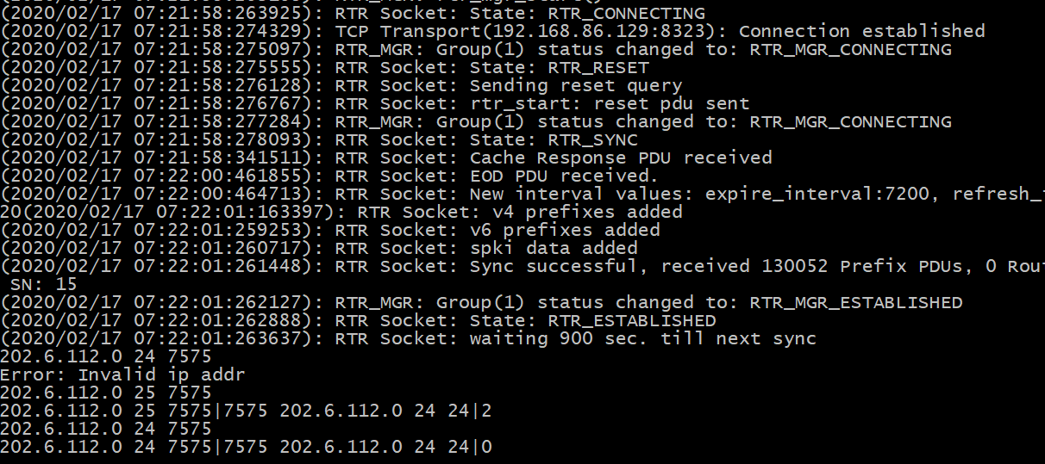
RTRLIB

Slide 7
RTRLIB (rtrclient)
./rtrclient -e -t csv -o /tmp/roa.csv tcp 192.168.86.129 8323
$ head /tmp/roa.csv
1.120.0.0, 13, 13, 1221
1.1.1.0, 24, 24, 13335
1.0.0.0, 24, 24, 13335
1.6.132.240, 29, 29, 9583
1.9.12.0, 24, 24, 65037
./bgpscanner ~/MRTdump/latest-bview | cut -d"|" -f 2,3 | sed -e 's/^\([0-9.\/]\+\)|.* \([0-9]\+\)$/\1 \2/p' | sort -u > /tmp/sorted

